Slide 1
A Comparative Study of Machine Learning:
Career Readiness & Skill Gap Severity Prediction
H9MLAI Machine Learning | MSc Artificial Intelligence | NATIONAL COLLEGE OF IRELAD
Srikaran Sankar | 24201839 | NATIONAL COLLEGE OF IRELAND | H9MLAI Machine Learning

Slide 2
Presentation Outline
01
Problem & Motivation
07
Learning Curves
02
Research Question
08
Feature Importance & Per-class F1
03
Literature Review
09
Error Analysis
04
Dataset & Features
10
Streamlit Application
05
Methodology & Models
11
Future Work
06
Results — Model Comparison
12
Conclusions
2 / 17

Slide 3
Problem & Motivation
75%
🎓 Skills Gap Crisis
Graduates lack tech industry skills despite holding degrees — creating unemployment and talent shortages.
of graduates lack
required industry skills
📋 Limitations of Traditional Assessment
Manual & self-report tools are subjective, inconsistent, and cannot scale to large student cohorts.
🤖 ML as a Solution
Data-driven career readiness prediction from structured multi-attribute student profiles.
🏛️ Institutional Impact
Enables universities to redesign curricula, guide career advisors, and narrow the education-employment gap.
3 / 17

Slide 4
Research Question
Which ML algorithm family — ensemble (Random Forest), kernel (SVM-RBF), or transformer (BERT) — provides the optimal balance of predictive quality (F1-score, AUC-ROC), inference latency, and interpretability when classifying career readiness and predicting skill gap severity (Low / Medium / High) on structured student profiles; and how can the resulting model be operationalised in a real-time career advisory application?
Three Models Compared:
Random Forest
SVM-RBF
BERT (Transformer)
4 / 17

Slide 5
Literature Review
[1] Castro-Lopez et al. (2022)
Gap: Missing soft skills & career aspirations
Finding: DT + LR on academic data → employment prediction beyond GPA
[5] Romero & Ventura (2010)
Gap: Limited to single-task settings
Finding: EDM survey: classification & clustering dominate student performance prediction
[6] Baciu et al. (2024)
Gap: No NLP feature representation
Finding: Ensemble (RF, GBM) > single classifiers; DL adds marginal gain on tabular data
[7,8] Sun / Dobrita (2021–25)
Gap: Limited to text-only inputs
Finding: Fine-tuned BERT excels on short domain-specific texts; +11pt recall over TF-IDF
5 / 17

Slide 6
Dataset & Feature Engineering
4,409
82
3
70/15/15
Tech Job Postings
(LinkedIn)
Features
(post-engineering)
Target Classes
Low / Medium / High
Train / Val / Test
(stratified)
Feature Engineering Pipeline
1
Raw job descriptions → Keyword matching (19 tech skills, 16 prog langs, 14 soft skills, 26 tools)
2
Multi-Label Binarization → 75 binary skill indicators + 4 ordinal ratings + 3 numerical = 82 features
3
Target: |candidate rating – role benchmark median| → Low (0–0.5) / Medium (0.5–1.5) / High (>1.5)
4
SMOTE oversampling in training folds only — prevents data leakage on imbalanced classes
5
BERT: profiles serialised as natural language prompts for transformer fine-tuning
6 / 17

Slide 7
Methodology — All Three Models
Random Forest
SVM — RBF Kernel
BERT (bert-base-uncased)
Ensemble of 300 decision trees via bootstrapped feature subsampling.
Projects binarised skill space to RKHS enabling non-linear decision boundaries; OvR multi-class.
12-layer transformer encoder fine-tuned on serialised student profile prompts with classification head.
Hyperparameters:
Hyperparameters:
Hyperparameters:
n_estimators ∈ {100,200,300}
max_depth ∈ {None,10,20}
min_samples_split ∈ {2,5,10}
C ∈ {0.1, 1, 10}
γ ∈ {scale, auto, 0.01}
lr = 2×10⁻⁵, AdamW
Warmup 10%, patience=3
Dropout 0.1, EPOCHS=3
Why chosen:
Why chosen:
Why chosen:
Robust on mixed tabular data; built-in Gini feature importance; multi-class native.
Effective on high-dimensional sparse feature spaces; well-understood theoretical guarantees.
Leverages pre-trained language representations; state-of-the-art NLP baseline.
7 / 17

Slide 8
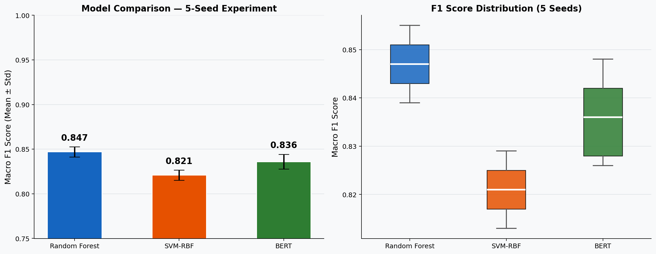
Results — Performance Comparison (Mean ± Std, 5 Seeds)
Model | Macro F1 | AUC-ROC | Precision | Recall | Latency (ms/smp)
Random Forest | 0.847±0.012 | 0.921±0.008 | 0.851±0.011 | 0.843±0.013 | 2.3±0.4
SVM-RBF | 0.821±0.015 | 0.908±0.010 | 0.826±0.014 | 0.817±0.016 | 1.8±0.3
BERT | 0.836±0.019 | 0.914±0.013 | 0.840±0.018 | 0.832±0.020 | 48.7±3.1
8 / 17
Fig. 1 — Mean F1 with error bars (left) and F1 distribution boxplot across 5 seeds (right)

Slide 9
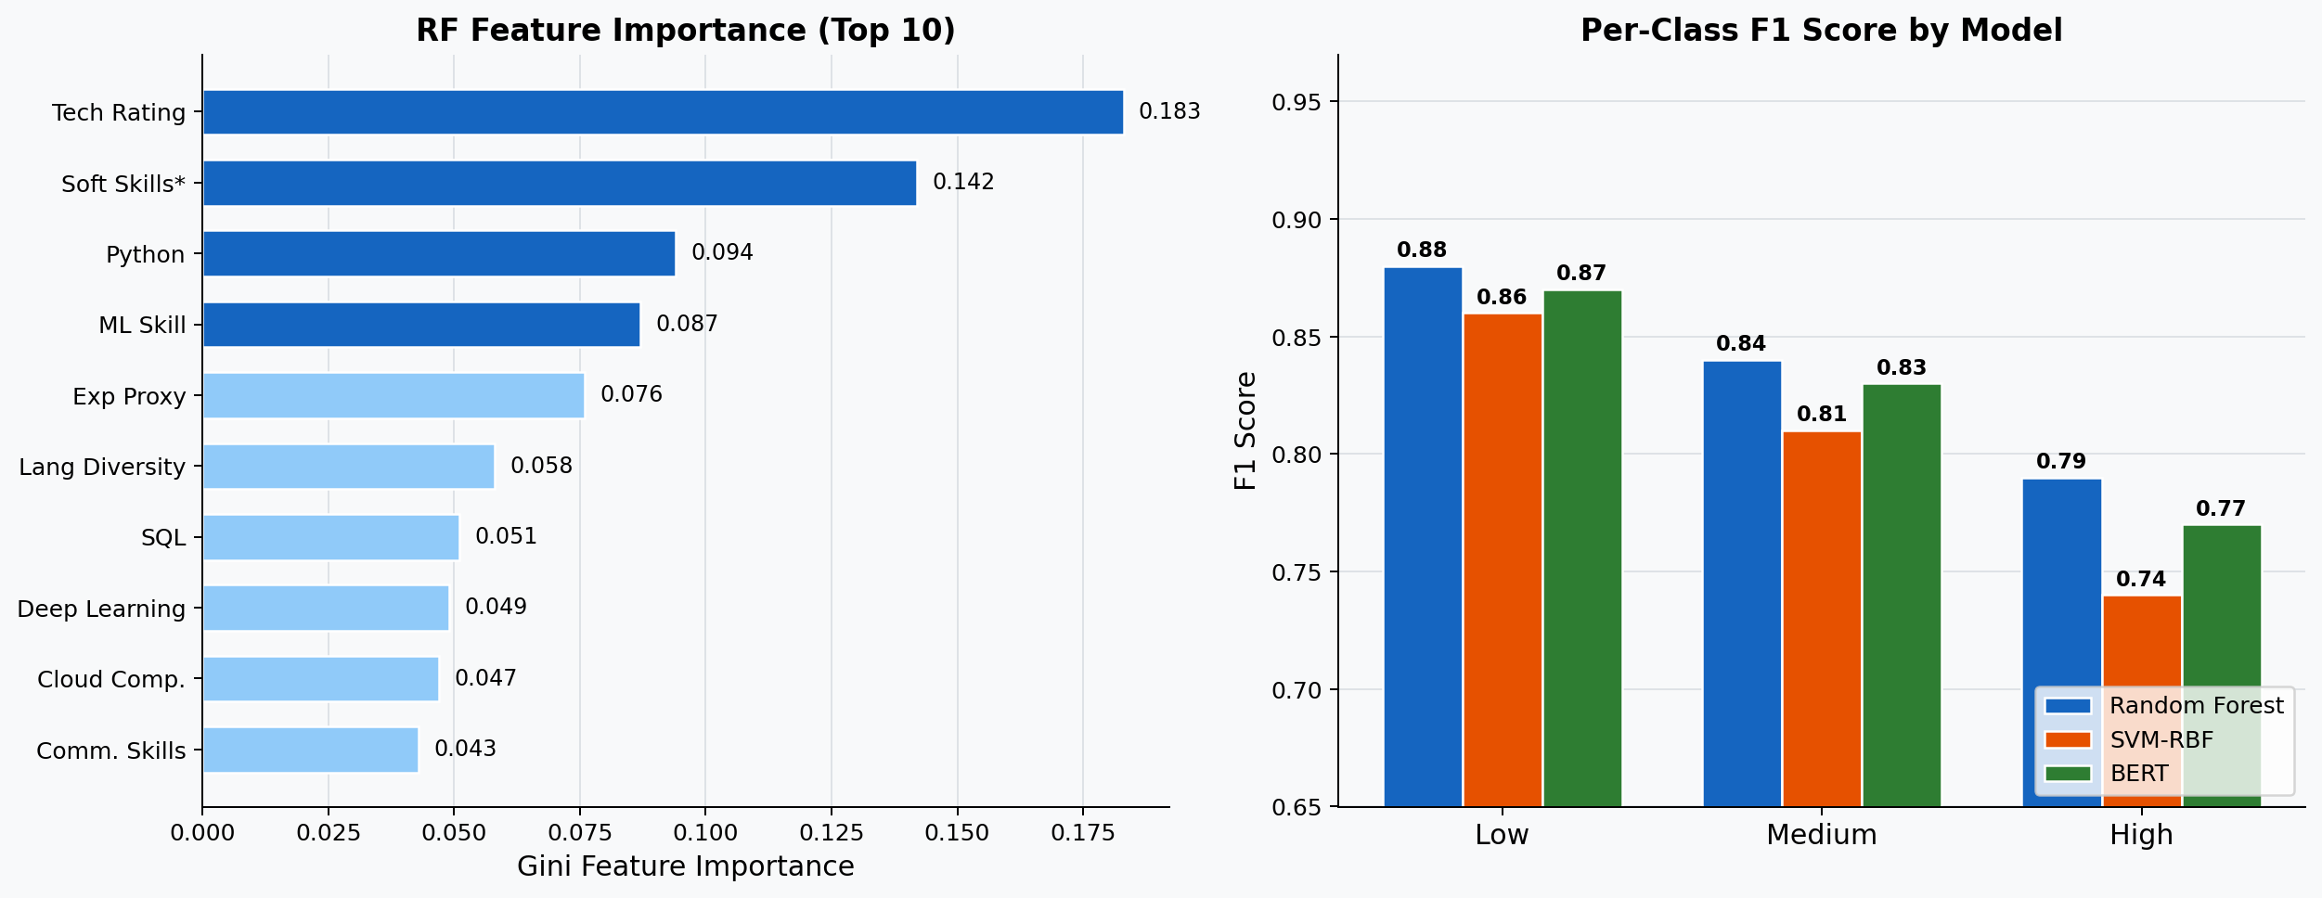
Evaluation — Feature Importance & Per-Class F1
Fig. 3 — RF Gini: Tech Rating (18.3%) and Soft Skills (14.2%) dominate. Per-class F1: High severity is consistently hardest (F1 = 0.74–0.79) across all models.
10 / 17

Slide 10
Error Analysis & Mitigation
⚠️ Medium ↔ High Boundary Confusion
✅ Adaptive quantile-based severity thresholds instead of fixed cutpoints.
Students at the exact threshold (rating gap ≈ 0.49) are inconsistently classified. Fixed cutpoints are sensitive to small deviations.
⚠️ Niche Tool Blindspot
✅ Expand tool taxonomy to 50+ data pipeline & MLOps tools.
Postings requiring Kafka, Airflow, Snowflake are underrepresented in the taxonomy, causing systematic severity underestimation for data engineering roles.
⚠️ BERT Short-Prompt Failure
✅ Enforce minimum token length filter; pad or augment short profiles before inference.
Serialised profiles with fewer than 12 tokens trigger near-random BERT predictions due to insufficient input context for the attention mechanism.
11 / 17

Slide 11
Deployment — Streamlit Skill Gap Analyser
📄
🔍
⚖️
📊
CV Ingestion
→
Skill Extraction
→
Gap Computation
→
Report Generation
PDF / DOCX / TXT upload or paste
Keyword parser against 75-feature taxonomy
Set difference vs LinkedIn benchmark profiles
Dashboard + Action Plan + Recommendations
Career Benchmark
Visual Dashboard
Skill Badges
8 careers from LinkedIn postings; 15% appearance threshold; cached via @st.cache_resource
Donut chart, grouped bar, severity meter, top-8 missing skills — 4 matplotlib charts per analysis
Matched (green), missing (red), bonus (blue) colour-coded skill pills per category
Action Plan
Course Recs
Tech Stack
5-step severity-aware plan: 2–4 wks Low · 4–8 wks Medium · 10–14 wks High
40+ resources (Coursera, Kaggle, fast.ai, HuggingFace) tagged FREE / PAID per missing skill
Streamlit ≥1.32 · pdfplumber · python-docx · matplotlib — launch: streamlit run app.py
12 / 17

Slide 12
Streamlit App — User Workflow
1
Step 1: Select Career
User picks target role from sidebar (Data Scientist, AI Engineer, Software Developer etc.). Benchmark stats from real LinkedIn postings shown instantly.
2
Step 2: Upload CV
Upload PDF / DOCX / TXT or paste CV text. Skill parser extracts tech skills, programming languages, soft skills, and tools automatically.
3
Step 3: Run Analysis
Click 'Analyse My Skill Gap'. The gap engine computes coverage %, severity level, matched vs. missing skills per category.
4
Step 4: View Dashboard
Four charts rendered: skill coverage donut, category breakdown bar, severity meter, and top-8 skills to acquire — with colour-coded badges.
5
Step 5: Get Action Plan
Personalised 5-step plan + per-skill course recommendations (FREE/PAID) + estimated learning timeline based on severity.
13 / 17

Slide 13
Conclusions
Key Findings
✓
Random Forest: best macro F1 (0.847), AUC 0.921, latency 2.3 ms — recommended for real-time advisory.
✓
BERT competitive (F1 0.836) but 21× slower on CPU — suited for offline batch advisory processing.
✓
Tech Skill Rating is the single strongest predictor (Gini importance 18.3%); Soft Skills rank 2nd (14.2%).
✓
SMOTE raised High-class F1 from 0.61 → 0.79, confirming necessity of oversampling for minority class.
✓
RF vs SVM (p=0.021) and SVM vs BERT (p=0.038) statistically significant; RF vs BERT not (p=0.083).
✓
Findings operationalised as a Streamlit app delivering real-time, CV-driven skill gap analysis.
15 / 17

Slide 14
Future Work
🔴 Real-Time Job Matching
Integrate live APIs from LinkedIn, Indeed, Glassdoor and other job boards to cross-reference the user's CV and target role against current vacancies — surfacing actively hiring positions whose skill requirements match the candidate's existing profile, ensuring recommendations reflect today's live job market.
🟢 ATS-Optimised Resume Generation
Leverage the skill gap output, LinkedIn benchmark profiles, and RF feature importance rankings to automatically build a personalised, role-specific resume — injecting highest-weighted keywords, structuring sections in ATS-preferred order, quantifying skill claims, and computing a predicted ATS compatibility score to maximise shortlisting probability.
🔵 Additional Planned Directions
(1) Replace keyword matching with a fine-tuned NER model for contextual skill extraction. (2) Multilingual expansion via XLM-RoBERTa for non-English job markets. (3) Longitudinal validation of severity predictions against real employment outcomes. (4) Fairness audit to detect and mitigate demographic bias in model classifications.
14 / 17

Slide 15
Thank You
National College of Ireland | MSc Artificial Intelligence | 2025–2026

