Slide 1
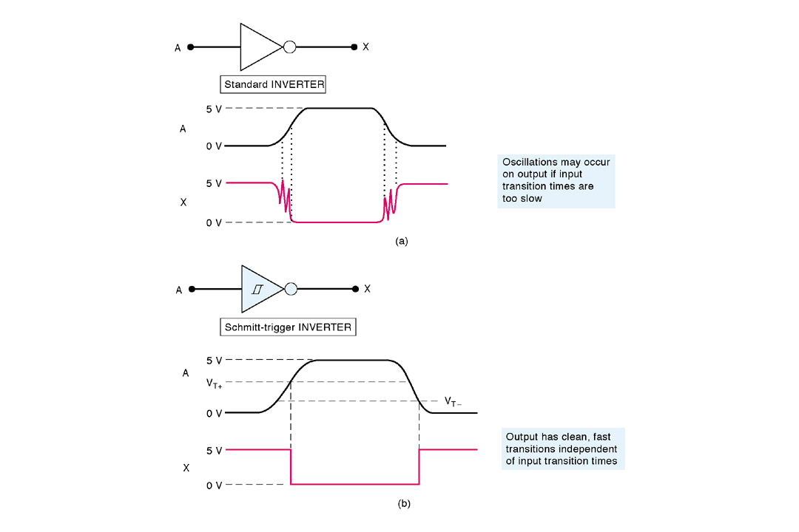
5-21 Schmitt-Trigger Devices
A Schmitt-Trigger circuit is not a flip-flop, but it does exhibit a type of memory characteristic.
FIGURE 5-49 (a) If input transition times are too long, a standard logic device-output might oscillate or change erratically; (b) a logic device with a Schmitt-trigger type of input will produce clean, fast output transitions.

Slide 2


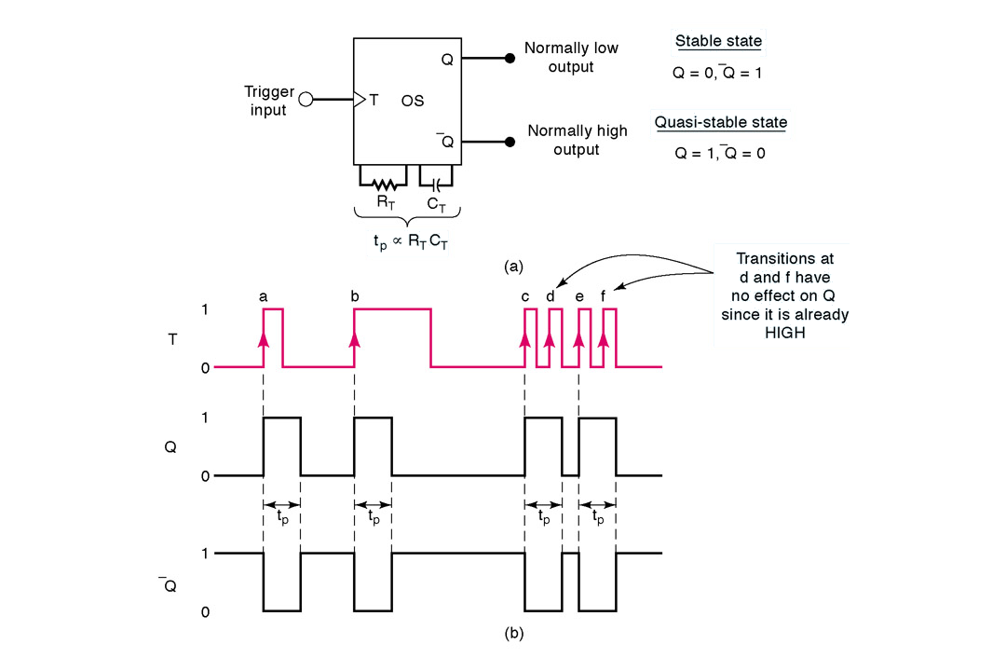
5-22 One-shot (Monostable Multivibrator)
One-short (OS) has only one stable output state . Once triggered, the outputs switch to the opposite state . It remains in this quasi-stable state for a fixed period of time t_{P}.
Two types: nonretriggerable and retriggerable
FIGURE 5-50 OS symbol and typical waveforms for nonretriggerable operation.

Slide 3
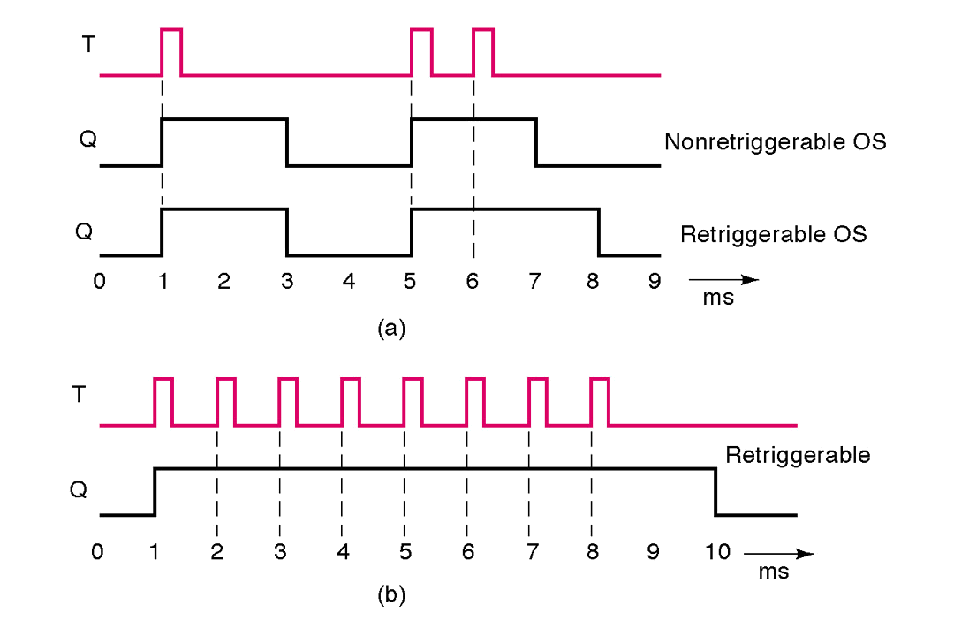
5-22 One-shot cont.
The retriggerable OS operates much like the the nonretriggerable one, except for one difference: it can be retriggered while it is in the quasi-stable state, and it will begin a new t_{P} interval.
FIGURE 5-51 (a) Comparison of nonretriggerable and retriggerable OS responses for t_{P} = 2 ms. (b) Retriggerable OS begins a new t_{P} interval each time it receives a trigger pulse.

Slide 4
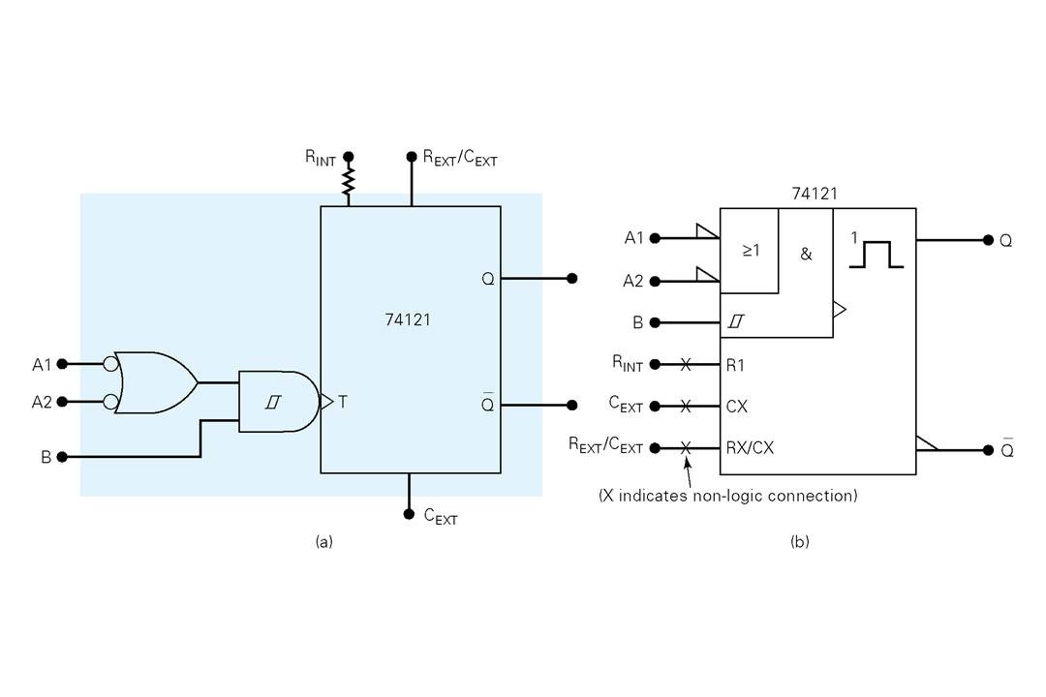
5-22 One-shot cont.
FIGURE 5-52 Logic symbols for the 74121 nonretriggerable one-shot; (a) traditional; (b) IEEE/ANSI.

Slide 5
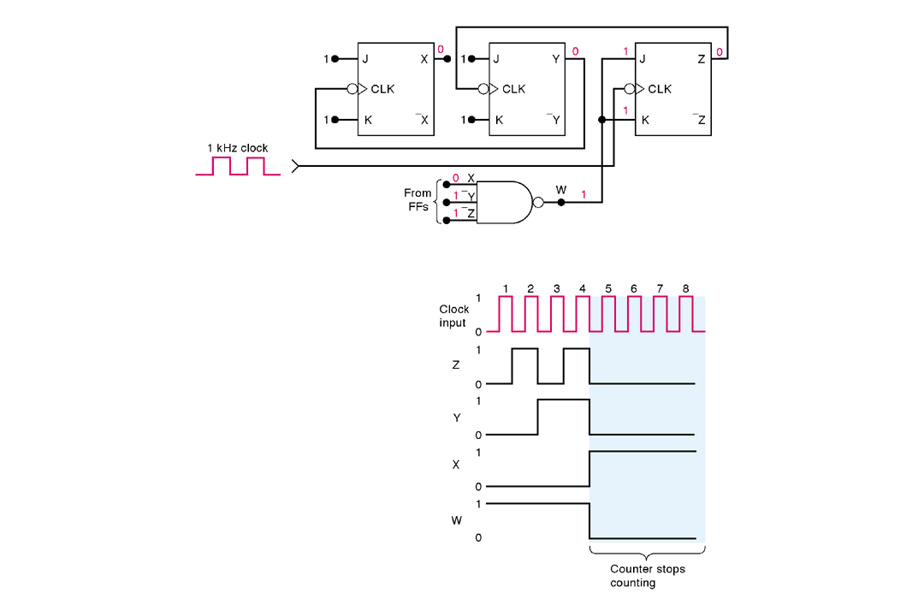
5-23 Analyzing Sequential Circuit
Example 5-16: All FF outputs are in the 0 state before the clock with 1kHZ are applied. Determine the waveforms at X, Y, Z and W.
Solution:
Step 1: Look for the familiar circuits such as counters, shift registers, and so on.
Step 2: Write down the logic levels at the inputs and outputs prior to the occurrence of the first clock pulse.
Step 3: Determine the new states of each FF in the response to the first clock pulse.
Step 4: Repeat steps 2 and 3 for the following pulses.

Slide 6
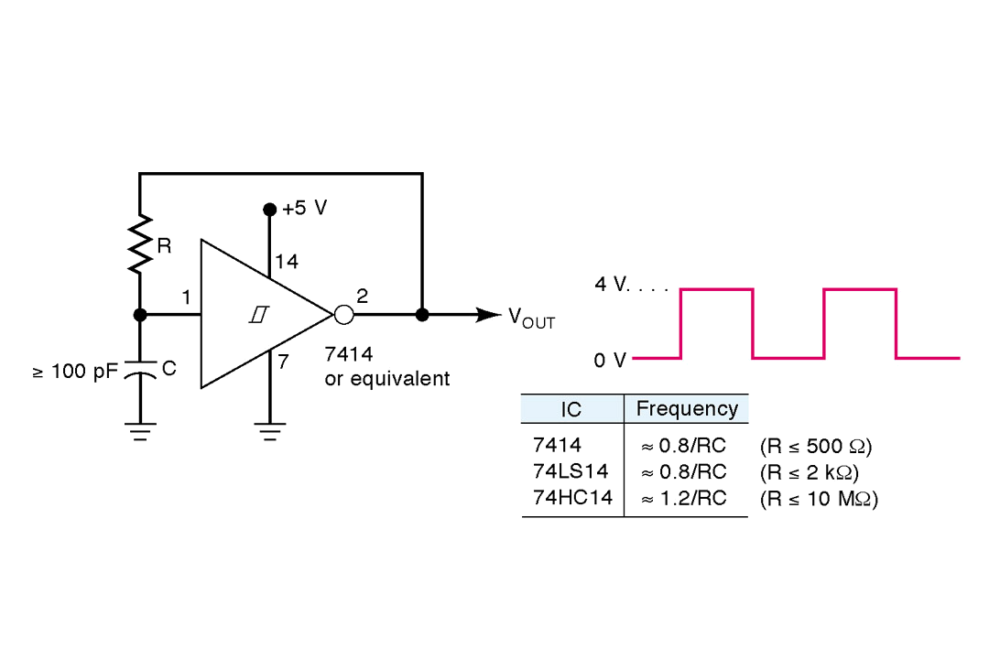
5-24 Clock Generator Circuit
Flip-flop: bistable multivibrator; One-shot: monostable multivibrator;
An astable or free-running multivibrator switches between two unstable states and is used to generate clock.
Examples are Schmitt-Trigger Oscillator, 555 Timer used as astable multivibrator and Crystal-Controlled clock Generators (which can satisfy the critical frequency accuracy and stability.)
FIGURE 5-54 Schmitt-trigger oscillator using a 7414 INVERTER. A 8413 Schmitt-trigger NAND may also be used.

Slide 7
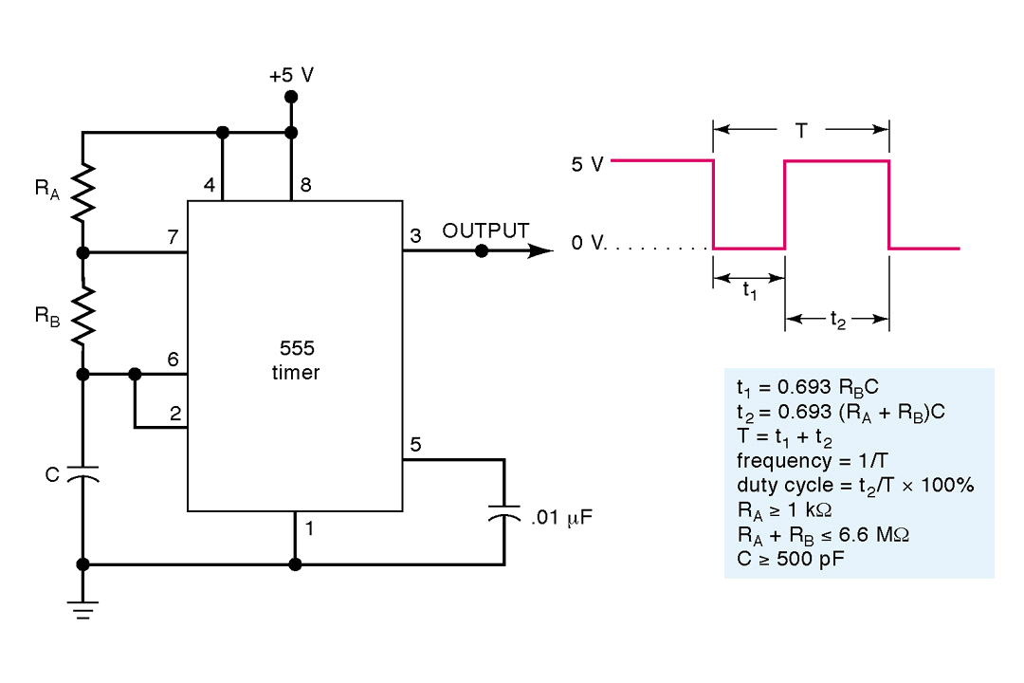
5-24 Clock Generator Circuit cont.
FIGURE 5-55 555 timer IC used as an a stable multivibrator.

Slide 8
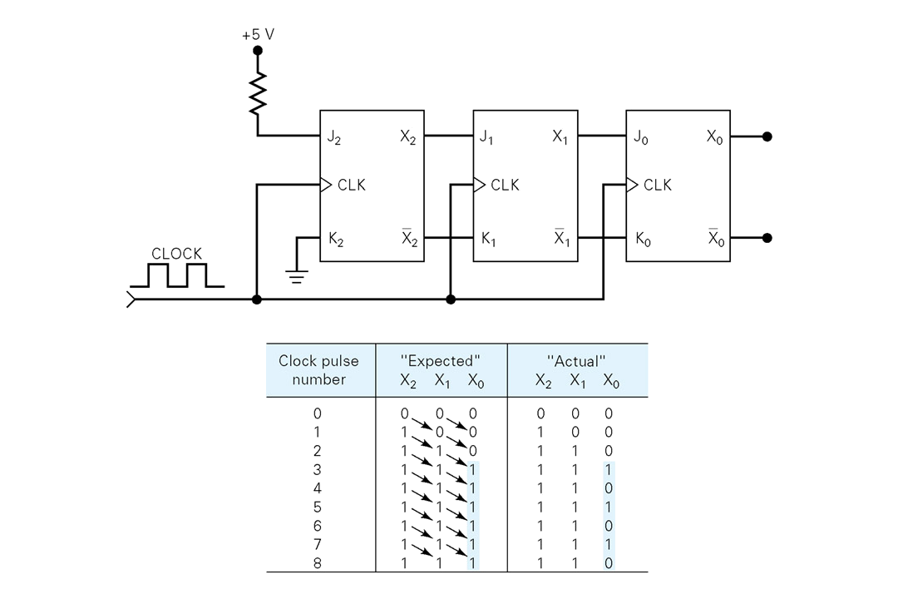
5-25 Troubleshooting Flip-flop Circuits
Open Inputs
FIGURE 5-56 Example 5-18.

Slide 9
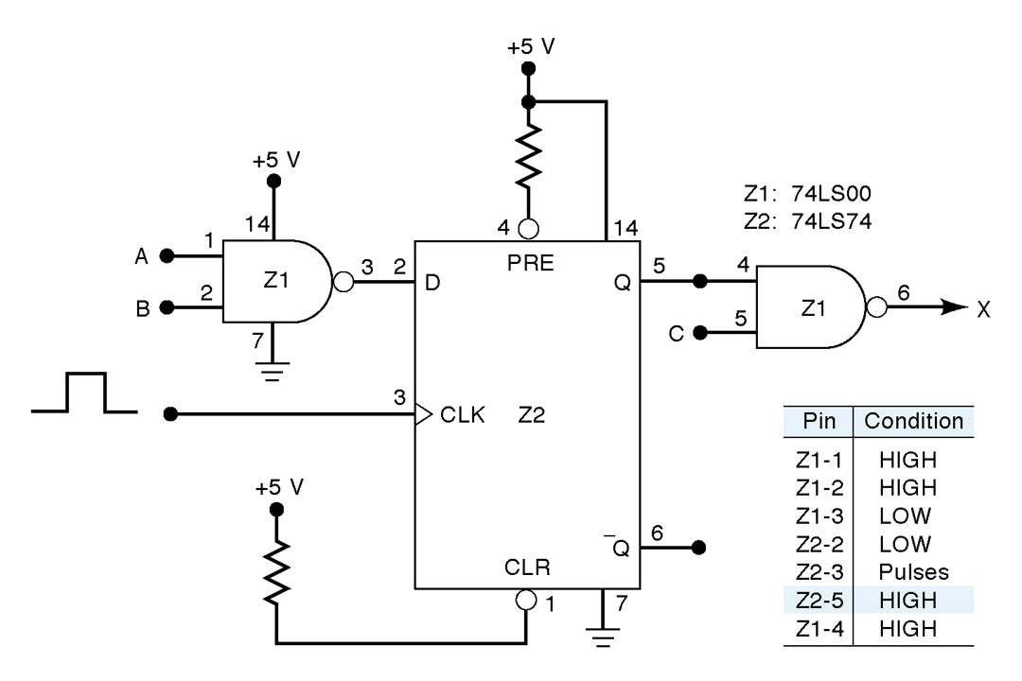

5-25 Troubleshooting Flip-flop Circuits cont.
Consider the following possible faults:
Z2-5 is internally shorted to V_{CG} .
Z1-4 is internally shorted to V_{CG} .
Z2-5 or Z1-4 is externally shorted to V_{CG} .
Z2-4 is internally or externally shorted to GROUND. This would keep Activated and would override the CLK input.
There is an internal failure in Z2 that prevents Q responding properly to its inputs.
FIGURE 5-57 Example 5-19

Slide 10
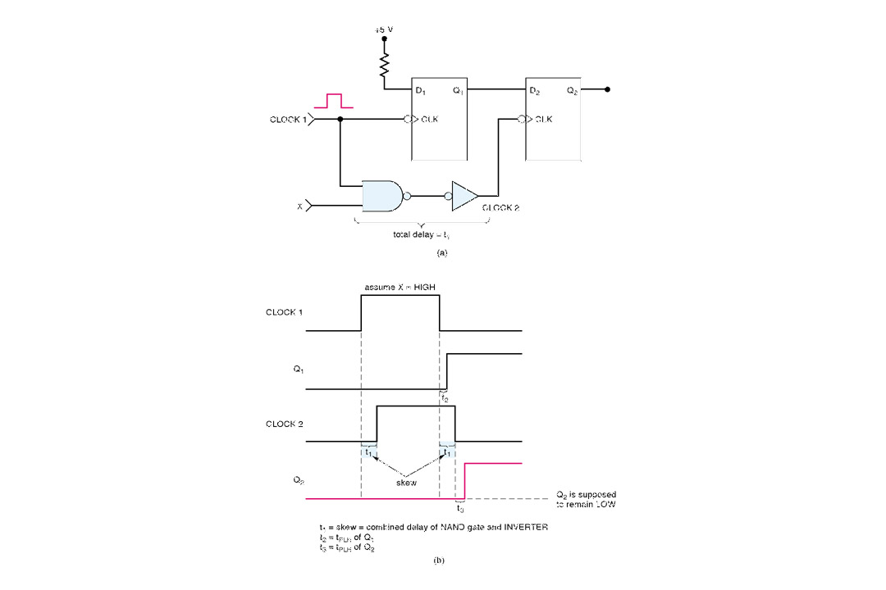
5-25 Troubleshooting Flip-flop Circuits cont.
Clock Skew
FIGURE 5-58 Clock skew occurs when two flip-flops that are supposed to be clocked simultaneously are clocked at slightly different times due to a delay in the arrival of the clock signal at the second flip-flop.

Slide 11
Summary
With a memory characteristics, a flip-flop’s outputs will go to a new state in response to an input pulse and will remain in that new state after the input pulse is terminated.
A NAND latch and a NOR latch are simple FFs that respond to the logic levels on their SET and CLEAR inputs.
Clocked FFs are edge-triggered.
Most clocked FFs have asynchronous inputs that can set or clear the FF independently of the clock input.
Some of FF applications include data storage and transfer, data shifting ,counting, and frequency division.
One-short circuits, Schmitt-trigger circuits..

