Slide 1
Give more life to your application…
48ª Reunião Presencial – 26/07/2014
http://netponto.org
... extending it with MEF
An introduction.
Nuno Cancelo

Slide 2

License
Attribution 3.0 Unported
You are free:
to Share - to copy, distribute and transmit the work
to Remix - to adapt the work to make commercial use of the work
Under the following conditions:
Attribution — You must attribute the work in the manner specified by the author or licensor (but not in any way that suggests that they endorse you or your use of the work)
Source: http://creativecommons.org/licenses/by/3.0/

Slide 3





Nuno Cancelo
About me:
Computer Science Engineer
nuno.cancelo@gmail.com
@masterzdran
www.linkedin.com/in/nunocancelo

Slide 4
Agenda
Introduction
Managed Extensibility Framework
GuideLines
Demonstration

Slide 5
Introduction
What is the problem?
Maintenance
Refactoring
Extend Application functionalities
Peace of Mind

Slide 6
Introduction
Extend functionalities?
Extensible syntax
Extensible compiler
Extensible runtime
Extensible at will

Slide 7
“And God said, ‘Let there be light,’ and there was light.”
Genesis 1:3

Slide 8
How to become modular?
Design Patterns
Façade, MVC, Template Method
Build infrastructure
Know the libraries
Load the libraries
Use the libraries

Slide 9
Demonstration

Slide 10
Before MEF ... there was MAF

Slide 11
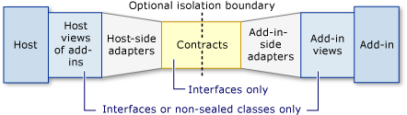
.NET Framework 3.5
Managed Add-in Framework
Full Pipeline Development

Slide 12
.NET Framework 3.5
Complex infra-structure
Time consuming
Codeplex sugested an alternative
Managed Extensibility Framework

Slide 13
Managed Extensibility Framework

Slide 14
Managed Extensibility Framework
Prior to .NET Framework 4.0
Codeplex
.Net Framework 4.0
Silverlight 4.0

Slide 15
Managed Extensibility Framework
Lightweight framework
Discover extensions
Little Configuration
Tags additional Metadata
Compatible with MAF

Slide 16
Managed Extensibility Framework
Supported Platforms :
.NET Framework 4.5
Windows 8
Windows Phone 8.1
Windows Phone Silverlight 8
Portable Class Libraries

Slide 17
One step forward

Slide 18
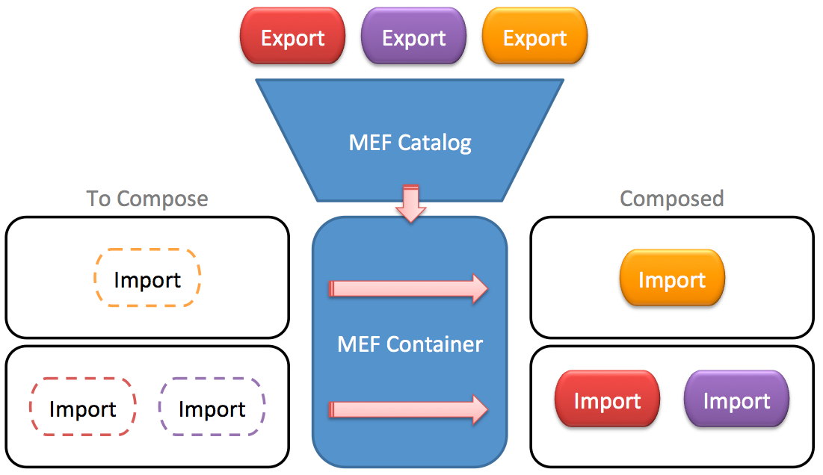
GuideLines
source. http://blogs.geniuscode.net/JeremiahRedekop/wp-content/uploads/2011/01/MEF-Diag.png

Slide 19
GuideLines
Define Contracts
The interface to be use
Declare Exports
Expose the object
Declare Imports
Consume the objects

Slide 20
Contract
A set of:
Fields
Methods
To be used by the application

Slide 21
Demonstration

Slide 22
Export it
[Export] attribute
In Class
In Method
In Properties
Notes:
A method export is where a Part exports one its methods.
Methods are exported as delegates which are specified in the Export contract. Method exports have several benefits including the following. They allow finer grained control as to what is exported. For example, a rules engine might import a set of pluggable method exports.
They shield the caller from any knowledge of the type.
They can be generated through light code gen, which you cannot do with the other exports.
Note: Method exports may have no more than 4 arguments due to a framework limitation.

Slide 23
Metadata
[ExportMetadata] attribute
Extra information
Importers can access Metadata
ex: sender.Metadata.ContainsKey("Issecure")

Slide 24
Import it
[Import] attribute
Fields
Properties
Constructors
Notes:
This means that instead of adding properties for each import, you add parameters to a constructor for each import. To use this, follow the following steps.
Parameter imports There are several different different ways to define imports on the constructor. 1. Implied import - By default the container will use the type of the parameter to identify the contract. For example in the code below, the IMessageSender contract will be used.
2. Explicit import - If you want to specify the contract to be imported
Optional imports
MEF allows you to specify that an import is optional. When you enable this, the container will provide an export if one is available otherwise it will set the import to Default(T). To make an import optional, setAllowDefault=true on the import as below.

Slide 25
Import Collections
[ImportMany ] attribute
All instances from one Contract will be loaded

Slide 26
Catalogue it
Ability to dynamically discover parts
Catalogues
Assembly Catalog
Directory Catalog
Aggregate Catalog
Type Catalog

Slide 27
Debugging
Debugging MEF (MSDN)
http://msdn.microsoft.com/en-us/library/ff603380(v=vs.100).aspx
Diagnosing Composition Problems
https://mef.codeplex.com/wikipage?title=Debugging%20and%20Diagnostics&referringTitle=Guide
In short .... .... ... Is A Bloody Pain.
Windows Store Differences ... UPS
https://mef.codeplex.com/wikipage?title=MetroChanges
Notes:
When using child containers it may be important to filter catalogs based on some specific criteria. For example, it is common to filter based on part's creation policy.

Slide 28
Conclusion
Simple Implementation
Play well with MAF
Provide Application Extensibility
Complex problem debugging

Slide 30
References
Building Composable Apps in .NET 4 with the Managed Extensibility Framework
http://msdn.microsoft.com/en-us/magazine/ee291628.aspx
Managed Extensibility Framework (MEF)
http://msdn.microsoft.com/en-us/library/dd460648(v=vs.110).aspx
Gentle Introduction to MEF
http://buksbaum.us/2011/08/20/gentle-introduction-to-mefpart-one/
Codeplex
https://mef.codeplex.com/wikipage?title=Guide
Virgilio Esteves Presentation about MAF
http://netponto.org/sessao/maf-managed-addin-framework-criacao-de-aplicacoes-extensiveis/

Slide 31

SQL Saturday #341 – Porto 2014
18 de Outubro de 2014
3 Tracks
Workshops:
SSAS Basics
Regis Baccaro (16 Out 2014)
SQL Server Query Optimizer
Fabiano Amorim (17 Out 2014)

Slide 32


Sponsor “GOLD”
Twitter: @PTMicrosoft
http://www.microsoft.com/portugal

Slide 33



Sponsor “Silver”

Slide 34

Sponsor “Bronze”

Slide 35

http://bit.ly/netponto-aval-48
* Para quem não puder preencher durante a reunião,
iremos enviar um email com o link à tarde
Notes:
Para quem puder ir preenchendo, assim não chateio mais logo ☺
É importante para recebermos nós feedback, e para darmos feedback aos nossos oradores
http://goqr.me/

Slide 36
Próximas reuniões presenciais
26/07/2014 – Julho (Lisboa)
20/09/2014 – Setembro (Lisboa)
18/10/2014 – Outubro - SQL Saturday – Track Programação (Porto)
25/10/2014 – Outubro (Lisboa)
22/11/2014 – Novembro (Lisboa)
??/??/???? – ????? (Porto)
Reserva estes dias na agenda! :)

Slide 37




Thanks!
Nuno Cancelo
www.facebook.com/nuno.cancelo
www.bitbucket.org/masterzdran
www.github.com/masterzdran
Source:
Iconset: Social Media Icons by Iconshock (12 icons) : http://www.iconarchive.com/show/social-media-icons-by-iconshock.html
Iconset: Flat Gradient Social Icons by limav (120 icons): http://www.iconarchive.com/show/flat-gradient-social-icons-by-limav.html

