Slide 1
Extend your application …
##ª Reunião Presencial - ##/##/####
http://netponto.org
... with MEF
An introduction.
Nuno Cancelo

Slide 2

License
Attribution 3.0 Unported
You are free:
to Share - to copy, distribute and transmit the work
to Remix - to adapt the work to make commercial use of the work
Under the following conditions:
Attribution — You must attribute the work in the manner specified by the author or licensor (but not in any way that suggests that they endorse you or your use of the work)
Source: http://creativecommons.org/licenses/by/3.0/

Slide 3





Nuno Cancelo
About me:
Computer Science Engineer
nuno.cancelo@gmail.com
@masterzdran
www.linkedin.com/in/nunocancelo

Slide 4
Agenda

Slide 5
Little bit of history

Slide 6
Before MEF ... there was MAF

Slide 7
Contract Oriented Development

Slide 8
“Hello MEF”
demonstração

Slide 9
One step forward

Slide 10
Some advanced topics

Slide 11
“Hello MEF”
demonstração

Slide 12
MEF play with others

Slide 13
Template
Utilizado desde o início dos tempos
Em diversas áreas
Em todas as empresas
É a identificação de um padrão

Slide 14
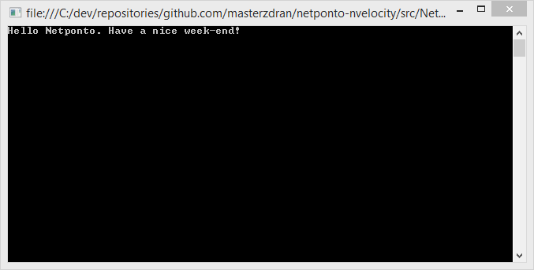
demonstração

Slide 15
Conclusion

Slide 17
References

Slide 18


Sponsor “GOLD”
Twitter: @PTMicrosoft
http://www.microsoft.com/portugal

Slide 19




Sponsor “Silver”

Slide 20

Sponsor “Bronze”

Slide 21
Próximas reuniões presenciais
23/11/2013 – Novembro (Lisboa)
30/11/2013 – Novembro (Porto)
14/12/2013 – Dezembro (Lisboa)
18/01/2014 – Janeiro (Lisboa)
Reserva estes dias na agenda! :)

Slide 22



Thanks!
Nuno Cancelo
www.facebook.com/nuno.cancelo
www.bitbucket.org/masterzdran
www.github.com/masterzdran
Source:
Iconset: Social Media Icons by Iconshock (12 icons) : http://www.iconarchive.com/show/social-media-icons-by-iconshock.html
Iconset: Flat Gradient Social Icons by limav (120 icons): http://www.iconarchive.com/show/flat-gradient-social-icons-by-limav.html

