Slide 1
Give more live to your application…
47ª Reunião Presencial - 31/05/2014
http://netponto.org
... extending it with MEF
An introduction.
Nuno Cancelo

Slide 2

License
Attribution 3.0 Unported
You are free:
to Share - to copy, distribute and transmit the work
to Remix - to adapt the work to make commercial use of the work
Under the following conditions:
Attribution — You must attribute the work in the manner specified by the author or licensor (but not in any way that suggests that they endorse you or your use of the work)
Source: http://creativecommons.org/licenses/by/3.0/

Slide 3





Nuno Cancelo
About me:
Computer Science Engineer
nuno.cancelo@gmail.com
@masterzdran
www.linkedin.com/in/nunocancelo

Slide 4
Agenda
Introduction
Managed Extensiability Frameworks
GuideLines
Reference
Demos
Conclusion

Slide 5
In the beginning

Slide 6
Introduction
Why extend an application?
Provide more funcionalities
Ease

Slide 7
Before MEF ... there was MAF

Slide 8
Contract Oriented Development

Slide 9
“Hello MEF”
demonstração

Slide 10
One step forward

Slide 11
Some advanced topics

Slide 12
“Hello MEF”
demonstração

Slide 13
MEF play with others

Slide 14
Template
Utilizado desde o início dos tempos
Em diversas áreas
Em todas as empresas
É a identificação de um padrão

Slide 15
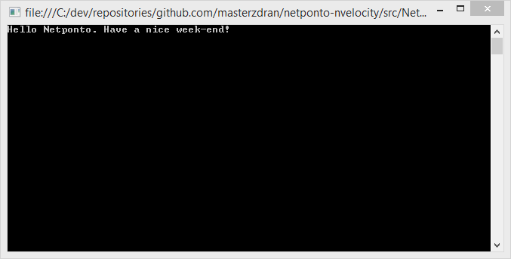
demonstração

Slide 16
Conclusion

Slide 18
References

Slide 19


Sponsor “GOLD”
Twitter: @PTMicrosoft
http://www.microsoft.com/portugal

Slide 20




Sponsor “Silver”

Slide 21

Sponsor “Bronze”

Slide 22
Próximas reuniões presenciais
23/11/2013 – Novembro (Lisboa)
30/11/2013 – Novembro (Porto)
14/12/2013 – Dezembro (Lisboa)
18/01/2014 – Janeiro (Lisboa)
Reserva estes dias na agenda! :)

Slide 23



Thanks!
Nuno Cancelo
www.facebook.com/nuno.cancelo
www.bitbucket.org/masterzdran
www.github.com/masterzdran
Source:
Iconset: Social Media Icons by Iconshock (12 icons) : http://www.iconarchive.com/show/social-media-icons-by-iconshock.html
Iconset: Flat Gradient Social Icons by limav (120 icons): http://www.iconarchive.com/show/flat-gradient-social-icons-by-limav.html

