Slide 1
ACADEMIC MINI PROJECT
+
Medicare
Doctor Appointment
Booking Platform
A responsive, role-based web application that lets patients discover, filter, and book verified doctors online — while giving doctors a real-time dashboard to manage their practice.
HTML5
Sunkara Manikanta
B.Tech, Computer Science & Engineering (Batch 2023–2027)
Annamacharya Institute of Technology and Sciences, Tirupati
CSS3
JavaScript

Slide 2
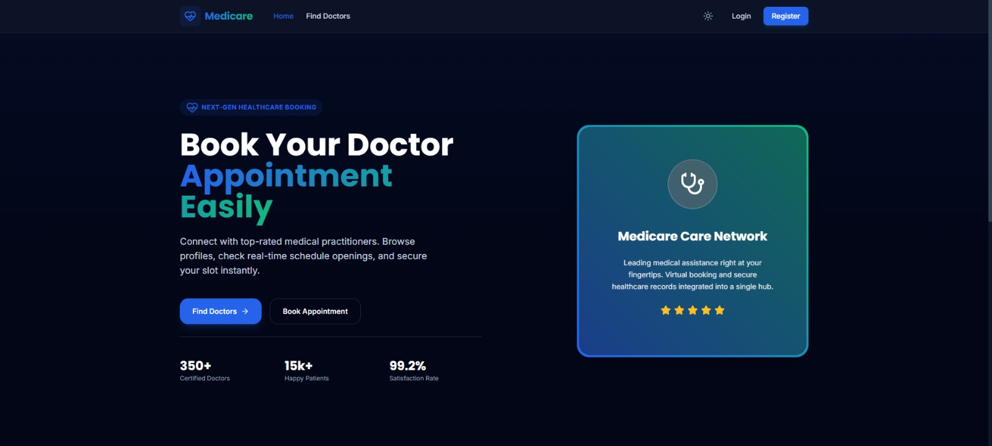
INTRODUCTION
What is Medicare?
Medicare is a front-end web application that digitizes the doctor-appointment workflow end to end — from searching a specialist to confirming a booking — using only client-side web technologies.
•
Search
Find doctors by specialty, rating, and consultation fee
•
Book
Reserve a slot and submit symptoms in a guided flow
•
Manage
Track, confirm, or cancel appointments from a dashboard
02

Slide 3
OBJECTIVES
Project Objectives
1
Simplify Discovery
2
Streamline Booking
Let patients find doctors by specialty, experience, and fee in a few clicks
Replace manual scheduling with an instant, wait-list-free booking flow
3
Role-Based Access
4
Practice Management
Serve three distinct experiences — Patient, Doctor, and Admin — from one app
Give doctors a live dashboard to confirm, decline, and track bookings
5
Responsive UI/UX
6
Pure Front-End Build
Deliver a clean, accessible, dark-themed interface across screen sizes
Demonstrate complete application logic using only HTML, CSS & JavaScript
03

Slide 4
TECHNICAL ARCHITECTURE
System Architecture
A layered, client-side architecture — every layer runs in the browser
1
Presentation Layer
HTML5 semantic markup + CSS3 (Flexbox / Grid, custom properties for the dark theme)
▼
2
Application Logic Layer
Vanilla JavaScript (ES6+) — DOM rendering, event handling, form validation, routing between views
▼
3
Data Layer
Structured JS objects / JSON, persisted client-side (localStorage) to simulate doctors, bookings & users
▼
4
Role-Based Rendering
Conditional UI rendering for Patient, Doctor, and Admin experiences from shared components
04

Slide 5
TECHNOLOGY STACK
Built With
</>
</>
</>
HTML5
CSS3
JavaScript (ES6+)
Semantic structure for pages, forms & dashboards
Flexbox/Grid layouts, custom properties, dark theme
DOM manipulation, event-driven interactivity
</>
</>
</>
LocalStorage / JSON
Responsive Design
Font & SVG Icons
Client-side data persistence & mock backend
Media queries for cross-device compatibility
Lightweight iconography across the UI
05

Slide 6
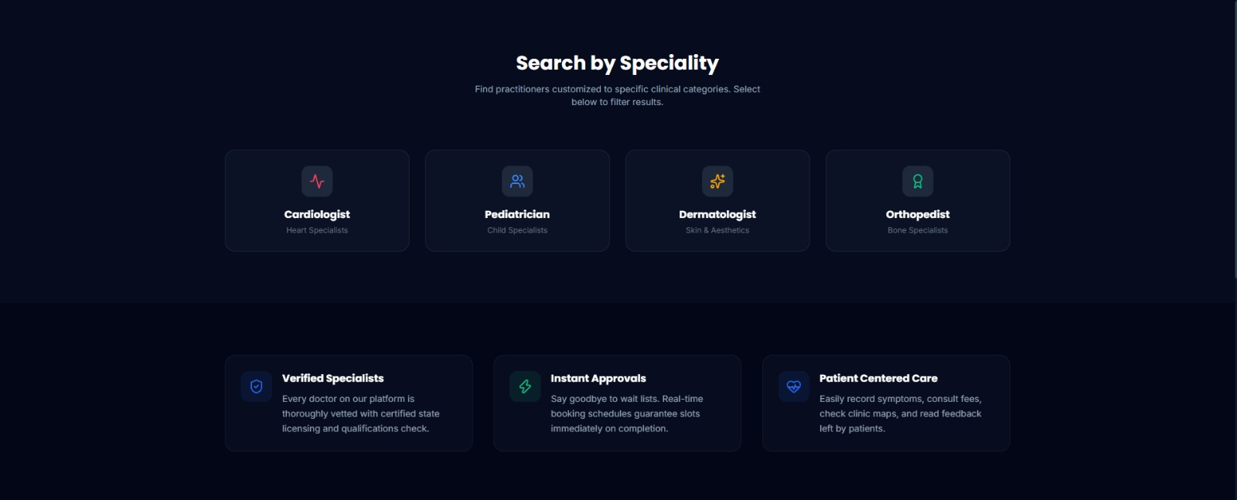
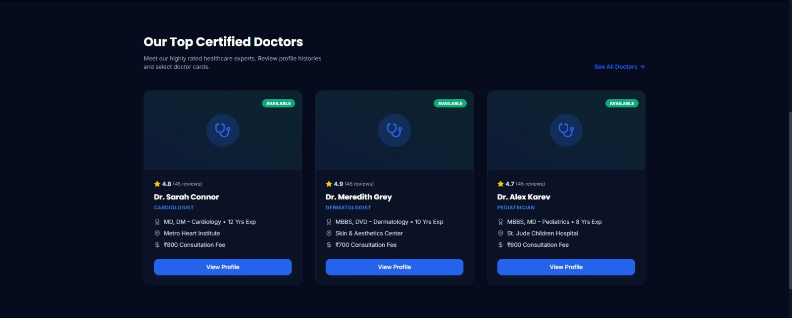
MODULE 01
Home Page & Doctor Discovery
✓
Hero section with live stats — 350+ doctors, 15k+ patients, 99.2% satisfaction
✓
"Search by Speciality" grid — Cardiologist, Pediatrician, Dermatologist, Orthopedist
✓
Doctor cards show rating, qualification, experience, hospital & consultation fee
✓
Trust indicators: Verified Specialists, Instant Approvals, Patient-Centered Care
06

Slide 7
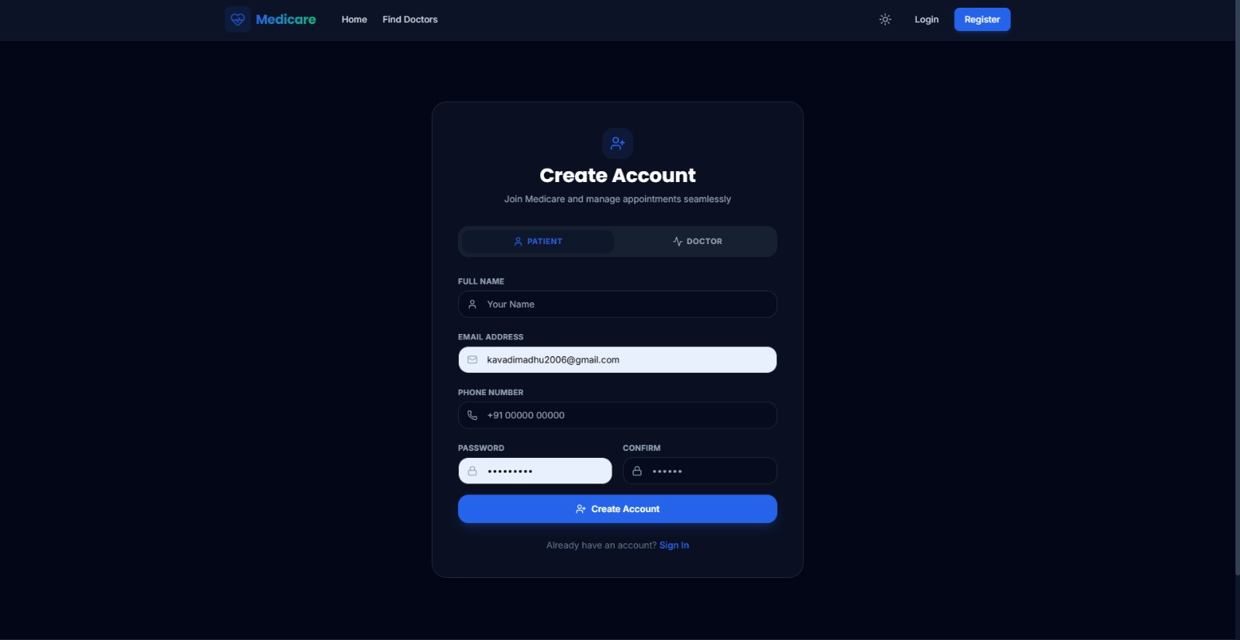
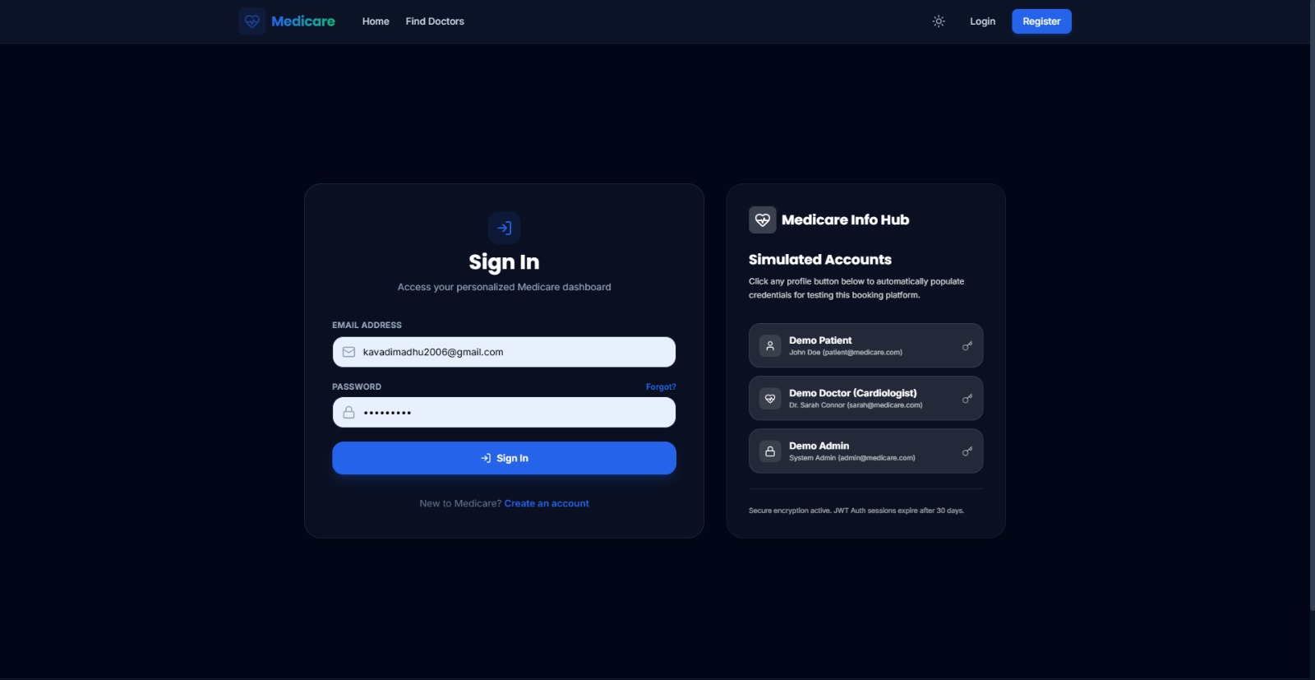
MODULE 02
Role-Based Authentication
✓
Single sign-up flow with a Patient / Doctor toggle for role selection
✓
Client-side form validation for name, email, phone & password fields
✓
Sign-in screen with a "Medicare Info Hub" for quick demo-account access
✓
Simulated secure sessions for Patient, Doctor, and Admin test accounts
07

Slide 8
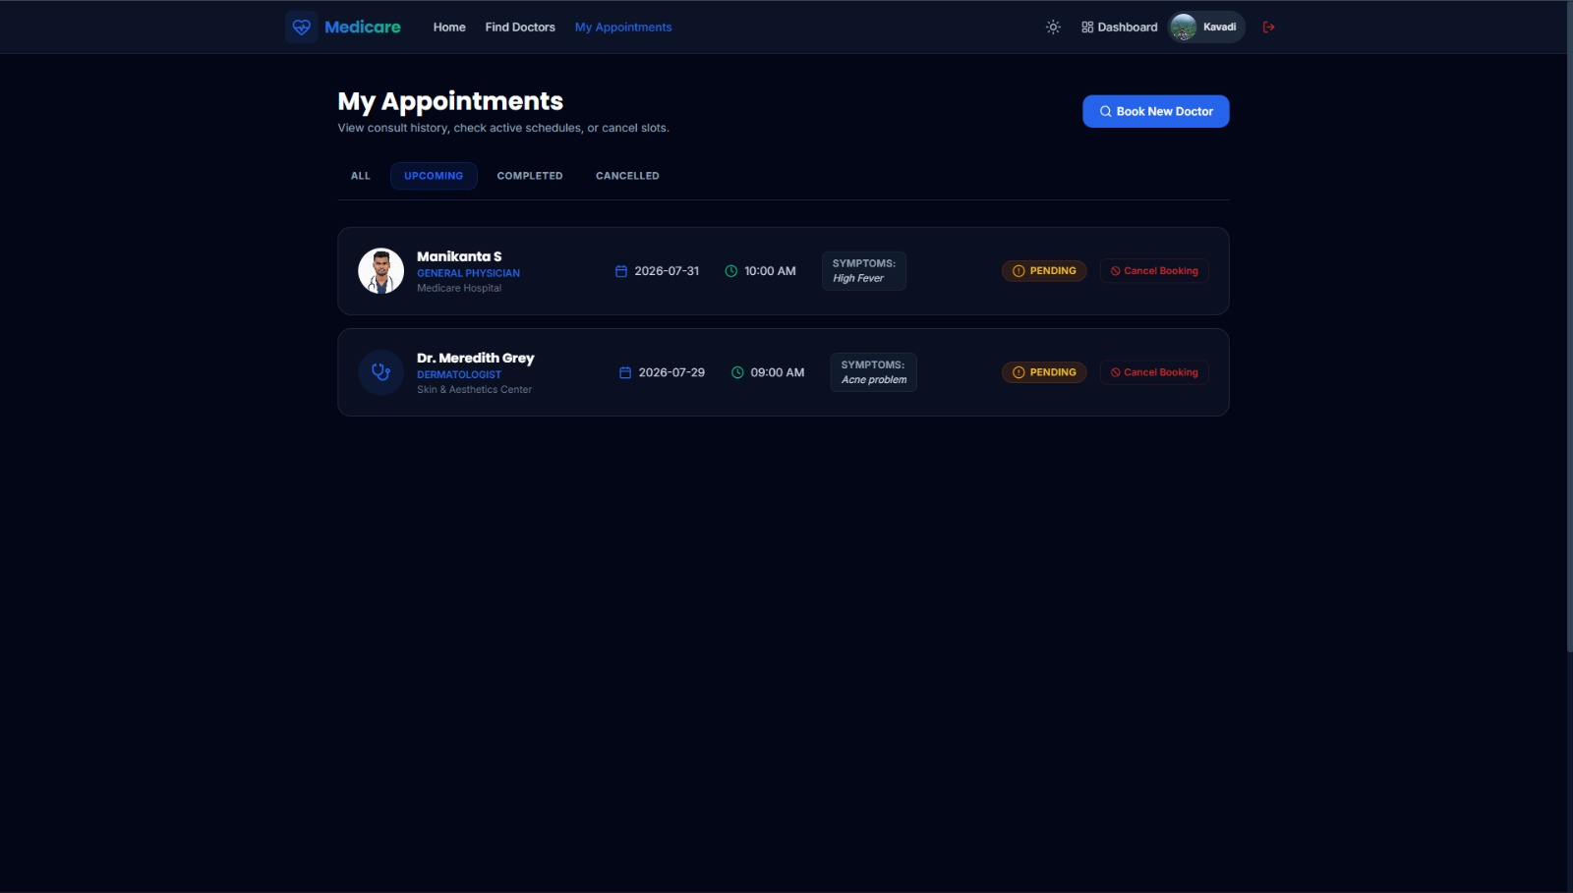
MODULE 03
Patient Module — My Appointments
✓
Tabbed view — All, Upcoming, Completed, Cancelled appointments
✓
Each card shows doctor, specialty, hospital, date, time & symptoms
✓
Live status badges (e.g. Pending) reflect the doctor's response
✓
One-click "Cancel Booking" and "Book New Doctor" actions
08

Slide 9
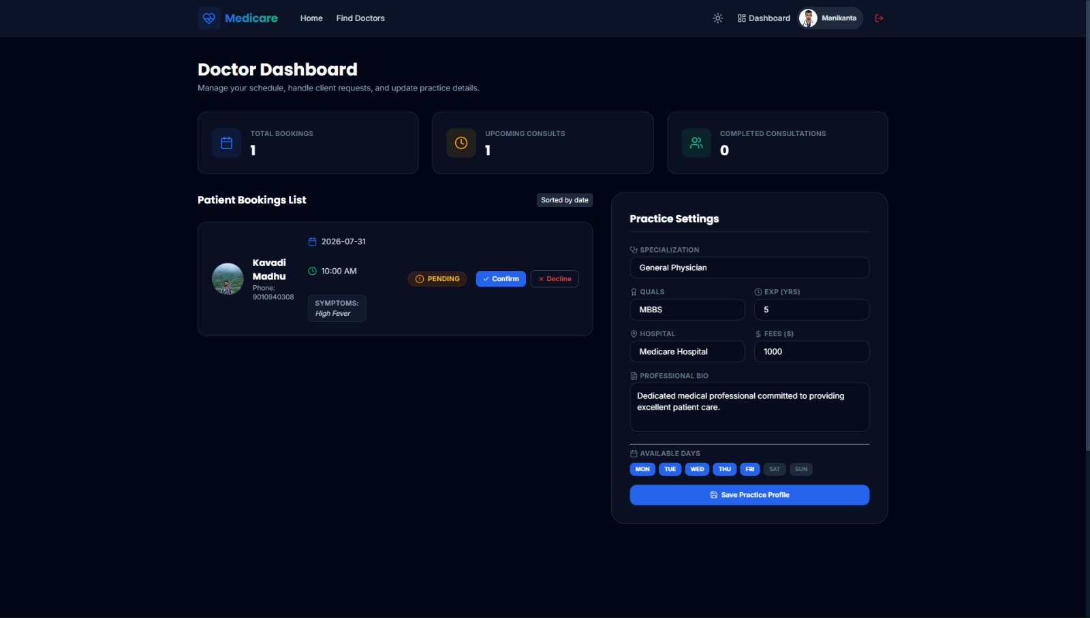
MODULE 04
Doctor Module — Practice Dashboard
✓
At-a-glance stats — total bookings, upcoming & completed consultations
✓
Patient bookings list with symptoms, sorted by date
✓
Confirm / Decline actions update booking status instantly
✓
Editable practice settings — specialization, fees, bio, available days
09

Slide 10
UNDER THE HOOD
Implementation Highlights
1
Dynamic Rendering
Doctor cards, bookings & dashboard stats are generated at runtime with JS template literals and injected into the DOM
2
Event Delegation
Confirm, Decline, Cancel and tab-filter actions are handled through centralized event listeners
3
Form Validation
Registration & login flows validate name, email, phone and password formats before submission
4
State & Persistence
Application state (users, doctors, bookings) is modeled as JS objects/arrays and persisted via localStorage
Typical Project Structure index.html • /css/style.css • /js/script.js • /assets/images
10

Slide 11
SUMMARY
Key Features at a Glance
★
★
★
Role-Based Dashboards
Specialty-Based Search
Instant Booking Status
Separate, tailored views for Patients and Doctors
Filter doctors by category, rating & fee
Pending / Confirmed / Cancelled tracked live
★
★
★
Appointment History
Practice Profile Management
Simulated Secure Auth
All, Upcoming, Completed & Cancelled tabs
Doctors edit fees, bio & availability
Demo accounts with session-style access
11

Slide 12
ROADMAP
Future Enhancements
1
Real Backend Integration
Node.js/Express + a database (e.g. MongoDB) to replace localStorage
2
Payment Gateway
Online consultation-fee payments at booking time
3
Notifications
Email/SMS alerts for booking confirmations & reminders
4
Video Consultation
In-app video calls between patient and doctor
5
Admin Analytics
Usage dashboards for bookings, revenue & doctor activity
12

Slide 13
CONCLUSION
Thank You
Medicare shows how a complete, role-based healthcare booking experience can be engineered using only HTML, CSS, and JavaScript — from doctor discovery to appointment management.
Sunkara Manikanta
B.Tech CSE, Batch 2023–2027
Annamacharya Institute of Technology and Sciences, Tirupati
13

