Slide 1

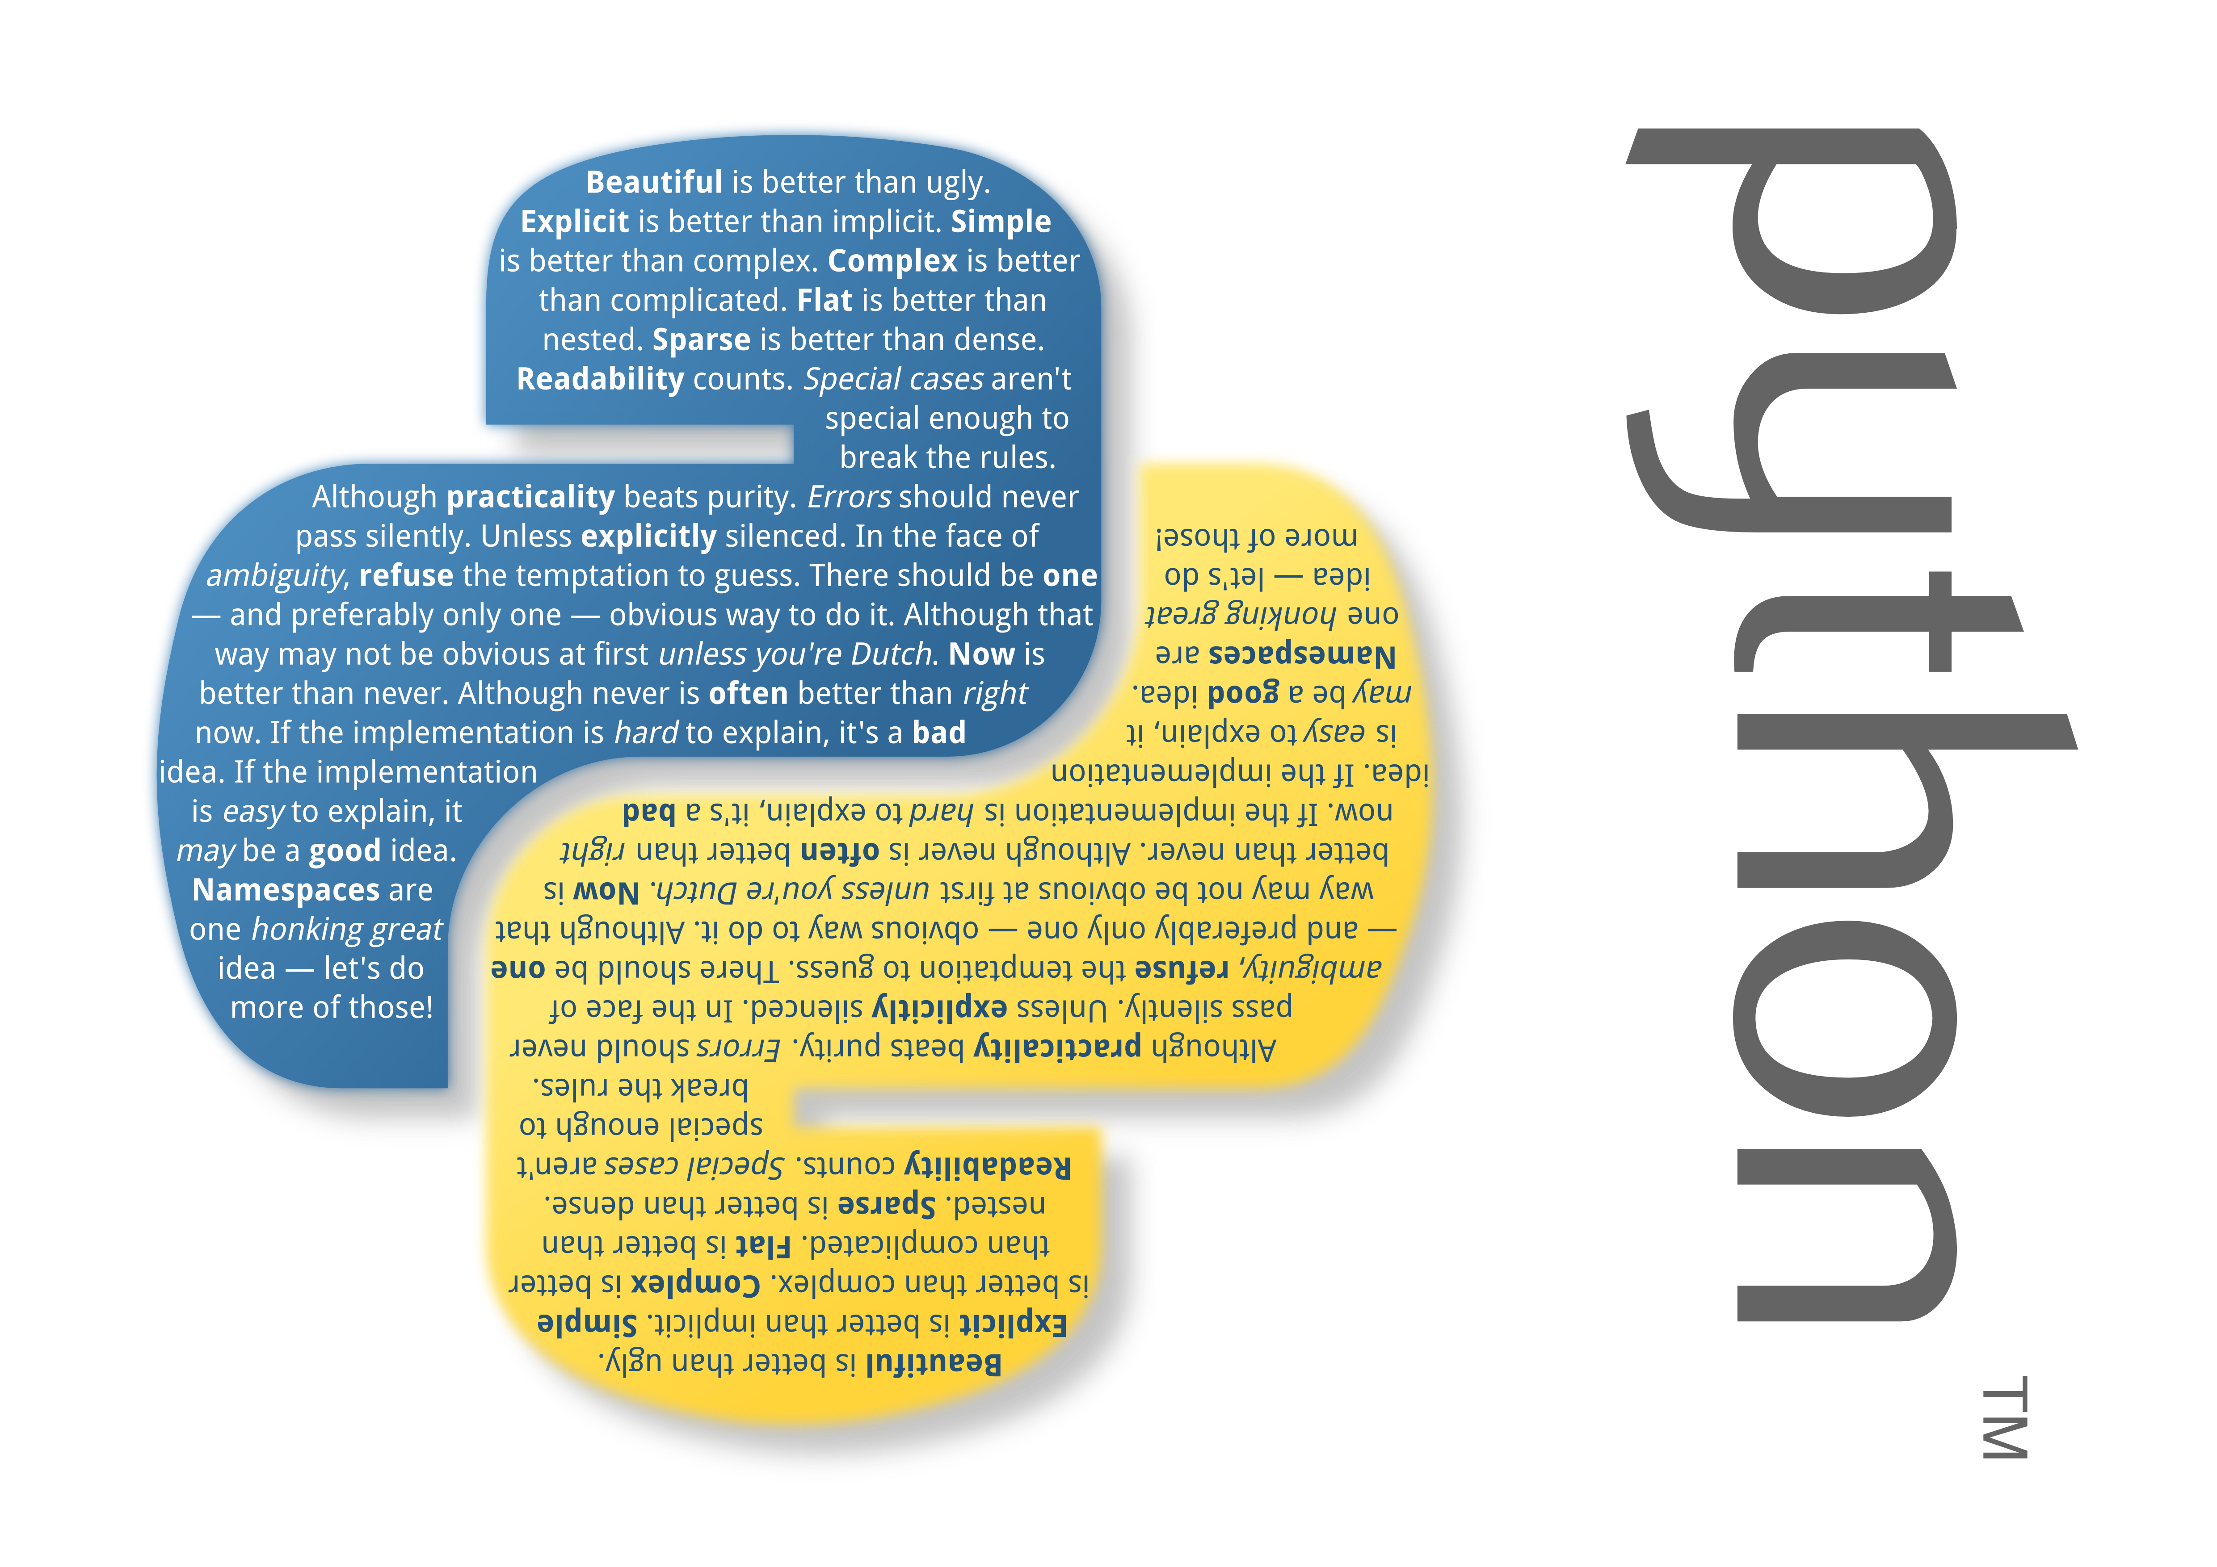

Slide 2
Python
Python is High Level Programming Language.
Its one of most used programming languages in the world.
Famous companies such as Google, NASA, Yahoo uses Python for their programs.

Slide 3
Python
Language syntax is very easy so everybody can learn it.
Its easy to understand program code written in Python.
You can develop programs for all systems (Linux, Mac, Windows, Android, iOS and etc.)

Slide 4
What is Syntax
Every language, programming and natural, have syntax. Its order of symbols, words and etc.

Slide 5
Programming Languages
Low Level Languages:
High Level Languages:
Source
Code
Checker
Interpreter
Output
Source
Code
Compiler
Checker
Object Code
(Low level)

Slide 6
What is Program
Program (or script) is a sequence of <definitions> and <commands> .
In Python we can type definitions and commands directly into a <shell>, or store it in a file and then read it into the shell and evaluate.

Slide 7
What is Program
Programs will manipulate data objects.
Each object has a type that defines the kinds of things programs can do to it.

Slide 8
Type of Objects
Scalar Objects:
int – integers such as 5 or 12345
float – real numbers such as 3.14 or 5.0
bool – Boolean values: True and False
Non-Scalar Object:
string – Strings such as “Python is C@@L”

Slide 9
Test Yourself in IDLE
Function type will show you type of variable
>>> type(5)
>>> type(5.0)
>>> type(True)
>>> type(“Hello World”)

Slide 10
Expressions
Objects and operators can be combined to form expressions, mostly like:
<object> <operator> <object>

Slide 11
Expressions
Examples:
i + j – sum
i - j – difference
i * j – product
i / j – division
i % j – remainder (module)
i ** j – I raised to the power of j

Slide 12
Try to make some Expressions
>>> 3 + 4
>>> 3.0 + 4
>>> 3.0 / 2
>>> 3 / 2
>>> 3 % 2
>>> 3 ** 2

Slide 13
Comparison operators
i > j
i >= j
i < j
i <= j
i == j
i != j

Slide 14
Try them in IDLE
>>> 3 > 3
>>> 3 > 4
>>> 3 == 3
>>> 3 != 3
>>> 3 != 4

Slide 15
Converting between in and float
>>> float(3)
>>> int(3.14)
>>> float(int(3.2345))

Slide 16
Exam
Now, Open http://j.mp/pyexam1 and try to solve exam. You will not get any points for this exam. Its only for testing yourself.
If you will have problems, don't miss to ask them.

Slide 17
Variables and Naming
Assignment
pi = 3.1415
radius = 10
area = pi * (radius ** 2)
Test it in IDLE
Test in Python Visualizer: http://j.mp/pyviz

Slide 18
Working with Strings
To assign a string to variable you must use “” or '' symbols:
name = “Emin”
surname = 'Mastizada'
birth = 1994
>>> name, surname, birth

Slide 19
Print Function
Now lets learn how to print variables to screen.
>>> print(“Hello World”)
>>> print(name, surname, birth)
>>> print(“My name is”, name)

Slide 20
IF function
If function is testing condition and if its true it executes code.
Syntax:
  if condition:
    code

Slide 21
IF function
To continue codes just use white space (press tab key to add white space, Python idle automatically adds white space after functions like if. When you will start coding from new line without white space if function will end.

Slide 22
Else if and else
If condition is false code will not be executed, but you can add other if functions that are depending on first condition like:
if True:
  do this
elif False:
  do this

Slide 23
Else if and else
For else if you can use elif and there is else function that executes code if all conditions are False:
if False:
  do this
elif another_False:
  do this
else:
  do this

Slide 24
Example
number = 5
if number > 5:
  print(“Your number is higher than 5”)
elif number < 5:
  print(“Your number is less than 5”)
else:
  print(“Your number is 5”)

Slide 25
Printing variables
name = “Emin”
print(“Welcome Mr.”, name)
this print will add space after , symbol.
print(“Welcome Mr.%s” % (name))
This will replace %s with name variable.

Slide 26
Printing variables
name = “Emin”
age = 19
print(“%s is %s years old” % (name, age))
This will replace %s with variables in () with its order. You can use %s in any place of the text, but number of variables after % symbol must be same with number of %s in the text.

Slide 27
Printing variables
If you have ' or “ symbol in the text it can crash your program. You must use \ symbol before this symbol:
print('Hi, I\'ll be there in 5 minutes. I\'m hungry')
If you start your text with “ symbol, it must end with “ too. Same for ' symbol. They are not same.

Slide 28
Printing variables
There are extra things that you can use for with print.
\n – will go to new line.
\t – will add white space.
Example:
print(“First line\nSecond line\tCool”)

Slide 29
Input Function
For making program interactive you need also to get input from user. For this you need input function:
variable = input(“Text for asking: ”)
By default this will return string type input. To convert it you can use int function:
name = int(input(“Enter your name:\t”))

Slide 30
For loop
So, sometimes we need to execute same program many times. For and While functions are mostly used for this.
Syntax:
  for condition:
    code

Slide 31
For loop
for x in range(0, 10, 1):
  print(x)
This will print numbers from 0 to 10.
for letter in name:
  print(letter)
This will print every letter from the variable “name”

Slide 32
Range
range(start, stop, step)
start – from which number to start.
stop – in which number to stop.
step – What to add to variable everytime

Slide 33
Lets Write first Game ;)
So, we will write a little game. It will guessing number.
What we need for this?
A number that user must guess
Give him some changes for guessing number
Tell him if number he entered is higher or lower.

Slide 34
Game: Guess Number
So, create new file for program. In IDLE just select File==>New file and new file will be opened. Then save this new file as guess_number.py – feel free to choose a name for file, but its extension must be .py
Now, lets start writing code.

Slide 35
Game: Guess Number
number = 5 ## Number that user must guess
chance = 5 ## Chance for guessing number
for i in range(0, chance, 1):
  guess = int(input(“Your Guess: \n”))
  if(guess == number):
    print(“You Win!!!\n”)
    break

Slide 36
Game: Guess Number
  elif (guess > number):
    print(“Its higher than my number”)
  elif(guess < number):
    print(“Its less than my number”)

Slide 37
Game: Guess Number
  Now, more detailed.
  break – this will stop for loop. It breaks loop.
  input function will get number from user.
  int function will convert it from string format to integer format.
  Others are simple functions.

Slide 38
Game: Guess Number
  In number guessing game we need random number every time. We will use randint function for this. But python haven't randint function by default. So we need library “random” for randint function. This code will import randint function from random library:
  from random import randint
  Lets learn how to use this function.

Slide 39
Game: Guess Number
  from random import randint
  start = 1
  stop = 10
  number = randint(start, stop)
  This will make number variable random integer between 1 and 10.

Slide 40
  from random import randint
  start = 1
  stop = 10
  Number = randint(start, stop)
  chance = 5
  for i in range(0,chance, 1):
  guess = int(input("Your Guess:\t"))
  if(guess == number):
  print("You Win!!!\n")
  break
  elif(guess > number):
  print("Higher than my number\n")
  elif(guess < number):
  print("Less than my number\n")

Slide 41
  Thats All for now, test yourself by making new different programs. Try to add users name and something different to your program.
  Good luck...
  Emin Mastizada
  ITU Software Freedom Student Club

