Slide 1

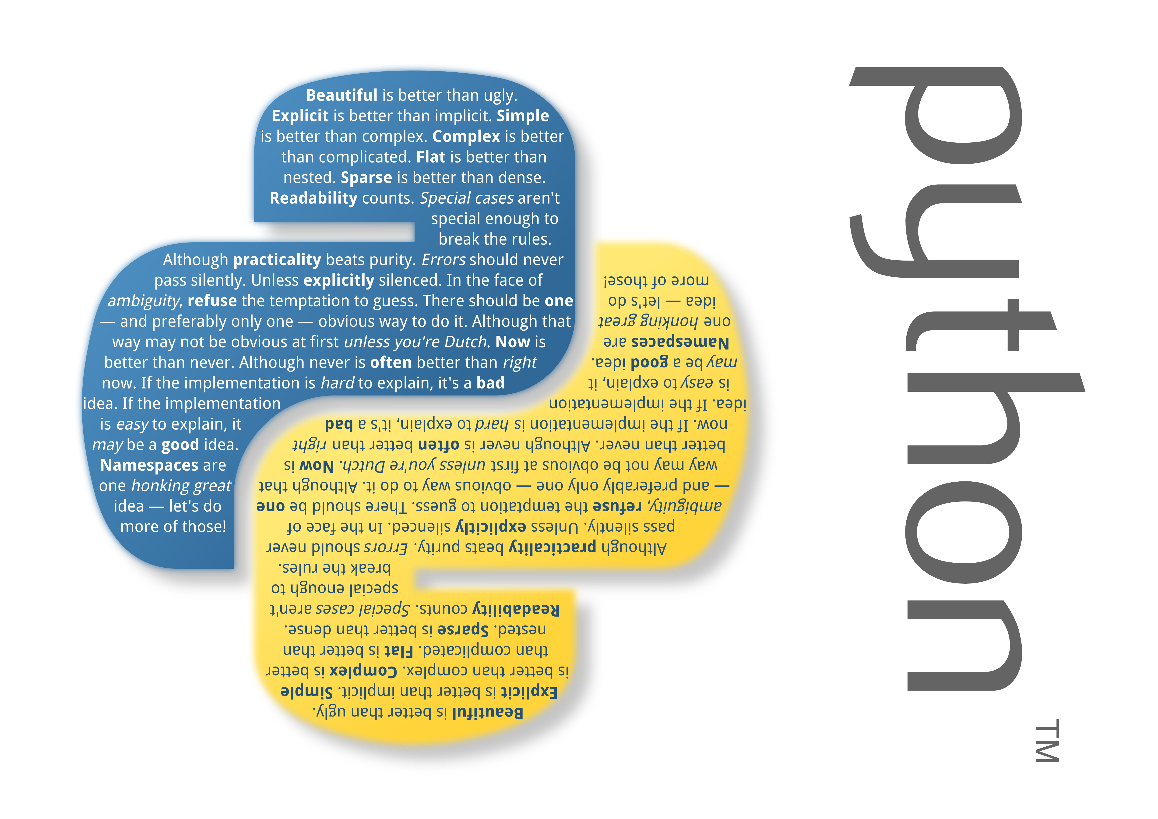

Slide 2
Python
Lecture 2

Slide 3
Python
Loops are very important. So, lets learn more about for loop.
We must be able to use them with numbers, strings, lists, arrays, dictionaries and etc.

Slide 4
Python
You already know how to use for loop with function range().
What if you must do something with letters of the word?
Lets define string:
text = 'Hello World'

Slide 5
Python
Now we want to change H and W to X and write new text to variable new_text:
new_text = “”
for letter in text:
  if letter == 'H' or letter == 'W'
    letter = 'X' #Changing letter to X
  new_text += letter #Adds current letter to variable
print('Your converted text is %s' % (new_text))

Slide 6
Python
Every string variable is an array of letters and symbols.
print(text[0])
print(text[3])
Lets find which index in our text is 'W' letter.

Slide 7
Python
for i in range(len(text)): #Length of text
  if text[i] == 'W':
    print('Index %s is W' % (I))
This method can be used in many places and its main rule for working with letters in many languages.
PS. Index can not be more or equal than arrays length.

Slide 8
Lists
String arrays can contain only 1 sentence, word or letter. What if you need more?
List can contain many symbols, words, strings, numbers and etc.
Sample list:
my_data = ['Emin', 1994, '@!£$%', 'Baku', True]
len(my_data)

Slide 9
Lists
In array (strings) we every symbol (letter) have index. In lists, every value have index:
my_data[0]
my_data[1]
As you can see, we stored both integer, boolean and string type in same variable.
Lets change '@' symbol and user's in our data and write it to new_data.

Slide 10
Lists
  my_data = ['Emin',1994, '@!235', 'Baku', True]
  new_data = [] #Do not use space between them
  new_word = '' #Space is for showing you that there are 2 symbols
  for word in my_data:
  if isinstance(word, int) == False: #Detect whether it is integer or not
  if word == 'Emin':
  word = 'EM'
  for letter in word:
  if letter == '@':
  letter = '^' #Change all '@' to '^'
  new_word += letter #Add all and modified letter to new word
  new_data.append(new_word) #Add new word to list
  new_word = '' #make variable ready for next loop
  else:
  new_data.append(word) #If its integer, just add it to list
  print(new_data)

Slide 11
Lists
Changing selected index of list:
my_data[0] = 'Mastizada'

Slide 12
Lists
There are 2 methods to add value to list:
append() and extend() :
my_data.append('ITU')
Deleting value from list:
remove(x) – will remove 1st item in list with value x.

Slide 13
Lists
pop([i]) – Will remove item in index i. Others will go 1 index back.
count(x) – Will tell you how many times x appears in list.
Reverse() - Will reverse the elements.

Slide 14
Lists
Getting selected items from list:
first_two_items = my_data[0:2] #First 2 items
till_index_two = my_data[::2]
after_index_two = my_data[2::]
last_two_items = my_data[-2::]
last_item = my_data[-1::]
PS.Same can be done with arrays

Slide 15
Lists
Getting index number:
name_index = my_data.index('Mastizada')
university_index = my_data.index('ITU')
Insert to selected position:
my_data.insert(name_index, 'Emin')

Slide 16
Lists
List of List
You can make list of lists such that:
my_list = [ [1, 2, 3], [4, 5, 6], [7, 8, 9]]

Slide 17
Lists
Sort() Function:
it sorts numbers in list:
nums = [2, 6, 12, 7, 19]
square_nums = [ ]
for x in nums:
  x = x ** 2
  square_nums.append(x)

Slide 18
Lists
Now, print your square list:
print(square_nums)
Sort it:
square_nums.sort()
Print it again:
print(square_nums)

Slide 19
Lists
You are not tired yet?

