Slide 1
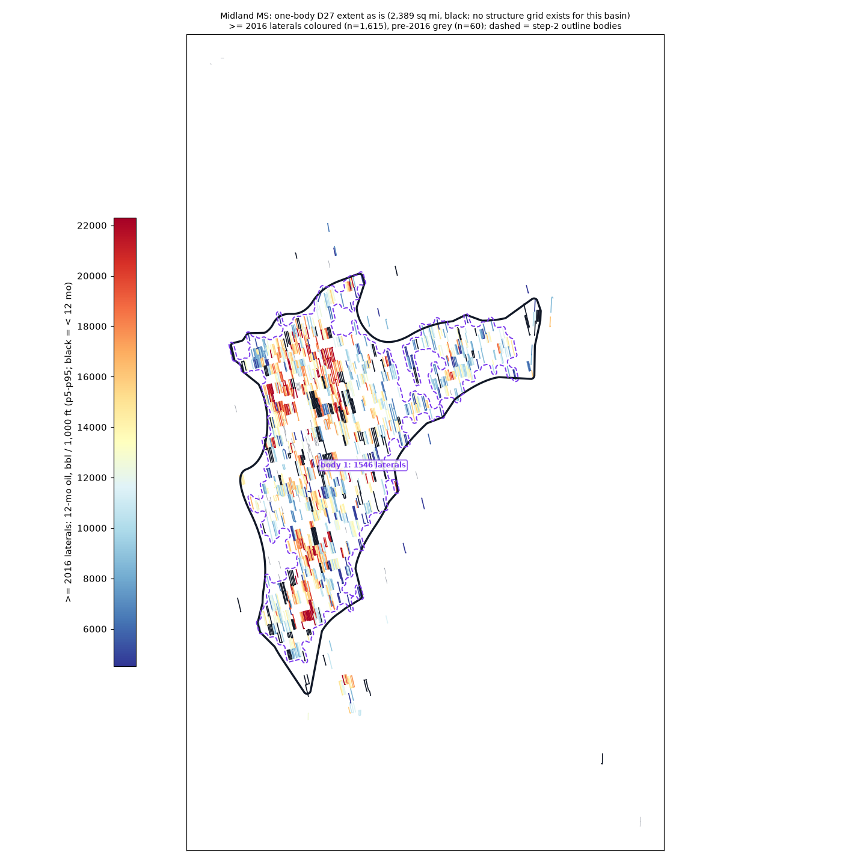
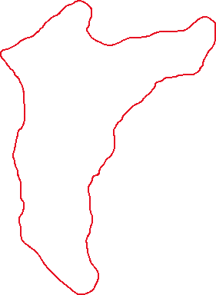
Midland MS
generated one-body D27 extent: 2,389 sq mi
>= 2016 laterals: 1,615; inside 1,573
bodies >= 50 laterals: 1 (dashed; body 1 = the D27 body)
isolated tests out: 42
Edits (pen or freeform, red):
your closed loops ARE the extent
(the black outline is ignored)
no drawing = accept as generated

Slide 2
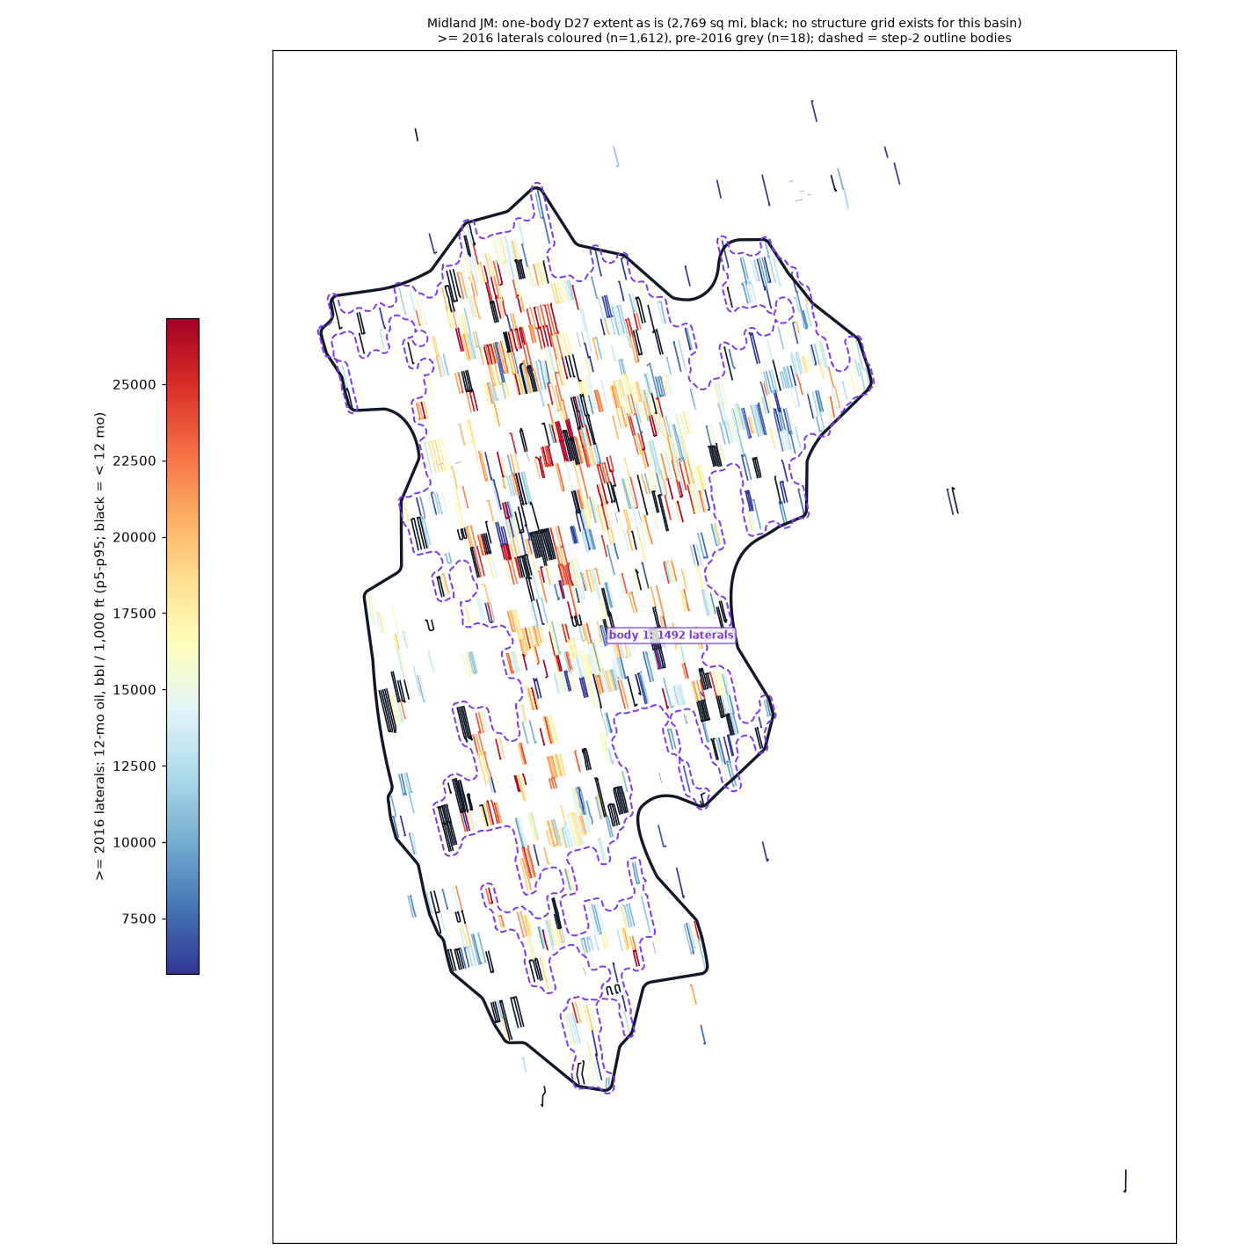
Midland JM
generated one-body D27 extent: 2,769 sq mi
>= 2016 laterals: 1,612; inside 1,587
bodies >= 50 laterals: 1 (dashed; body 1 = the D27 body)
isolated tests out: 28
Edits (pen or freeform, red):
your closed loops ARE the extent
(the black outline is ignored)
no drawing = accept as generated

Slide 3
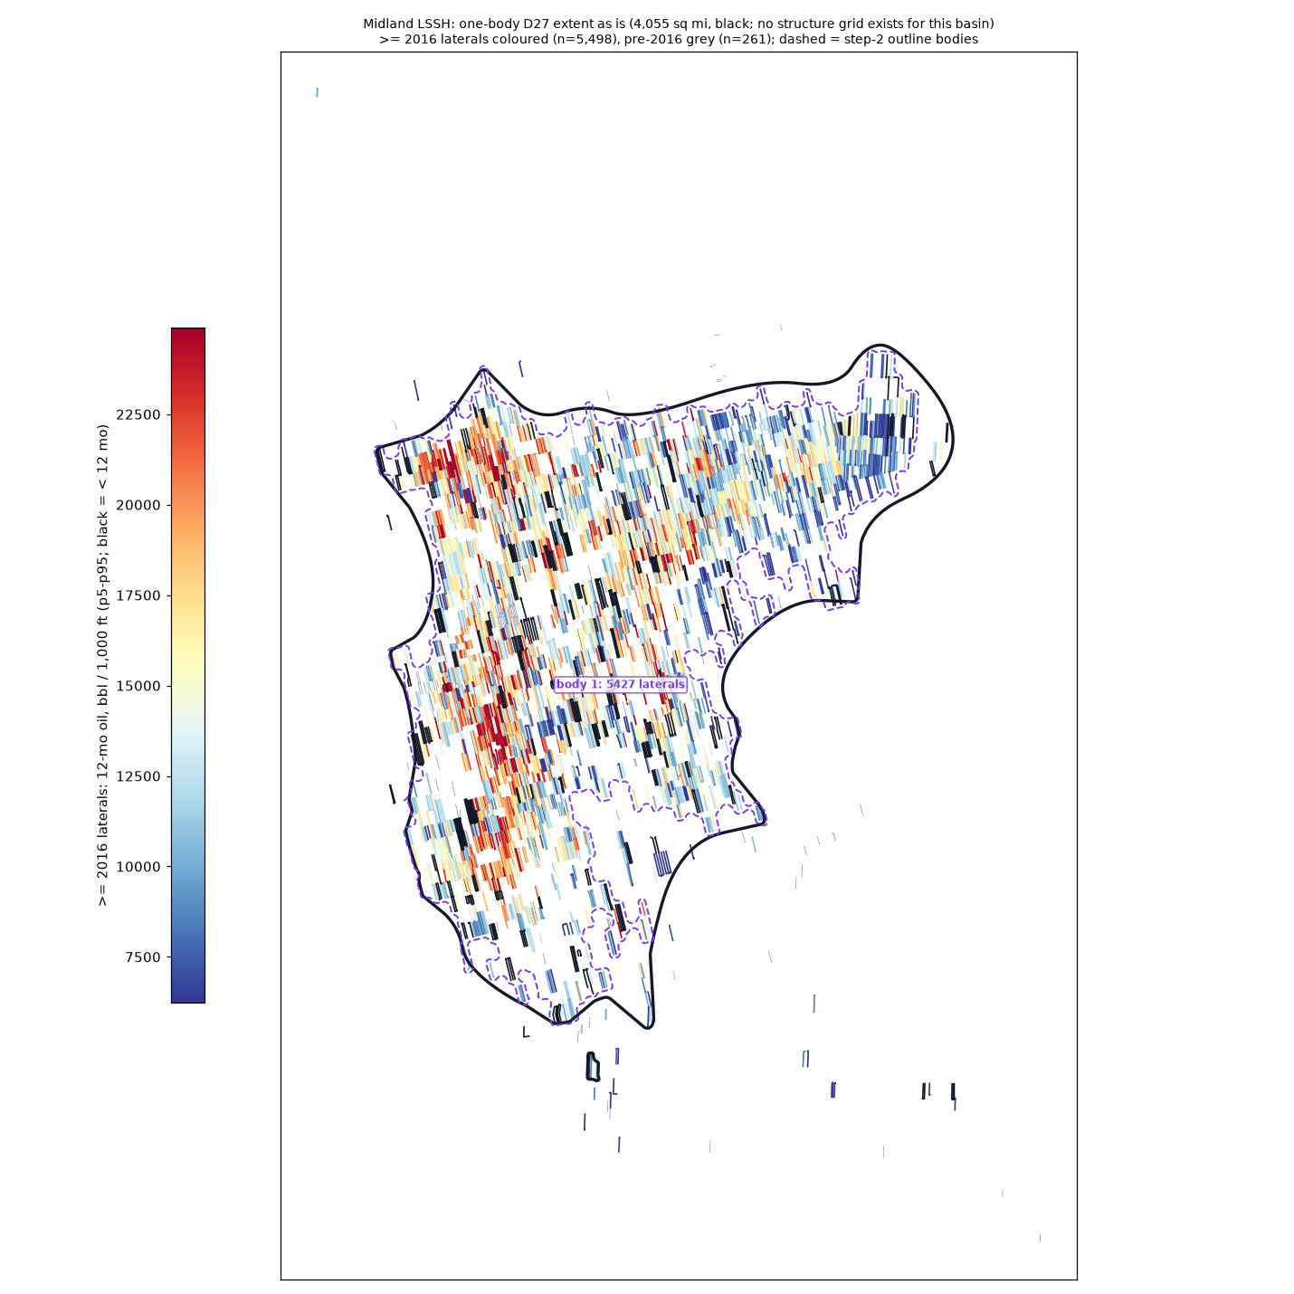
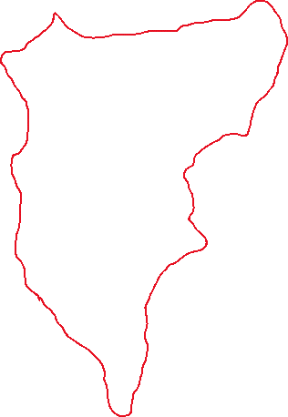
Midland LSSH
generated one-body D27 extent: 4,055 sq mi
>= 2016 laterals: 5,498; inside 5,465
bodies >= 50 laterals: 1 (dashed; body 1 = the D27 body)
isolated tests out: 33
Edits (pen or freeform, red):
your closed loops ARE the extent
(the black outline is ignored)
no drawing = accept as generated

Slide 4
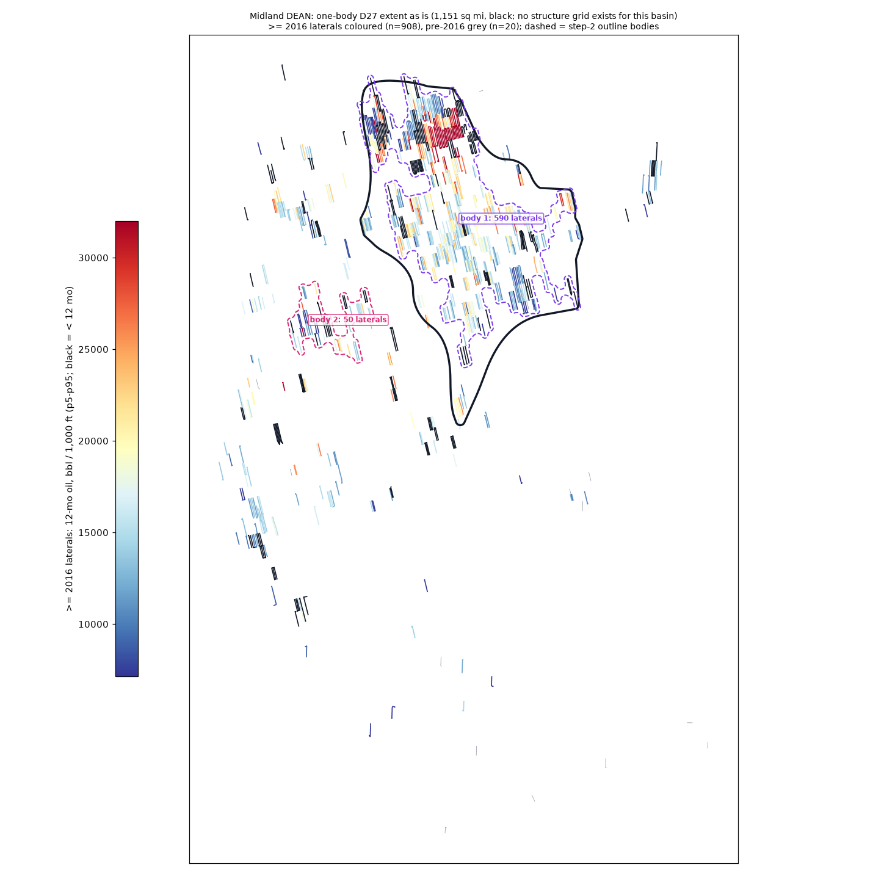
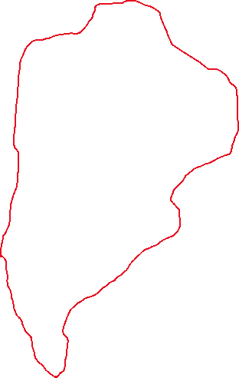
Midland DEAN
generated D27 body: 1,151 sq mi, FAILS one-body (284 developed laterals out)
>= 2016 laterals: 908; inside 624
bodies >= 50 laterals: 2 (dashed; body 1 = the D27 body)
isolated tests out: 289
Edits (pen or freeform, red):
your closed loops ARE the extent
(the black outline is ignored)
no drawing = accept as generated

