Slide 1
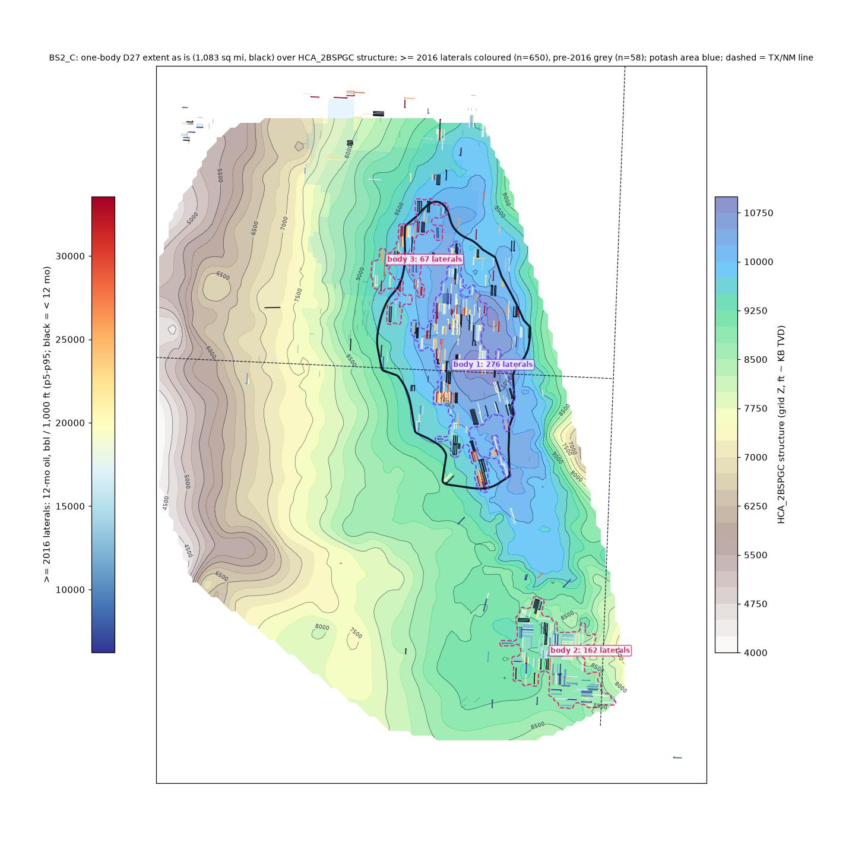
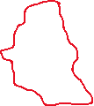
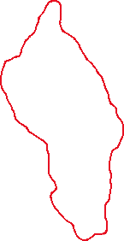
BS2_C
generated one-body D27 extent: 1,083 sq mi
>= 2016 laterals: 650; inside 367
bodies >= 50 laterals: 3 (dashed; body 1 = the D27 body)
isolated tests out: 297
Draw edits as red freeforms:
outside the black outline = add
inside = cut
no drawing = accept as generated

Slide 2
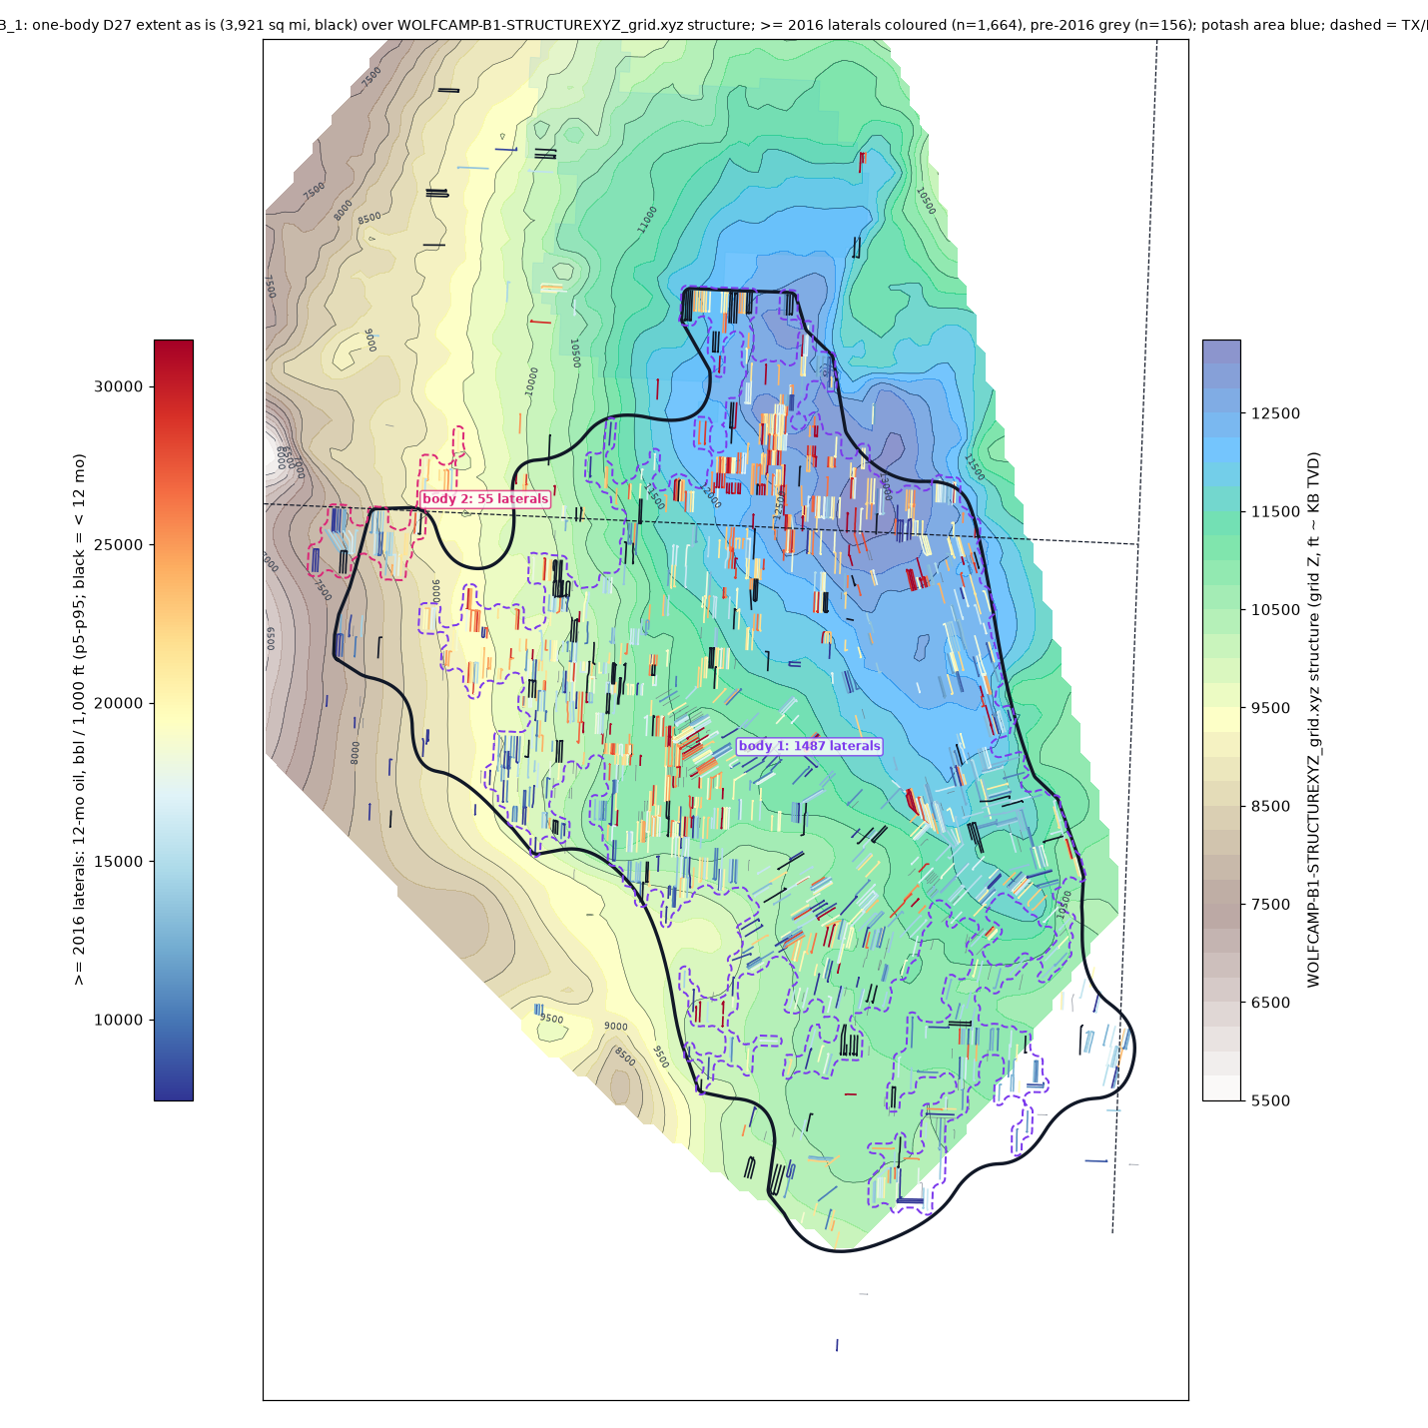
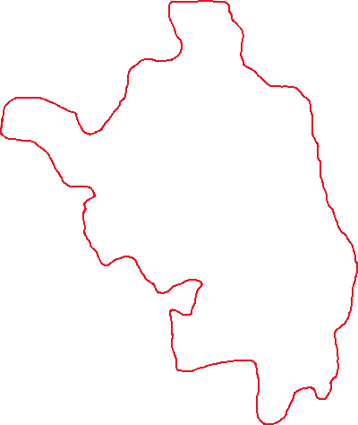
WCB_1
generated one-body D27 extent: 3,921 sq mi
>= 2016 laterals: 1,664; inside 1,580
bodies >= 50 laterals: 2 (dashed; body 1 = the D27 body)
isolated tests out: 111
Draw edits as red freeforms:
outside the black outline = add
inside = cut
no drawing = accept as generated

Slide 3
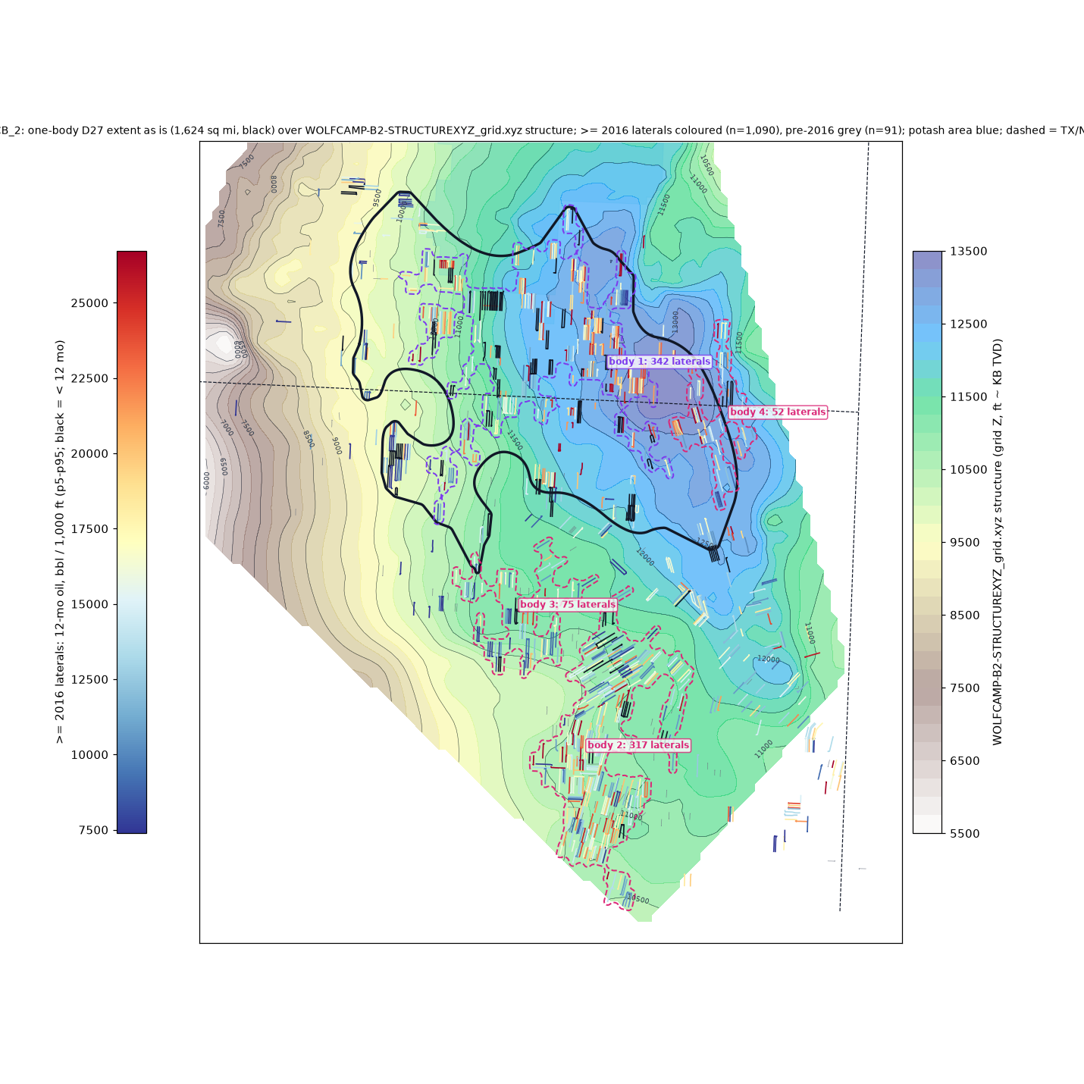
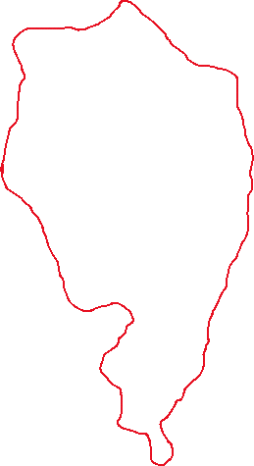
WCB_2
generated one-body D27 extent: 1,624 sq mi
>= 2016 laterals: 1,090; inside 507
bodies >= 50 laterals: 4 (dashed; body 1 = the D27 body)
isolated tests out: 601
Draw edits as red freeforms:
outside the black outline = add
inside = cut
no drawing = accept as generated

Slide 4
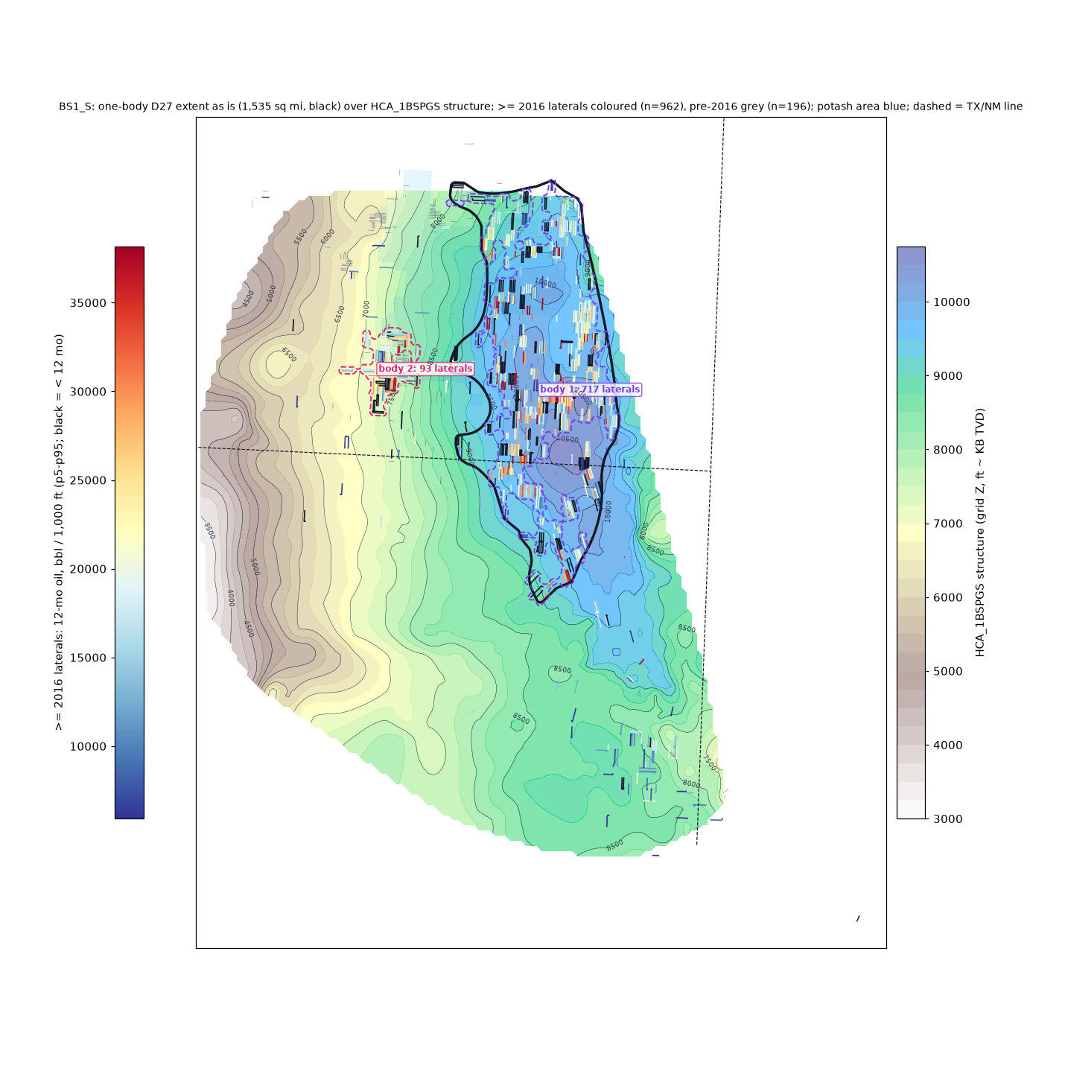
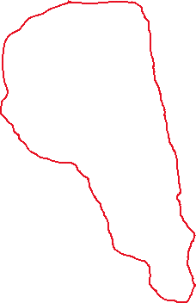
BS1_S
generated one-body D27 extent: 1,535 sq mi
>= 2016 laterals: 962; inside 777
bodies >= 50 laterals: 2 (dashed; body 1 = the D27 body)
isolated tests out: 190
Draw edits as red freeforms:
outside the black outline = add
inside = cut
no drawing = accept as generated

Slide 5
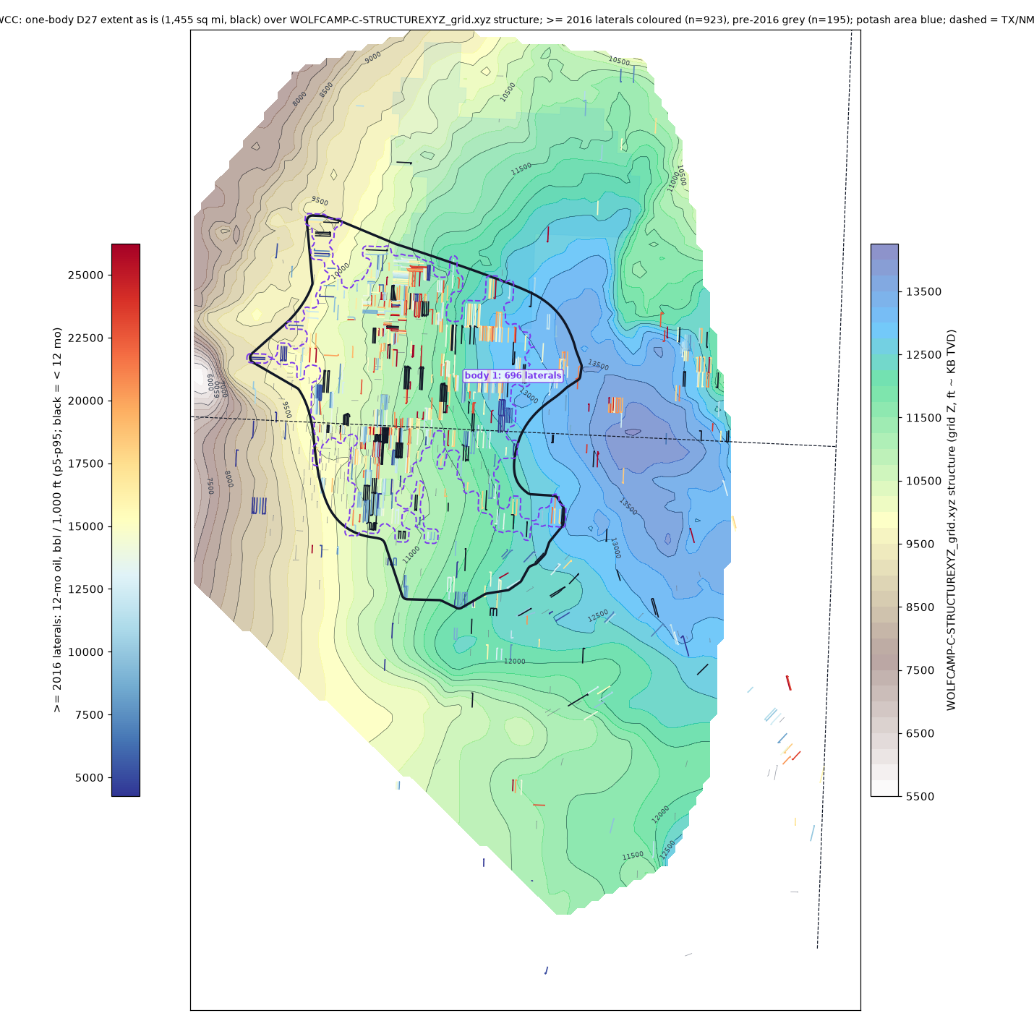
WCC
generated one-body D27 extent: 1,455 sq mi
>= 2016 laterals: 923; inside 751
bodies >= 50 laterals: 1 (dashed; body 1 = the D27 body)
isolated tests out: 183
Draw edits as red freeforms:
outside the black outline = add
inside = cut
no drawing = accept as generated

Slide 6
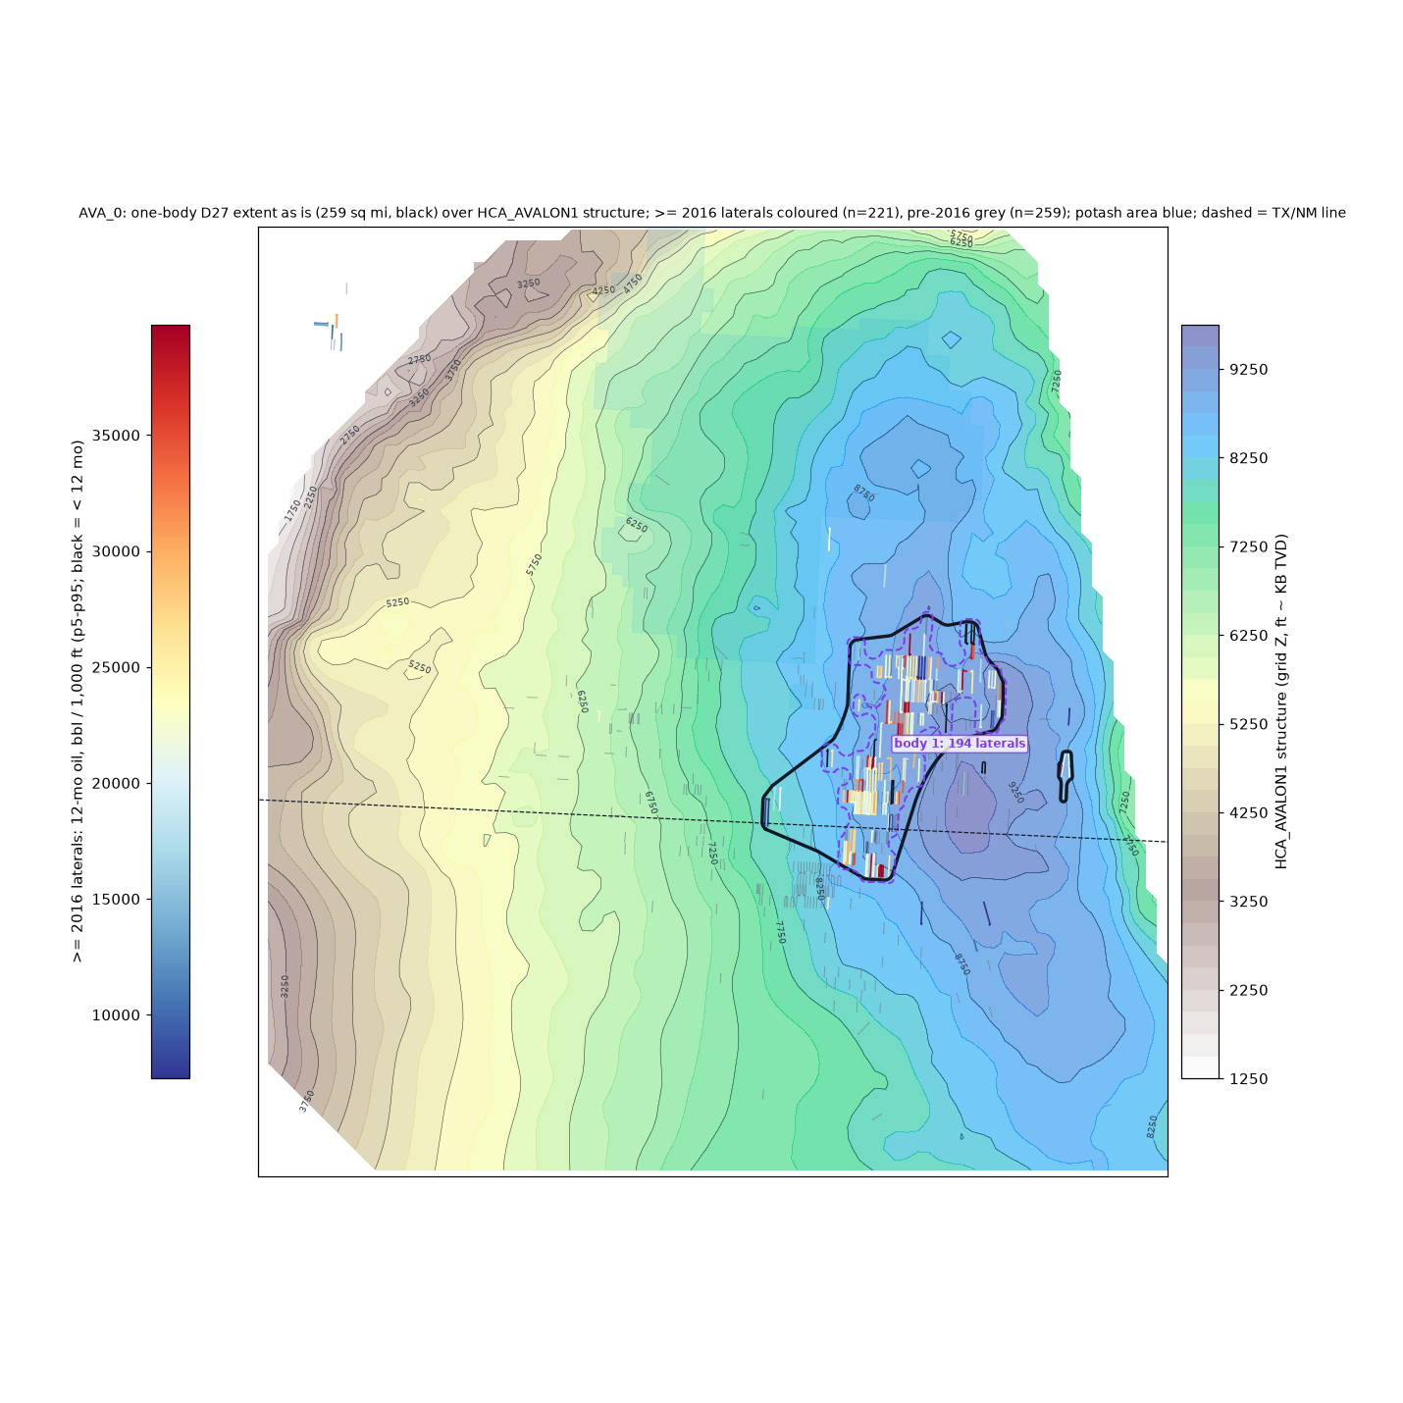
AVA_0
generated one-body D27 extent: 259 sq mi
>= 2016 laterals: 221; inside 202
bodies >= 50 laterals: 1 (dashed; body 1 = the D27 body)
isolated tests out: 19
Draw edits as red freeforms:
outside the black outline = add
inside = cut
no drawing = accept as generated

Slide 7
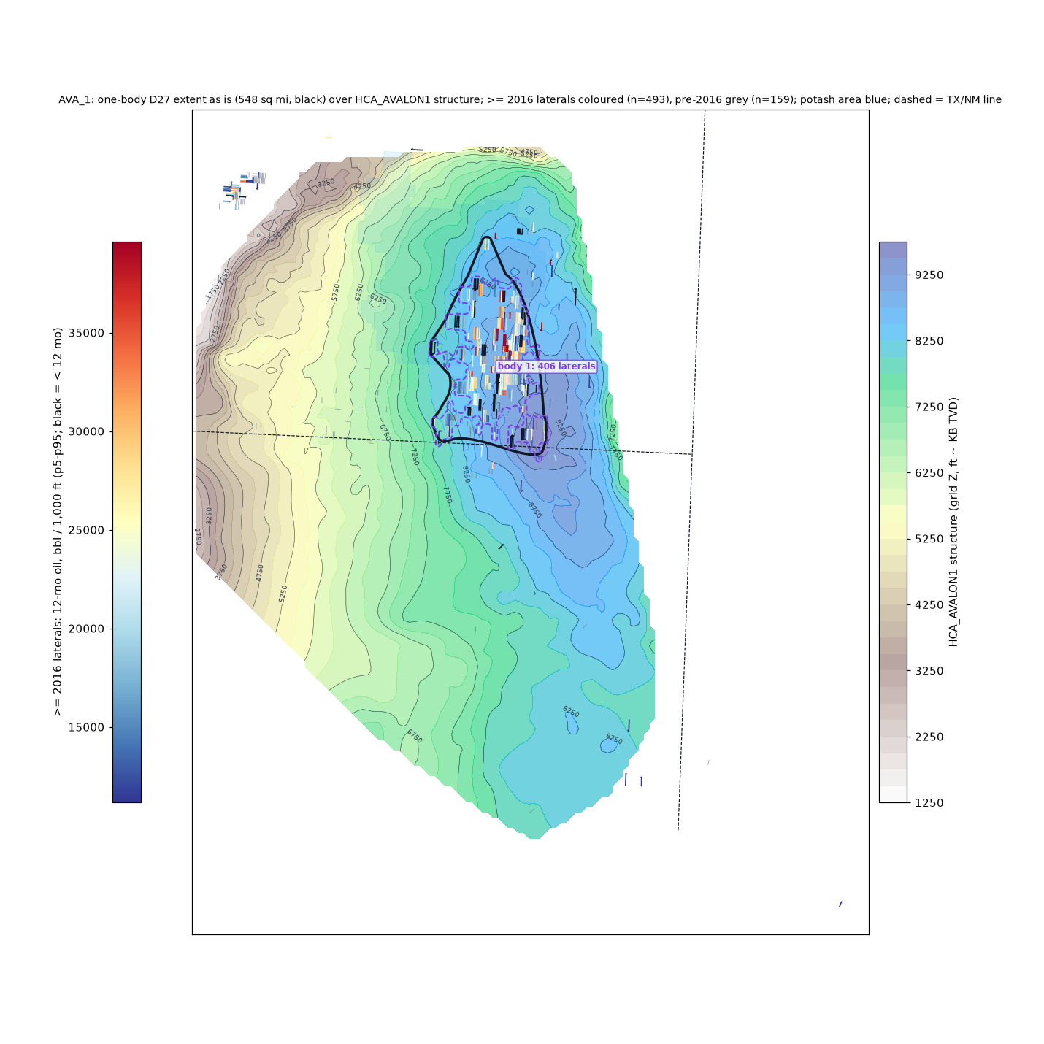
AVA_1
generated one-body D27 extent: 548 sq mi
>= 2016 laterals: 493; inside 409
bodies >= 50 laterals: 1 (dashed; body 1 = the D27 body)
isolated tests out: 84
Draw edits as red freeforms:
outside the black outline = add
inside = cut
no drawing = accept as generated

Slide 8
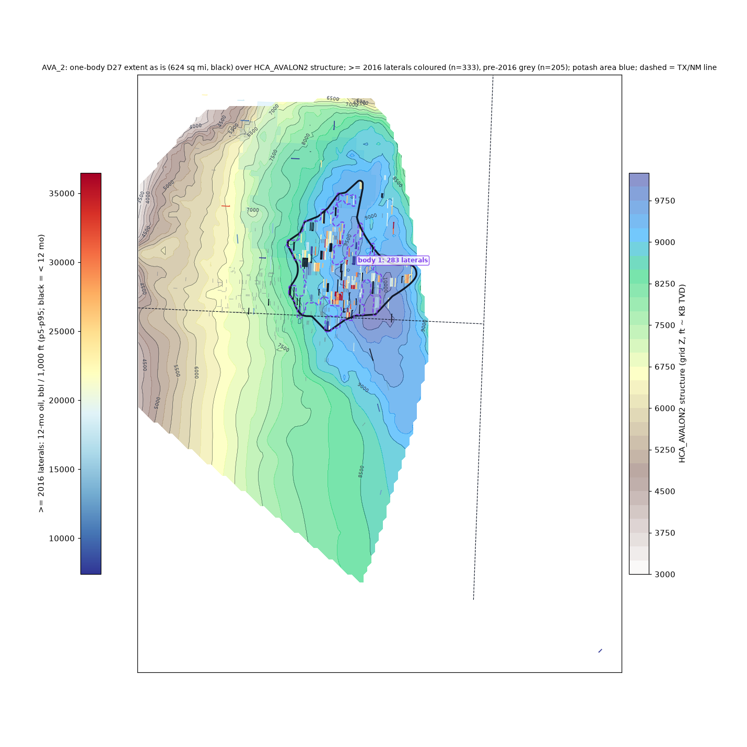
AVA_2
generated one-body D27 extent: 624 sq mi
>= 2016 laterals: 333; inside 298
bodies >= 50 laterals: 1 (dashed; body 1 = the D27 body)
isolated tests out: 35
Draw edits as red freeforms:
outside the black outline = add
inside = cut
no drawing = accept as generated

Slide 9
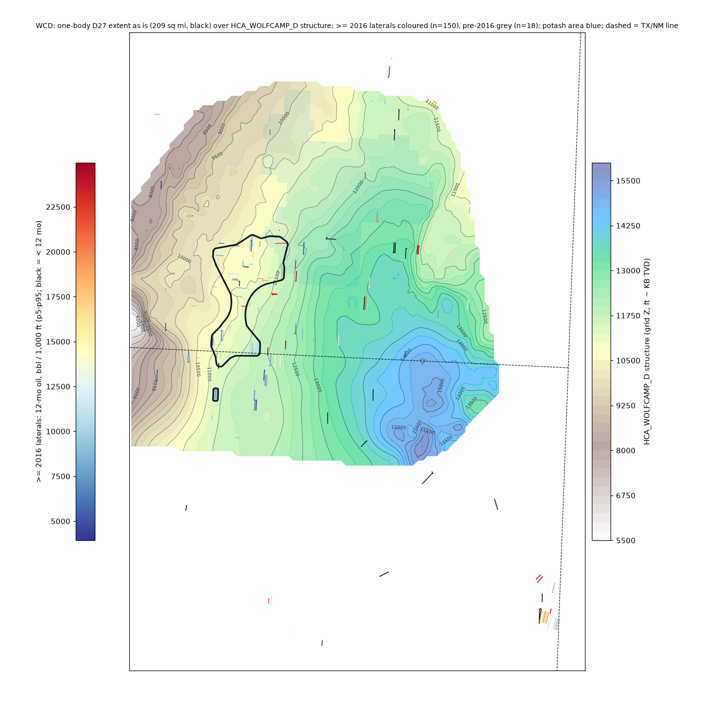
WCD
generated one-body D27 extent: 209 sq mi
>= 2016 laterals: 150; inside 56
bodies >= 50 laterals: 0 (dashed; body 1 = the D27 body)
isolated tests out: 94
Draw edits as red freeforms:
outside the black outline = add
inside = cut
no drawing = accept as generated

