Slide 1
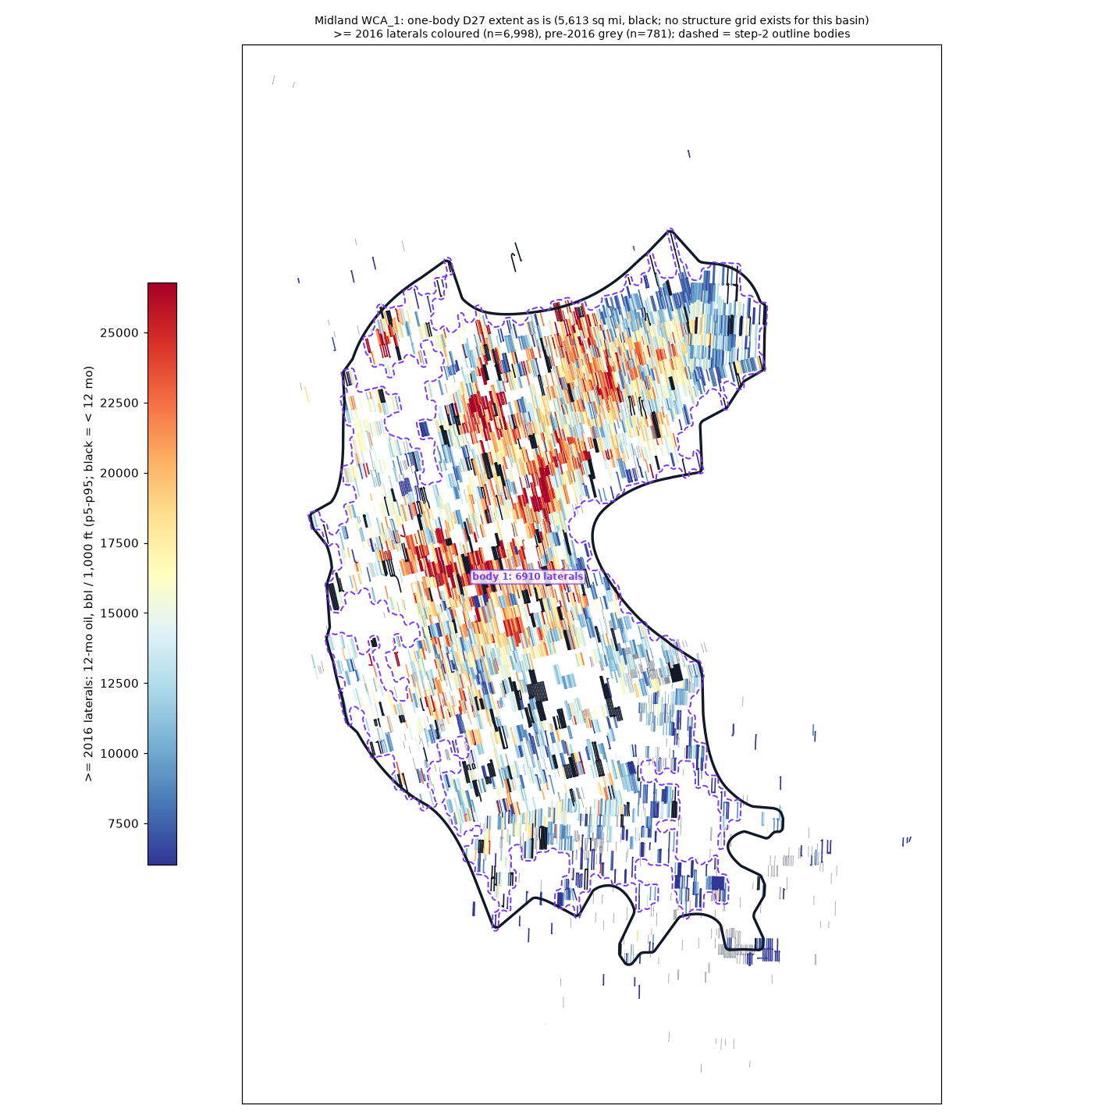
Midland WCA_1
generated one-body D27 extent: 5,613 sq mi
>= 2016 laterals: 6,998; inside 6,939
bodies >= 50 laterals: 1 (dashed; body 1 = the D27 body)
isolated tests out: 63
Edits (pen or freeform, red):
your closed loops ARE the extent
(the black outline is ignored)
no drawing = accept as generated

Slide 2
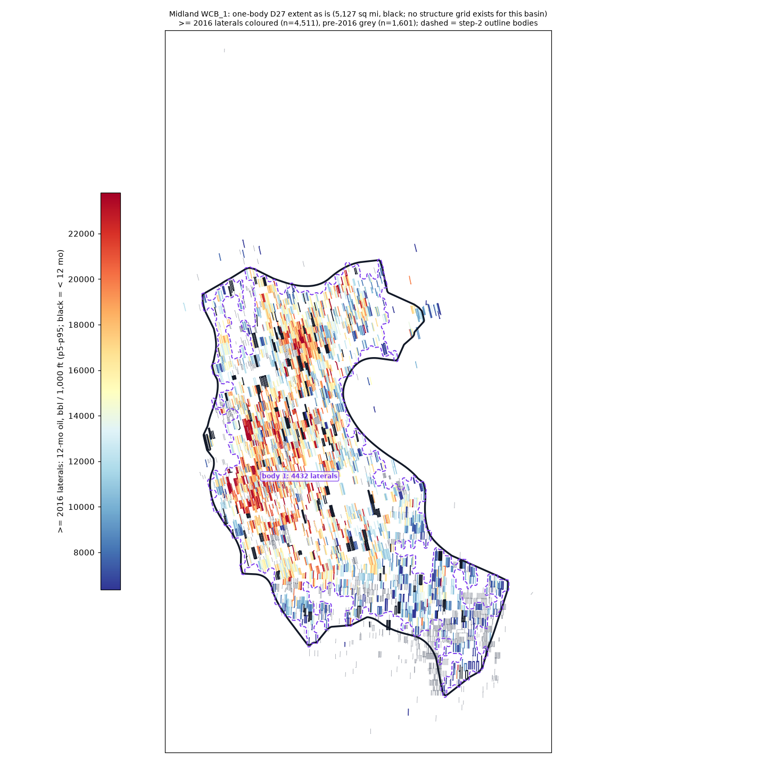
Midland WCB_1
generated one-body D27 extent: 5,127 sq mi
>= 2016 laterals: 4,511; inside 4,478
bodies >= 50 laterals: 1 (dashed; body 1 = the D27 body)
isolated tests out: 37
Edits (pen or freeform, red):
your closed loops ARE the extent
(the black outline is ignored)
no drawing = accept as generated

Slide 3
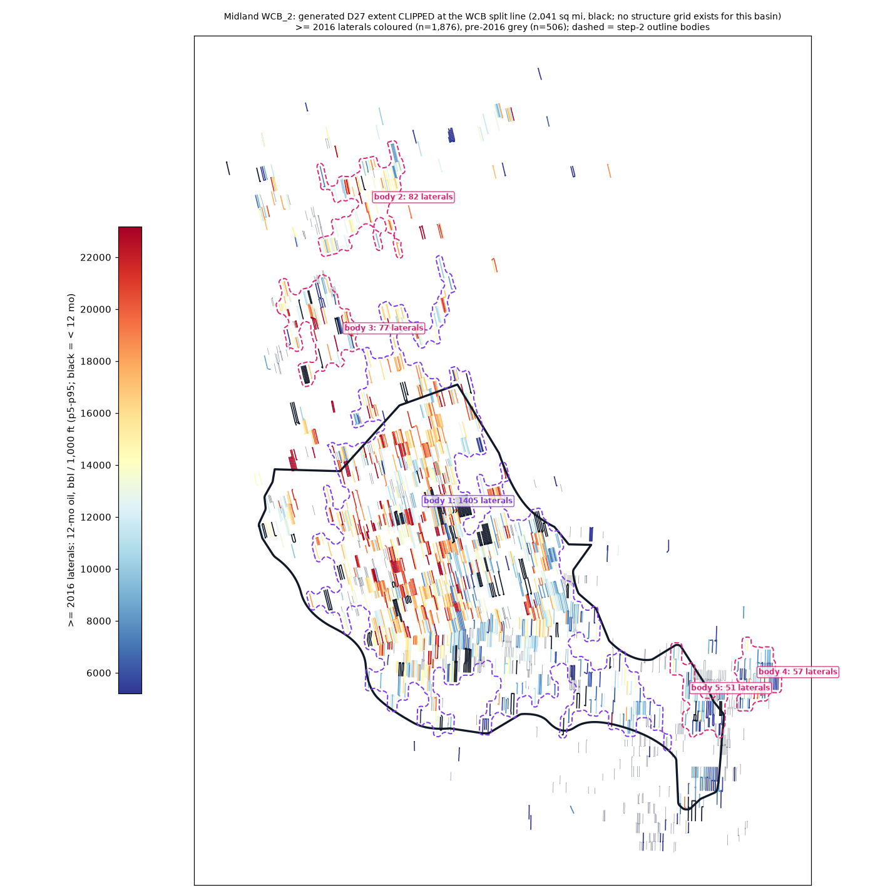
Midland WCB_2
D136: generated extent CLIPPED at the WCB split line, 2,041 sq mi (unclipped 2,675)
>= 2016 laterals: 1,876; inside 1,593
bodies >= 50 laterals: 5 (dashed; body 1 = the D27 body)
isolated tests out: 306
Edits (pen or freeform, red):
your closed loops ARE the extent
(the black outline is ignored)
no drawing = accept as generated

Slide 4
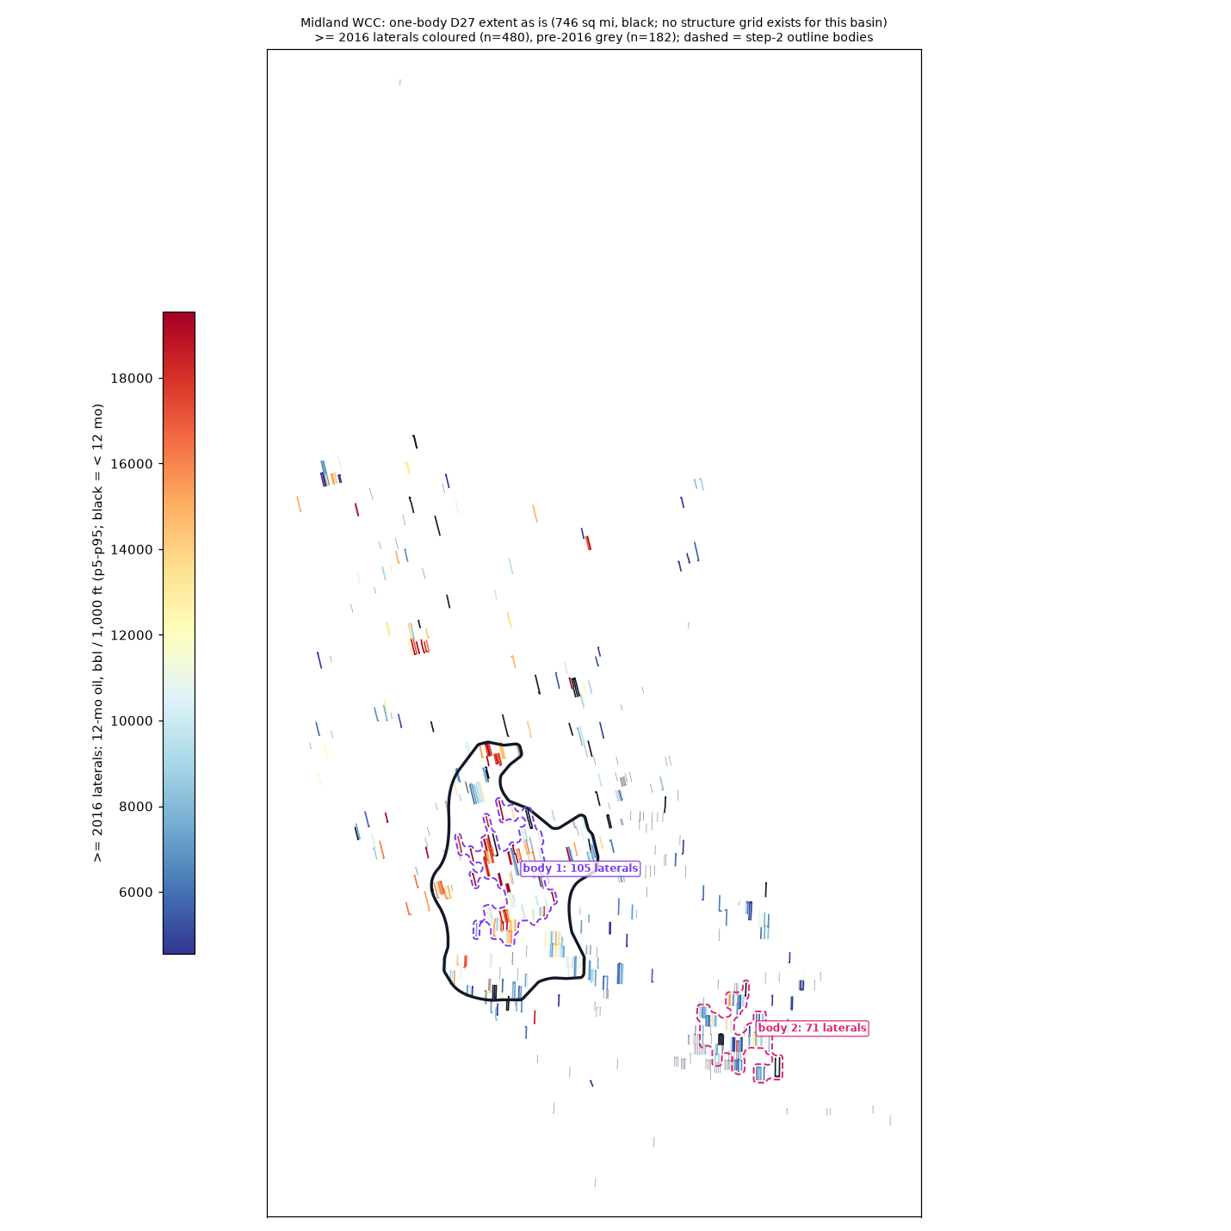
Midland WCC
generated one-body D27 extent: 746 sq mi
>= 2016 laterals: 480; inside 233
bodies >= 50 laterals: 2 (dashed; body 1 = the D27 body)
isolated tests out: 256
Edits (pen or freeform, red):
your closed loops ARE the extent
(the black outline is ignored)
no drawing = accept as generated

Slide 5
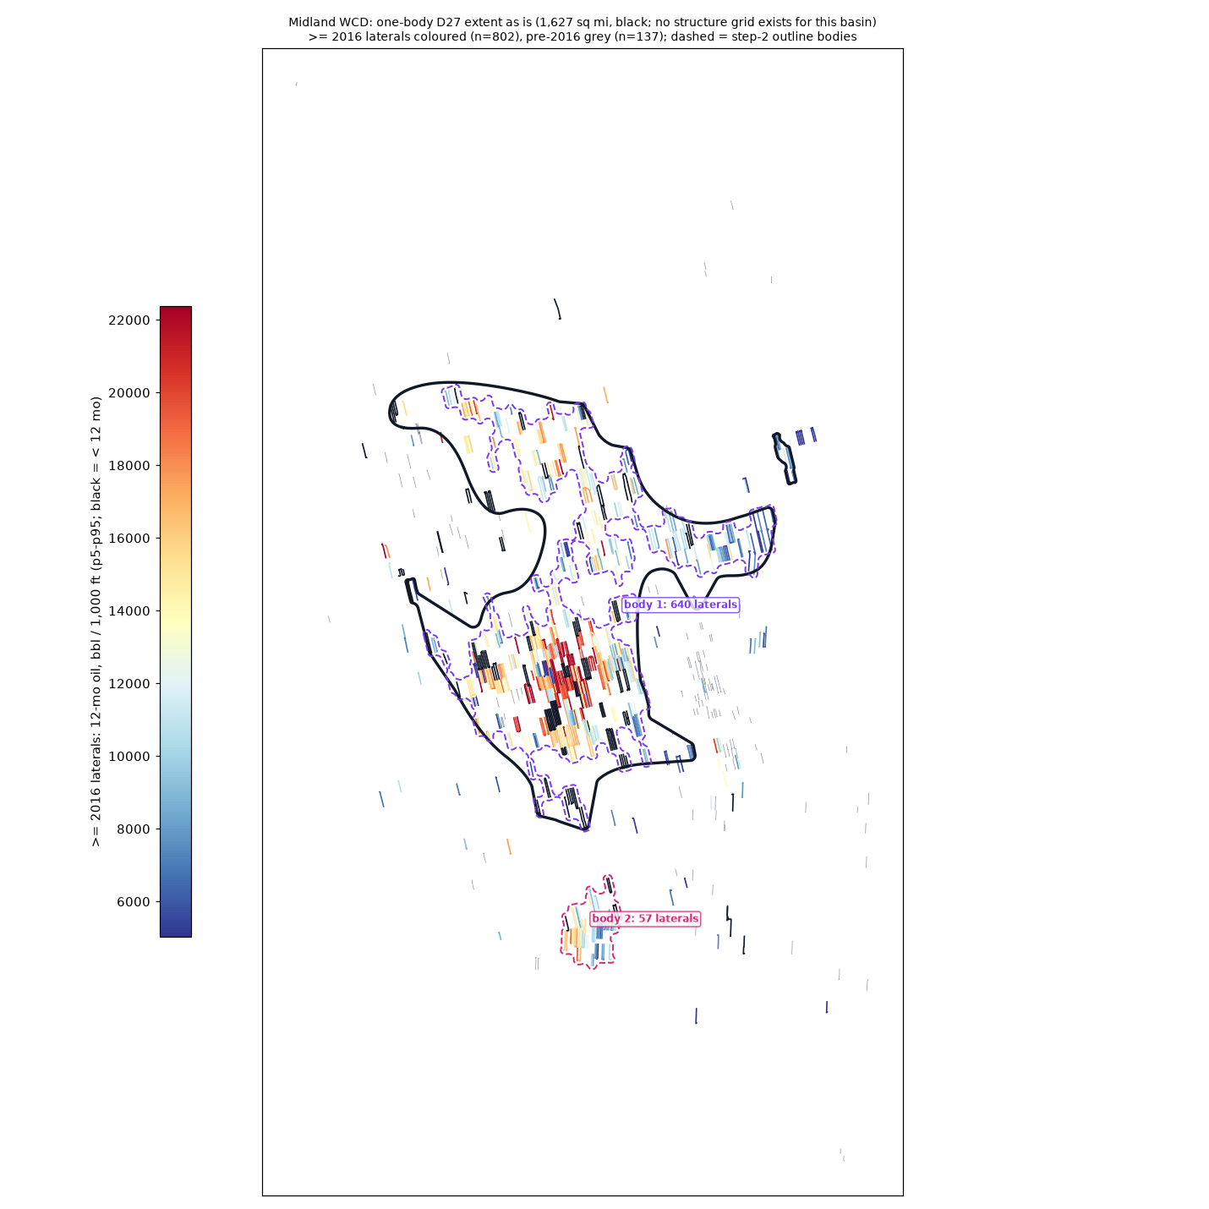
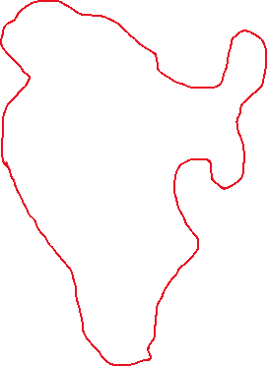
Midland WCD
generated one-body D27 extent: 1,627 sq mi
>= 2016 laterals: 802; inside 672
bodies >= 50 laterals: 2 (dashed; body 1 = the D27 body)
isolated tests out: 135
Edits (pen or freeform, red):
your closed loops ARE the extent
(the black outline is ignored)
no drawing = accept as generated

