Slide 1
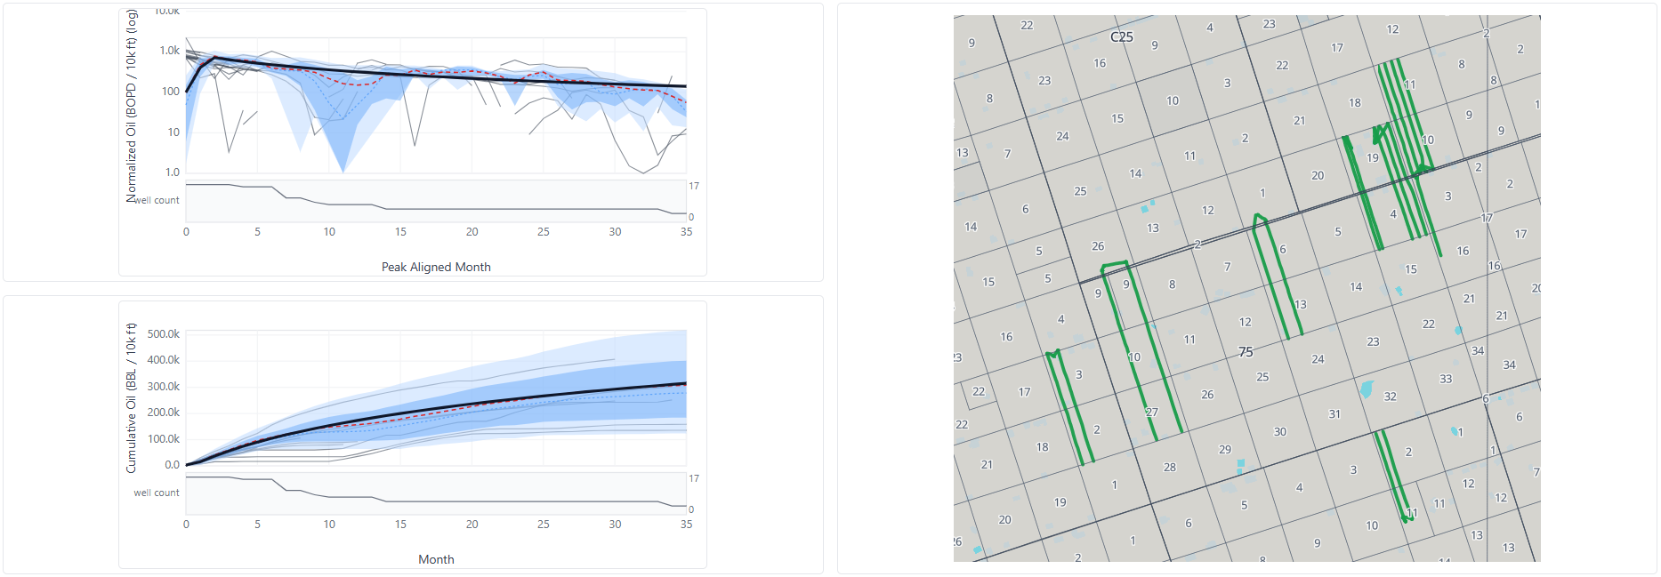
holdTheLine_bs2s Oil
Type Curve Name | Oil Initial | Oil Mo | Oil Peak | Oil B | Oil Di | Oil EUR | Gas Initial | Gas Mo. | Gas Peak | Gas B | Gas Di | Gas EUR | Water Peak | Water B | Water Di | Water EUR
holdTheLine_bs2s | 100 | 2 | 720 | 1 | 0.6 | 705,417 | 200 | 3 | 1,800 | 1 | 0.55 | 2,069,292 | 4,000 | 1 | 0.6 | 3,917,294

Slide 2
Type Curve Wells
api14 | Wellname | Operator | Formation | Lateral Length | BWPF | PPF | Oil EUR | Gas EUR | Oil EUR/ft | GOR EUR | WOR EUR
42301373860000 | SCOTT-STATE-REVOLVER C 141H | SM ENERGY | 2ND BONE SPRING | 10054 | 60 | 1,977 | 542,812 | 4,275,710 | 54 | 7.9 | 25.3
42301358020000 | GOODNIGHT 10/11 B B101MD | MEWBOURNE OIL | 2ND BONE SPRING | 9945 | 50 | 1,976 | 517,474 | 1,601,435 | 52 | 3.1 | 16.5
42301373850000 | SCOTT-STATE-REVOLVER B 121H | SM ENERGY | 2ND BONE SPRING SAND | 9915 | 57 | 2,106 | 529,164 | 3,433,285 | 53 | 6.5 | 6.9
42301371650000 | PREQUEL STATE A 651H | CONOCOPHILLIPS | 2ND BONE SPRING SAND | 11433 | 43 | 2,274 | 656,625 | 3,208,770 | 57 | 4.9 | 3.9
42301371660000 | PREQUEL STATE B 652H | CONOCOPHILLIPS | 2ND BONE SPRING | 10225 | 48 | 2,564 | 999,327 | 1,239,400 | 98 | 1.2 | 2.0
42301371300000 | GOODNIGHT 10/11 D B201NC | MEWBOURNE OIL | 2ND BONE SPRING SAND | 9975 | 54 | 2,099 | 371,785 | 1,701,895 | 37 | 4.6 | 4.7
42301371290000 | GOODNIGHT 10/11 C B101NC | MEWBOURNE OIL | 2ND BONE SPRING | 10184 | 52 | 2,158 | 375,482 | 1,572,128 | 37 | 4.2 | 8.7
42301371110000 | SLINGSHOT STATE H 951H | CONOCOPHILLIPS | 2ND BONE SPRING | 15581 | 49 | 2,505 | 2,635,679 | 958,058 | 169 | 0.4 | 0.7
42301371140000 | SLINGSHOT STATE J 952H | CONOCOPHILLIPS | 2ND BONE SPRING | 15612 | 48 | 2,500 | 694,836 | 814,304 | 45 | 1.2 | 3.8
42301370390000 | SCOTT-STATE-AFTERBUZZ C 112H | SM ENERGY | 2ND BONE SPRING | 10415 |  |  | 740,634 | 6,917,246 | 71 | 9.3 | 4.4
42301370400000 | SCOTT-STATE-AFTERBUZZ E 143H | SM ENERGY | 2ND BONE SPRING | 10188 |  |  | 705,113 | 6,005,247 | 69 | 8.5 | 1.7
42301370370000 | SCOTT-STATE-AFTERBUZZ B 142H | SM ENERGY | 2ND BONE SPRING | 10055 |  |  | 446,470 | 5,623,529 | 44 | 12.6 | 4.5
42301361360100 | AFTERMATH WEST A UNIT BS 350H | CONOCOPHILLIPS | 2ND BONE SPRING | 6927
42301360350000 | DREADNAUGHT F 250H | CONOCOPHILLIPS | 2ND BONE SPRING | 8072 | 58 | 3,093 | 835,907 | 2,155,936 | 104 | 2.6 | 3.7
42301359900000 | RUDD DRAW E 341H | CONOCOPHILLIPS | 2ND BONE SPRING SAND | 10265 | 47 | 2,559 | 698,922 | 2,031,317 | 68 | 2.9 | 3.8
42301359890000 | RUDD DRAW D 351H | CONOCOPHILLIPS | 2ND BONE SPRING | 9885 | 47 | 2,605 | 1,368,109 | 1,896,835 | 138 | 1.4 | 1.1
42301357720000 | GOODNIGHT 10/11 A B201MD | MEWBOURNE OIL | 2ND BONE SPRING | 9943 | 48 | 1,837 | 486,065 | 3,777,417 | 49 | 7.8 | 14.5
42301353360000 | DREADNAUGHT D 240H | CONOCOPHILLIPS | 2ND BONE SPRING SAND | 7976 | 58 | 3,130 | 507,547 | 1,271,684 | 64 | 2.5 | 4.7

