Slide 1
autoemulate
A Python package for making emulation easy - Martin Stoffel, Eric Daub, Steven Niederer

Slide 2
Why do we emulate?
Complex simulations can be too slow and expensive for …

Slide 3

(Fast) prediction
Sensitivity analysis
Optimization
Uncertainty Quantification

Slide 4
Building an emulator is hard
Experimental design
If each run is expensive, which data should we evaluate the simulation at?
Creating the emulator
Which model? Gaussian process, neural network, …
Which hyperparameters?
The goal of autoemulate is to make this easy!
currently focusing on 2.
Intro

Slide 5

Emulating a rocket simulation with autoemulate

Slide 6
Rocket simulation

Slide 7
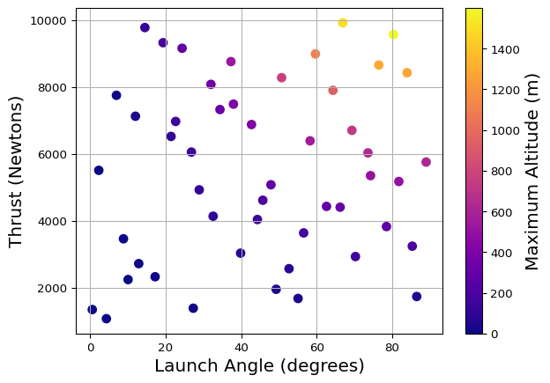
Rocket simulation
Input X: launch angle, thrust
Output y: maximum altitude
Problem: simulation takes too long
Solution: build an emulator

Slide 8
Rocket simulation

Slide 9
autoemulate - building a rocket emulator
 | Values
Simulation input shape (X) | (50, 2)
Simulation output shape (y) | (50,)
# hold-out set samples (test_set_size) | 10
Do hyperparameter search (param_search) | False
Type of hyperparameter search (search_type) | random
# sampled parameter settings (param_search_iters) | 20
Scale data before fitting (scale) | True
Scaler (scaler) | StandardScaler
Dimensionality reduction before fitting (reduce_dim) | False
Dimensionality reduction method (dim_reducer) | PCA
Cross-validation strategy (cross_validator) | KFold
# parallel jobs (n_jobs) | 1
from autoemulate.compare import AutoEmulate ae = AutoEmulate() ae.setup(X, y) # X=thrust, launch angle, y=max altitude best_emulator = ae.compare() # compare models
<IPython.core.display.HTML object>

Slide 10
Initializing: 0%| | 0/10 [00:00<?, ?it/s]
. . .
Behind the scenes, autoemulate
fits and cross-validates various models
optimises hyperparameters
returns the best model

Slide 11
autoemulate - basic diagnostics
best_model = ae.compare() best_model ae.print_results()
Initializing: 0%| | 0/10 [00:00<?, ?it/s]
<IPython.core.display.HTML object>
Scatterplots: Prediction vs. true (simulation) output
ae.plot_results()

Slide 12
autoemulate - using the rocket emulator
# Create a grid of launch angles and thrusts X = np.array(np.meshgrid(np.linspace(0, 90, 100), np.linspace(1000, 10000, 100))).T.reshape(-1, 2) # Emulate the rocket simulation using the best model y = best_model.predict(X)

Slide 13
autoemulate - customisation
-> idea: balance simplicity and customisation
# set up ae = AutoEmulate() ae.setup(X, y, # simulation input and output use_grid_search=True, # search for best hyperparameters grid_search_type='random', # hyperparameter search strategy normalise=True, # standardise input fold_strategy='kfold', # use k-fold cross-validation n_jobs=4) # parallelise computation # ae.compare()

Slide 14
Summary
autoemulate makes emulation easy
takes simulation input and output
returns emulator model
current features
model selection
hyperparameter optimisation
parallelisation
compatible with the scikit-learn ecosystem

Slide 15
(Near-)future work
deep learning + GPU support
visual diagnostics for each model
make contribution easy (to allow new models, metrics etc.)
automating the experimental design step
keep it simple

Slide 16
Collaboration
searching for new datasets/simulations
ideas for models / features
feedback on autoemulate once the MVP is ready
and of course: code

Slide 17
Thanks to:
Collaborators: Steven Niederer, Eric Daub
And a lot of people for discussions / data:

Slide 18
Imperial:
Marina Strocchi
BAS:
Rosie Williams
Ieva Kazlauskaite
Robert Arthern
DT-TRIC / Turing:
Kalle Westerling
Sophie Arana
Keith Worden
Zack Xuereb Conti

Slide 19
autoemulate GitHub repo
https://github.com/alan-turing-institute/autoemulate

Slide 20
Glossary 1
Emulator: also metamodel, surrogate model. A model that approximates a simulation, but runs faster and more efficient. Could be any machine learning model. Gaussian Processes are a popular choice.
Experimental design: choosing which points to run the simulation at to create a dataset for training an emulator. A common technique is Latin Hypercube Sampling.

Slide 21
Glossary 2
Hyperparameters: parameters of a model that are not learned from the data, such as the kernel type in a Gaussian Process or the number of hidden layers in a neural network.
Cross-validation: A method to evaluate models. The idea is to split data into a training and test set, train the model on the training set and evaluate it on the test set. This is repeated multiple times with different splits of the data to get a more robust estimate of the model performance.

