Slide 1

Multiple Sclerosis: a Visual Perspective on Epidemiological Data
Francesco Mastrostefano
1672787

Slide 2
My Project Goal
Multiple Sclerosis (MS) is a chronic, auto-immune demyelinating neuro-disease, one of the leading cause of non-traumatic disability in young adults.
My main goal: development of a Visual Analytics web-app for visualizing and exploring data about MS and social-demographic infos
Desired Result: transforms static informations into an user-friendly interactive application such that everyone can extract knowledge about MS epidemiology
MS Epidemiology Analyzer
05/07/2025
Pagina <number>

Slide 3
What is MS?
Multiple Sclerosis (MS) is a chronic, often disabling-cause, neuro-disease (including the brain, spinal cord and optic nerves).
Immune system mistankely attacks myelin (i.e. layer surrounding nerve fibers). These attacks lead to infiammations and communication disruptions between brain and rest of body
Bring to permanent damage of nerves
Most common symptoms: fatigue, walking difficulties, balance and stability problems
Types of MS: RRMS, SPMS, PPMS
Cause of MS: remains unknown (possible triggered by a combination of genetic and environmental factors)
No cure but there are various treatments for managing symptoms, reducing relapses and slowing progression
MS Epidemiology Analyzer
05/07/2025
Pagina <number>

Slide 4
Related Works
This project has been inspired by:
Atlas of MS: produced by MSIF, inspiration of this project (exploration of epidemiology data about MS using a simple chropleth map) and induced a reflection about limitations of this tool
AISM (Barometro della Sclerosi Multipla): at national level AISM publishes Barometro della Sclerosi Multipla, a detailed yearly report covering epidemiology data for every region in Italy, it provides a view of this disease in Italian context. Main limitation of this work: no possibility of interactions
➔ These 2 related works shaped my work idea on integrating epidemiological data with social informations
MS Epidemiology Analyzer
05/07/2025
Pagina <number>

Slide 5
Datasets
Combinationation of two datasets (epidemiology and lifestyle factor) used:
Atlas of MS: most complete global data source on epidemiology of MS, data gathered from various sources (e.g. neurologist, MS organizations, etc…) covering about 87 % of World population, contains infos about prevalence, incidence, age, MS types, and many others. I have decided to focus on a selected subset of attributes.
GBD Smokers Dataset: a recent study highlights heavy smoking habit aggravates MS progression. Selected dataset provides an estimation of the number of smokers across countries.
MS Epidemiology Analyzer
05/07/2025
Pagina <number>

Slide 6
Visualizations
A coordinated multiple views approach to support the exploration developed to allow synchronized updates wrt selected year changes.
Visualizations choices guided with the goal idea to capture geospatial distribution, intervariable relationships, temporal comparisons and hidden discoverable patterns.
Chropleth Map (incidence/prevalence across 3 different time periods)
Stacked Bar Chart (to visualize distributions of disease-course types wrt WHO macro-regions)
Parallel Coordinates Chart (multivariate view allowing a comparison of trends over time)
Bubble Chart (relationship between smoking habits and MS prevalence across global regions)
PCA Scatter Plot (supporting identification of epidemiological profiles, allowing comparison and identification of clusters across different dimensions and time periods)
MS Epidemiology Analyzer
05/07/2025
Pagina <number>

Slide 7
Analytics
Backend of this WebApp was implemented as a lightweight Flask app
Prepare, process and serve all the data required for interactive exploration
Data saved and changes are tracked using a SHA-256 approach (i.e. data are recomputed only when necessary) ➔ time and computation resources saving approach
  Compute_file_hash() for hash computation, needs_update() for checking whether recomputation is necessary and comparing with previous results inside EXPECTED_HASHES dictionary used for hash tracking
Required data are returned in a structured, ready-to-visualize data in JSON format
MS Epidemiology Analyzer
05/07/2025
Pagina <number>

Slide 8
Insights
This tool enables users to explore static data, uncover meaningful patterns and reason about MS spreads, care requirements and potential risk factors.
Supporting Neurorehabilitation planning (using map to identify countries with higher number of MS cases and parallel coordinates to reveal a grow in case numbers over time across WHO regions)
Smoking as progression factor (using bubble chart to analyze relationship between smokers and MS cases withing WHO regions and studying stacked bar chart to set a correlation for smoking as worsening factor)
Strategic DMT launches (using stacked bar chart and parallel coordinates chart is possible to identify WHO regions where introducing new DMT for MS)
Temporal trends exploration (discovering of regions where MS cases remain stable , constant grow trends like in Europe or America)
MS Epidemiology Analyzer
05/07/2025
Pagina <number>

Slide 9
Conclusion
System developed allows various types of final users (i.e. clinicians, researchers, policy makers) to reason about MS epidemiology using an interactive tool.
Possible future developments:
Correlation analysis with additional pathologies associated with MS (i.e. obesity, D vitamin deficiency, physical inactivity)
Exploring and studying how many people have been exposed to EBV (Epstein-Barr virus), linking this to MS cases
Possibility of creating custom filters and comparison features for comparing user-defined multivariate analysis
Improve evaluation methods for directly understanding effectiveness of this application (i.e. by directly proposing a survey related to the use of this tool to neurologists and health experts)
MS Epidemiology Analyzer
05/07/2025
Pagina <number>

Slide 10
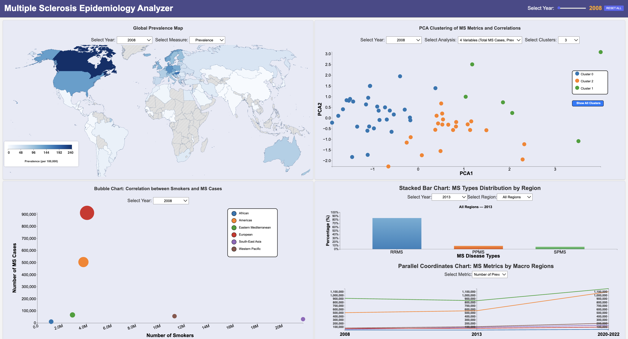
MS Epidemiology Visual Analyzer
MS Epidemiology Analyzer
05/07/2025
Pagina <number>

Slide 11
Thanks for your attention
MS Epidemiology Analyzer
05/07/2025
Pagina <number>

