Slide 1
Results of TD(λ) for different λ and Adaptive TD(λ) (First-visit MC is used as benchmark)
Wed, 20-May-2020
Updated: Mon, 25-May-2020
Daniel Mastropietro
Ref: Python/test/simu_lambdas.py

Slide 2
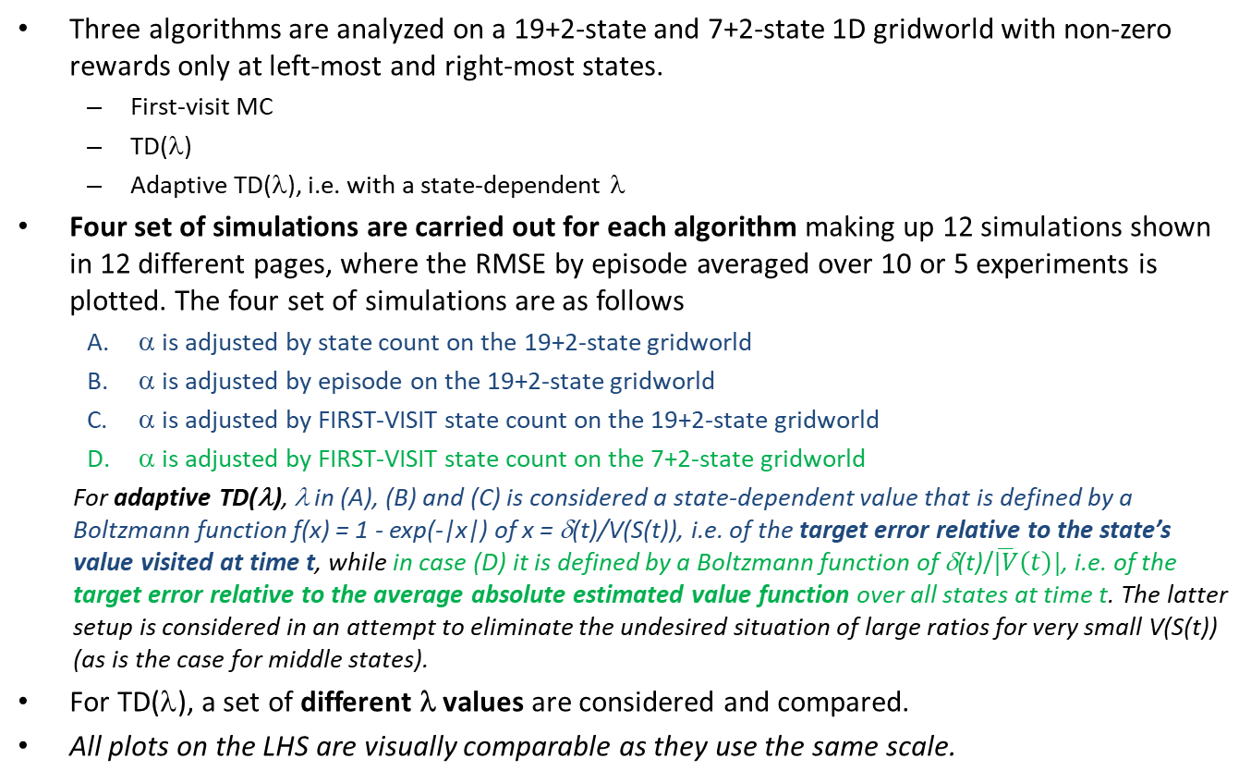
Simulation setup
Three algorithms are analyzed on a 19+2-state and 7+2-state 1D gridworld with non-zero rewards only at left-most and right-most states.
First-visit MC
TD(λ)
Adaptive TD(λ), i.e. with a state-dependent λ
Four set of simulations are carried out for each algorithm making up 12 simulations shown in 12 different pages, where the RMSE by episode averaged over 10 or 5 experiments is plotted. The four set of simulations are as follows
α is adjusted by state count on the 19+2-state gridworld
α is adjusted by episode on the 19+2-state gridworld
α is adjusted by FIRST-VISIT state count on the 19+2-state gridworld
α is adjusted by FIRST-VISIT state count on the 7+2-state gridworld
For adaptive TD(λ), λ in (A), (B) and (C) is considered a state-dependent value that is defined by a Boltzmann function f(x) = 1 - exp(-|x|) of x = δ(t)/V(S(t)), i.e. of the target error relative to the state’s value visited at time t, while in case (D) it is defined by a Boltzmann function of δ(t)/$\overline{|V}\left(t\right)|$, i.e. of the target error relative to the average absolute estimated value function over all states at time t. The latter setup is considered in an attempt to eliminate the undesired situation of large ratios for very small V(S(t)) (as is the case for middle states).
For TD(λ), a set of different λ values are considered and compared.
All plots on the LHS are visually comparable as they use the same scale.

Slide 3
(A) α adjusted by state count; adaptive λ as a function of δ(t)/V(S(t))

Slide 4
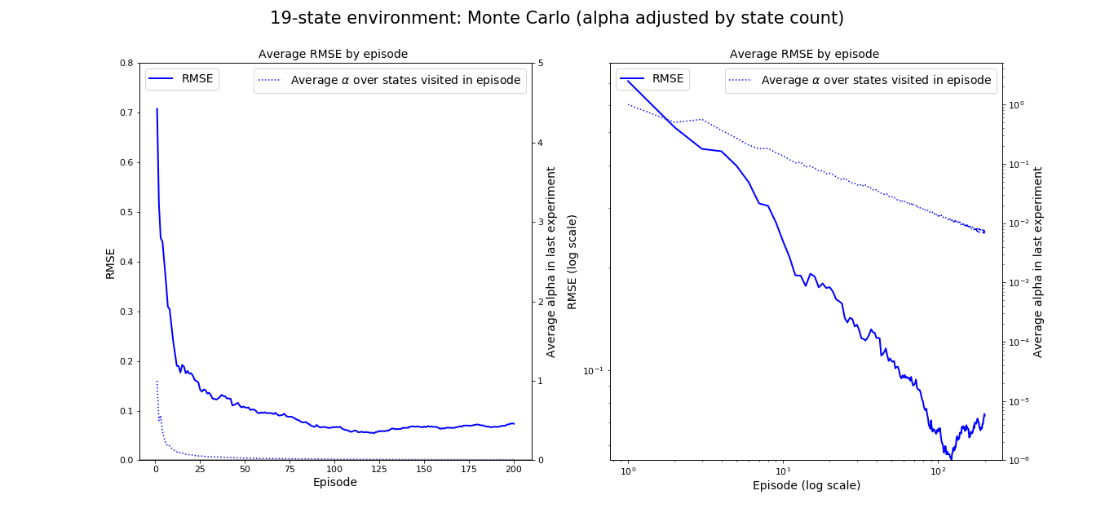
MC, α-adjust by first-visit State Count seed=1717, #exp=10, start=10
Initial α = 1
The variability observed across experiments (not plotted) is reasonable

Slide 5
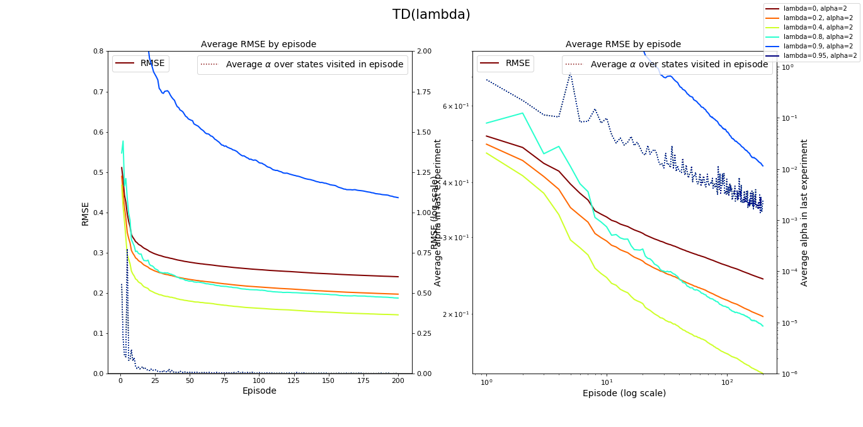
TD(λ), α-adjust by State Count seed=1717, #exp=10, start=10
Initial α = 2
The variability observed across experiments (not plotted) is reasonable, but increases for larger λ’s

Slide 6
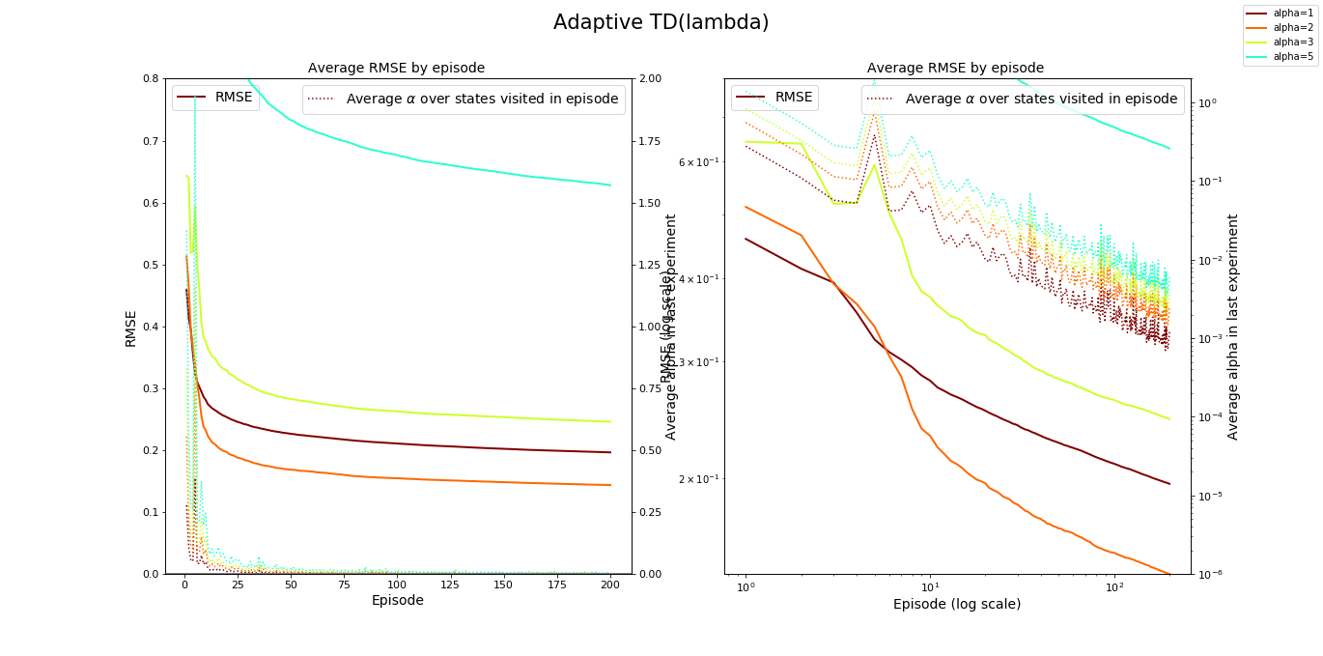
Adaptive TD(λ), α-adjust by State Count seed=1717, #exp=10, start=10
The variability observed across experiments (not plotted) is reasonable, but increases for larger α’s

Slide 7
(B) α adjusted by episode; adaptive λ as a function of δ(t)/V(S(t))

Slide 8
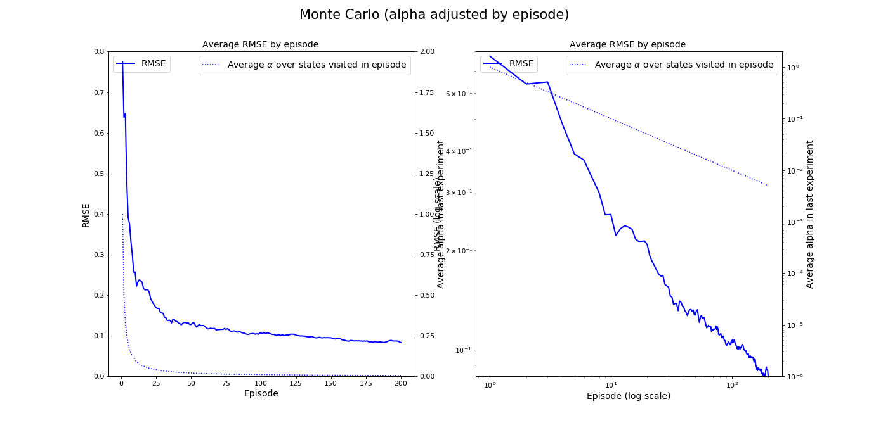
First-visit MC, α-adjust by Episode seed=1717, #exp=10, start=10
Initial α = 1
The variability observed across experiments (not plotted) is reasonable

Slide 9
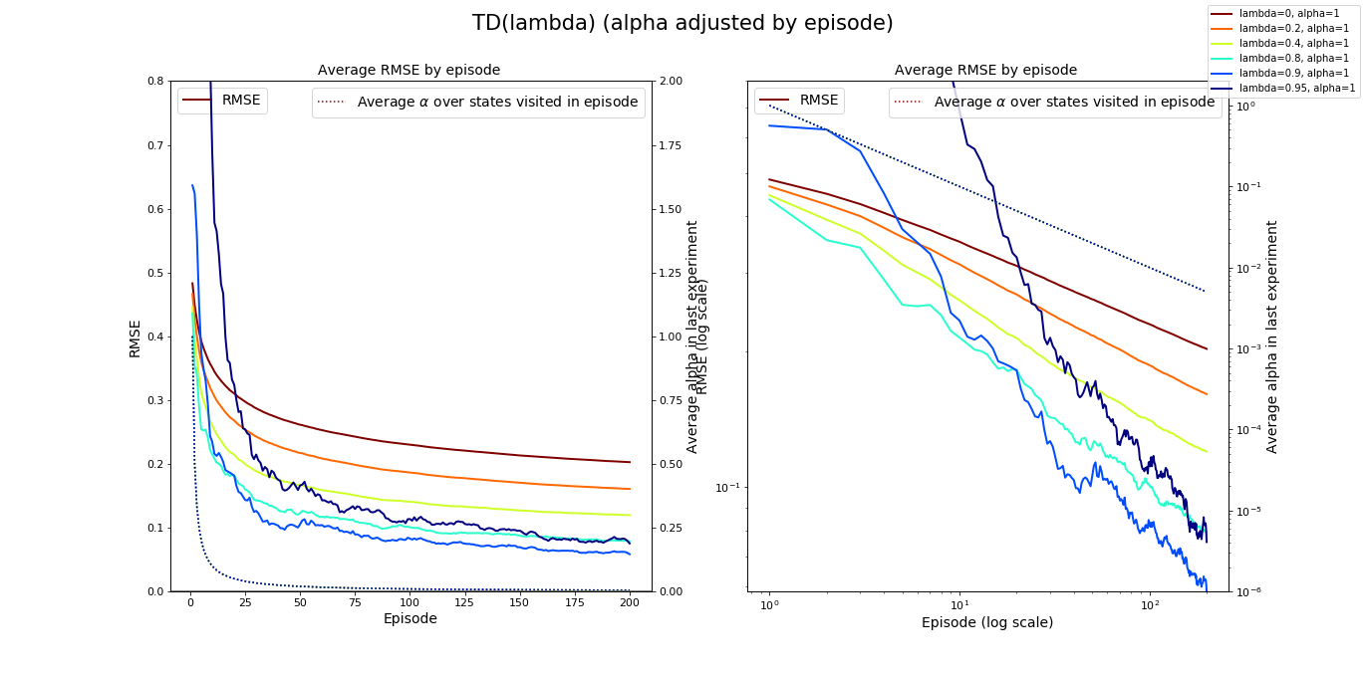
TD(λ), α-adjust by Episode seed=1717, #exp=10, start=10
Initial α = 1
The variability observed across experiments (not plotted) is reasonable, but increases for larger λ’s

Slide 10
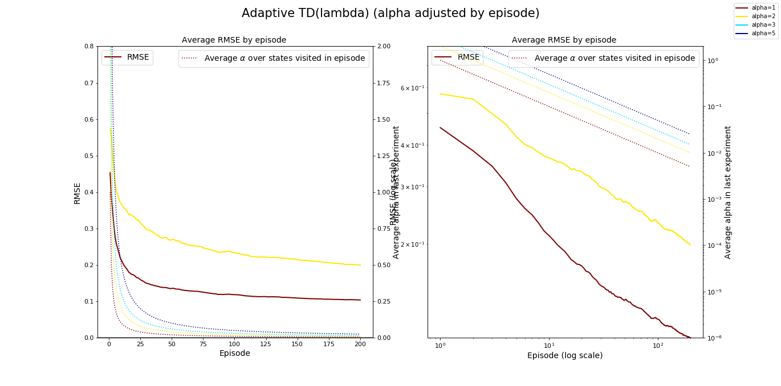
Adaptive TD(λ), α-adjust by Episode seed=1717, #exp=10, start=10
The variability observed across experiments (not plotted) is reasonable, but increases for larger α’s

Slide 11
(C) α adjusted by FIRST-VISIT state count; adaptive λ as a function of δ(t)/V(S(t))

Slide 12
MC, α-adjust by first-visit State Count seed=1717, #exp=10, start=10^{(*)}
(*) This output is the same as already shown in slide 4.
Initial α = 1
The variability observed across experiments (not plotted) is reasonable

Slide 13
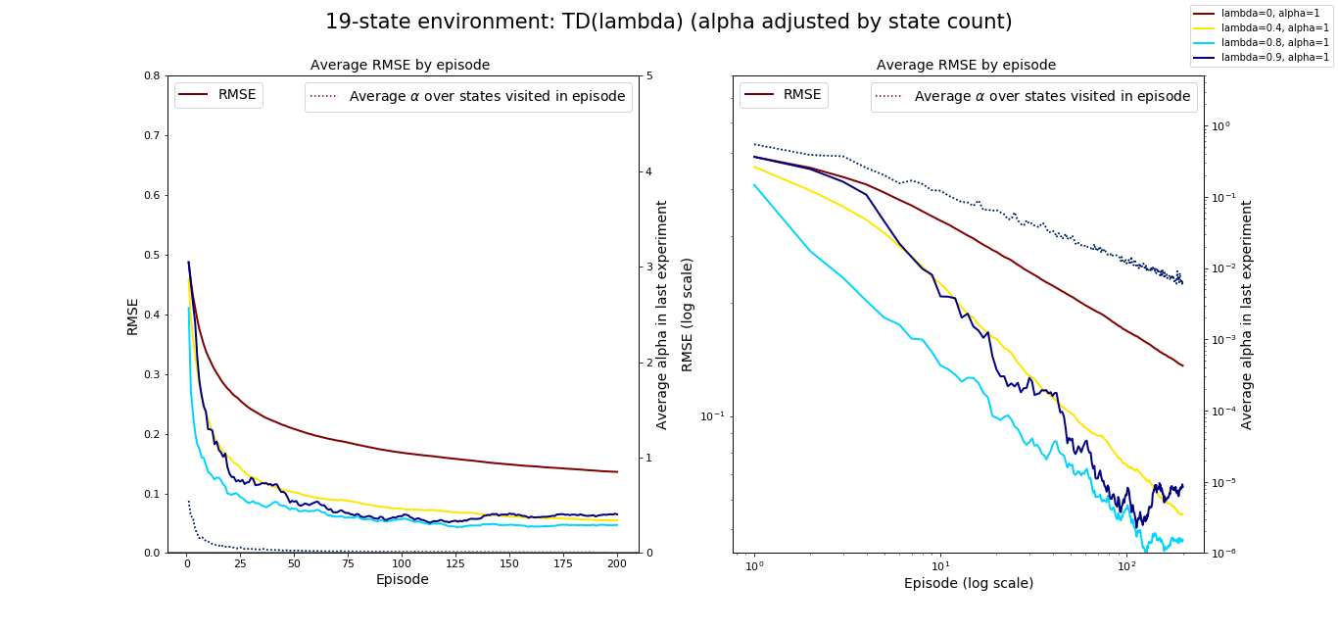
TD(λ), α-adjust by FIRST-VISIT State Count seed=1717, #exp=10, start=10
Initial α = 1
The variability observed across experiments (not plotted) is reasonable, but increases for larger λ’s

Slide 14
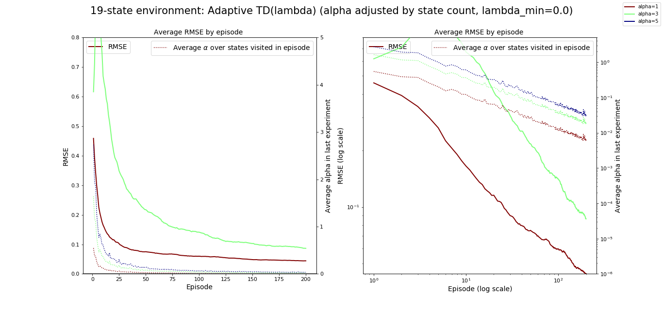
Adaptive TD(λ), α-adjust by FIRST-VISIT State Count seed=1717, #exp=10, start=10
The variability observed across experiments (not plotted) is reasonable, but increases for larger α’s

Slide 15
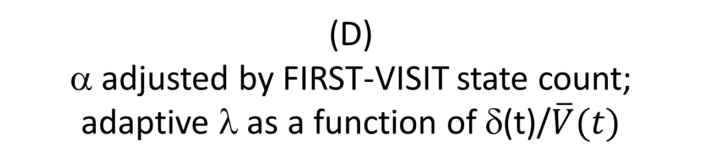
(D) α adjusted by FIRST-VISIT state count; adaptive λ as a function of δ(t)/$\overline{V}(t)$
For faster generation of results:
only 5 experiments were run per algorithm,
on a smaller environment with 7 non-terminal states.

Slide 16
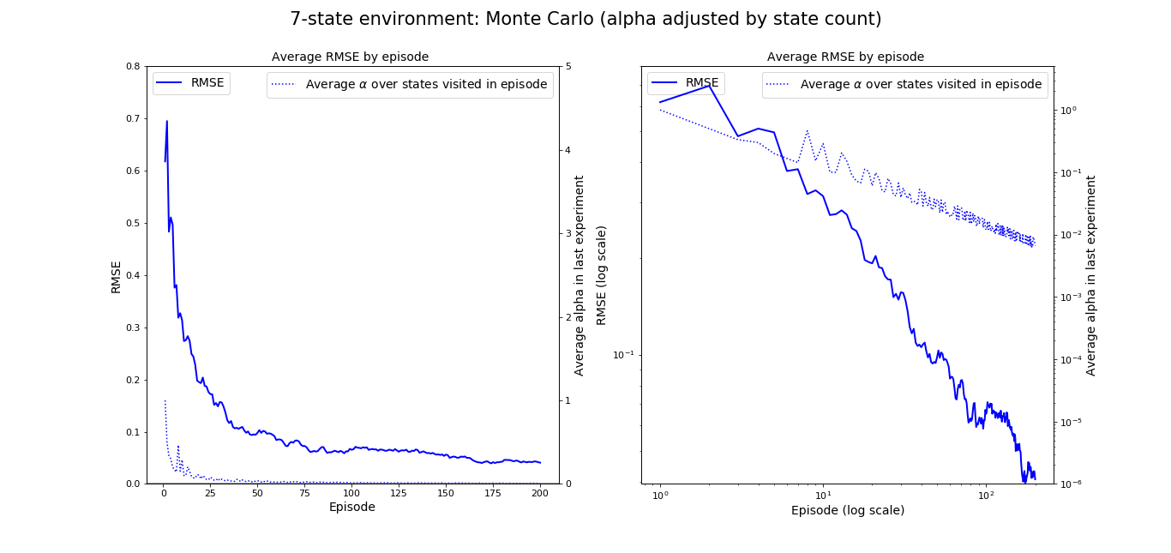
MC, adjust by first-visit State Count seed=1717, #exp=5, start=10
Initial α = 1

Slide 17
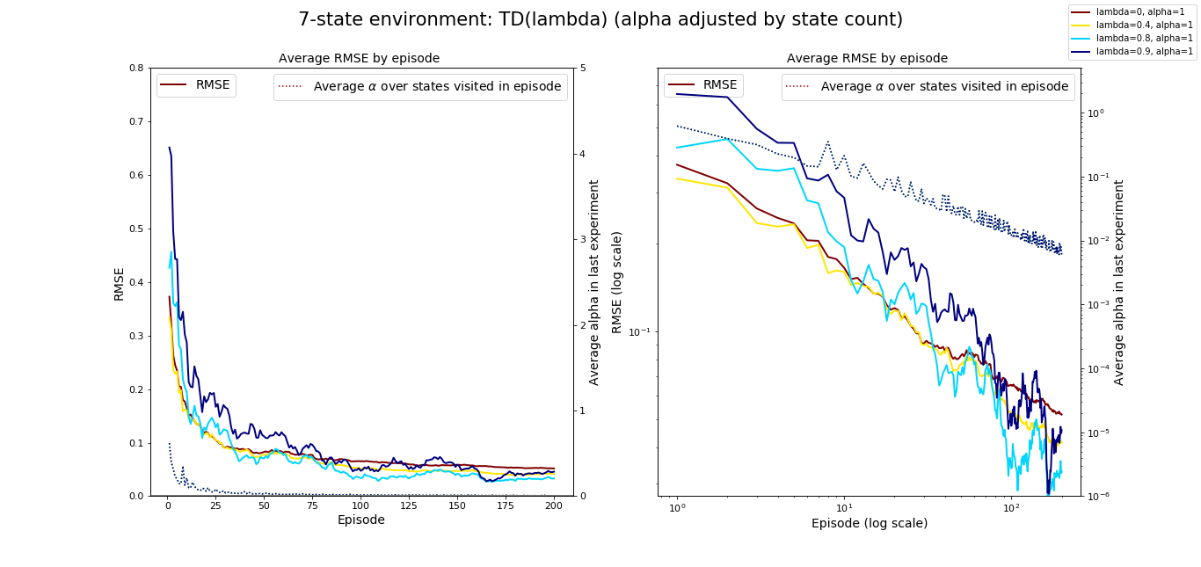
TD(λ), adjust by FIRST-VISIT State Count seed=1717, #exp=5, start=10
Initial α = 1

Slide 18
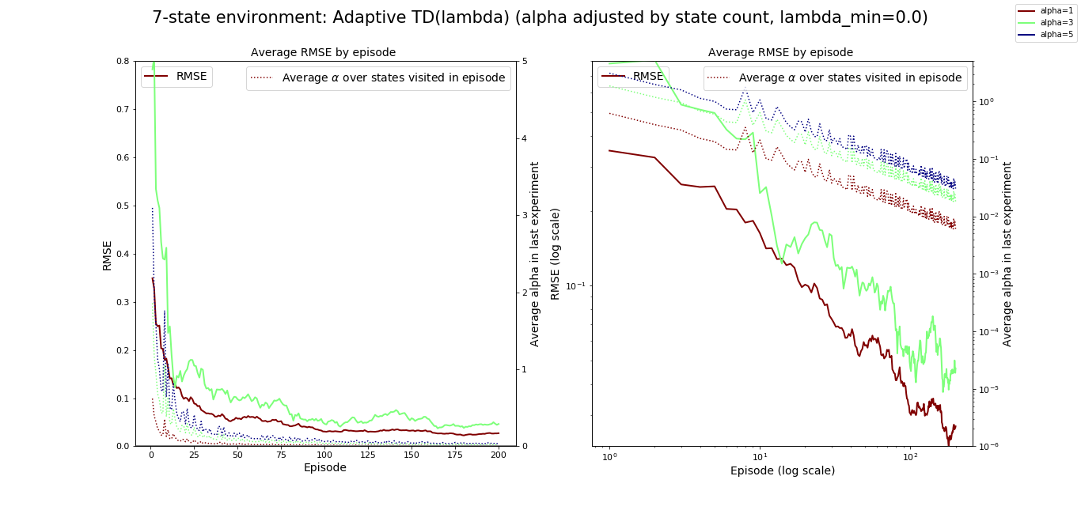
Adaptive TD(λ), adjust by FIRST-VISIT State Count seed=1717, #exp=5, start=10

Slide 19
Observations
Given the λ and α values considered in these experiments, the following is observed for both the 7-state and 19-state 1D gridworld environment:
The smallest RMSE at the end of 200 episodes is observed for the Adaptive TD(λ) algorithm, with α adjusted by FIRST-VISIT state count.
The smallest RMSE for TD(λ) is observed for λ = 0.8 (also for the “α adjusted by FIRST-VISIT state count” case), with an RMSE at the end of 200 episodes very similar to the adaptive TD(λ) case.
MC is the slowest algorithm to converge and it converges to the largest RMSE at the end of 200 episodes.
As expected, the convergence of MC is very similar to TD(0.9) --i.e. the closest we got to λ = 1 in our simulations– although this is the case only when α is updated by FIRST-VISIT state count, which is the setting under which the two algorithms are most similar.
The convergence to the RMSE at the last episode is a little slower in the adaptive TD(λ) case than in TD(λ) for the 19-state environment, but faster for the 7-state environment.

Slide 20
Conclusions (1/2)
In terms of α-update strategies
Given the convergence rates observed in the 1D gridworld environment for the three studied α-update strategies, we may conclude that:
Update by state count is too aggressive, as it prevents most algorithms from learning sufficiently fast^{(*)}.
Update by episode is less aggressive, allowing the algorithm to learn for a longer time, but it penalizes states that are not visited in an episode.
Update by FIRST-VISIT state count is a trade-off strategy, that brings the best from both worlds, as it proposes a less aggressive decrease than “by state count” strategy and at the same time does not penalize states non-visited in an episode.
(*) This lack of learning most likely happens because the value of α is reduced even when there is no actual update of the state value because non-zero rewards only occur at the two terminal states.

Slide 21
Conclusions (2/2)
In terms of learning strategies
The adaptive TD(λ) algorithm seems to perform as good as the best λ among TD(λ), or even slightly better (in terms of faster convergence and possibly slightly lower RMSE), with the great advantage that there is no need to specify the value of this hyperparameter.
Out of the two state-dependent λ strategies considered for adaptive TD(λ) --(C) vs. (D)--, the best one (smaller RMSE, faster convergence) chooses λ as a function of the target error relative to the average state value function estimate over all states, which avoids divisions by a very small value observed in the other strategy.
(*) This lack of learning most likely happens because the value of α is reduced even when there is no actual update of the state value because non-zero rewards only occur at the two terminal states.

Slide 22
Results of experiments run on Apr-2022
ATD(lambda) & HATD(lambda)
(Adaptive and Homogeneous Adaptive TD(lambda))
Ref: simu_lambdas.py
(version of 28-Apr-2022)

Slide 23
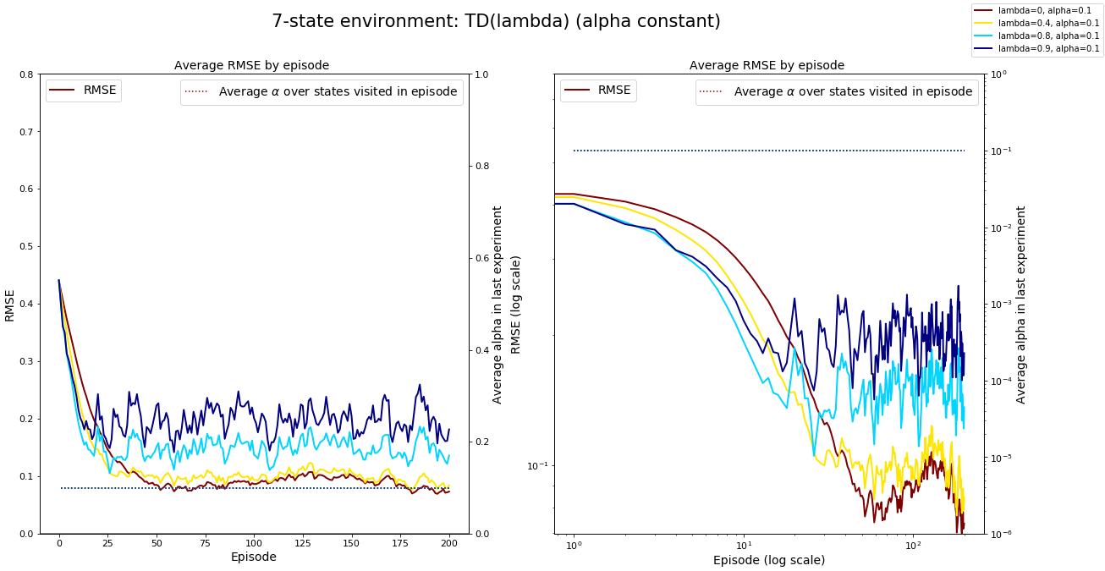
TD(λ), α = 0.1 CONSTANT

Slide 24
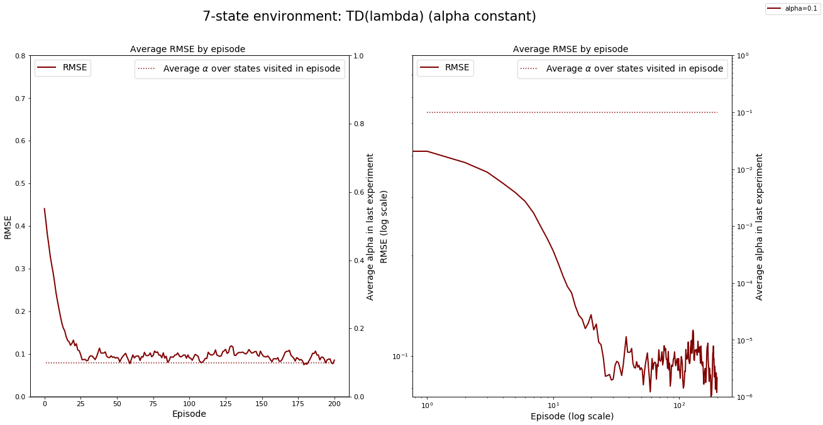
ATD(λ), α ~ 0.1 CONSTANT

Slide 25
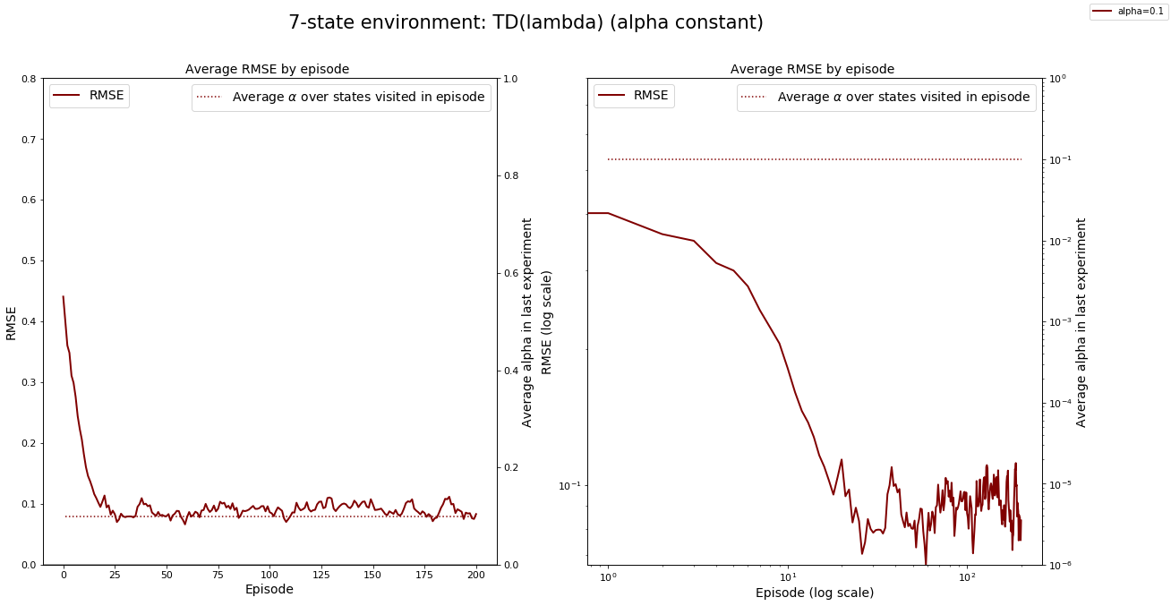
HATD(λ), α ~ 0.1 CONSTANT

Slide 26
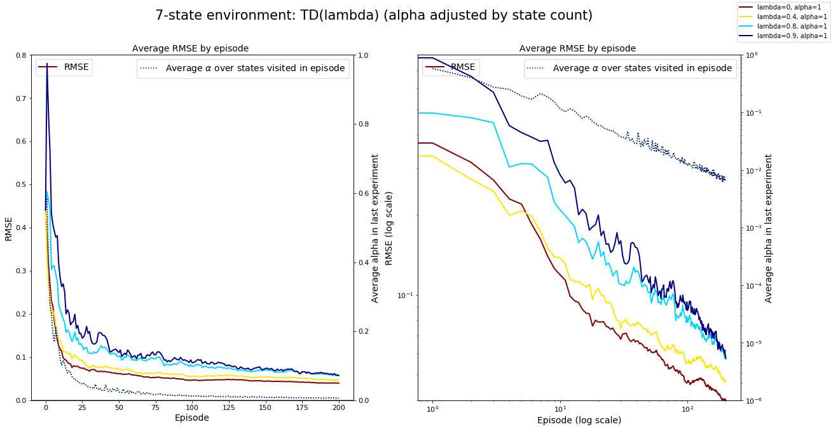
TD(λ), α = 1.0

Slide 27
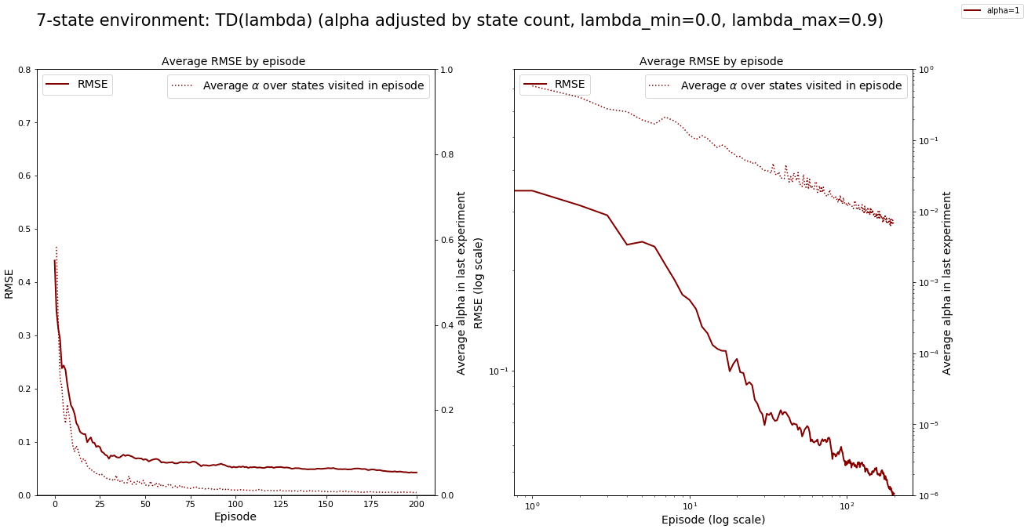
ATD(λ), α = 1.0

Slide 28
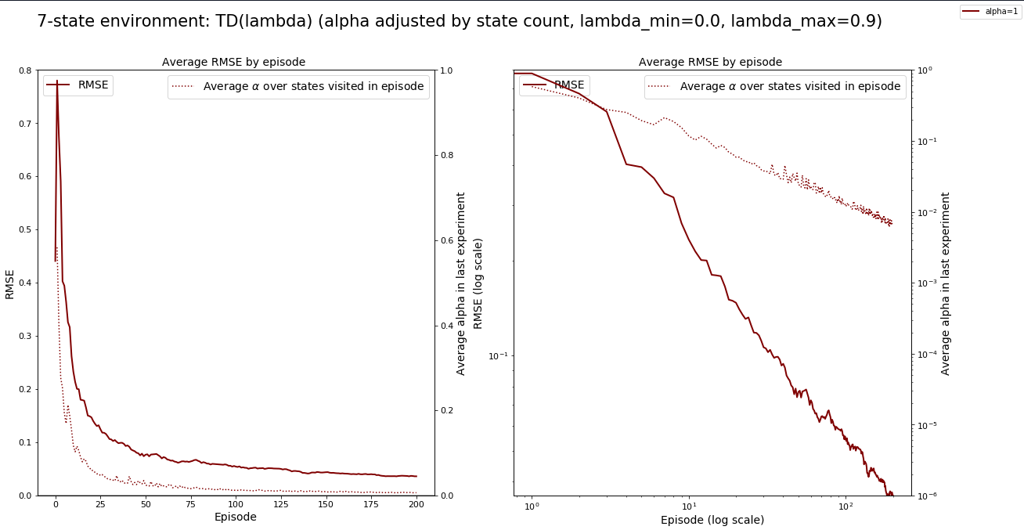
HATD(λ), α = 1.0

Slide 29
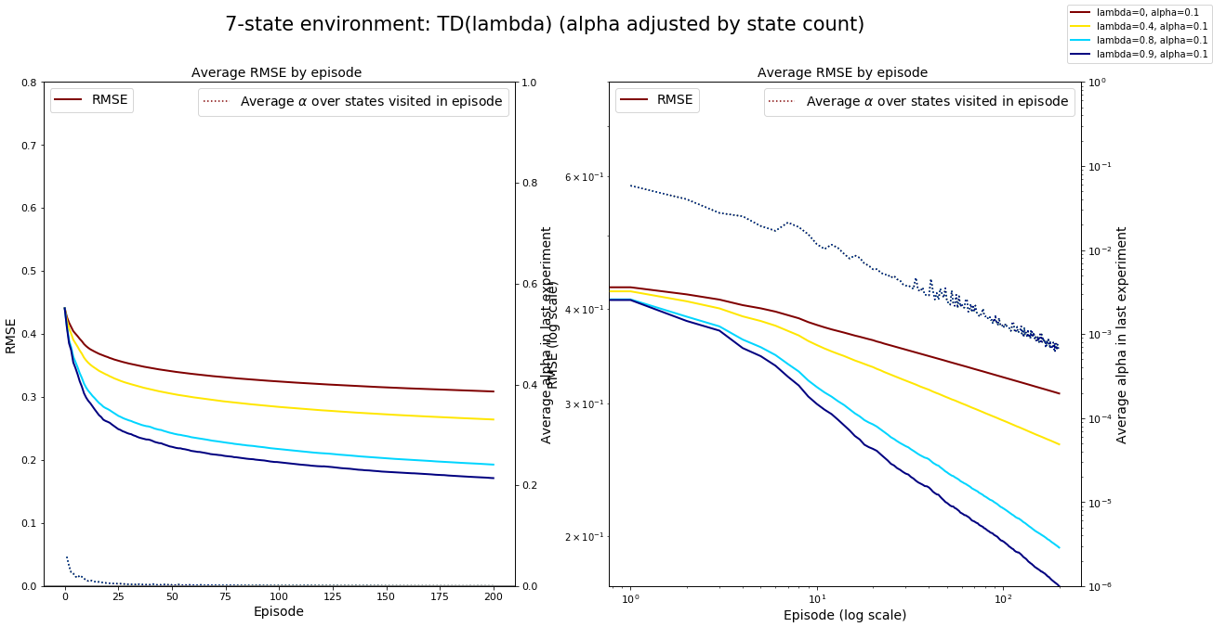
TD(λ), α = 0.1

Slide 30
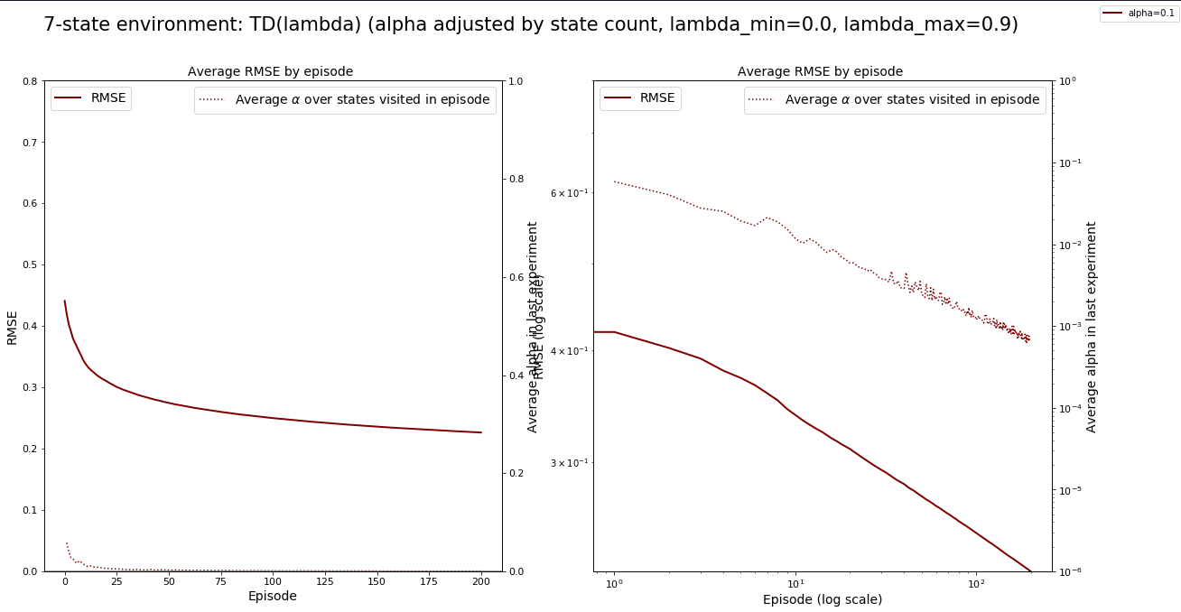
ATD(λ), α ~ 0.1

Slide 31
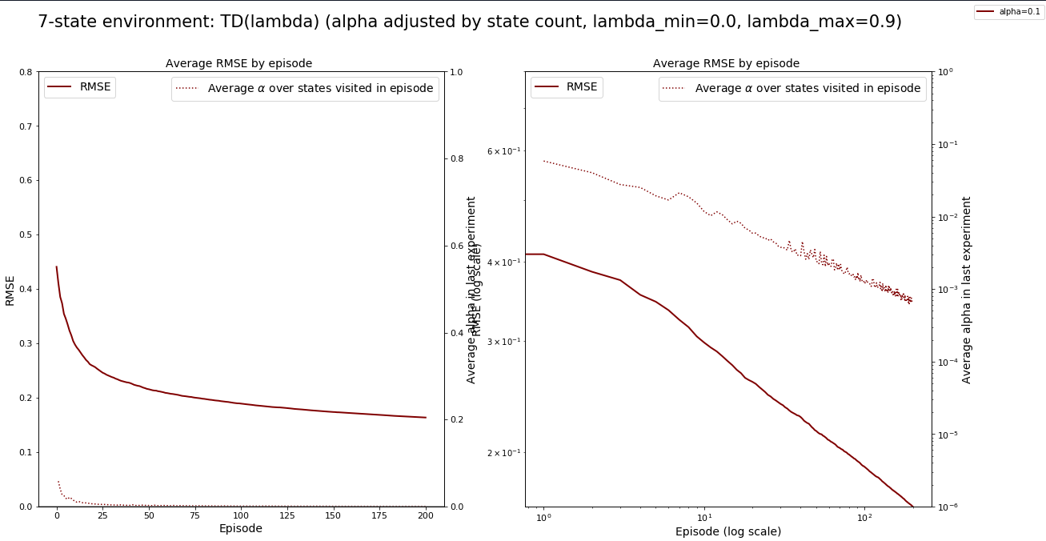
HATD(λ), α ~ 0.1

Slide 32
ATD(λ), α ~ 0.1, 0.2, 0.3

Slide 33
HATD(λ), α ~ 0.1, 0.2, 0.3

Slide 34
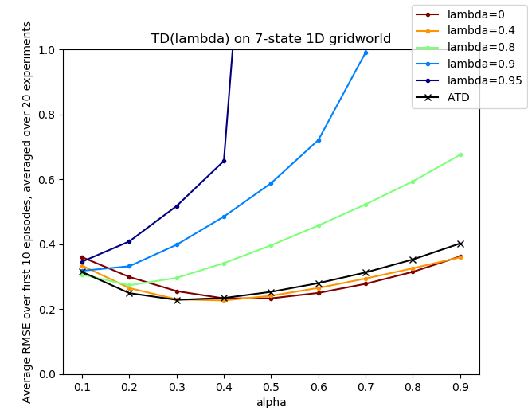
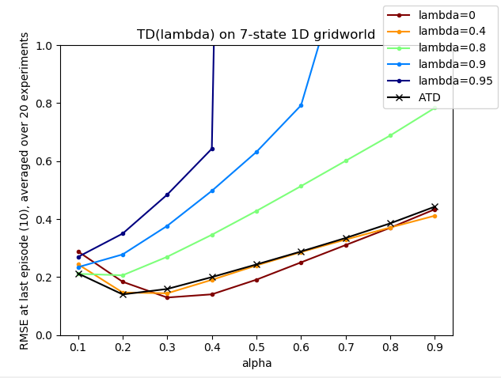
TD(λ) and ATD(λ) for different α’s 7-state 1D gridworld

Slide 35
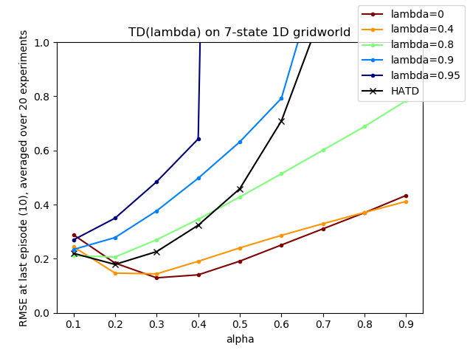
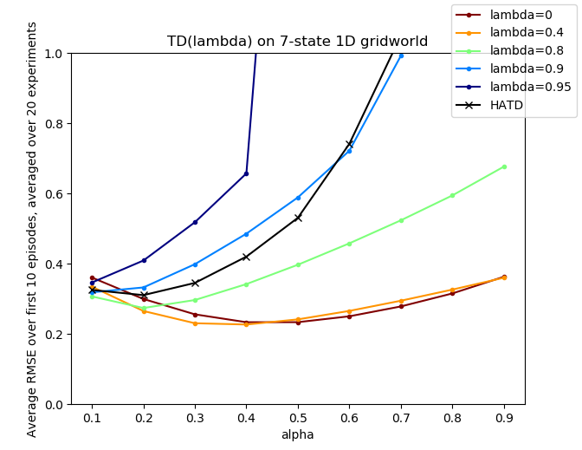
TD(λ) and HATD(λ) for different α’s 7-state 1D gridworld

Slide 36
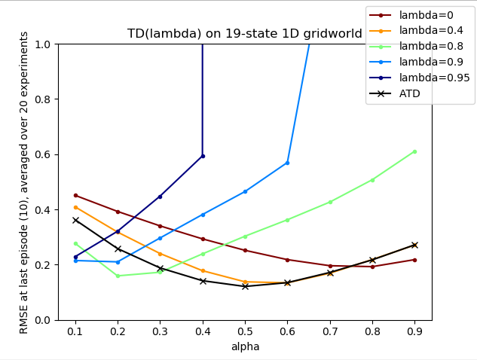
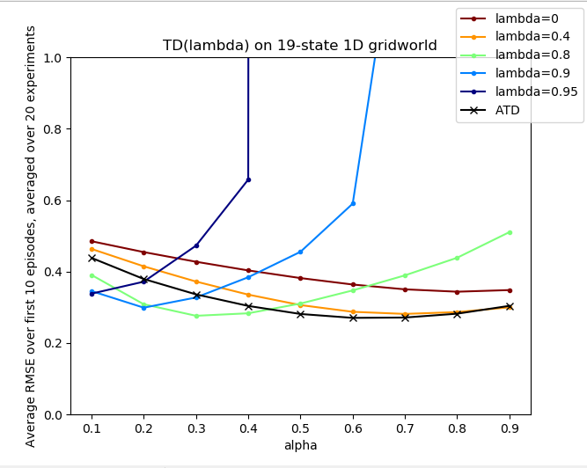
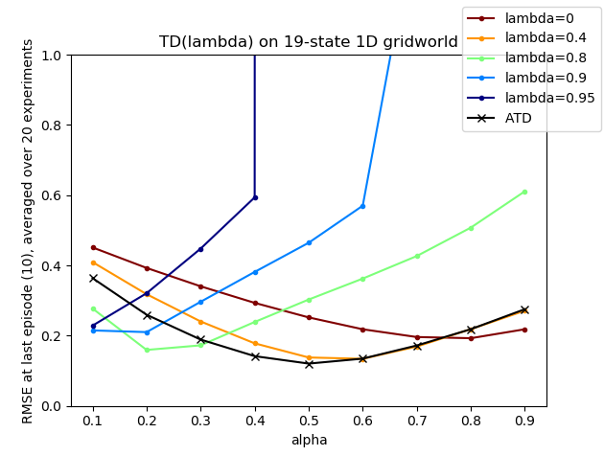
TD(λ) and ATD(λ) for different α’s 19-state 1D gridworld
λmax = 0.95
λmax = 0.99

Slide 37
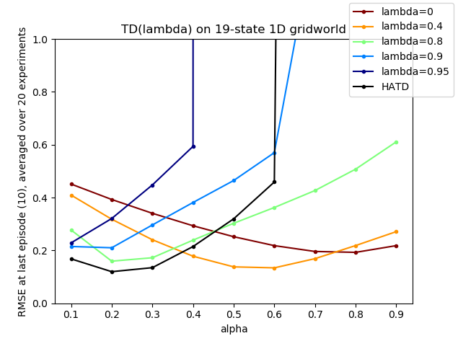
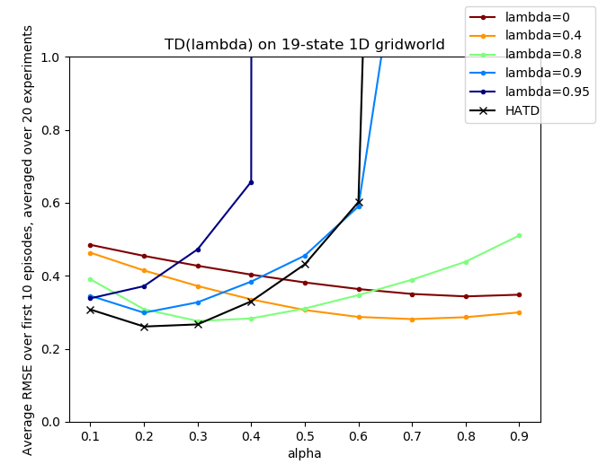
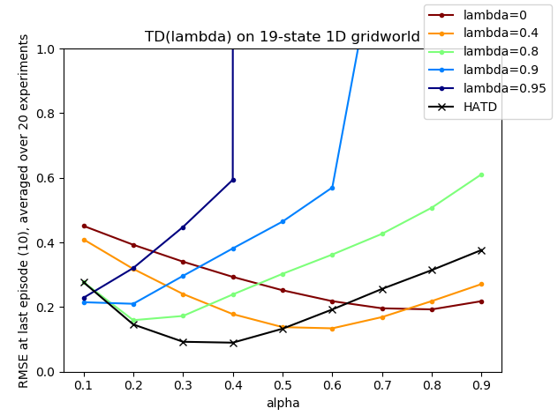
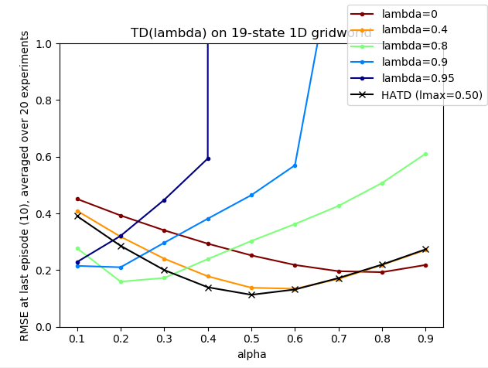
TD(λ) and HATD(λ) for different α’s 19-state 1D gridworld
λmax = 0.95
λmax = 0.8
λmax = 0.5

Slide 38
APPENDIX

Slide 39
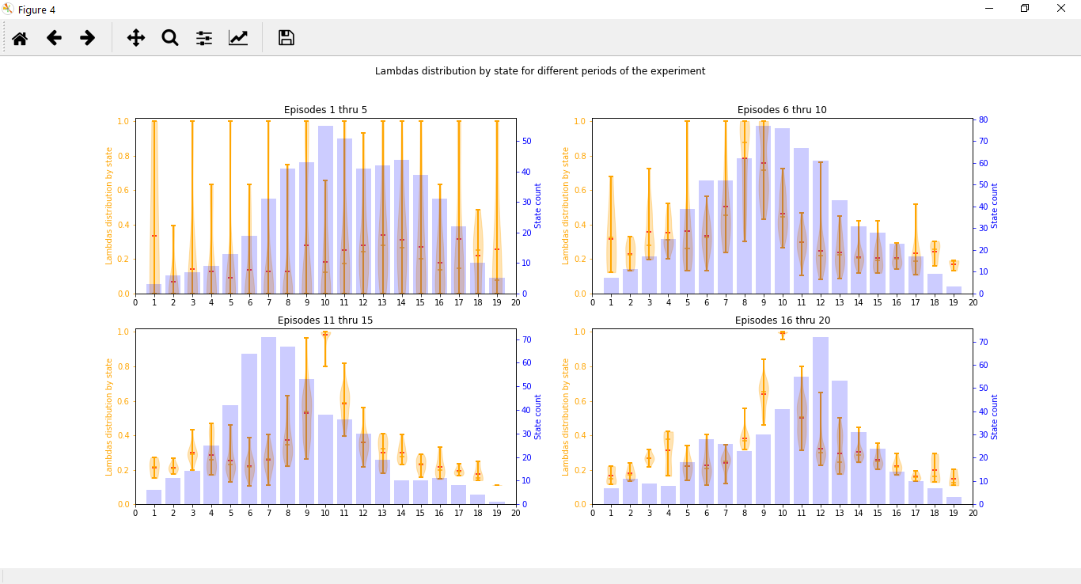
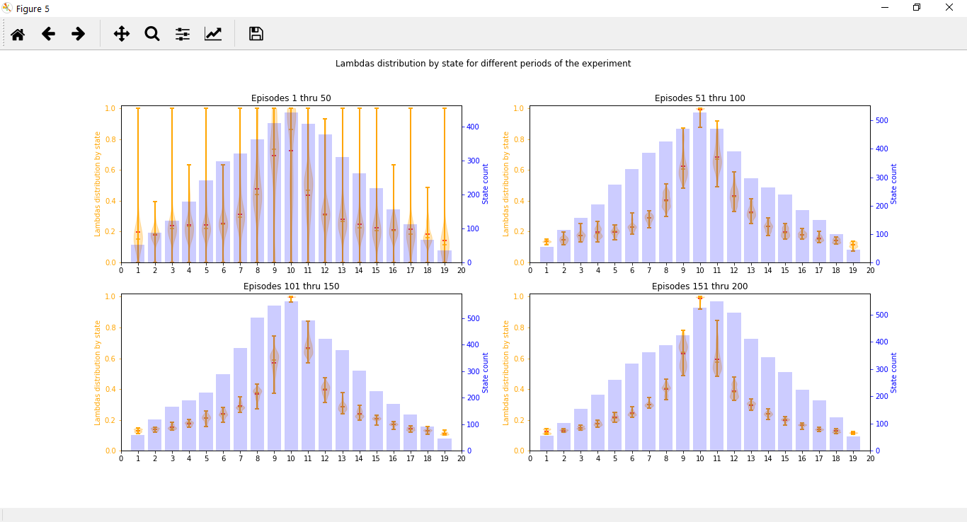
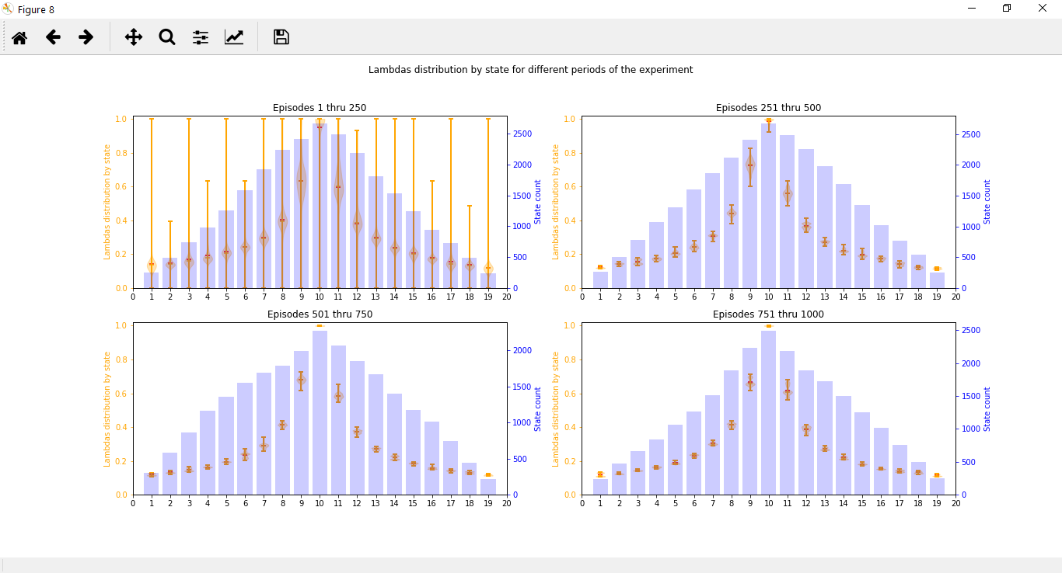
Distribution of λ by state over time Boltzmann law f(x) = 1 – exp(-|x|) is a function of x = δ(t)/V(S(t))
First
20 episodes
First
200 episodes
First
1000 episodes
We observe that the distribution of λ by state tends to an Atari shape… which is due to the division by V(S(t)) which is very small for middle states, explaining the larger values of λ for those states compared to border states.

Slide 40
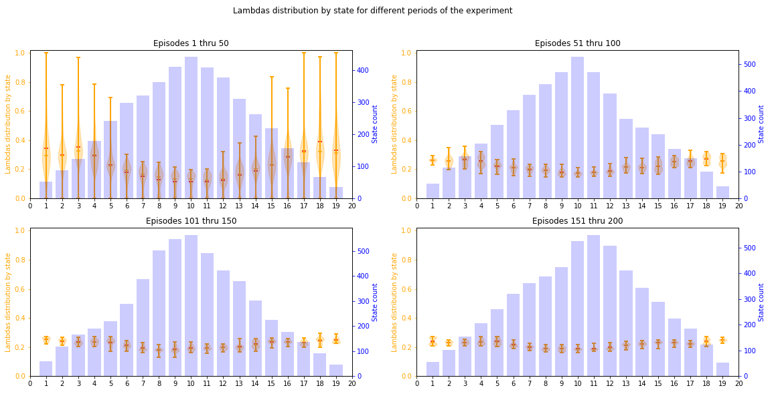

Distribution of λ by state over time Boltzmann law is a function of δ(t)/$\overline{|V}\left(t\right)|$
In this case we avoid a division by a very small state value for middle states by replacing V(S(t)) with the value function averaged over all states at time t. This still gives a qualitative measure of the magnitude of δ(t) (i.e. whether it is large or small) which is essential to correctly define λ. After introducing this change we see that the state distribution of λ tends to almost a constant value.
Note that the constant value is a characteristic of this 1D gridworld, where all state values differ from their neighbour’s by a constant value (= 0.1 in the 19-state 1D gridworld).

Slide 41
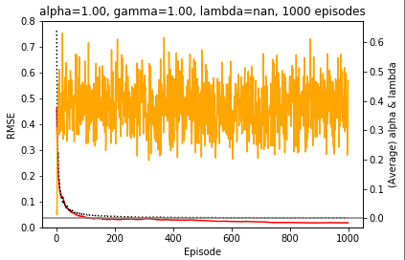
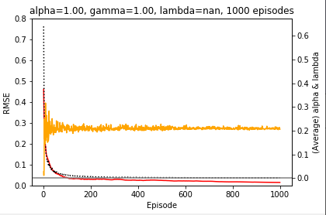
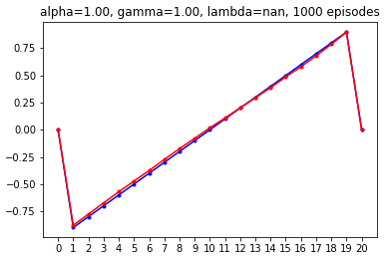
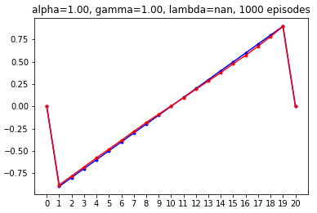

Comparison of the average λ by episode and estimated value function between the two Boltzmann laws
Boltzmann(δ(t)/V(S(t)))
Boltzmann(δ(t)/|$\overline{V}(t)$|)
Both estimated functions after 1000 episodes are of good quality, but the red Boltzmann law (left) generates a very “noisy” λ structure, which is clearly an artifact since, near convergence, all states have similar δ(t)’s, namely around 0.1, which is the difference in state value for contiguous states.
On the contrary, the green Boltzmann law (right) generates a λ structure that converges to ~ 0.2, which is ~ 1 – exp(-0.1/0.5) = 0.18, which comes from the fact that δ(∞) ~= 0.1 is and $\overline{V}(∞)$ ~= 0.5.

Slide 42
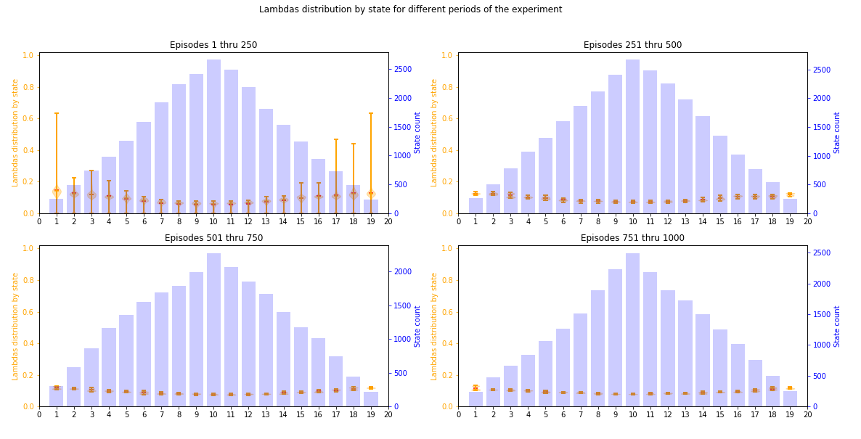
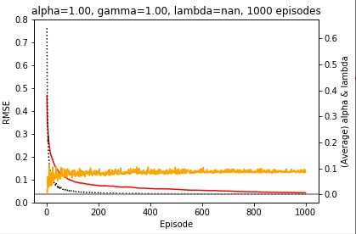

When λ is adjusted by the absolute δ(t)… Boltzmann law is a function of δ(t)
Distribution of λ by state over time
Convergence speed and average λ by episode
We observe the following:
- The λ structure tends to ~ 0.1, which is the value of δ(∞).
- Although the λ structure is not noisy, the convergence to the true value function is slower than in the other two cases presented earlier.
- Contrary to the other two cases, the values of λ don’t “jump immediately” to the limit value, but tends to it more slowly.

Slide 43
DRAFT

Slide 44
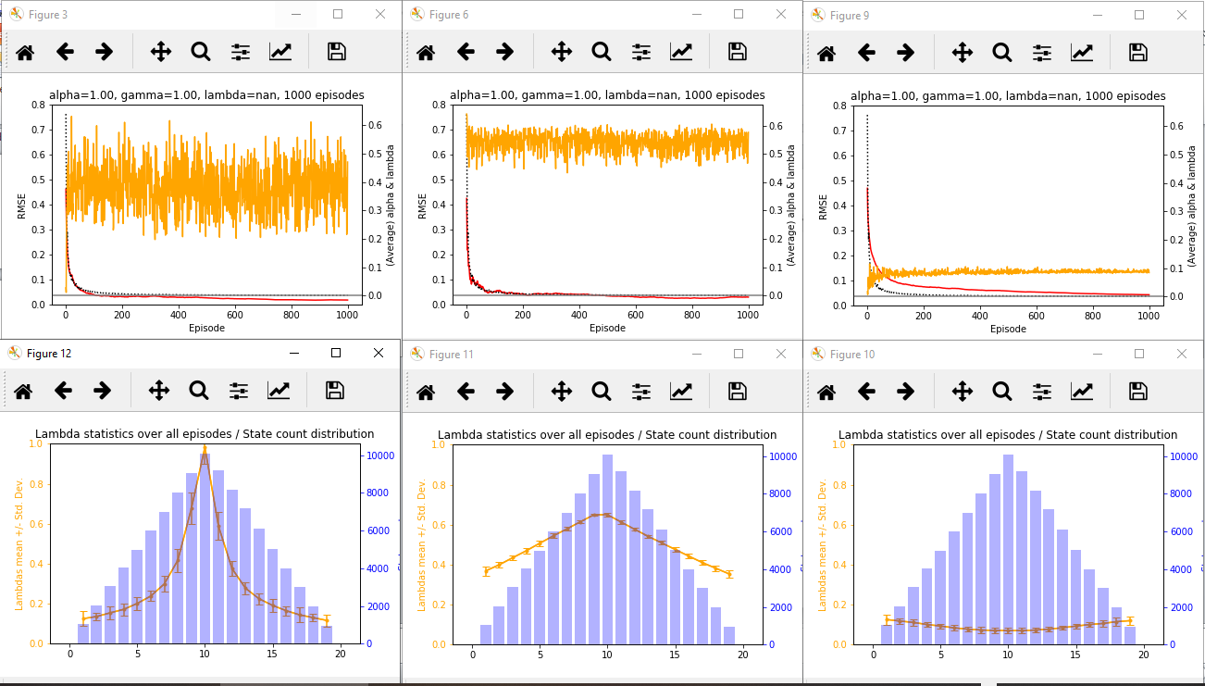
Adaptive TD(λ) - λ distribution Three ways of adjusting λ as a function of δ(t)
Relative to state’s value ~ |δ(t)| / |V(S(t)) |
Relative, but avoiding division by 0 ~ exp( |δ(t)| - |V(S(t)| )
Absolute
~ |δ(t)|

Slide 45
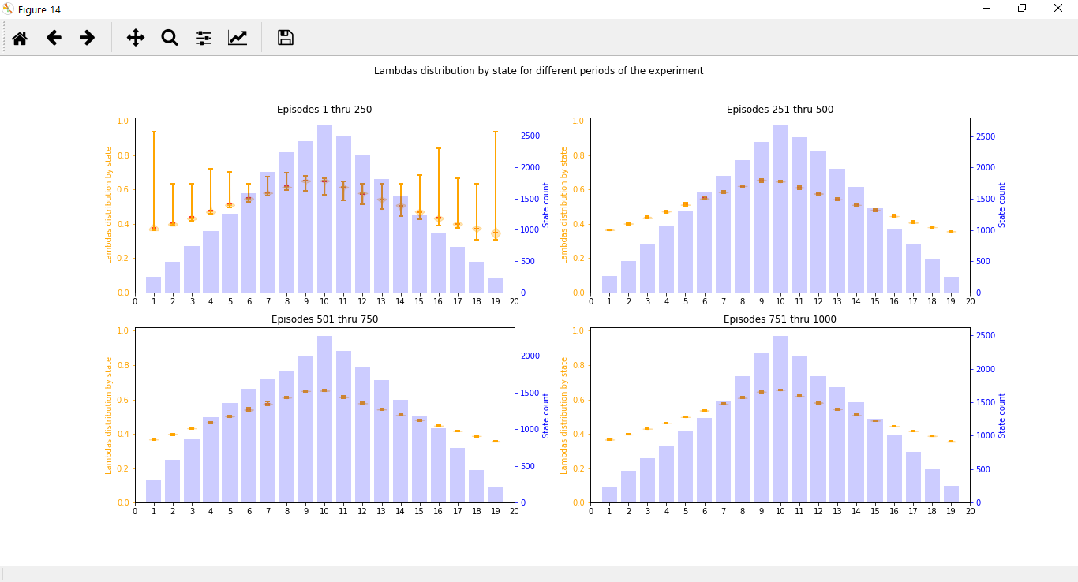
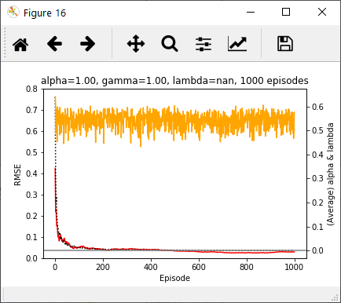
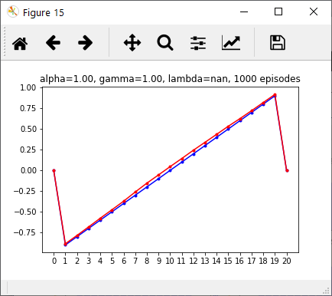
λ adjusted ~ exp( |δ(t)| - |V(S(t)| ) Formula: λ(t) = 1 – exp(-exp(|δ(t)| - |V(S(t)|))
The goal of using this calculation as an indication of the “relative change of δ(t)” is to avoid division by 0 or by a very small value (e.g. for states near the middle of the grid).
This option however has two drawbacks:
λ never reaches 0. Its minimum is around 0.4 (in fact, in order for λ to reach a very small value, V(S(t)) should be much larger than δ(t) in absolute value, and in the “worst” case we could have |δ(t)| - |V(S(t))| ~= 0 - 1 = -1, for which λ = 0.3 (still far from 0…))
The limit for λ is still “noisy”, as is the case with the relative δ(t) adjustment (red law).
Note that the limit for λ should oscillate between 1 – exp(-exp(0.1 - 0.0)) and 1 – exp(-exp(0.1 – 0.9), i.e. between 0.67 and 0.36. The oscillation in the plot below is smaller than this range because we are plotting the average λ over all states visited in the episode.

