Slide 1
Results of implementation of TD(λ) and MC(λ) algorithms for 1D gridworld
Fri, 17-Apr-2020
Ref: SimulateTDLambda.ipynb

Slide 2
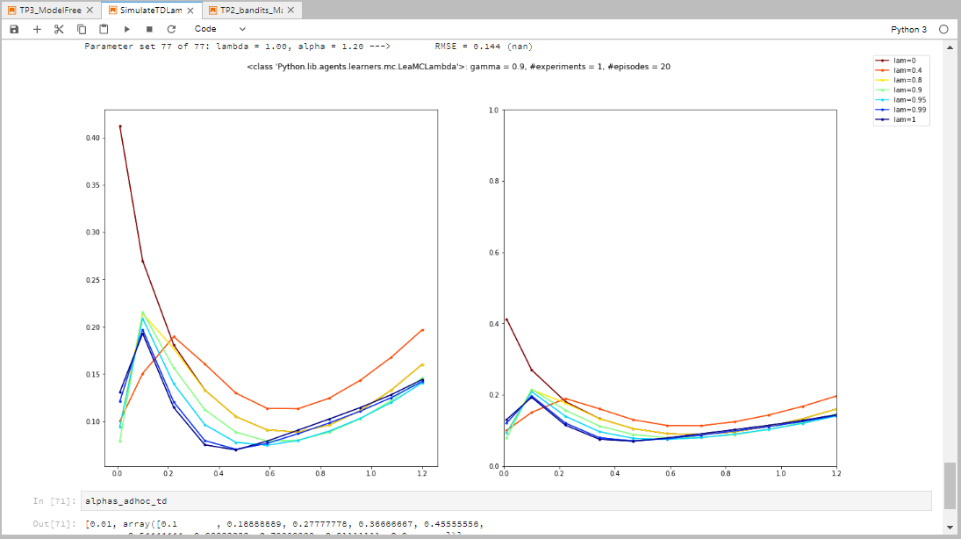
Before fixing reset in td.py and mc.py

Slide 3
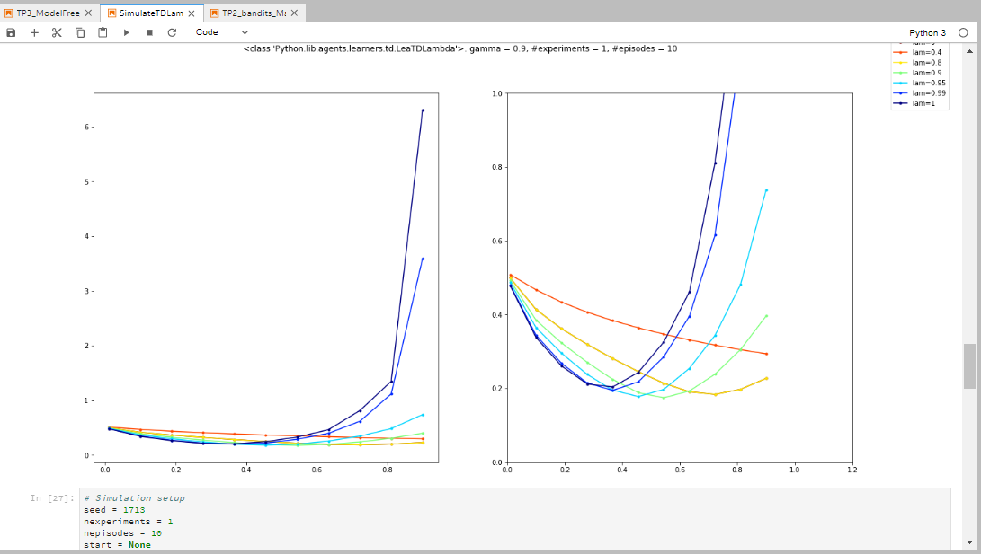
TD(λ), γ=0.9, seed=1717, #exp=1

Slide 4
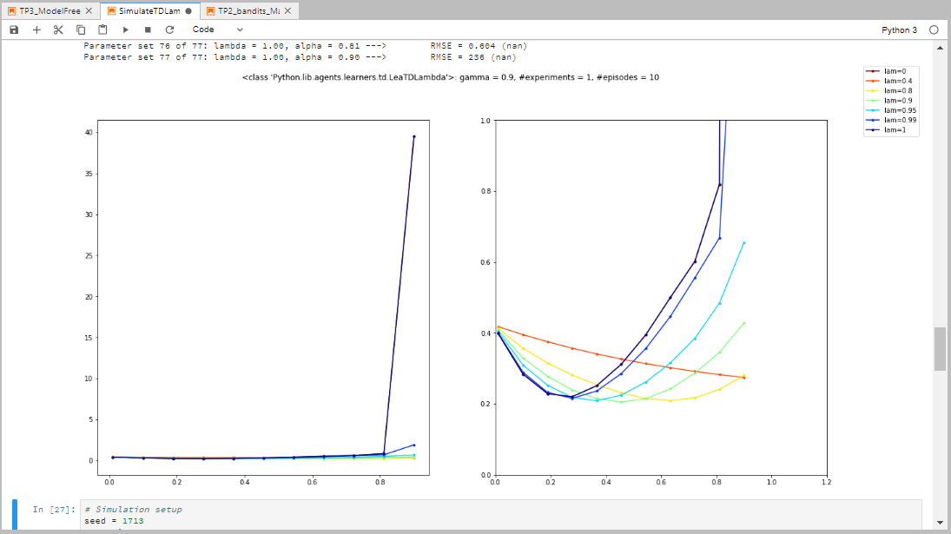
TD(λ), γ=0.9, seed=1713, #exp=1

Slide 5
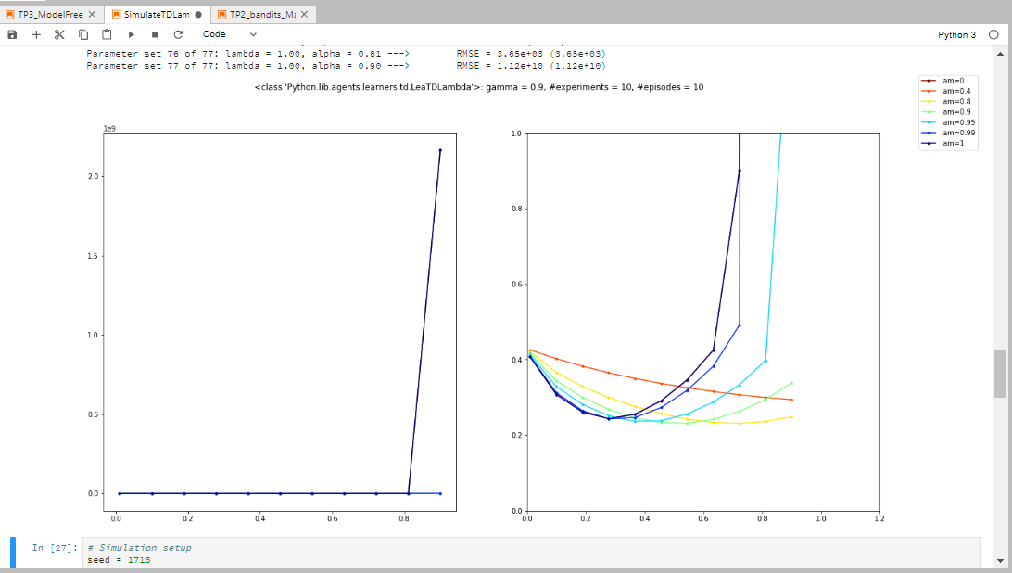
TD(λ), γ=0.9, seed=1713, #exp=10

Slide 6
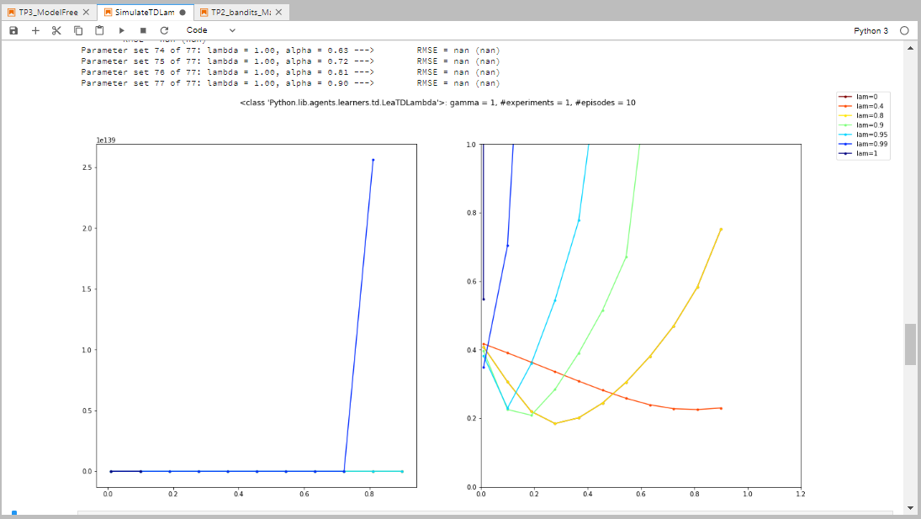
TD(λ), γ=1, seed=1713, #exp=1

Slide 7
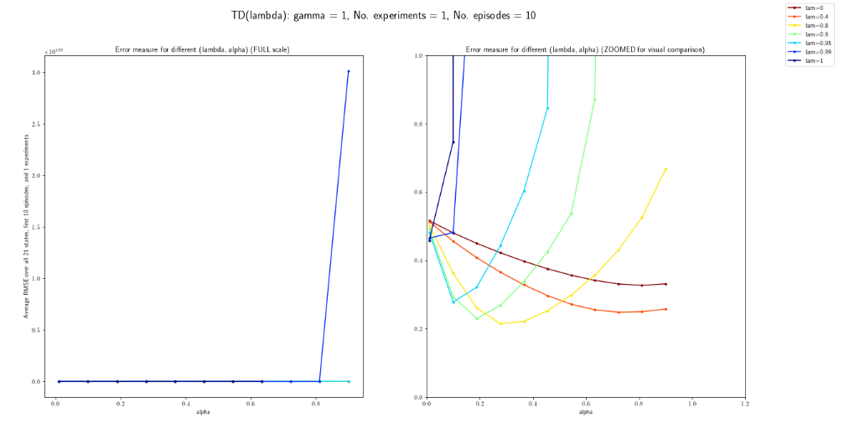
TD(λ), γ=1, seed=1713, #exp=1 Tue, 12-May-2020: After fixing λ = 0 (earlier plots of λ = 0 were actually for λ = 0.8) and other fixes done as well

Slide 8
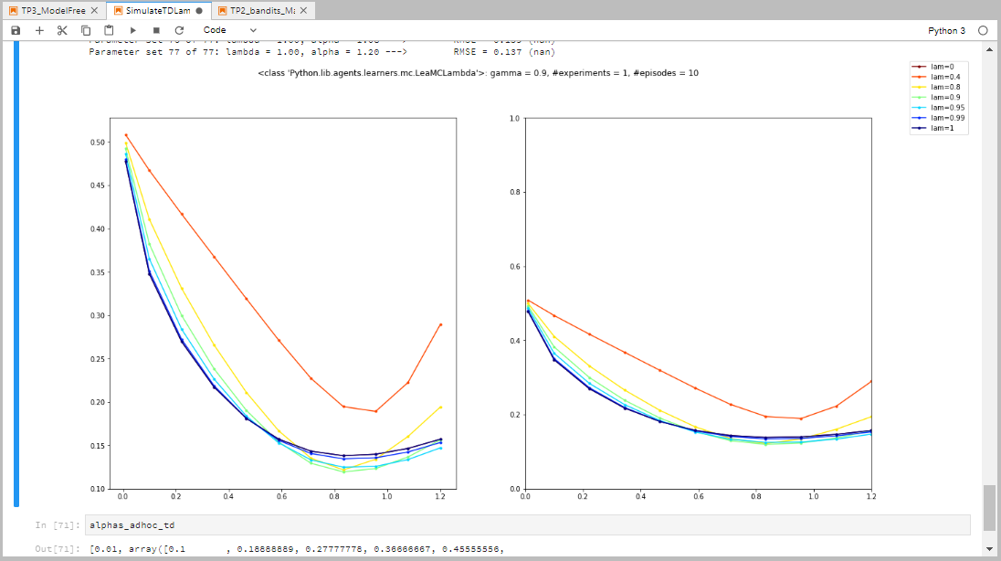
MC(λ), γ=0.9, seed=1717, #exp=1

Slide 9
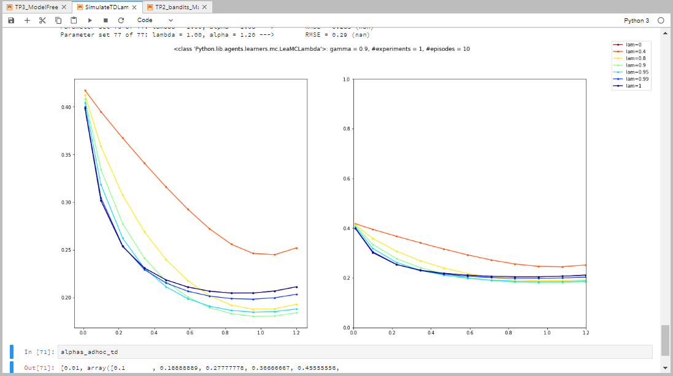
MC(λ), γ=0.9, seed=1713, #exp=1

Slide 10
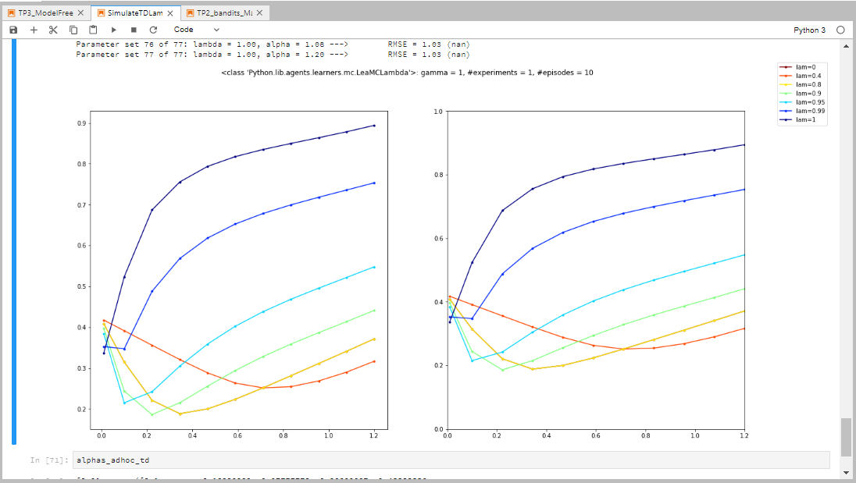
MC(λ), γ=1, seed=1713, #exp=1

Slide 11
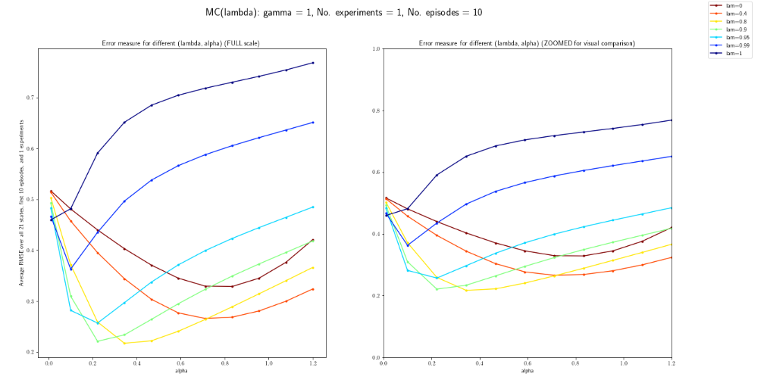
MC(λ), γ=1, seed=1713, #exp=1 Tue, 12-May-2020: After fixing a few things in the code (check Tasks Excel) EVERY VISIT λ-return

Slide 12
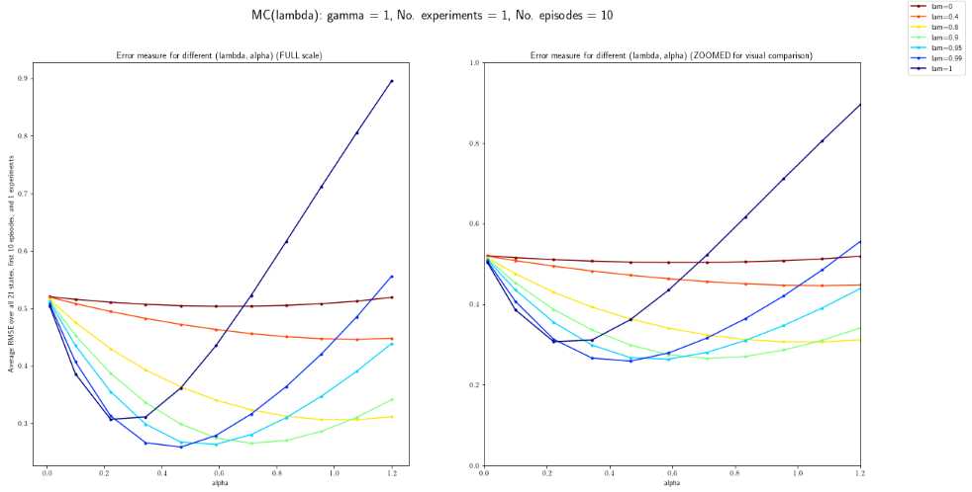
MC(λ), γ=1, seed=1713, #exp=1 Tue, 12-May-2020: After fixing a few things in the code (check Tasks Excel) FIRST VISIT λ-return

Slide 13
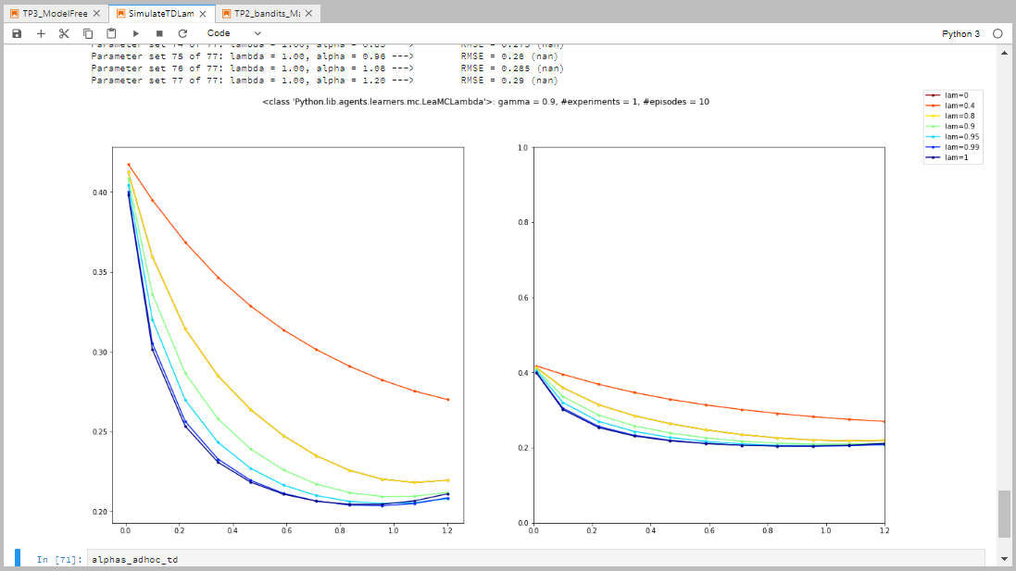
λ-return^{(*)}, γ=0.9, seed=1713, #exp=1
(*) I use the term “λ-return” to indicate the estimation that does NOT leverage the nested nature of the n-step returns in its implementation

Slide 14
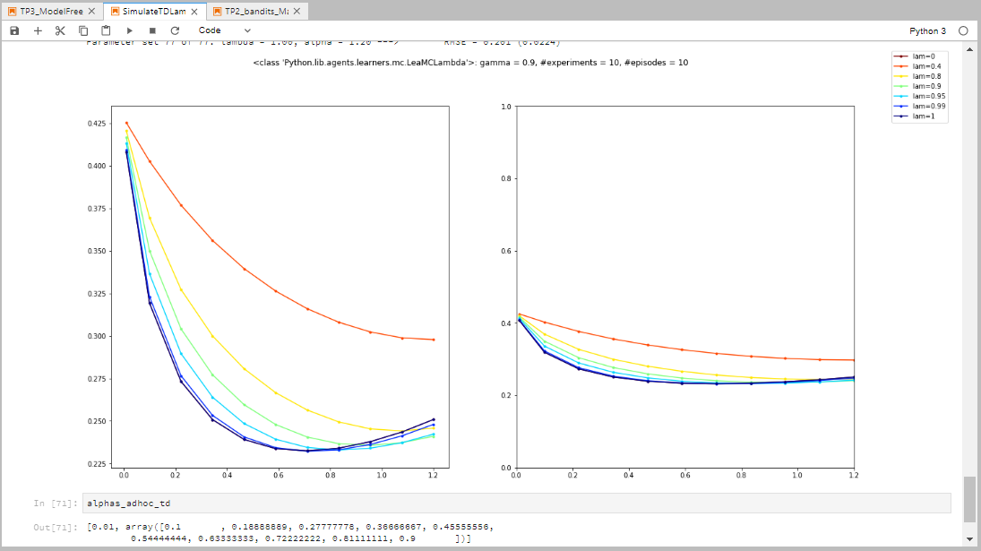
λ-return, γ=0.9, seed=1713, #exp=10
(*) I use the term “λ-return” to indicate the estimation that does NOT leverage the nested nature of the n-step returns in its implementation

Slide 15
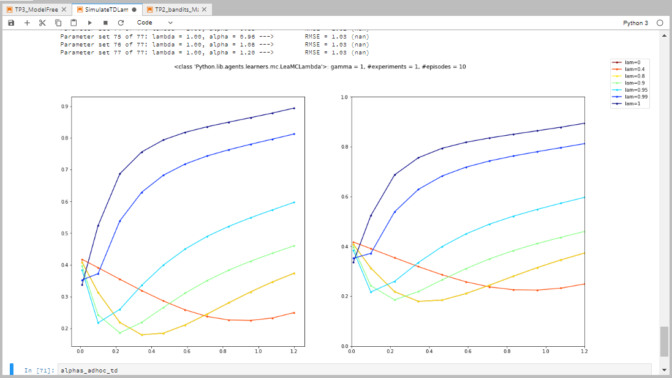
λ-return, γ=1, seed=1713, #exp=1
(*) I use the term “λ-return” to indicate the estimation that does NOT leverage the nested nature of the n-step returns in its implementation

Slide 16
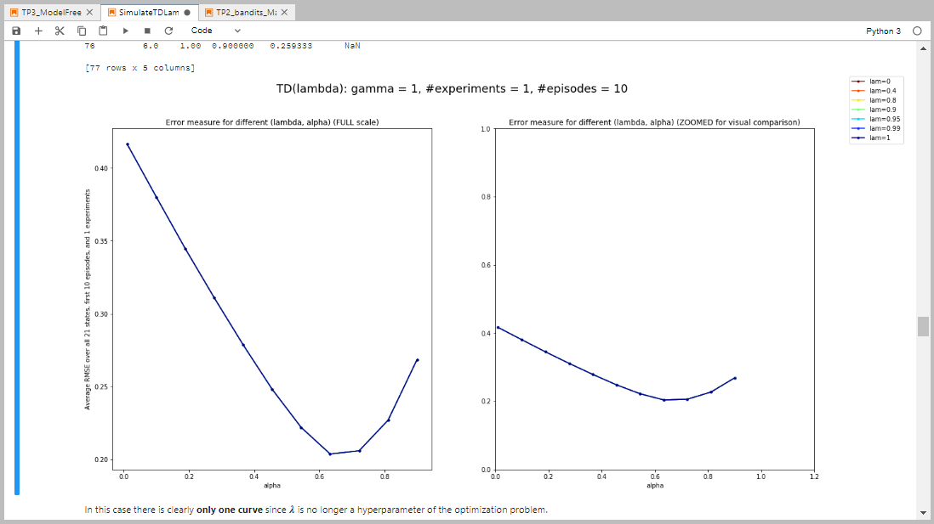
TD(λ) adaptive, γ=1, seed=1713, #exp=1

Slide 17
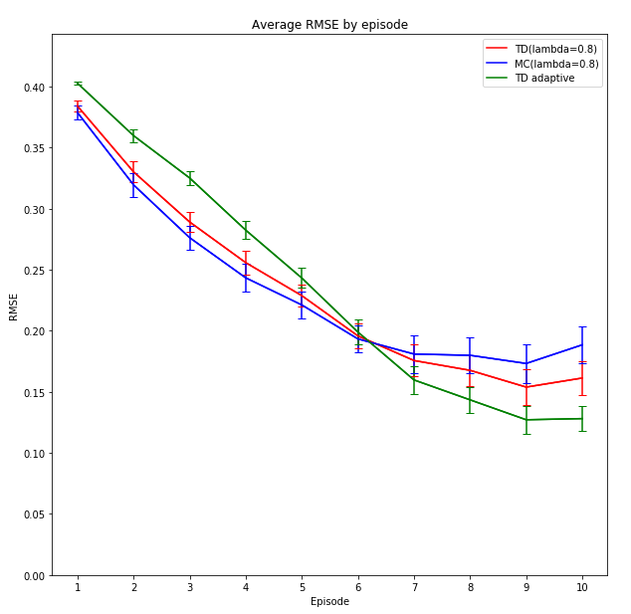
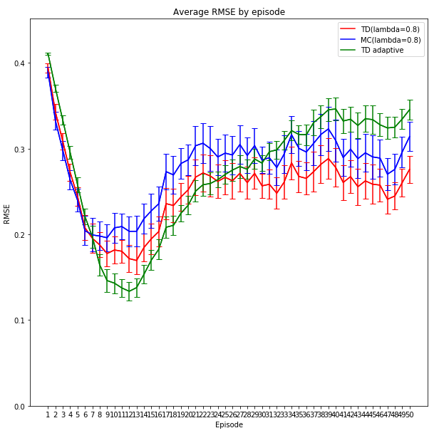
Comparison of convergence speed among the three algorithms

Slide 18
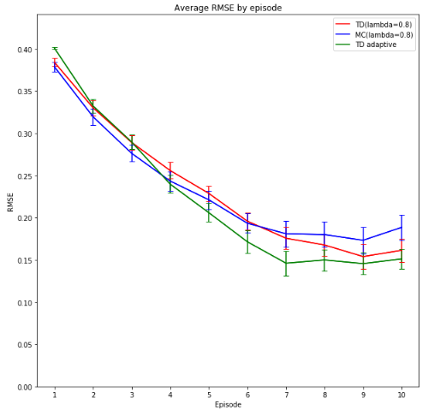
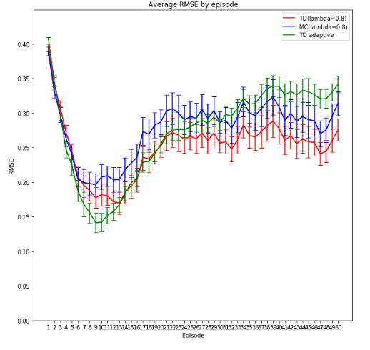
Comparison of convergence speed among the three algorithms using offset λ = 0.1 for all updates in the adaptive case
We observe a faster convergence of the adaptive case (green curve) compared to using a 0 offset!

Slide 19
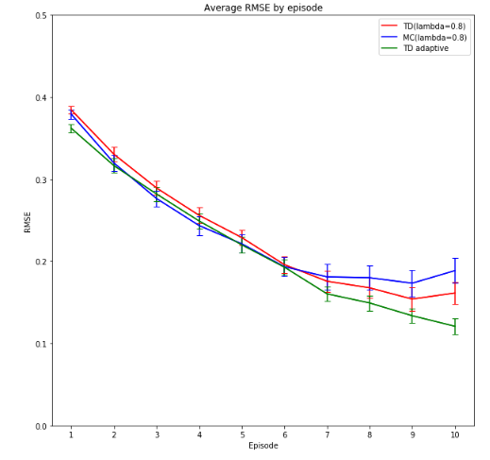
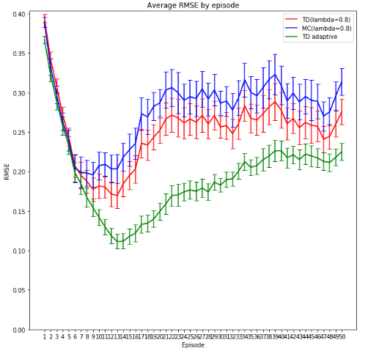
Comparison of convergence speed among the three algorithms using fixed λ as long as the value function is not updated once
We observe similar convergence rate at the beginning and smaller error at the end, compared to the other two algorithms!

Slide 20
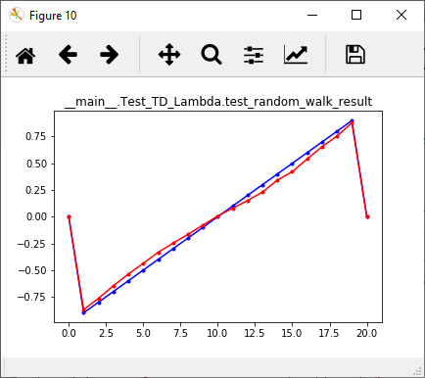
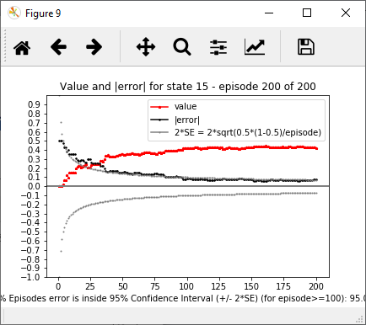
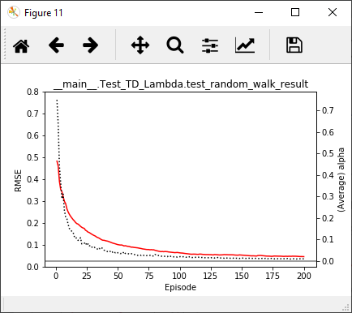
Convergence of TD(0) 12-May-2020
We need to use an initial α that is sufficiently large.
α₀ = 1.5, decay with state count for every FIRST VISIT.

Slide 21
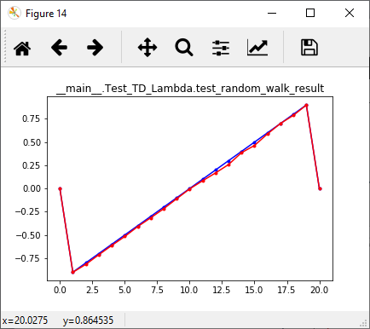
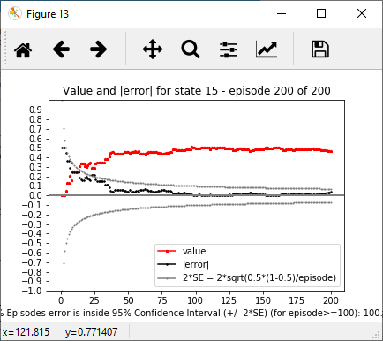
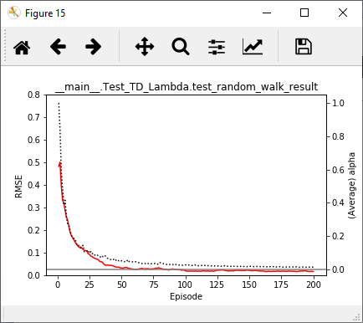
Convergence of TD(0) 12-May-2020
We need to use an initial α that is sufficiently large.
α₀ = 2, decay with state count for every FIRST VISIT.

Slide 22
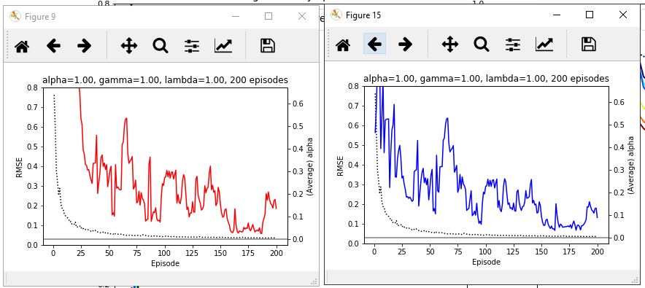
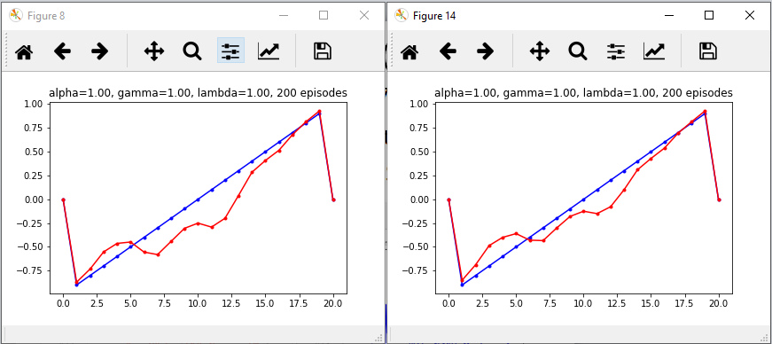
Comparison between TD(1) and MC α = 1, λ = 1, γ = 1 (seed = 1717, start = 10)
α updated by FIRST-VISIT state count^{(*)}
TD(1)
Every-visit MC
(*) This is like update by EPISODE but α is NOT updated in an episode if the state is NOT visited
Ref: test_TD_lambda.py, test_MC_lambda.py

Slide 23
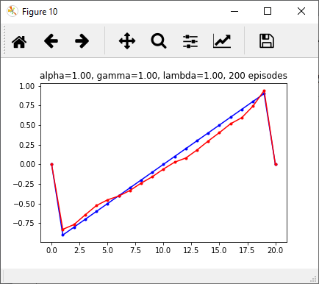
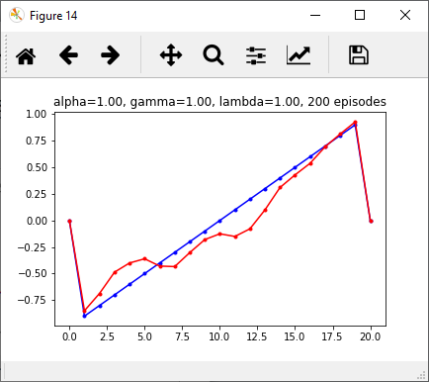
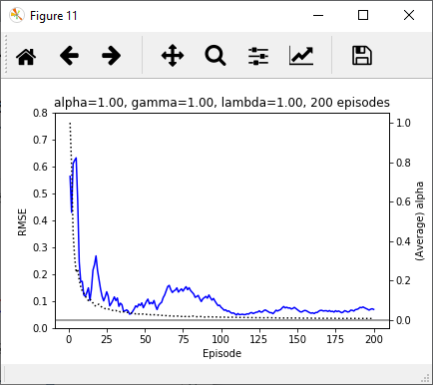
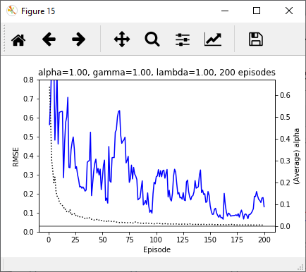
MC first-visit vs. every-visit α = 1, γ = 1 (seed = 1717, start = 10)
α updated by FIRST-VISIT state count
First-visit MC
Every-visit MC

Slide 24
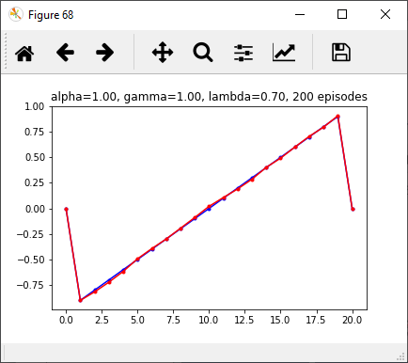
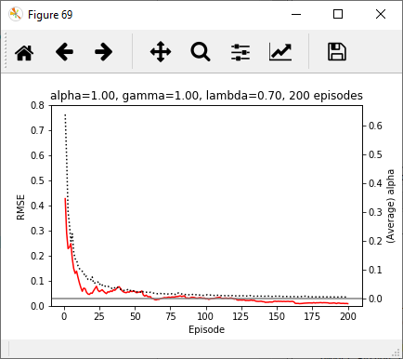
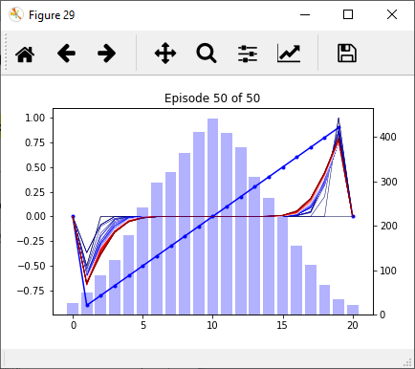
TD(λ) first-visit α-update α = 1, λ = 0.7, γ = 1 (seed = 1717, start = 10)
α updated by FIRST-VISIT state count
Evolution of TD(0) with every-visit state count update → VERY SLOW!
Ref: test_TD_lambda.py

