Slide 1
Results of TD(λ) for different λ and Adaptive TD(λ) (First-visit MC is used as benchmark)
Wed, 20-May-2020
Daniel Mastropietro
Ref: Python/test/simu_lambdas.py

Slide 2
Simulation setup
Three algorithms are analyzed on the 21-state 1D gridworld with non-zero rewards only at left-most and right-most states.
First-visit MC
TD(λ)
Adaptive TD(λ), i.e. with a state-dependent λ
Two simulations are carried out for each algorithm making up 6 simulations shown in 6 different pages, where the RMSE by episode averaged over 10 experiments is plotted:
α is adjusted by state count
α is adjusted by episode
Considering that rewards are only received at the end, the α adjustment by episode may make more sense in the TD(λ) algorithms.
For TD(λ), a set of different λ values are considered, whereas α starts at 2 when adjusted by state-count and at 1 when adjusted by episode.
For Adaptive TD(λ), the same set of α values is considered in both adjustment types.
All plots on the LHS are visually comparable as they use the same scale.

Slide 3
α adjusted by State Count

Slide 4
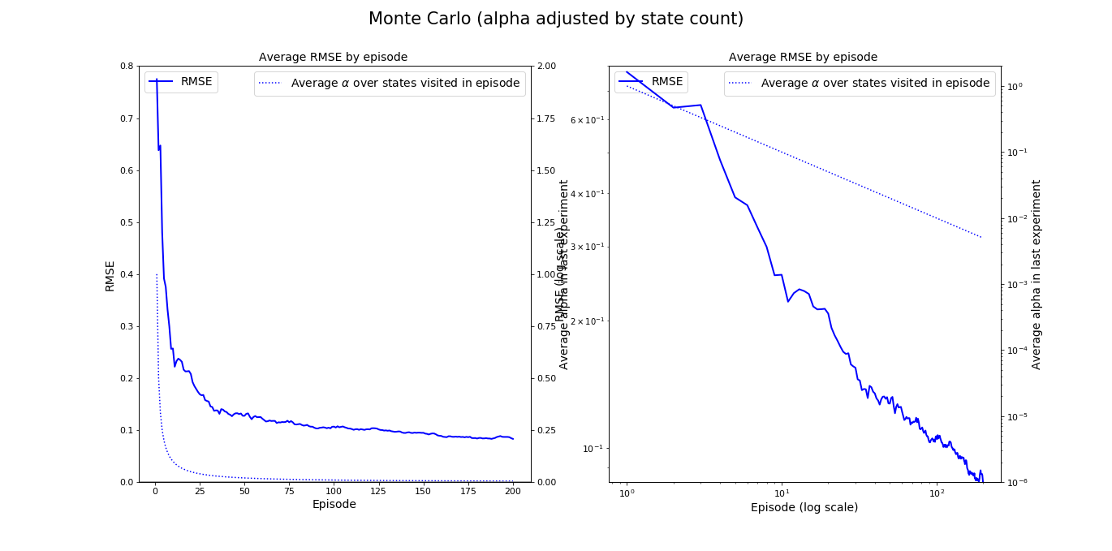
MC, adjust by first-visit State Count seed=1717, #exp=10, start=10
Initial α = 1
The variability observed across experiments (not plotted) is reasonable

Slide 5
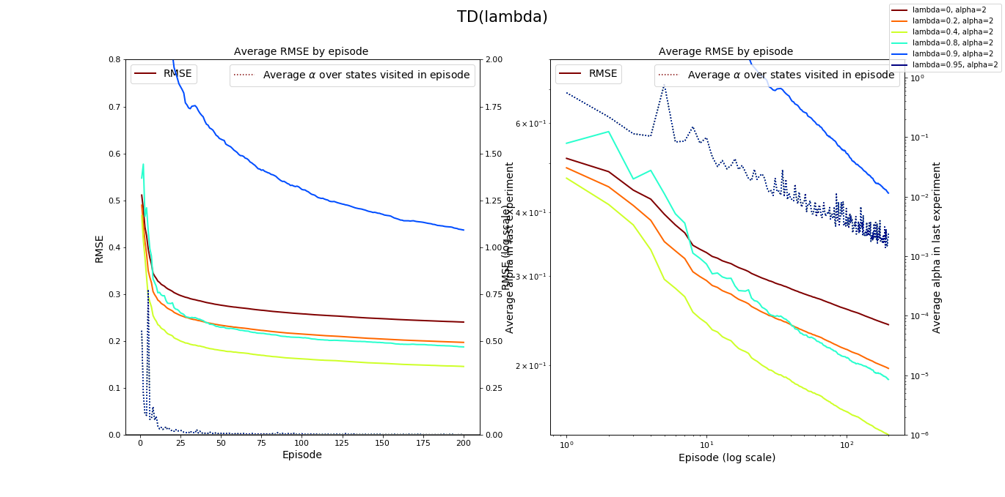
TD(λ), adjust by State Count seed=1717, #exp=10, start=10
The variability observed across experiments (not plotted) is reasonable, but increases for larger λ’s

Slide 6
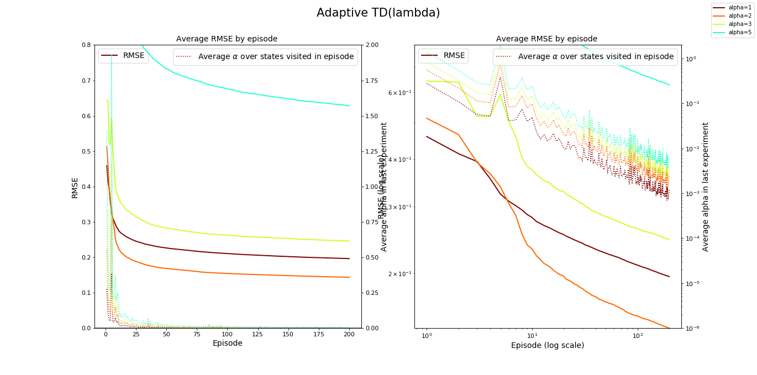
Adaptive TD(λ), adjust by State Count seed=1717, #exp=10, start=10
The variability observed across experiments (not plotted) is reasonable, but increases for larger α’s

Slide 7
α adjusted by Episode

Slide 8

First-visit MC, adjust by Episode seed=1717, #exp=10, start=10
Initial α = 1
The variability observed across experiments (not plotted) is reasonable

Slide 9
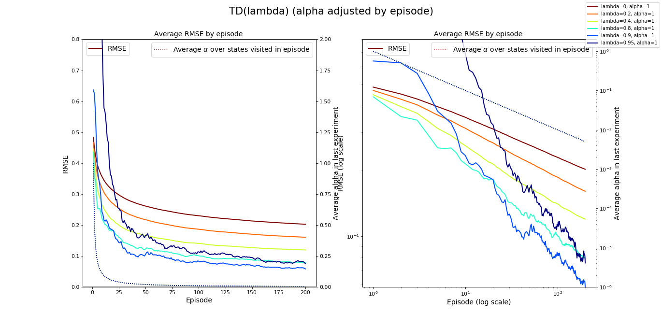
TD(λ), adjust by Episode seed=1717, #exp=10, start=10
The variability observed across experiments (not plotted) is reasonable, but increases for larger λ’s

Slide 10
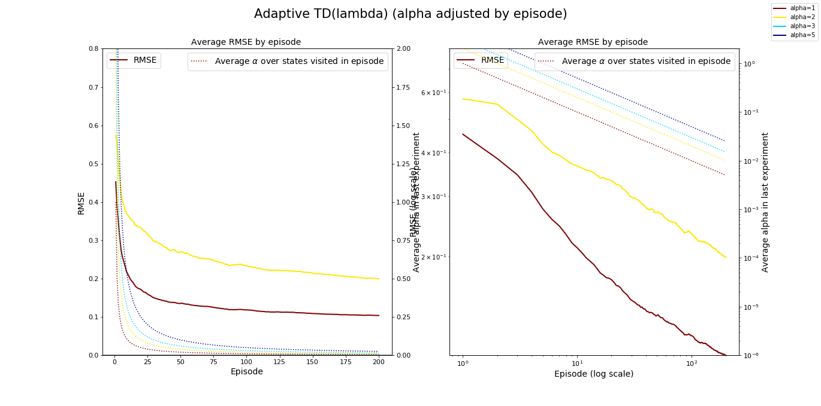
Adaptive TD(λ), adjust by Episode seed=1717, #exp=10, start=10
The variability observed across experiments (not plotted) is reasonable, but increases for larger α’s

Slide 11
Observations
Given the λ and α values considered:
MC with α adjusted by state count shows the smallest RMSE at the end of 200 episodes.
The smallest RMSE for TD(λ) is observed:
for λ = 0.4 when α is adjusted by state count
for λ = 0.9 when α is adjusted by episode
For the same initial α, the Adaptive TD(λ) gives a very similar RMSE by episode as the best TD(λ).
This is a promising result for the goal of eliminating the need to define the hyperparameter λ.

Slide 12
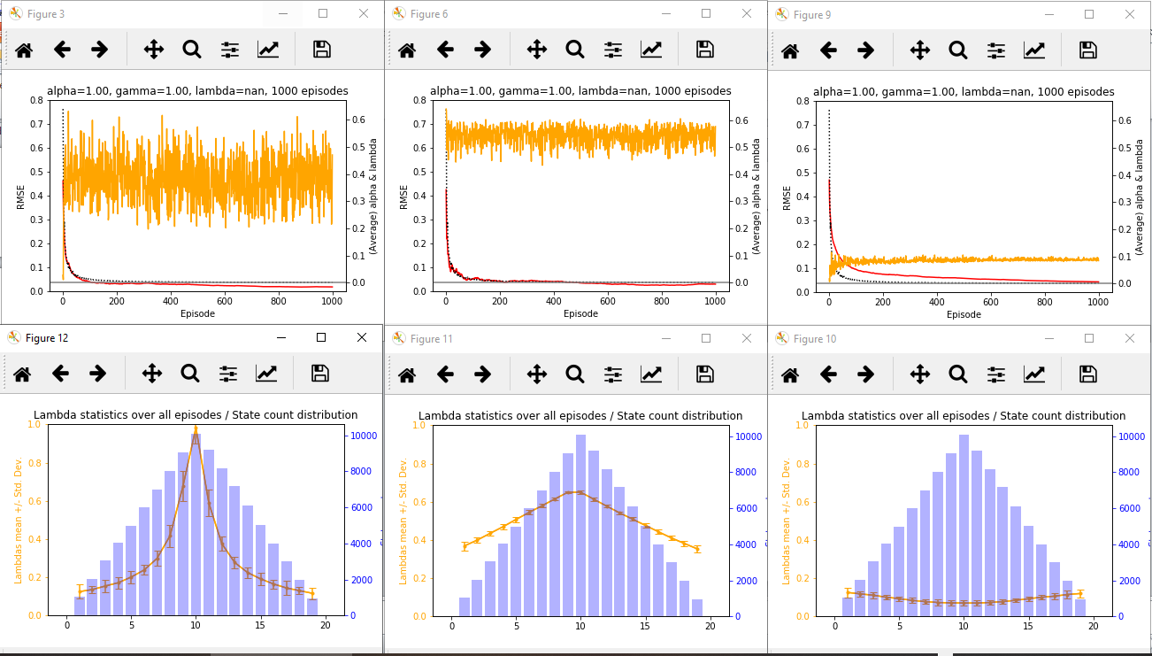
Adaptive TD(λ) - λ distribution Three ways of λ = function(δ(t))
~ |Delta| / |value |
~ exp( |Delta| - |value| )
~ |Delta|

