Slide 1
Policy Gradient on Single Server for optimum blocking
16-Nov-2021
Ref: simulators.py -> SimulatorQueue class

Slide 2
TODO
Plot the true value function as a comparison --> try to plot the points on top, as a boxplot... but how? I would need to bin the theta values and this is not so easy...
Compare methods (1) and (2) with comparable alpha values (without adjustment)
Analyze the case where the true theta is large (does it converge?)

Slide 3
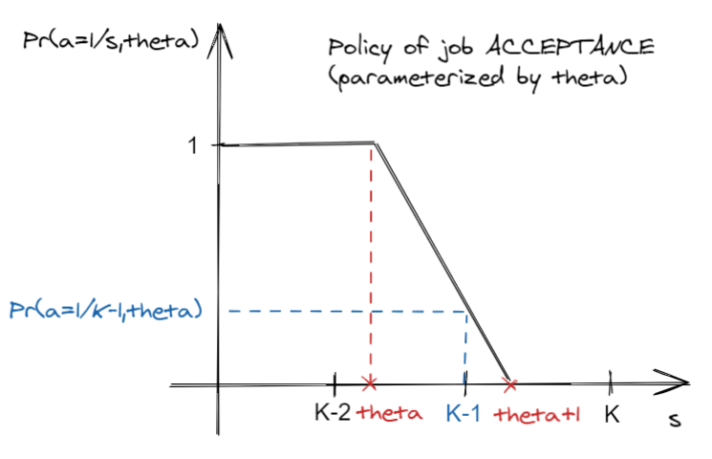
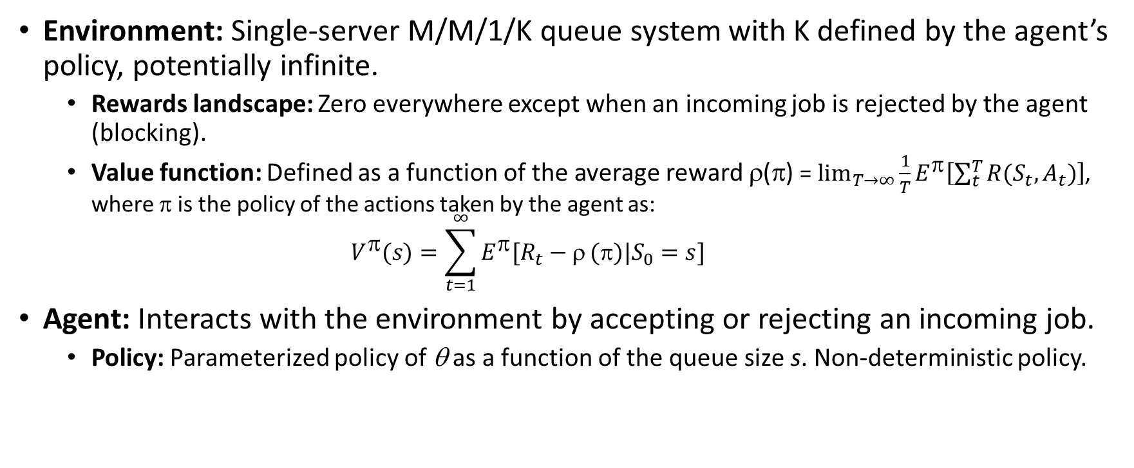
The environment and the agent of the RL problem
Environment: Single-server M/M/1/K queue system with K defined by the agent’s policy, potentially infinite.
Rewards landscape: Zero everywhere except when an incoming job is rejected by the agent (blocking).
Value function: Defined as a function of the average reward ρ(π) = $\lim_{T→∞}{\frac{1}{T}E^{π}\left[\sum_{t}^{T}{R(S_{t},A_{t})}\right]}$, where π is the policy of the actions taken by the agent as: $V^{π}(s)=\sum_{t=1}^{∞}{E^{π}[R_{t}−ρ}(π)|S_{0}=s]$
Agent: Interacts with the environment by accepting or rejecting an incoming job.
Policy: Parameterized policy of θ as a function of the queue size s. Non-deterministic policy.
Learning: Policy gradient learning of the optimum parameter that maximizes the average reward. Learning is done by estimating the required quantities either by Monte-Carlo or Fleming-Viot.

Slide 4
Policy gradient learning

Slide 5
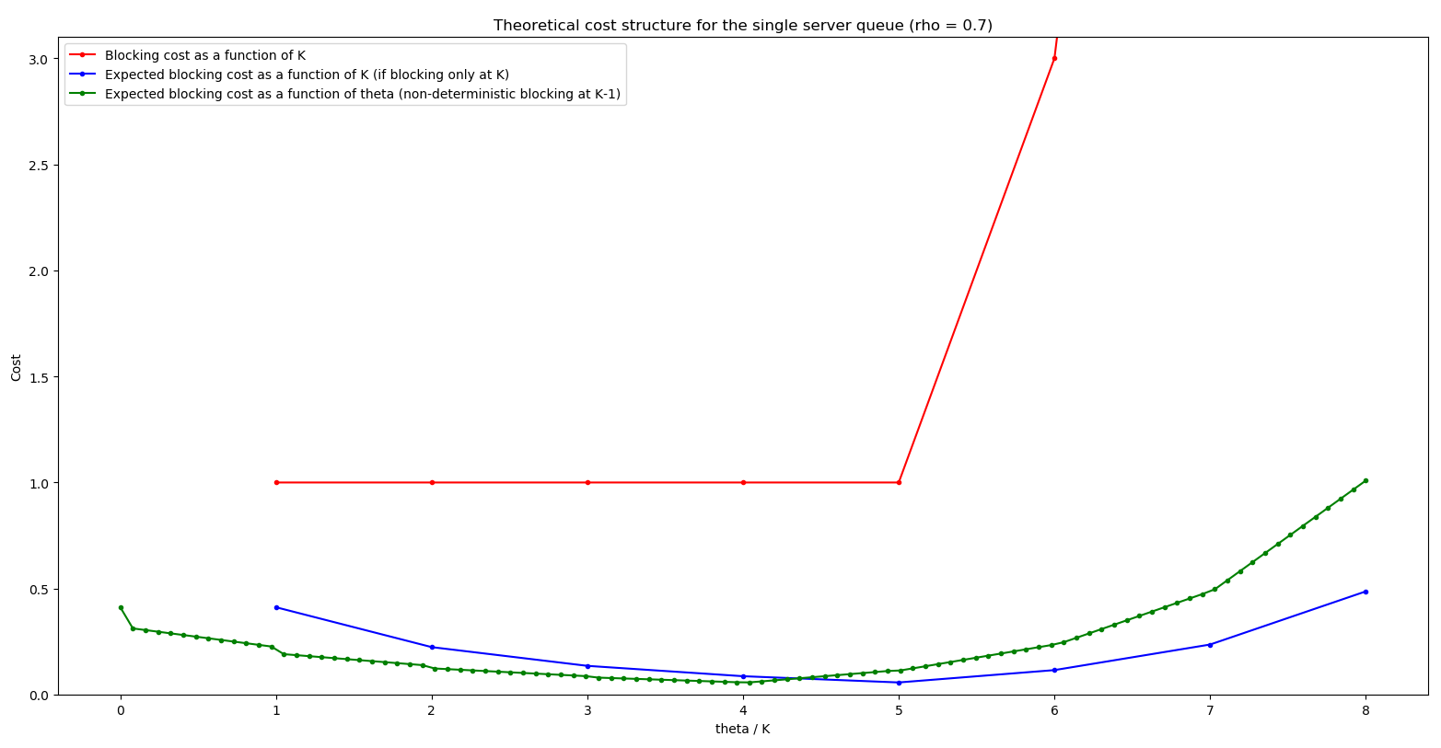
Theoretical blocking cost structure
Notes on the blocking cost function: (Wed, 17-Nov-2021)
Interpretation of current cost: the larger the K the system is more reliable, then blocking with larger K is more serious.
Cost function should probably be changed to strictly increasing function of K, for easier understanding/selling/realistic.
When blocking occurs, the system is completely out of function (e.g. Cards castle problem, but this is a different problem, because in the latter when destruction occurs, the state goes to 0).

Slide 6
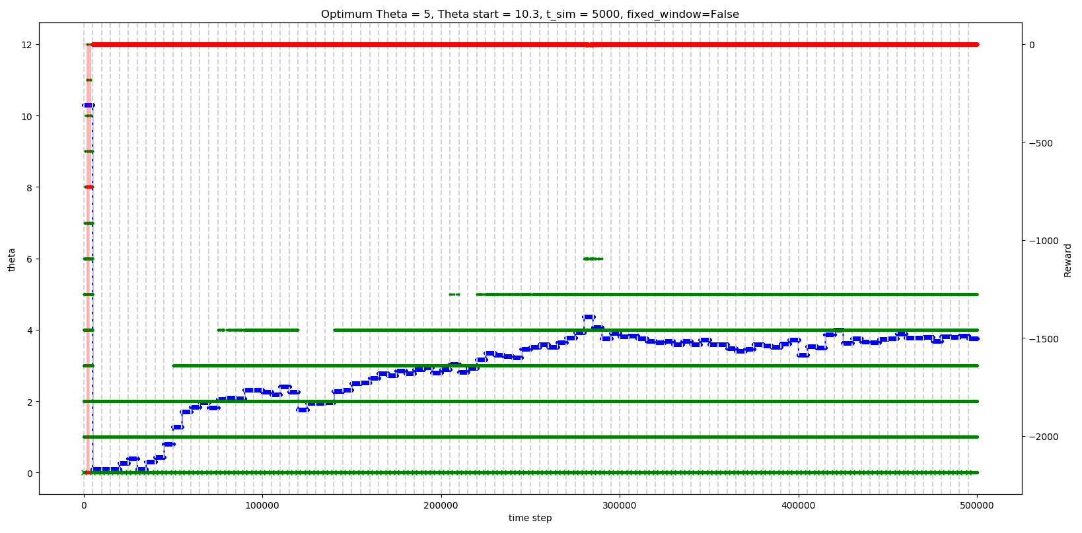
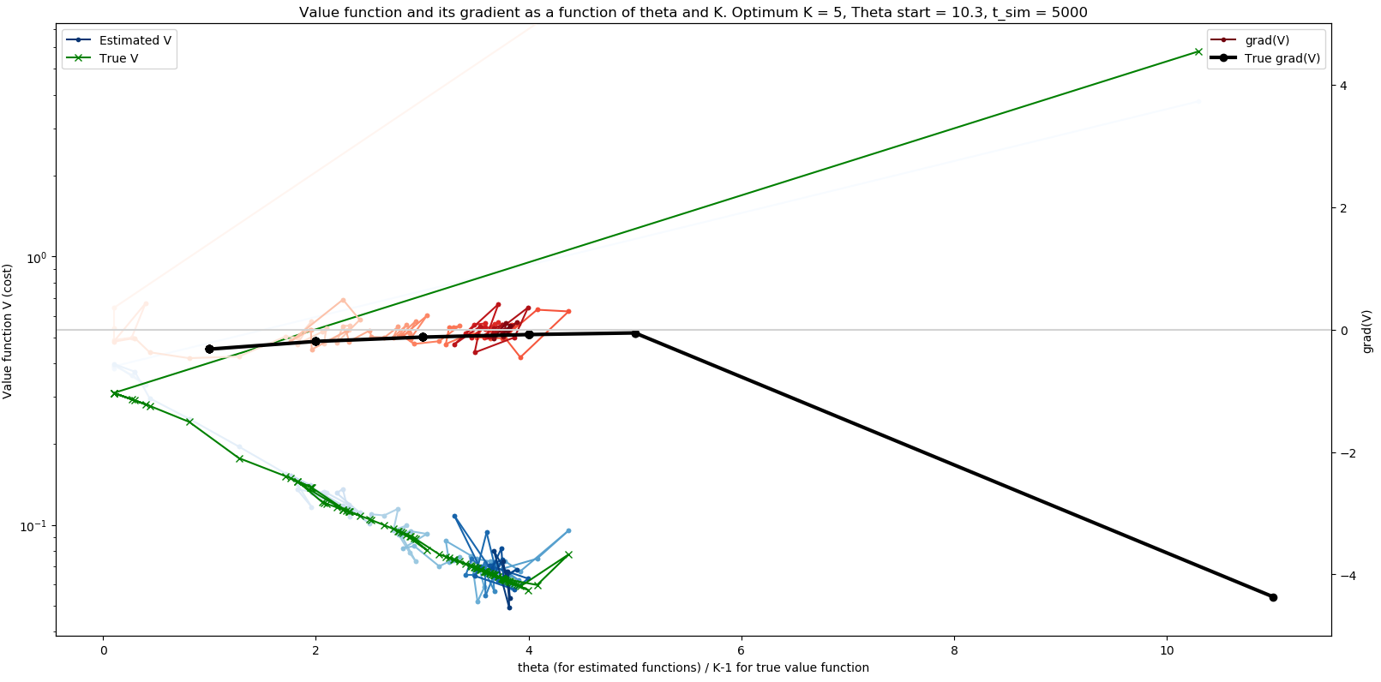
Method 1: Update once at end of episode (T = 5,000) (α = 1, no constraint on delta(θ))

Slide 7
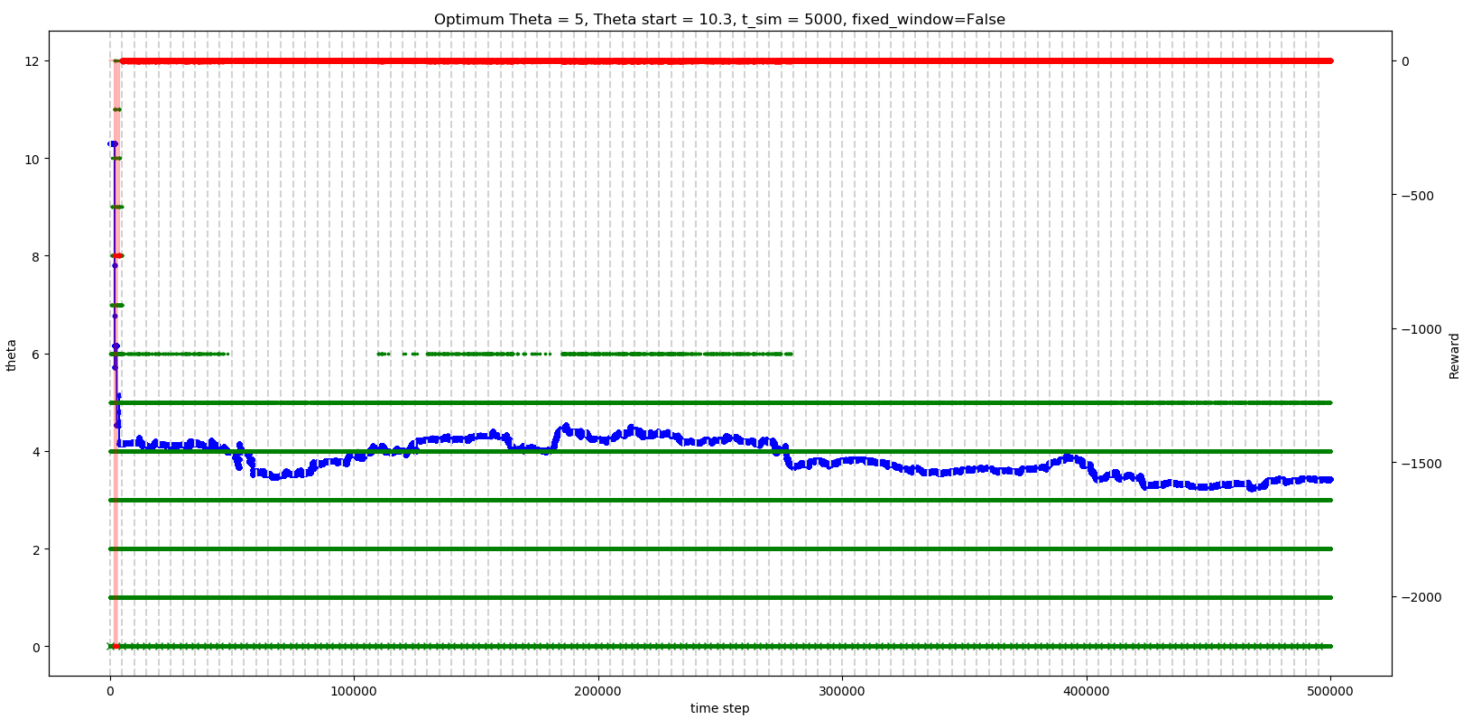
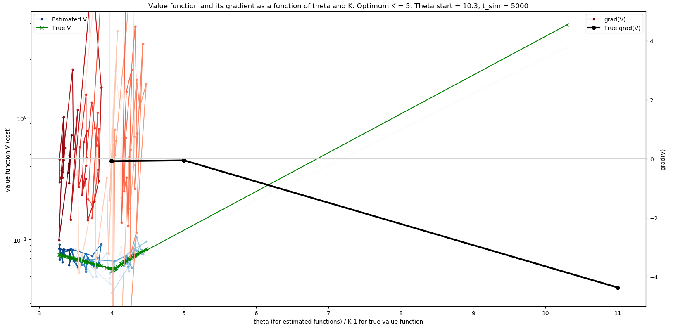
Method 2: Update at every time step (T = 5,000) (α = 1/T, no constraint on delta(θ))

Slide 8
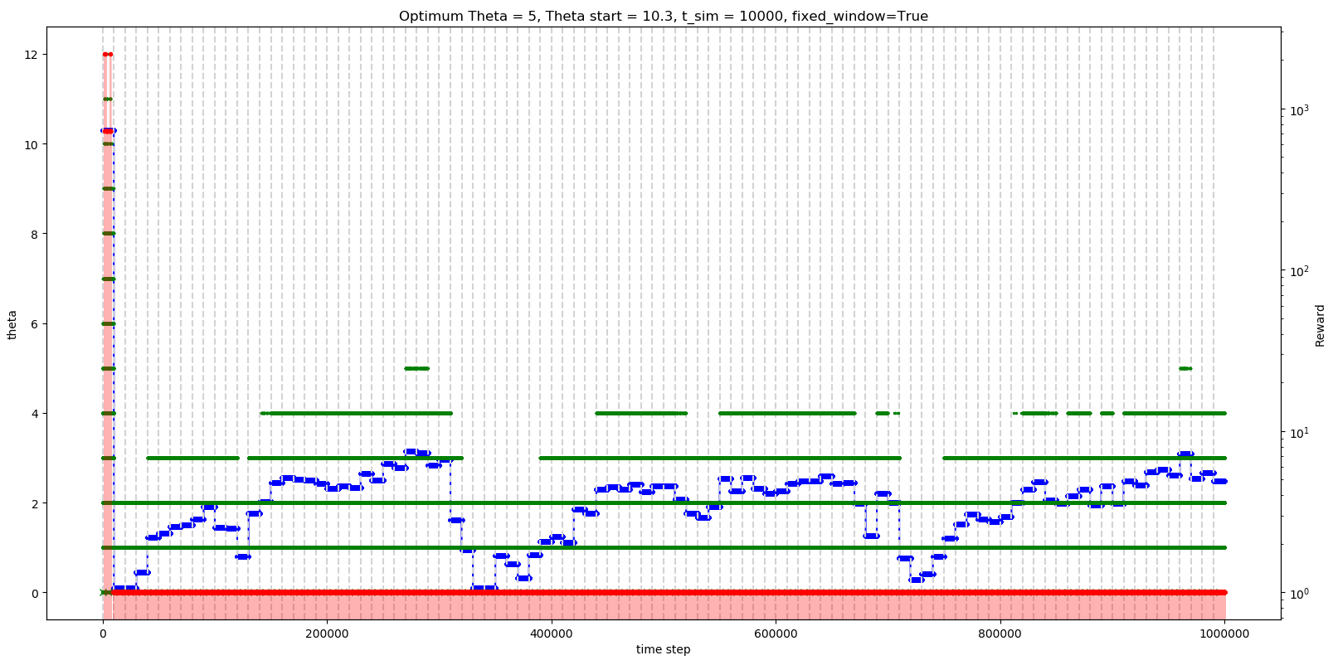
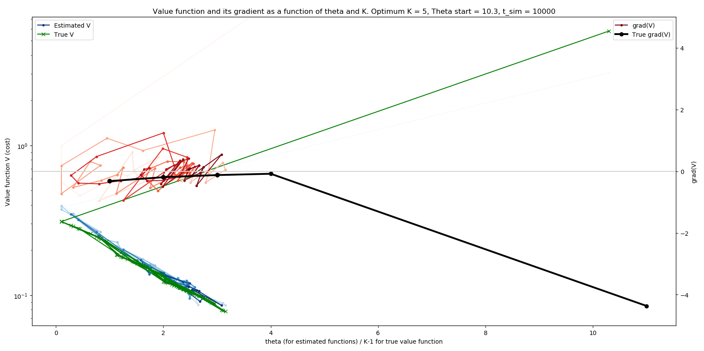
Method 3: Update once at end of episode (T = 10,000) (α = 1, no constraint on delta(θ))

Slide 9
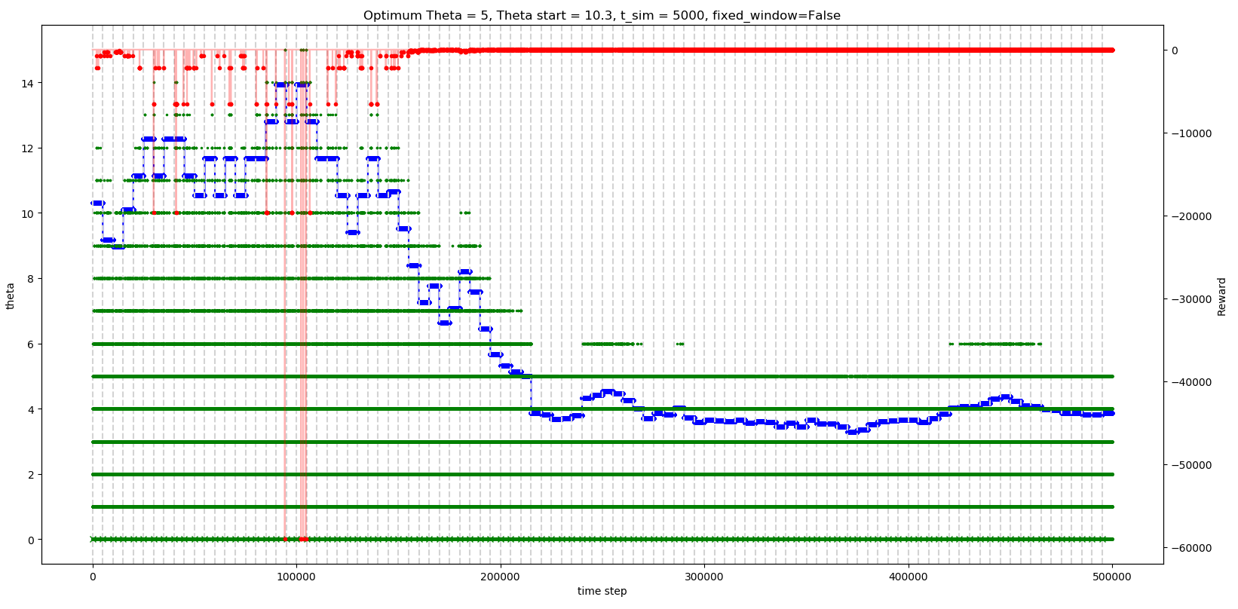
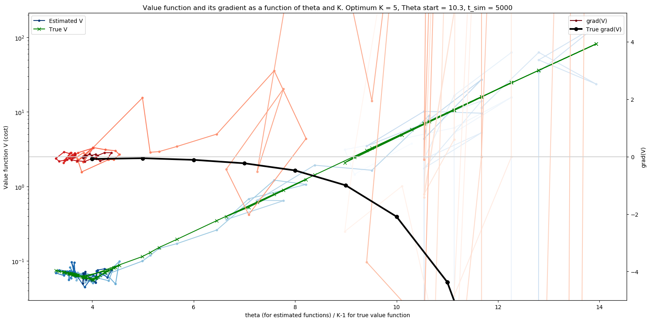
Method 1: Update once at end of episode (T = 5,000) (α = 1, |delta(θ)| <= 1.131)

Slide 10
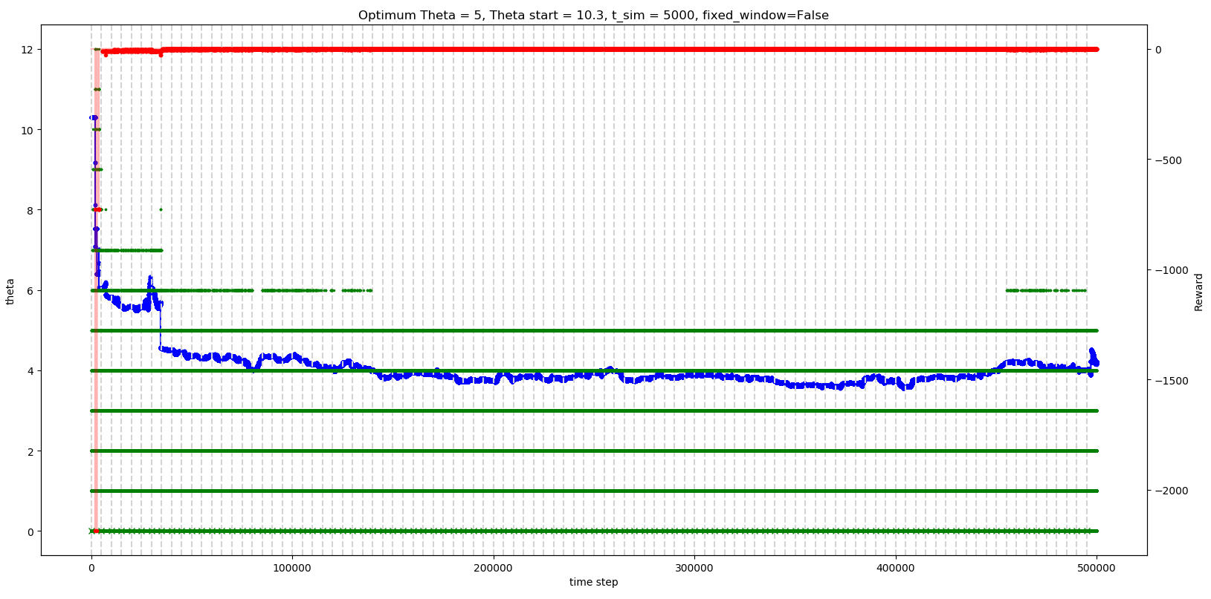
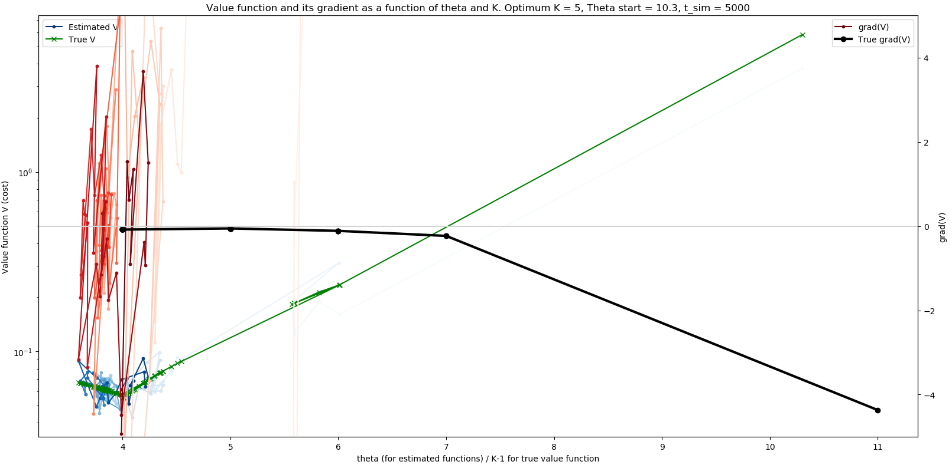
Method 2: Update at every time step (T = 5,000) (α = 1/T, |delta(θ)| <= 1.131)

Slide 11
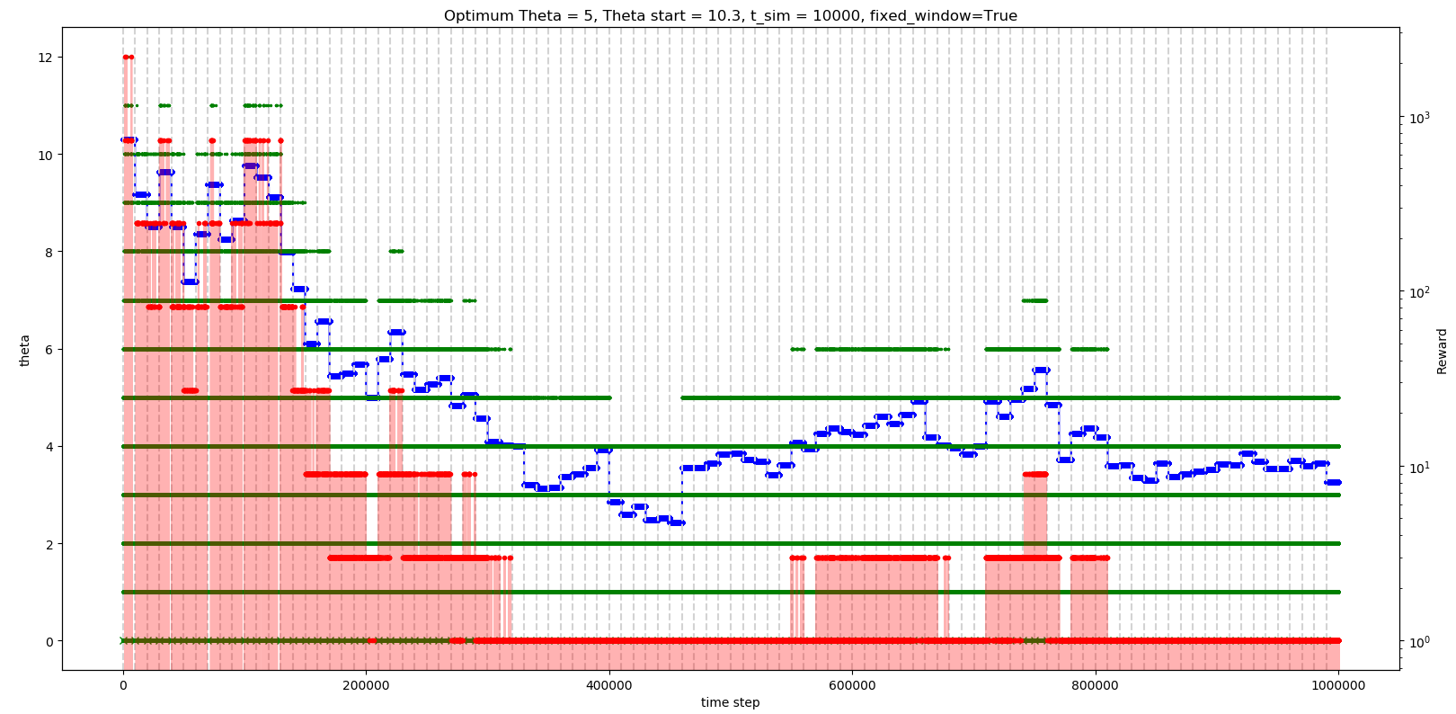
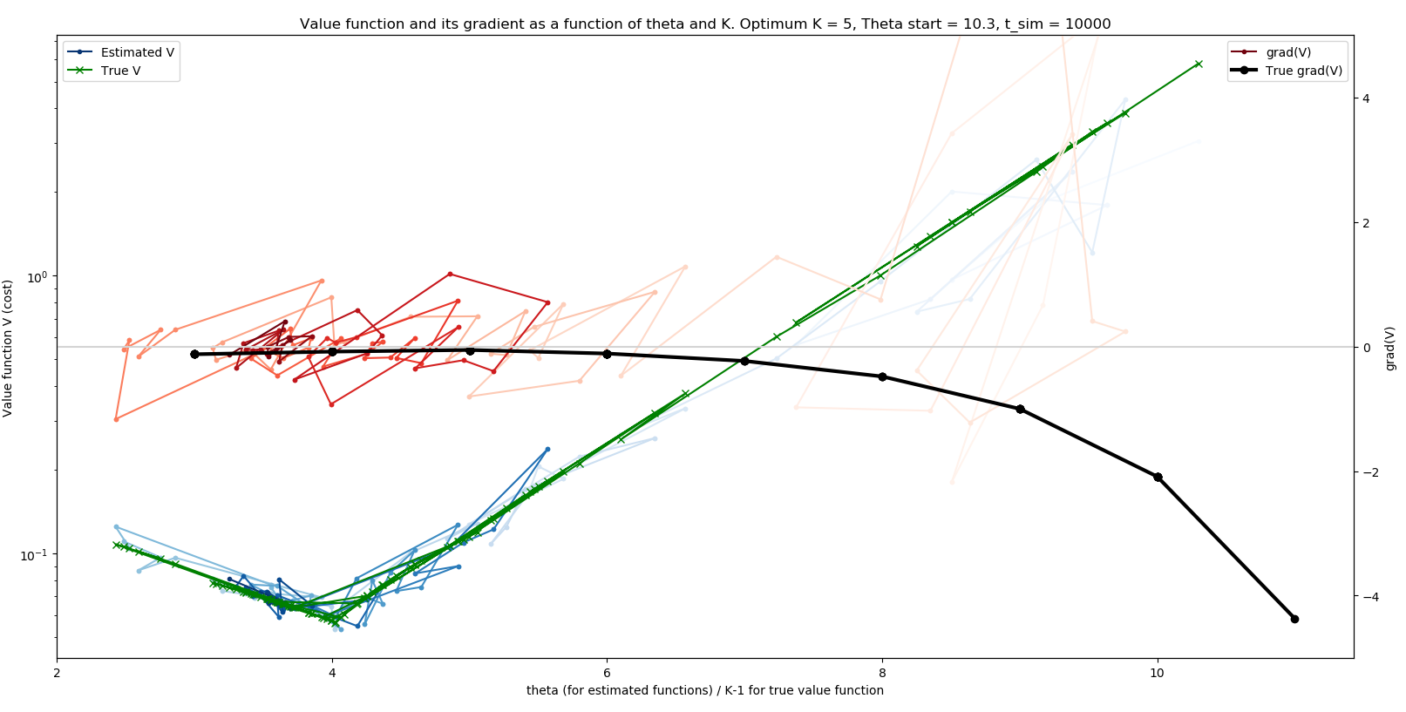
Method 3: Update once at end of episode (T = 10,000) (α = 1, |delta(θ)| <= 1.131)

Slide 12
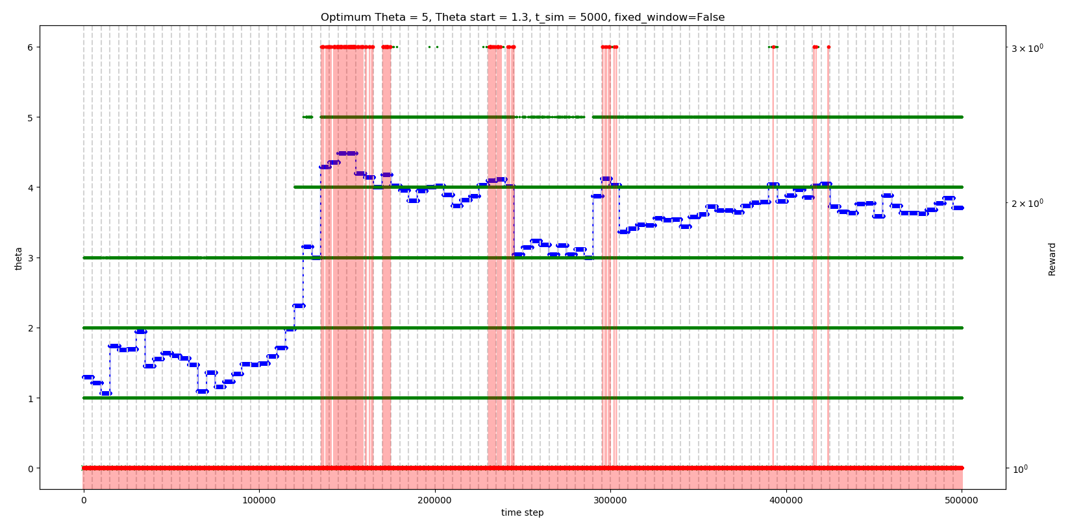
Method 1: T = 5,000, start at θ = 1.3 (small) (α = 1, no constraint on delta(θ))

Slide 13
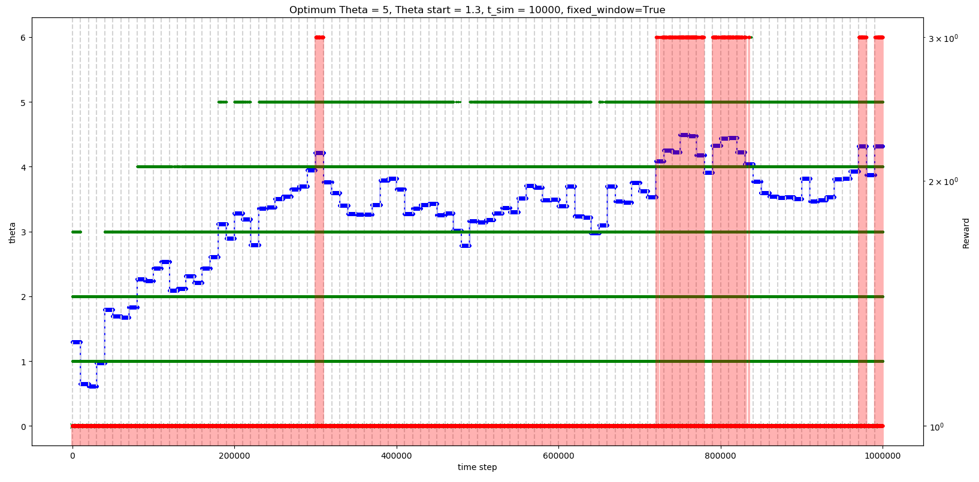
Method 3: T = 10,000, start at θ = 1.3 (small) (α = 1, no constraint on delta(θ))

Slide 14
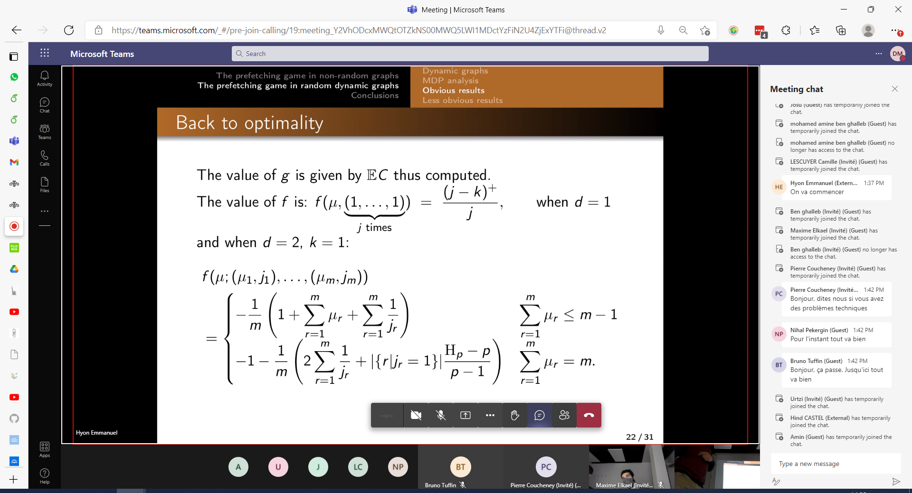
f(s) + g = … (average reward context) Ref: conference at Paris on 22-Nov-2021

Slide 15
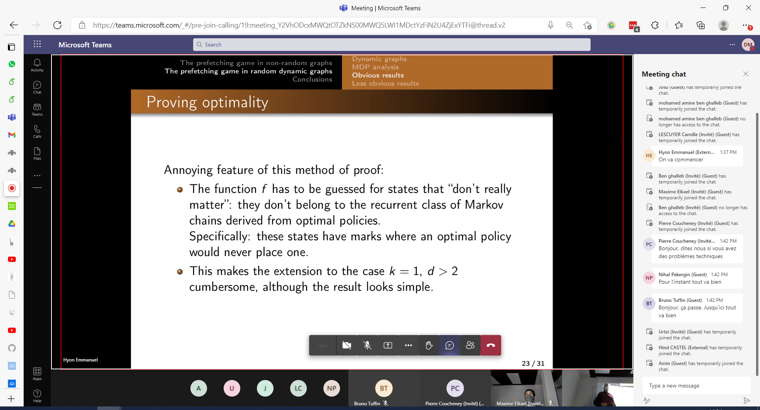
f(s) + g = … cont’d

Slide 16
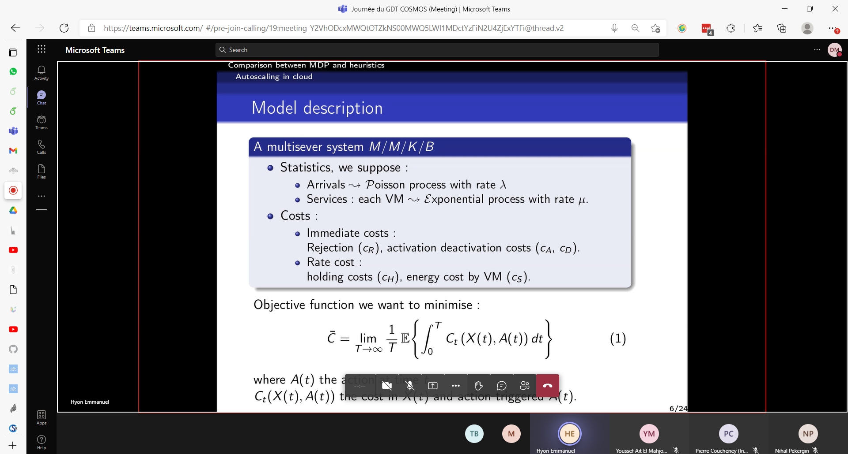

Slide 17
Thu, 25-Nov-2021 After fixing discrete-time indices
That is, each discrete-time index is defined by a new job arrival, but NOT by a job being served.

Slide 18
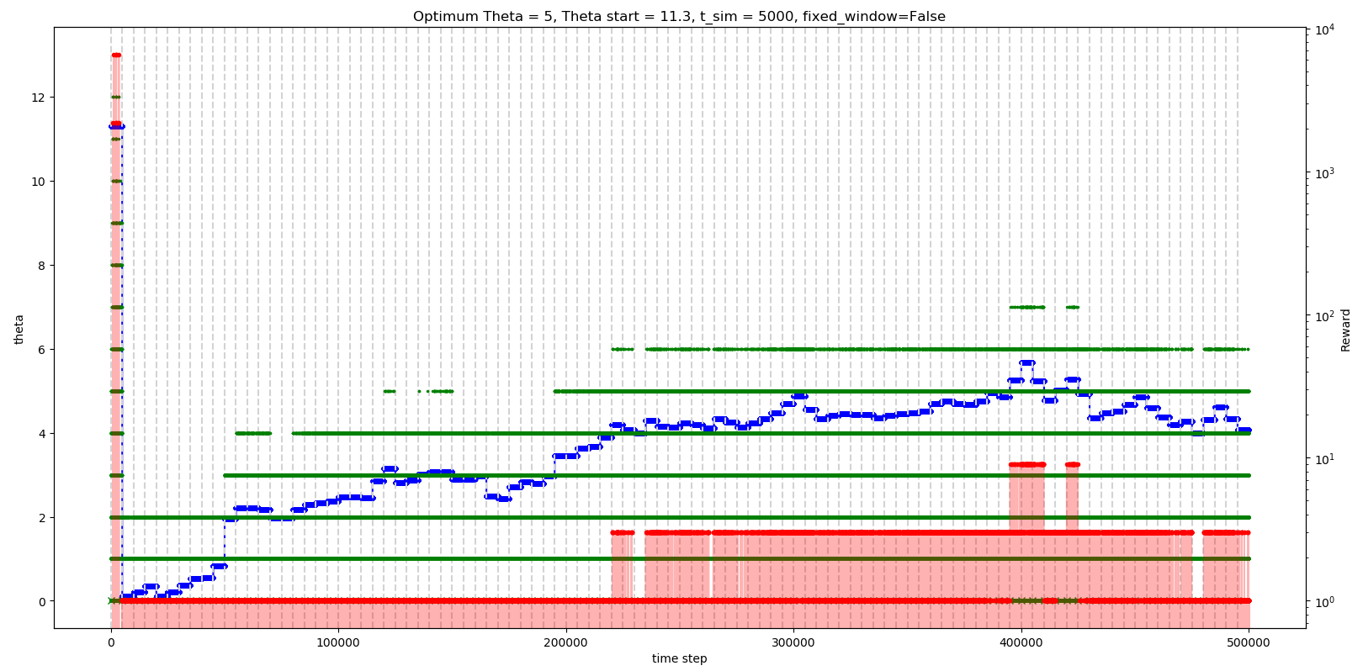
Method 1: Update once at end of episode (T = 5,000) (α = 1, no constraint on delta(θ))

Slide 19
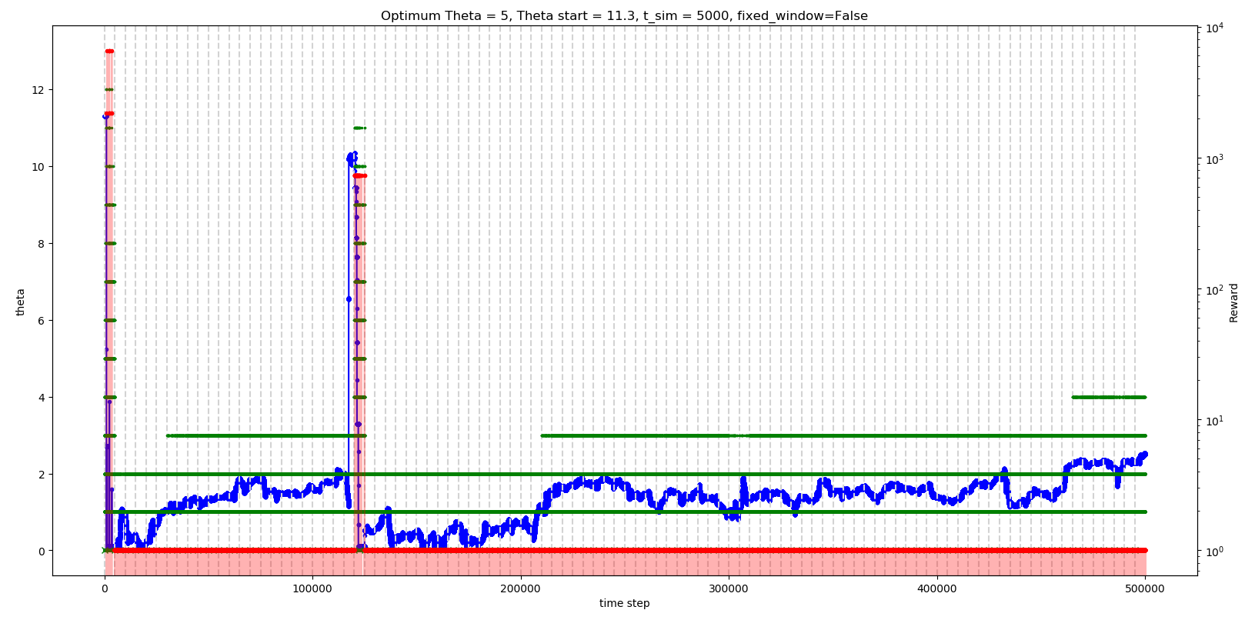
Method 2: Update at every time step (T = 5,000) (α = 1/T, no constraint on delta(θ))

Slide 20
Method 3: Update once at end of episode (T = 10,000) (α = 1, no constraint on delta(θ))

Slide 21
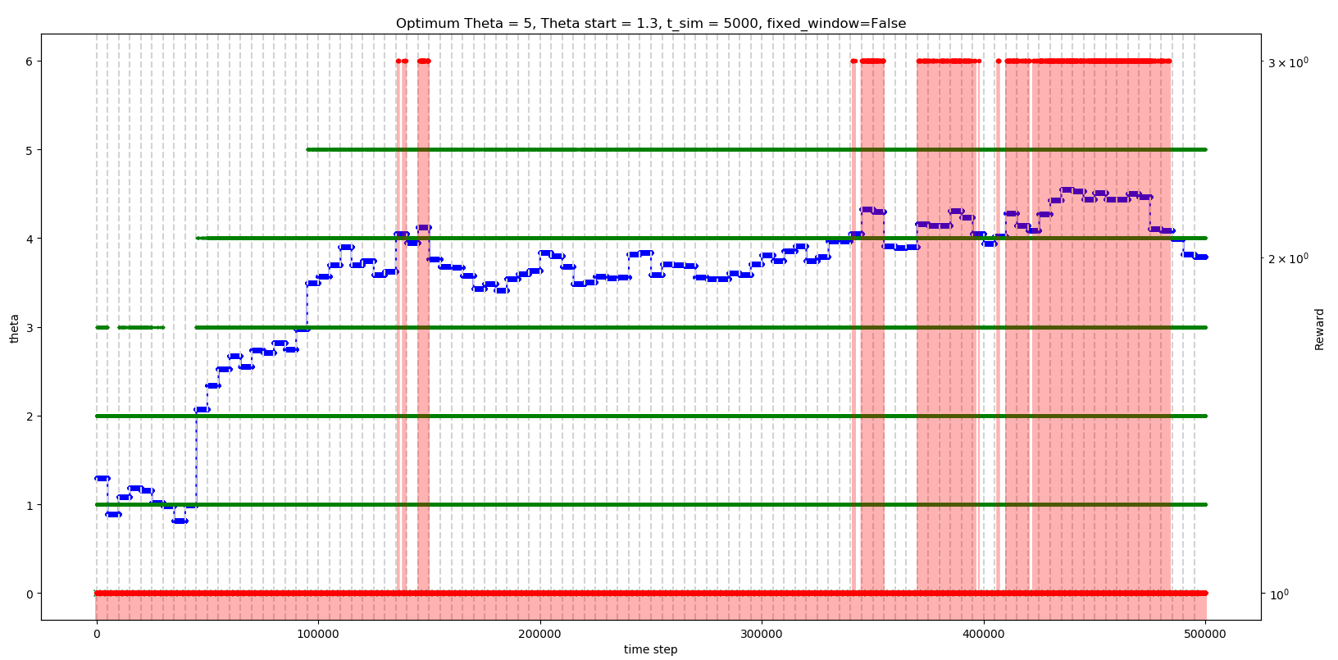
Method 1: T = 5,000, start at θ = 1.3 (small) (α = 1, no constraint on delta(θ))

Slide 22
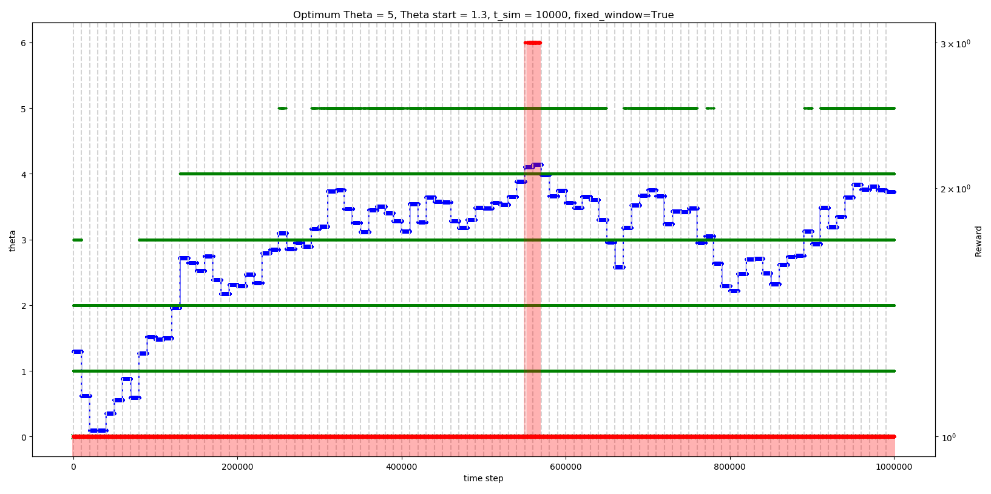
Method 3: T = 10,000, start at θ = 1.3 (small) (α = 1, no constraint on delta(θ))

