Slide 1
Results of implementation of TD(λ) and MC(λ) algorithms for 1D gridworld
Fri, 17-Apr-2020
Ref: SimulateTDLambda.ipynb

Slide 2
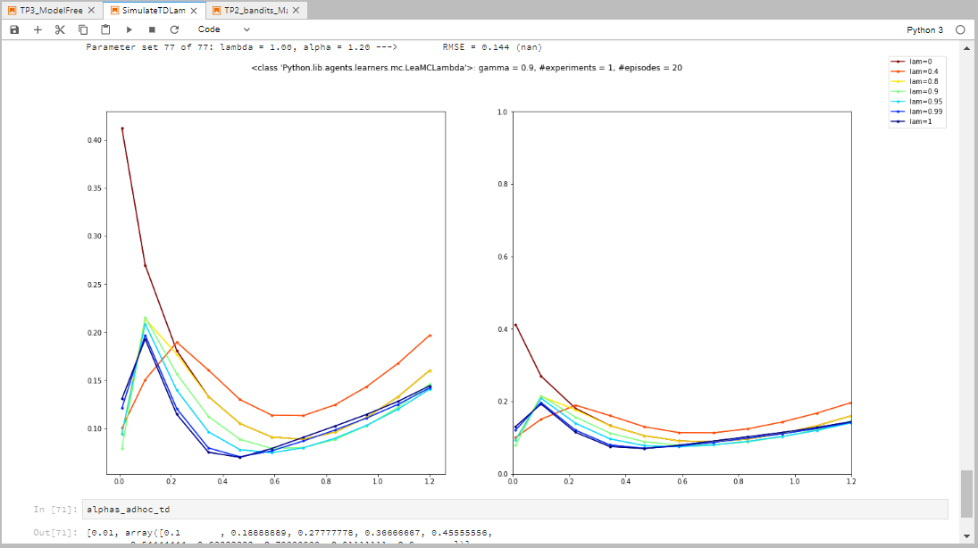
Before fixing reset in td.py and mc.py

Slide 3
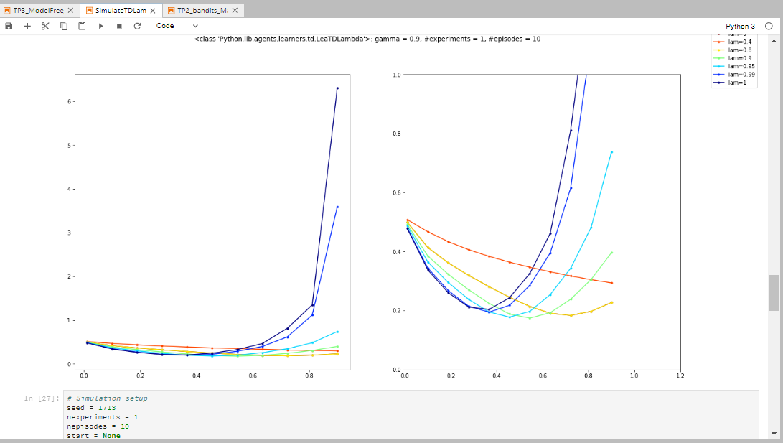
TD(λ), γ=0.9, seed = 1717, #exp = 1

Slide 4
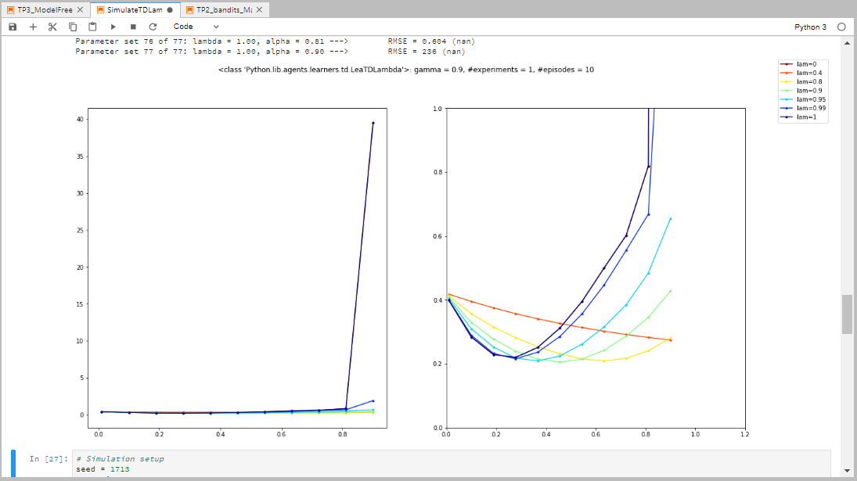
TD(λ), γ=0.9, seed = 1713, #exp = 1

Slide 5
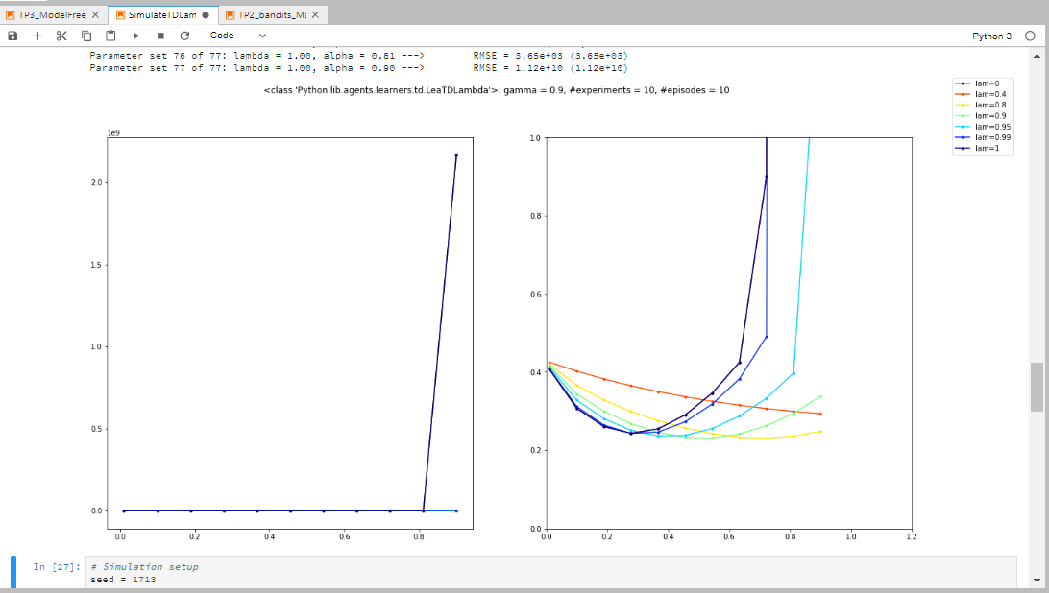
TD(λ), γ=0.9, seed = 1713, #exp = 10

Slide 6
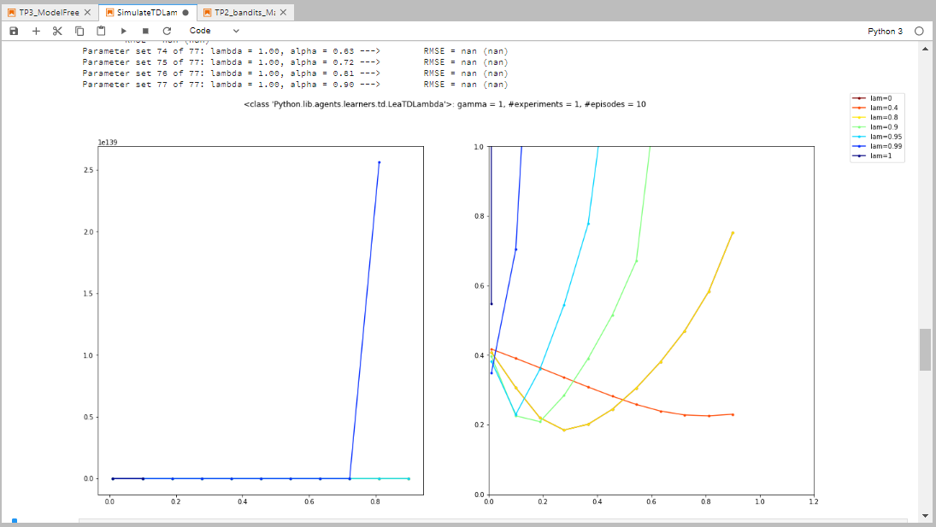
TD(λ), γ=1, seed = 1713, #exp = 1

Slide 7
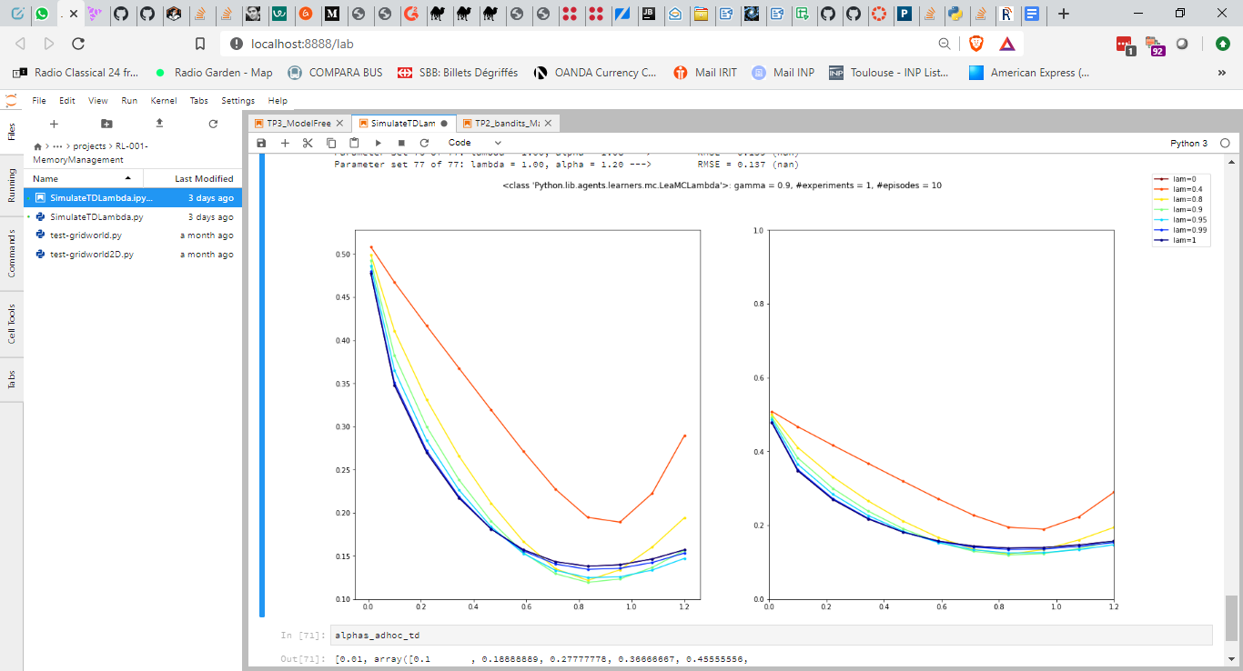
MC(λ), γ=0.9, seed = 1717, #exp = 1

Slide 8
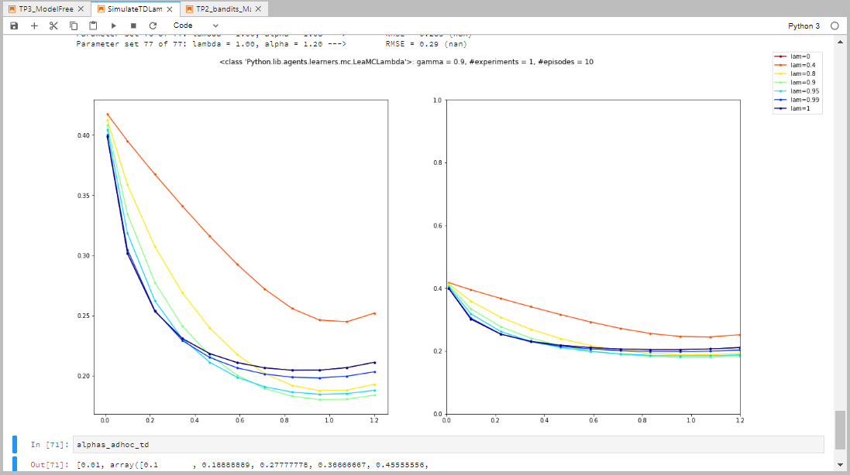
MC(λ), γ=0.9, seed = 1713, #exp = 1

Slide 9
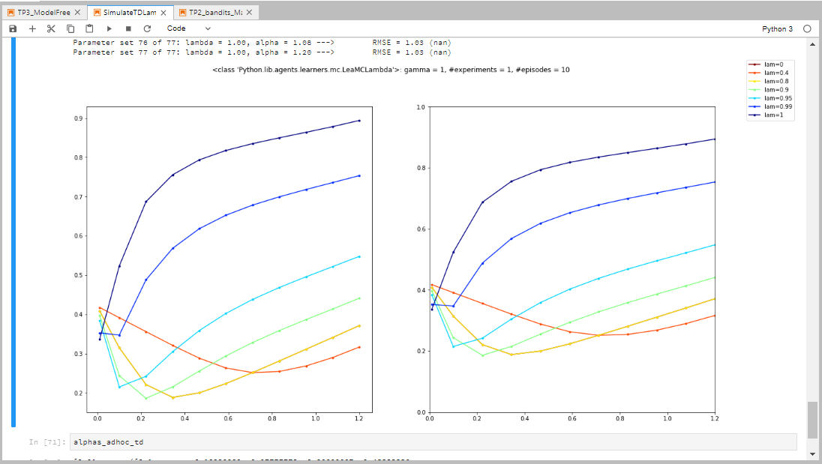
MC(λ), γ=1, seed = 1713, #exp = 1

Slide 10
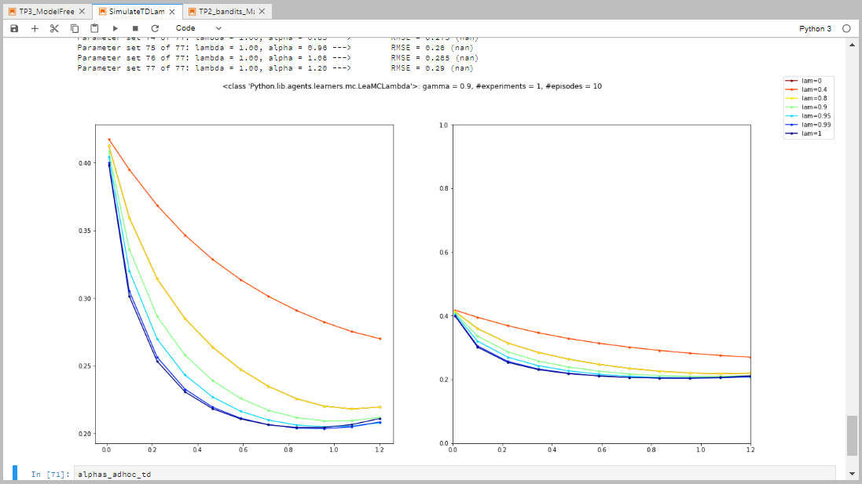
λ-return, γ=0.9, seed = 1713, #exp = 1

Slide 11
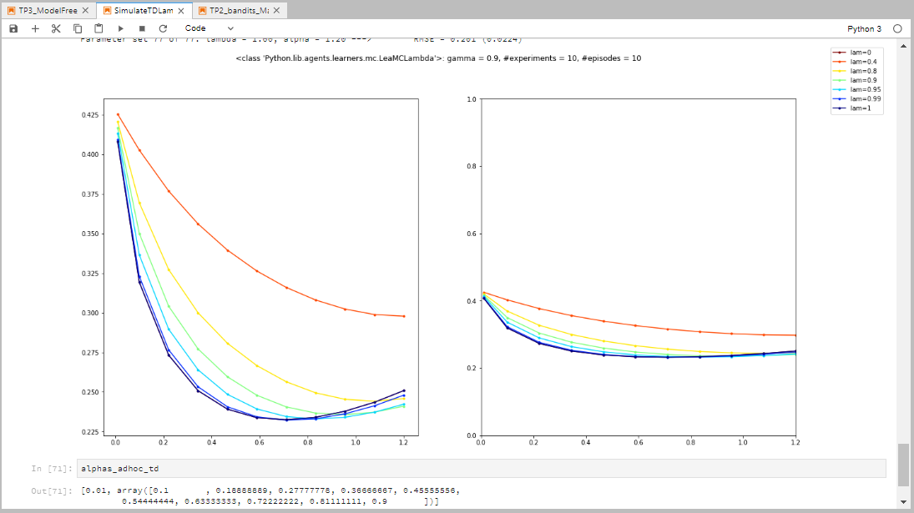
λ-return, γ=0.9, seed = 1713, #exp = 10

Slide 12
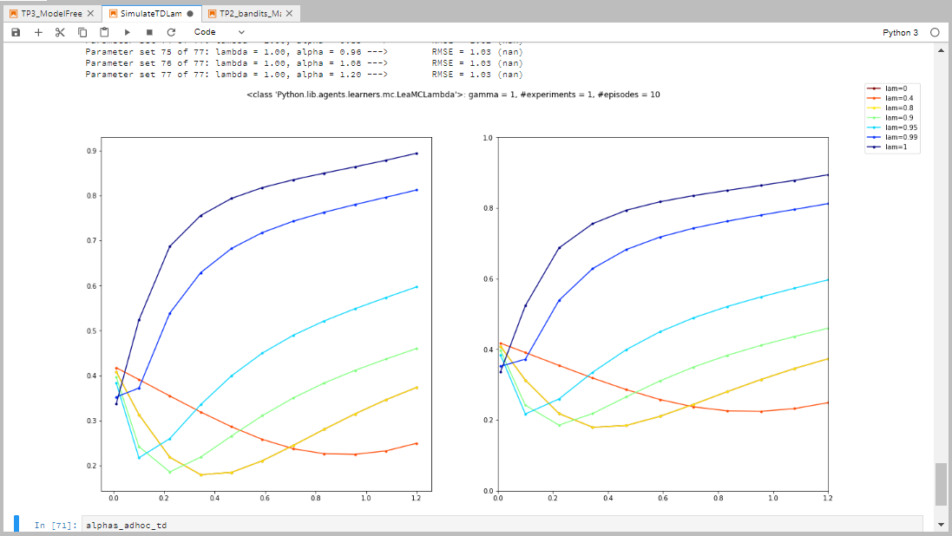
λ-return, γ=1, seed = 1713, #exp = 1

