Slide 1
State value function estimation using TD(λ) and Monte Carlo algorithms on a 1D gridworld with the random walk policy
Thu, 30-Apr-2020
Updated: Mon, 04-May-2020
Daniel Mastropietro
Ref: RL-001-MemoryManagement/SimulateTDLambda.ipynb

Slide 2
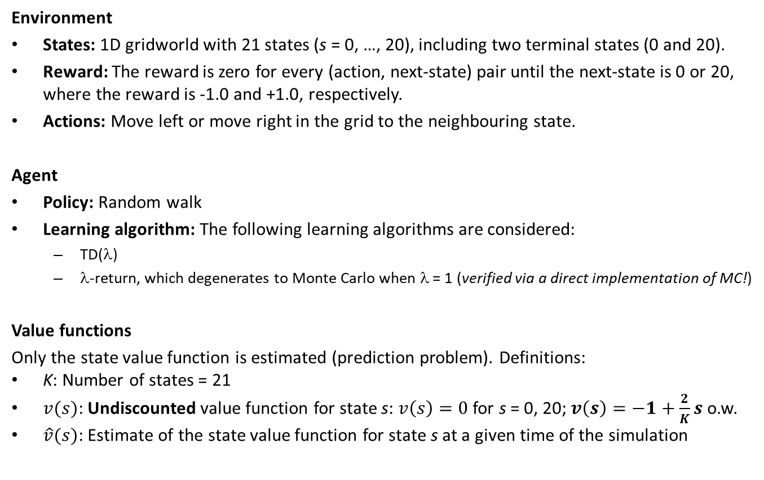
Problem setup and notation
Environment
States: 1D gridworld with 21 states (s = 0, …, 20), including two terminal states (0 and 20).
Reward: The reward is zero for every (action, next-state) pair until the next-state is 0 or 20, where the reward is -1.0 and +1.0, respectively.
Actions: Move left or move right in the grid to the neighbouring state.
Agent
Policy: Random walk
Learning algorithm: The following learning algorithms are considered:
TD(λ)
λ-return, which degenerates to Monte Carlo when λ = 1 (verified via a direct implementation of MC!)
Value functions
Only the state value function is estimated (prediction problem). Definitions:
K: Number of states = 21
$v(s)$: Undiscounted value function for state s: $v\left(s\right)=0$ for s = 0, 20; $v\left(s\right)=−1+\frac{2}{K}s$ o.w.
$\hat{v}(s)$: Estimate of the state value function for state s at a given time of the simulation

Slide 3
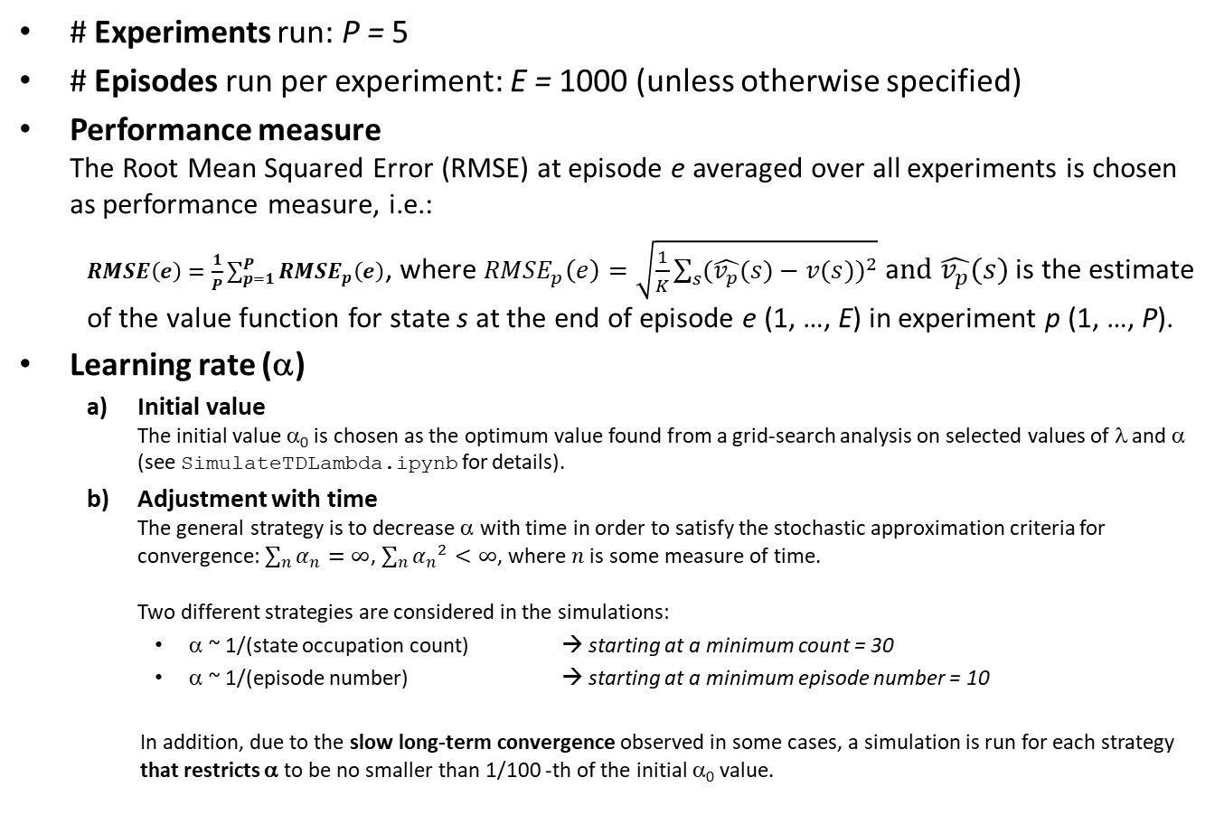
Simulation setup for all cases
# Experiments run: P = 5
# Episodes run per experiment: E = 1000 (unless otherwise specified)
Performance measure The Root Mean Squared Error (RMSE) at episode e averaged over all experiments is chosen as performance measure, i.e.:
$RMSE\left(e\right)=\frac{1}{P}\sum_{p=1}^{P}{{RMSE}_{p}\left(e\right)}$, where ${RMSE}_{p}\left(e\right)=\sqrt{\frac{1}{K}\sum_{s}{{(\hat{v_{p}}(s)−v(s))}^{2}}}$ a$nd \hat{v_{p}}(s)$ is the estimate of the value function for state s at the end of episode e (1, …, E) in experiment p (1, …, P).
Learning rate (α)
Initial value The initial value α₀ is chosen as the optimum value found from a grid-search analysis on selected values of λ and α (see SimulateTDLambda.ipynb for details).
Adjustment with time The general strategy is to decrease α with time in order to satisfy the stochastic approximation criteria for convergence: $\sum_{n}{α_{n}}=∞$, $\sum_{n}{{α_{n}}_{}^{2}}<∞$, where $n$ is some measure of time. Two different strategies are considered in the simulations:
α ~ 1/(state occupation count) → starting at a minimum count = 30
α ~ 1/(episode number) → starting at a minimum episode number = 10
In addition, due to the slow long-term convergence observed in some cases, a simulation is run for each strategy that restricts α to be no smaller than 1/100 -th of the initial α₀ value.

Slide 4
Main conclusions (1): convergence
TD(0) and MC converge to the true state value function Both TD(0) and MC seem to converge to the true state value function in a “reasonable” amount of time as long as the learning rate α does not decrease too aggressively and/or too close to 0. See for instance the graphs of the RMSE evolution by episode and the final state value estimation obtained for TD(0) and MC.
TD(0) yields more accurate and reliable estimations than MC A higher accuracy is achieved in TD(0) in the sense that the RMSE tends to be smaller than in MC given the same number of episodes run in each case. A higher reliability is achieved in TD(0) in the sense that the variability of the estimations along the episodes is smaller than in MC for similar learning rate setups. These characteristics are observed in the following simulations for TD(0) and MC.

Slide 5
Main conclusions (2): convergence rate
Controlled decrease of α enables faster convergence Following a controlled strategy to decrease α (using a positive lower bound) enables faster convergence to the true value function. This is observed both in the adjustment by state occupation (1 vs. 2, 5 vs. 6) count as well as in the adjustment by episode number (3 vs. 4, 7 vs. 8). Under this controlled setting, convergence is significantly less noisy for TD(0) than for MC.
Adjusting α by state occupation count generates large estimation variability Variability in the value function estimation after a fixed number of episodes is larger in the adjustment by state occupation count than in the adjustment by episode number. Ref: Discrepancy in the RMSE values in the 5000-long experiments w.r.t. the 1000-long experiments. More details in the appendix.
TD(0) performs better than MC in terms of convergence speed and final RMSE TD(0) approaches the true value function faster and with less variance than MC. In addition, the best setups found for a decrease strategy for α are:
TD(0): decrease α by episode but no less than a 100th of the initial α₀.
MC: decrease α by episode and freely (otherwise convergence is too noisy).

Slide 6
Main conclusions (3): convergence rate
Analysis of the two decrease strategies for α The decrease strategy that is proportional to the state occupation count is too aggressive, making convergence too slow in the long-term. The following convergence rates are observed for each simulation setup: (T is the episode number)
TD(0), α₀ = 0.8 | Free decrease (α > 0) | Controlled decrease (α ≥ 0.008)
State count decrease | short term: T^{-1/4} long term: T^{-1/100} Link to results | T^{-1/2} Link to results
Episode number decrease | T^{-1/4} Link to results | T^{-1/2} Link to results
MC, α₀ = 0.1 | Free decrease (α > 0) | Controlled decrease (α ≥ 0.001)
State count decrease | T^{-1/10} Link to results | short term: T^{-1/3} long term: T^{-1/5} Link to results
Episode number decrease | T^{-1/4} Link to results | T^{-1/4} Link to results

Slide 7
Structure of results
TD(0) results are shown in reddish color.
MC results are shown in blueish color.
The results are displayed in 8 pages and each page contains the results for each of the 8 parameter combinations laid out in the two tables of the previous page.
Each page contains 4 plots laid out as follows:
The top row shows plots of the RMSE (left axis) and average α by episode (right axis). The plot on the left is in the original scale, and the plot on the right is in log-scale, so that the convergence rate can be more easily analyzed.
The bottom row normally shows results for one experiment: the RMSE by episode (left) and the estimated value function at the end of the experiment (right). Exceptions are the 4 pages displaying the results for the free decrease of α case: in this case the graph on the left shows the RMSE by episode for the first 5000 episodes, with the intention of further exploring the long-term convergence.
For controlled decrease of α, a horizontal gray line is shown to mark its value.
TIP FOR VISUALLY COMPARING RESULTS: The scale is the same across all graphs on the left hand side. This is also true for the right axis on the top-right graph showing the average α by episode.

Slide 8
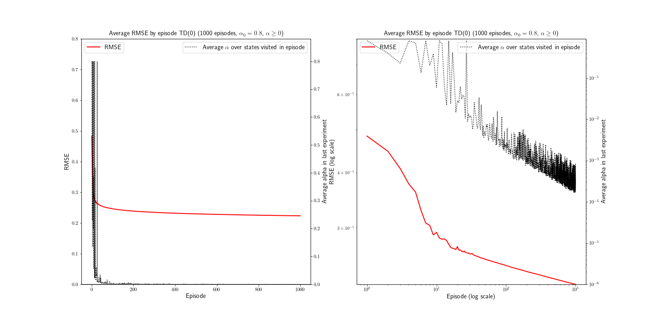
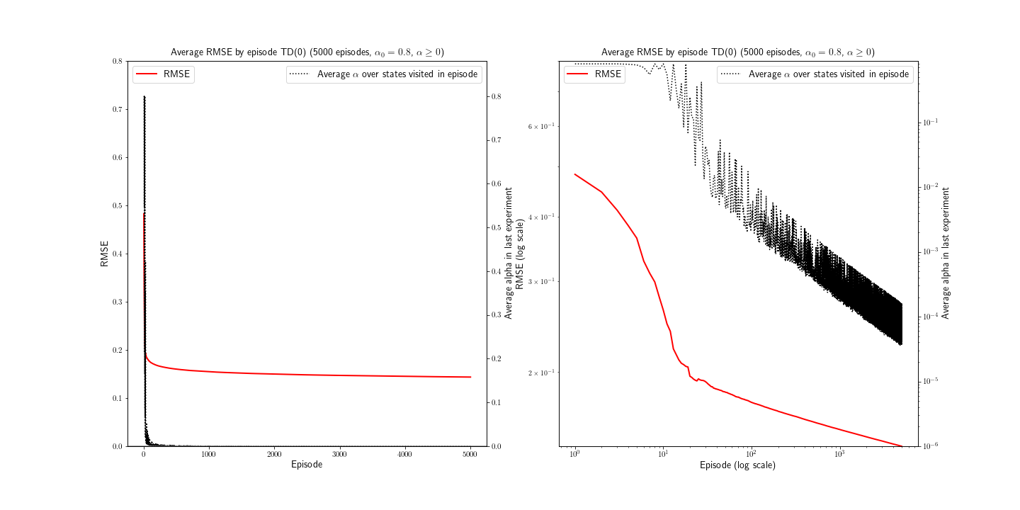
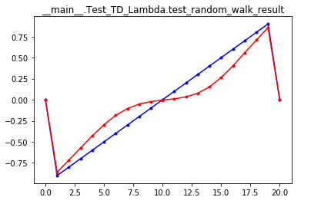
TD(0) learning rate adjusted by state occupation count
Back to conclusions (1) Back to conclusions (2) After 1000 episodes…
Back to conclusions (3)
After 5000 episodes… Value Function estimation we see a different story^{(*)}! at the end of one experiment
α₀ = 0.8
α_{min} = 0
OBSERVATIONS:
The final RMSE after 1000 episodes is too large to be acceptable.
The convergence rate is ~ T^{-1/4} in the short term and ~ T^{-1/100} in the long term (very small!).
The estimated state value function is unacceptable.
(*) See appendix

Slide 9
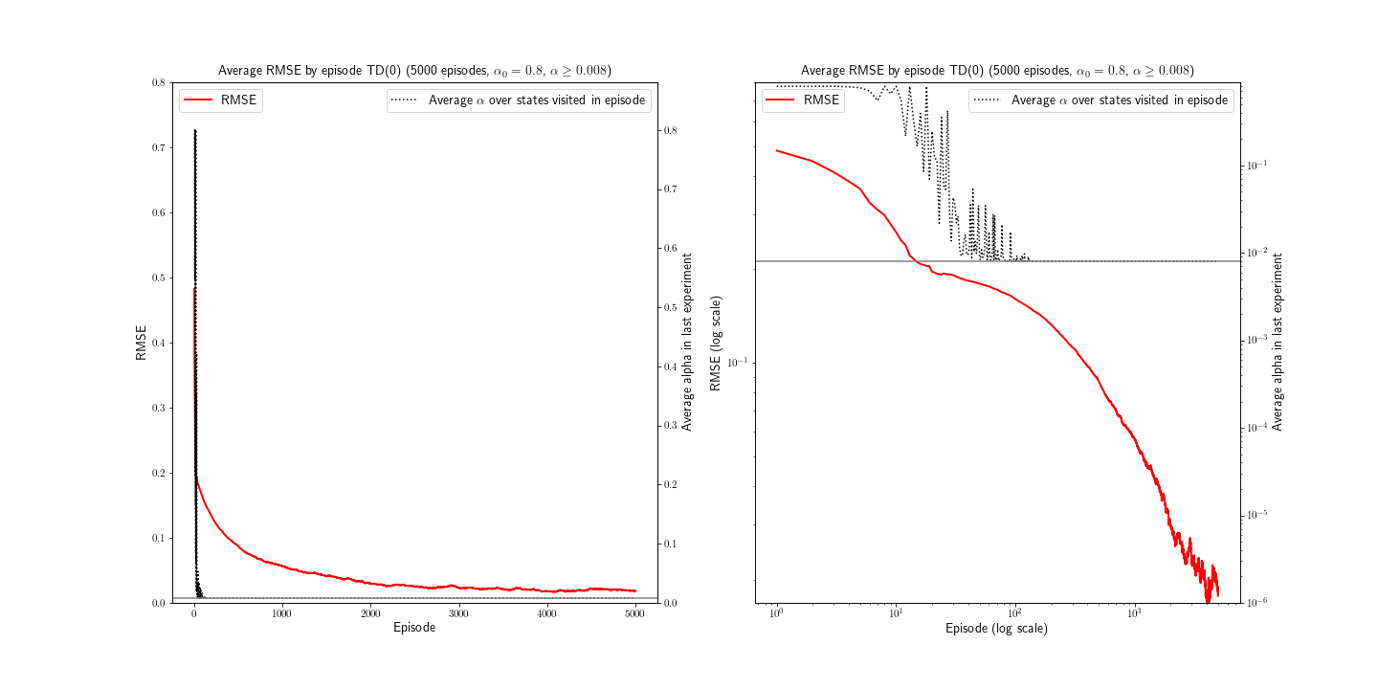
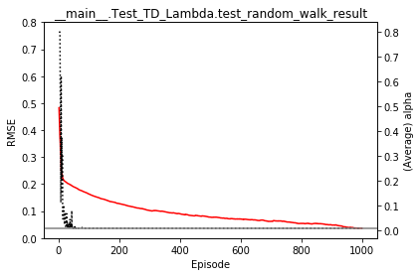
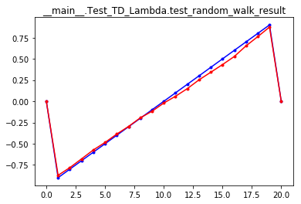
TD(0) learning rate adjusted by state occupation count
Back to conclusions (1) Back to conclusions (2) After 1000 episodes…
Back to conclusions (3)
RMSE in one experiment Value Function estimation decreases smoothly. at the end of one experiment
α₀ = 0.8
α_{min} = 0.008
OBSERVATIONS:
The final RMSE after 1000 episodes is 10 times smaller than the case where α is allowed to decrease freely.
The convergence rate is ~ T^{-1/2}.
The estimated state value function is acceptable.

Slide 10
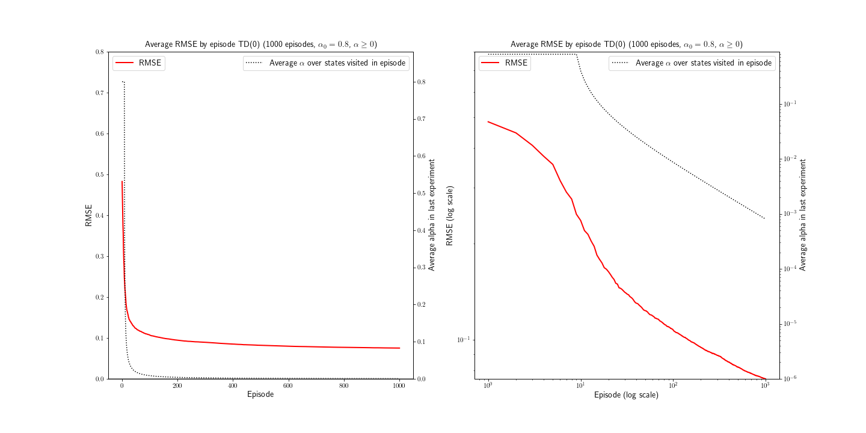
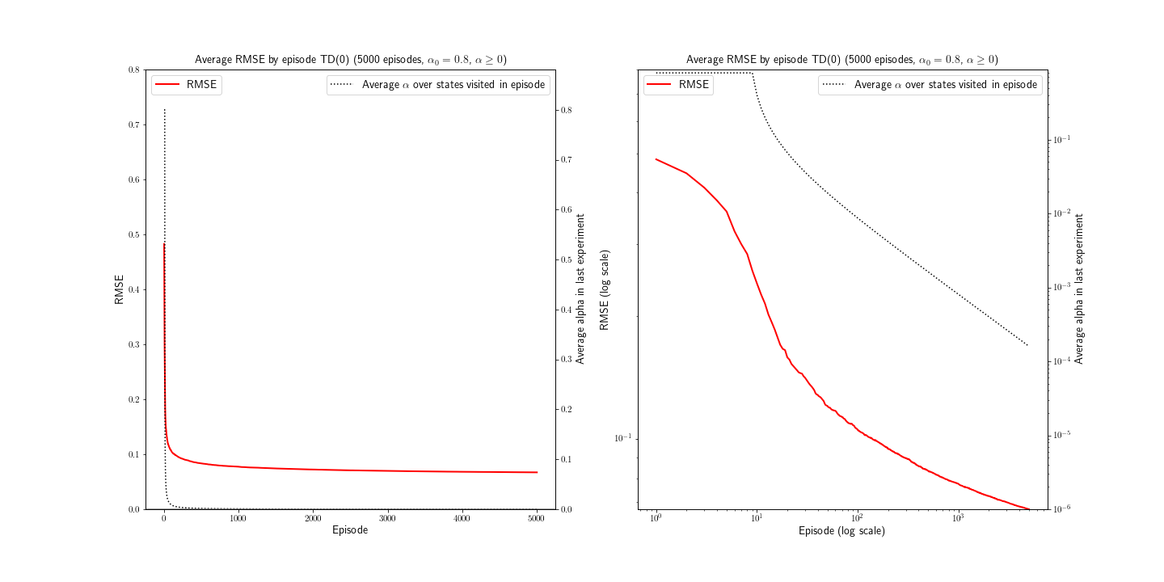
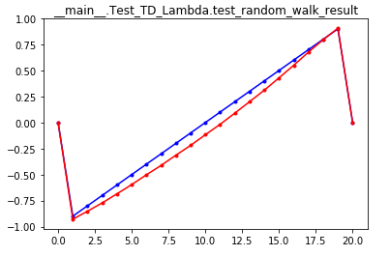
TD(0) learning rate adjusted by episode number
Back to conclusions (1) Back to conclusions (2) After 1000 episodes…
Back to conclusions (3)
After 5000 episodes… Value Function estimation the RMSE doesn’t change much. at the end of one experiment
α₀ = 0.8
α_{min} = 0
OBSERVATIONS:
The final RMSE after 1000 episodes is 2-3 times smaller than the case where α is adjusted by the state occupation count.
The convergence rate is ~ T^{-1/4}.
The estimated state value function is quite acceptable (although it could be better)

Slide 11
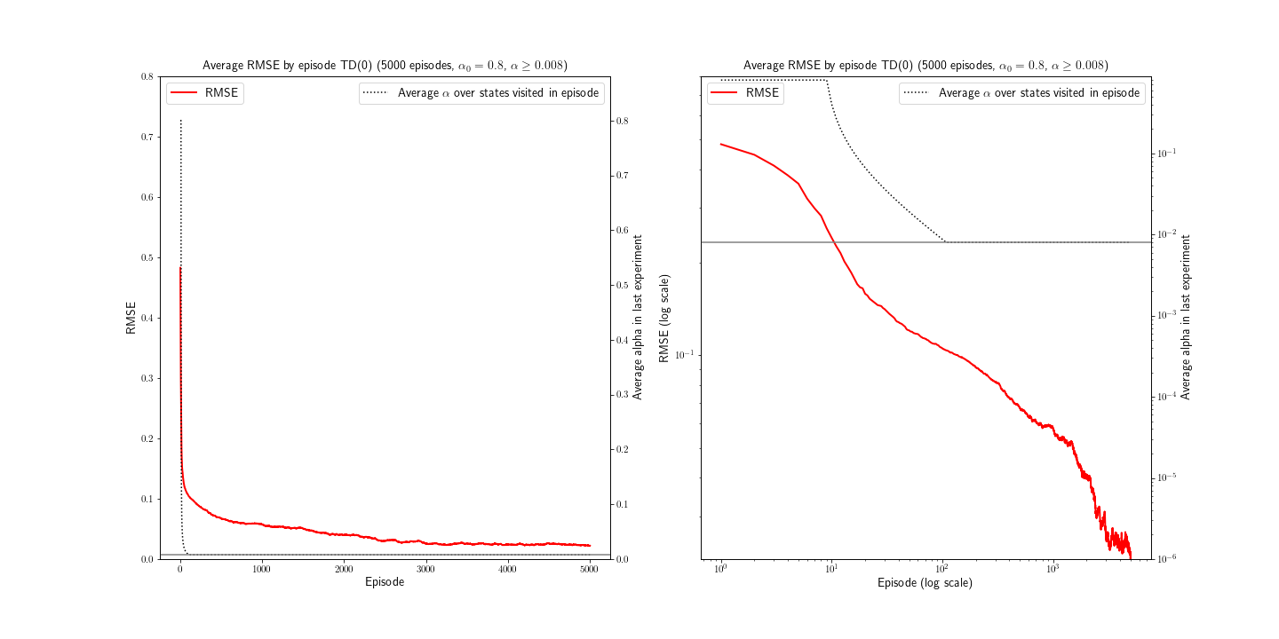
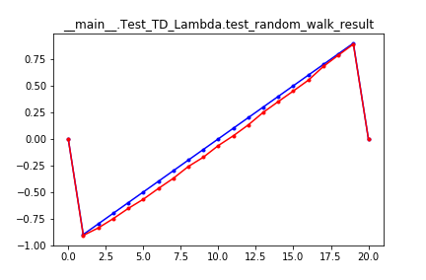
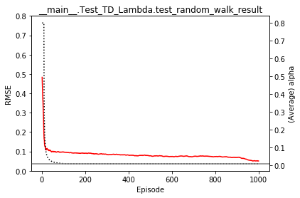
TD(0) learning rate adjusted by episode number
Back to conclusions (1) Back to conclusions (2) After 1000 episodes…
Back to conclusions (3)
RMSE in one experiment Value Function estimation decreases smoothly. at the end of one experiment
α₀ = 0.8
α_{min} = 0.008
OBSERVATIONS:
The final RMSE after 1000 episodes is very similar to the case where α is adjusted by the state occupation count.
The convergence rate is slightly faster in the short term than the case where α is adjusted by the state occupation count. Overall it is ~ T^{-1/2}.
The estimated state value function is acceptable.

Slide 12
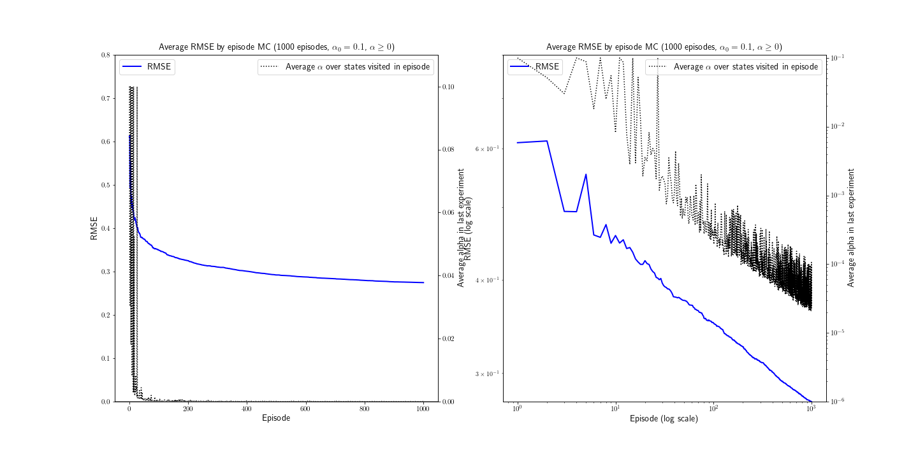
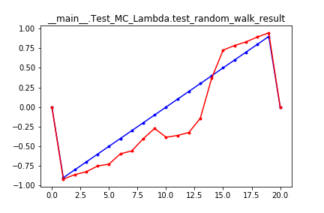
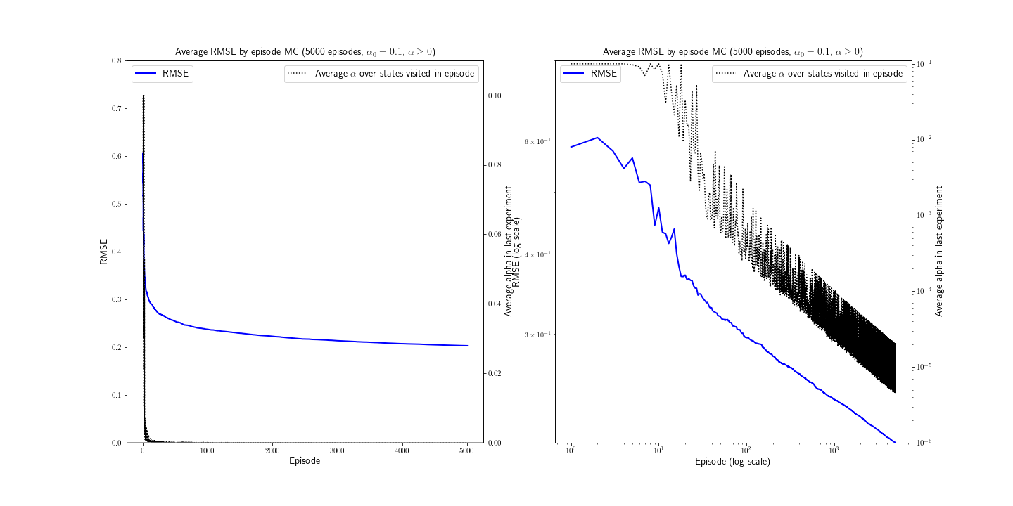
Every-visit MC learning rate adjusted by state occupation count
Back to conclusions (1) Back to conclusions (2) After 1000 episodes…
Back to conclusions (3)
After 5000 episodes… Value Function estimation we see a different story^{(*)}!… at the end of one experiment
α₀ = 0.1
α_{min} = 0
OBSERVATIONS:
The final RMSE after 1000 episodes is larger than the TD(0) case by 0.5 (~ 20% larger).
The convergence rate is ~ T^{-1/10}.
The estimated state value function is unacceptable.
(*) See appendix

Slide 13
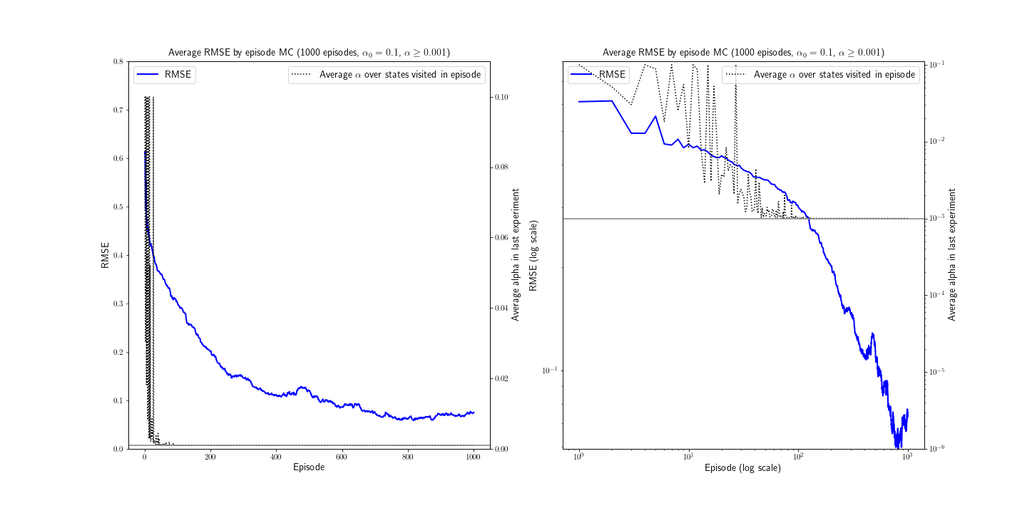
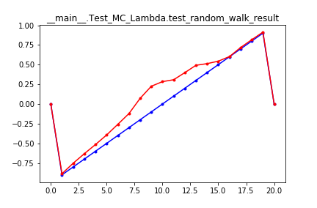
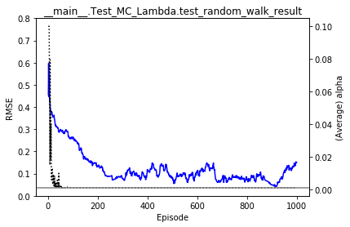
Every-visit MC learning rate adjusted by state occupation count
Back to conclusions (1) Back to conclusions (2) After 1000 episodes…
Back to conclusions (3)
RMSE in one experiment Value Function estimation is quite noisy. at the end of one experiment
α₀ = 0.1
α_{min} = 0.001
OBSERVATIONS:
The final RMSE after 1000 episodes is 3 times smaller than the case where α is allowed to decrease freely, but convergence is “noisy”.
The convergence rate is ~ T^{-1/3} in the short term and ~ T^{-1/5} in the long term.
The estimated state value function is unacceptable.

Slide 14
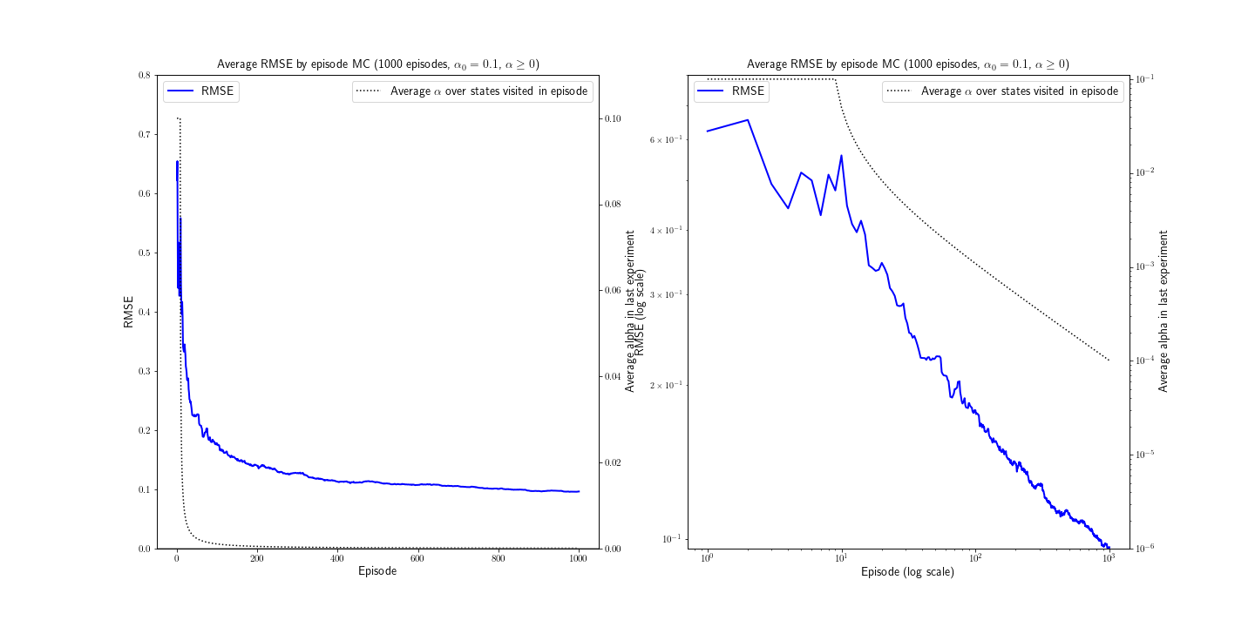
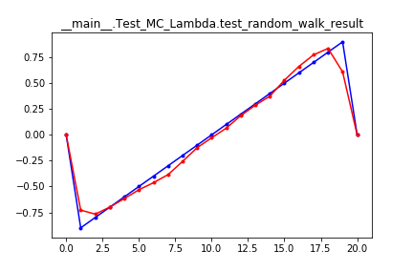
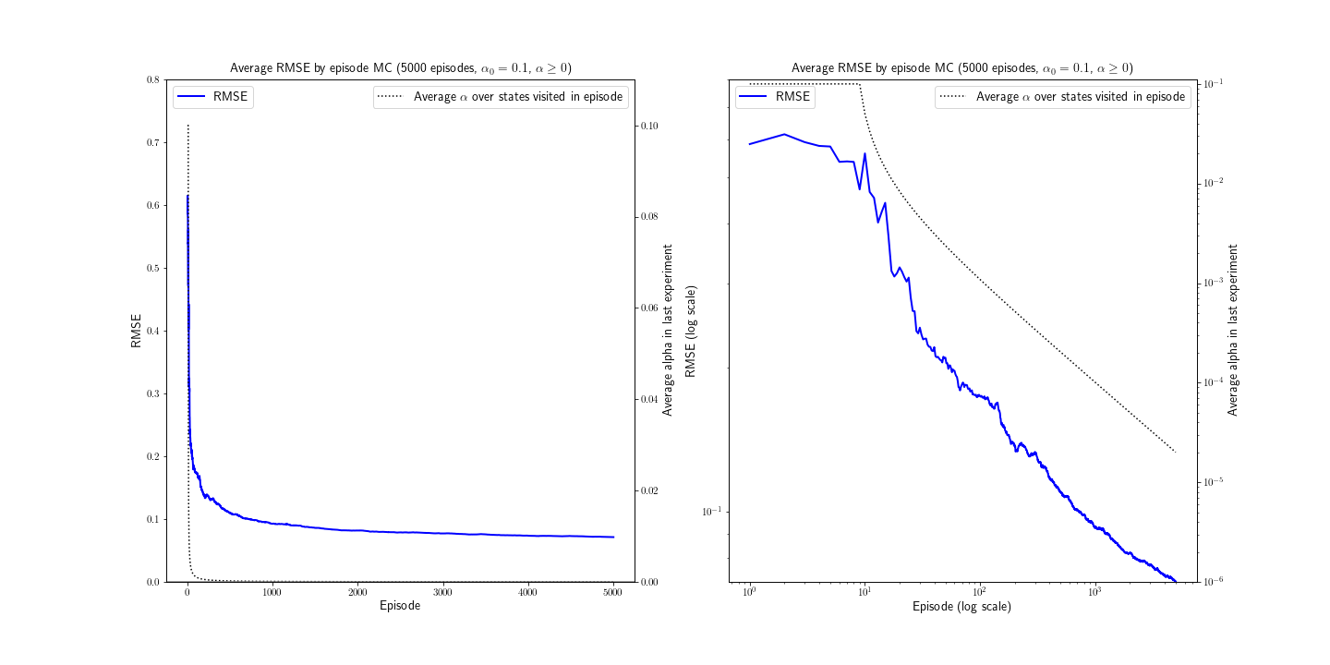
Every-visit MC learning rate adjusted by episode number
Back to conclusions (1) Back to conclusions (2) After 1000 episodes…
Back to conclusions (3)
After 5000 episodes… Value Function estimation the RMSE doesn’t change much. at the end of one experiment
α₀ = 0.1
α_{min} = 0
OBSERVATIONS:
The final RMSE after 1000 episodes is 3 times smaller than the case where α is adjusted by the state occupation count.
The convergence rate is ~ T^{-1/4}, very similar to the TD(0) case, especially in the long term.
The estimated state value function is mostly acceptable.

Slide 15
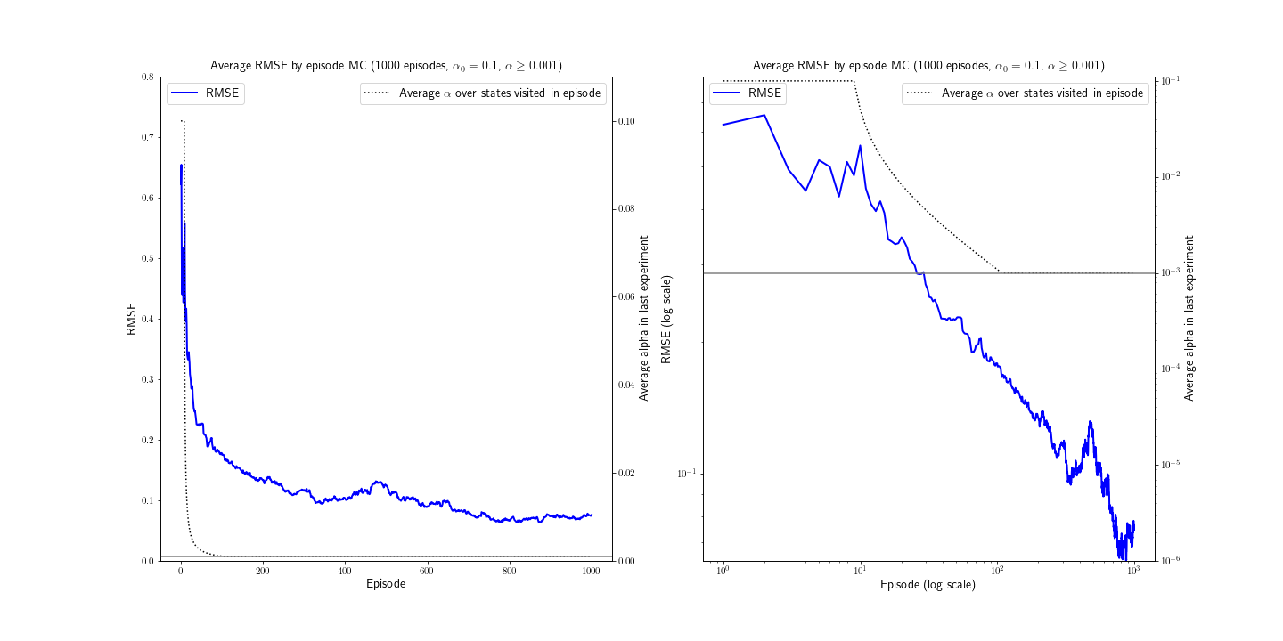
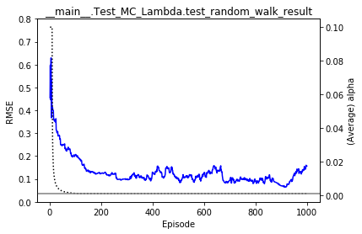
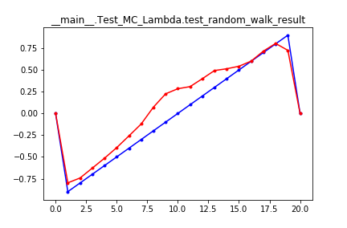
Every-visit MC learning rate adjusted by episode number
Back to conclusions (1) Back to conclusions (2) After 1000 episodes…
Back to conclusions (3)
RMSE in one experiment Value Function estimation is quite noisy. at the end of one experiment
α₀ = 0.1
α_{min} = 0.001
OBSERVATIONS:
The final RMSE after 1000 episodes is very similar to the case where α is adjusted by the state occupation count. The convergence is as well “noisy”.
The convergence rate is slightly faster in the short term than the case where α is adjusted by the state occupation count. Overall it is ~ T^{-1/4}.
The estimated state value function is unacceptable.

Slide 16
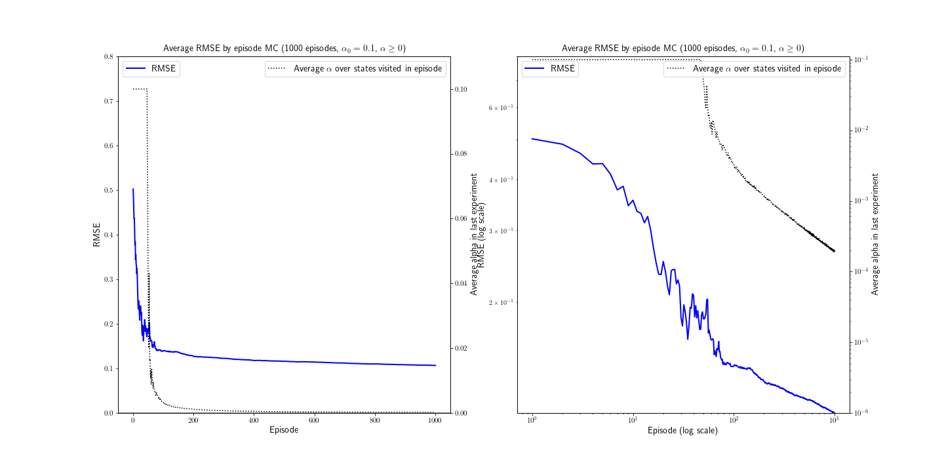
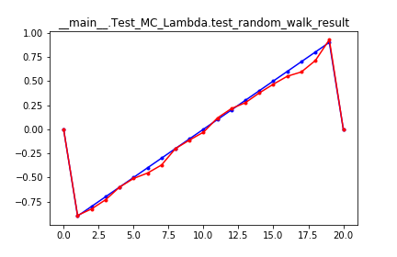
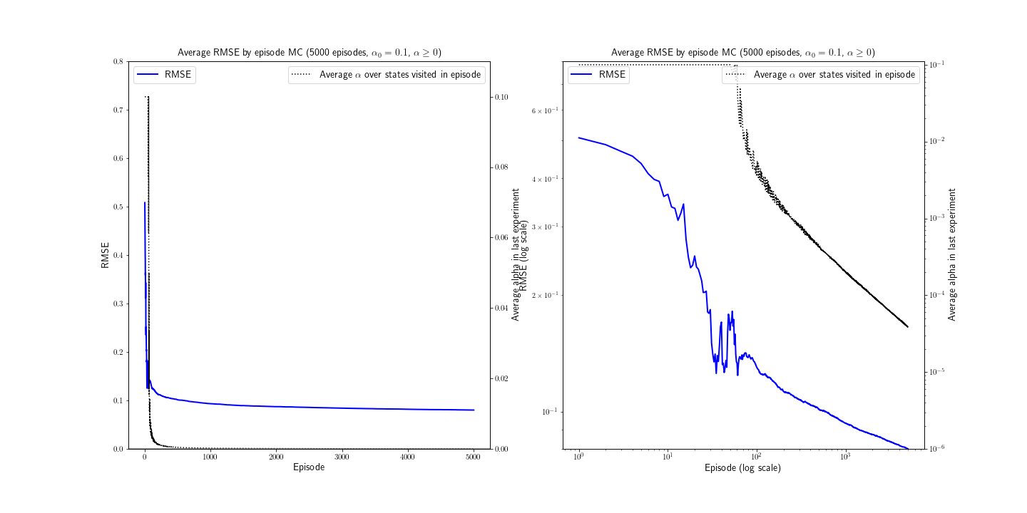
First-visit MC learning rate adjusted by state occupation count
Back to conclusions (1) Back to conclusions (2) After 1000 episodes…
Back to conclusions (3)
After 5000 episodes… Value Function estimation convergence continues slowly. at the end of one experiment
α₀ = 0.1
α_{min} = 0
OBSERVATIONS:
The first-visit MC is similar to the every-visit MC with learning rate adjusted by episode but faster to converge in the short term.
The convergence rate is ~ T^{-1/4}.
The estimated state value function is accetable.

Slide 17
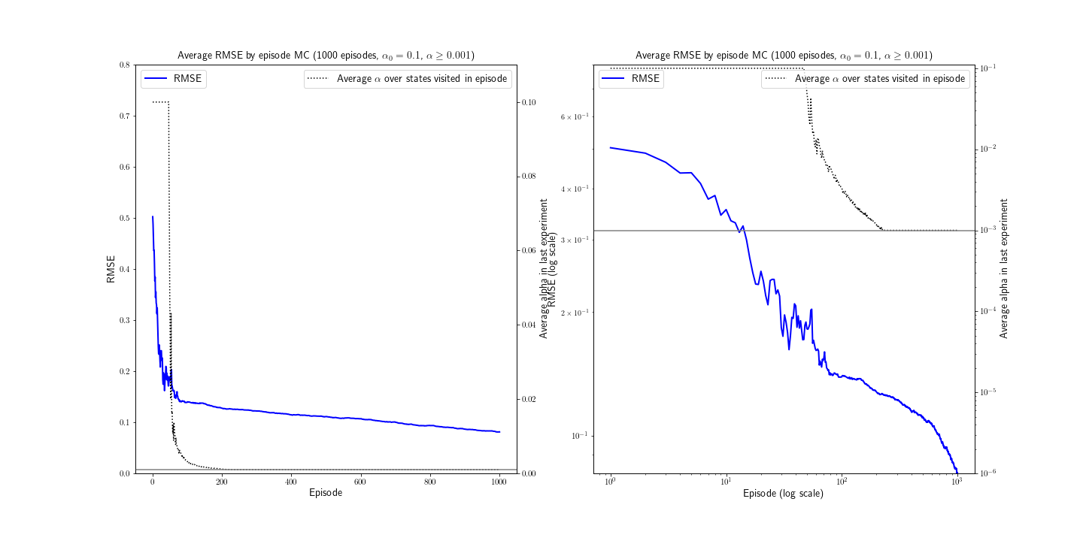
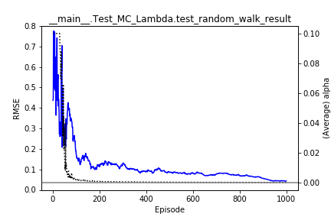
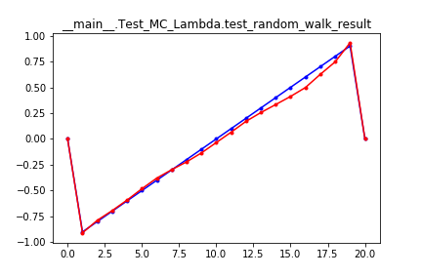
First-visit MC learning rate adjusted by state occupation count
Back to conclusions (1) Back to conclusions (2) After 1000 episodes…
Back to conclusions (3)
RMSE in one experiment Value Function estimation is quite noisy. at the end of one experiment
α₀ = 0.1
α_{min} = 0.001
OBSERVATIONS:
The final RMSE after 1000 episodes is slightly smaller than the case where α is allowed to decrease freely, and convergence is not “noisy” as is the case in the every-visit MC.
The convergence rate is ~ T^{-1/4}.
The estimated state value function is accetable.

Slide 18
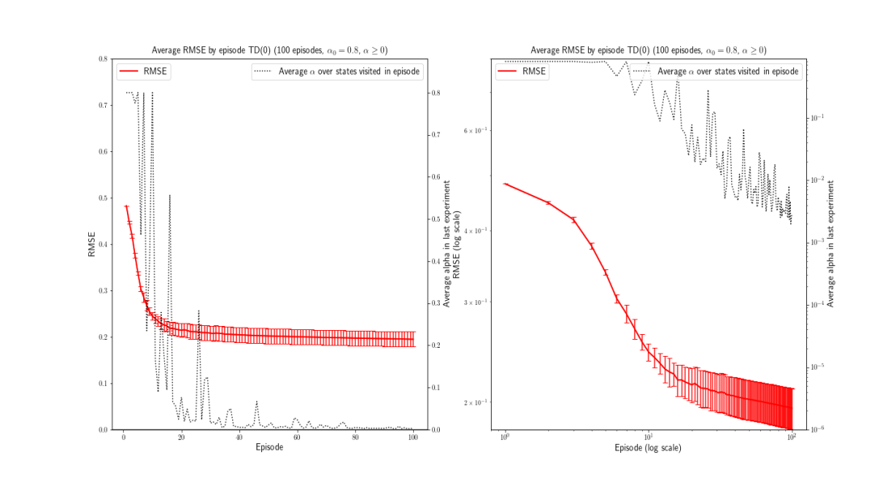
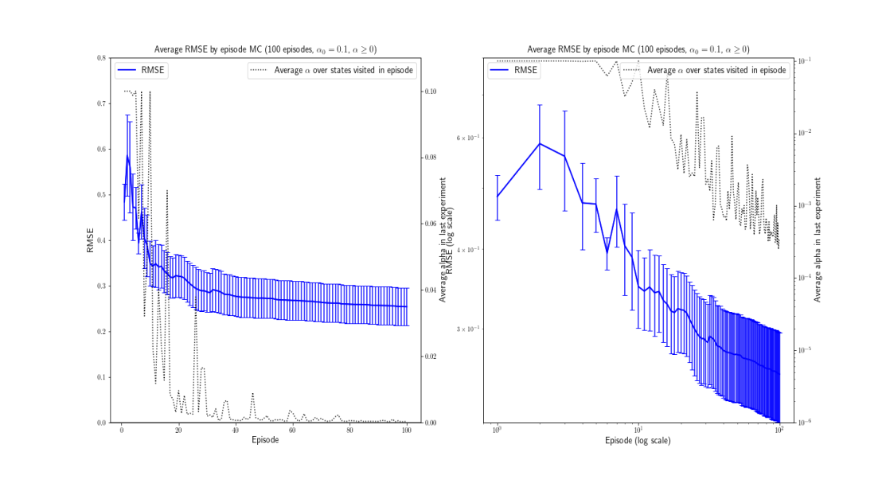
APPENDIX: Analysis of the estimation variability (1/2)
Following the significantly lower RMSE by episode (averaged across experiments) observed on five 5000-long experiments compared to five 1000-long experiments in the α-adjustment by state occupation count in the every-visit case, an analysis of the RMSE variability across the five experiments was carried out.
For this, the TD(0) and MC learners with free decrease of α were run on five 100-long episodes and the standard error of the average RMSE by episode was collected.
The following graphs show the results in the α-adjustment by state occupation count.
TD(0)
Every-visit MC

Slide 19
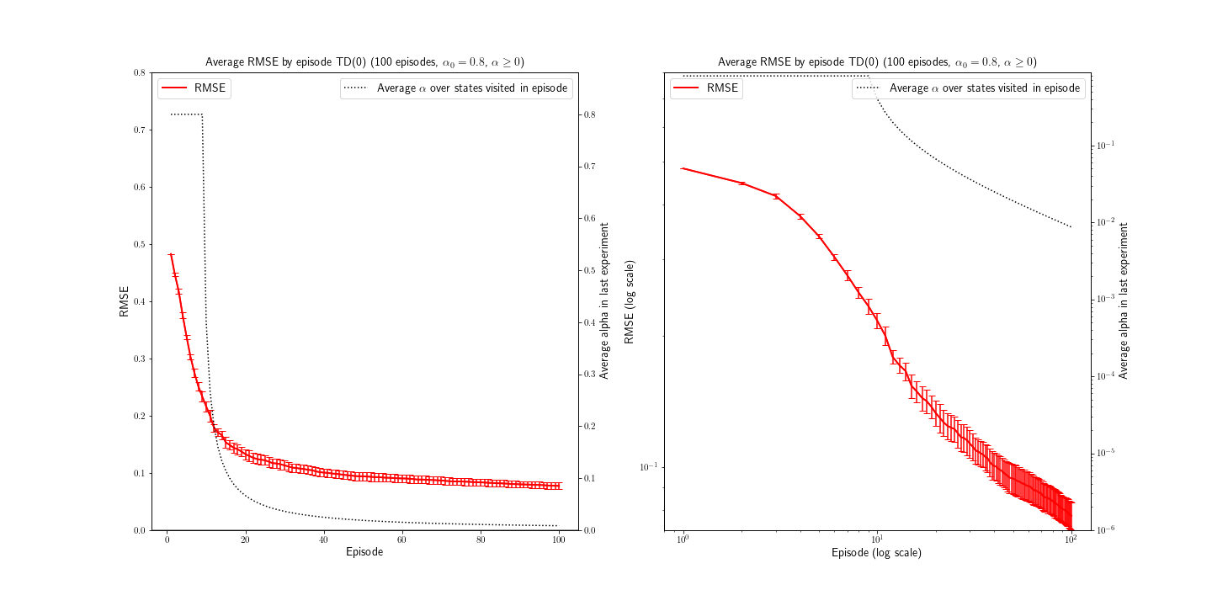
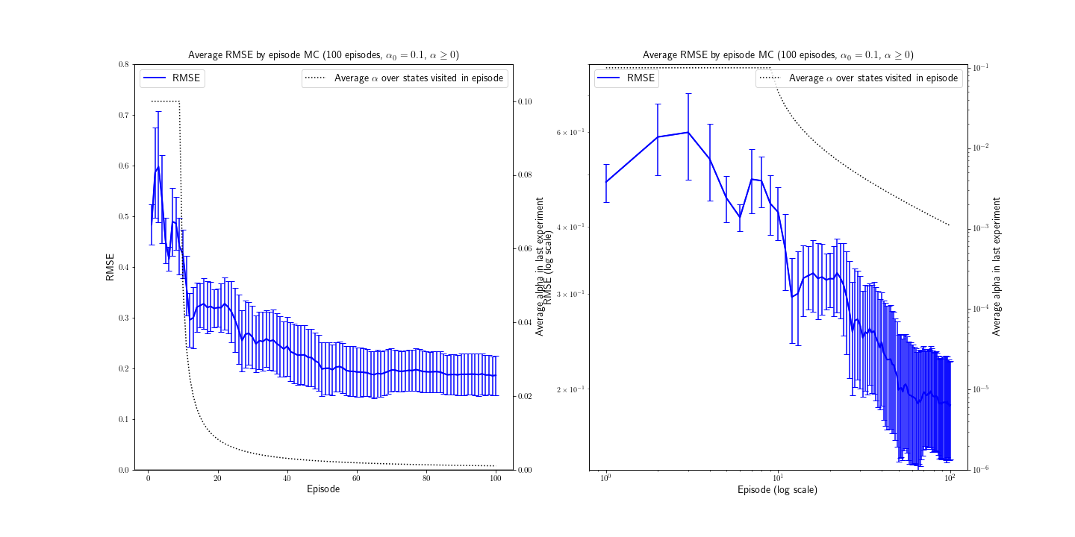
APPENDIX: Analysis of the estimation variability (2/2)
The following graphs show the results in the α-adjustment by episode number.
In the TD(0) case a smaller variability is observed compared to the α-adjustment by state occupation count. In the MC case however, the variability is very similar.
The smaller variability in the TD(0) case is most likely explained by the fact that different trajectories in each episode do not impact the value of α as they do in the adjustment by state occupation count.
The similar variability in the MC case might be due to the intrinsic variability of the method, which makes the impact of the adjustment strategy less noticeable.
TD(0)
Every-visit MC

