Slide 1
Results of implementation of TD(λ) and MC(λ) algorithms for 1D gridworld
Fri, 17-Apr-2020
Ref: SimulateTDLambda.ipynb

Slide 2
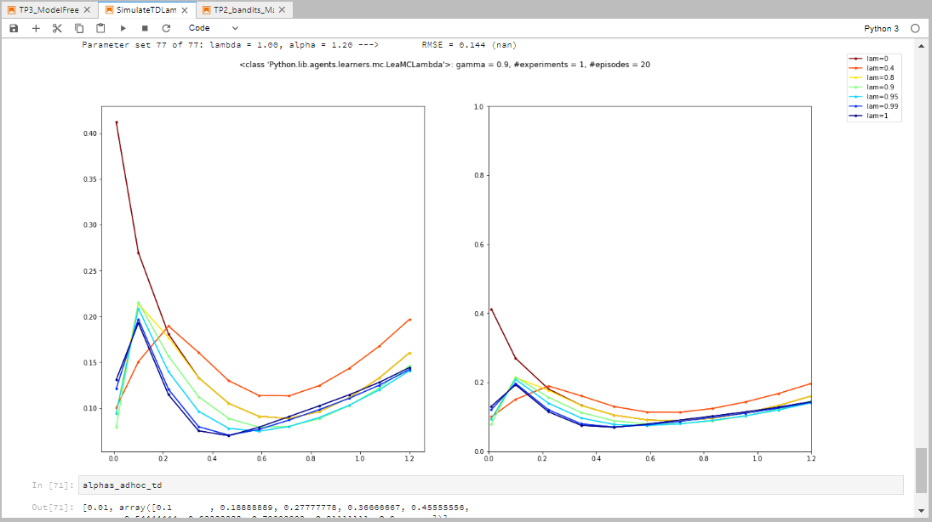
Before fixing reset in td.py and mc.py

Slide 3
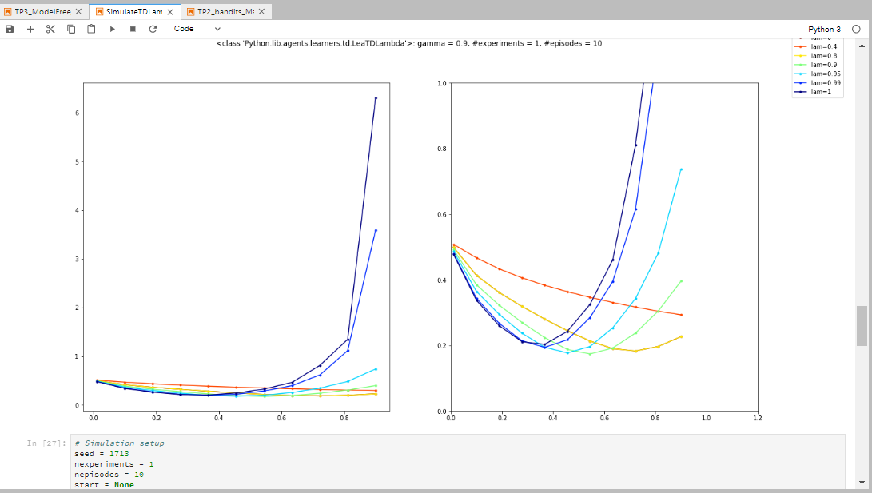
TD(λ), γ=0.9, seed=1717, #exp=1

Slide 4
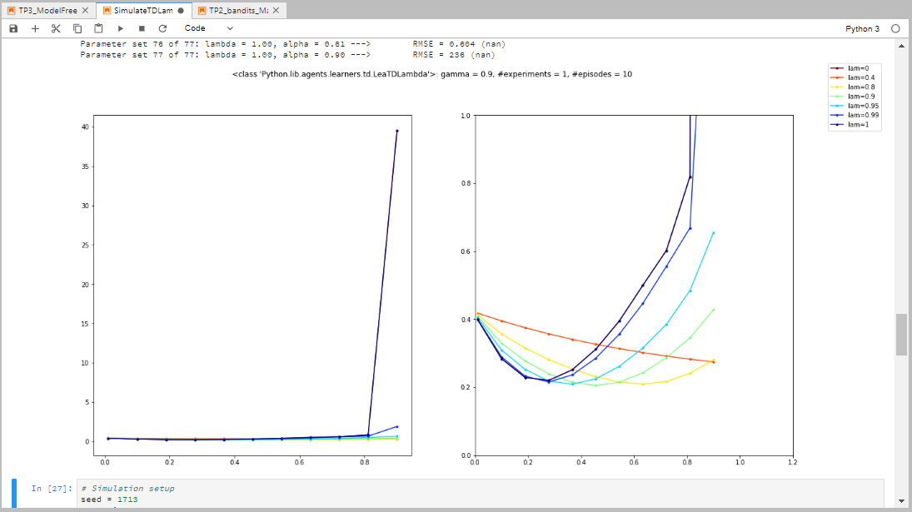
TD(λ), γ=0.9, seed=1713, #exp=1

Slide 5
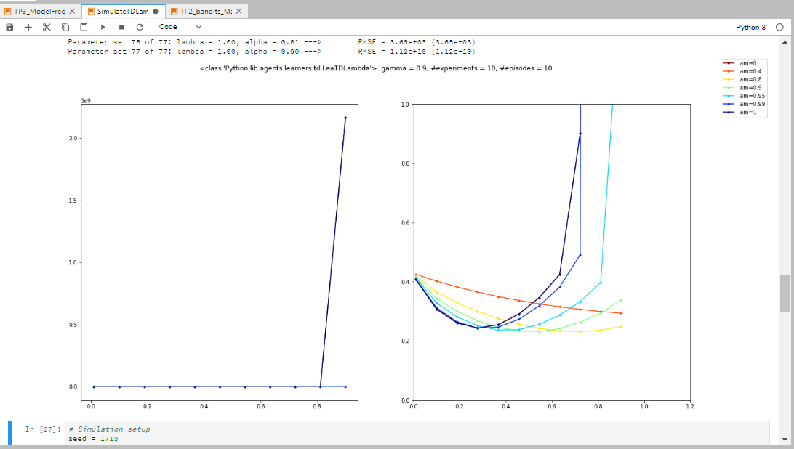
TD(λ), γ=0.9, seed=1713, #exp=10

Slide 6
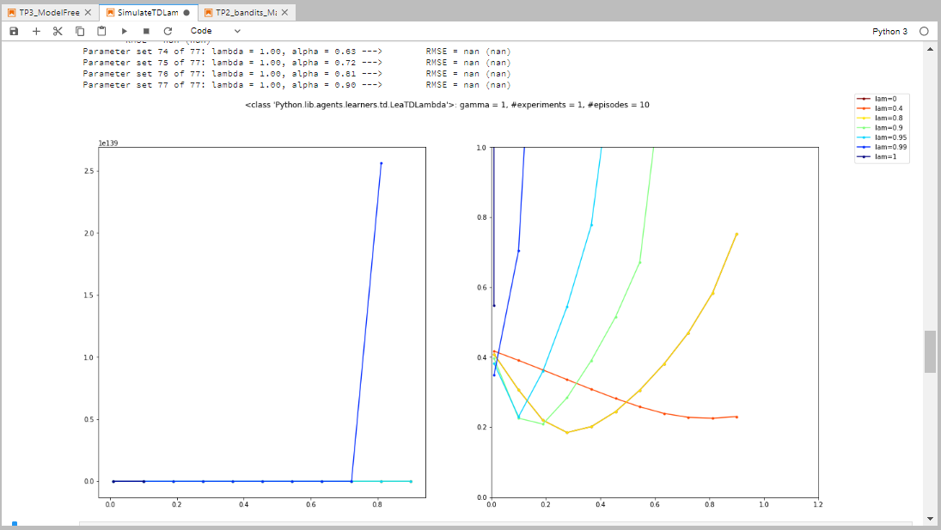
TD(λ), γ=1, seed=1713, #exp=1

Slide 7
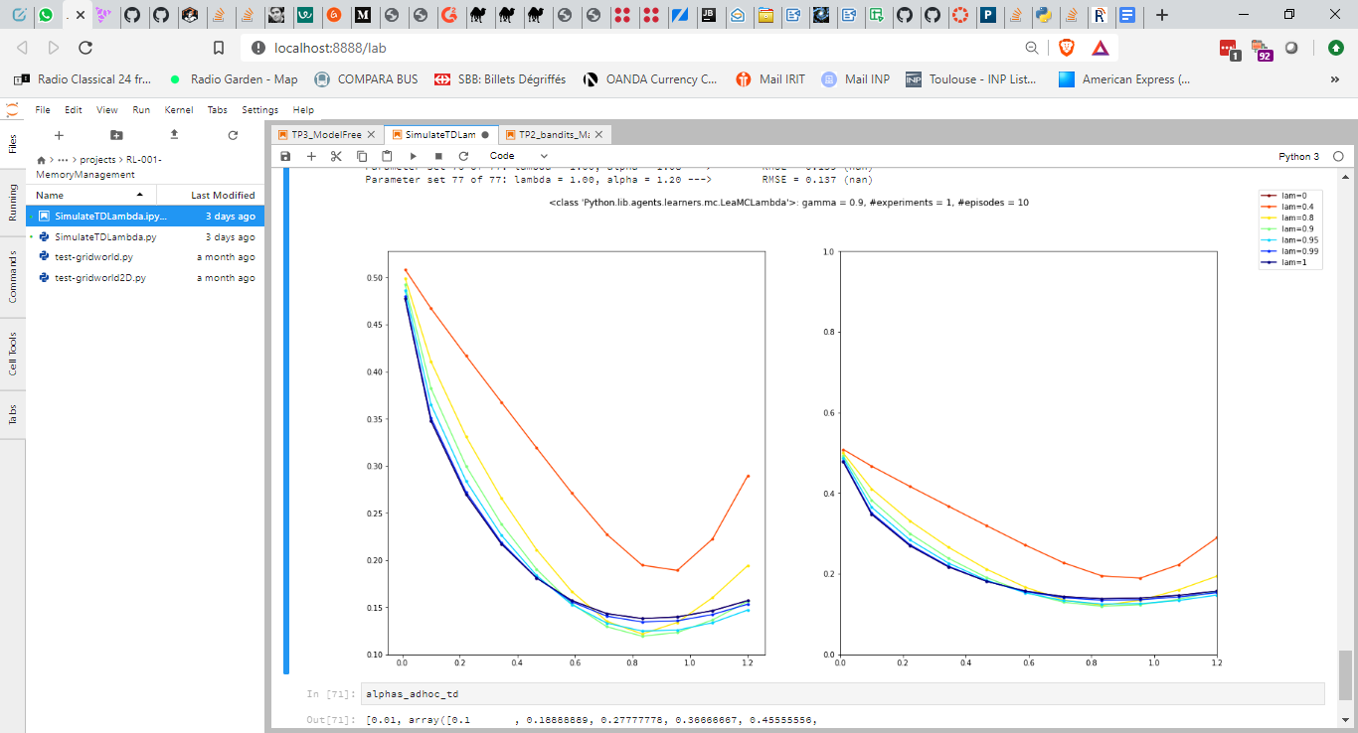
MC(λ), γ=0.9, seed=1717, #exp=1

Slide 8
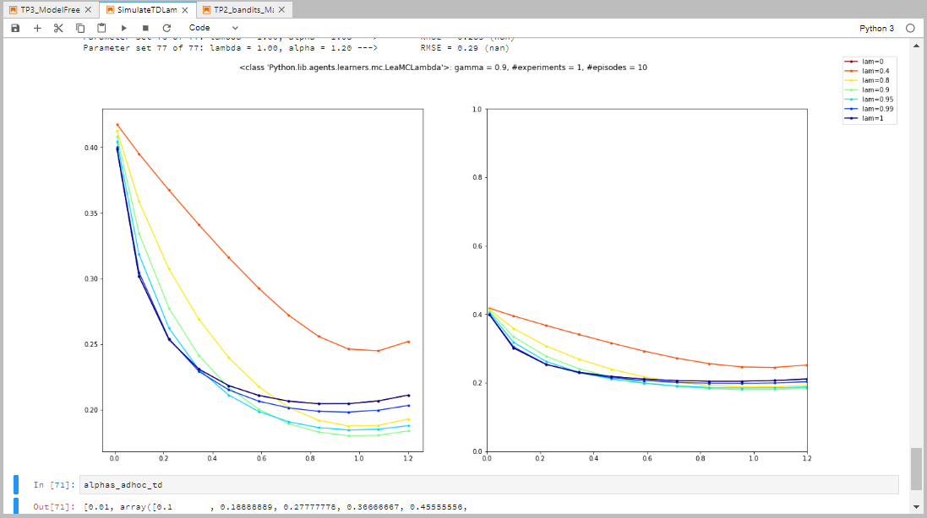
MC(λ), γ=0.9, seed=1713, #exp=1

Slide 9
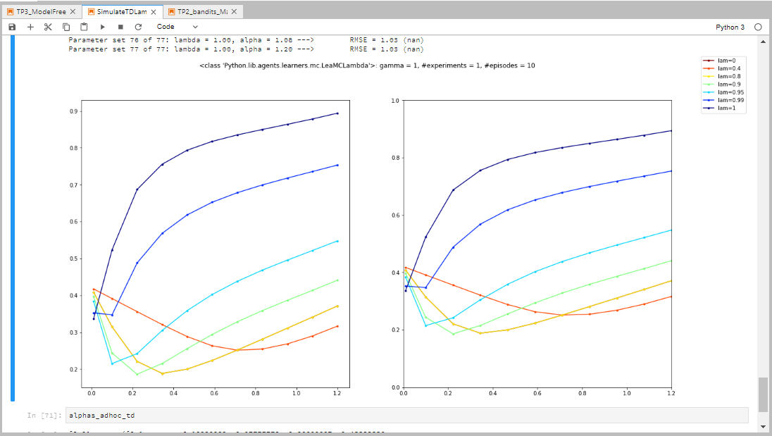
MC(λ), γ=1, seed=1713, #exp=1

Slide 10
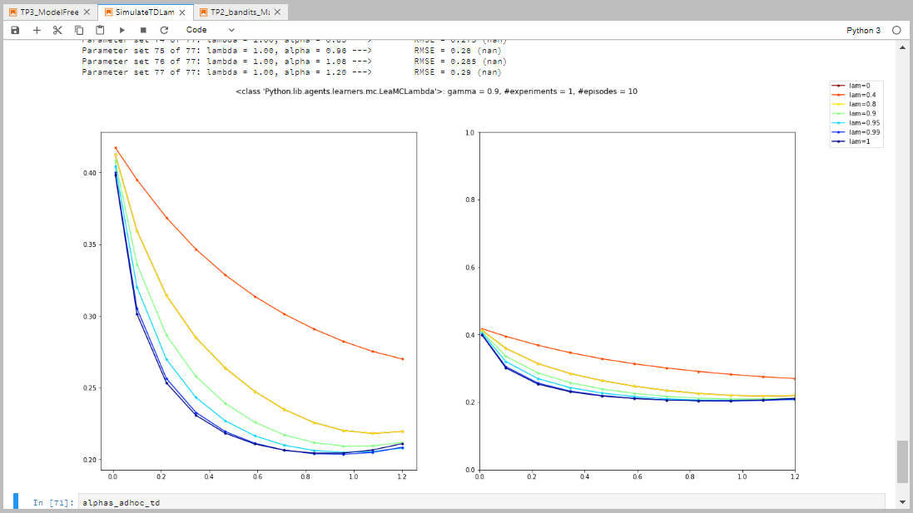
λ-return^{(*)}, γ=0.9, seed=1713, #exp=1
(*) I use the term “λ-return” to indicate the estimation that does NOT leverage the nested nature of the n-step returns in its implementation

Slide 11
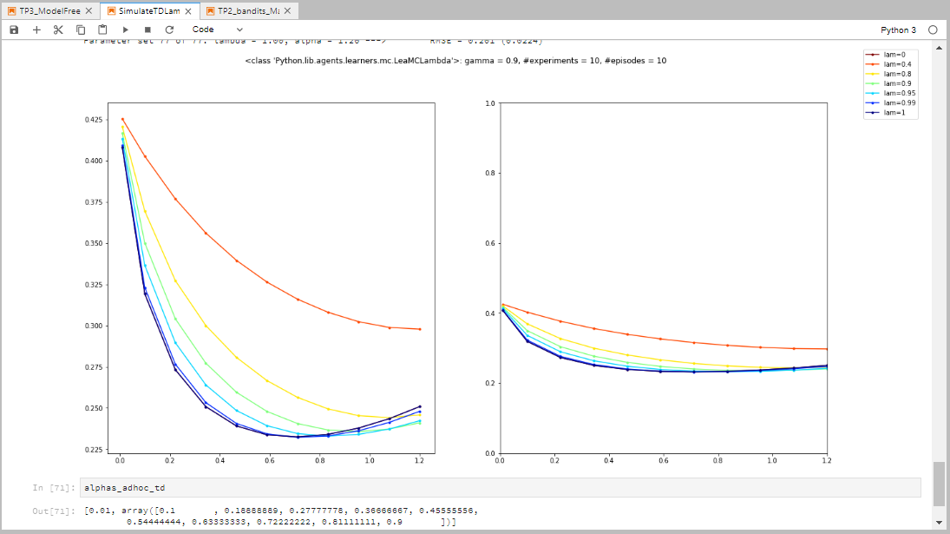
λ-return, γ=0.9, seed=1713, #exp=10
(*) I use the term “λ-return” to indicate the estimation that does NOT leverage the nested nature of the n-step returns in its implementation

Slide 12
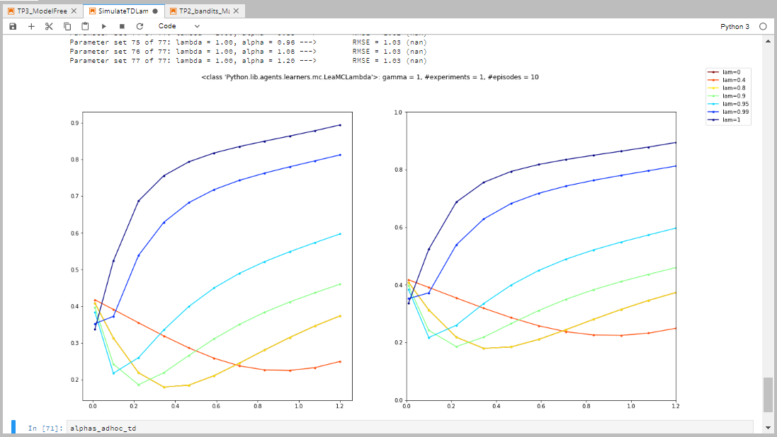
λ-return, γ=1, seed=1713, #exp=1
(*) I use the term “λ-return” to indicate the estimation that does NOT leverage the nested nature of the n-step returns in its implementation

Slide 13
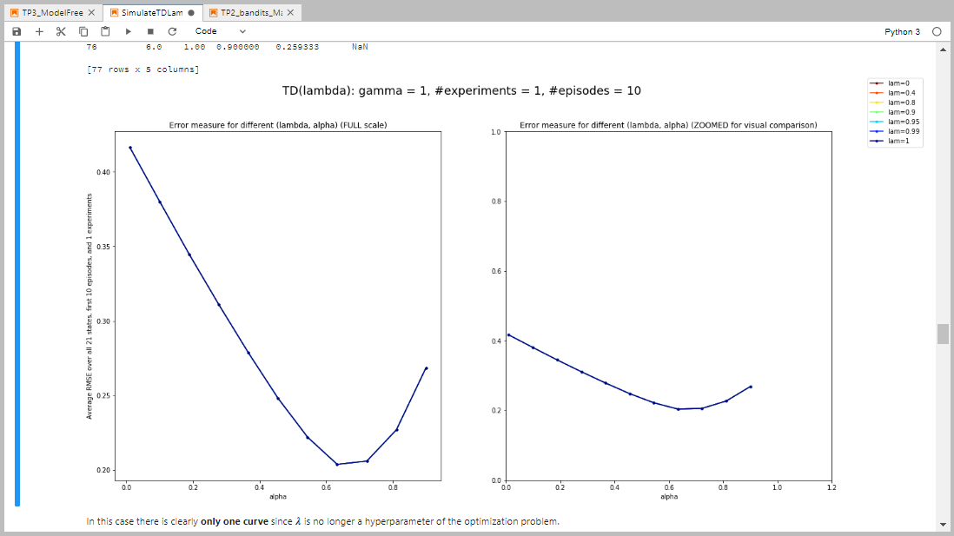
TD(λ) adaptive, γ=1, seed=1713, #exp=1

Slide 14
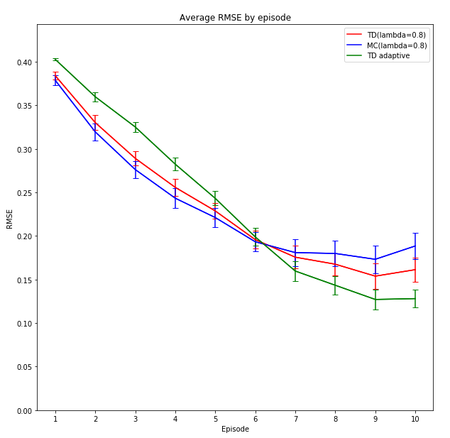
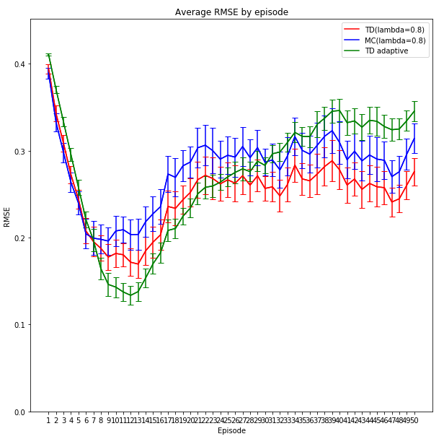
Comparison of convergence speed among the three algorithms

Slide 15
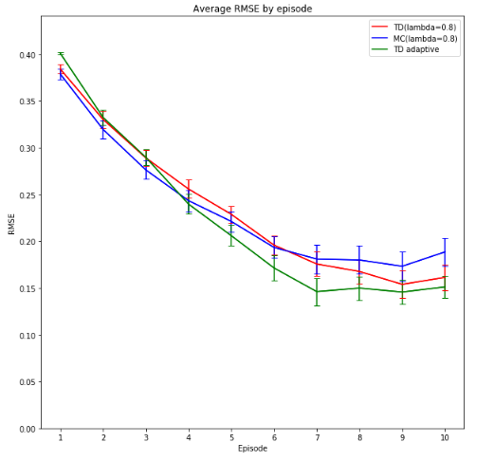
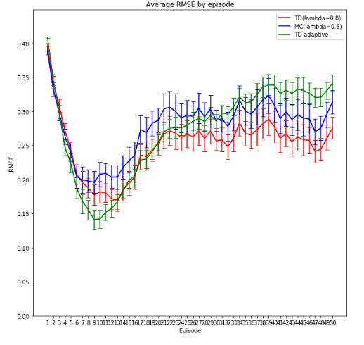
Comparison of convergence speed among the three algorithms using offset λ = 0.1 for all updates in the adaptive case
We observe a faster convergence of the adaptive case (green curve) compared to using a 0 offset!

Slide 16
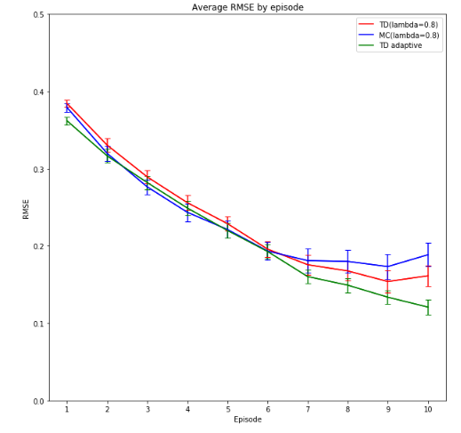
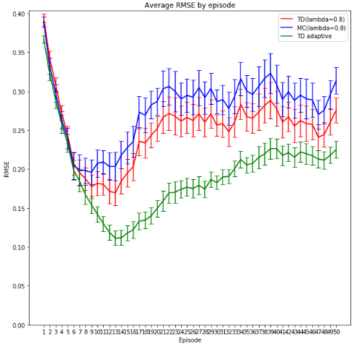
Comparison of convergence speed among the three algorithms using fixed λ as long as the value function is not updated once
We observe similar convergence rate at the beginning and smaller error at the end, compared to the other two algorithms!

