Slide 1
Results of traditional and adaptive TD(λ) in 2D gridworld
Tue, 28-Jul-2020
Daniel Mastropietro
Ref: Python/test/test_TD_lambda.py

Slide 2
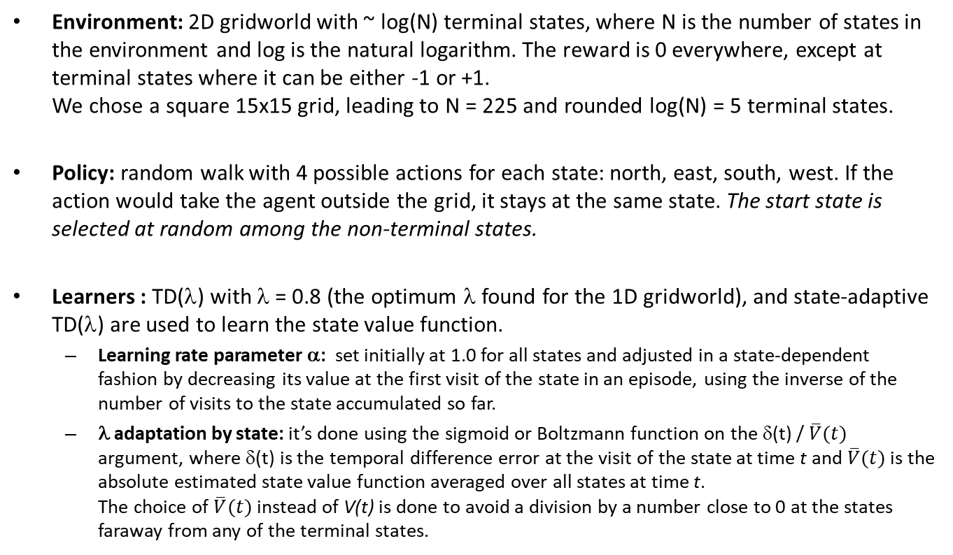
Simulation setup
Environment: 2D gridworld with ~ log(N) terminal states, where N is the number of states in the environment and log is the natural logarithm. The reward is 0 everywhere, except at terminal states where it can be either -1 or +1. We chose a square 15x15 grid, leading to N = 225 and rounded log(N) = 5 terminal states.
Policy: random walk with 4 possible actions for each state: north, east, south, west. If the action would take the agent outside the grid, it stays at the same state. The start state is selected at random among the non-terminal states.
Learners : TD(λ) with λ = 0.8 (the optimum λ found for the 1D gridworld), and state-adaptive TD(λ) are used to learn the state value function.
Learning rate parameter α: set initially at 1.0 for all states and adjusted in a state-dependent fashion by decreasing its value at the first visit of the state in an episode, using the inverse of the number of visits to the state accumulated so far.
λ adaptation by state: it’s done using the sigmoid or Boltzmann function on the δ(t) / $\overline{V}(t)$ argument, where δ(t) is the temporal difference error at the visit of the state at time t and $\overline{V}(t)$ is the absolute estimated state value function averaged over all states at time t. The choice of $\overline{V}(t)$instead of V(t) is done to avoid a division by a number close to 0 at the states faraway from any of the terminal states.

Slide 3
A: Initial check Check that the algorithms work on a 2D gridworld having just two terminal states at opposite corners (considering the equivalent 1D gridworld scenario as a reference)
Environment setup:
15x15 2D grid with two terminal states:
- top-left with reward = -1
- bottom-right with reward = +1

Slide 4
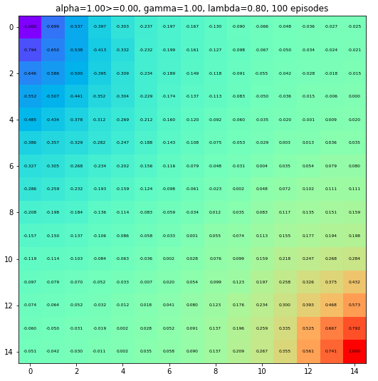
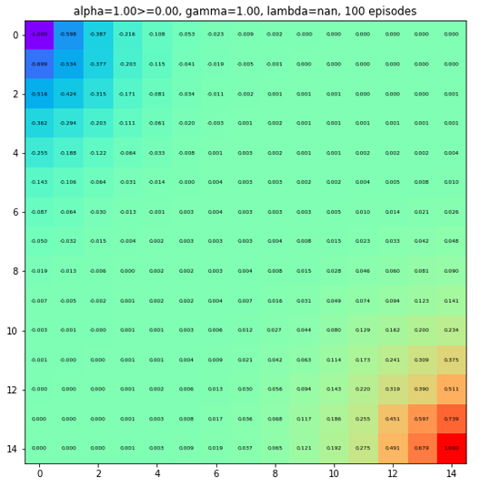
Estimated state value function after 100 episodes
TD(λ=0.8)
exec time: 35 sec
Adaptive TD(λ)
exec time: 50 sec
Legend: violet: -1.0, green: 0.0, red: +1
Observation: The estimated state value function in the adaptive case goes faster to 0 from the extremes of -1 and +1 at the corners.

Slide 5
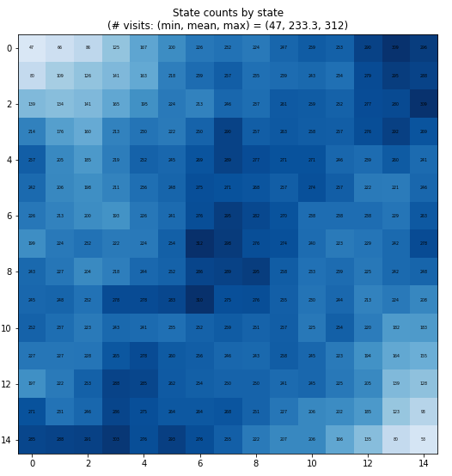
Number of visits per state at the end of the simulation (valid for both methods)
We observe that the counts are smaller near the terminal states, as the episode is likely to terminate soon when the agent visits those regions.
Legend: white: count = 0, darkest blue: largest state count observed (312)

Slide 6
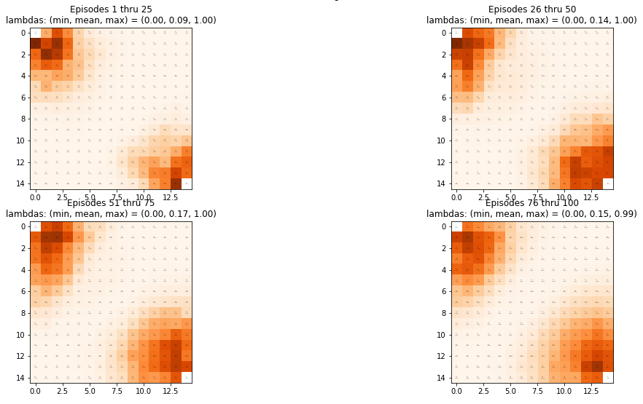
Evolution of the state-adaptive λ over episodes
Average λ by state over the indicated episode number ranges
Overall average λ over all states and steps = 0.14
We observe how the structure of λ values evolves towards the same structure seen for the state value function.

Slide 7
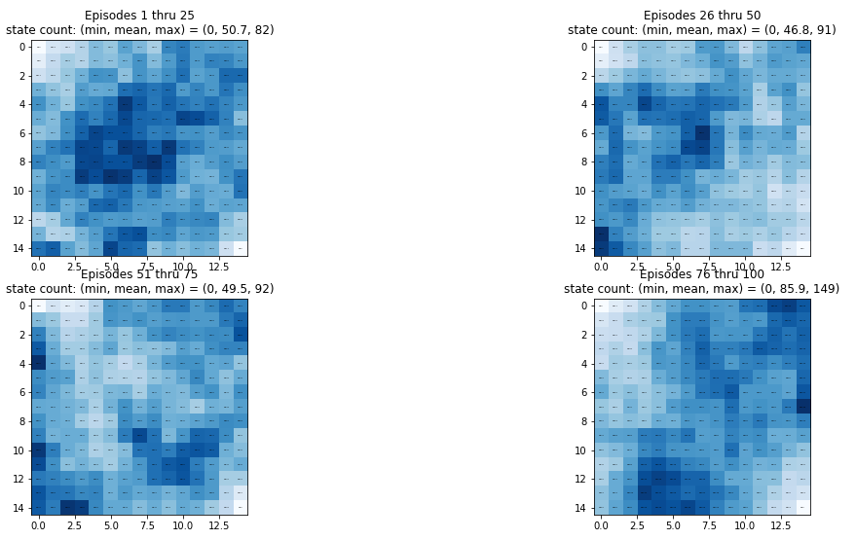
State count distribution over different episodes
State count distribution on the indicated episode numbers
The set of most visited states is different across episode ranges due to random variation.

Slide 8
B: Simulation with log(N) = 5 terminal states
Environment setup:
15x15 2D grid with 5 terminal states randomly distributed:
- two with reward -1
- three with reward +1

Slide 9
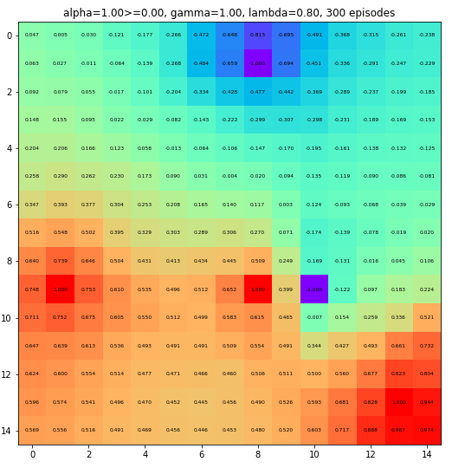
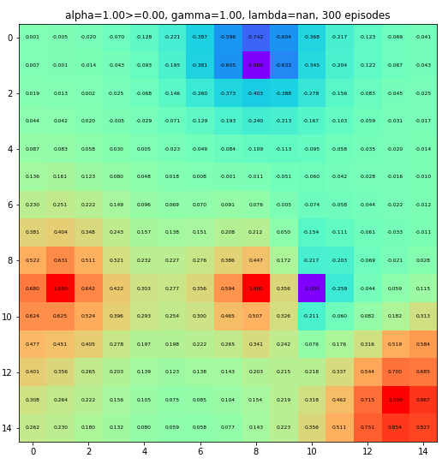
Estimated state value function after 300 episodes
TD(λ=0.8)
exec time: 7 sec
Adaptive TD(λ)
exec time: 11 sec
Legend: violet: -1.0, green: 0.0, red: +1
Observation: We observe the same type of difference pointed out in case (A) between the two algorithms, and even more strongly due to terminal states being closer to each other.

Slide 10
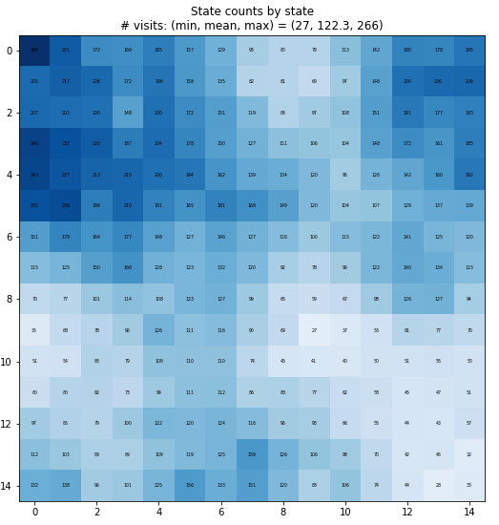
Number of visits per state at the end of the simulation (valid for both methods)
As in case (A), we observe that state counts are smaller near the terminal states.
Legend: white: count = 0, darkest blue: largest state count observed (266)

Slide 11
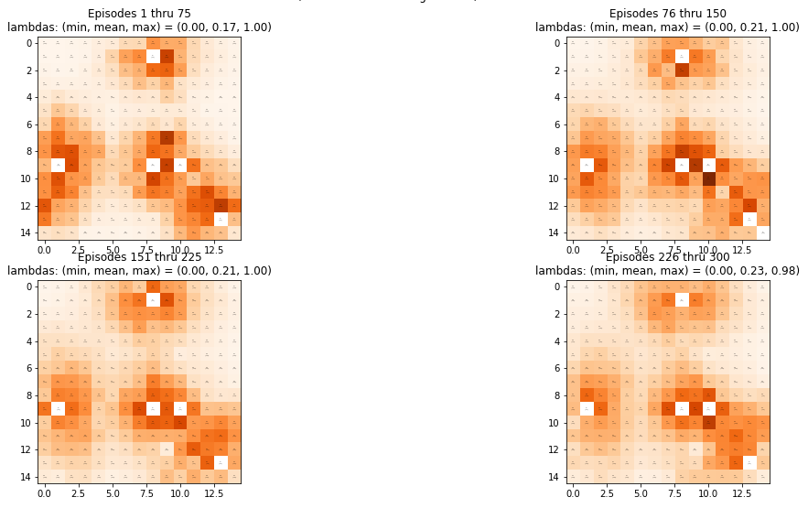
Evolution of the state-adaptive λ over episodes
Average λ by state over all indicated episode numbers
Overall average λ over all states and steps = 0.21
We observe how the structure of λ values evolves towards a similar structure as the one observed for the state value function.
It is interesting to note that the darkest color (highest λ) happens near the two terminal states with reward +1 and reward -1 in the center of the grid. This happens because those states are "all the time“ receiving "innovative" information, since about half of the cases are supposed to end at the state with reward +1 and the other half at the state with reward -1.

Slide 12
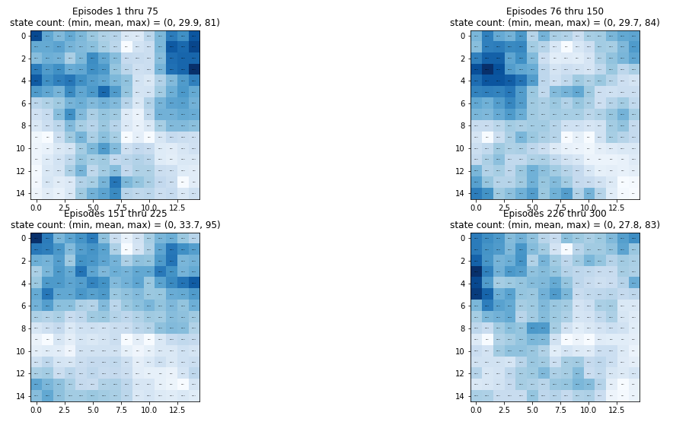
State count distribution over different episodes
State count distribution on the indicated episode numbers
The set of most visited states is different across episode ranges due to random variation, but the structure observed for the overall state counts is preserved.

Slide 13
Conclusions
The adaptive TD(λ) algorithm seems to estimate a sharper state value function than the traditional one, in the sense that there is a steepest change from non-zero values (near terminal states) to zero values (far from terminal states).
We should investigate what algorithm gives the state value function estimate that is closest to the true value function.

Slide 14
Proposed next steps
Compute RMSE of each algorithm If possible, compute the theoretical state value function and calculate the RMSE of each algorithm. Goal: Find out what algorithm gives the smallest estimation error.
Convergence rate Analyze the speed of convergence of each algorithm by analyzing the number of episodes until the state value estimates stabilize. Goal: Find out what algorithm converges faster.
Random rewards Consider an environment with random rewards at terminal states, with absolute values range from 0.25 to 1. Goal: Analyze how the distribution of the adaptive λ varies near terminal states as a function of their reward.

