Slide 1
Convergence speed and eligibility traces in adaptive vs. non-adaptive TD(λ) in 1D gridworld
11-Nov-2020
Daniel Mastropietro
Ref: test_TD_Lambda.py

Slide 2
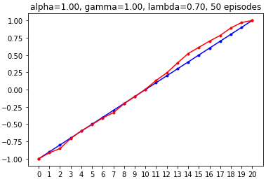
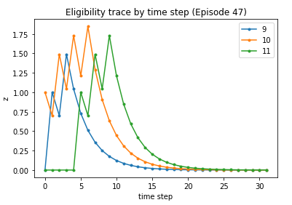
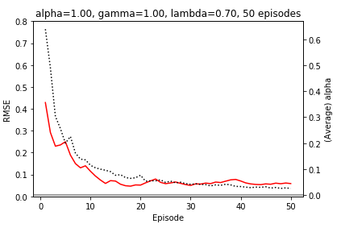
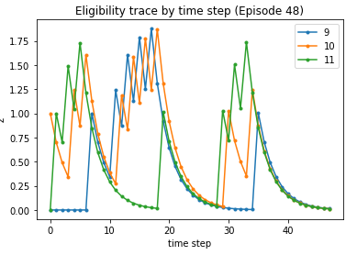
Non-adaptive (λ= 0.7) (On a 50 episodes run, we plot eligibility traces for 3 central states for a couple of LATEST episodes)

Slide 3
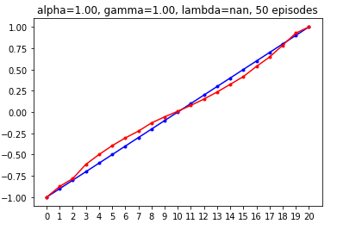
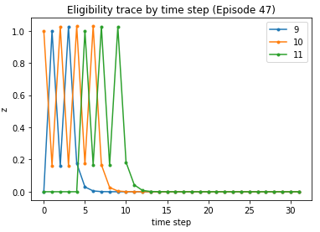
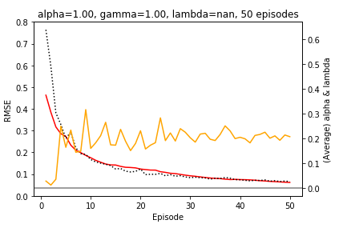
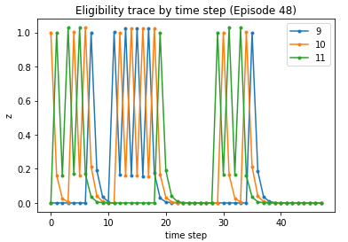
Adaptive (average λ tends to 0.2) (On a 50 episodes run, we plot eligibility traces for 3 central states for a couple of LATEST episodes)

Slide 4
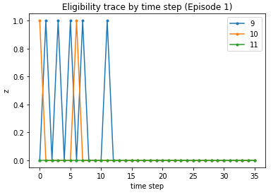
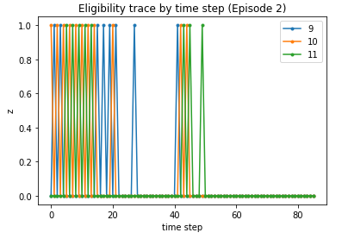
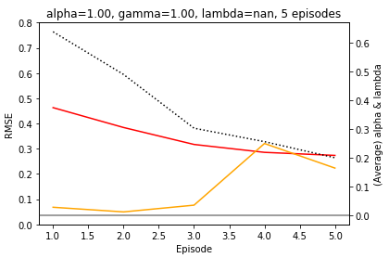
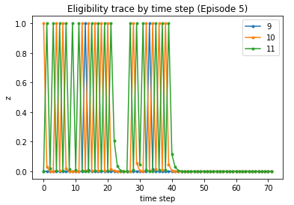
Adaptive (average λ tends to 0.2) (On a 50 episodes run, we plot eligibility traces for 3 central states for a couple of INITIAL episodes)
Initially, the elibigility trace drops instantaneously to 0 because the TD error is 0 and sets adaptive λ to 0.

Slide 5
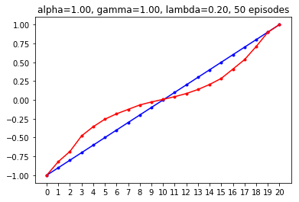
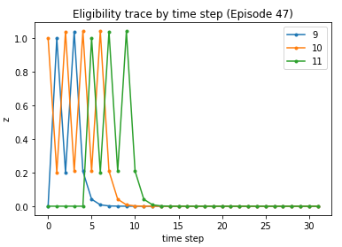
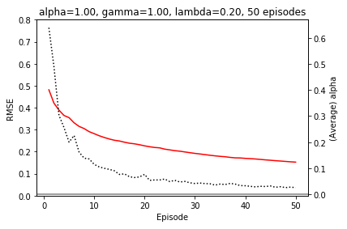
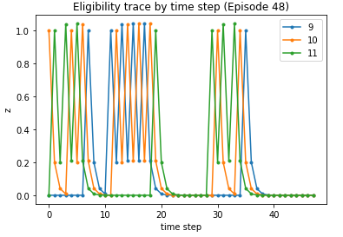
Non-adaptive (λ=0.2, the adaptive limit) (On a 50 episodes run, we plot eligibility traces for 3 central states for a couple of latest episodes)
Using the limiting adaptive λ (0.2) as non-adaptive λ is too small for fast enough convergence because the effective learning rate α(n)z(n,s) becomes too small soon --z(n,s) is the eligibility trace at time n for state s

Slide 6
Conclusions
Rate of convergence (plot on the bottom-left on each page)
Comparing the non-adaptive λ = 0.7 with the adaptive λ:
Initial episodes: the non-adaptive case reduces its RMSE faster than the adaptive one, basically due to the adaptive λ being initially zero due to a zero TD error.
Latest episodes: the adaptive case outperforms the non-adaptive case and converges faster to 0.
Using the limiting adaptive λ (0.2) as non-adaptive λ is a too small of a value because the eligibility trace becomes small too fast, making the effective learning rate drop too quickly to 0 (c.f. Shimkin lectures on TD(λ) convergence, Sec. 6.2)
Adaptive λ at initial episodes is 0… is this a problem? Although a zero λ value yields an effective learning rate (α(n,s)*z(n,s)) equal to zero at the very first time step after the visit of the state, it doesn’t pose a problem in convergence becuase it makes the algorithm behave initially as TD(0) and become a TD(λ) algorithm a few episodes later as the TD error becomes non-zero, with the advantage that we don’t need to fix the value of λ. (Note that already at episode 5 the average λ is about equal to its limiting value of 0.2.)
Limiting value of adaptive λ is rather small… (0.2) The limiting average adaptive λ is small compared to the non-adaptive λ = 0.7 (which tends to generate smaller RMSE than smaller λ based on experiments available at Sutton) because the agent has already been learning the value function for a few episodes, before a non-zero adaptive λ kicks in. In addition, we should recall that this is an average value; the specific adaptive λ value may be different for different states.

