Slide 1
CMPT 370 Tutorial On Subversion Introducing Git

Slide 2
Subversion
A Centralized Version Control System
D₁
D₈
D₂
Server
D₇
D₃
D₆
D₄
D₅
Notes:
Centralized meaning that it uses a central server to store files and enable team collaboration
The purpose is to track changes and to manage collaborative development
You only need to contact with server when you want to commit changes

Slide 3
Terminology
Subversion Server: Stores files in a repository
Subversion Client: Talk to the server and create a working copy of the files in that repository
Commit: An operation through you inform the server about changes.
Notes:
Users make changes their working copy and commit those changes to the repository.
Other members can only see those changes after the commit operation

Slide 4
Subversion Vs. CVS
Revision Number: In CVS revision numbers are per file basis where in SVN each revision appears as a completely new file system
Commits: In SVN commits are atomic while in CVS it is not true.
Renaming: CVS cannot track file renaming but SVN does.
Directory: CVS only track files whereas SVN track both files and directories.
Notes:
CVS(Concurrent versions system) also known as Concurrent Versioning system and predates Subversion. It also uses a client server system.

Slide 5
Installing A Client
Windows: You can download Subversion command line binaries from here: www.collab.net/downloads/subversion
Mac and Ubuntu: Usually comes with command line subversion client.
How to verify subversion installation? Run this at the command prompt: prompt> svn --version

Slide 6
Graphical Client
Windows: Tortoise SVN is an Apache Subversion client. It can be downloaded from here: www.tortoisesvn.net/downloads.html
For Mac: A number of choices available:
Versions: www.versionsapp.com
Cornerstone: www.zennaware.com/cornerstone
Windows/Mac OS X/Linux: SmartSVN www.smartsvn.com/download

Slide 7
Creating a Local Repository
A repository is a place where all files together with changes are stored
Steps:
Create a new directory: > mkdir repos
Inform svn about the directory: > svnadmin create repos
Now verify the repos directory: A number of files and directories is in there now

Slide 8
Import Existing Source Files
You are already working on a project that did not use subversion before.
Steps to import existing source tree:
Clean existing source tree
Import the entire source tree: >svn import –m “initial import” project-to-import file:////Users/parvez/repos/recommender

Slide 9
Checking Out a Source Tree
Before editing any existing files stored in your repository you need to check out the entire source tree first. This is called the working copy.
How to check out?
>svn checkout repository-location local-copy-location or
>svn co repository-location local-copy-location
How to check status? >svn status
Check which files are changed: > svn diff -r oldRevisionNumber: newRevisionNumber

Slide 10
Commit Your Changes
>svn commit –m “message you want to tell”
After your commit operation, the revision number will be updated.
Notes:
A

Slide 11
Adding/Removing Files
Adding/Deleting files is a two step process
Add/Delete the file
Inform subversion about the changes
>svn add fileToAdd
>svn commit –m “message to tell”
To delete use the del command
Notes:
dding a file in a repository is a two step process in svn.
You need add the files first. Then you need to commit it.
>svn add fileName
>svn commit –m “message to tell”

Slide 12
Renaming/Moving a file
This is also a two step process.
You need to Rename/Move file
Then inform the subversion about the changes
To rename: >svn mv A.txt B.txt >svn commit –m “message to tell”
To move a file: >svn mv src/A.java src/App/A.java >svn commit –m “message to tell”

Slide 13
Updating Your Copy
To update your copy to latest revision, simply use the following command while you are in the working copy. >svn update
Updating requires when you are doing collaborative development
Update Frequently☑

Slide 14


Conflicts?
Alice Local Revision: 5
Bob Local Revision: 5
Both checkout
Time: 12 pm
Server
Server Revision 5

Slide 15
Conflicts?
Alice Local Revision: 5
Bob Local Revision: 5
Alice changes A.java file
and commit first
✔
Alice
Local Revision 6
Server
Both checkout
Time: 12 pm
Bob
Local Revision 5
Server
Server Revision 5

Slide 16
Conflicts?
Alice Local Revision: 5
Bob Local Revision: 5
Alice changes A.java file
and commit first
✔
Alice
Local Revision 6
Server
Both checkout
Time: 12 pm
Bob
Local Revision 5
Server
Server Revision 5
Server
Bob
Local Revision 5
Server Revision 6
Bob changes A.java file in
the same place and tries to commit

Slide 17
Conflicts?
Alice Local Revision: 5
Bob Local Revision: 5
Alice changes A.java file
and commit first
✔
Alice
Local Revision 6
Server
Both checkout
Time: 12 pm
Bob
Local Revision 5
Server
Server Revision 5
Server

Bob
Local Revision 5
Server Revision 6
Bob changes A.java file in
the same place and tries to commit

Slide 18
Conflicts?
Alice Local Revision: 5
Bob Local Revision: 5
Alice changes A.java file
and commit first
✔
Alice
Local Revision 6
Server
Both checkout
Time: 12 pm
Bob
Local Revision 5
Server
Server Revision 5
Conflict
Server

Because his file version
is out of date
Bob
Local Revision 5
Server Revision 6
Bob changes A.java file in
the same place and tries to commit

Slide 19
How to resolve conflict
Update and merge previous changes >svn update
During update you can discover conflicting changes and need to resolve first
Subversion will prompt you a number of options: Conflict discovered in A.java Select: (p) postpone (df)diff-full (e) edit (h) help
For each conflicted file you need to tell subversion that you have fixed the problem >svn resolved A.java

Slide 20
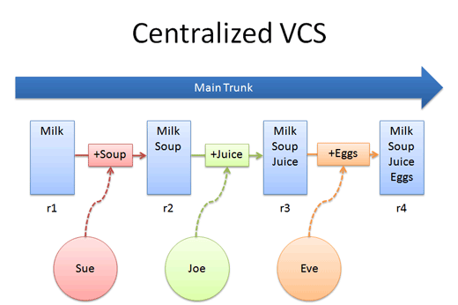
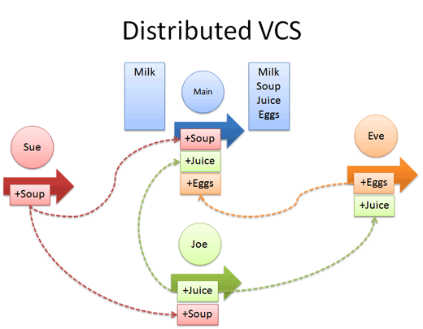
What is Git
A Distributed Version Control System
It makes branching and merging easier
Notes:
Images are taken from: http://betterexplained.com/articles/intro-to-distributed-version-control-illustrated/

Slide 21
Comparing Commands
svn checkout url
git clone url
svn update
git pull
svnadmin create repo
svn import file://repo
git init
git add . git commit
svn log
git log
svn blame file
git blame file
Notes:
See git.or.cz/course/svn.html

Slide 22
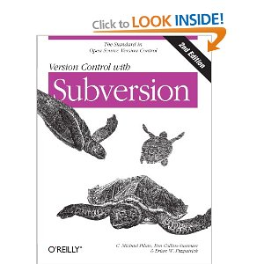

Learn More …
Version Control with Subversion
Pragmatic Guide to Subversion

Slide 23
Learn More…
Subversion Tutorial
http://svnbook.red-bean.com/
http://www.slideshare.net/Ocramius/svn-basic-tutorial
http://refcardz.dzone.com/refcardz/getting-started-subversion
http://wiki.alliedmods.net/Subversion_Tutorial

Slide 24
Learn More …
Subversion Vs. CVS
http://stackoverflow.com/questions/245290/subversion-vs-cvs
https://www.cs.virginia.edu/~csadmin/wiki/index.php/CVS_and_Subversion_Differences

Slide 25
Learn More About Git
http://betterexplained.com/articles/a-visual-guide-to-version-control/
http://betterexplained.com/articles/intro-to-distributed-version-control-illustrated/
http://www.gitguys.com/
http://stackoverflow.com/questions/315911/git-for-beginners-the-definitive-practical-guide
http://try.github.io/levels/1/challenges/1
http://git-scm.com/doc

