Slide 1
SIFT Digit Recognition
Ruibo Zhang, Abdullah Al Masud

Slide 2
Problem Statement
SIFT:
Image content is transformed into local feature coordinates.
Invariant to translation, rotation, and scale.
Good for object detection, digits recognition (somewhat similar).
Limitation:
NOT able to detect complete different hand writing.

Slide 3


Motivation
Figure 1. SIFT working
Figure 2. SIFT NOT working
Utilize the foundation of SIFT
Make a robust program capable of recognizing:
Various hand-writings.
Different pen strokes.

Slide 4
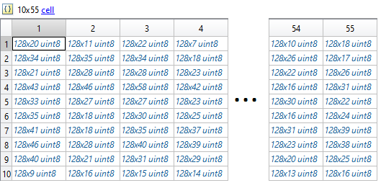
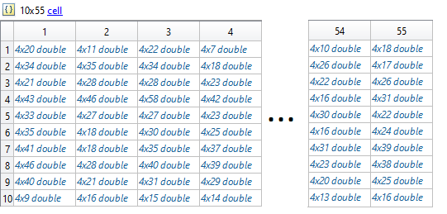
Implementation
Utilize a database:
55 different images for each digit (550 images total for 10 digits).
“vl_sift”: extract features and descriptors of each image.
Figure 3. Descriptors Cell
Figure 4. Features Cell

Slide 5
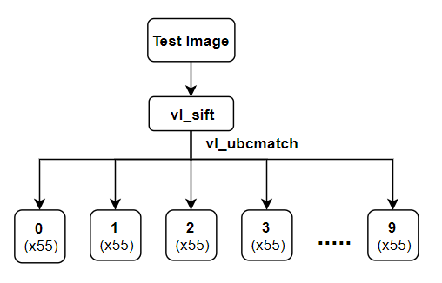
Implementation (Continued)
“vl_ubcmatch” (descriptor1, descriptor2, threshold):
[matches,scores]
Matches: the indices of the matched features
Scores: the squared Euclidean distance between the matches
Threshold: to limit the matches

Slide 6
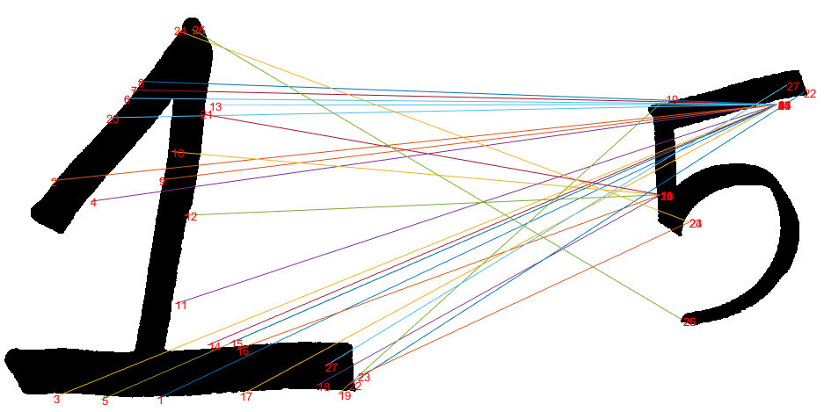
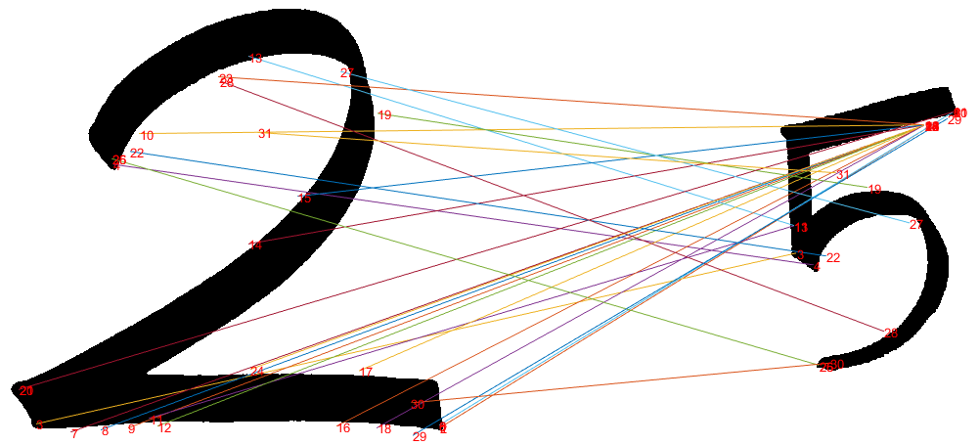
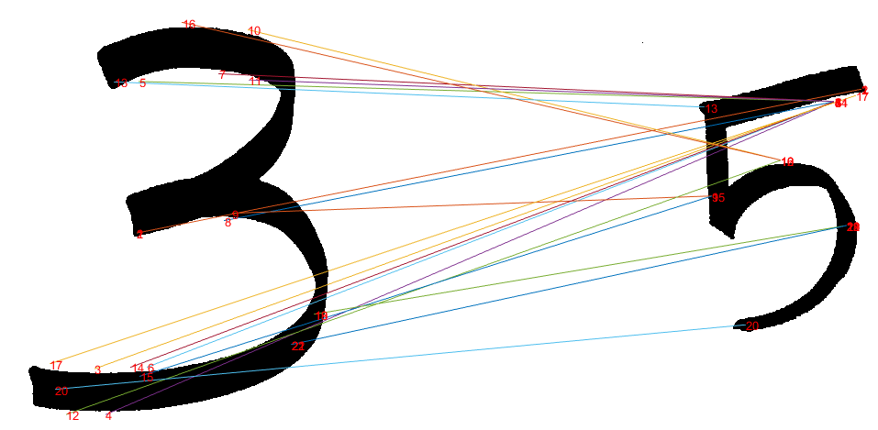
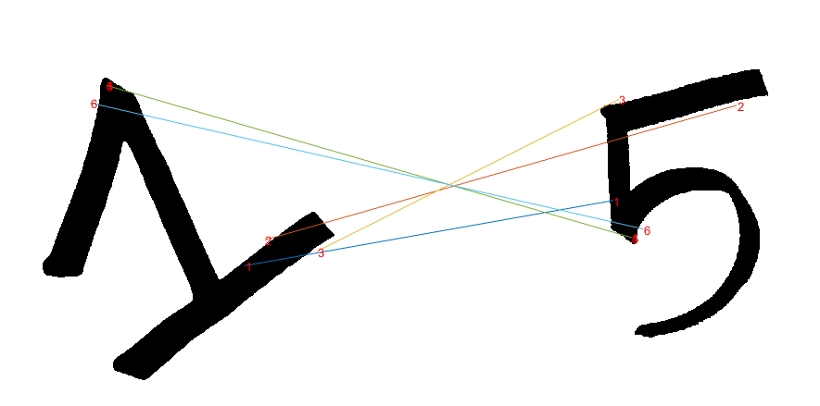
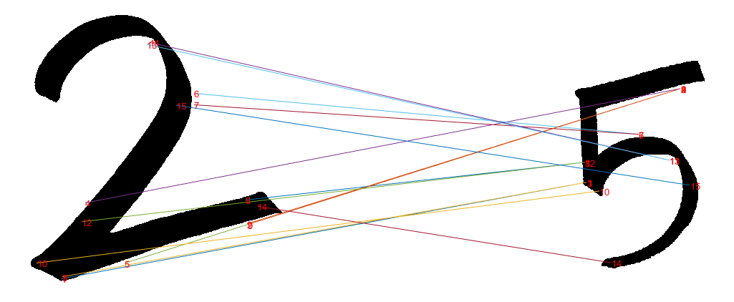
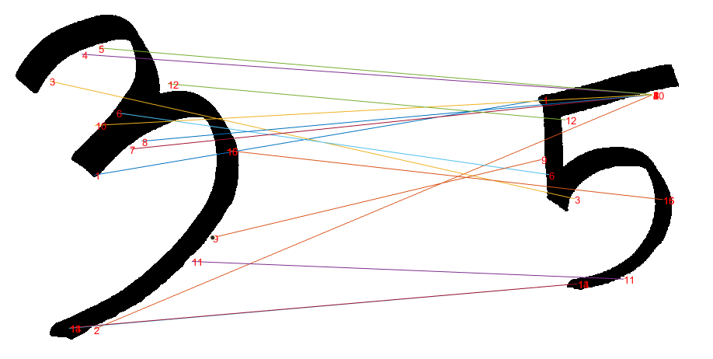
Preliminary Results

Slide 7
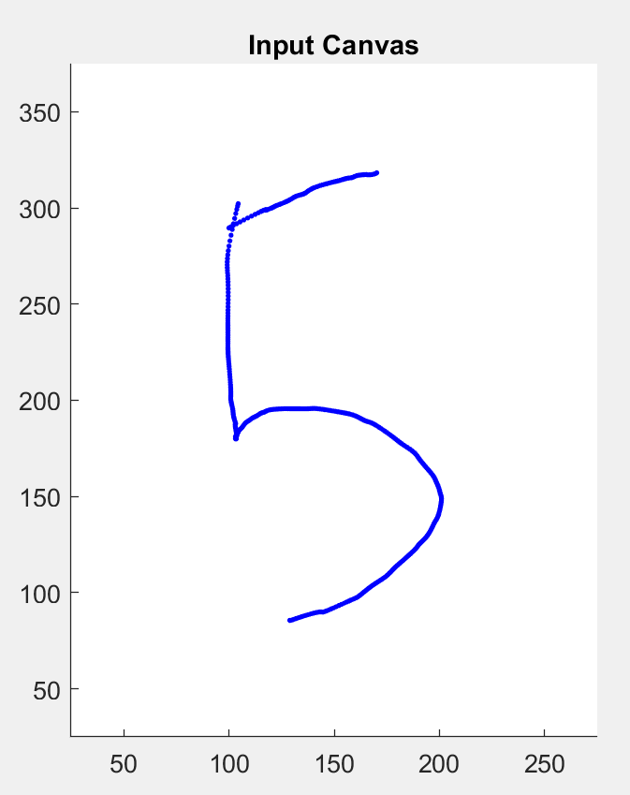

2.1 Test image acquisition
1) Input image is written on a 300x400 canvas;
2) The position of mouse (x,y) is monitored and recorded;
3) These scatted dots are interpolated obtaining 10 times more (x,y) points;
4) All these (x,y) points are rounded to int, and corresponding pixels are labeled as “1”, o.w. “0”;
5) Dilate this bw image with a disk to simulate the strokes.

Slide 8
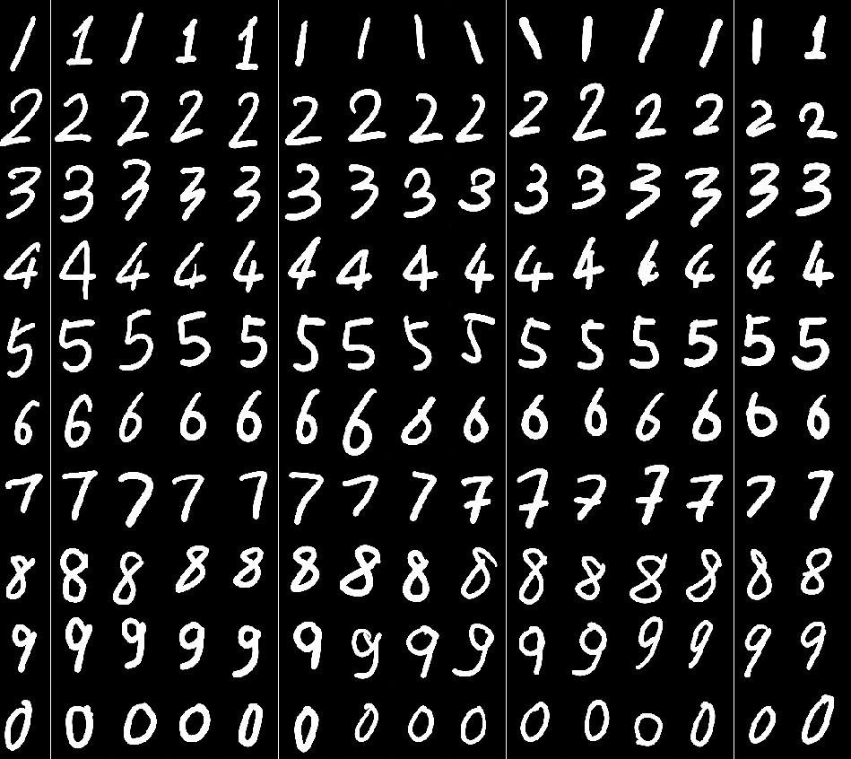
2.2 SIFT feature extraction and ubc_matching
SIFT features (frames, descriptors) and extracted, and compared to the features of reference (training) images one by one.
=> Matching pairs matching scores

Slide 9
2.3 Post processing on matches
Matches trimming:
In some cases, more than 1 frames are generated on 1 key point;
One key point can be matched with 2 or more key points in its counterpart;
However, in this case, only one matching could be valid.
Matches trimming is to remove the replicated matches associated to one key point.
(Only the match having the highest score is preserved)
Test image
Ref image

Slide 10
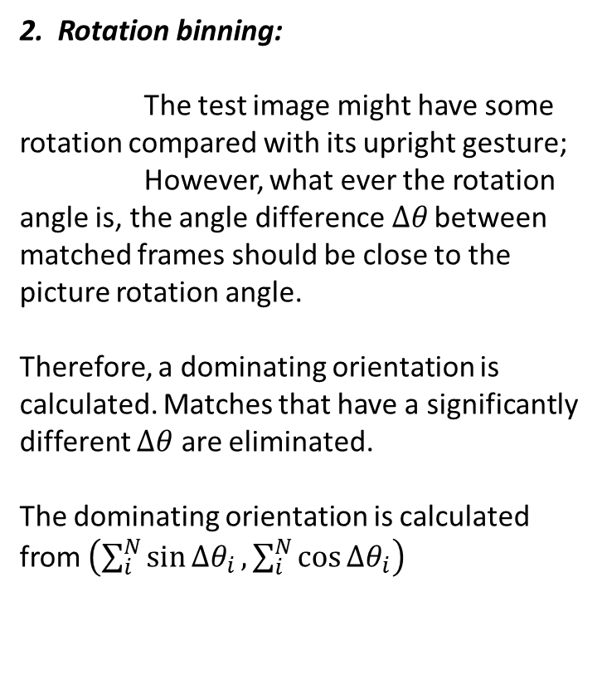



2.3 Post processing on matches
2. Rotation binning:
The test image might have some rotation compared with its upright gesture;
However, what ever the rotation angle is, the angle difference$Δθ$ between matched frames should be close to the picture rotation angle.
Therefore, a dominating orientation is calculated. Matches that have a significantly different $Δθ$ are eliminated.
The dominating orientation is calculated from $\left(\sum_{i}^{N}{\sin{Δθ_{i}}},\sum_{i}^{N}{\cos{Δθ_{i}}}\right)$
$$≈$$
3. Using Hough-transform to eliminate mismatches.

Slide 11
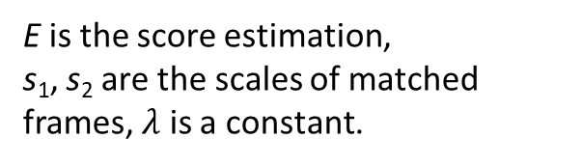
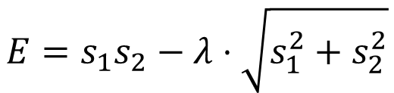
2.4 Scores evaluation
Only large scaled features denotes the structure information of a digit.
Large—large matches should be more valued.
Large—small matches are mismatches.
(The scale difference of two pictures are obtained from the median of scales ratios of all matches. )
Good!
$$E=s_{1}s_{2}−λ⋅\sqrt{s_{1}^{2}+s_{2}^{2}}$$
Useless!
E is the score estimation,
s₁, s₂ are the scales of matched frames, $λ$ is a constant.
Wrong!

Slide 12
2.5 Punish term
Different digits have different feature amounts;
Therefore, numbers having more features tend to have high matching scores.
e.g., 9 have more features than 1, and test digits tend to have more matches to 9 than to 1.
A punish term is introduced to correct this imbalance.
Feature amounts generated from each digit in the dataset are summed up as the punish term.
e.g., from all the “2”s in our dataset, we got 1421 features in total. So the punish term to “2” is 1421.
For our dataset:
1: 830
2: 1421
3: 1446
4: 2349
5: 1385
6: 1248
7: 1450
8: 1836
9: 1295
0: 737

Slide 13
Eliminate the mismatching features based on Hough Transform
O(x, y)=(x2+V1(1),y2+(V1(2)))
O’(x, y)=(x4+V3(1),y4+(V3(2)))
-(x₁,y₁,a₁,s₁)
-(x₂,y₂,a₂,s₂)
-(x₃,y₃,a₃,s₃)
-(x₄,y₄,a₄,s₄)
V1
V1
V3
V3
（x₁,y₁）
（x₂,y₂）
（x₃,y₃）
（x₄,y₄）
Training Image
Testing Image
V1=[-x₁;-y₁]
V1=[-x₁;-y₁]
V3=[-x₃;-y₃]
V3=[-x₃;-y₃]

Slide 14
Eliminate the mismatching features based on Hough Transform
O(x, y)=(x2+V2(1),y2+(V2(2)))
-(x₁,y₁,a₁,s₁)
-(x₂,y₂,a₂,s₂)
V1
V2
（x₁,y₁）
（x₂,y₂）
Training Image
Testing Image
V1=[-x₁;-y₁]
V2=R*(V1/sr)
Scale Ratio(sr)=s₁/s₂
Angle Difference(ad)=a₁-a₂
R=[cos(ad),sin(ad);-sin(ad).cos(ad)]

Slide 15
Assumptions
If the features in the training image and testing image are matched correctly with each other, after applying the vector offsets gotten from the features on the training image on the feature positions of the testing image, should all vote to the same origin position.

Slide 16
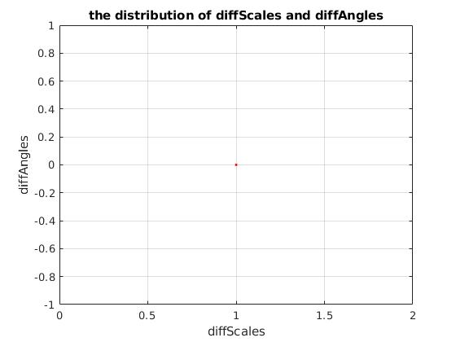
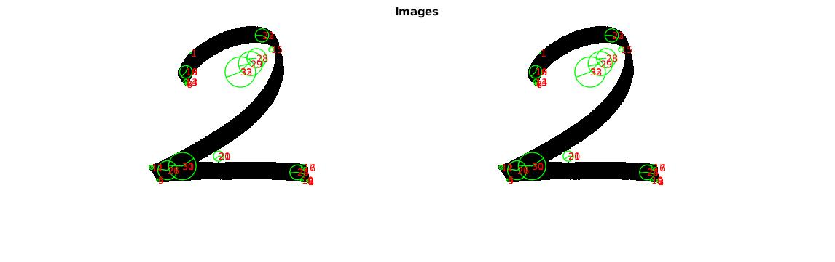
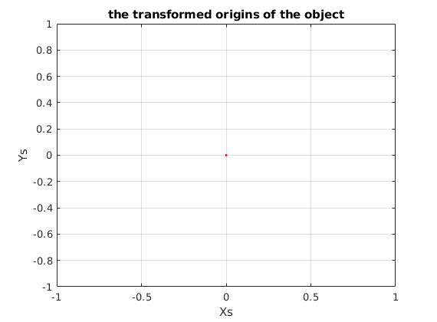
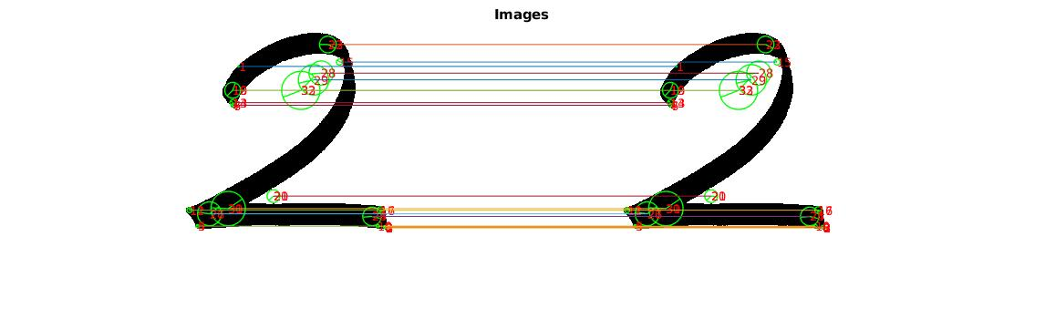
Example

Slide 17
What Should We Do Next?
Find the point with maximum votes Keep the features that voted the point;

Slide 18
How to Do?
Build an accumulator matrix H to store the votes on each image patch
ChangedAngles=-pi : pi/4 : pi
ScaleRatio= 0.1 : 2 : 6.5
xBin=1 : imageWidth/5 : imageWidth
yBin=1 : imageHeight/5 : imageHeight
H=zeros(length(ChangedAngles),length(ScaleRatio),length(xBin),length(yBin))
Notes:
The corrected matched feature sets have the same changed angle and same scale ratio;

Slide 19
Pseudocode
Build an accumulator matrix H to store the votes on each image patch
for feature in matchedFeatures
angleDiff <- (fTrain(3)-fTest(3))
scaleRatio <- (fTrain(4)/fTest(4))
x <- estimatedOrigin.x
y <- estimatedOrigin.y
ia <- min(angleDiff-ChangedAngles)
is <- min(scaleRatio-ScaleRatio)
ix <- min(x-xBin)
iy <- min(y-yBin)
H(ia,is,ix,iy) <- H(ia,is,ix,iy)+1
end
An Example
For a matched feature set1, if the changed Angle is closet to –pi,
and Scale Ratio is closest to 0.5, and the estimated x is closest to 1,
estimated y is closest 1;
H(1,1,1,1)=H(1,1,1,1)+1
Notes:
The corrected matched feature sets have the same changed angle and same scale ratio;
Since we don’t the actual differences of angles between the matched features; as well as the actual scale ratio between them.
We basically divided the angles space into 9 bins and ScaleRatio space into 6 bins, and test image into 25 patches, to calculate

Slide 20
Retrieve the features that vote the largest bin
After building the accumulator matrix, we can find the bin with maximum votes;
Get the index of the bin with maximum votes;
Retrieve those matched features again, and record the features that vote for this bin
Notes:
The corrected matched feature sets have the same changed angle and same scale ratio;
Since we don’t the actual differences of angles between the matched features; as well as the actual scale ratio between them.
We basically divided the angles space into 9 bins and ScaleRatio space into 6 bins, and test image into 25 patches, to calculate

Slide 21
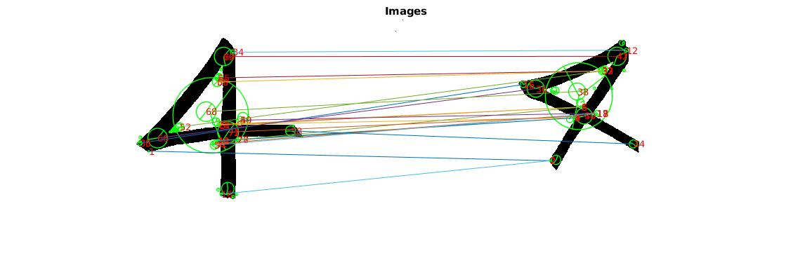
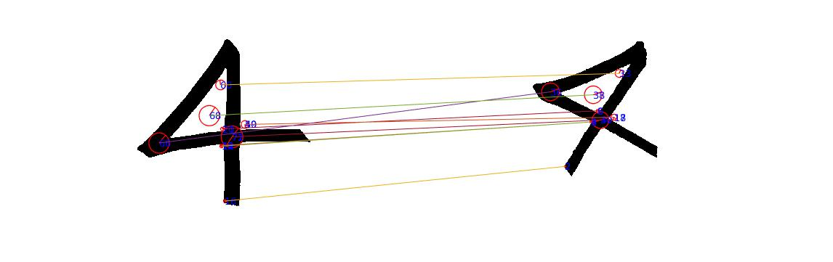
Disadvantages
The number of selected features largely depends the parameter we selected，so some of the
good matched features also was deleted.
Notes:
The corrected matched feature sets have the same changed angle and same scale ratio;
Since we don’t the actual differences of angles between the matched features; as well as the actual scale ratio between them.
We basically divided the angles space into 9 bins and ScaleRatio space into 6 bins, and test image into 25 patches, to calculate

Slide 22
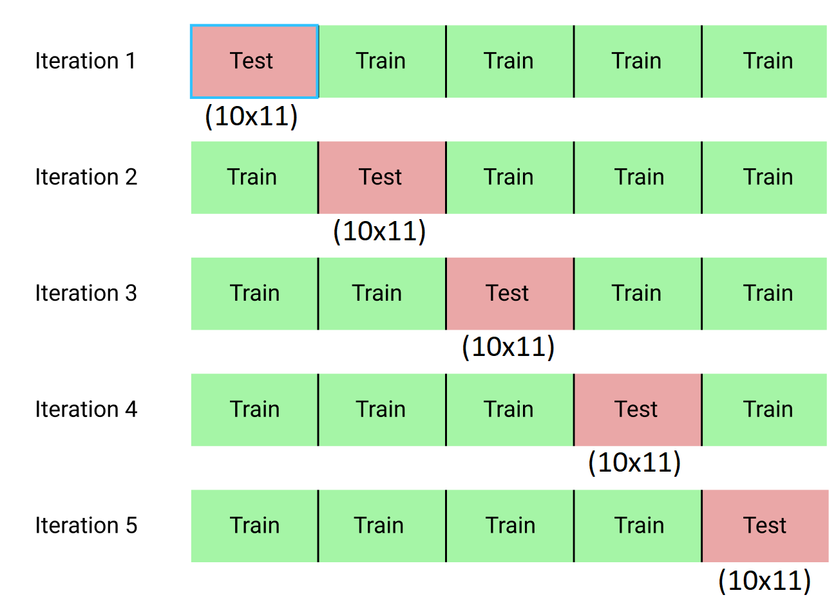
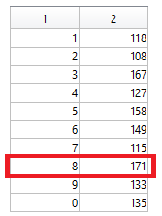
Experimental Results
Accuracy based on Test dataset with 5-fold Cross-validation.
Example: when Test Image = “0”
Raw matches → 58.5%

Slide 23
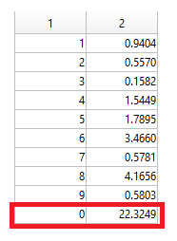
Experimental Results (continued)
Added “match_trim” → 63.1%
Added “scoring” → 78.2%
Added “punish” → 80.1%

Slide 24
List of References
[1] A. Vedaldi and B. Fulkerson, VLFeat: An Open and Portable Library of Computer Vision Algorithms,2008. http://www.vlfeat.org
[2] Guo, Dong. Digits Dataset.
[3] Hoff, William. 2012. http://inside.mines.edu/~whoff/courses/EENG512/lectures/
[4] https://www.kaggle.com/dansbecker/cross-validation
[5] SIFT detector and descriptor, http://www.vlfeat.org/overview/sift.html

Slide 25
Demo

