Slide 1

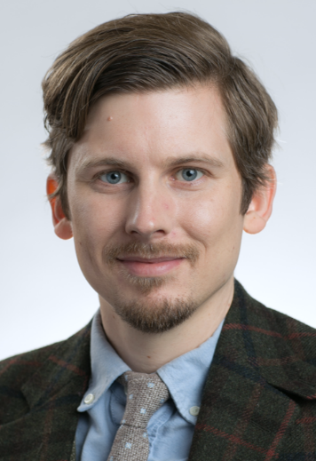
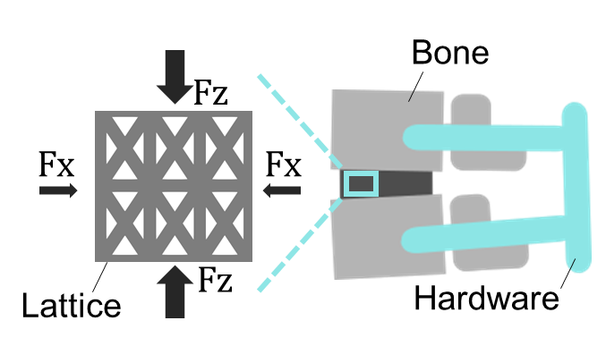

Design and testing of 3D printed tissue
scaffolds with directionally tunable stiffness
Abdullah Al Masud
Amit Arefin
Ming-Chien Chyu
Paul Egan
Dept. Mechanical Engineering
Texas Tech University
Abdullah Masud
Paul Egan
paul-egan.com

Slide 2
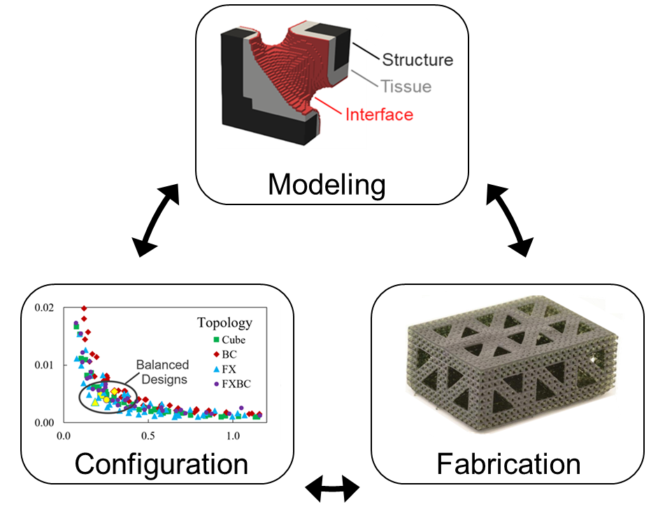
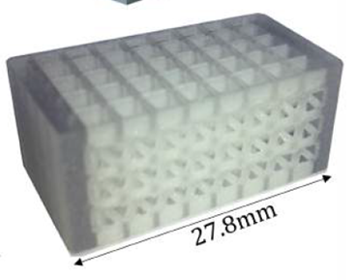
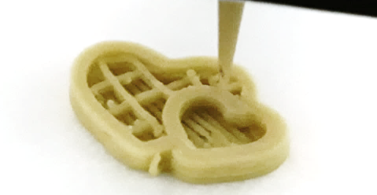
Medicine, Mechanics, and Manufacturing Design (M3D) Lab
Integrated Design
for
Medical Innovations
Tissue Scaffolds
Personalized Nutrition

Slide 3
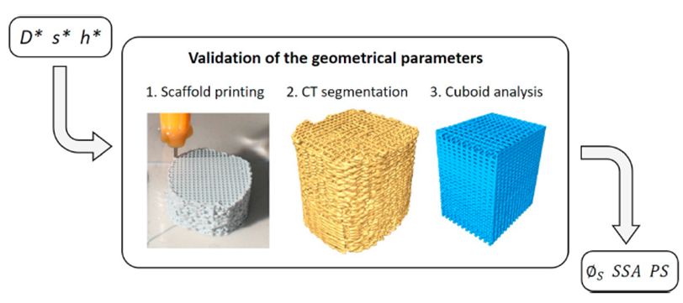
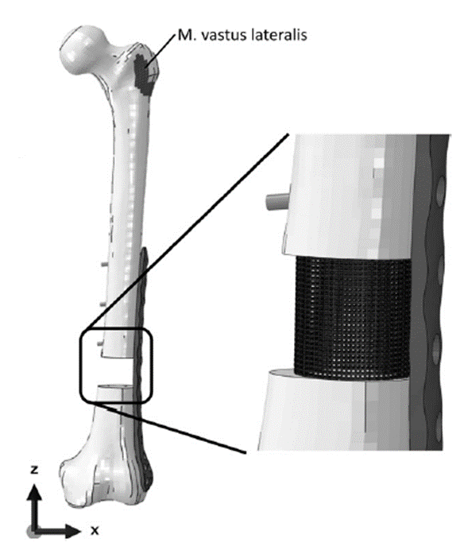
Background: Bone tissue scaffold printing
Tissue scaffold design
Mimic bone geometry
Potentially complex loading cases
Requires biocompatibility
Must achieve high porosity
Blazquez-Carmona et. al. J. Mech. Behav. Biomed. Mat. 2021
Wieding et. al. Med. Eng. Phys. 2013

Slide 4
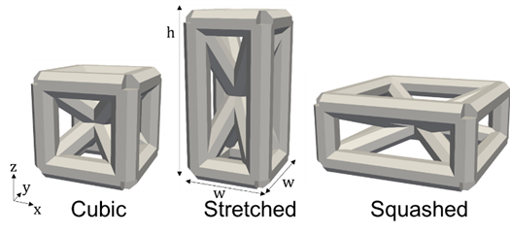
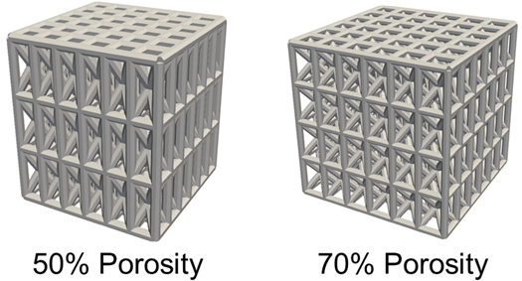
Aim: Design bone scaffolds with bi-axial tuning
Bi-axial tuning
Systems have asymmetric loads
Unit cells in lattices can have their geometry modified appropriately
Unit cells are patterned to form scaffolds of specified geometries

Slide 5
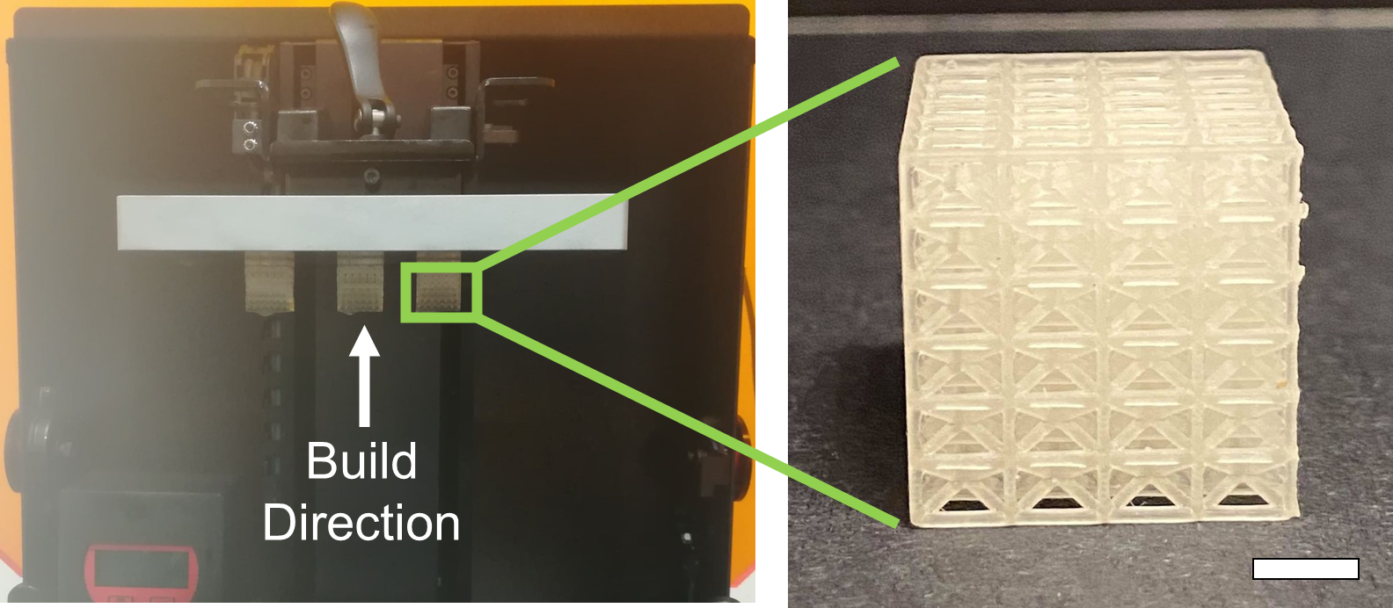
Methods: Scaffold fabrication
Printing process
EnvisionTEC DLP printing
E-shell 600 Methacrylic acid-based resin
Build-direction may affect mechanics

Slide 6
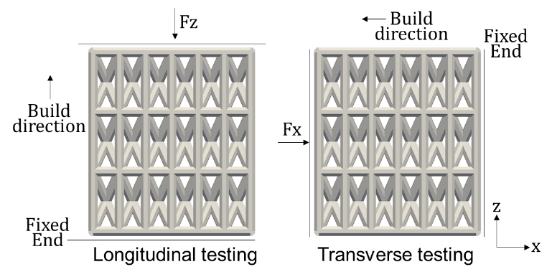
Methods: Mechanical testing orientation
Compression testing
Fixed ends interface with compression plates
Orientation of fixed ends and build direction dictate whether E_{z} or E_{x} elastic moduli tested

Slide 7
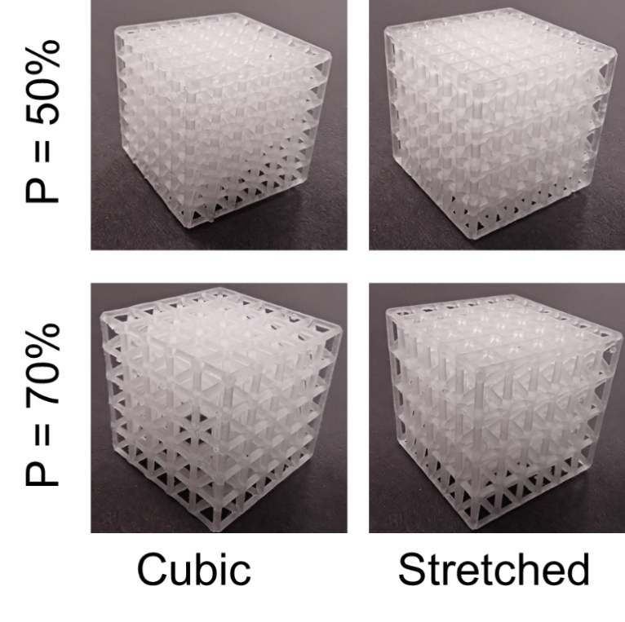
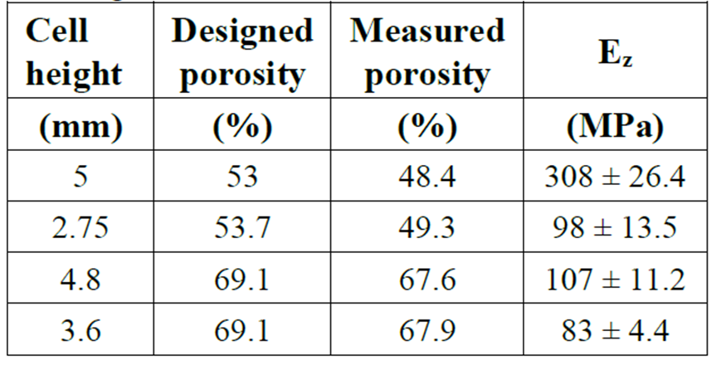
Results: Porosity differences
Mechanical testing
Higher porosity leads to higher longitudinal elastic modulus
Higher unit cell length leads to higher longitudinal elastic modulus

Slide 8
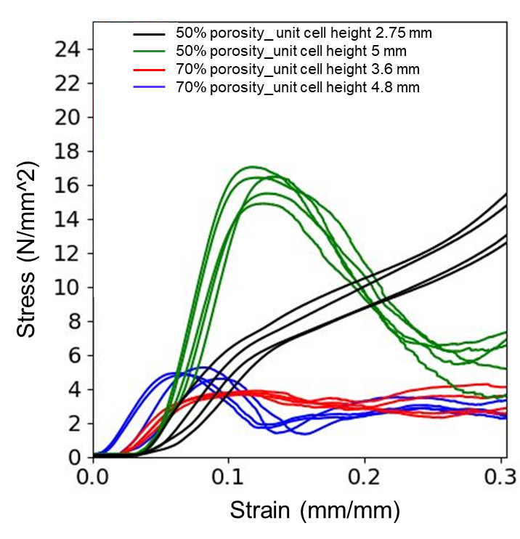
Results: Porosity differences
Mechanical testing
Higher porosity leads to higher longitudinal elastic modulus
Higher unit cell length leads to higher longitudinal elastic modulus

Slide 9
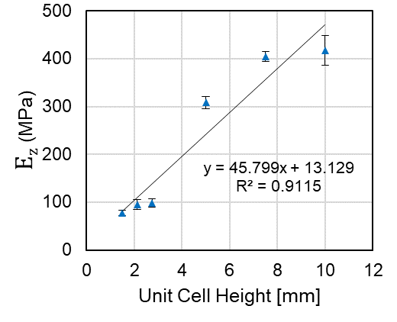
Results: Stretching unit cell height
Trends
Higher unit cell height increases elastic modulus
Not perfectly linear, could have manufacturing affect mechanics

Slide 10
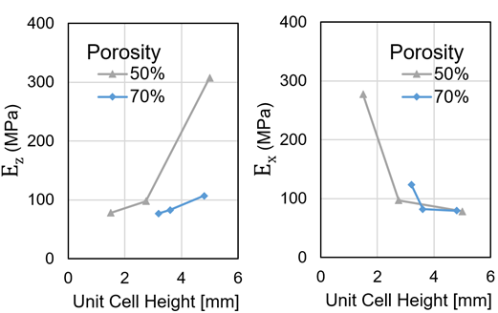
Results: Biaxial loading
Mechanical results
Longitudinal elastic modulus E_{z} is greater than tranvserve elastic modulus E_{x} only for stretch designs.
Increase in E_{z} is sharper than decrease in E_{x} as designs are stretched

Slide 11
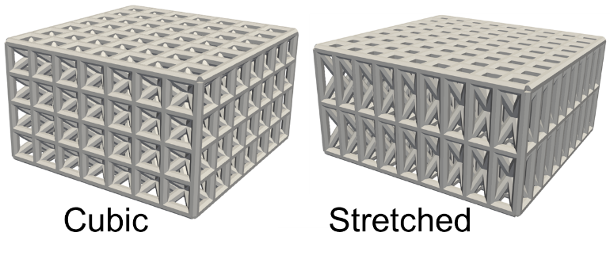
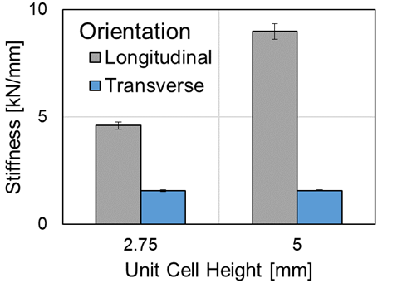
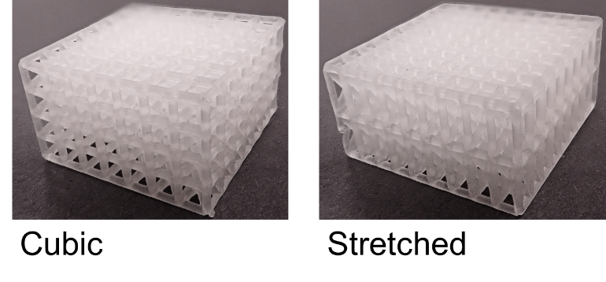
Results: Fabricated scaffolds
Scaffold testing
Longitudinal stiffness of 10 kN/mm for bone tissue engineering
By stretching the design you increase stiffness in E_{z} while maintaining stiffness in E_{x}
Egan et. al. J. Mech. Des. 2019

Slide 12
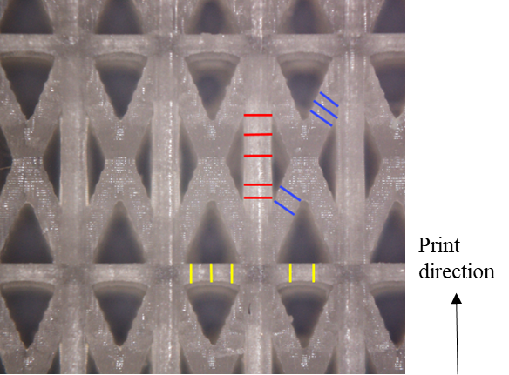
Discussion: Manufacturing affects mechanics
Limitations
Checking print defects and porosity influences
Can’t test every condition
Future work
Greater characterization of printing defects and failures
Design, build, and test for scaffold viability in use case

Slide 13
Conclusion: Biaxial tuning is viable
Key takeaways
Scaffolds qualitatively printed in a number of varied configurations for porosity and unit cell design
Can tune mechanics in multiple directions with varying relative trade-offs
Viable for scaffold problem in terms of overall stiffness, further optimization and testing needed

Slide 14

Thank you
paul-egan.com

