Slide 1
Machine Learning Techniques for Anti-Money Laundering
Aedron Bank - SAR Prediction
Date: November 9, 2025

Slide 2
Business Problem

Slide 3
Business Problem & Objective
Aedron Bank Profile
Nordic bank, 1 year old
1,000 customers
FSA requires enhanced AML monitoring
Problem:
Current Control
Rule: Investigate if turnover > €9,000/month
  Simple but ineffective
  Single feature decision
  Generate excessive false alerts – operation costly
Regulatory Pressure
  Need to file accurate SARs
  Demonstrate sophisticated controls
  Balance detection with efficiency
Objective:
Build Machine Learning - Driven AML Detection approach
  Find more suspicious customers (SARs) - Increase detection rate
  Reduce False Positives - Minimize unnecessary investigations
  Create sustainable controls - Justifiable and robust over time
  Explainable & Transparency
“From Rule-Based to ML-Driven AML Detection”

Slide 4
Data overview
Three Data Sources are used:
KYC Data
- Number of customers 1,000
- Attributes: Demographics, risk flags, intentions
2. Transactions
- Total s 165,736
- All customer transactions over 12 months
3. Labels
- Number of records: 12,000 (customer-months combinations)
- SAR filings (ground truth): 0- No SAR, 1- SAR Filed
Feature Engineering
Created 21 Features Across 3 Categories:
1. Transaction Volume (8 features)
- Turnover, count, sum, mean, std, min, max, range
2. Flow Patterns (7 features)
- Incoming/outgoing counts and amounts
- Flow ratio, internal transaction ratio
3. Customer Profile (6 features)
- Age, sex, high-risk country, vulnerable area
- Payment intentions
Notes:
Feature engineering is the process of transforming raw data into meaningful variables (features) that help machine learning models learn more effectively.

Slide 5
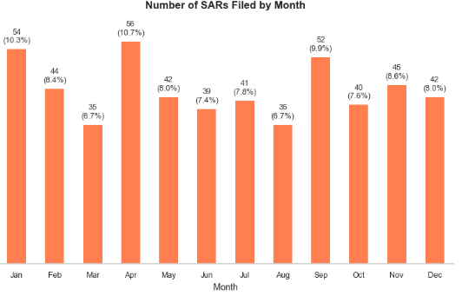
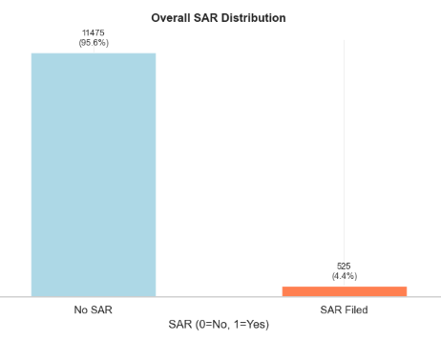
Data Exploration - Key Insights
SAR Distribution:
35-56 SARs filed across 12 months
Varies by month -seasonal patterns
  The highest volumes occur in January (54 filings, 10.3%) and April (56 filings, 10.7%), suggesting possible links to:
  End-of-year financial reporting cycles (Jan)
  Tax season or quarterly deadlines (Apr)
  Conversely, March (35, 6.7%) and August (35, 6.7%) show the lowest activity - possibly due to slower periods during holidays or reduced transaction volumes.
Overall SARs filed rate 4.4%.
About 308 unique customers (30.8%) with SARs
Key Challenge: Highly imbalanced (~4% SAR rate)

Slide 6
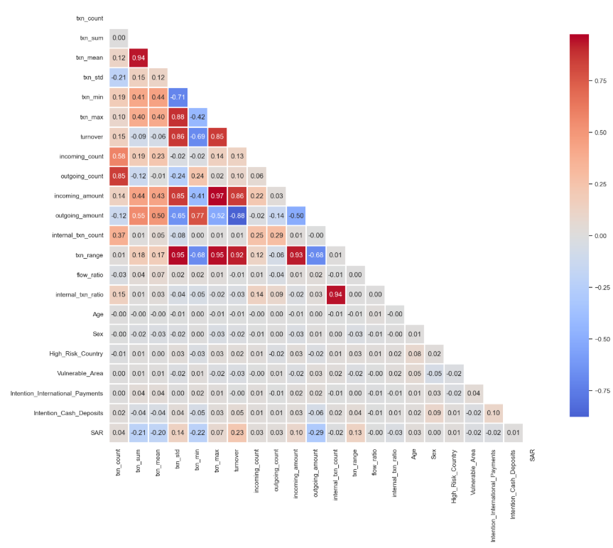
Feature Correlations
Turnover most correlated (but not only factor)
Transaction patterns matter
Customer risk profile adds signal
Flow ratios (income vs outgoing) important
Fig: Heatmap of feature confusion matrix

Slide 7
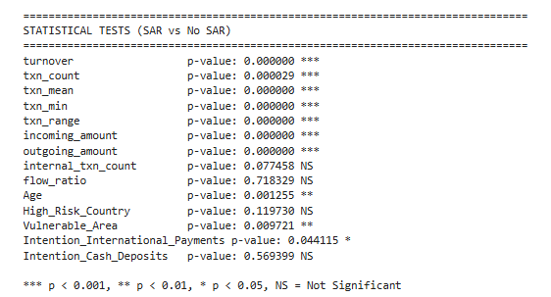
Statistical Significance
Most features show significant difference between SAR and non-SAR
Turnover, transaction count, mean, min, range, and flow amounts differ highly significantly (p < 0.001) between SAR and non-SAR customers - strong behavioral discriminators.
Age and Vulnerable_Area are significant (p < 0.01), suggesting older customers and those from vulnerable regions are overrepresented in SAR cases.
Intention_International_Payments is borderline significant (p ≈ 0.044) - may need further monitoring.
Internal_txn_count, flow_ratio, High_Risk_Country and Intention_Cash_Deposits show no significant difference, and may not reflect actual suspicious behavior.

Slide 8
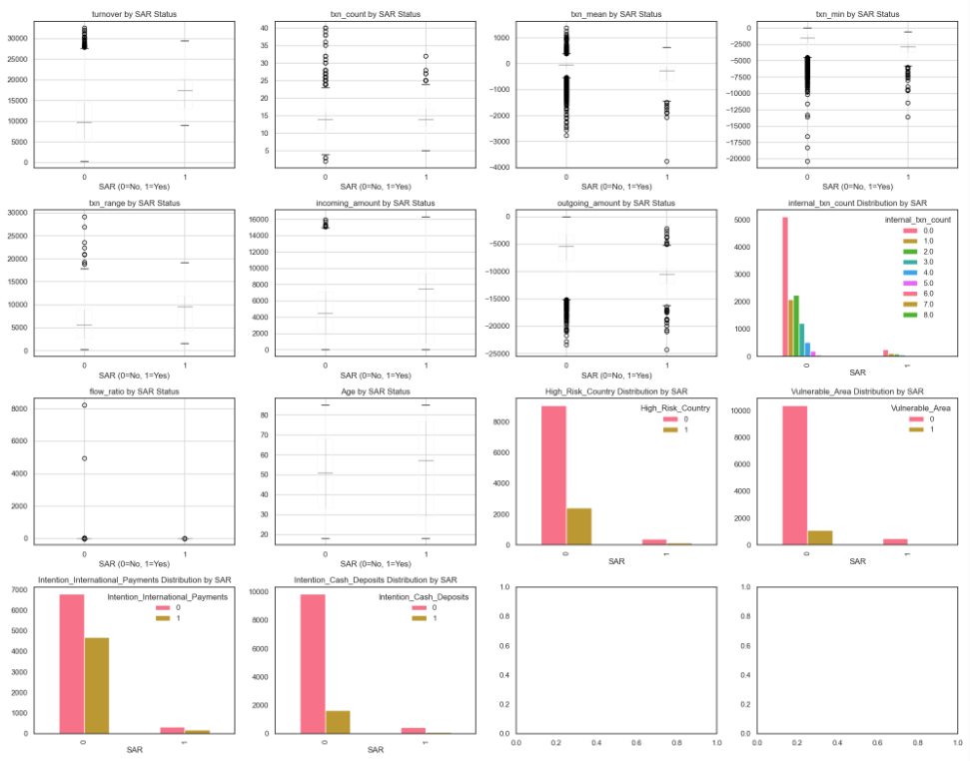
Features Distributions by SAR Status

Slide 9
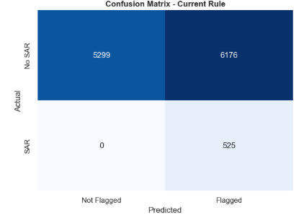
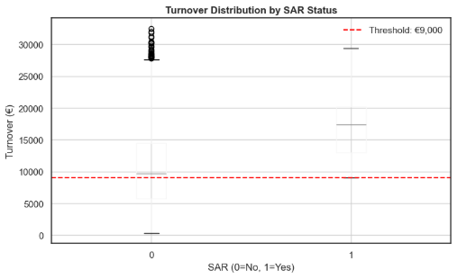
Current Rule Performance
Baseline Metrics
  Very Low Precision (7.8%) - For every 1 true SAR, ~12 false positives flagged.
  Perfect Recall (100%) - No SARs missed. All 525 suspicious cases captured.
  High False Positive Rate (54%) - Over half of all flagged customers are non-SAR → high operational cost.
  55.8% of Customers Flagged - Rule is overly broad; nearly half the customer base triggers alerts.

Slide 10

Machine Learning Techniques (Supervised)
Based on the nature of Data:
Supervised learning: labeled data
Unsupervised learning: unlabeled data
Historical Data
X1,X2
Features
Supervised Machine Learning: It uses ”labeled” data to build model and make predictions to ”unlabeled/not seen” data
Label
Build Model
F(X1,X2) = Y
X1,X2
Features
Predict
Label
New Data
Use Model
Notes:
Machine learning can be categorized into several types based on different criteria. Some common types of machine learning: Supervised Learning, Unsupervised Learning, Semi-Supervised Learning, Reinforcement Learning, etc.

Slide 11
Model Development
Models Evaluated:
  - Logistic Regression
  Random Forest
Training Approach:
- 80/20 train-test split
- Stratified sampling (preserve class balance)
- Class weighting to handle imbalance
- Cross-validation for robustness
Feature Importance Analysis:
  Random Forest provides explainability
  Top features align with business intuition

Slide 12
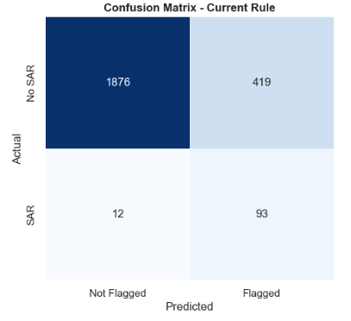
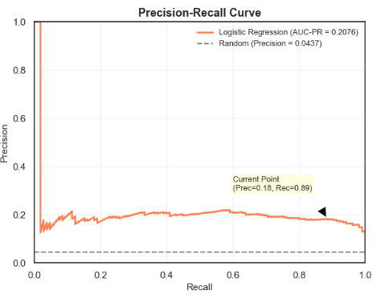
Model Performance (Logistic Regression)
Recall (SAR)= 89%, Catches nearly all true SARs (only 12 missed (FN)).
Precision (SAR)= 18%, 1 in 5 alerts is a true SAR. High false positives (419).
ROC-AUC= 0.90, Overall strong, but dominantes by the majority class.
The model achieves AUC-PR = 0.2076 (~20.8%), shows approximately 5x better than random, but still low.
Most Important Features (by coefficient magnitude)
Feature | Coefficient
turnover | 1.593331
incoming_amount | 1.410773
txn_range | -1.404151
txn_range | -1.404151
outgoing_amount | -1.355821
txn_min | -0.827766
internal_txn_ratio | -0.212711
Vulnerable_Area | -0.212026
internal_txn_count | 0.160228
txn_mean | -0.105929
Intention_International_Payments | -0.093247
incoming_count | 0.071964
txn_count | -0.071579
outgoing_count | -0.057656
Age | 0.057259
High_Risk_Country | 0.055352
Intention_Cash_Deposits | -0.050983
Sex | -0.021861
flow_ratio | -0.016814
Feature “turnover” is the most important feature for SAR prediction and has a positive relationship with SAR value 1.

Slide 13
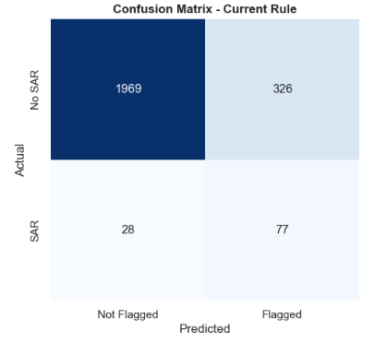
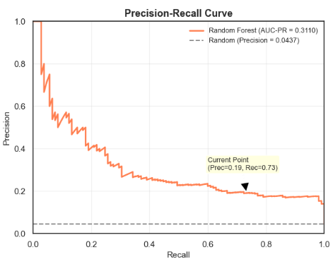
Model Performance (Random Forest)
Recall (SAR)= 73%, Catches nearly all true SARs (only 28 missed (FN))
Precision (SAR)= 19%. Low false positives (326).
ROC-AUC= 0.91, Overall strong, but dominantes by the majority class.
The model achieves AUC-PR = 0.3110 (~31.1%), shows approximately 5x better than random, but still low.
outgoing_amount dominates (33% importance) - stronger signal than turnover alone.
Most Important Features (by coefficient magnitude)
Feature | Importance
outgoing_amount | 0.331568
turnover | 0.169461
txn_min | 0.107961
txn_mean | 0.072638
incoming_amount | 0.067226
flow_ratio | 0.053149
txn_range | 0.050416
txn_range | 0.048180
Age | 0.024990
incoming_count | 0.018474
txn_count | 0.018223
outgoing_count | 0.011932
internal_txn_ratio | 0.011085
internal_txn_count | 0.005059
Sex | 0.002170
Vulnerable_Area | 0.002081
Intention_Cash_Deposits | 0.002054
High_Risk_Country | 0.001732
Intention_International_Payments | 0.001600

Slide 14
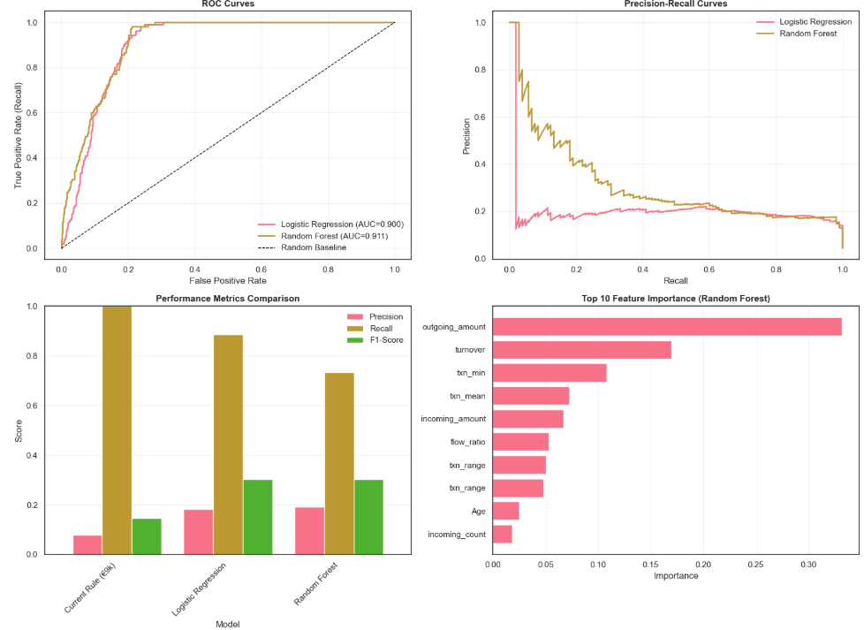
Model Comparison and Evaluation
Performance Metrics:
Model | Precision | Recall | F1-Score | ROC-AUC | AUC-PR | FALSE | Positive Rate | TRUE | Positives | FALSE2 | Positives3 | FALSE4 | Negatives | TRUE5 | Negatives6
Current Rule (€9k) | 0.078711 | 1.000000 | 0.145935 | N/A | N/A |  | 0.535512 |  | 105 |  | 1229 |  | 0 |  | 1066
Logistic Regression | 0.181641 | 0.885714 | 0.301459 | 0.9004 | 0.2076 |  | 0.182571 |  | 93 |  | 419 |  | 12 |  | 1876
Random Forest | 0.191067 | 0.733333 | 0.303150 | 0.9114 | 0.3110 |  | 0.142048 |  | 77 |  | 326 |  | 28 |  | 1969
• Best Recall (Detection Rate): Current Rule (€9k) (100.00%)
• Best Precision (Lowest False Positives): Random Forest (19.11%)
• Best F1-Score (Balance): Random Forest (0.3031)

Slide 15
Summary of Findings
Current State (€9,000 Turnover Rule):
Simple threshold-based approach
Limited detection capability
High false negative rate (missing suspicious customers)
Not leveraging customer profile or transaction patterns
Key Insights from Analysis:
Class Imbalance: SARs represent a small fraction of all customer-months
Multiple Risk Factors: Turnover alone is insufficient; transaction patterns, frequency, and KYC factors matter
Feature Importance: Top predictors include:
  Transaction turnover
  Transaction count and patterns
  Incoming/outgoing flow ratios
  Customer risk profile (high-risk country, vulnerable area)
Model Performance:
Random Forest outperforms both Logistic Regression and the current rule
Achieves better recall (finding more SARs) with manageable precision
Can be tuned via threshold adjustment to balance detection vs investigation workload

