Slide 1

Software Development project II
Mawlana Bhashani Science and Technology University
Santosh,Tangail-1902
Department of Information and Communication Technology(ICT)
Supervised By,
Dr. Md. Abir Hossain
Associate Professor
Dept. Of ICT,MBSTU
Presented By,
Anik Adnan (IT20021)
Md. Masud Rana (IT20024)

Slide 2

Safety Insurance Mobile Application
Outlines
Android Introduction
Project Overview
App Features
Permissions
Data Storage
App Screens

Slide 3
Android Introduction
Android is an open-source operating system designed primarily for mobile devices like smartphones and tablets. It is developed by Google and the Open Handset Alliance, a consortium of technology companies.
Key characteristics and aspects of Android include:
Open Source
App Ecosystem
Customization
User Interface
Multitasking
Security
Hardware Support
Google Services
Updates
Community and Support

Slide 4
Project Overview
The Safety Insurance Mobile Application is a Java-based mobile application designed to enhance personal safety by providing users with valuable features. The primary objective of this application is to empower users to quickly and effectively communicate their location and emergency messages to designated contacts in critical situations.
This mobile application allows users to save essential contact numbers and compose emergency messages. In case of an emergency, the user can trigger the application by pressing the volume button three times in succession when the screen is off. The application will then send an SMS to the saved contacts containing the user's message, current location details, and a Google Maps link.

Slide 5
App Features
The key features of the Safety Insurance Mobile Application include:
Emergency SMS functionality is triggered by volume button presses.
Retrieval of the user's current location using GPS coordinates and reverse geocoding.
Integration with Google Maps to provide a clickable map link.
User-friendly interface for saving contacts and customizing emergency messages.

Slide 6
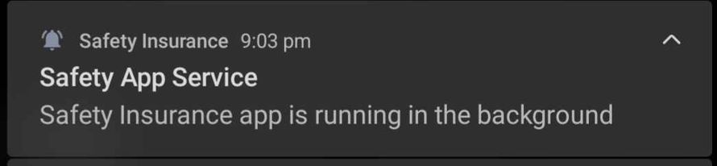
Permission
Location access (for obtaining user's current location).
SMS sending (for sending emergency messages).
Volume Button Access Permission (Enables the emergency feature for quick succession).
Foreground Service(Allows the app to run in the foreground).
ForegroundService Notification

Slide 7
Data Storage
SharedPreferences: SharedPreferences is a simple and lightweight data storage mechanism in Android used for storing small pieces of data, such as user preferences, settings, and configuration values. It allows an Android app to store and retrieve data in the form of key-value pairs.
Using SharedPreferences for securely store user-entered phone numbers, the emergency message and Geocoder Location details.

Slide 8
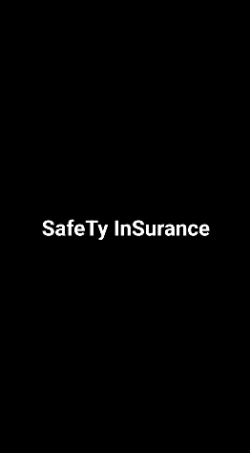
App Screens
Splash Screen
The splash screen is the first screen users see when they open the app.
Its purpose is to provide a visually appealing and branded welcome to users as the app loads.
It sets the initial tone for the user's interaction with the app, making a positive first impression.

Slide 9
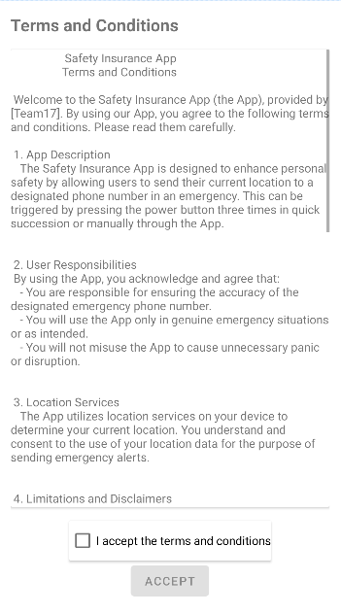
App Screens
Terms and Conditions Agreement
The "Terms and Conditions Agreement" is presented to the user when they first open the app after installation.
The user is required to review and accept these terms before proceeding further.
Once the user accepts the terms and conditions, this agreement is stored locally on the user's device, indicating their consent and agreement to abide by the terms.

Slide 10
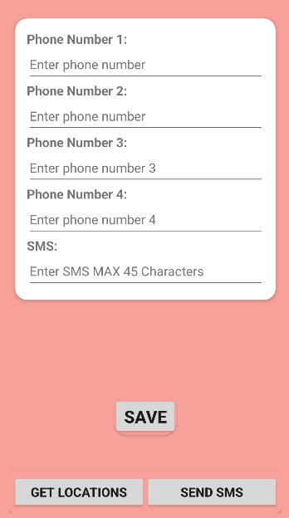
App Screens
Main Activity
MainActivity is a crucial component of this app. It serves as the central hub for users to input essential information and initiate critical functions related to safety and communication.
It contains max four phone numbers and message. Data are saved by the user pressing saved button.
It contains another two buttons
Get Locations button
2.Send SMS button.

Slide 11
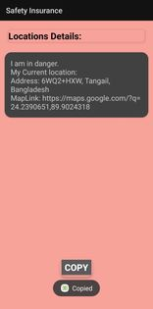
App Screens
Get Locations Activity
Purpose:
Explain that the "Get Location" activity serves the purpose of providing users with essential location details.
Copying Location Details:
Emphasize that users have the ability to copy these location details for sharing with trusted contacts or others.
Mention the convenience of this feature for quick communication during emergencies.

Slide 12
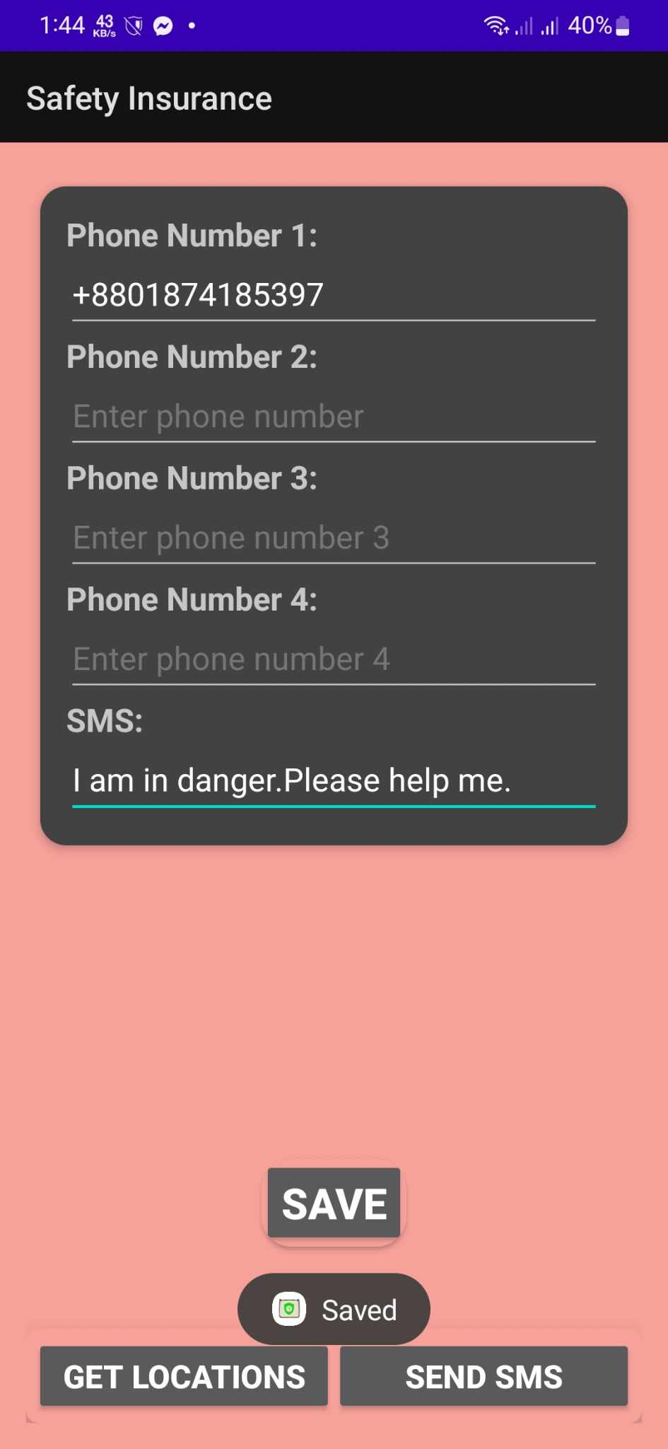
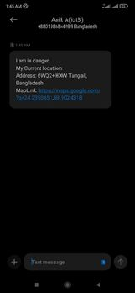
App Screens
Send SMS Button
Users can send emergency SMS messages by pressing the send SMS button.
User personalized emergency message concatenating with Location details obtained from geocoding and users current Google Maplink sent to the saved phone numbers.
Volume Button Service
By pressing volume button 3 times users can send SMS to the saved phone numbers same as "SMS Button". In addition, here burglarAlarm will be ringing a few seconds for user confirmation

