Slide 1
Chapter 28
Formal Modeling and Verification
Slide Set to accompany
Software Engineering: A Practitioner’s Approach, 8/e
by Roger S. Pressman and Bruce R. Maxim
Slides copyright © 1996, 2001, 2005, 2009, 2014 by Roger S. Pressman
For non-profit educational use only
May be reproduced ONLY for student use at the university level when used in conjunction with Software Engineering: A Practitioner's Approach, 8/e. Any other reproduction or use is prohibited without the express written permission of the author.
All copyright information MUST appear if these slides are posted on a website for student use.
These slides are designed to accompany Software Engineering: A Practitioner’s Approach, 8/e (McGraw-Hill 2014). Slides copyright 2014 by Roger Pressman.

Slide 2
Formal Modeling and Verification
Cleanroom software engineering and formal methods
  Both demand a specialized specification approach and each applies a unique verification method.
  Both are quite rigorous and neither is used widely by the software engineering community.
If you must build “bullet-proof” software, these methods can help immeasurably.
These slides are designed to accompany Software Engineering: A Practitioner’s Approach, 8/e (McGraw-Hill 2014). Slides copyright 2014 by Roger Pressman.

Slide 3
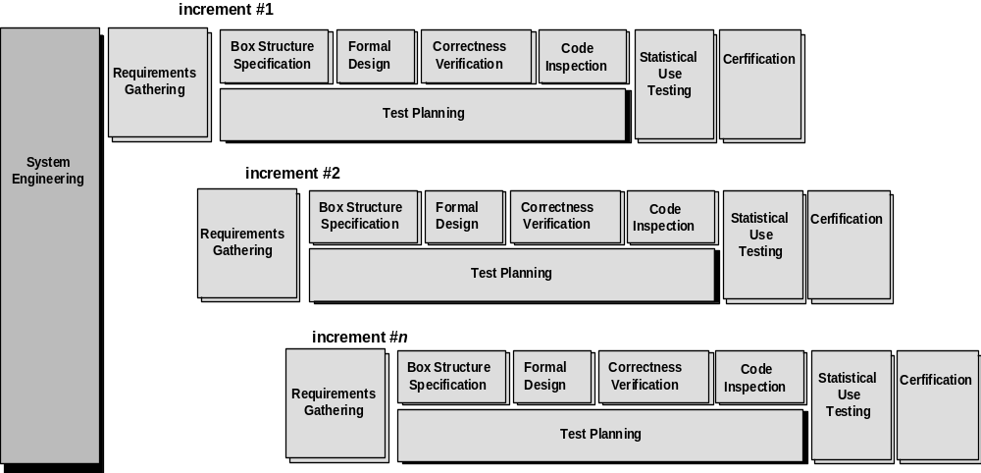
The Cleanroom Process Model
These slides are designed to accompany Software Engineering: A Practitioner’s Approach, 8/e (McGraw-Hill 2014). Slides copyright 2014 by Roger Pressman.

Slide 4
The Cleanroom Strategy-I
Increment Planning—adopts the incremental strategy
Requirements Gathering—defines a description of customer level requirements (for each increment)
Box Structure Specification—describes the functional specification
Formal Design—specifications (called “black boxes”) are iteratively refined (with an increment) to become analogous to architectural and procedural designs (called “state boxes” and “clear boxes,” respectively).
Correctness Verification—verification begins with the highest level box structure (specification) and moves toward design detail and code using a set of “correctness questions.” If these do not demonstrate that the specification is correct, more formal (mathematical) methods for verification are used.
Code Generation, Inspection and Verification—the box structure specifications, represented in a specialized language, are transmitted into the appropriate programming language.
These slides are designed to accompany Software Engineering: A Practitioner’s Approach, 8/e (McGraw-Hill 2014). Slides copyright 2014 by Roger Pressman.

Slide 5
The Cleanroom Strategy-II
Statistical Test Planning—a suite of test cases that exercise of “probability distribution” of usage are planned and designed
Statistical Usage Testing—execute a series of tests derived from a statistical sample (the probability distribution noted above) of all possible program executions by all users from a targeted population
Certification—once verification, inspection and usage testing have been completed (and all errors are corrected) the increment is certified as ready for integration.
These slides are designed to accompany Software Engineering: A Practitioner’s Approach, 8/e (McGraw-Hill 2014). Slides copyright 2014 by Roger Pressman.

Slide 6
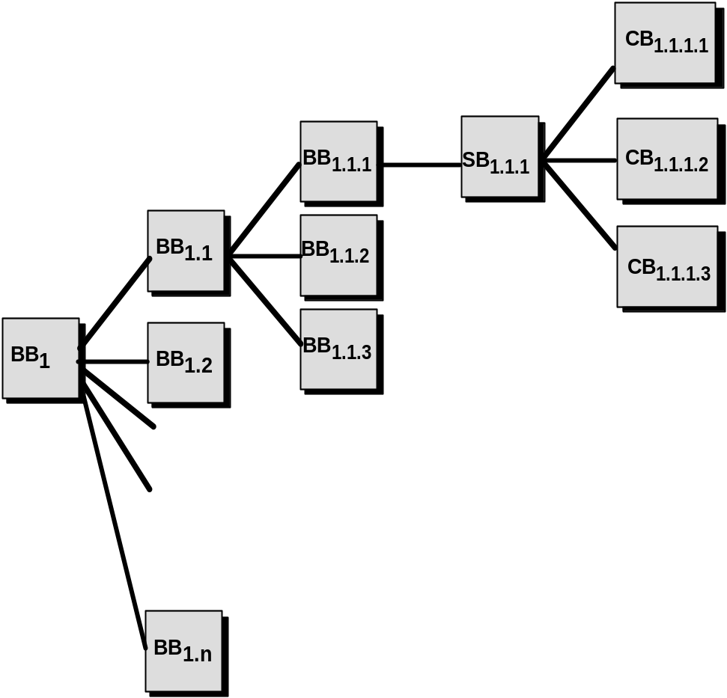
Box Structure Specification
black box
clear box
state box
These slides are designed to accompany Software Engineering: A Practitioner’s Approach, 8/e (McGraw-Hill 2014). Slides copyright 2014 by Roger Pressman.

Slide 7
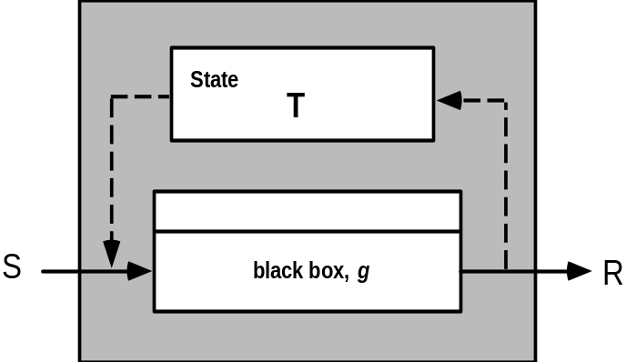
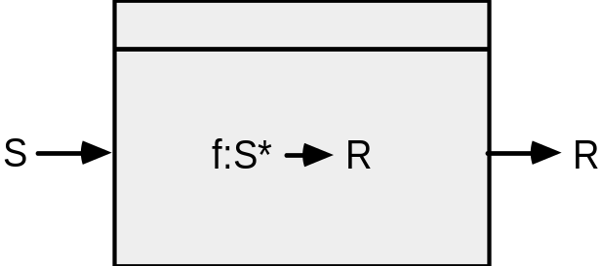
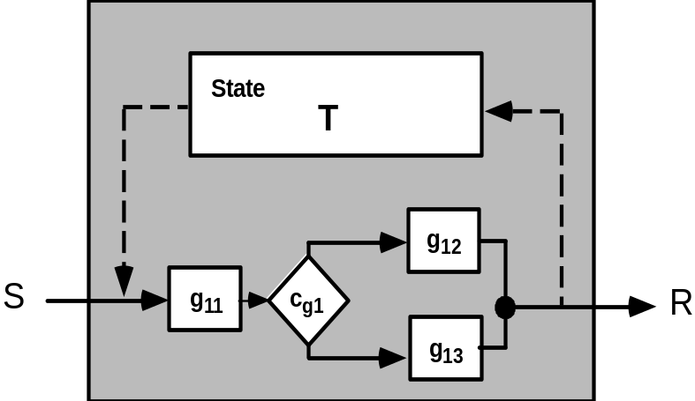
Box Structures
black box
state box
clear box
These slides are designed to accompany Software Engineering: A Practitioner’s Approach, 8/e (McGraw-Hill 2014). Slides copyright 2014 by Roger Pressman.

Slide 8
Design Refinement & Verification
If a function f is expanded into a sequence g and h, the correctness condition for all input to f is:
• Does g followed by h do f?
When a function f is refined into a conditional (if-then-else), the correctness condition for all input to f is:
• Whenever condition <c> is true does g do f and whenever <c> is false, does h do f?
When function f is refined as a loop, the correctness conditions for all input to f is:
• Is termination guaranteed?
• Whenever <c> is true does g followed by f do f, and whenever <c> is false, does skipping the loop still do f?
These slides are designed to accompany Software Engineering: A Practitioner’s Approach, 8/e (McGraw-Hill 2014). Slides copyright 2014 by Roger Pressman.

Slide 9
Advantages of Design Verification
It reduces verification to a finite process.
It lets cleanroom teams verify every line of design and code.
It results in a near zero defect level.
It scales up.
It produces better code than unit testing.
These slides are designed to accompany Software Engineering: A Practitioner’s Approach, 8/e (McGraw-Hill 2014). Slides copyright 2014 by Roger Pressman.

Slide 10
Cleanroom Testing
statistical use testing
  tests the actual usage of the program
determine a “usage probability distribution”
  analyze the specification to identify a set of stimuli
  stimuli cause software to change behavior
  create usage scenarios
  assign probability of use to each stimuli
  test cases are generated for each stimuli according to the usage probability distribution
These slides are designed to accompany Software Engineering: A Practitioner’s Approach, 8/e (McGraw-Hill 2014). Slides copyright 2014 by Roger Pressman.

Slide 11
Certification
1. Usage scenarios must be created.
2. A usage profile is specified.
3. Test cases are generated from the profile.
4. Tests are executed and failure data are recorded and analyzed.
5. Reliability is computed and certified.
These slides are designed to accompany Software Engineering: A Practitioner’s Approach, 8/e (McGraw-Hill 2014). Slides copyright 2014 by Roger Pressman.

Slide 12
Certification Models
Sampling model. Software testing executes m random test cases and is certified if no failures or a specified numbers of failures occur. The value of m is derived mathematically to ensure that required reliability is achieved.
Component model. A system composed of n components is to be certified. The component model enables the analyst to determine the probability that component i will fail prior to completion.
Certification model. The overall reliability of the system is projected and certified.
These slides are designed to accompany Software Engineering: A Practitioner’s Approach, 8/e (McGraw-Hill 2014). Slides copyright 2014 by Roger Pressman.

Slide 13
Formal Methods
“Formal methods used in developing computer systems are mathematically based techniques for describing system properties. Such formal methods provide frameworks within which people can specify, develop, and verify systems in a systematic, rather than ad hoc manner.”
The Encyclopedia of Software Engineering [Mar01]
The Problem with conventional specs:
  contradictions
  ambiguities
  vagueness
  incompleteness
  mixed levels of abstraction
These slides are designed to accompany Software Engineering: A Practitioner’s Approach, 8/e (McGraw-Hill 2014). Slides copyright 2014 by Roger Pressman.

Slide 14
Formal Specification
Desired properties—consistency, completeness, and lack of ambiguity—are the objectives of all specification methods
The formal syntax of a specification language enables requirements or design to be interpreted in only one way, eliminating ambiguity that often occurs when a natural language (e.g., English) or a graphical notation must be interpreted
  The descriptive facilities of set theory and logic notation enable clear statement of facts (requirements).
Consistency is ensured by mathematically proving that initial facts can be formally mapped (using inference rules) into later statements within the specification.
These slides are designed to accompany Software Engineering: A Practitioner’s Approach, 8/e (McGraw-Hill 2014). Slides copyright 2014 by Roger Pressman.

Slide 15
Formal Methods Concepts
data invariant—a condition that is true throughout the execution of the system that contains a collection of data
state
  Many formal languages, such as OCL (Section 28.5) , use the notion of states as they were discussed in Chapters 7 and 8, that is, a system can be in one of several states, each representing an externally observable mode of behavior.
  The Z language (Section 28.6)defines a state as the stored data which a system accesses and alters
operation—an action that takes place in a system and reads or writes data to a state
  precondition defines the circumstances in which a particular operation is valid
  postcondition defines what happens when an operation has completed its action
These slides are designed to accompany Software Engineering: A Practitioner’s Approach, 8/e (McGraw-Hill 2014). Slides copyright 2014 by Roger Pressman.

Slide 16
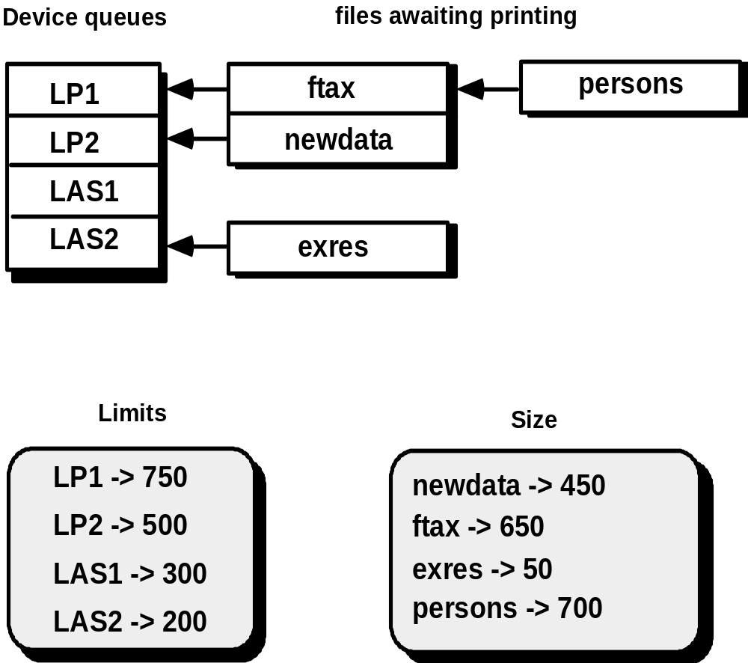
An Example—Print Spooler
These slides are designed to accompany Software Engineering: A Practitioner’s Approach, 8/e (McGraw-Hill 2014). Slides copyright 2014 by Roger Pressman.

Slide 17
States and Data Invariant
The state of the spooler is represented by the four components Queues, OutputDevices, Limits, and Sizes.
The data invariant has five components:
• Each output device is associated with an upper limit of print lines
• Each output device is associated with a possibly nonempty queue of files awaiting printing
• Each file is associated with a size
• Each queue associated with an output device contains files that have a size less than the upper limit of the output device
• There will be no more than MaxDevs output devices administered by the spooler
These slides are designed to accompany Software Engineering: A Practitioner’s Approach, 8/e (McGraw-Hill 2014). Slides copyright 2014 by Roger Pressman.

Slide 18
Operations
An operation which adds a new output device to the spooler together with its associated print limit
An operation which removes a file from the queue associated with a particular output device
An operation which adds a file to the queue associated with a particular output device
An operation which alters the upper limit of print lines for a particular output device
An operation which moves a file from a queue associated with an output device to another queue associated with a second output device
These slides are designed to accompany Software Engineering: A Practitioner’s Approach, 8/e (McGraw-Hill 2014). Slides copyright 2014 by Roger Pressman.

Slide 19
Pre- & Postconditions
For the first operation (adds a new output device to the spooler together with its associated print limit):
Precondition: the output device name does not already exist and that there are currently less than MaxDevs output devices known to the spooler
Postcondition: the name of the new device is added to the collection of existing device names, a new entry is formed for the device with no files being associated with its queue, and the device is associated with its print limit.
These slides are designed to accompany Software Engineering: A Practitioner’s Approach, 8/e (McGraw-Hill 2014). Slides copyright 2014 by Roger Pressman.

