Slide 1

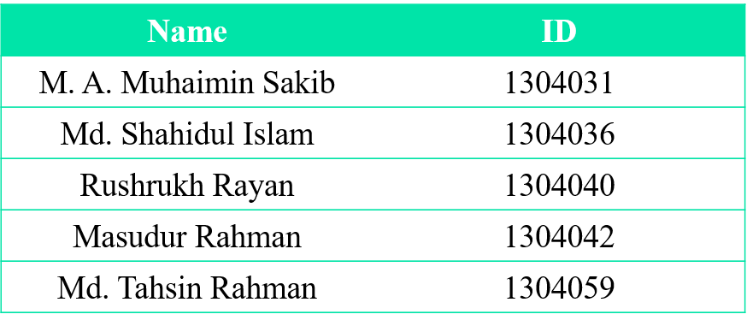
FEASIBILITY ANALYSIS OF MUTUAL TRUST BANK Ltd. (Agrabad Branch)
Presented by:
Supervisors:
Miss Shayla Sharmin
Lecturer, Dept. of CSE, CUET
Dr. Kaushik Deb
Professor, Dept. of CSE, CUET

Slide 2
Contents
Introduction to Feasibility Analysis.
Proposal for Improvements on Different Banking System of MTB.
Analyzing the Feasibility-
Technical Feasibility
Operational Feasibility
Economical Feasibility
Calculating Optimal Solution.

Slide 3
Feasibility Analysis
Feasibility analysis is used to assess the strength and weaknesses of a proposed system and present directions of activities which will improve the system and achieve desired result.
Any Feasibility analysis consists of three basic steps:
Evaluating Technical Feasibility
Evaluating Operational Feasibility
Evaluating Economical Feasibility

Slide 4
Lackings of Mutual Trust Bank System
Number of ATM Booths is not sufficient.
No facility of Mobile Banking.

Slide 5
Proposed Improvements
Proposal A: Increasing amount of ATM Booth
Proposal B: Introducing Mobile Banking System

Slide 6
Analyzing Feasibility of Proposal A
Technical Feasibility
ATM machine required.
Available.
Internet connection for ATM booth.
Can be easily managed.
Software for ATM machine.
Available.
CC Camera required.
Available.

Slide 7
Analyzing Feasibility of Proposal A (Cont.)
Operational Feasibility
Renting land for ATM booth.
Manageable.
Security guard.
Manageable.
Transportation of money to ATM booth.
Can be done.

Slide 8
Analyzing Feasibility of Proposal A (Cont.)
Economical Feasibility
Investment:
Cost of Space– 200000tk
Cost of ATM machine – 800000tk
Cost of installing ATM booth – 50000tk
Cost of software – 50000tk
Cost of IPS – 40000tk
Cost of CC Camera – 30000tk
Cost of Making ATM card (500) – 10000tk
Investment for 1 booth = 1180000tk
For 20 booth = 1180000tk * 20 =23600000tk.
Total Investment = 23600000tk

Slide 9
Analyzing Feasibility of Proposal A (Cont.)
Economical Feasibility
Cost Per Year:
Power supply– 30000tk
Salary of security guards – 100000tk
Transportation cost – 50000tk
Maintenance cost – 100000tk
Cost for 1 booth = 280000tk
For 20 booth = 20 * 280000tk = 5600000tk
Total yearly cost : 5600000tk

Slide 10
Analyzing Feasibility of Proposal A (Cont.)
Economical Feasibility
Payback Period Calculation:
Investment = 23600000tk
Total Cost = 5600000tk
Total expected income = 10000000tk (per year)
Net benefit = Total income – Total Cost = 10000000tk – 5600000tk =4400000tk
Payback period = Investment / Net benefit =23600000tk / 4400000tk = 5.3~5.4 years.

Slide 11
Analyzing Feasibility of Proposal B
Technical Feasibility
Required server for data storage.
Available.
Required security software.
Available from security software provider companies.
Required Network provider.
Available from mobile operator companies.

Slide 12
Analyzing Feasibility of Proposal B (Cont.)
Operational Feasibility
Required expert software and database analyst..
Manageable.
Required Agent all over the country.
Can be easily managed.
Recruiting employee and training them.
Can be done.
Require employee for advertisement.
Can be done.

Slide 13
Analyzing Feasibility of Proposal B (Cont.)
Economical Feasibility
Investment:
Cost of security software – 1000000tk
System software – 500000tk
Cost of server – 800000tk
Cost of network utilities – 500000tk
Cost of Employee training – 100000tk
Total Investment: 2900000tk

Slide 14
Analyzing Feasibility of Proposal B (Cont.)
Economical Feasibility
Cost Per Year:
Salary of software and database experts – 200000tk
Salary of Employees – 1000000tk
Salary of server room controller – 100000tk
Cost of Maintenance software – 10000tk
Cost of Maintenance server – 10000tk
Cost of Advertisement – 1000000tk
Others cost – 20000tk
Total Cost : 2340000tk

Slide 15
Analyzing Feasibility of Proposal B (Cont.)
Economical Feasibility
Payback Period Calculation:
Investment = 2900000tk
Total Cost = 2340000tk
Total expected income = 5000000tk (per year)
Net benefit = Total income – Total Cost = 5000000tk – 2340000tk =2660000tk
Payback period = Investment / Net benefit =2900000tk / 2660000tk = 1~1.1 years.

Slide 16
Calculating Optimal Solution
Proposal A
Technically Feasible
Operationally Feasible
Not Economically Feasible
High investment cost and long payback period.
Proposal B
Technically Feasible
Operationally Feasible
Economically Feasible

Slide 17
Calculating Optimal Solution (Cont.)
Considering Initial investment and payback period,
PROPOSAL B IS ACCEPTED.

Slide 18
Conclusion
In this presentation we have analyzed the feasibility of two different proposals and also calculated the optimal one.
All the cost values are approximate not exact. The cost may vary slightly.
This Proposal is not mandatory but it can be a possible improvement to the system.

Slide 19


