Slide 1
Chapter 39
Concluding Comments
Slide Set to accompany
Software Engineering: A Practitioner’s Approach, 8/e
by Roger S. Pressman and Bruce R. Maxim
Slides copyright © 1996, 2001, 2005, 2009, 2014 by Roger S. Pressman
For non-profit educational use only
May be reproduced ONLY for student use at the university level when used in conjunction with Software Engineering: A Practitioner's Approach, 8/e. Any other reproduction or use is prohibited without the express written permission of the author.
All copyright information MUST appear if these slides are posted on a website for student use.
These slides are designed to accompany Software Engineering: A Practitioner’s Approach, 8/e (McGraw-Hill 2014). Slides copyright 2014 by Roger Pressman.

Slide 2
Importance of Software-Revisited
In Chapter 1, software was characterized as a differentiator.
  The function delivered by software differentiates products, systems, and services and provides competitive advantage in the marketplace.
But software is more that a differentiator.
The programs, documents, and data that are software help to generate the most important commodity that any individual, business, or government can acquire—information.
These slides are designed to accompany Software Engineering: A Practitioner’s Approach, 8/e (McGraw-Hill 2014). Slides copyright 2014 by Roger Pressman.

Slide 3
People - Building Systems
Communication is changing
  e.g., video conferencing, social media
Work patterns are changing
  e.g., intelligent agents
Knowledge acquisition is changing
  e.g., data mining, the Web
These slides are designed to accompany Software Engineering: A Practitioner’s Approach, 8/e (McGraw-Hill 2014). Slides copyright 2014 by Roger Pressman.

Slide 4
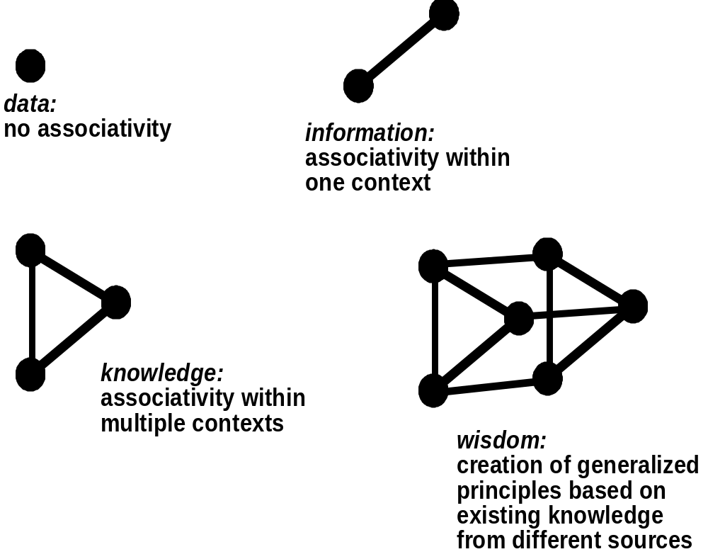
An Information Spectrum
These slides are designed to accompany Software Engineering: A Practitioner’s Approach, 8/e (McGraw-Hill 2014). Slides copyright 2014 by Roger Pressman.

Slide 5
The Long View
Two conflicting views:
  Ray Kurzweil—digital utopia and immortality
  Bill Joy—digital distopia and extinction
For a thorough discussion, see a special issue of IEEE Spectrum, June, 2008
  The Rapture of the Geeks
These slides are designed to accompany Software Engineering: A Practitioner’s Approach, 8/e (McGraw-Hill 2014). Slides copyright 2014 by Roger Pressman.

Slide 6
Software Engineering Ethics-I
An ACM/IEEE-CS Joint Task Force has produced a Software Engineering Code of Ethics and Professional Practices (Version 5.1). The code [ACM98] states:
  Software engineers shall commit themselves to making the analysis, specification, design, development, testing and maintenance of software a beneficial and respected profession. In accordance with their commitment to the health, safety and welfare of the public, software engineers shall adhere to the following Eight Principles:
These slides are designed to accompany Software Engineering: A Practitioner’s Approach, 8/e (McGraw-Hill 2014). Slides copyright 2014 by Roger Pressman.

Slide 7
Software Engineering Ethics-II
1. PUBLIC - Software engineers shall act consistently with the public interest.
2. CLIENT AND EMPLOYER - Software engineers shall act in a manner that is in the best interests of their client and employer consistent with the public interest.
3. PRODUCT - Software engineers shall ensure that their products and related modifications meet the highest professional standards possible.
4. JUDGMENT - Software engineers shall maintain integrity and independence in their professional judgment.
5. MANAGEMENT - Software engineering managers and leaders shall subscribe to and promote an ethical approach to the management of software development and maintenance.
6. PROFESSION - Software engineers shall advance the integrity and reputation of the profession consistent with the public interest.
7. COLLEAGUES - Software engineers shall be fair to and supportive of their colleagues.
8. SELF - Software engineers shall participate in lifelong learning regarding the practice of their profession and shall promote an ethical approach to the practice of the profession.
These slides are designed to accompany Software Engineering: A Practitioner’s Approach, 8/e (McGraw-Hill 2014). Slides copyright 2014 by Roger Pressman.

Slide 8
Ethics-On a Personal Level
Never steal data for personal gain.
Never distribute or sell proprietary information obtained as part of your work on a software project.
Never maliciously destroy or modify another person’s programs, files, or data.
Never violate the privacy of an individual, a group, or an organization.
Never hack into a system for sport or profit.
Never create or promulgate a computer virus or worm.
Never use computing technology to facilitate discrimination or harassment.
These slides are designed to accompany Software Engineering: A Practitioner’s Approach, 8/e (McGraw-Hill 2014). Slides copyright 2014 by Roger Pressman.

