Slide 1

East West University
TIC TAC TOE
Prepared by Team believers
MASUM (2023-3-60-066)
MAIDUL (2023-3-60-068)
YASIR ARAFAT (2023-3-60-079)
Course Instructor : Dr. Hasan Mahmood Aminul Islam(DHMAI)

Slide 2
Purpose of TIC-TAC-TOE
This cultivates strategic thinking skills
Players are constantly making decisions about where to place their marks.
It's a great way to pass the time, relax, and have fun.
It also exercises memory and attention skills.

Slide 3
Methodology:
The game is a two player game.
Firstly, run the game, then display the start game, control, exit.
Then we start the game then take the name of the players as input.
One of the players chose ‘X’ and the other player chose ‘O’.
The player who has four 'X' symbols across a horizontal, vertical, or diagonal row wins. Then a message is displayed “You Win” and other players display “You Loss”.
If all of the indexes are full of the symbols ‘X’ and ‘O’, then the message is displayed “Match is Draw”.

Slide 4
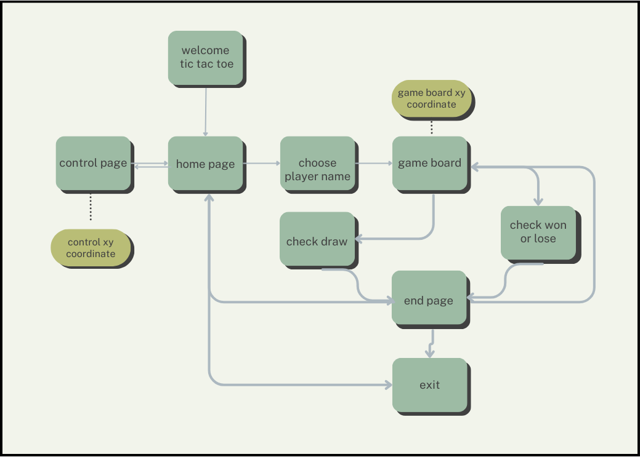
Process flow:
Home page
Choose player name
Game board
Win or lose
Terminated

Slide 5
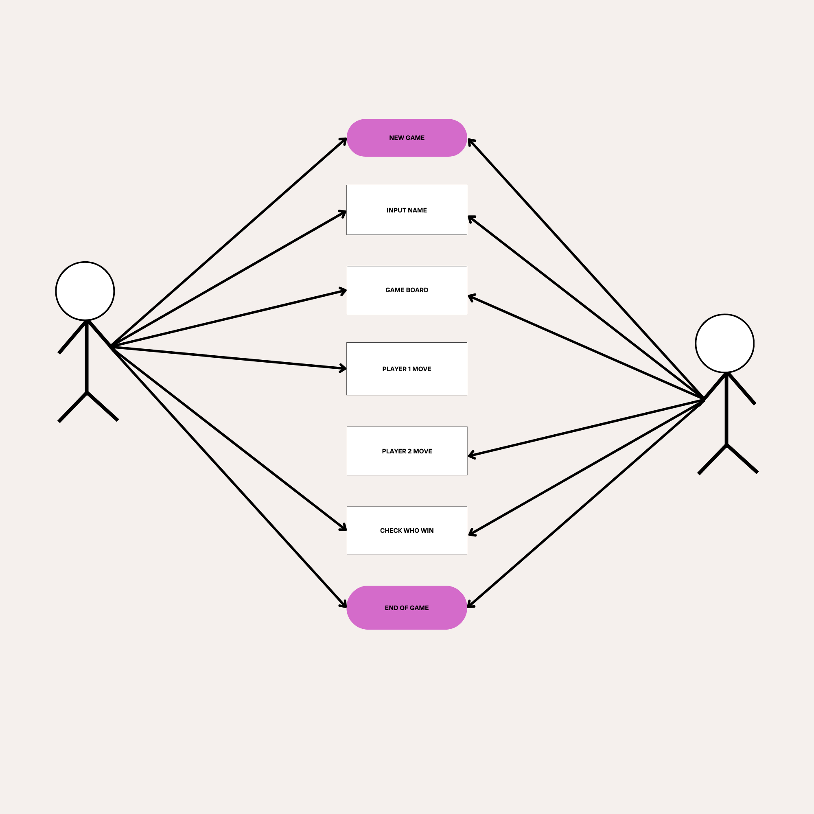
Use case:
Start game
Input player name
Show game board
Move players
Win or lose
Terminated

Slide 6
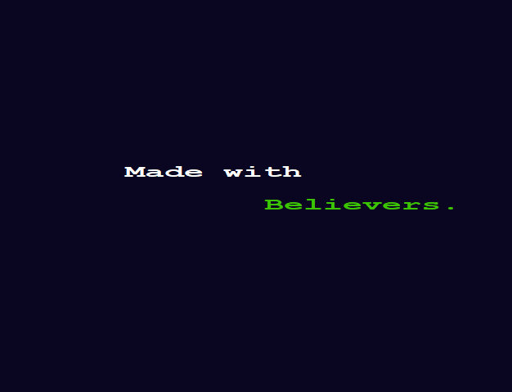
Welcome page

Slide 7
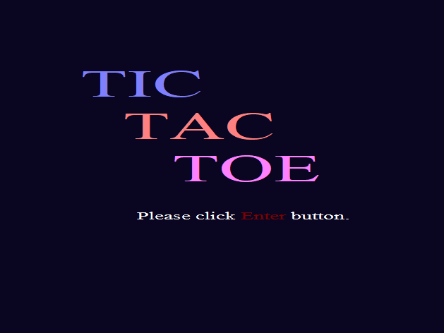
Home page

Slide 8
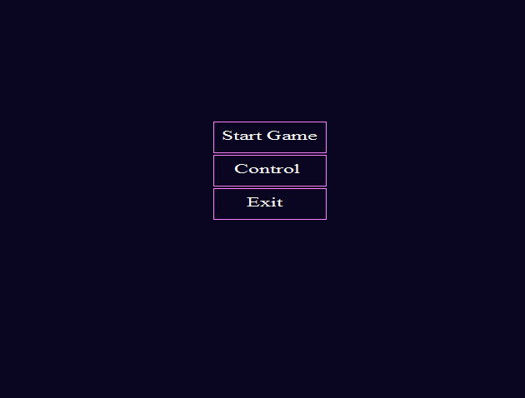
Menu page

Slide 9
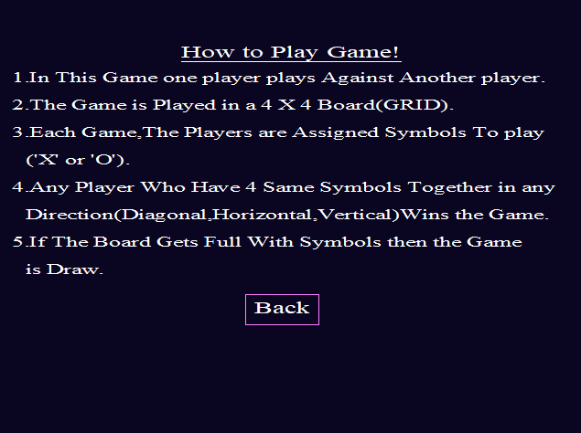
Control page

Slide 10
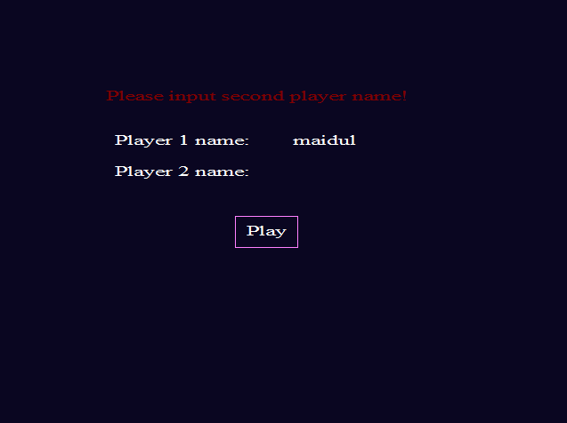
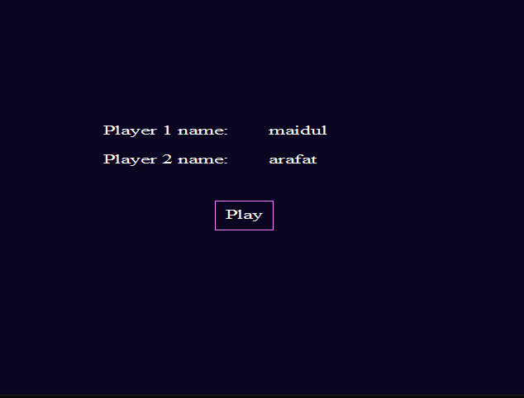
Input player name
Show error message
Play game

Slide 11
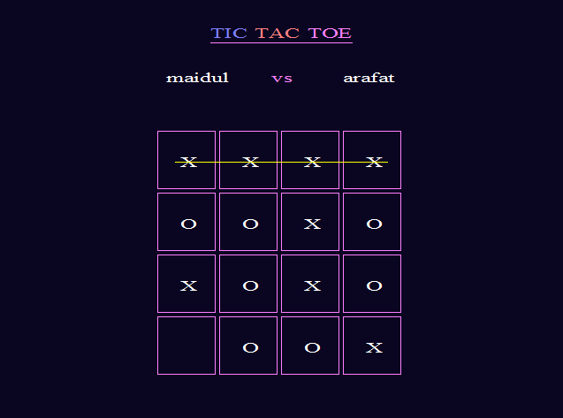
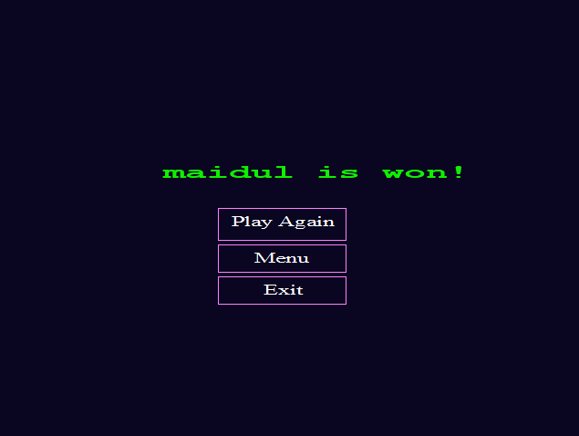
Show player name
Game win
play again
menu page
exit

Slide 12
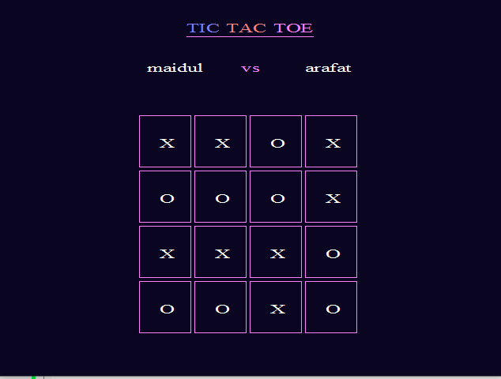
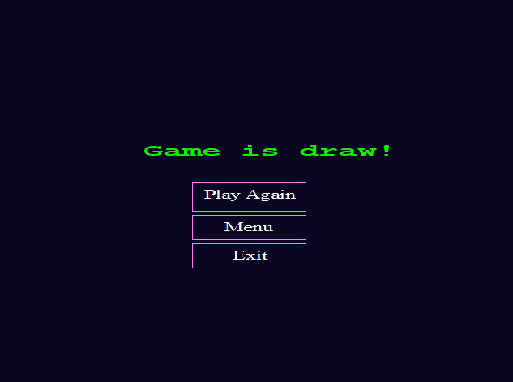
Game Draw
play again
menu page
exit

Slide 13
Future Plan:
Single player
Add sound
Game toss

Slide 14

Question and Answer
Thank You!

