Slide 1
Enhanced Urban Mobility through Deep Learning Based Real Time Passenger Head Counting and Occupancy Estimation
Md Masum Billah

Slide 2
INTRODUCTION
Why Accurate Passenger Counting Matters
Motivation
Objectives
1
Why it matters
1
Vision based counting system
Accurate occupancy data drives scheduling, overcrowding prevention, and passenger safety.
Design and test a vision based passenger count system within bus interior using head detection method
2
Sensors fall short
2
Object detection
Infrared beams, pressure mats, and ticketing systems degrade during simultaneous boarding/alighting.
Study different model and select the best model to detect passenger head in real bus scenario
3
Vision is promising — but different
3
Density Estimation
Bus interiors bring heavy occlusion, ceiling-mounted perspective distortion, and tiny head sizes.
Handle counting scenarios where the individuals heads are difficult to accurately localise
Notes:
Passenger counting matters for scheduling and safety, but traditional sensors fail under crowding. Cameras are promising, but bus interiors cause severe occlusion, perspective distortion, and tiny heads — this is the core challenge we address.

Slide 3
LITERATURE SUMMARY
Existing Work on Passenger Counting
Study | Approach | Main Objective | Limitation
Wi-Fi Passenger Counting (2020) | De-randomization | Privacy-preserving APC | Close stop & inactive Wi-Fi
NAPC Neural Algorithm (2021) | LSTM RNN + 3D LiDAR | Real-time vehicle load | Heavy annotation & excludes kids
Social Distance Monitoring(2022) | OpenPose | Distance & crowd estimation | High compute requirement
Video APC Deployment (2025) | MobileNetV3 SSD | On-bus vs off-buss comparison | Occlusion & lighting sensitivity

Slide 4
LITERATURE SUMMARY
The Problem & the Gap in Existing Work
THE PROBLEM
THE RESEARCH GAP
Detection-based counting works in sparse scenes but breaks down under heavy occlusion
.
Density-regression counting handles dense crowds well but is unreliable for small groups.
No single method performs well across the full range of bus occupancy.
Density-only methods estimate crowd density, not individuals, causing double-counting risk in video applications.
No prior study systematically compares detection vs. density approaches under bus-specific occlusion and scale conditions.
No adaptive mechanism exists to route each scene to whichever counting strategy suits it best.

Slide 5
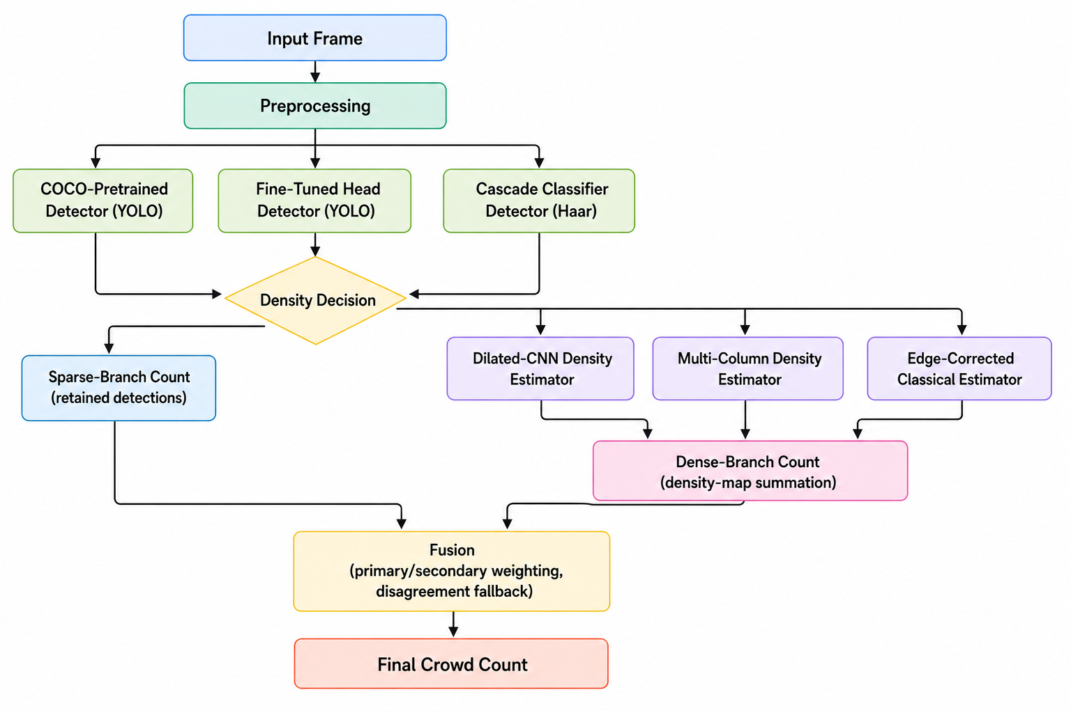
PROPOSED APPROACH
An Adaptive Hybrid Counting Framework
Notes:
This is the core idea: two branches run in parallel on the same frame — a detector for sparse scenes, a density regressor for dense/occluded scenes — and a lightweight, training-free fusion rule decides how to combine them per frame.

Slide 6
DATASETS
Three Datasets, Three Distinct Roles
SCUT-HEAD
ShanghaiTech Part B
Public Transport Crowd Counting
Fine-tune & validate the sparse detector
Train & validate
density-regression nets
Held-out final evaluation
of the FULL pipeline only
4,329 images
716 images
285 images

Slide 7



PROPOSED APPROACH
Sparse Branch
Cascade Classifier
Pretrained Detector
Head Detector
BASE ARCHITECTURE
BASE ARCHITECTURE
BASE ARCHITECTURE
Haar Feature Cascade
YOLOv8 Standard
YOLOv8 Custom Head
TARGET OBJECT
TARGET OBJECT
TARGET OBJECT
Face Region
Person Class
Passenger Head
TRAINING OVERHEAD
TRAINING OVERHEAD
TRAINING OVERHEAD
Pre-Calculated
Zero Fine Tuning
50 Epoch

Slide 8
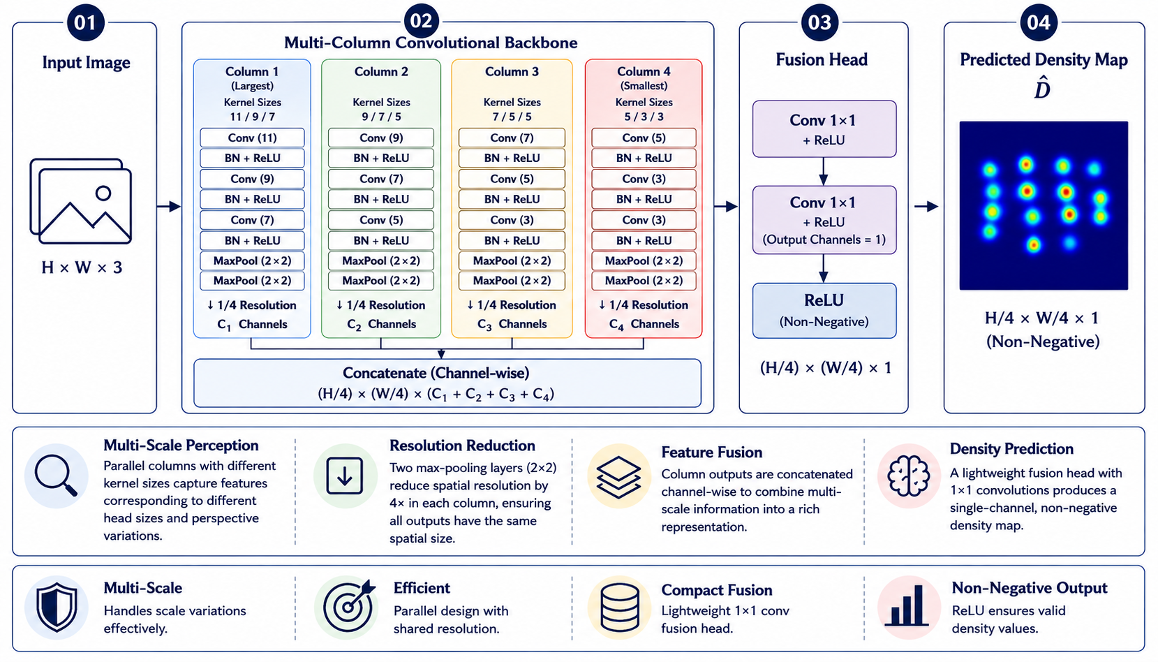
PROPOSED APPROACH
Dense Branch: MCNN

Slide 9
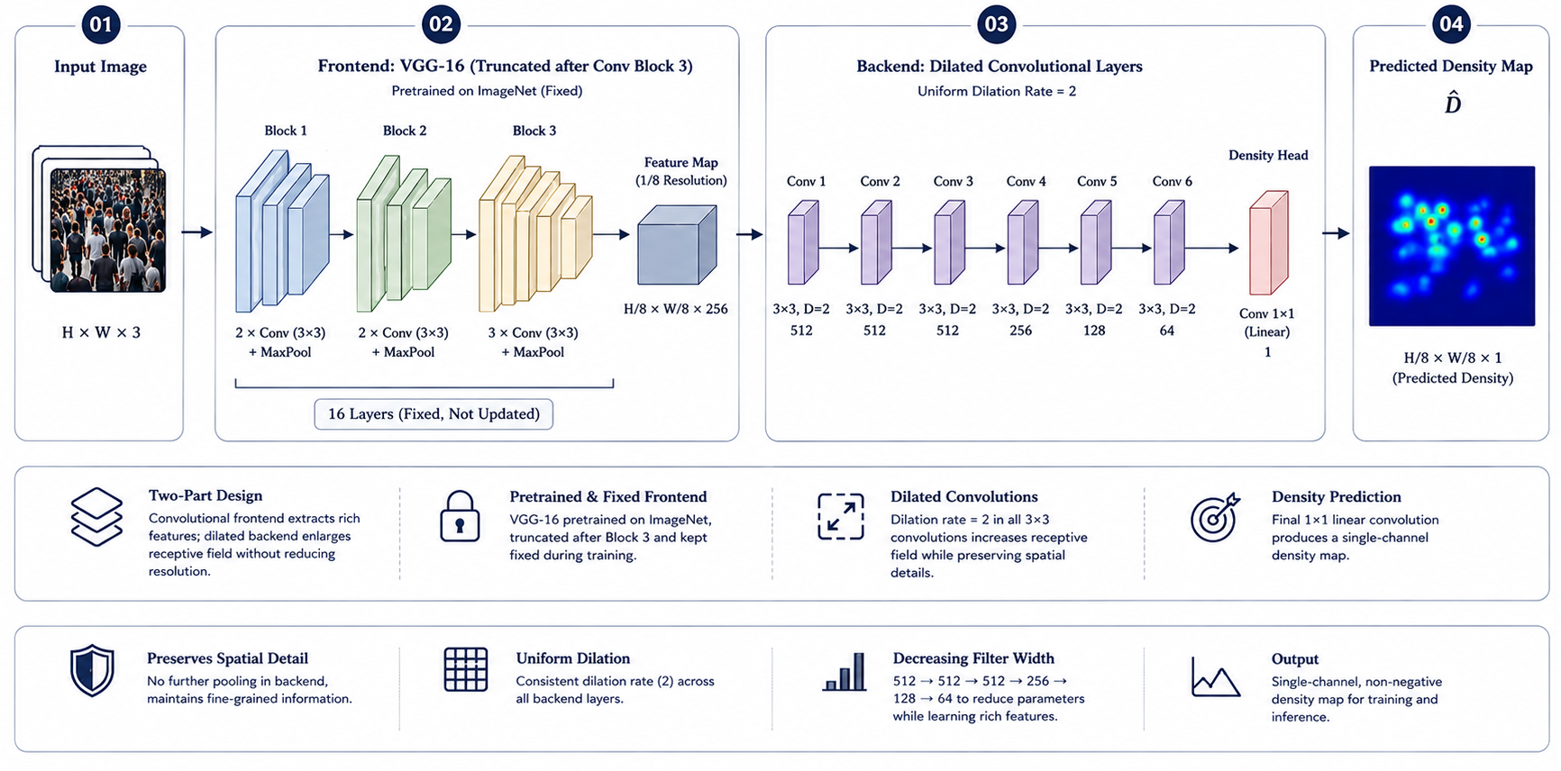
PROPOSED APPROACH
Dense Branch: CSRNet

Slide 10
PROPOSED APPROACH
Fusion Logic
DENSITY DECISION
FUSION RULE
A frame is labelled dense if either signal crosses its threshold:
The scene label sets a primary (P) and secondary (S) branch count. Relative disagreement Δ = |P − S| / P then decides how they combine:
Detection density ρ: detections per 1,000 px² of frame area
Pairwise overlap ratio r: share of detection pairs with IoU > 0
P ≤ 0
C = max(P, S)
Δ > threshold
C = P (trust primary)
Δ ≤ threshold
C = weighted average of P, S

Slide 11
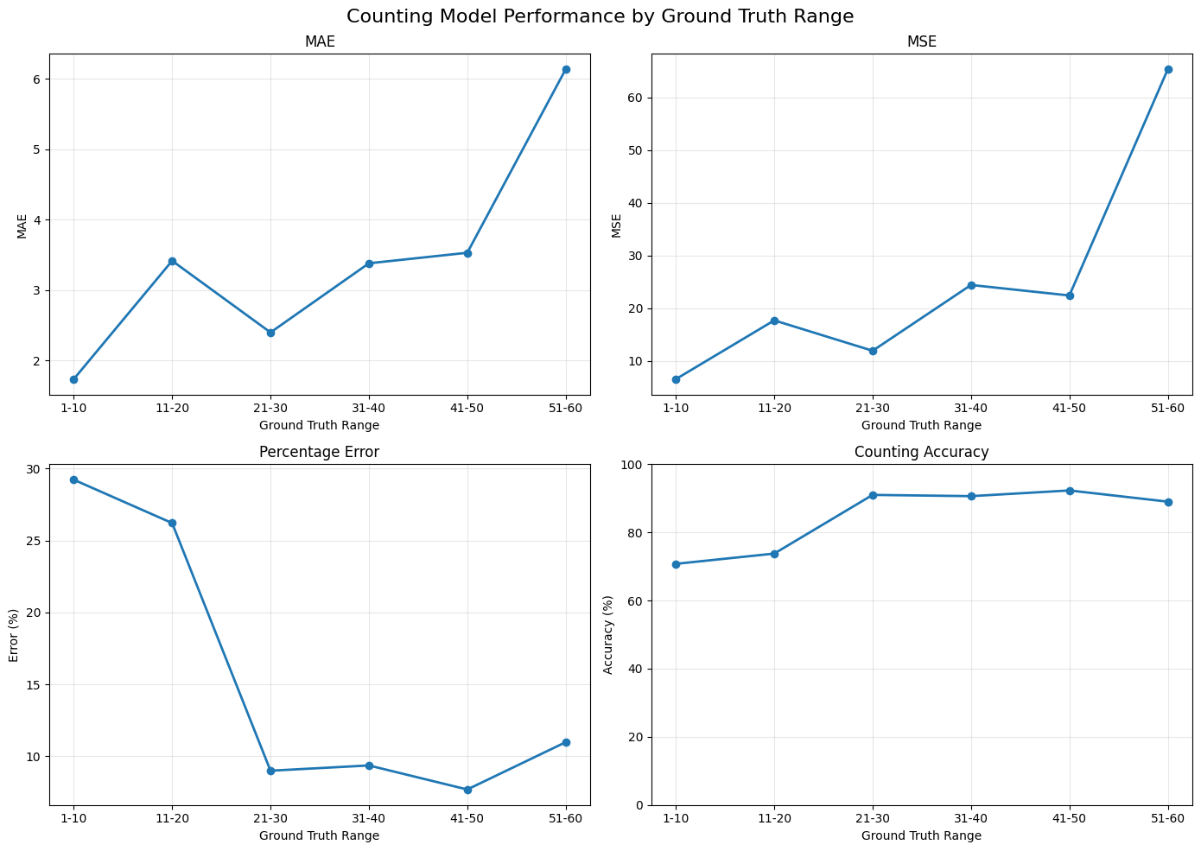
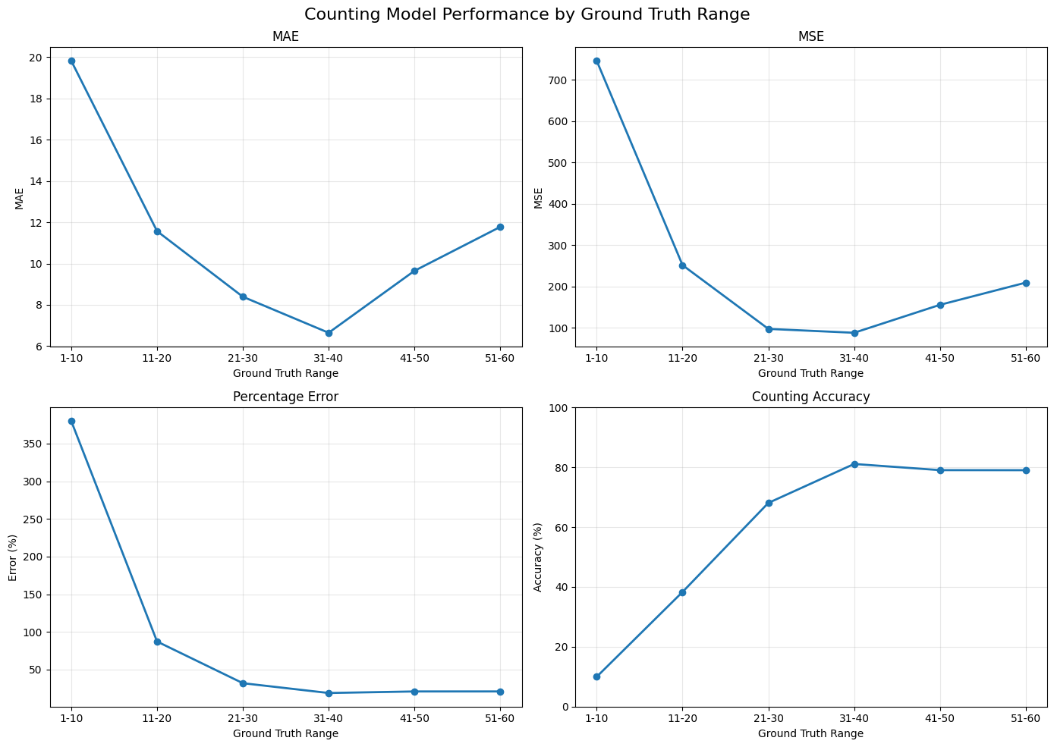
RESULTS I
Standalone Models
Fine-tuned YOLO
CSRNet
Notes:
Fine-tuning cut detector error roughly in half, and the fine-tuned detector alone was the best standalone model on the full benchmark. Both density networks performed far worse on their own — exactly the weakness that motivates fusion.

Slide 12
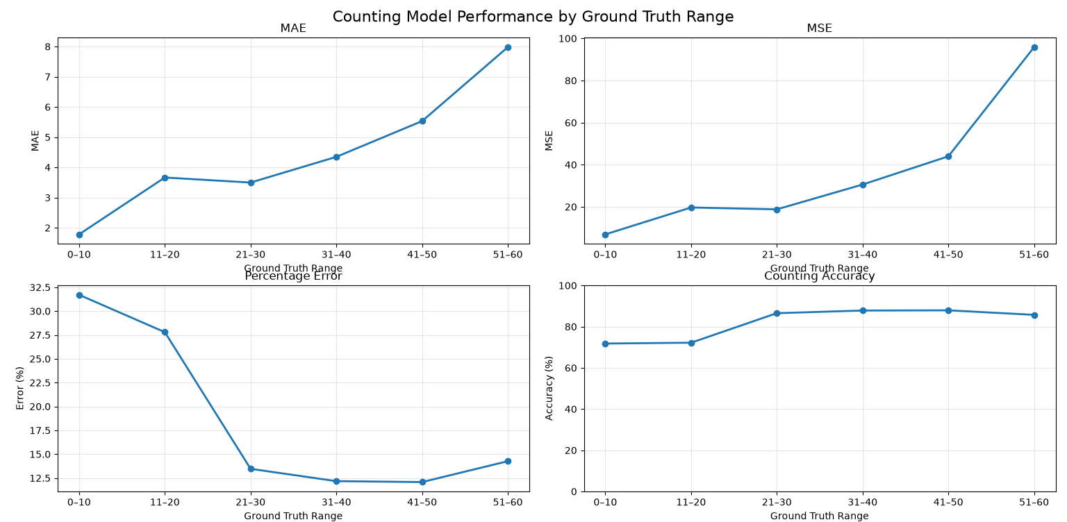
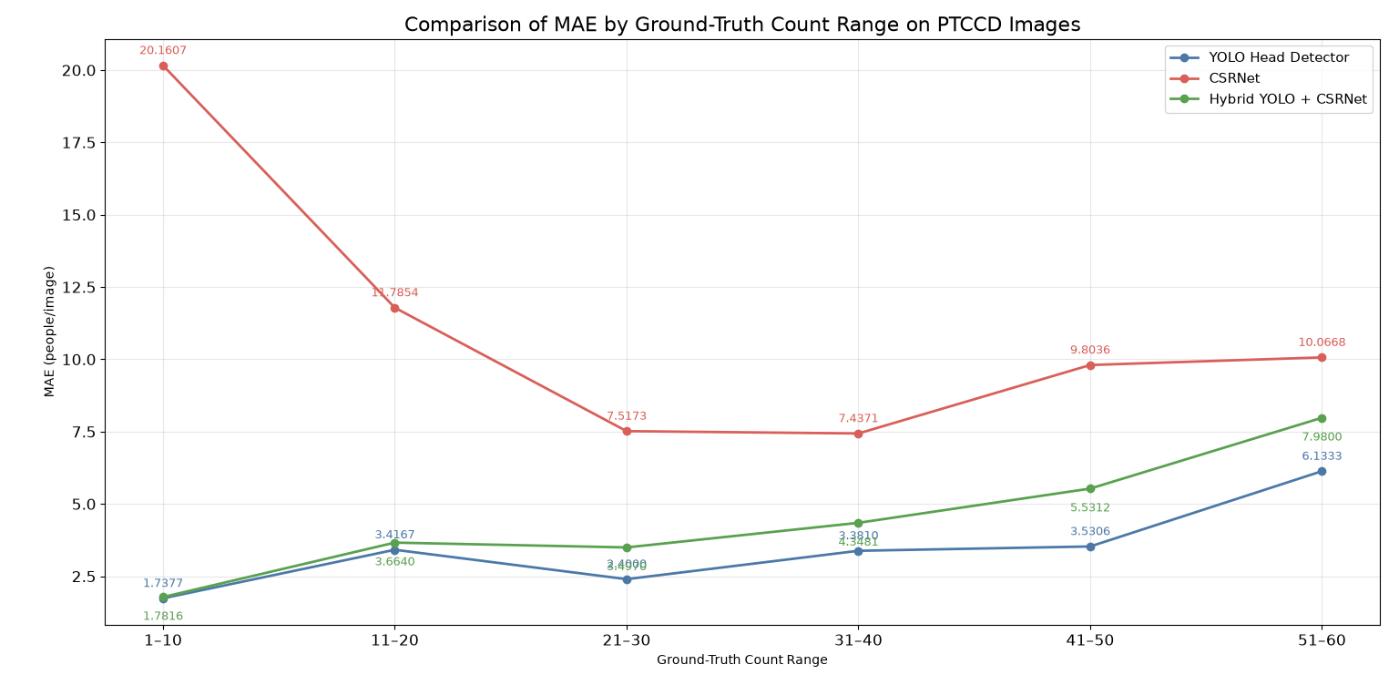
RESULTS II
Hybrid Fusion Result
Fine-tuned YOLO + CSRNet
Comparison
Notes:
Neither hybrid beats the detector on average, but the CSRNet-based hybrid narrows the gap and, critically, slashes worst-case errors when the detector fails completely — that's why CSRNet was selected as the preferred fusion partner.

Slide 13
CONTRIBUTION AND FUTURE WORK
Contributions, Limitations & What's Next
MAIN CONTRIBUTIONS
LIMITATIONS
Isolated the specific effect of head-level fine-tuning on detection accuracy
Proved detection and density methods fail in opposite density regimes
Designed a lightweight, training-free adaptive fusion rule
Evidence-based selection between competing hybrid configurations
Single 285-image test set; limited scene diversity
Fusion threshold empirically fit, not independently validated
FUTURE WORK
Learned, confidence-weighted fusion
Temporal fusion using video sequences
Domain-specific fine-tuning on real bus footage
Notes:
To summarize: we isolated the fine-tuning effect, proved the complementary failure modes empirically, and built and selected a working hybrid fusion framework — with clear limitations and a concrete roadmap for future work.

Slide 14
THANK YOU

