Slide 1

Cardiovascular Disease Prediction using Machine Learning
Presented By:
Name: Md. Tahidul Islam
Roll:200119
Session:2019-20
$$4^{th}year 1^{st}semester$$
Dept. of CSE,PUST.

Slide 2
Here I used five Machine Learning Algorithms to predict cardiovascular disease.
The algorithms are mentioned below:
Logistic Regression.
Random Forest.
Decision Tree.
K-nearest Neighbors
Support Vector Machine.(SVM)

Slide 3
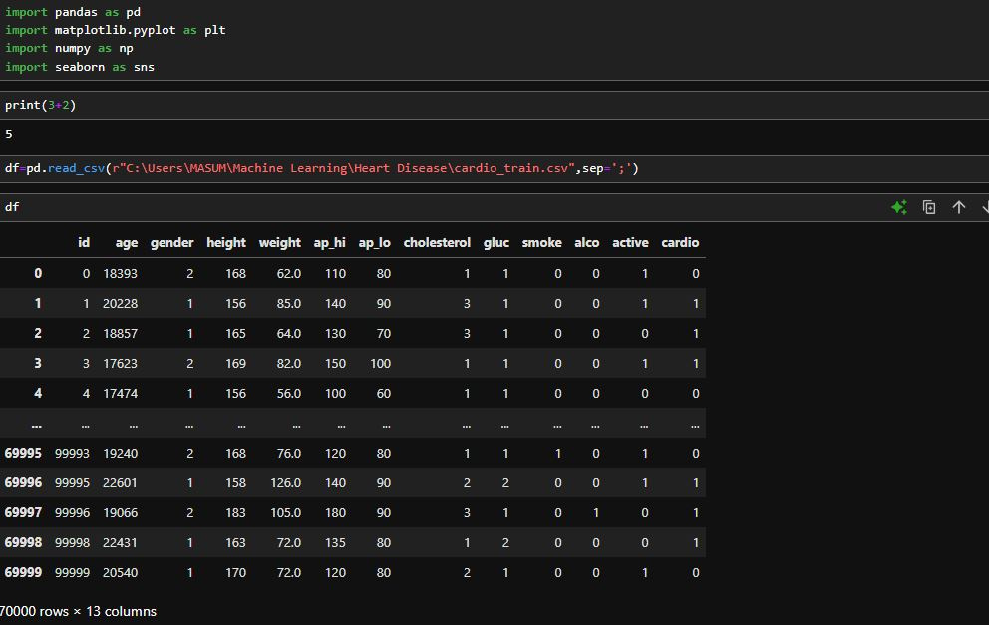
Using Pandas library from Python, here we used to read the CSV dataset.

Slide 4
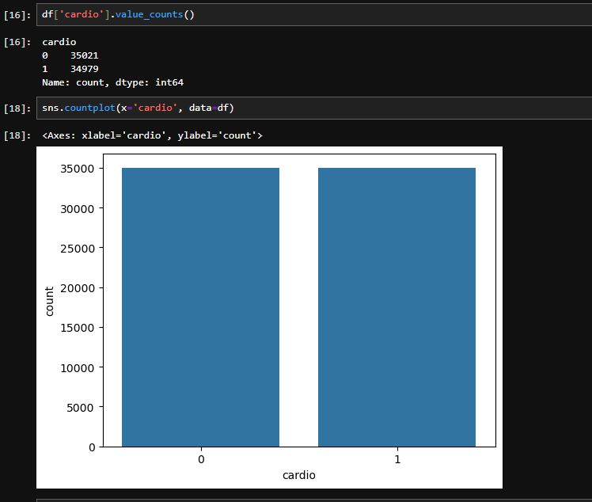
Plotting cardio feature from the Dataset

Slide 5
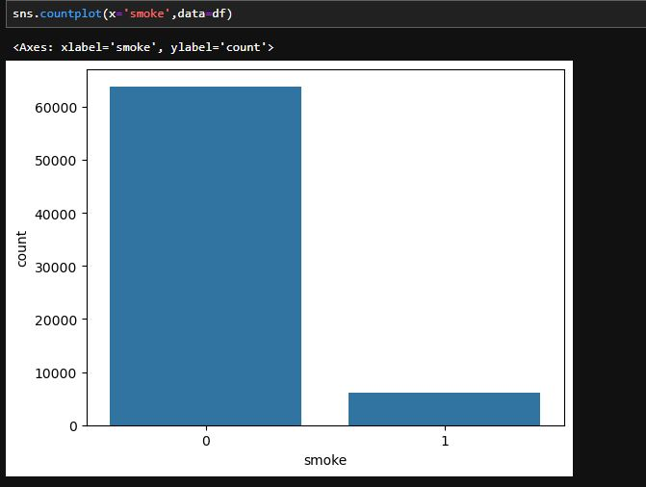
Plotting Smoke status from the Dataset

Slide 6
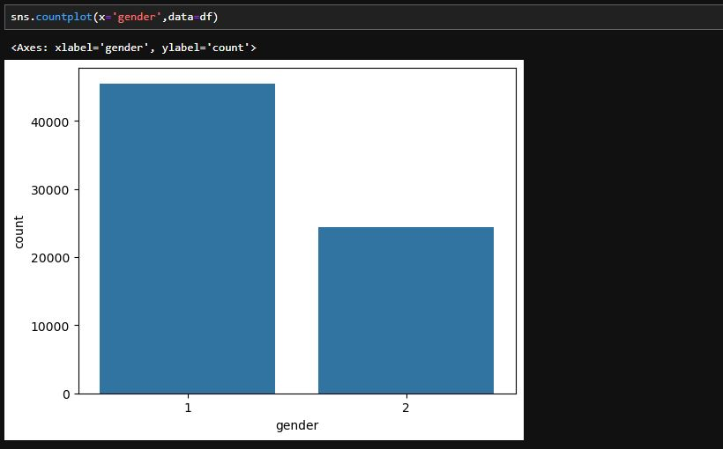
Plotting gender status from the Dataset

Slide 7
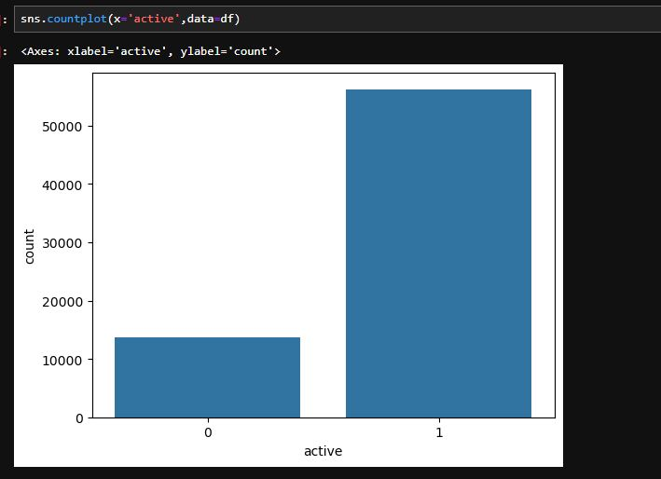
Plotting active stroke status from the Dataset

Slide 8
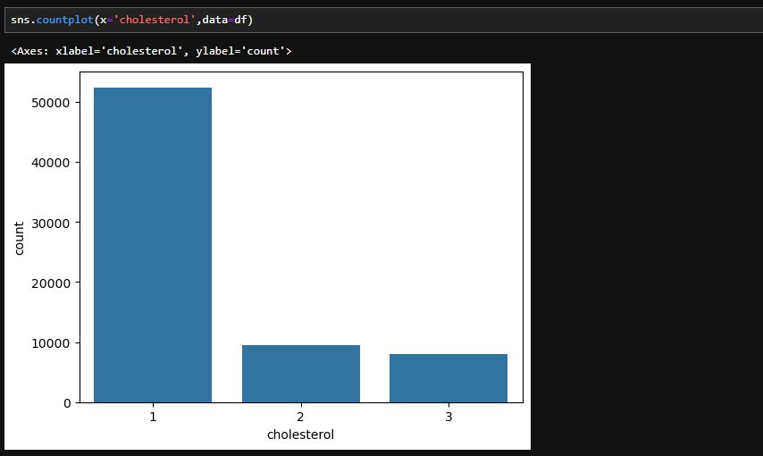
Plotting cholesterol level from the Dataset

Slide 9
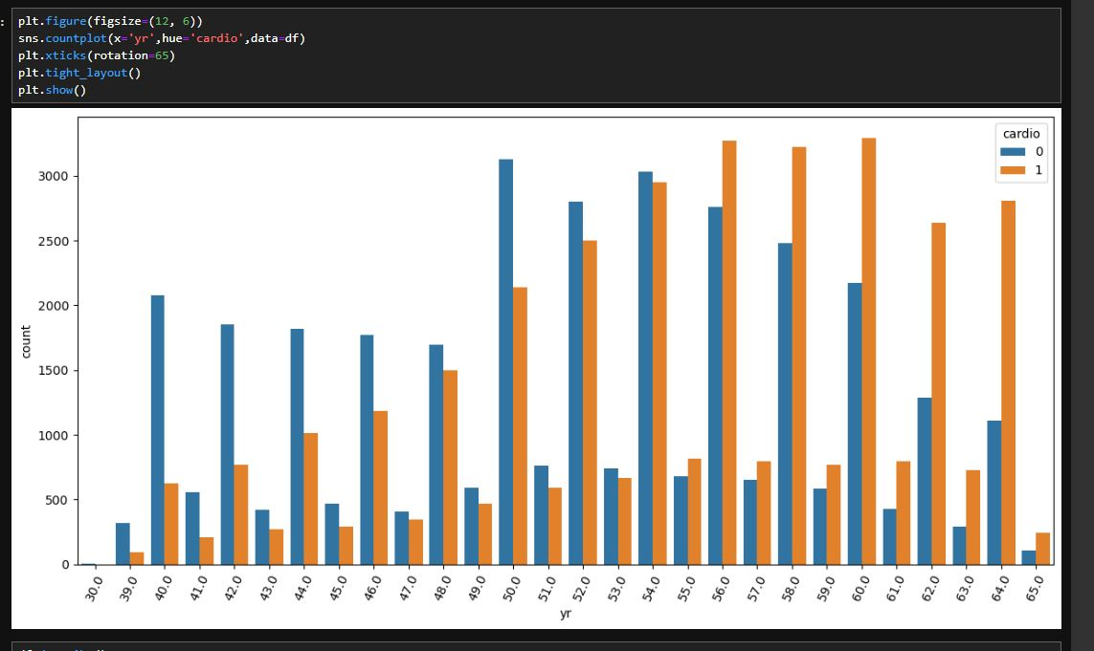
Plotting cardio with respect to age from the Dataset

Slide 10
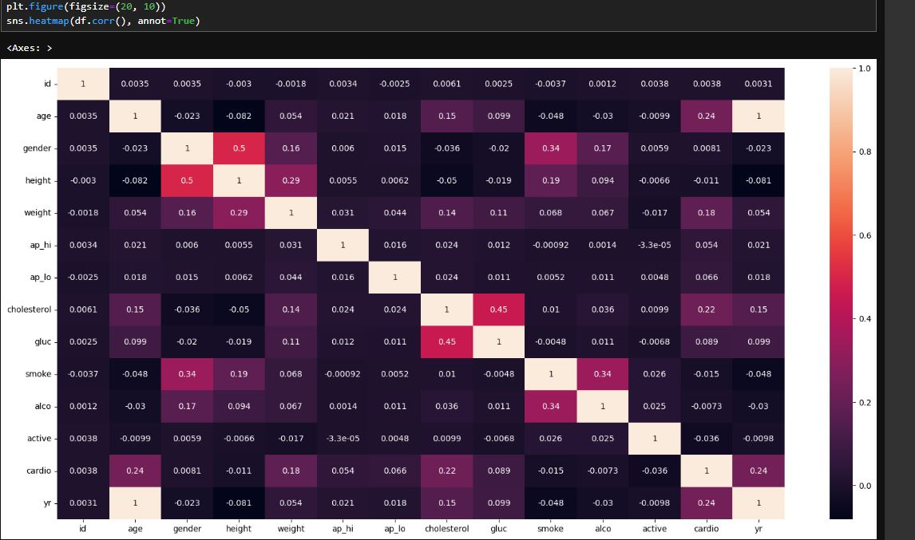
Heatmap the correlation from the Dataset.

Slide 11
After train the model with the training datapoints, the accuracy(test datapoints) of the model given below:
Logistic Regression – 70%
Random Forest – 71%
Decision Tree – 63%
SVM – 60%
KNN – 68%

Slide 12
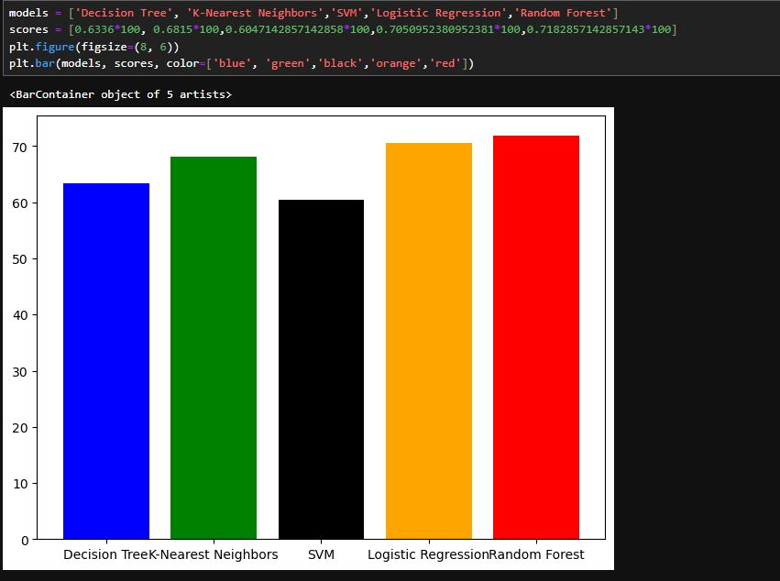
Here is the comparative accuracy plotted below:

Slide 13
Thank You

