Slide 1


Undergraduate Conference on Intelligent Computing And Systems(UCICS-2025)
Paper ID: 96
Breast Cancer Detection Using Deep Learning Networks
Presenting Author:
MD. Tahidul Islam
Department of Computer Science and Engineering
Pabna University of Science and Technology
Organized By: Department of Computer Science and Engineering, Varendra University

Slide 2
Agenda
Problem Statement
Implementation
Introduction
Results and Discussion
Related Works
Dataset
Methodology

Slide 3
Problem Statement.
Traditional methods for breast cancer detection rely on manual screening, leading to human error.
Machine learning approaches have difficulty handling the high-dimensional nature of mammographic images.
The need for an automated and highly accurate diagnostic system is critical to improving early detection.
This study overcomes these challenges by leveraging deep learning techniques to enhance breast cancer detection.

Slide 4
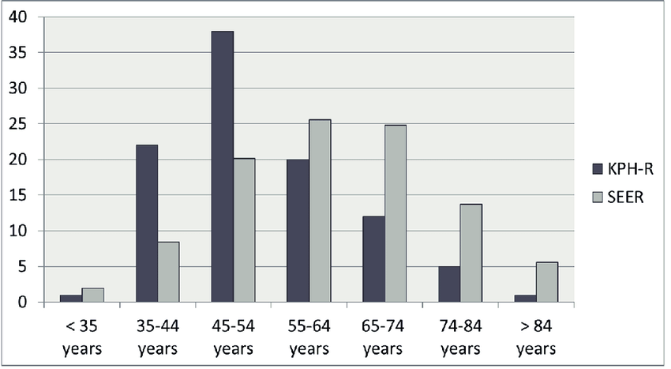

Introduction
Breast cancer is the second leading cause of cancer-related deaths worldwide.
It affects millions of women annually.
Early detection can significantly improve survival rates.
The bar chart compares breast cancer deaths across different age groups for two datasets: KPH-R (dark bars) and SEER (light bars). The highest mortality in the KPH-R dataset occurs in the 45–54 age group, while the SEER dataset shows peak deaths in the 55–74 age range.

Slide 5
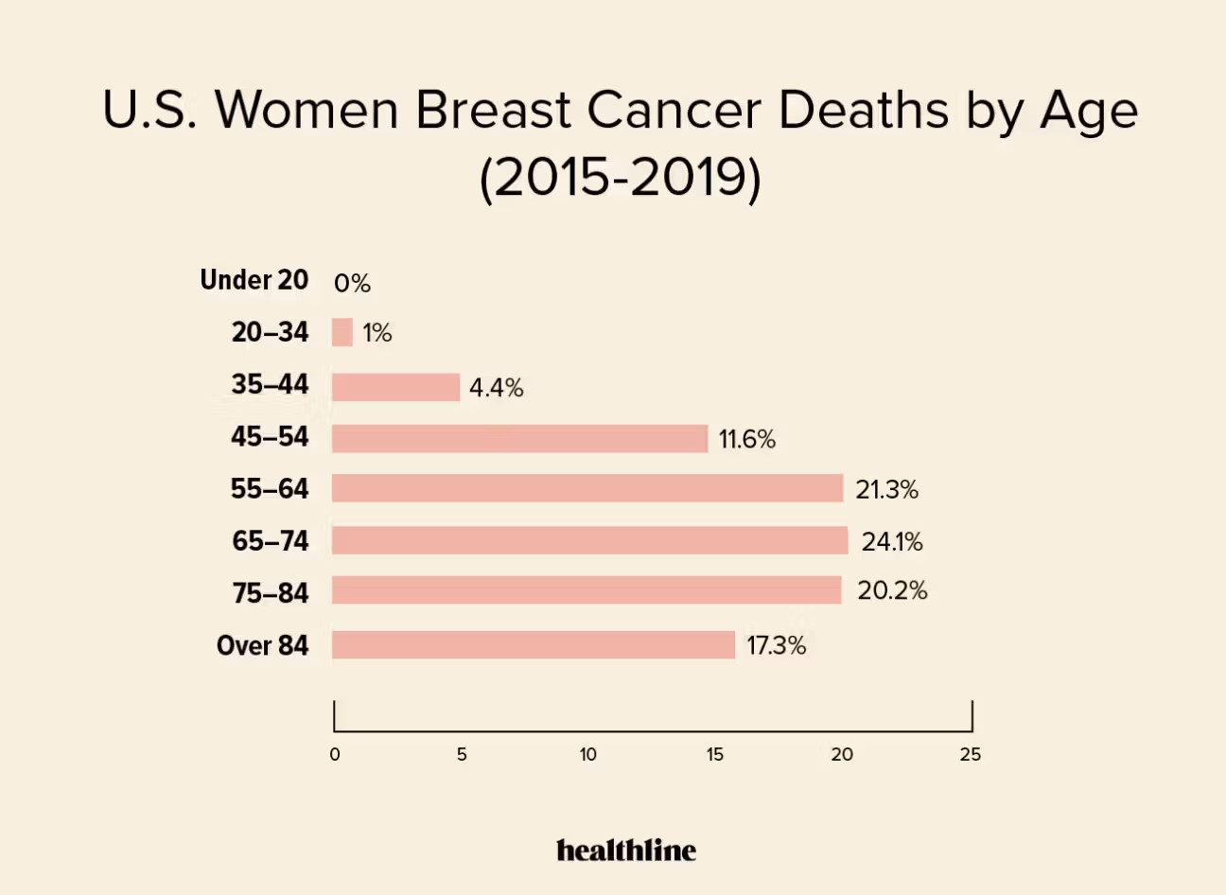
Mammograms are the standard screening method.
Traditional detection methods have limitations, including human error.
AI-based techniques can enhance accuracy and reduce diagnostic time.
The bar chart displays the percentage of breast cancer deaths across different age groups in US women. The highest death rates are in the 65–74 age group (24.1%), followed by 55–64 (21.3%) and 75–84 (20.2%).

Slide 6
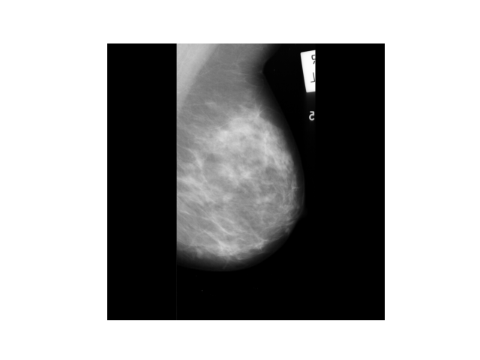
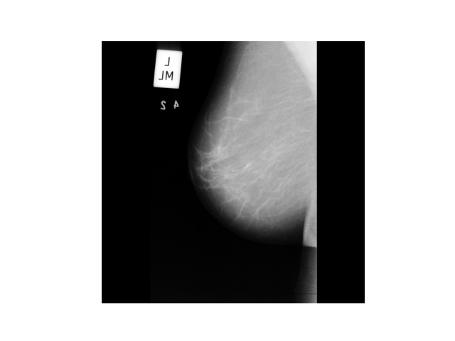
Related Works
Previous studies have utilized traditional Computer-Aided Diagnosis (CAD) methods for mammographic image segmentation. However, these methods often lack robustness and accuracy. More recent approaches include deep learning-based models such as YOLO for breast cancer detection. However, these approaches also face challenges, including dataset limitations and computational complexity. In our research, we aim to address these challenges by leveraging CNN architectures like VGG16 and DenseNet.

Slide 7
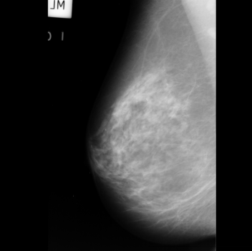
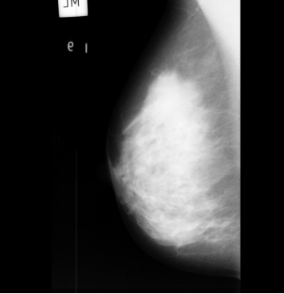
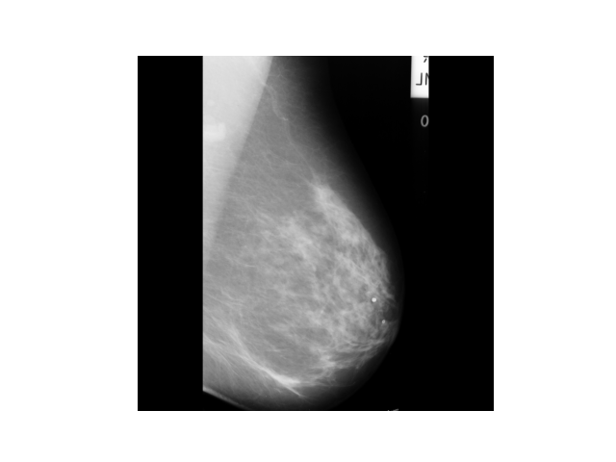
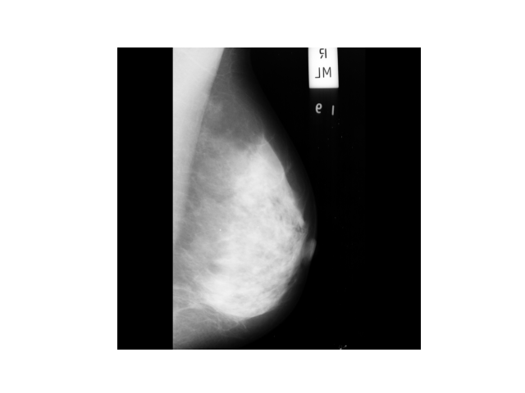
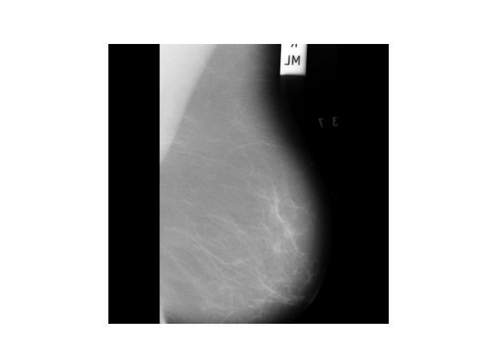
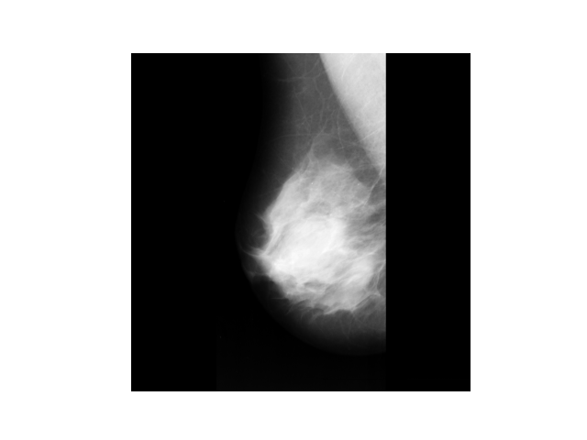
Dataset

Slide 8

Dataset Description
Overview
Dataset Used: Mammographic Image Analysis Society (MIAS). Source: United Kingdom Mammography Image store center.
Dataset Properties
Number of Images: 322 grayscale mammogram images (1024x1024 pixels). Classes: Benign, Malignant, Normal. Challenges: Noise, irregularities, varying image quality.

Slide 9
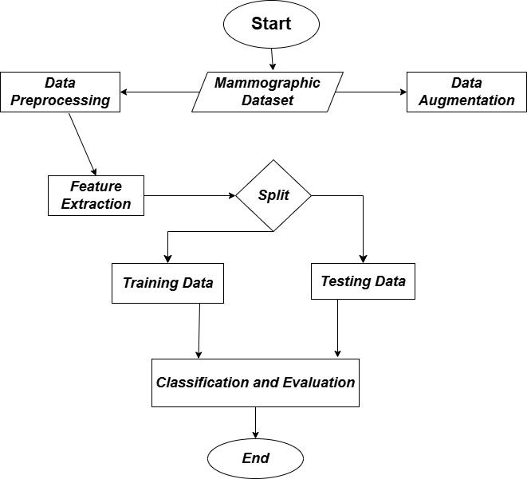
Methodology Workflow

Slide 10
Methodology: The Methodology Workflow shown in the image represents the step-by-step process of analyzing a mammographic dataset for classification. It starts with data preprocessing, where raw images are cleaned and normalized, and data augmentation, where additional variations of images are generated to enhance model performance. The dataset is then subjected to feature extraction to identify relevant patterns. Afterward, it is split into training and testing sets, where the training data is used to build the model, and the testing data is used to assess its performance. Finally, the model undergoes classification and evaluation, leading to the final results.

Slide 11
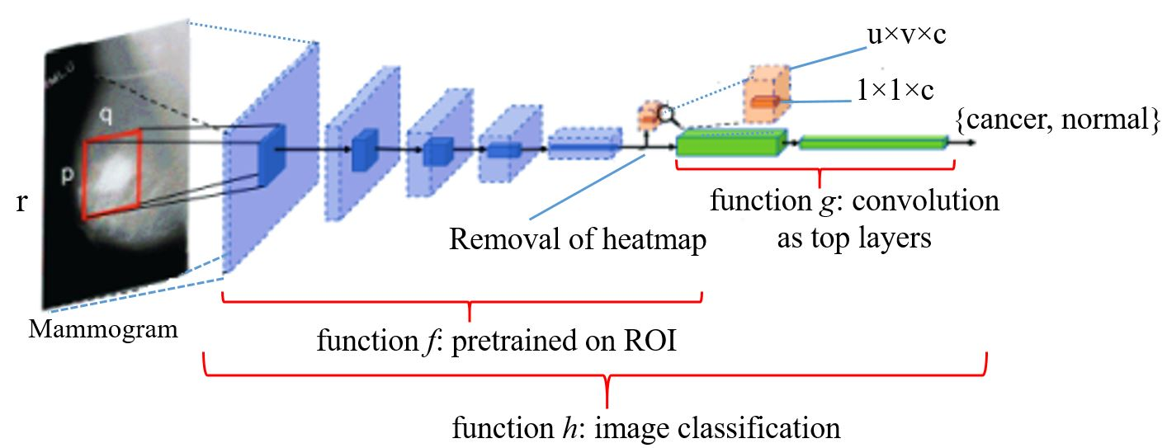
Feature Extraction Map.
ROI Selection – A specific area with potential abnormalities is highlighted.
Pretrained Model (Feature Extractor) – A deep learning model extracts features from the ROI.
Convolutional Layers – Filters detect patterns like edges, textures, and shapes.
Classification – Extracted features are used to classify the image (e.g., cancer vs. normal).
Input Image – A grayscale image (e.g., mammogram) is used.

Slide 12
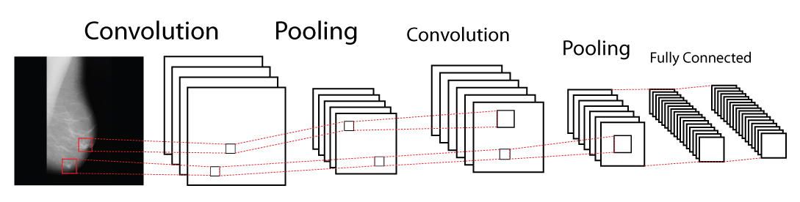
CNN Architecture
The CNN (Convolutional Neural Network) Architecture used for feature extraction from grayscale medical images, such as mammograms. The process begins with a convolution layer, where filters scan the image to detect patterns like edges, textures, and shapes. This is followed by a pooling layer, which reduces the dimensionality while preserving important features. The sequence of convolution and pooling layers continues, refining the extracted features at each stage. Finally, a fully connected layer processes the high-level features for classification, determining whether the image belongs to a specific category, such as cancerous or normal.

Slide 13
Dataset Split
Train dataset contains 242 grayscale images.
Validation dataset contains 16 images.
Test dataset 65 grayscale images.

Slide 14
Implementation
Phase 3
Phase 2
Phase 1
Feature Extraction.
CNN Model Selection(VGG16,Densenet).
Training & Tuning.
Performance Testing.
Comparison Analysis.
Dataset Acquisition.
Data Cleaning.
Data Augmentation.

Slide 15
Results
Table-1. VGG16 Model Classification Report For MALIGNANT and BENIGN.
Class Name | Precision | Recall | F1-Score | Accuracy
Class_1 | 92.0 | 100.0 | 96.0 | -
Class_2 | 100.0 | 91.0 | 95.0 | -
Average | 96.0 | 95.0 | 96.0 | 96.0

Slide 16
Table-2. DENSENET Model Classification Report For MALIGNANT and BENIGN.
Class Name | Precision | Recall | F1-Score | Accuracy
Class_1 | 97.0 | 100.0 | 98.0 | -
Class_2 | 100.0 | 97.0 | 98.0 | -
Average | 98.0 | 98.0 | 98.0 | 98.0

Slide 17
Future Work
Expanding the Dataset(Testing on larger dataset).
Improving Model Performance.
Enhancing Explainability.
Multi-Modal Learning.
Reducing False Positives and Negatives.

Slide 18
Limitations
Smaller Dataset size(used only 322 images).
Dataset lacks diversity, limiting model's generalizability.
Computational Requirements.
No integration with advanced diagnostic frameworks yet.

Slide 19
References
[1] A. G. Waks, and E. P. Winer, ”Breast cancer treatment: a review,” Jama, vol. 321, no. 3, pp. 288-300, Jan 2019.
[2] Y. S. Sun, Z. Zhao, Z. N. Yang, F. Xu, H. J. Lu, Z. Y. Zhu, et al., ”Risk factors and preventions of breast cancer. International journal of biological sciences,” vol. 13, no. 11, pp. 1387, 2017.
[3] S. Njor, L. Nystr¨ om, S. Moss, E. Paci, M. Broeders, N. Segnan, and E. Lynge, ”Breast cancer mortality in mammographic screening in Europe: a review of incidence-based mortality studies,” Journal of medical screening, vol. 19, no. 1 suppl, pp. 33-41, Sep 2012.
[4] S. Morrell, R. Taylor, D. Roder, and A. Dobson, ”Mammography screening and breast cancer mortality in Australia: an aggregate cohort study,” Journal of medical screening, vol. 19, no. 1, pp. 26-34, Mar 2012.
[5] S. Z. Ramadan. ”Methods Used in Computer-Aided Diagnosis for Breast Cancer Detection Using Mammograms: A Review.” Journal of healthcare engineering, vol. 2020, no. 1, pp. 9162464, 2020.
[6] I. Christoyianni, A. Koutras, E. Dermatas, and G. Kokkinakis, ”Com puter aided diagnosis of breast cancer in digitized mammograms,” Computerized medical imaging and graphics, vol. 26, no. 5, pp. 309-319, Sep 2002.

Slide 20
Thank you!
Do you have any questions?

