Slide 1
Final-DEFENSE PRESENTATION • B.Sc. ENGINEERING IN CSE
AgroSense
An IoT-Based Smart Farming and Crop Monitoring System
Md Emam Masum
ID: 220201056
Zihan Hossain
ID: 220201067
Supervised by: Taher Muhammad Mahdee
Associate Professor
Co-Supervised by: Mahadi Hasan
Assistant Professor
Department of Computer Science and Engineering (CSE)
Bangladesh Army University of Science & Technology (BAUST)
August 2026

Slide 2
OUTLINE
What We'll Cover
01
02
03
Introduction
Related Works
Problem Statement
04
05
06
Objectives
Proposed Methodology
Dataset
07
08
09
Project Timeline
Results
Expected Outcomes
10
11
12
Team Roles & Contributions
Conclusion
References
AgroSense — IoT Smart Farming & Crop Monitoring System
2 / 25

Slide 3
INTRODUCTION
Introducing AgroSense
Agriculture in regions like Bangladesh still relies on manual, guesswork-driven irrigation. AgroSense brings a low-cost IoT sensor node together with a real-time cloud dashboard to close that gap.
🌾
🚜
Domain & Relevance
Application Area
IoT-based smart farming pairs low-cost sensors, cloud databases, and automation to replace manual, guesswork-driven irrigation practices.
Small and mid-scale farms that need remote soil, water, and climate monitoring with pump control accessible from any phone or browser.
AgroSense — IoT Smart Farming & Crop Monitoring System
3 / 25

Slide 4
RELATED WORKS
Related Works & Existing Solutions
🏭
Commercial Precision-Ag Platforms
🔧
DIY / Open-Source IoT Sensors
Full-featured systems (e.g. Netafim, CropX) give accurate monitoring but are too costly for small farms.
Community ESP32/Arduino projects read soil data but usually lack a cloud dashboard or automated control.
📄
Academic IoT-Irrigation Studies
📱
Mobile Farm-Monitoring Apps
Prior research shows soil-moisture-based irrigation, often as lab prototypes without a full web interface.
Existing apps visualize sensor data but rely on manual entry or lack real-time automated pump logic.
AgroSense — IoT Smart Farming & Crop Monitoring System
4 / 25

Slide 5
PROBLEM STATEMENT
The Challenge in Modern Agriculture
💧
📊
🌧️
Water Waste
No Live Data
Weather Blind
Manual irrigation wastes up to 40% more water than needed.
Farmers can't see soil, temperature, or crop conditions remotely.
Rain and water-level changes go undetected.
💡
💸
🔌
No Automation
High Cost
No Integration
Pump control is entirely manual, no threshold logic.
Commercial precision-ag platforms are unaffordable.
Sensors, cloud data, and irrigation control are disconnected.
AgroSense — IoT Smart Farming & Crop Monitoring System
5 / 25

Slide 6
OBJECTIVES
Project Objectives
🌱
☁️
⚡
01
02
03
Multi-Sensor IoT Node
Real-Time Cloud Dashboard
Automated Pump Control
Design and deploy an ESP32-based node with 7 sensors: soil moisture, rain, water level, light, soil & air temperature, and humidity.
Develop a 9-page, mobile-responsive web dashboard synced with Firebase Realtime Database every 2 seconds.
Implement threshold-and-hysteresis auto-irrigation with manual override to cut water waste and manual labor.
AgroSense — IoT Smart Farming & Crop Monitoring System
6 / 25

Slide 7
PROPOSED METHODOLOGY
System Workflow — Sense, Send, Store, Serve, Act
1
2
3
4
5
🌱
📡
☁️
📊
⚡
Field Sensing
Firmware Processing
Cloud Sync
Web Dashboard
Decision Logic
ESP32 reads 7 sensors
every 2 seconds
Calibrate ADC values,
compute % readings
Push to Firebase
/latestReading + /history
9-page PWA renders
live data & charts
Threshold + hysteresis
auto-irrigation check
Closed-Loop Automation
When soil moisture falls below the threshold − hysteresis band, the ESP32 activates the relay to run the pump; when it rises above threshold + hysteresis, the pump stops. A manual override from the dashboard can take precedence at any stage, and this decision instantly updates the cloud state, which reflects back on the dashboard in real time.
AgroSense — IoT Smart Farming & Crop Monitoring System
7 / 25

Slide 8
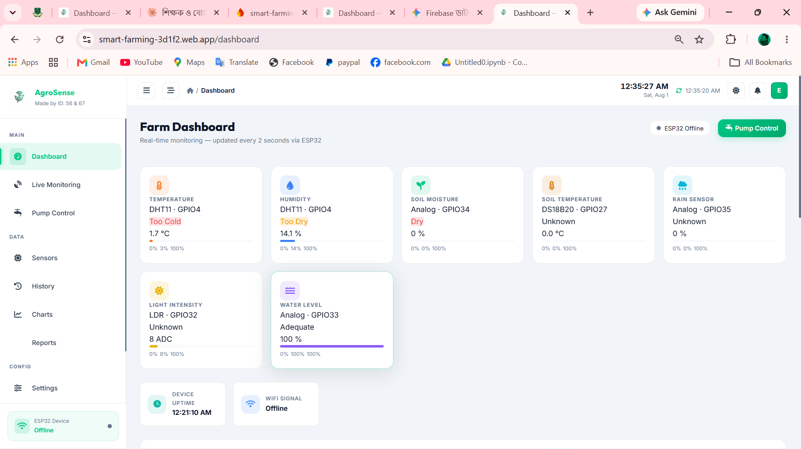
WEB DASHBOARD
Main Dashboard
🔐 Login Page
AgroSense — IoT Smart Farming & Crop Monitoring System
8 / 25

Slide 9
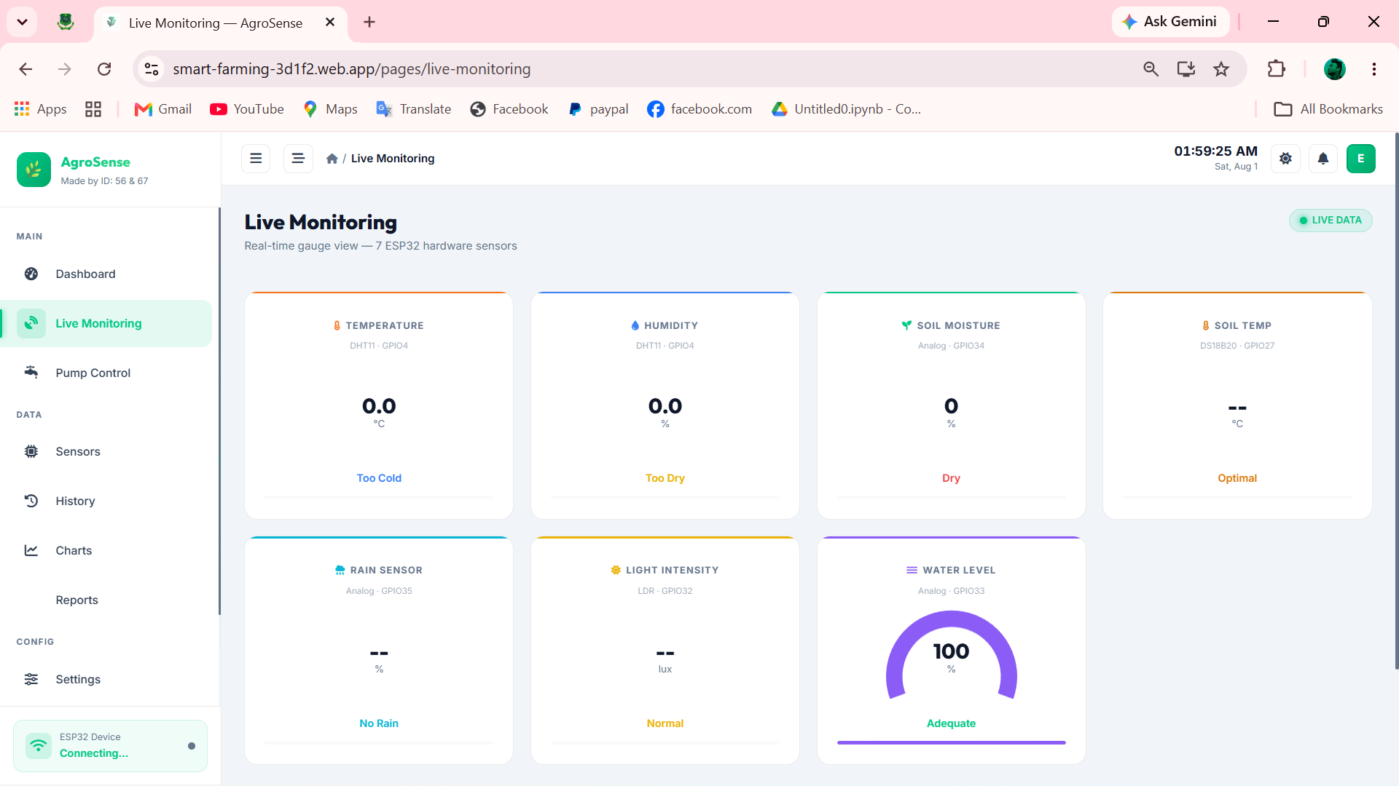
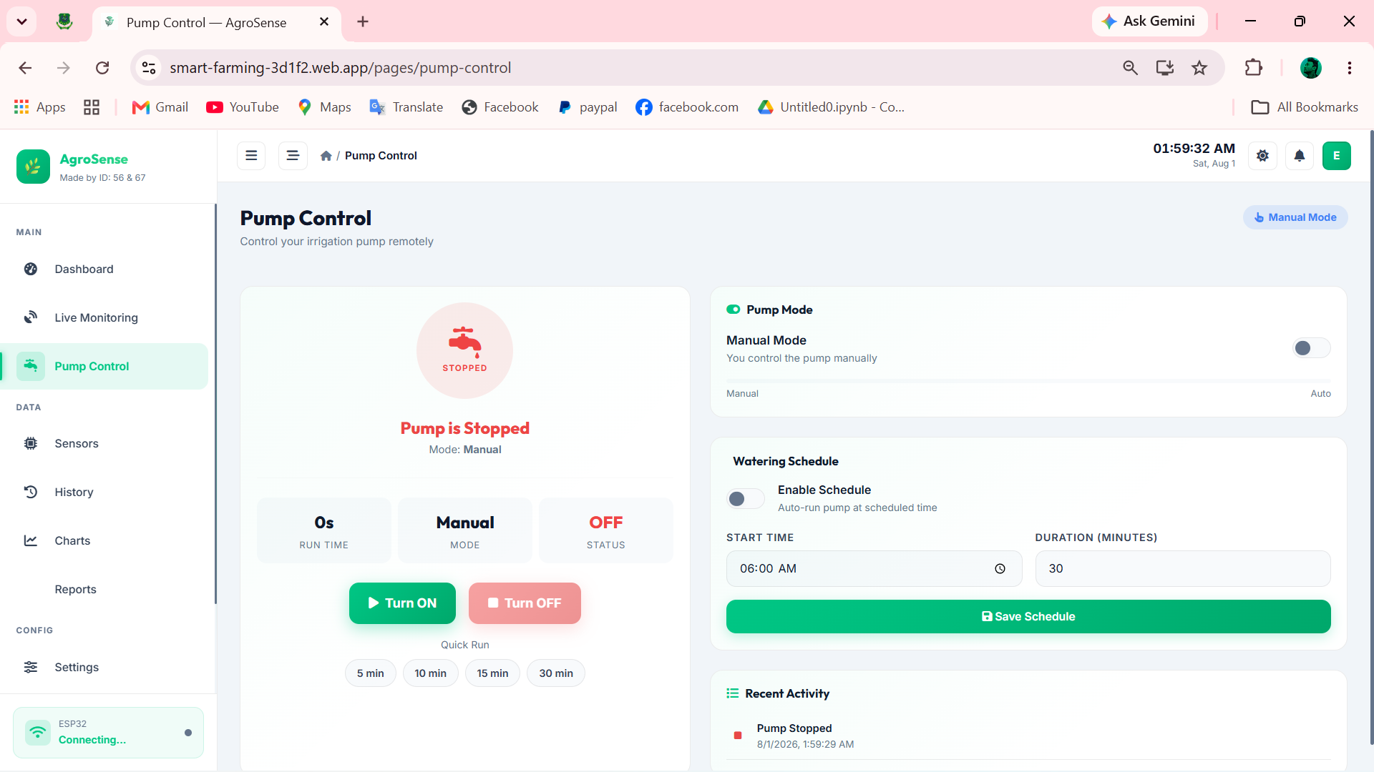
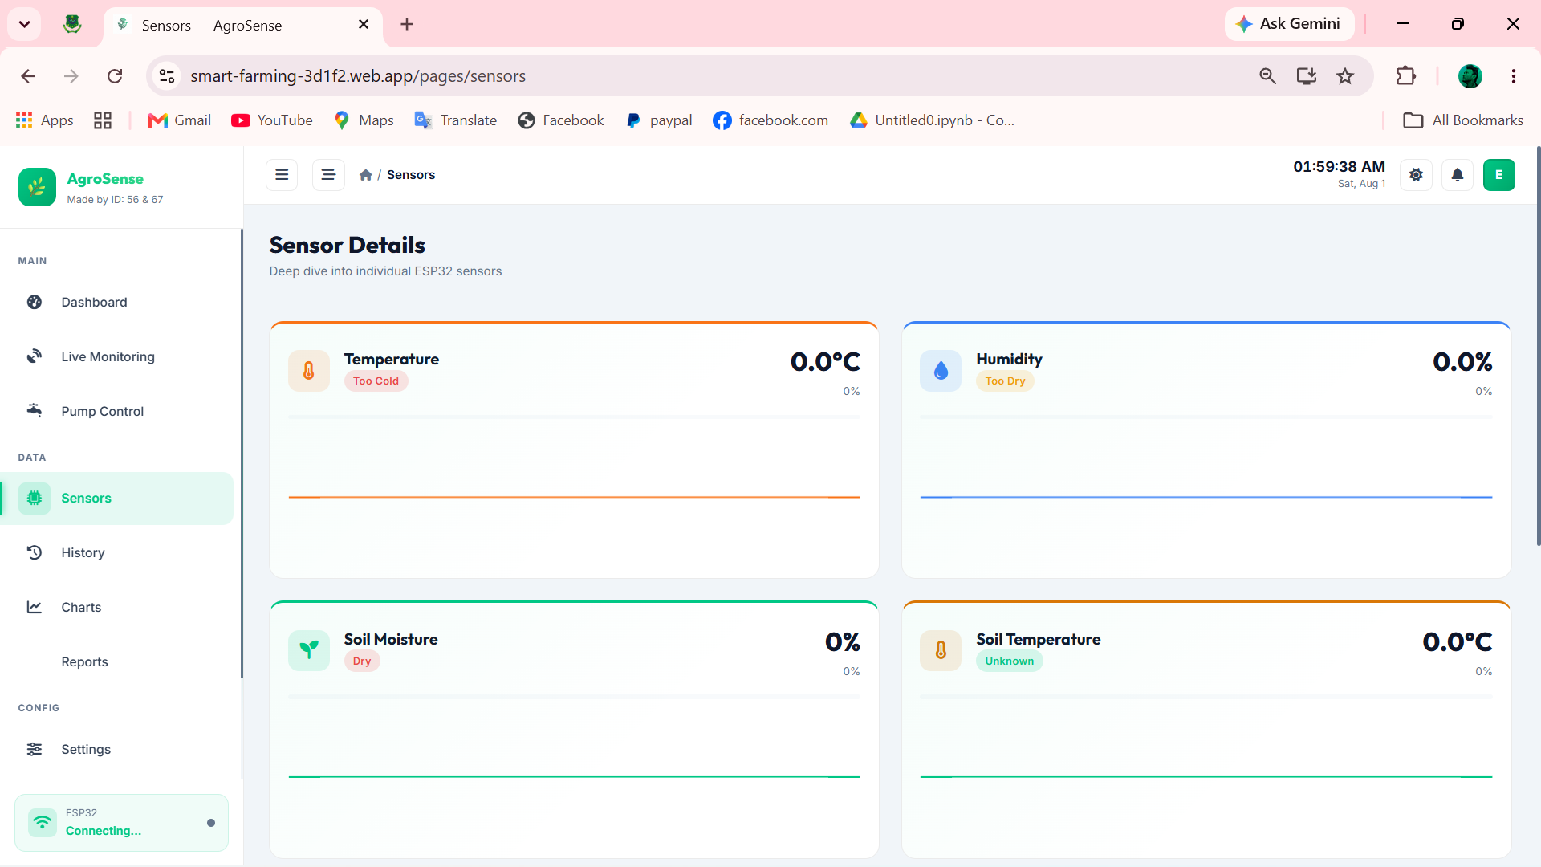
WEB DASHBOARD
Live Monitoring, Pump Control & Sensors
📡 Live Monitoring
💧 Pump Control
🔬 Sensors
AgroSense — IoT Smart Farming & Crop Monitoring System
9 / 25

Slide 10
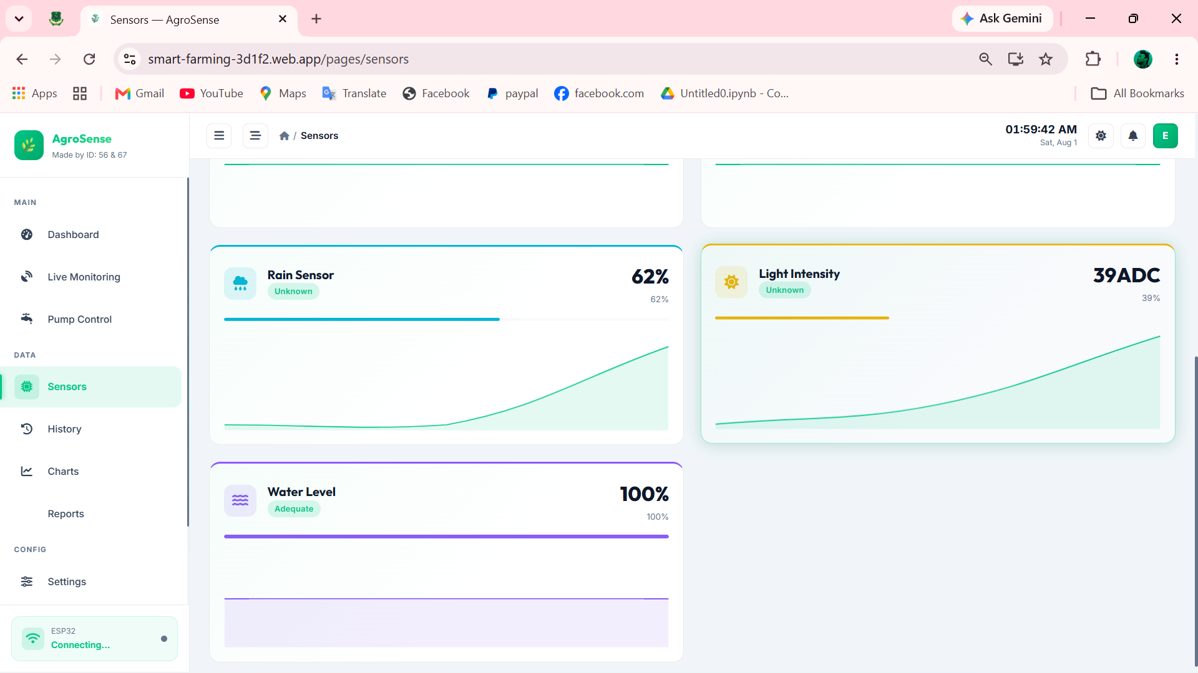
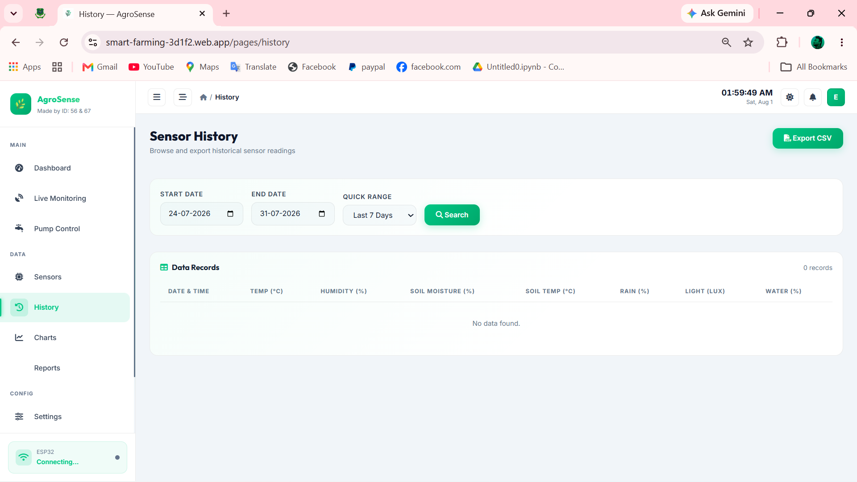
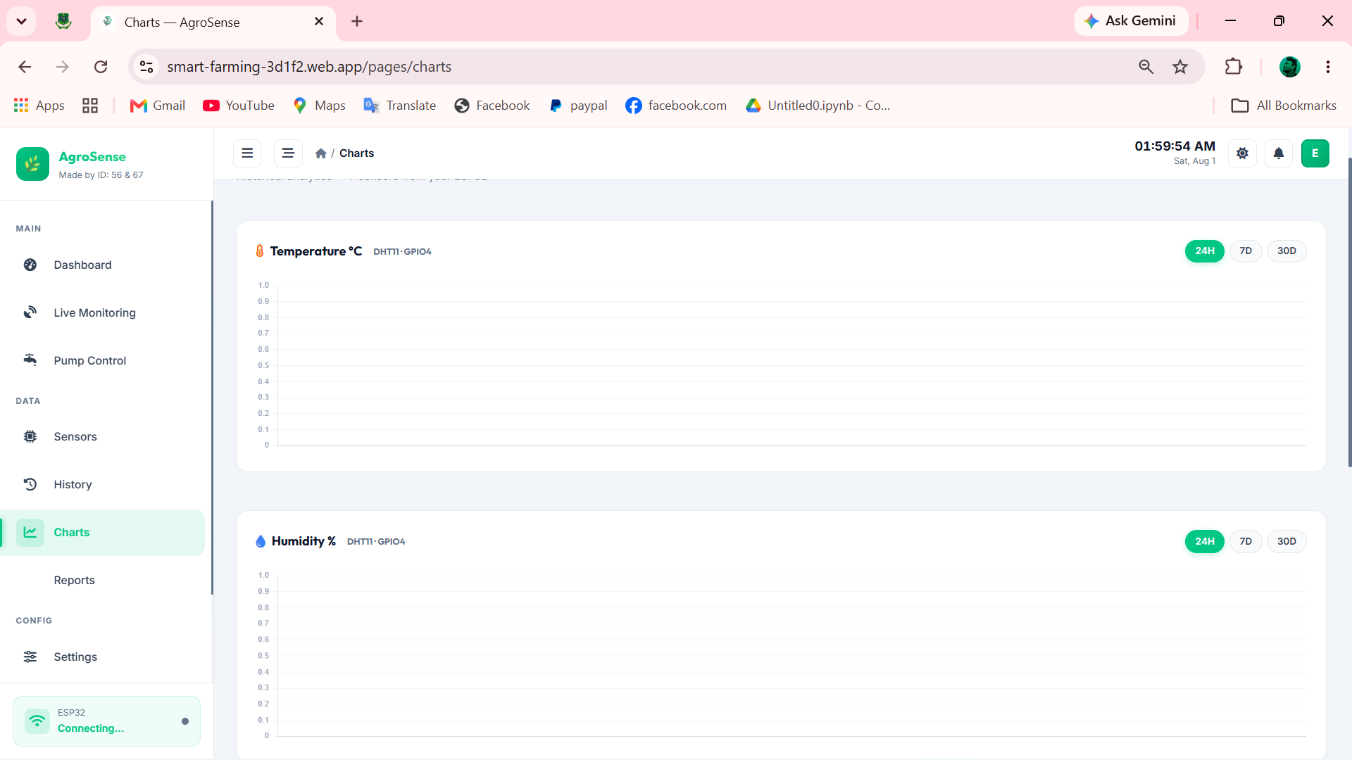
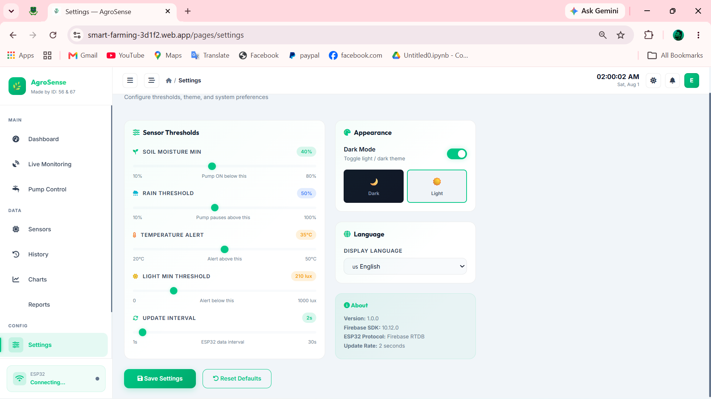
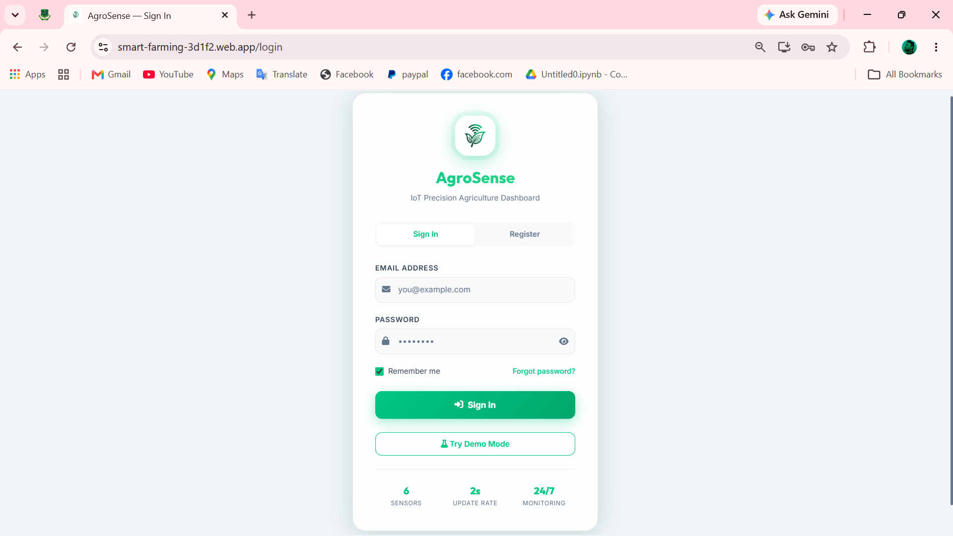
WEB DASHBOARD
History, Charts, Reports, Settings & Account
📋 History
📈 Charts
📄 Reports
⚙️ Settings
👤 Account Login
AgroSense — IoT Smart Farming & Crop Monitoring System
10 / 25

Slide 11
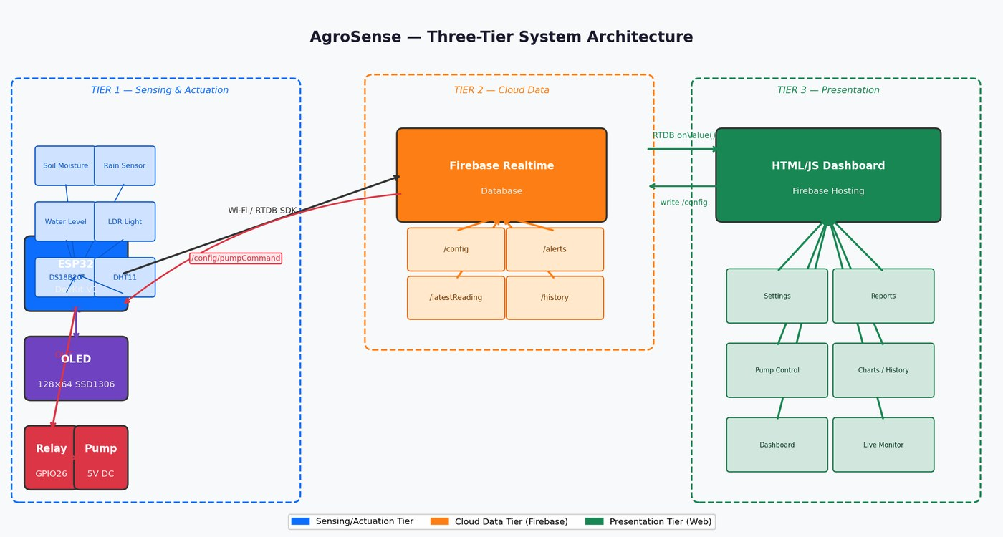
SYSTEM DESIGN
Three-Tier System Architecture
Sensor node (ESP32) → Firebase Cloud (RTDB, Auth, Hosting) → Web Dashboard, showing the full data path end to end.
AgroSense — IoT Smart Farming & Crop Monitoring System
11 / 25

Slide 12
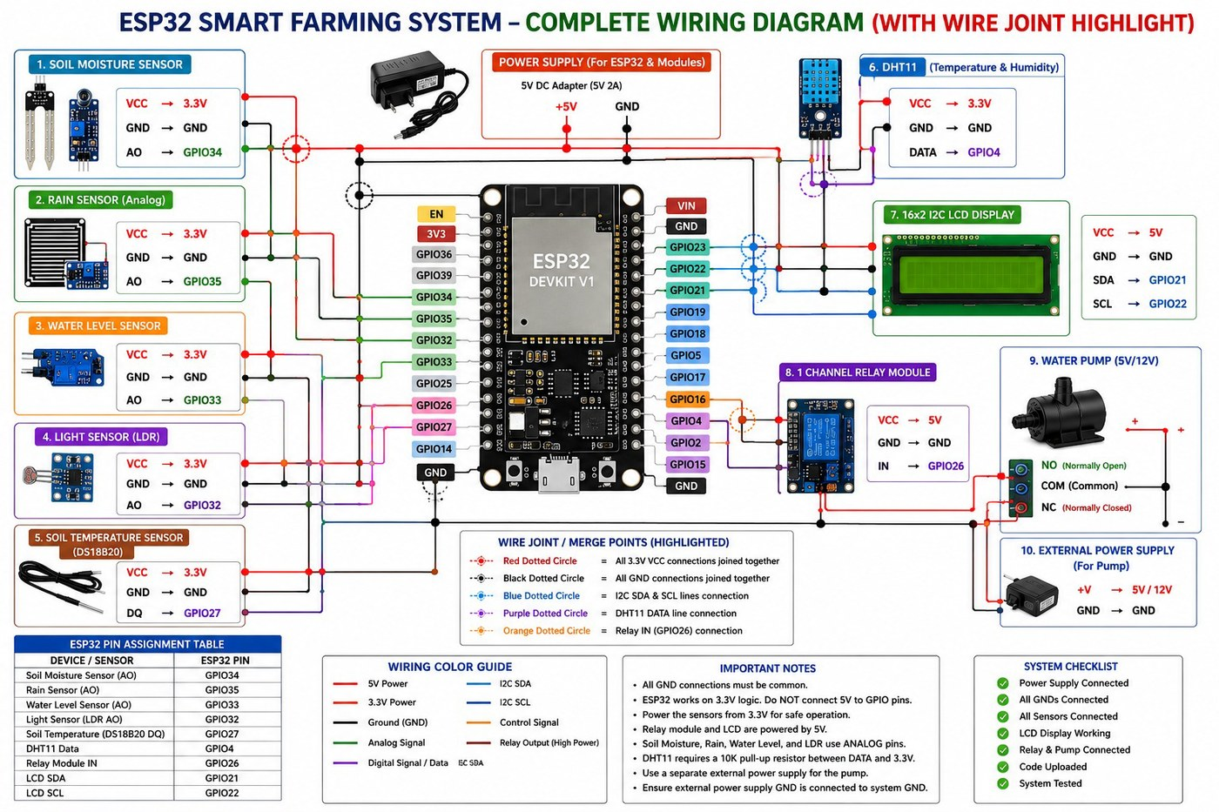
HARDWARE
Complete Wiring Diagram
ESP32 DevKit V1 wired to all 7 sensors, the OLED display, and the relay-driven pump circuit.
AgroSense — IoT Smart Farming & Crop Monitoring System
12 / 25

Slide 13
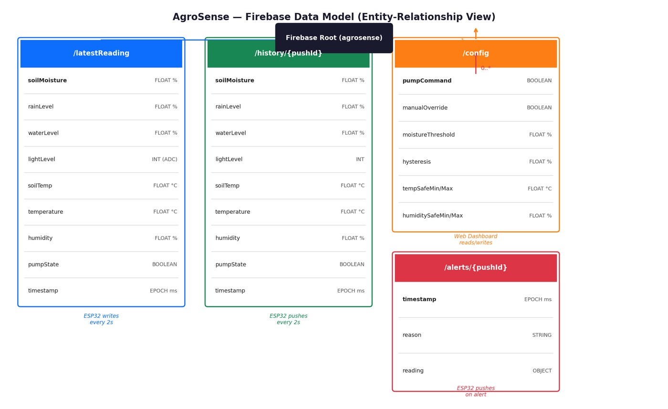
DATABASE DESIGN
Firebase Realtime Database — Data Model
Entity-relationship view of the RTDB schema: latestReading, history, config, and alerts nodes.
AgroSense — IoT Smart Farming & Crop Monitoring System
13 / 25

Slide 14
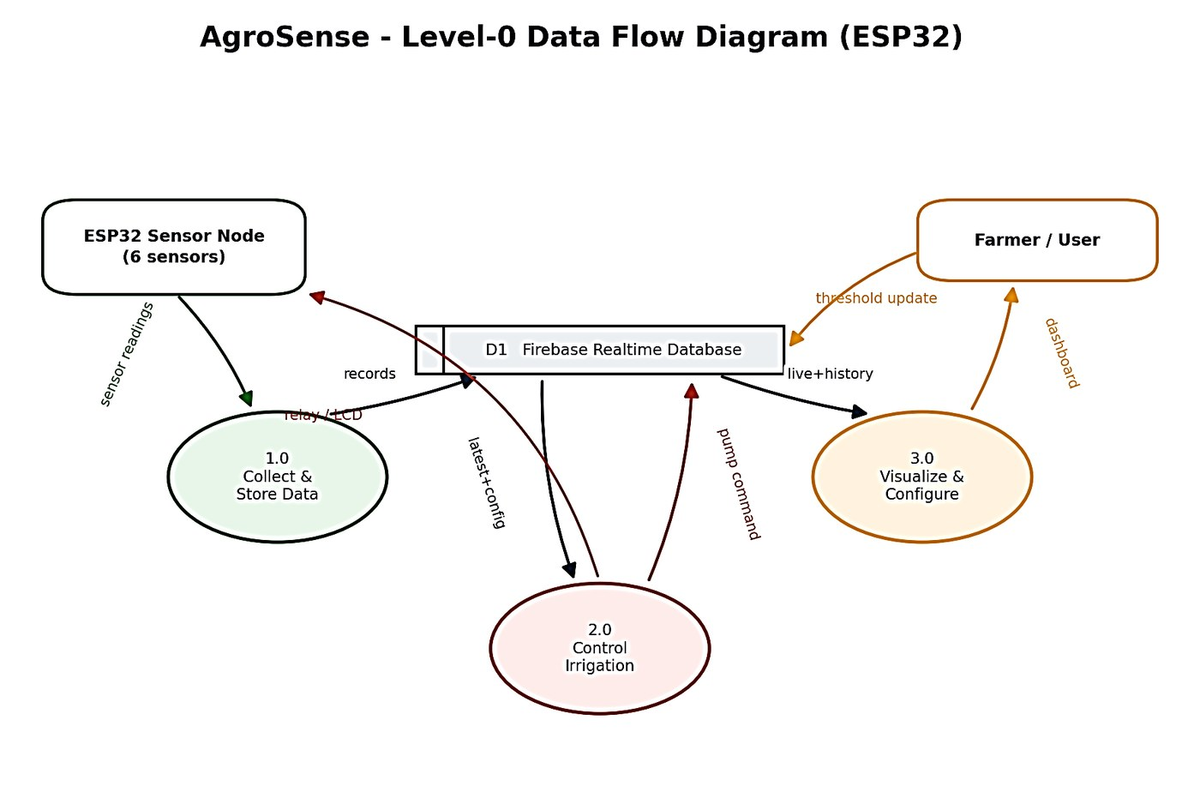
SYSTEM DIAGRAMS
Level-0 Data Flow Diagram (DFD)
How sensor data moves between the ESP32 node, cloud database, and the farmer/user.
AgroSense — IoT Smart Farming & Crop Monitoring System
14 / 25

Slide 15
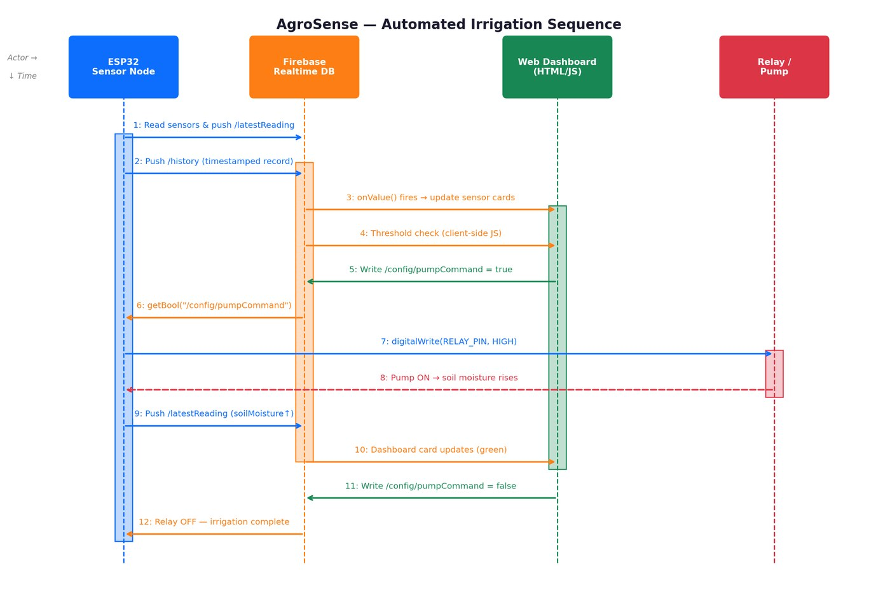
SYSTEM DIAGRAMS
Sequence Diagram — Automated Irrigation Cycle
Step-by-step message flow between sensor, ESP32, Firebase, and dashboard during one irrigation cycle.
AgroSense — IoT Smart Farming & Crop Monitoring System
15 / 25

Slide 16
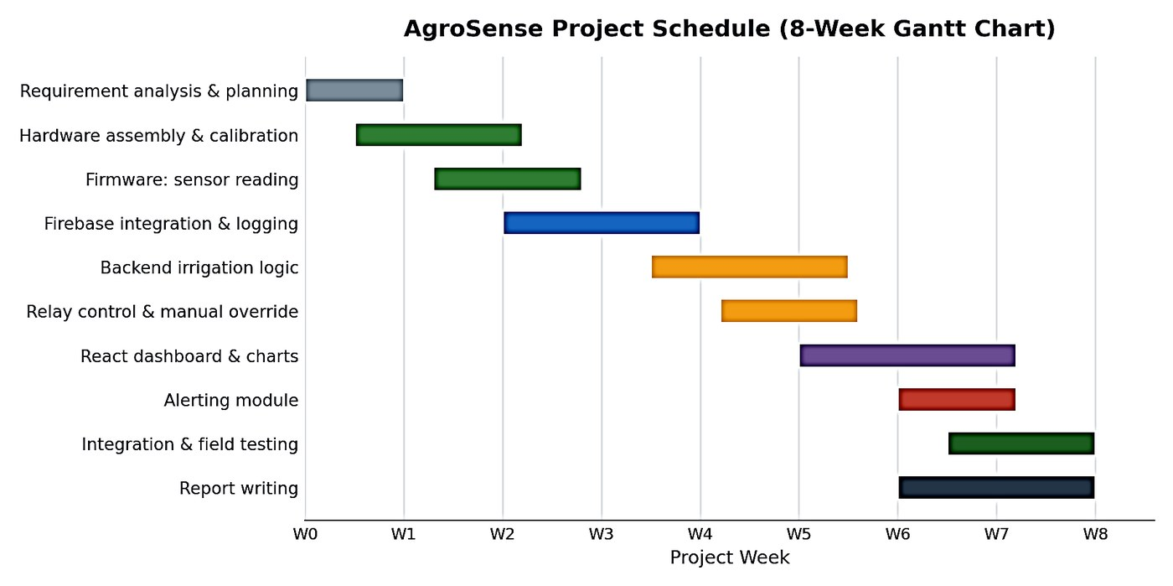
SYSTEM DIAGRAMS
Development Schedule — 8-Week Gantt Chart
Actors (farmer, ESP32 device) and the core use cases the AgroSense platform supports.
AgroSense — IoT Smart Farming & Crop Monitoring System
16 / 25

Slide 17
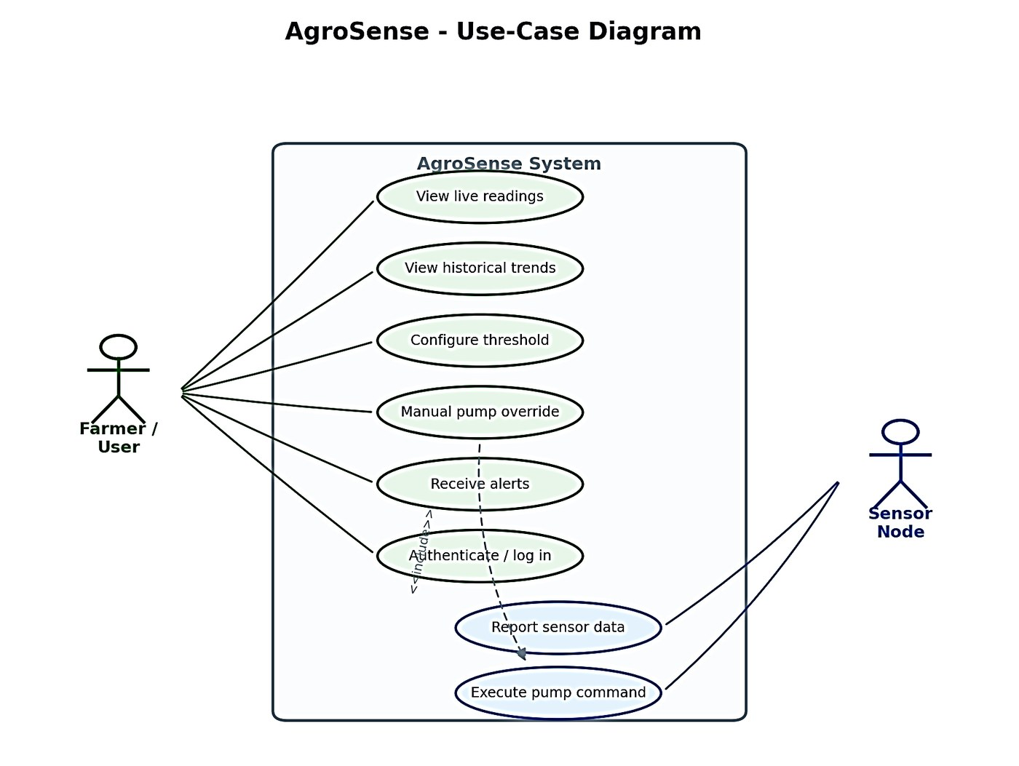
PROJECT MANAGEMENT
Use-Case Diagram
Detailed task-level Gantt chart complementing the milestone timeline shown earlier.
AgroSense — IoT Smart Farming & Crop Monitoring System
17 / 25

Slide 18
DATASET
Sensor Data Collected
Parameter | Sensor | GPIO Pin | Range / Output
Soil Moisture | Capacitive (ADC1) | GPIO34 | 0–100%
Rain Level | Analog wetness (ADC1) | GPIO35 | 0–100%
Water Level | Reservoir analog (ADC1) | GPIO33 | 0–100%
Light Intensity | LDR (ADC1) | GPIO32 | ADC lux value
Soil Temperature | DS18B20 (1-Wire) | GPIO27 | °C
Air Temp & Humidity | DHT11 (digital) | GPIO4 | °C / %RH
Data is streamed live via ESP32 firmware, pushed to Firebase every 2 seconds, and logged in /history for charting and reports.
AgroSense — IoT Smart Farming & Crop Monitoring System
18 / 25

Slide 19
PROJECT / THESIS TIMELINE
8-Week Development Schedule
Requirement Analysis & Literature Review
Firmware Development (Sensors + Wi-Fi)
Web Dashboard — Core Pages
Testing (17 Test Cases) & Debugging
W1
W3
W5
W7
W2
W4
W6
W8
Hardware Procurement & Circuit Design
Firebase Schema & Cloud Integration
Pump Control & Automation Logic
Documentation & Pre-Defense Prep
AgroSense — IoT Smart Farming & Crop Monitoring System
19 / 25

Slide 20
PRELIMINARY RESULTS / PROGRESS
Where We Stand Today
7
2s
9
17/17
Sensors integrated
Live update rate
Dashboard pages built
Test cases passed
Firmware complete: reads all 7 sensors, drives OLED display, uploads to Firebase every 2 seconds.
Web dashboard functional across Login, Live Monitoring, Pump Control, Charts, History, and Reports pages.
Threshold + hysteresis (±5%) auto-irrigation logic validated with manual override support.
Field-style testing completed: all 17 test cases passed, covering sensors, automation, Wi-Fi recovery, and auth.
AgroSense — IoT Smart Farming & Crop Monitoring System
20 / 25

Slide 21
EXPECTED OUTCOMES
What AgroSense Will Deliver
💧
Reduced Water Waste
📲
Remote Visibility
Threshold-based auto-irrigation cuts unnecessary watering compared to manual routines.
Farmers monitor soil, water, and climate conditions live from any phone or browser.
⚙️
Reliable Automation
💰
Affordable Precision Agriculture
Hysteresis logic and manual override prevent pump stress and give the farmer final control.
A low-cost ESP32 + Firebase stack brings capabilities of costly commercial platforms within reach.
AgroSense — IoT Smart Farming & Crop Monitoring System
21 / 25

Slide 22
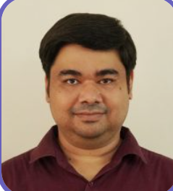
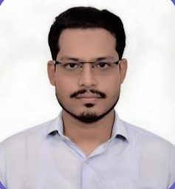
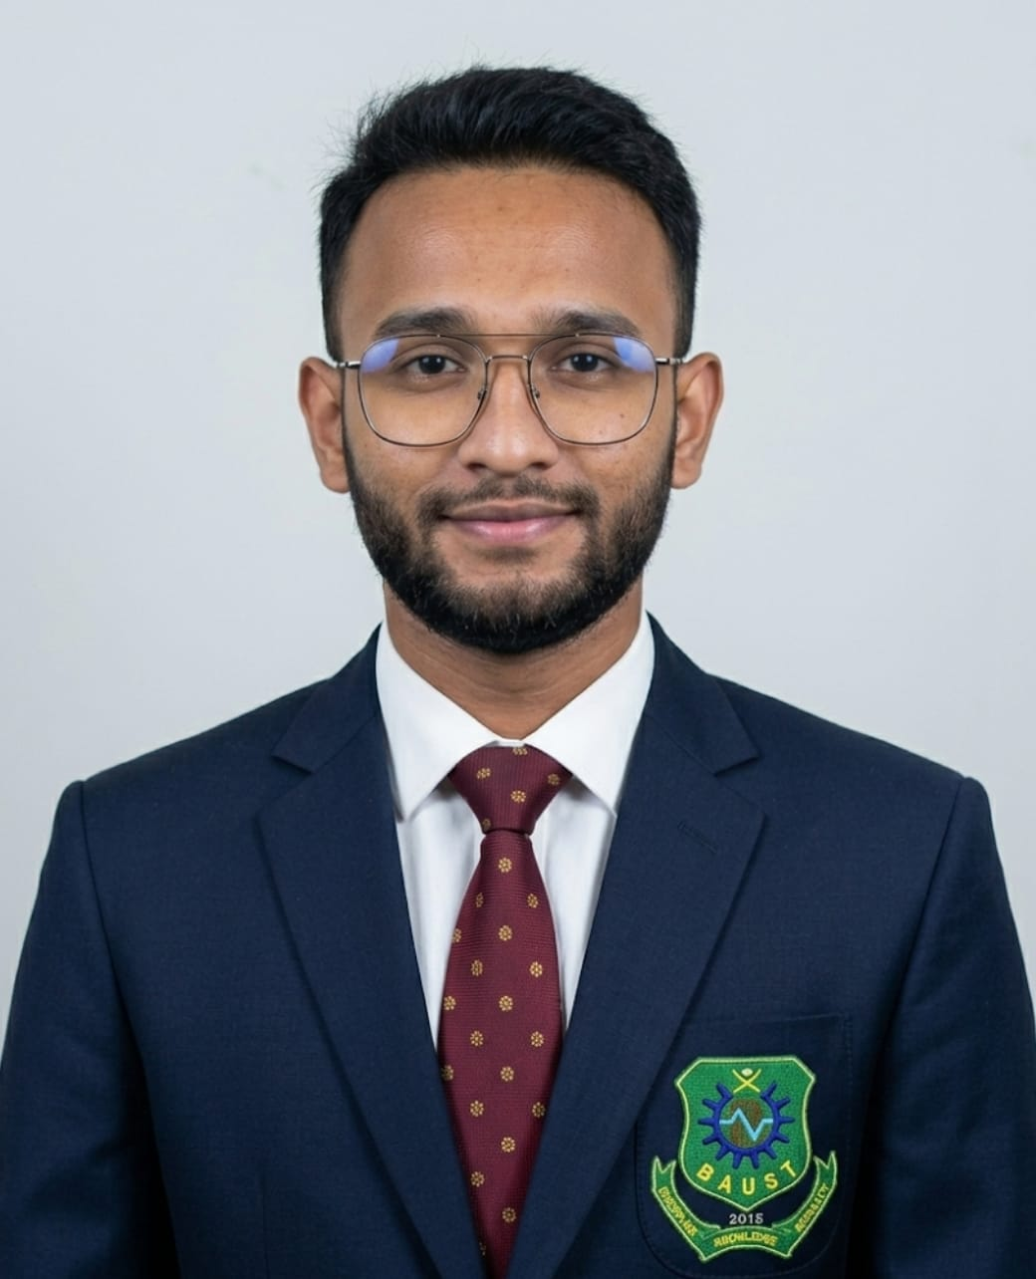
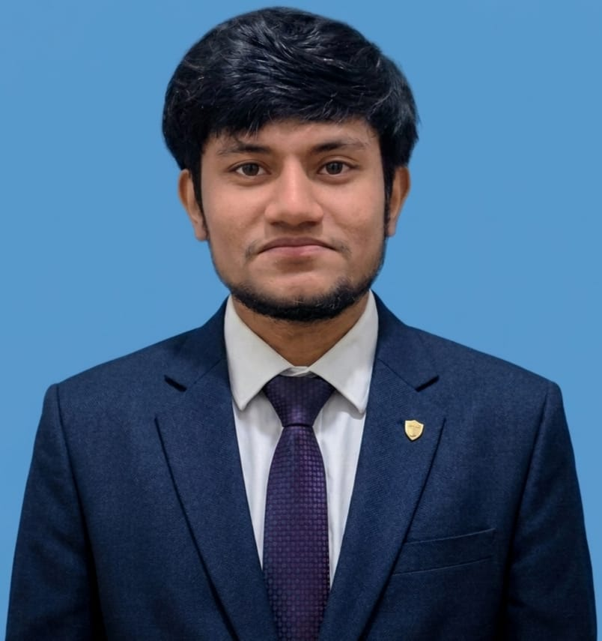
TEAM ROLES & CONTRIBUTIONS
Team Roles & Contributions
Taher Muhammad Mahdee
Mahadi Hasan
Md Emam Masum
Zihan Hossain
Supervisor
Co-Supervisor
ID: 220201056
ID: 220201067
Associate Professor, Dept. of CSE (BAUST)
Assistant Professor, Dept. of CSE (BAUST)
Software Back-end, Database & Deployment, Hardware Integration, Firmware & Hardware Testing.
Software Front-end, Hardware Collection,
Diagrams & Documentations, overall UI design, Software Testing.
AgroSense — IoT Smart Farming & Crop Monitoring System
22 / 25

Slide 23
CONCLUSION
Conclusion
1
AgroSense addresses four core problems in manual irrigation — water waste, blind monitoring, weather risk, and high commercial cost — with one integrated IoT platform.
2
All three objectives were met: a 7-sensor ESP32 node, a real-time Firebase-synced dashboard, and automated threshold-hysteresis pump control.
3
The system was validated with 17/17 test cases passed during field-style testing, confirming its accuracy and reliability.
4
AgroSense proves that affordable, integrated IoT can bring precision agriculture within reach of small-scale farmers.
AgroSense — IoT Smart Farming & Crop Monitoring System
23 / 25

Slide 24
REFERENCES
References
IEEE format — literature-review and technical reference list
[1] S. Rahman and T. Islam, “IoT-Based Smart Irrigation Systems: A Review of Architectures and Applications,” Int. J. Computer Applications, vol. 186, no. 4, pp. 12–19, 2024.
[2] M. Chowdhury and N. Akter, “Design of a Low-Cost Sensor Network for Precision Agriculture in Developing Regions,” Proc. Int. Conf. on Innovation in Engineering and Technology, pp. 1–6, 2023.
[3] R. Karim, “Cloud-Based Real-Time Data Logging for Embedded IoT Applications,” J. Emerging Technologies in Computing, vol. 9, no. 2, pp. 45–53, 2022.
[4] Espressif Systems, ESP32 Technical Reference Manual, Version 5.1, Shanghai: Espressif Systems, 2023.
[5] Google LLC, Firebase Realtime Database Documentation, 2024. [Online]. Available: firebase.google.com/docs/database.
AgroSense — IoT Smart Farming & Crop Monitoring System
24 / 25

Slide 25
🌱
Thank You
AgroSense — IoT-Based Smart Farming & Crop Monitoring System
Md Emam Masum (220201056) • Zihan Hossain (220201067)
Supervised by: Taher Muhammad Mahdee (Associate Professor) • Co-Supervised by: Mahadi Hasan (Assistant Professor)
Department of CSE • Bangladesh Army University of Science & Technology (BAUST) • August 2026
🌐 smart-farming-3d1f2.web.app

