Slide 1

The wrong spray starts with a guess.
documentation/photos/01_problem.jpg
A farmer sees a spotted rice leaf.
The wrong advice means the wrong spray: wasted money, and a crop still at risk.
Many farmers have limited, costly mobile data.
Notes:
A farmer sees spots on a leaf. They ask whoever is nearby, often the pesticide seller. If the problem is not what the seller thought, the spray is wrong, the money is gone, and the crop is still at risk.
This problem is specific to rice and to Bangla speakers. Many users have a shared phone, a weak connection and limited reading comfort.
Many rural farmers face limited or costly connectivity, so the app must work on-device without requiring continuous internet or server uploads. Do not add review percentages or any other unverified number.

Slide 2
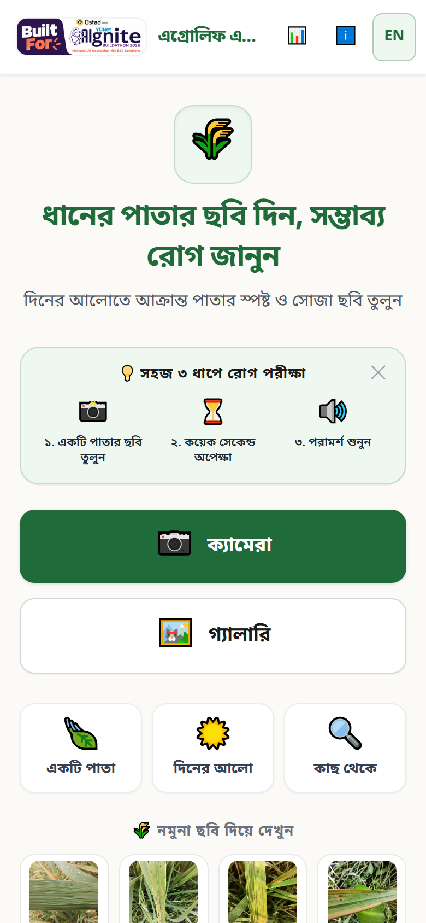
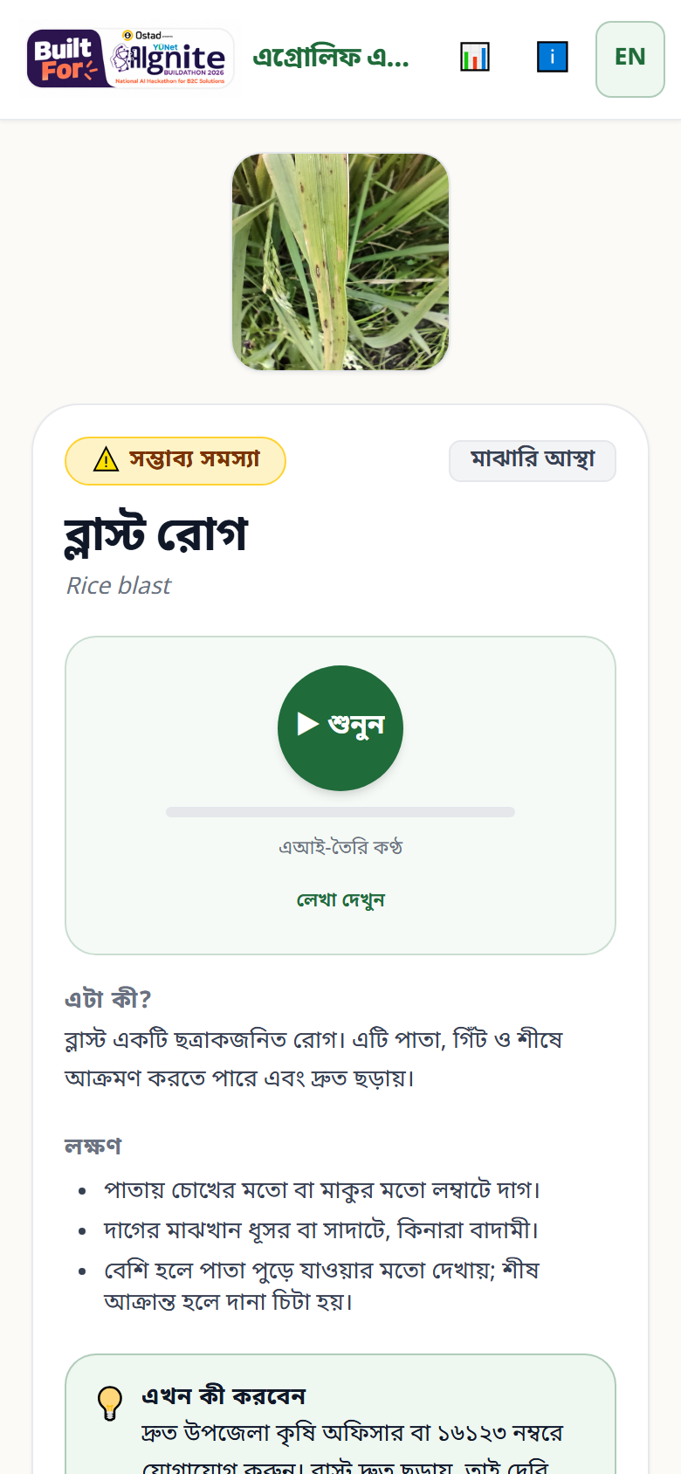
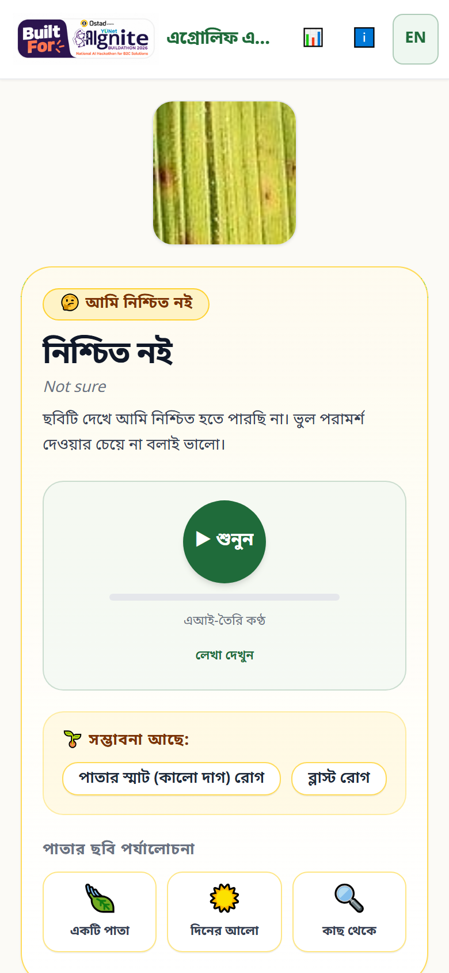
One photo. One honest answer.
Upload a photo
Bangla result + audio
Not sure: নিশ্চিত নই · 16123
“Tells you what's wrong in Bangla, and tells you when it doesn't know.”
Notes:
The flow is deliberately short: photo, check, result.
The result is in Bangla, with English available, and can be read aloud. Audio starts when the user taps play; it is labelled as AI voice.
When the model is not confident, it says "not sure" and shows the two closest possibilities, how to retake the photo, and the 16123 hand-off. It does not force an answer.
This is preliminary screening, not a diagnosis.

Slide 3
On the phone. Not in the cloud.
Photo
EfficientNet-B0
Threshold
Bangla card + audio
Internal test macro-F1: 0.844 · answered: 0.886
Unseen district (Sylhet) macro-F1: 0.570 · answered: 0.748
Train: Bangladeshi field photos (Gazipur, Savar, Sirajganj-Pabna, Dhan-Shomadhan, DIU half A) + India/Taiwan + non-rice photos
Independent tests: Sylhet-Dhaka (never seen) · Aman 2025 · DIU half B
Notes:
The model is EfficientNet-B0 (live version v10) with 8 outputs, including 'not a rice leaf' and 'other rice problem', fine-tuned in PyTorch on free Kaggle GPUs and exported to a 15 MB ONNX file. It runs in the browser with ONNX Runtime Web's WASM build. The photo never leaves the phone.
The confidence is calibrated on validation data with temperature scaling, and the threshold is chosen there to target a precision level. There is no hard-coded threshold.
The split is grouped by perceptual hash, so burst photos cannot leak between train and test. I checked that no group is shared.
The headline number is external, not internal: Sylhet-Dhaka, a district the model never saw. There, 56% of its answers are right; I show that on purpose. Leaf Smut has no external test and is never named, and the accuracy page says so.
Fill in the numbers from metrics-v10.json, with the sample sizes in the speaker notes. If training is not finished, say "evaluation in progress" and do not estimate.
Measured values from metrics-v10.json: Internal test: macro-F1 0.8442, coverage 0.8862, n 1467. External RiceLeafBD real-field photos, Sylhet-Dhaka (Mendeley), never used for training or tuning: macro-F1 0.5697, coverage 0.7479, n 1446. External Rice Leaf Disease Classification BD (Aman 2025, Hugging Face Project-AgML), 422 photos with no copy in other datasets: macro-F1 0.8964, coverage 0.9371, n 422. External DIU Rice Leaf Disease and Pest Dataset, Bangladesh (half B, never used for training or tuning): macro-F1 0.7843, coverage 0.8414, n 1375.

Slide 4
About me
[[Your name]]
documentation/photos/portrait.jpg
[[University]]
[[Skills]]
Solo builder for AIgnite.
Research began in a team idea competition.
This web app is my own individual build.
Why this problem: [[one personal line]]
Notes:
I am [[Your name]], a [[Year]] student at [[University]]. My skills are [[Skills]].
Be transparent: the idea and early research began in a team idea competition. The web app, the ML pipeline, the design and the deployment are my own individual work for AIgnite. The team research is credited in the repo.
I built this because I want a farmer to get a useful second opinion without an account, without an upload and without a sales pitch.
Do not imply endorsement by BRRI, DAE, AIS or any other organisation.

Slide 5
Useful, and honest about its limits.
No AI-written pesticide doses
16123 hand-off — charges may apply
✓
✓
Photo never leaves the phone
“Not sure” when the model does not know
✓
✓
Next: more crops · officer review · field testing
Notes:
Safety is a design constraint, not a disclaimer. The app never generates a dose. Official guidance is quoted verbatim with a link and a "confirm with your officer / 16123" note.
Privacy is structural: inference is on-device, with no accounts and no analytics that capture images.
The limits are visible in the product: one district and one season in training, Leaf Smut has no external test, and sheath symptoms may be missed on a photo of a leaf. The disease information is preliminary and has not been reviewed by an agronomist.
Next: more districts and phones, a proper negative-example check, more crops, and a field review with an agriculture officer.
Close with the ask: try the live app, open the accuracy page, and tell me what a farmer would still find confusing.

