Slide 1
University Admission Care BD
Md Abir Hasan
Id-:181-15-1887
Md. Kawser Ahamed
Id-:181-15-1722
Mst.Tania Sultana
Id:-181-15-1945
Amit Chakraborty Chhoton
Senior Lecturer
Daffodil International University
Co-superviser
Saima Afrin
Lecturer
Daffodil International University
Monday 17 January 2022

Slide 2
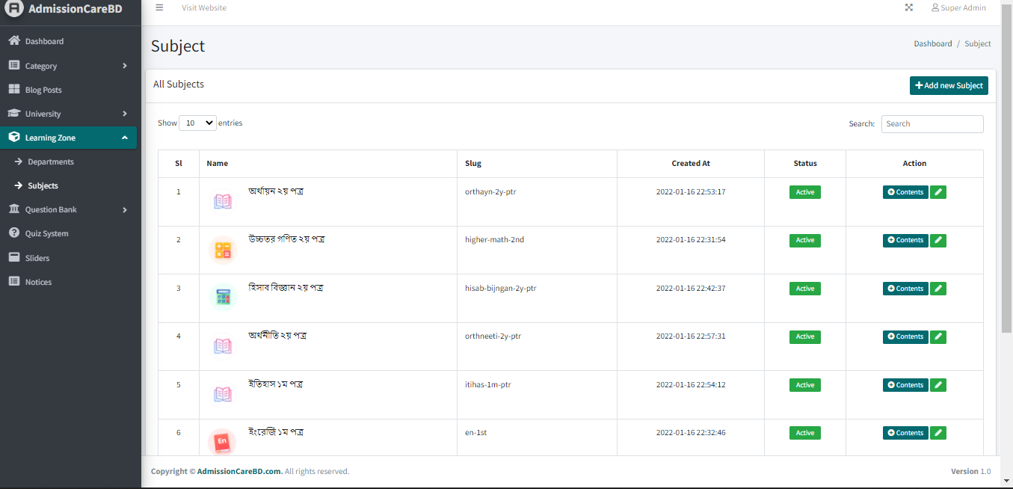
LEARNING ZONE ADMIN PANEL

Slide 3
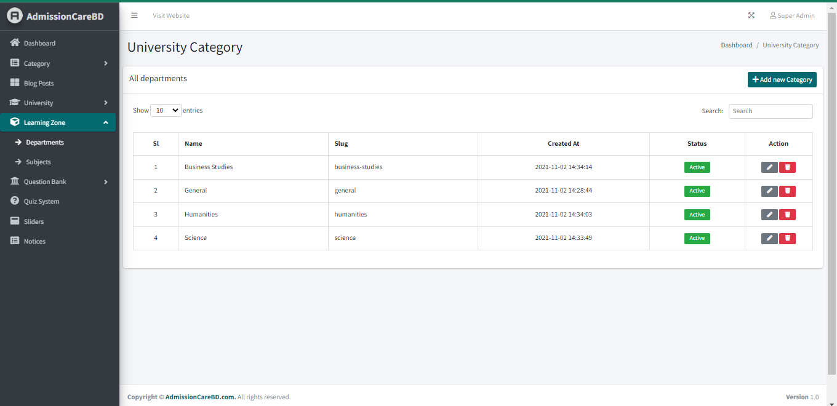
DEPARTMENT

Slide 4
Table of Content
Problem Definition
Introduction .
Motivation .
Comparative study .
Methodology .
Result Analysis.
Future work and conclusion
References

Slide 5
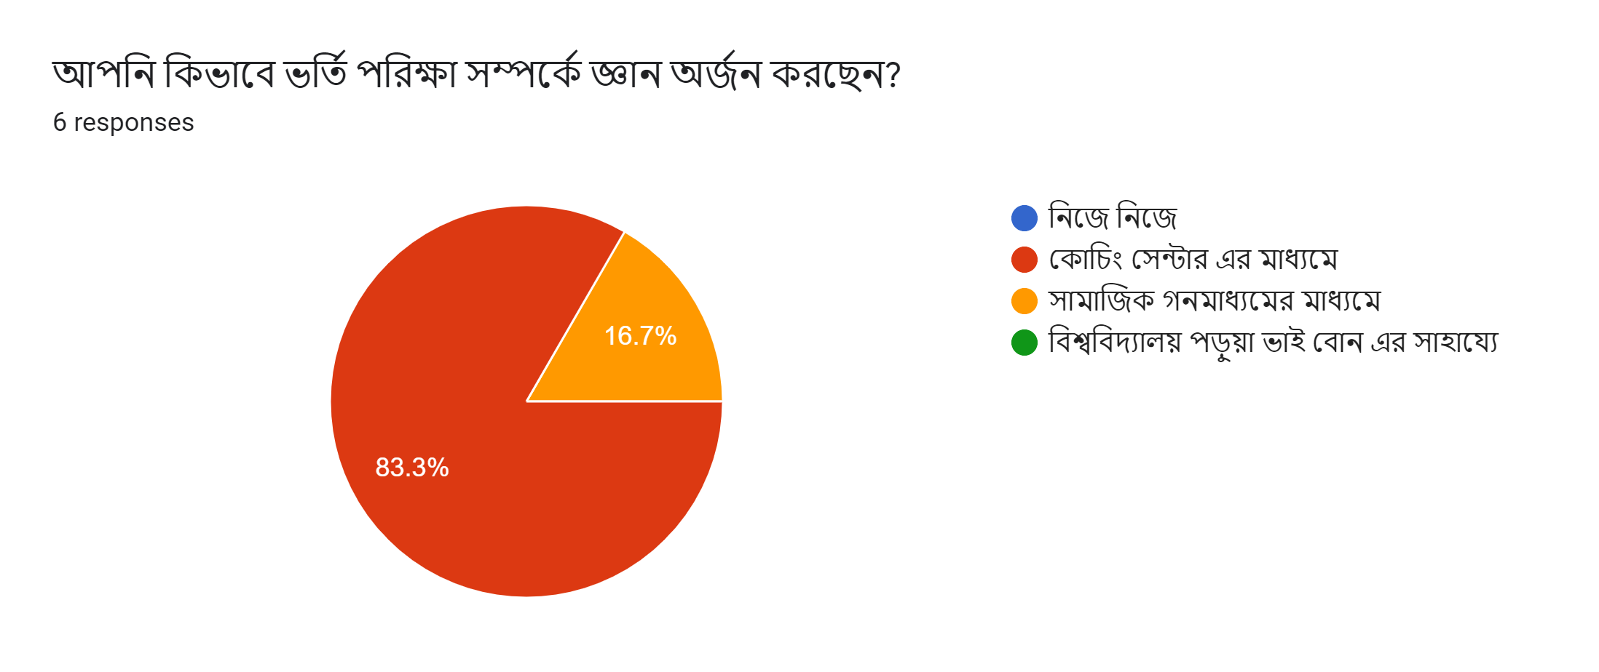
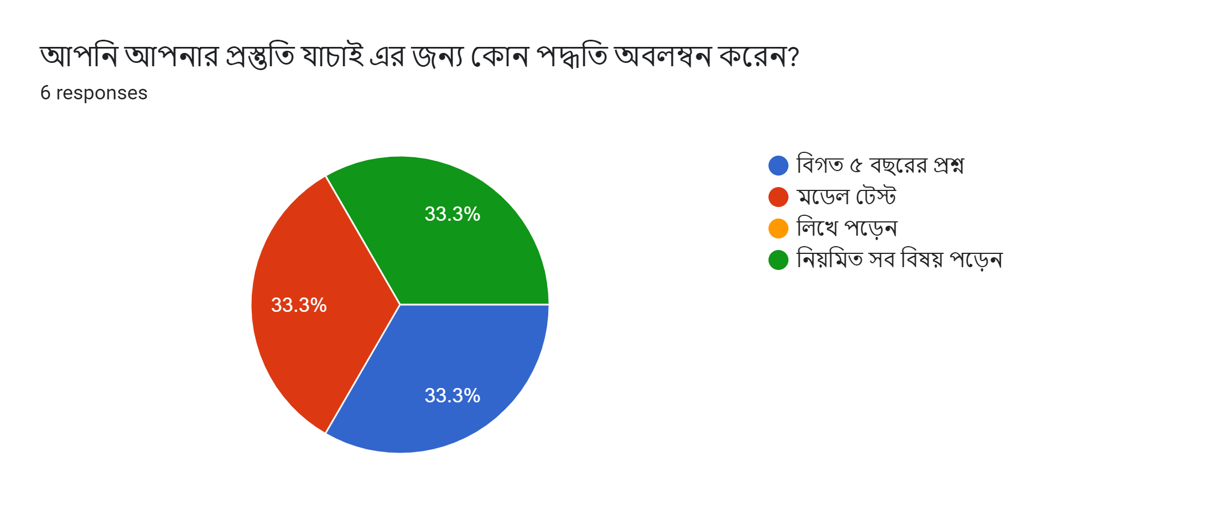
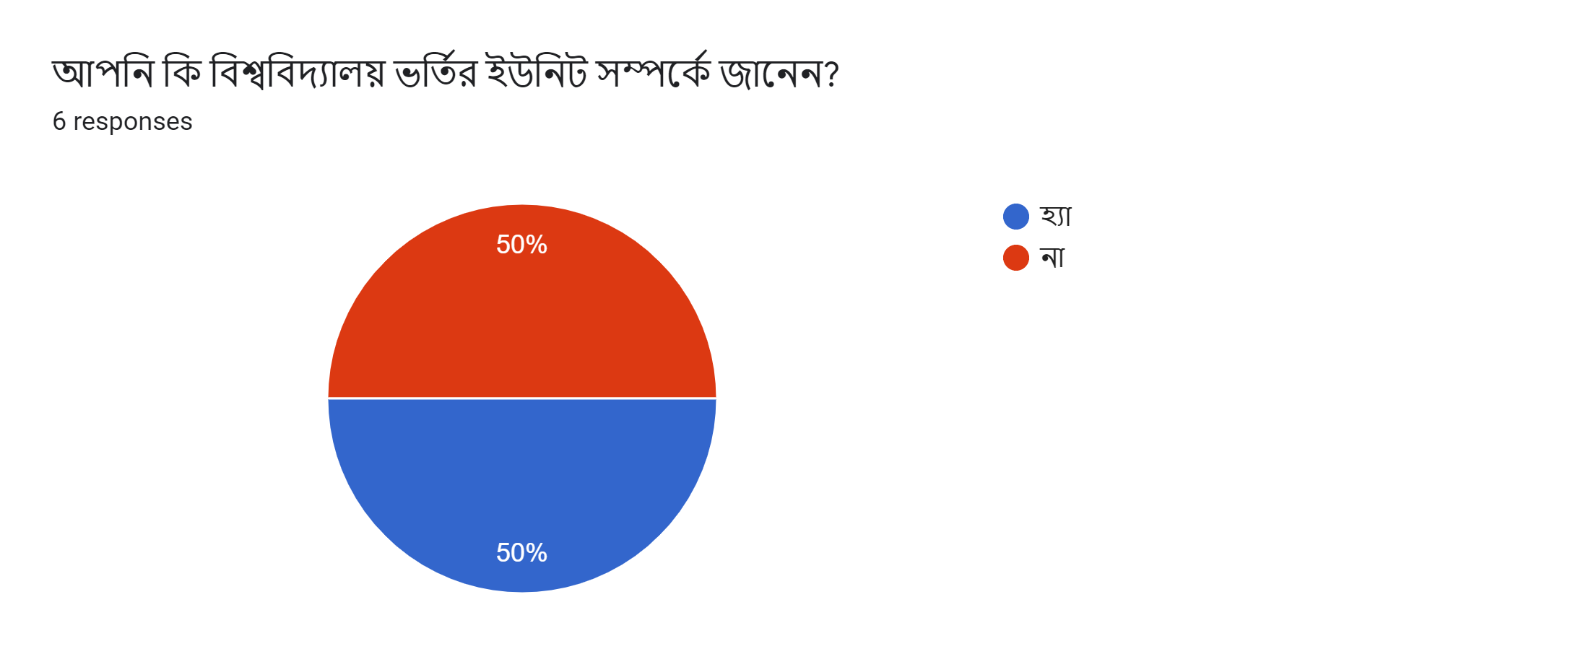
Problem definition?

Slide 6
Introduction
We live in an age of science. Science and technology made our life easy and comfortable. To collect admission requirement student need to search the website of the university and visiting the university.
Sometimes students can't know about university admission test guides properly. Our project made by all types of a guideline of admission test, our web-based application is contained by preparation to a full guide of admission test. Our application why used it? Our project feature is the Learning Zone. Notification of result. Seat plan Helpline University location map. The grading system of admission.

Slide 7
Motivations
Every year a large number of candidates face a lot of problems during the admission test. They don’t get proper guideline for their Admission test's, we want to help and notice them all information and guideline with our site. And this will be the first proper guideline website on admission tests.

Slide 8
Objective
Our main goal is to make a website where students can get proper guidelines for university admission.
Students can learn from our website for admission preparation.
Students get all the information about all the public universities in Bangladesh. (Subject requirement, map)
Students can test their skills in the self-test zone. They can give quiz/model tests on their preferred subjects and see their study progress.
Students can get university subjects related to future planning and the future of the subject in the job sector.
Students can get to their preferred university by giving their results and studying medium.
Students will receive all admission notices and upcoming events on our website.

Slide 9
Expected outcome:
The expected outcome of this project is given below:
This will be an easy way to collect university information.
There will be proper guidelines and information about all public universities in Bangladesh.
Learning and self-testing will help students to be preferable for admission tests from home.
This website will be user-friendly.
All information will be given to the student by mail/SMS.

Slide 10
Tools
Html5
Bootstrap4
Css3
Javascript
Xampp
Php
Laravel.
Domain hosting.
Mysql database.
Internet connection.
Computer / Android mobile.

Slide 11
Scope of problem
DATA COLLECTION.
TIME MAINTAINS.
DATA FOLLOW DIAGRAM.
MODEL DESIGN

Slide 12
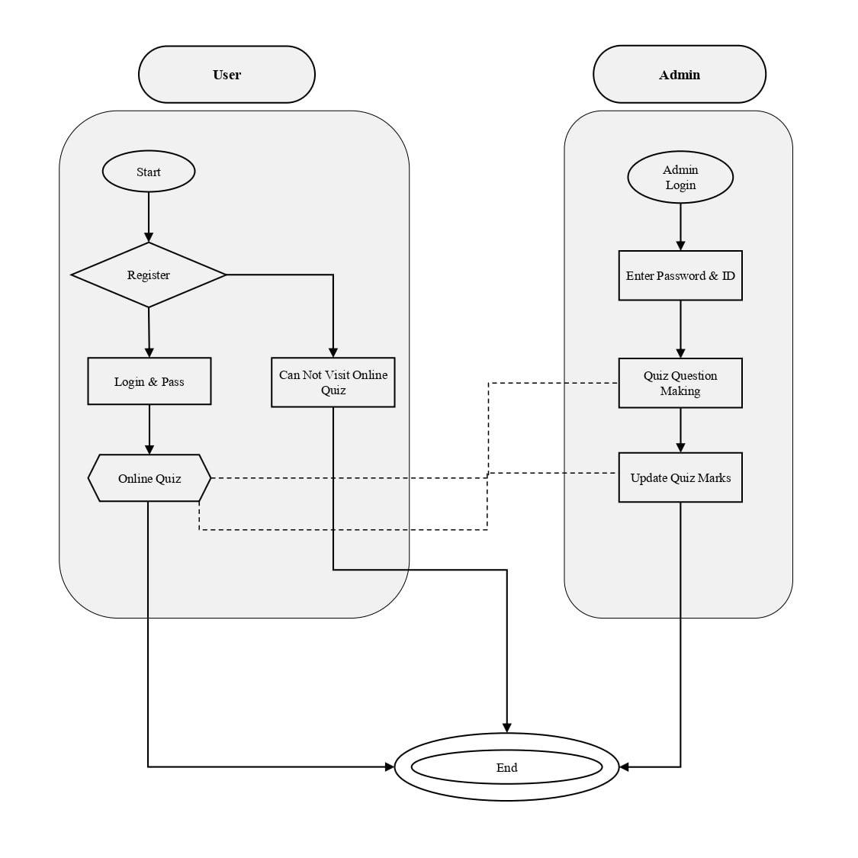
BPM

Slide 13
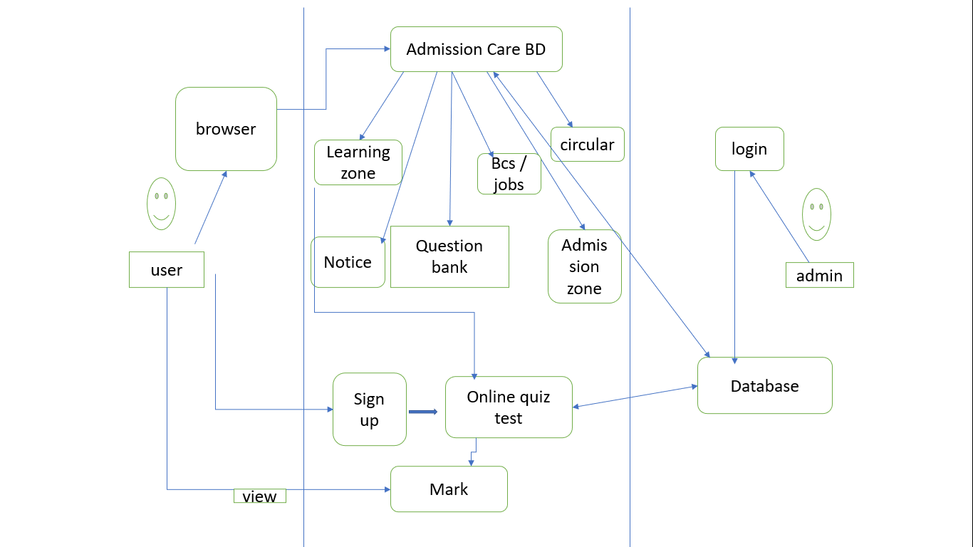
Use case diagram

Slide 14
COMPARATIVE STUDY
Case | University Admission Care BD | Admission War | Eduicon.Com | Admission Help Desk | 10 Minute School
Registration Login | Yes | No | No | Yes | Yes
Question Bank | Yes | Yes | No | No | No
Learning Zone | Yes | No | No | No | Yes
Online Quiz System | Yes | No | No | No | No
Notices & Update News | Yes | Yes | Yes | Yes | No
Motivation | Yes | No | No | No | No
Subject Review & Future | Yes | No | No | No | No

Slide 15
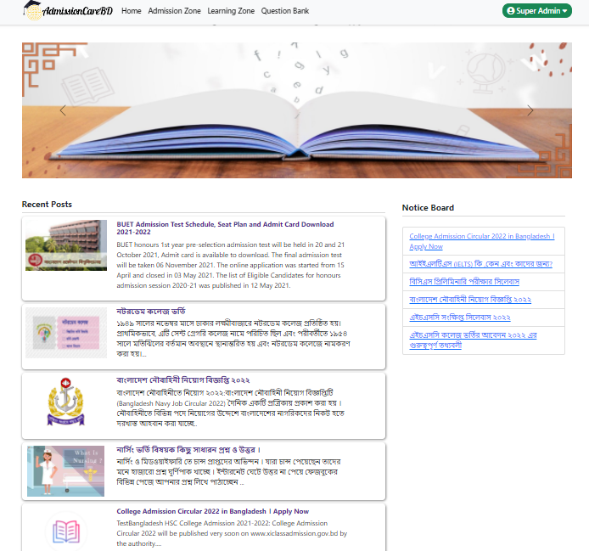
HOMEPAGE

Slide 16
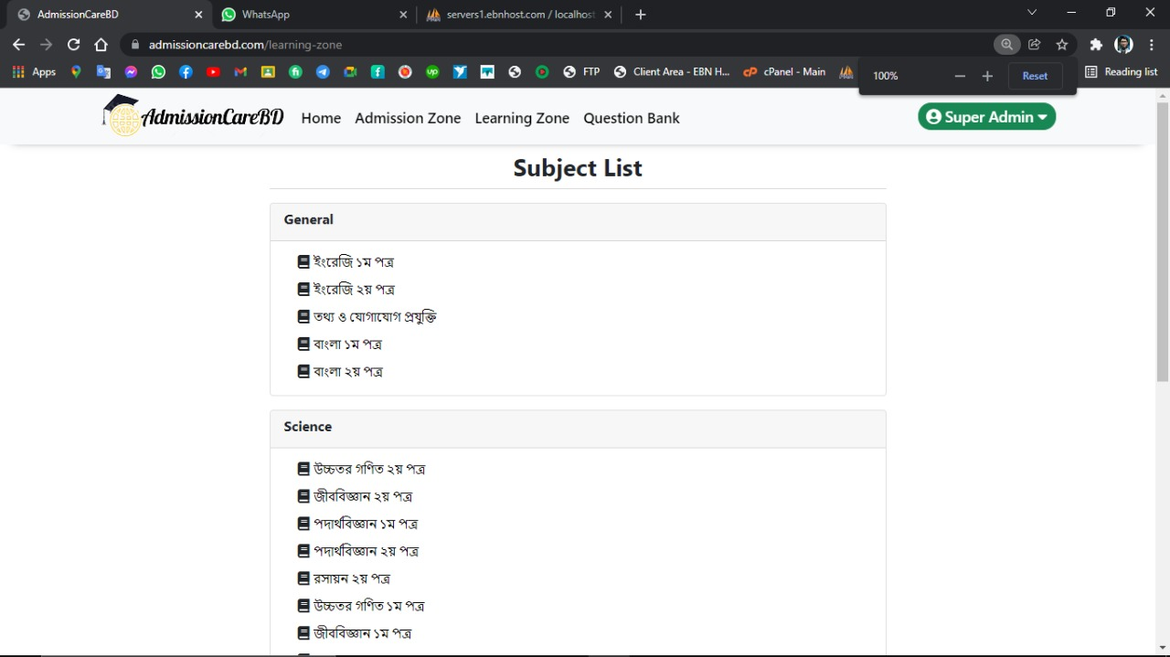

Slide 17
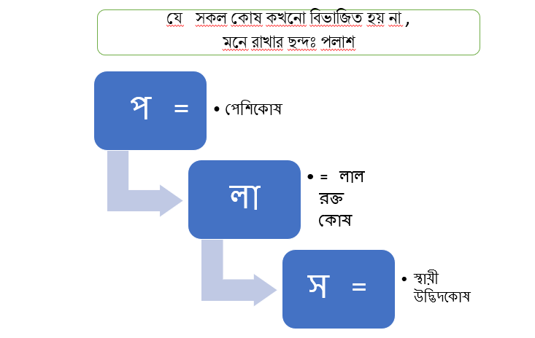
SUBJECTIVE SHORTCUT TECHNIQUE

Slide 18
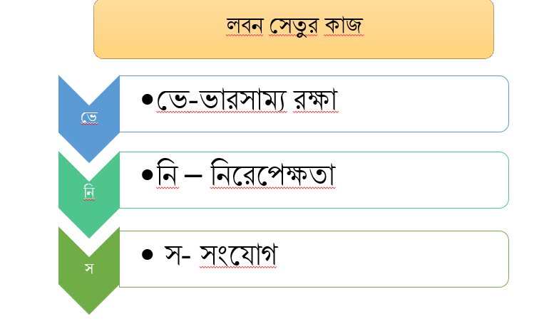
CHEMISTRY

Slide 19
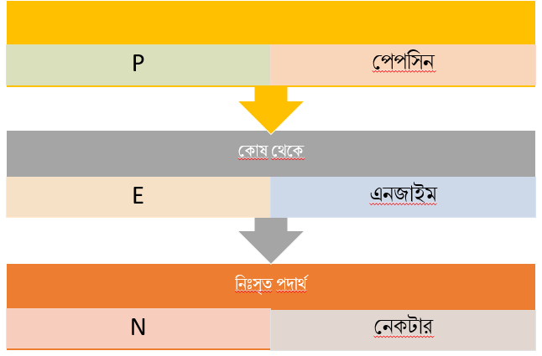
BIOLOGY SHORTCUT TECHNIQUE

Slide 20
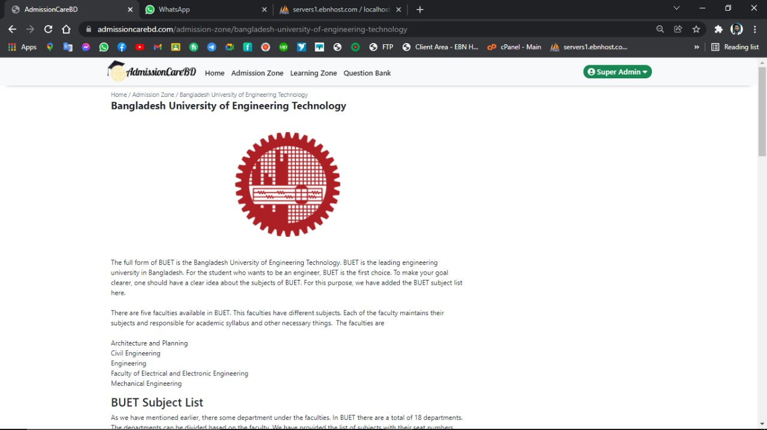

Slide 21
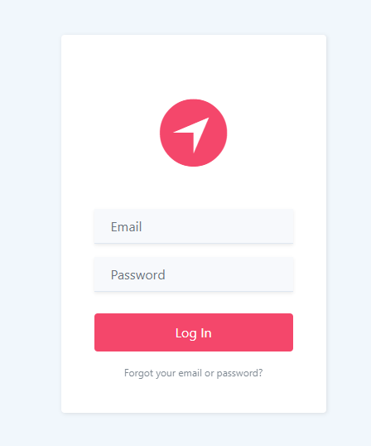
LOG IN PAGE

Slide 22
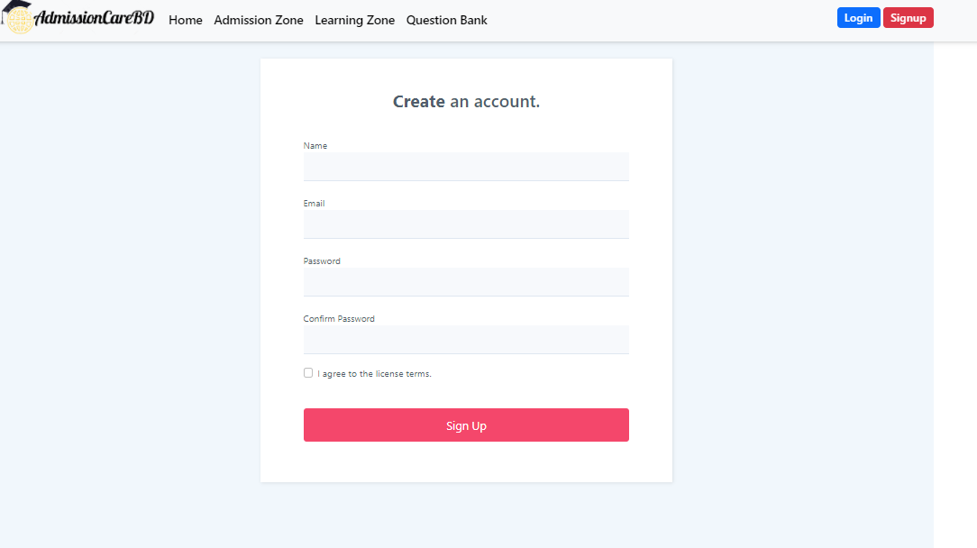

Slide 23
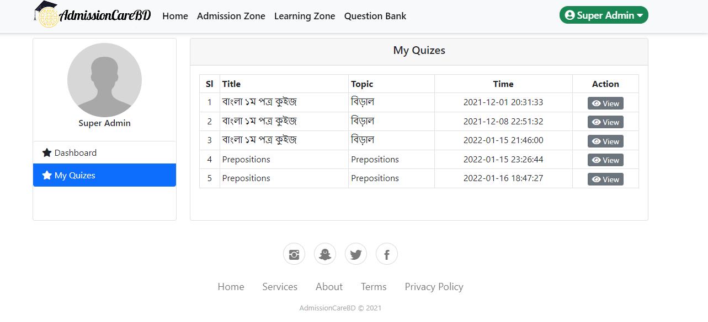
MY QUIZES

Slide 24
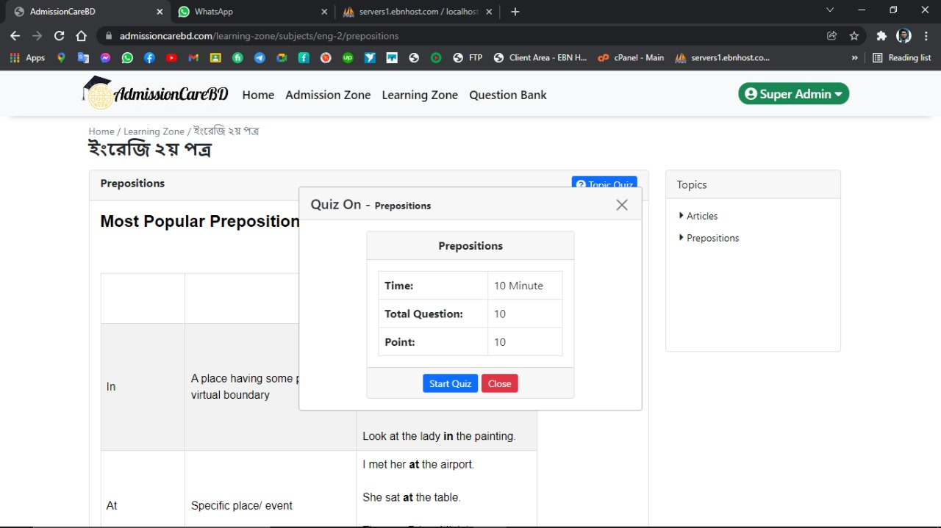

Slide 25
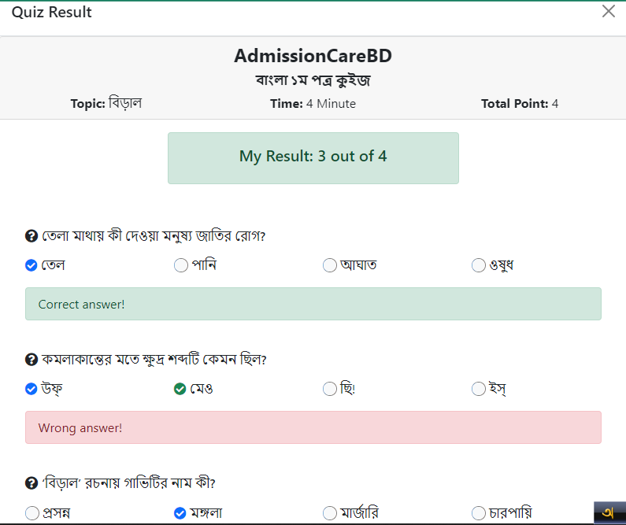
QUIZ RESULT

Slide 26
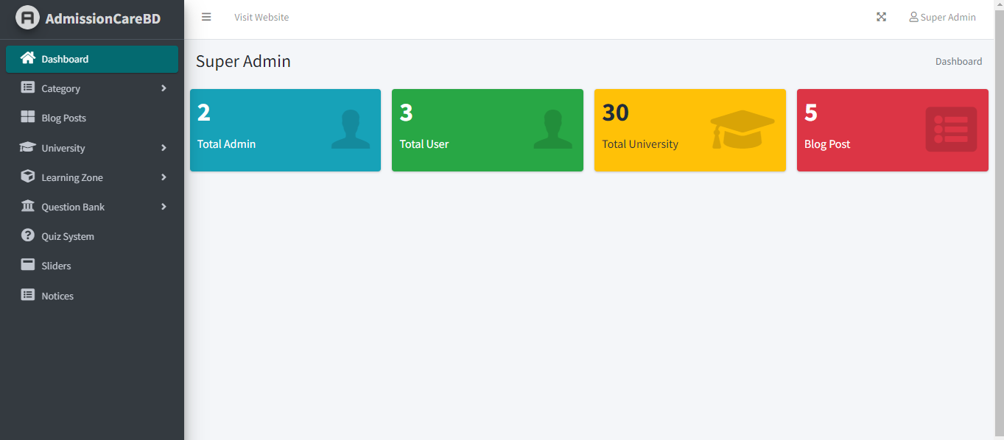
DASHBOARD(ADMIN)

Slide 27
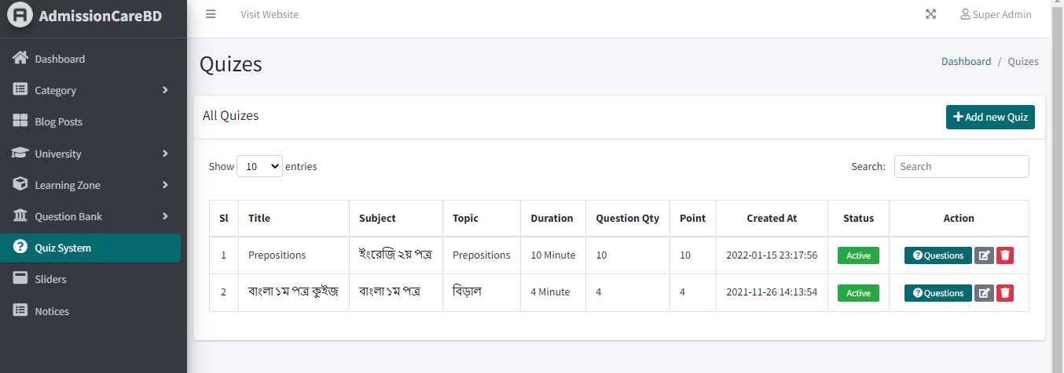
ADD NEW QUIZ

Slide 28
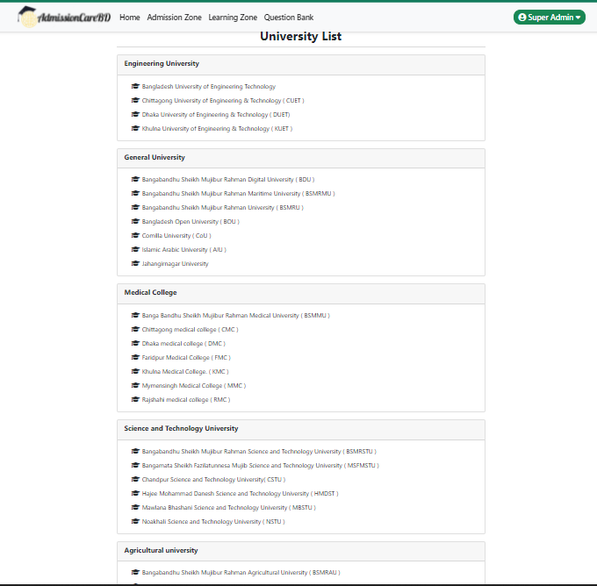

Slide 29
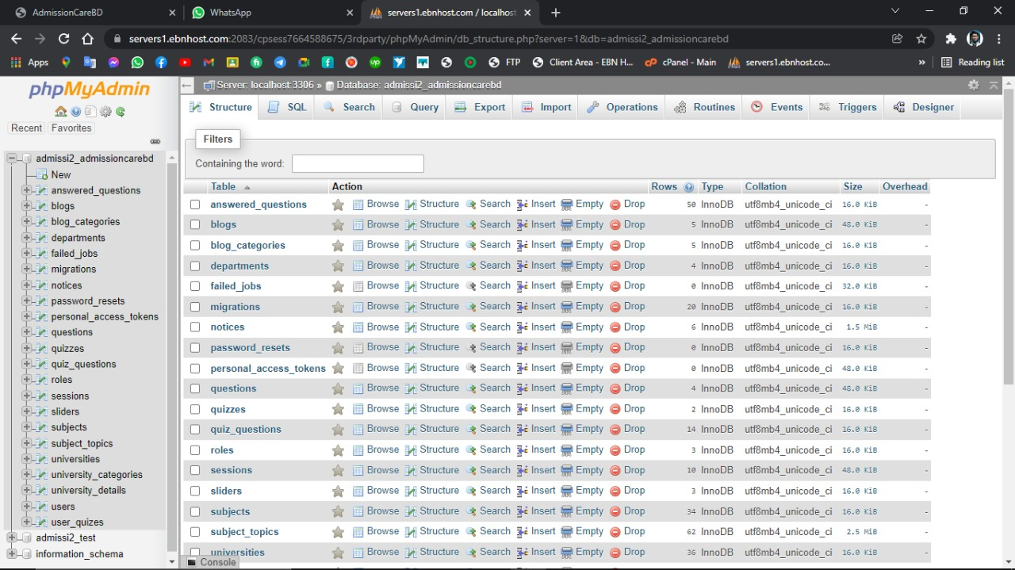
DATABASE(LAYOUT)

Slide 30
FUTURE WORK
We want to add some more new features in the future, which will take our project further. Below are some of them:
Convert to Android app.
offline admission preparation ebook.
Job Study and BCS.
Added skills development courses and certificates.
Hospitality and transportation arrangements for students.

Slide 31
REFERENCES :
[1] Shahinoor, S. A., Ahmed, M., Akhter, R., & Tasnim, M. (2018). Admission Helpdesk.
[2] Nath, N. R., Ahmed, M., & Rajbongshi, U. (2019). Private University Admission Assistant by Neel Ratan Nath.
[3] Samad, M. A. Comparison of Preference and Admission Status of Applicants in Different Under-graduate Programs with Special Emphasis to DVM Degree at Bangladesh Agricultural University.
[4] https://www.admissionwar.com/
[5] http://resultinbd.net/
[6] http://www.eduicon.com/
[7] https://www.w3schools.com
[8] https://10minuteschool.com/
[9] https://bootstrapstudio.io/docs/

