Slide 1
Room Management Appliance System
Presented by-
Masum Rana
ID: 151-35-1029

Slide 2
About The System
Managing office, meeting, laboratory, and teaching space.
Offer check room and information facilities through internet.
Reservation facilities through internet to the web users.

Slide 3

Features(Admin)
Add user
Delete User
Update Info.
Delete Room
Add Room

Slide 4

Features(Web User)
Do Registration
Login
Cancel Reservation
Reserve Room
Check Room

Slide 5
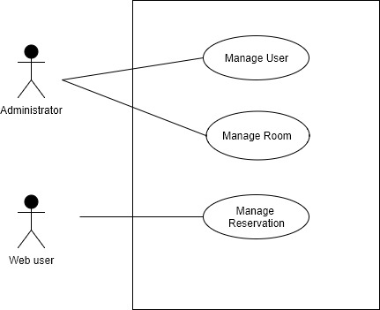
Use Case Diagram

Slide 6
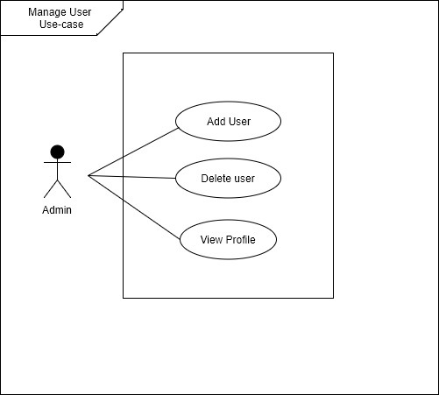
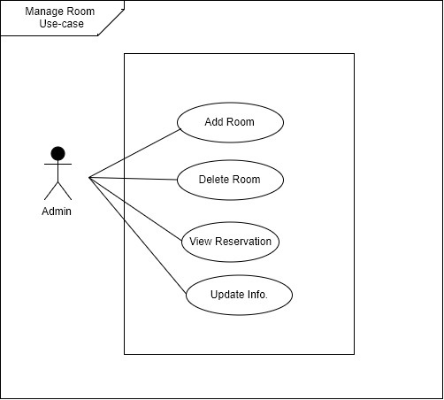
Use Case Diagram(Cont.)

Slide 7
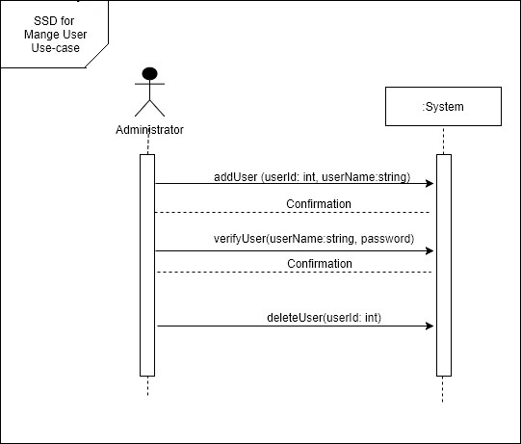
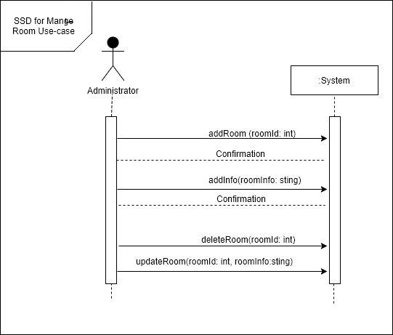
System Sequence Diagram

Slide 8
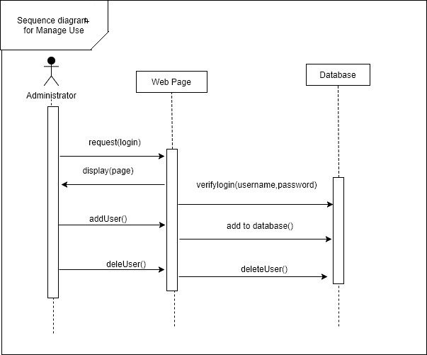
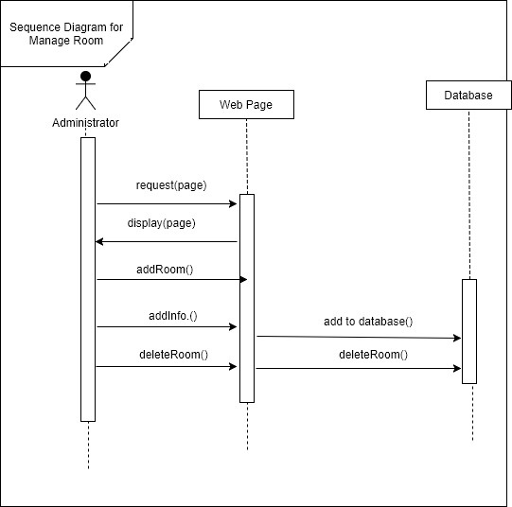
Sequence Diagram

Slide 9
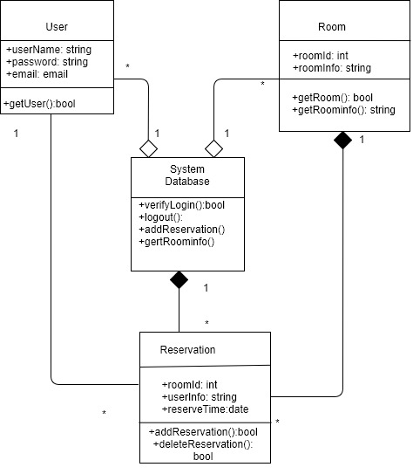
Class Diagram

Slide 10
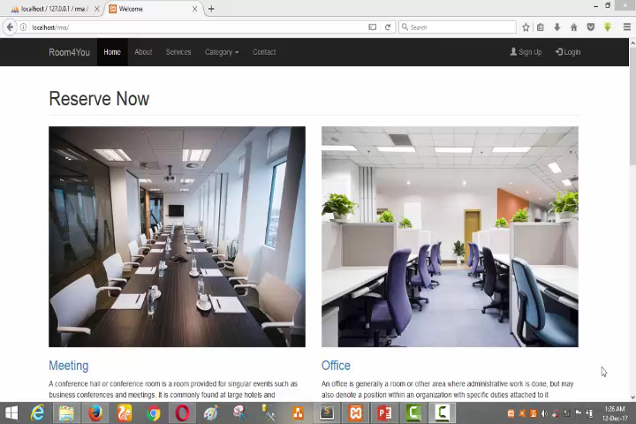
Demo Video

Slide 11
Thank You!

