Slide 1
Presentation On Email Spam Classification
Team members:
Md Masum Rana Id: 1902005
Hasi Rani Roy Id: 1902031
Mostakim Ara Jaba Id: 1802048

Slide 2
Outline of our Thesis
Introduction
Objectives
Problem definition
Language and Libraries
Description of dataset
Methodology
Results and Discussion
Conclusion
Future works

Slide 3
Introduction
In today’s globalized world, email is a primary source of communication. This communication can vary from personal, business, corporate to government. With the rapid increase in email usage, there has also been increase in the SPAM emails. SPAM emails, also known as junk email involves nearly identical messages sent to the numerous recipients by email. Apart from being annoying, spam email can also pose a security threat to computer system.
It is estimated that spam emails make up 45% of all email sent globally with over 150 billion spam emails sent daily. Approximately 36% of all spam emails were advertising, 26% were phishing attempts, and 2.5% were malware.

Slide 4



So, we need to identity which mail is ham or spam. Different machine learning algorithms have been used for the detection and classification of spam mails such as naïve bayes, support vector machines, k-nearest neighbor, decision tree etc.
In this project, we use machine learning classification algorithm (naïve bayes) to perform automatic spam filtering to use emails effectively.
Not Spam
Machine Learning
Model
Spam
Fig.1. Classification into Spam and non-spam

Slide 5
Objectives
Effectively identify and filter out spam emails from user’s inboxes, thereby reducing the risk of users falling victim to phishing scams, malware, or other malicious activities associated with spam.
Develop a spam detection model with a high level of accuracy to minimize misclassifying legitimate emails as spam.
Also increase precision value to predict spam emails appropriately

Slide 6
Problem Definition
Short message and email has grown into multi-billion dollars commercial industry.
SMS spam is still not as common as email spam.
From 2020 to 2021, the global spam volume was the highest in July 2021, when 283 billion out of 336.41 billion emails were spam and it is increasing day by day

Slide 7
Language And Libraries
Language: Libraries:
1. Python 1. Pandas 4. Sklearn
2. SMOTE 5. Streamlit
Platform:
VS Code

Slide 8
Description Of Dataset
A data set is a collection of data that is used to train the model. A dataset acts an example to teach the machine learning algorithm how to make predictions. We collect our dataset from Kaggle that contains of 504 emails
Number of data | Ham | Spam
504 | 287 | 217
Table. Description of dataset

Slide 9
Methodology
Data Set
Train Data
Test Data
Model
Real-Time Input Data
Predict
Output
Fig. 1. Block Diagram of System Architecture

Slide 10
Model building process: 1. Data Collection: To build our proposed model 1st we collect our dataset from Kaggle that contains 5575 lines. 2. Data cleaning: In this part, we check missing values and then duplicate values. If we find any duplicate value then remove it. 3. Data preprocessing: i Tokenization ii. Remove special characters iii. Remove stop words iv. Stemming 4. Feature extraction and selection: Feature extraction reduces the number of redundant data without losing vital information. The features can be extracted based on the weight and frequency measure of words from texts. Count Vectorization is Applied To Extract The Most Important Features.

Slide 11
5. Model selection: There are many machine learning algorithms are used for spam email classification such as naïve bayes, support vector machine, decision tree, logistic regression, k-nearest neighbor etc. Naïve bayes : It is based on the bayes theorem, which is at the core of the classifier’s functionality. In our model we used multinominal naive bayes. It is commonly utilized for document classification tasks, where the goal is to determine if a document belongs to a specific category such as sports, politics, or technology. Support vector machine : A SVM is a supervised machine learning algorithm that can be used for classification or regression problems. It works by finding the optimal hyperplane that separates the data points of different classes with the maximum margin. K-nearest neighbor (K-NN) : It is considered an example-based classifier, that means that the training documents are used for comparison rather than an explicit category representation, such as the category profiles used by other classifiers. As such, there is no real training phase.

Slide 12
Decision tree : It is a collection of well defined questions about test record attributes. Each time we get an answer, a follow up question is raised until a decision is not made on the record. The decision tree based algorithms goal is used to predict a target variable’s value on a given set of input values. This algorithm uses a tree structure to solve classification and regression problems. Here the model selection step is covered by find out accuracy and precision. Here naïve bayes provide highest precision as well as satisfying accuracy so that is why we select naïve bayes algorithm to build our model.
Algorithm | Accuracy | Precision
Naïve Bayes | 0.92 | 0.87
K-Nearest Neighbors | 0.68 | 0.86
Decision Tree | 0.79 | 0.74
Support Vector Machine | 0.85 | 0.82
Table 2. performance table of four machine learning algorithms.

Slide 13
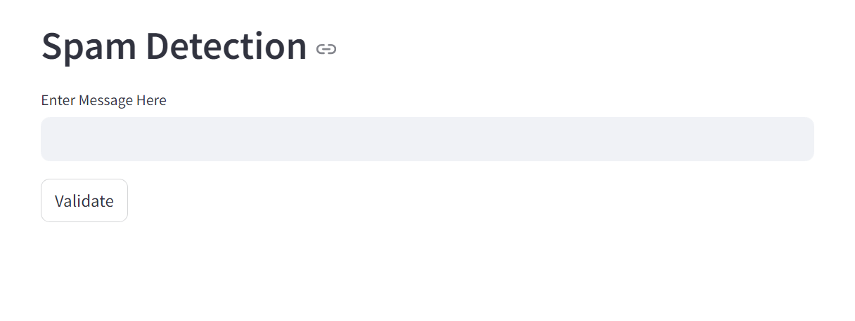
Results And Discussion This is our web application. Here we enter an email and it detect this email and also shows either it is spam or ham.
Fig. 2. shows email spam detection interface

Slide 14
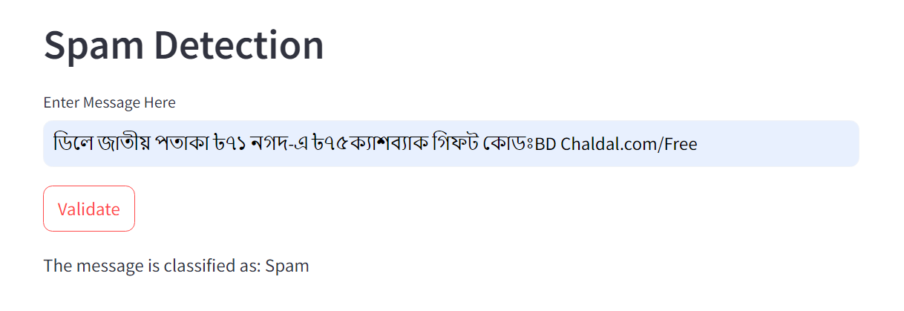
Here we enter an email and this web application shows that it is a spam email.
Fig. 3. shows spam email

Slide 15
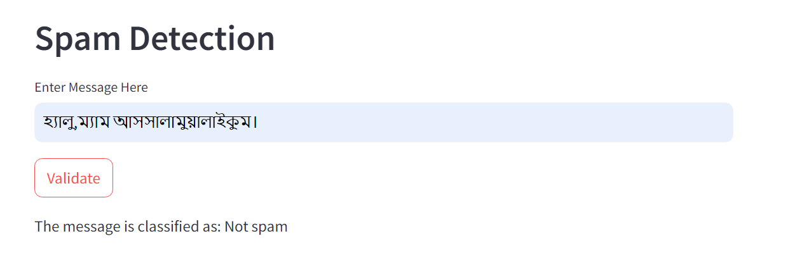
This figure shows that this is a ham mail.
Fig. 4. shows spam email

Slide 16
Conclusion
Spam messages the end user clients receive in our daily lives. Spam emails are available nothing but an ad for any company, any kind of virus etc. It is easy for hackers to access our system using these spam emails. Due to the increase in number of spam emails by the users, email spam has become one of the most demanding research topics. Various methods are used by different authors for spam email classification. We have used the concept of Naïve Bayes, Support Vector Machine, K-nearest Neighbor, Decision tree for spam email detection. The accuracy and precision percentage in the four methods have the less value, while in term of accuracy we can find that the Naïve Bayes and it shows a very satisfying performance among the other methods.

Slide 17
Future Works
In future work, we plan to extend our study to explore the use of larger and more diverse datasets to improve the performance and robustness of our models. Additionally, we aim to explore deep learning approach for optimizing the efficiency and scalability of spam detection of email, which would involve exploring several new approaches to make the models faster and more reliable.

Slide 18
Thank You

