Slide 1

Presentation On Deep Learning Based Approach To Detect Potato Leaf Diseases
Team members:
Md Masum Rana Id: 1902005
Hasi Rani Roy Id: 1902031
Mostakim Ara Jaba Id: 1802048

Slide 2

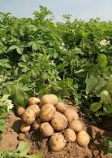
Outline of our Presentation
Introduction
Objectives
Contributions
Problem definition
Language and Tools
Methodology
Results and Discussion
Conclusion
Future works

Slide 3
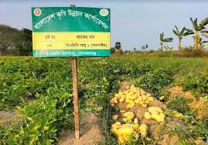
Introduction
There are many different types of occupations in the world, but agriculture is the most common and Bangladeshi economy is heavily reliant on agriculture. Among the various crops grown in Bangladesh, potato is the most in-demand crop. Bangladesh is the fourth largest potato producing country within Asia and ranks among the top 15 globally.
Recent data from the National Board of Revenue (NBR) reveals that Bangladesh imported 98,731 tons of potatoes at a cost of 15.7 million US dollars during the 2023-24 fiscal year, while exporting only 12,352 tons, generating 3.8 million US dollars.

Slide 4
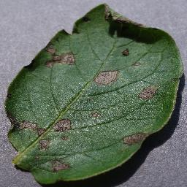
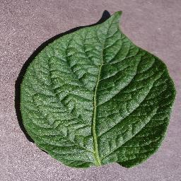
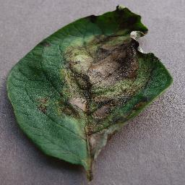
But potato production is being hampered due to some diseases such as early blight, late blight which are increasing the cost of farmers in potato production.
Timely and accurate identification of these diseases is crucial for effective crop management. This thesis investigates the application of deep learning models, including CNN, VGG19,EfficientNetB0, and ResNet50, for the classification of potato leaf diseases.
Early Blight
Healthy Leaf
Late Blight

Slide 5

Problem Definition
The core problem is the necessity for accurate and prompt prediction of potato leaf diseases, especially early blight and late blight.
Different diseases often display similar visual symptoms, making it hard to differentiate between them. The study aims to fill this gap by proposing a modified dataset and utilizing various models to enhance accuracy, providing a more reliable tool for farmers and agricultural stakeholders.

Slide 6
Objectives
To accurately identify and classify various potato leaf diseases (e.g., late blight, early blight) at an early stage using deep learning models.
Develop a system that can autonomously detect diseases from images of potato leaves.
Minimize crop losses caused by diseases by identifying and managing infected plants promptly.
Also increase accuracy value to predict potato leaf disease appropriately.

Slide 7
Contributions
Compared within four models: Our research contributed to the field of plant disease detection by applying and comparing advanced deep learning models—CNN, VGG19, EfficientNetB0, and ResNet50—to classify potato leaf diseases.
Best-Performing Model: EfficientNetB0 achieved the highest accuracy which making it the most reliable for detecting potato leaf diseases.
Class Imbalance Challenge: The limited number of healthy leaf samples impacted model performance; data augmentation helped mitigate this issue.
Agricultural Impact: This research offers a promising solution for early disease detection, supporting precision agriculture and better crop management

Slide 8
Languages and Tools
Language: Python
Tools: Tensorflow, Keras, Scikit-learn, Numpy, Matplotlib,
Platform: Jupyter Notebook

Slide 9
Methodology
Data Collection
Data Pre-Processing
Data Augmentation
Data Partitioning
Testing Dataset
Training+Validation Dataset
Image Classification
Training
Performance Evaluation
Deep Learning Models
Accuracy
Precision
CNN
Recall
F1-Score
VGG19
EfficientNetB0
ResNet50
Fig. 1. Block Diagram of System Architecture

Slide 10
Model building process: 1. Data Collection: To build our proposed model 1st we collect our dataset from Kaggle that contains 2152 images. 2. Data preprocessing: i. Resizing. ii. Normalization. i. Resizing: To maintain consistency across the dataset, all potato leaf images are resized to a standard dimension, such as 256x256 pixels. ii. Normalization: Pixel values in the potato leaf images are normalized to a range between 0 and 1. This step ensures uniformity in the input data.
Number of data | Early Blight | Late Blight | Healthy Plant
2152 | 1000 | 1000 | 152

Slide 11
3. Data Augmentation: As our dataset is imbalance, so we need to balanced it. For doing this, we follow data augmentation process. In this process, we slightly shift, rotate, and resize each image in the training set by different percentages, and then add all of the resulting photos to the training set. 4. Data Partitioning: Our dataset has divided into 3 subsets, namely: i. Training: Dataset to be used while training. 80% data has used for training. ii. Validation: Dataset to be tested against while training. 10% data has used for validation. iii. Test: Dataset to be tested against after we trained a model. 10% data has used for testing. 5. Training: We have used 80% data to train the proposed models for the potato leaves disease detection, an adaptive optimization algorithm for learning rate is employed. 6. Feature Extraction: Using convolutional neural networks, key features are automatically extracted from the input images through multiple convolutional layers. These layers identify patterns such as edges, textures, and shapes that differentiate healthy leaves from diseased ones.

Slide 12
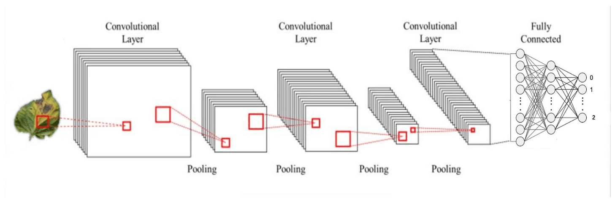
Model architecture
Convolution Neural Network(CNN):
(128*128,64)
(128*128,64)
(128*128,64)
0 Early Blight
1 Late Blight
2 Healthy potato
(128*128,64)
(62*62,64)
2304
(256*256,32)
(62*62,64)
2304
Dropout
Dropout
(256*256,32)
256*256
Input Layer: We take image size 256*256 as a input and use 3 RGB channel for this
Convolutional Layer: These layers use a series of filters to extract edges ,texture, shapes and generate feature map.

Slide 13
Pooling Layers: Pooling reduce the spatial dimensions of a feature maps, keeping only the most important information. We use here Max pooling.
Flattening: After the last pooling layers, the 2D feature maps are "flattened" into 1D vector.
Fully Connected Layers (Dense Layers): The fully connected layers take the flattened feature vector and learn to classify the input image. The last fully connected layer uses a softmax function to output probabilities for each class (healthy, early blight, late blight).
Output Layer: The output could be a three-class classification corresponding to healthy, early blight, or late blight

Slide 14
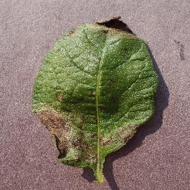
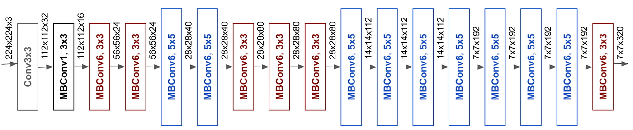
EfficientNetB0:
Batch Normalization
Dropout
Global avg
pooling
Dense
Softmax
Output
Input Layer: The model starts with an input layer of RGB images with a shape of (224, 224, 3)
Pre-trained Models as Feature Extractors:
Global Average Pooling: After passing through the MBConv blocks, the output feature map is reduced to a single value per feature channel through global average pooling.
13

Slide 15
Batch Normalization: Batch normalization is applied for keeps balanced, faster learning, less overfitting, makes activation function work better, improves gradient flow.
Dropout Layer: A dropout layer with a dropout rate of 0.5 is added. Dropout is a regularization technique that randomly sets a fraction of the input units to 0 at each update during training. It helps prevent overfitting.
Dense: A dense (fully connected) layer with 128 units and ReLU activation is added.
Flatten Layer: A flattening layer is added to convert the 2D feature maps into a 1D vector.
Softmax output: The softmax function is used in the final layer to normalize the output into probability distributions across the classes. The output could be a three-class classification corresponding to healthy, early blight, or late blight

Slide 16
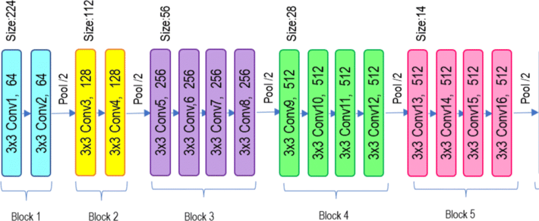
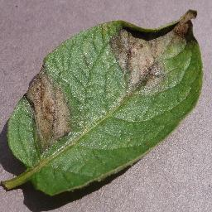
VGG19(Visual Geometry Group 19)
Softmax
output
Dense
Flatten
Dropout
Input Layer: The input to VGG19 is typically an image with dimensions 224x224x3 (RGB image).
Convolutional Layers: VGG19 has 16 convolutional layers grouped into blocks.
⦁ Block 1: 2 convolutional layers (64 filters) + Max Pooling
⦁ Block 2: 2 convolutional layers (128 filters) + Max Pooling
⦁ Block 3: 4 convolutional layers (256 filters) + Max Pooling
⦁ Block 4: 4 convolutional layers (512 filters) + Max Pooling
⦁ Block 5: 4 convolutional layers (512 filters) + Max Pooling

Slide 17
Max Pooling Layers: After each convolutional block, there is a Max Pooling layer with a 2x2 window and stride of 2.
Flattening: After the last pooling layers, the 2D feature maps are "flattened" into 1D vector.
Dense: A dense (fully connected) layer with 512 units and ReLU activation is added.
Dropout: A dropout layer with a dropout rate of 0.5 is added for preventing overfitting.
Softmax: The softmax function is used in the final layer to normalize the output into probability distributions across the classes. The output could be a three-class classification corresponding to healthy, early blight, or late blight
Output layer:

Slide 18
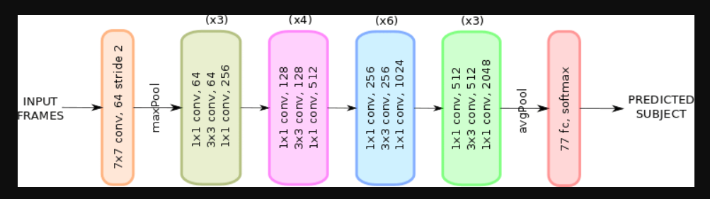
Resnet50
Input Layer:
Initial Convolutional Layer:
Identity Block:
Convolutional Block:
Global Avg Pooling:
Dense Layers:
Output:

Slide 19
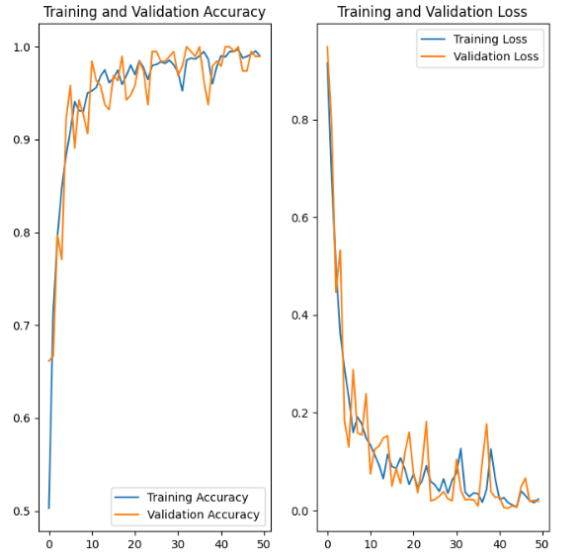
Results And Discussion
In this section, we present the outcomes of our analysis of the four models.
CNN: The CNN model demonstrated a strong performance on the training dataset, with a loss of 0.0070 and an accuracy of 0.9971 at 45th epoch and the validation dataset, with a loss of 0.0219 and an accuracy of 1.0000 at 33th epoch.
Table 4. Evaluation Metrics of CNN
Figure 2. The Plot Diagram of Training and Validation Accuracy, Loss
Category Name | Precision | Recall | F1-Score
Potato_Early_Blight(0) | 0.56 | 0.56 | 0.56
Potato_Late_Blight (1) | 0.65 | 0.66 | 0.65
Potato_Healthy (2) | 0.41 | 0.39 | 0.40

Slide 20
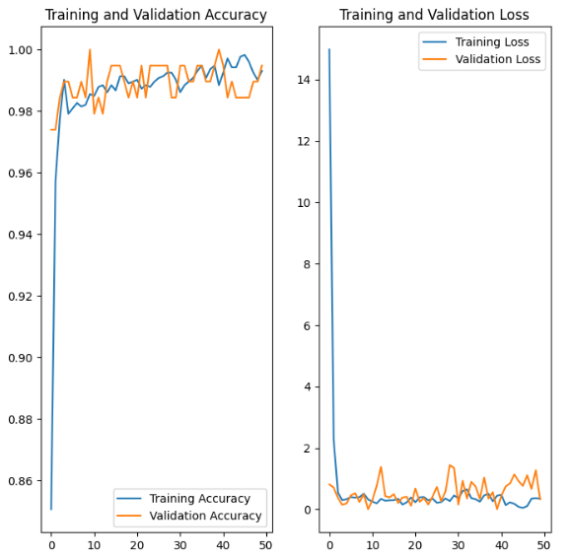
VGG19:
The VGG19 model demonstrated a strong performance on the training dataset, with a loss of 0.0476 and an accuracy of 0.9983 at 46th epoch. However, its performance on the validation dataset, with a loss
of 0.0012 and an accuracy of 1.0000 at 10th epoch.
Table 4. Evaluation Metrics of VGG19
Figure 3. The Plot Diagram of Training and Validation
Accuracy as well as Loss for VGG19
Category Name | Precision | Recall | F1-Score
Potato_Early_Blight (0) | 0.44 | 0.45 | 0.44
Potato_Late_Blight (1) | 0.56 | 0.55 | 0.55
Potato_Healthy (2) | 0.17 | 0.17 | 0.17

Slide 21
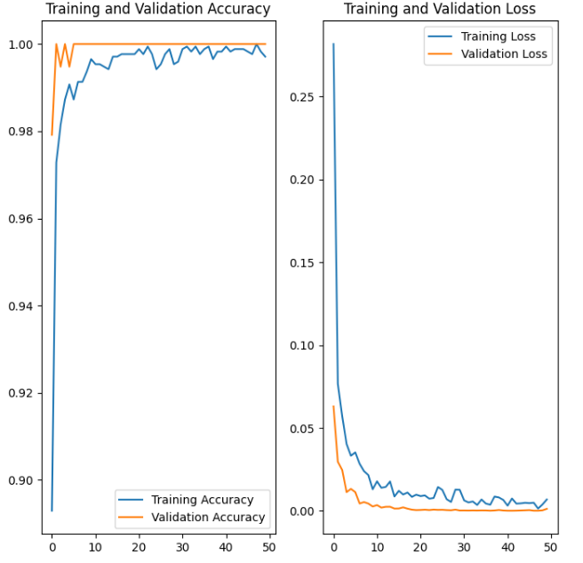
EfficientNetB0
For the training dataset, loss is 0.0013 and an accuracy is 1.00 at 48th epoch and performance on the validation dataset, with a loss of 0.0296 and an accuracy of 1.00 at 2th epoch.
Figure 4. The Plot Diagram of Training and Validation Table 4. Evaluation Metrics of EfficientNetB0
Accuracy as well as Loss for EfficientNetB0
Category Name | Precision | Recall | F1-Score
Potato_Early_Blight (0) | 0.46 | 0.46 | 0.46
Potato_Late_Blight (1) | 0.52 | 0.52 | 0.52
Potato_Healthy (2) | 0.28 | 0.28 | 0.28

Slide 22
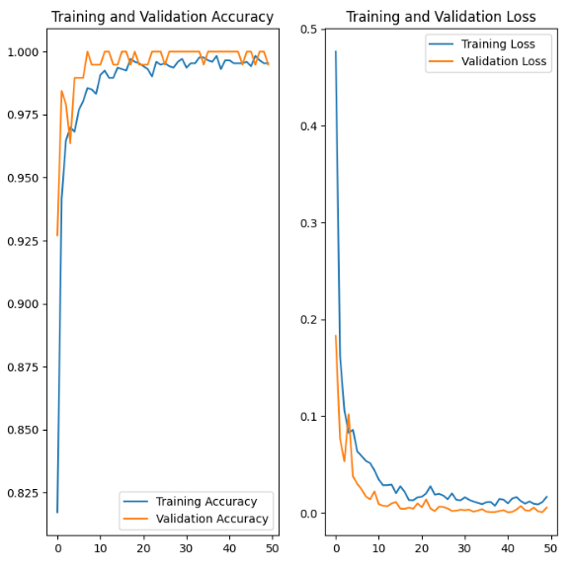
Resnet50:
Here on the training dataset, the loss is 0.0537 and an accuracy is 1.00 at 8th epoch and on the validation dataset was slightly lower, with a loss of 0.0008 and an accuracy of 0.9983 at 38th epoch.
Table 4. Evaluation Metrics of EfficientNetB0
Figure 5. The Plot Diagram of Training and Validation accuracy and loss
Category Name | Precision | Recall | F1-Score
Potato_Early_Blight (0) | 0.44 | 0.44 | 0.44
Potato_Late_Blight (1) | 0.50 | 0.51 | 0.51
Potato_Healthy (2) | 0.12 | 0.12 | 0.12

Slide 23
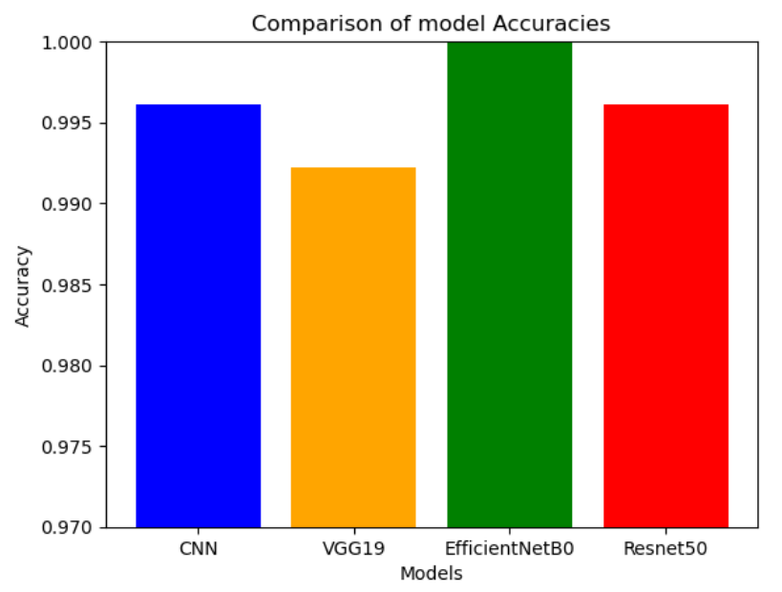
Overall Result Analysis And Discussion:
Among these models, EfficientNetB0 emerges as the best-performing model, achieving the highest scores accuracy while CNN and ResNet50 are similarly strong, and VGG19, though slightly behind, remains a reliable option.
Figure 6. Performance of four models

Slide 24
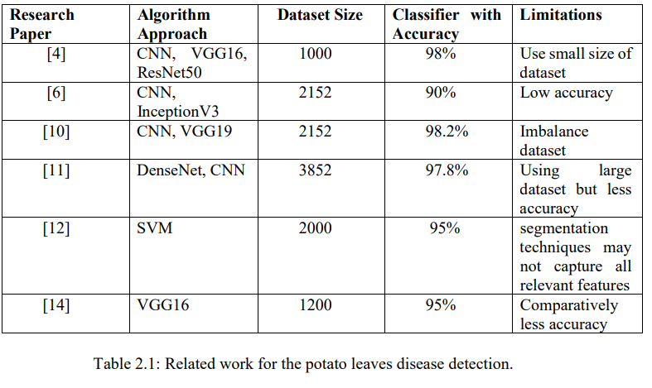
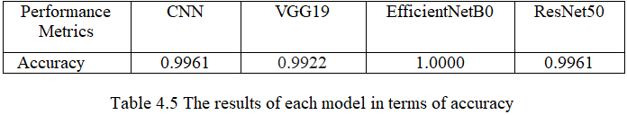
Comparison between others papers model
Table 5. Related work for potato leaves disease detection
Our Models
Table 6. The results of each model in terms of accuracy

Slide 25
Comparison of precision,recall,f1-score of other paper
Papers [2] | Precision | Recall | F1-score
Early Blight | 0.57 | 0.19 | 0.28
Late Blight | 0.20 | 0.01 | 0.02
Healthy Leaf | 0.58 | 0.59 | 0.57
Our Models
 | Precision | Recall | F1-score
Early Blight | 0.56 | 0.56 | 0.56
Late Blight | 0.65 | 0.66 | 0.65
Healthy Leaf | 0.41 | 0.39 | 0.40

Slide 26
Conclusion
This thesis explored the application of advanced deep learning architectures - CNN, VGG19, EfficientNetB0, and ResNet50 to classify potato leaf diseases, focusing on early blight, late blight, and healthy leaves. Among these models EfficientNetB0 emerged as the best-performing, achieving the highest accuracy making it the most reliable model for disease detection in this study. A significant challenge in the study was the class imbalance, particularly the small number of healthy leaf samples, which impacted the model's ability to generalize well to this class. Although data augmentation helped mitigate this issue, increasing the number of healthy samples and using more sophisticated augmentation techniques would likely improve the model's performance. Overall, this research demonstrates that deep learning models, especially EfficientNetB0 is highly effective tools for automatic potato leaf disease detection.

Slide 27
Future Works
In future work, we plan to extend our study to explore the use of larger and more diverse datasets under various environmental conditions to improve the performance and robustness of our models.
Additionally, we explore hybrid models that combine the strengths of different architectures. For instance, integrating features from VGG19 with EfficientNetB0 could potentially yield a model that balances accuracy with computational efficiency.
we also try to find out macro elements for which this diseases are affected by the potato leaf.

Slide 28
Thank You

