Slide 1
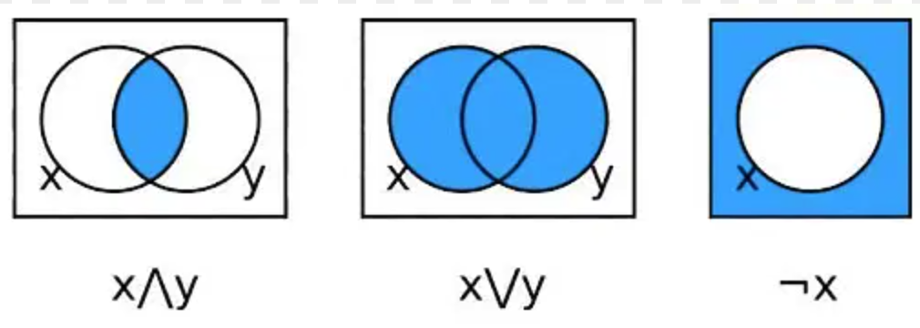
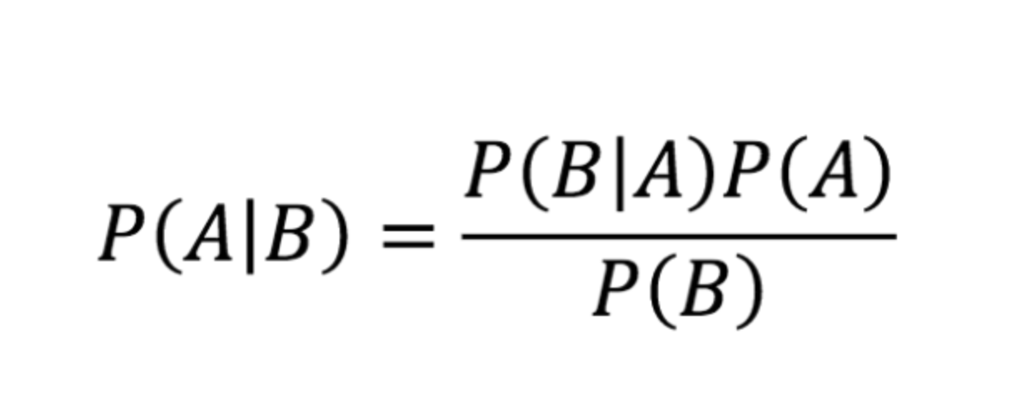
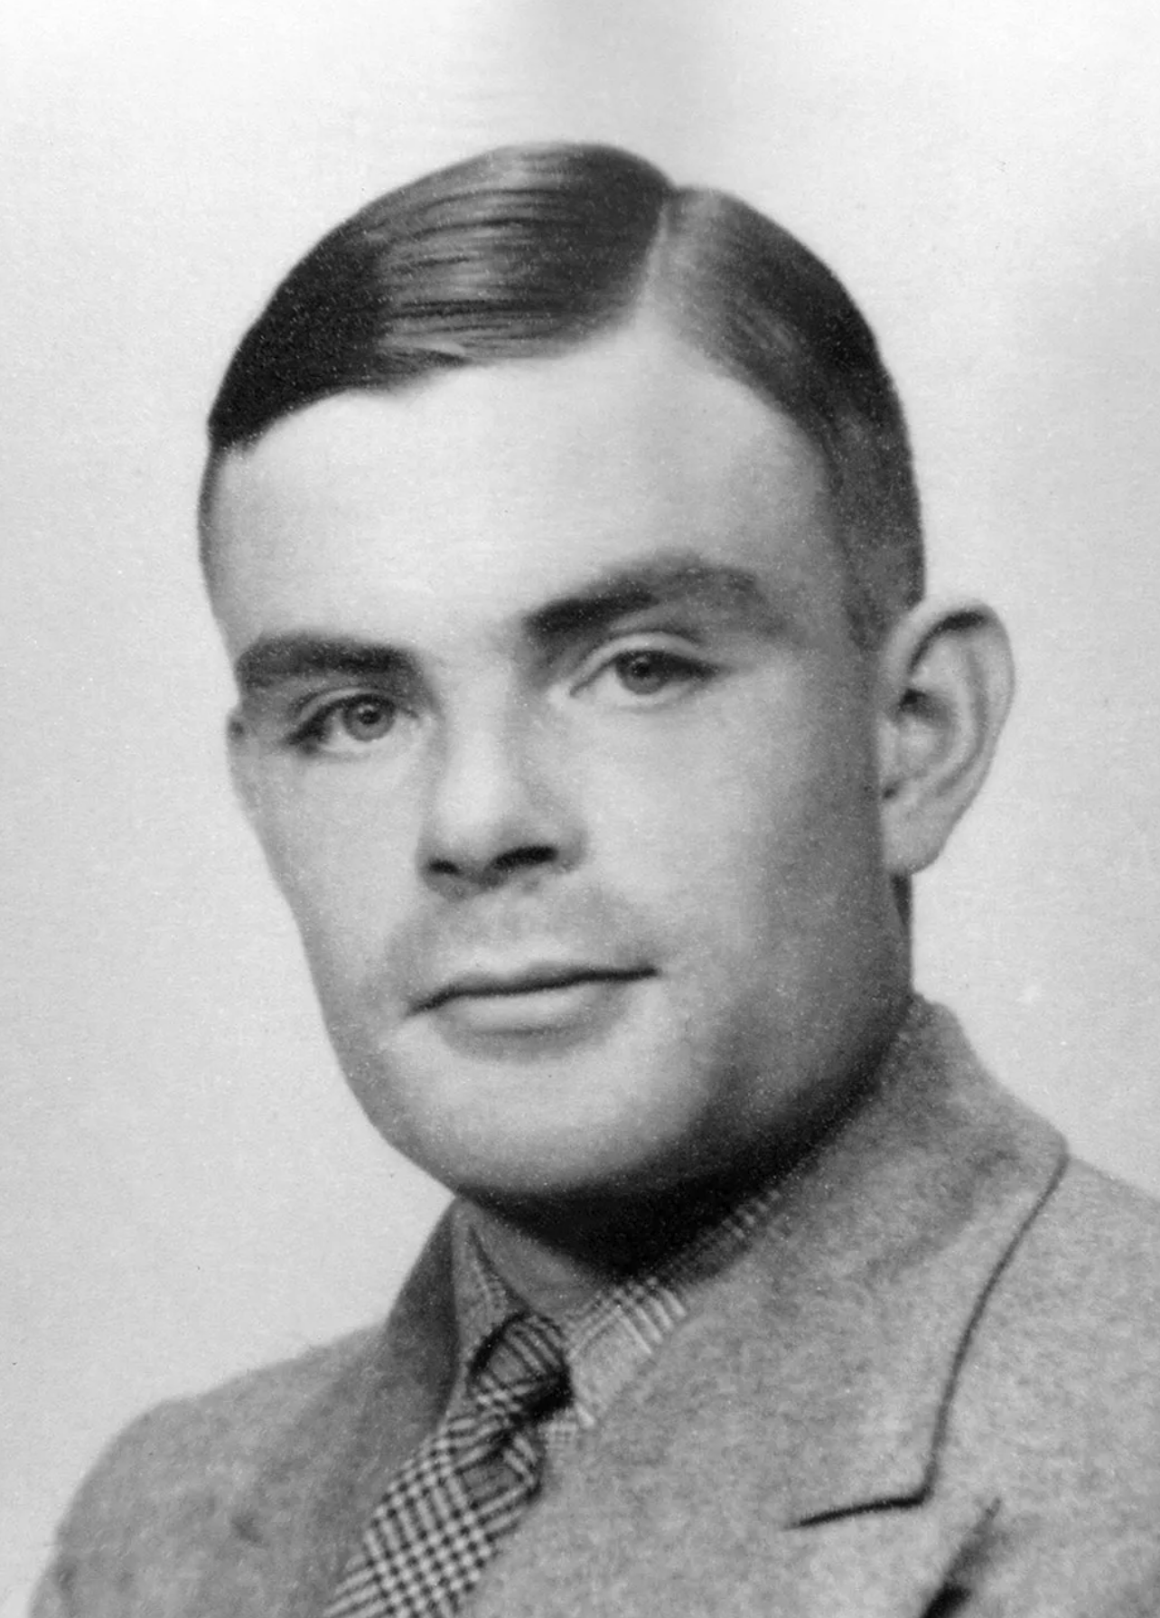
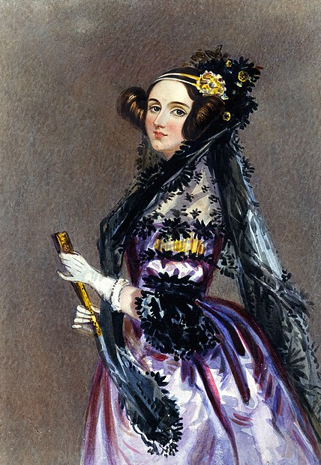
BAYES’ THEOREM
Reverend Thomas Bayes's work is published two years after his death
It presents major underpinnings of Bayes theorem that is still used in Machine Learning (and Bayesian Statistics) today
BOOLEAN LOGIC
George Boole invents the Boolean Algebra
It has been fundamental in the development of digital electronics, and is provided for in all modern programming languages
1842
1934
1763
1854
MACHINES THAT LEARN?
Alan Turing proposes a machine that can learn
The Universal Turing Machine is an abstract computing machine consisting of a limitless memory and a scanner that moves back and forth through the memory, symbol by symbol, reading what it finds and writing further symbols
FIRST ALGORITHM?
Ada Lovelace develops the first algorithm ”Note G”
She is widely seen as the first programmer
She suggested that a machine could take advantage of computation in order to deal with the realms of music, graphics, and language

Slide 2
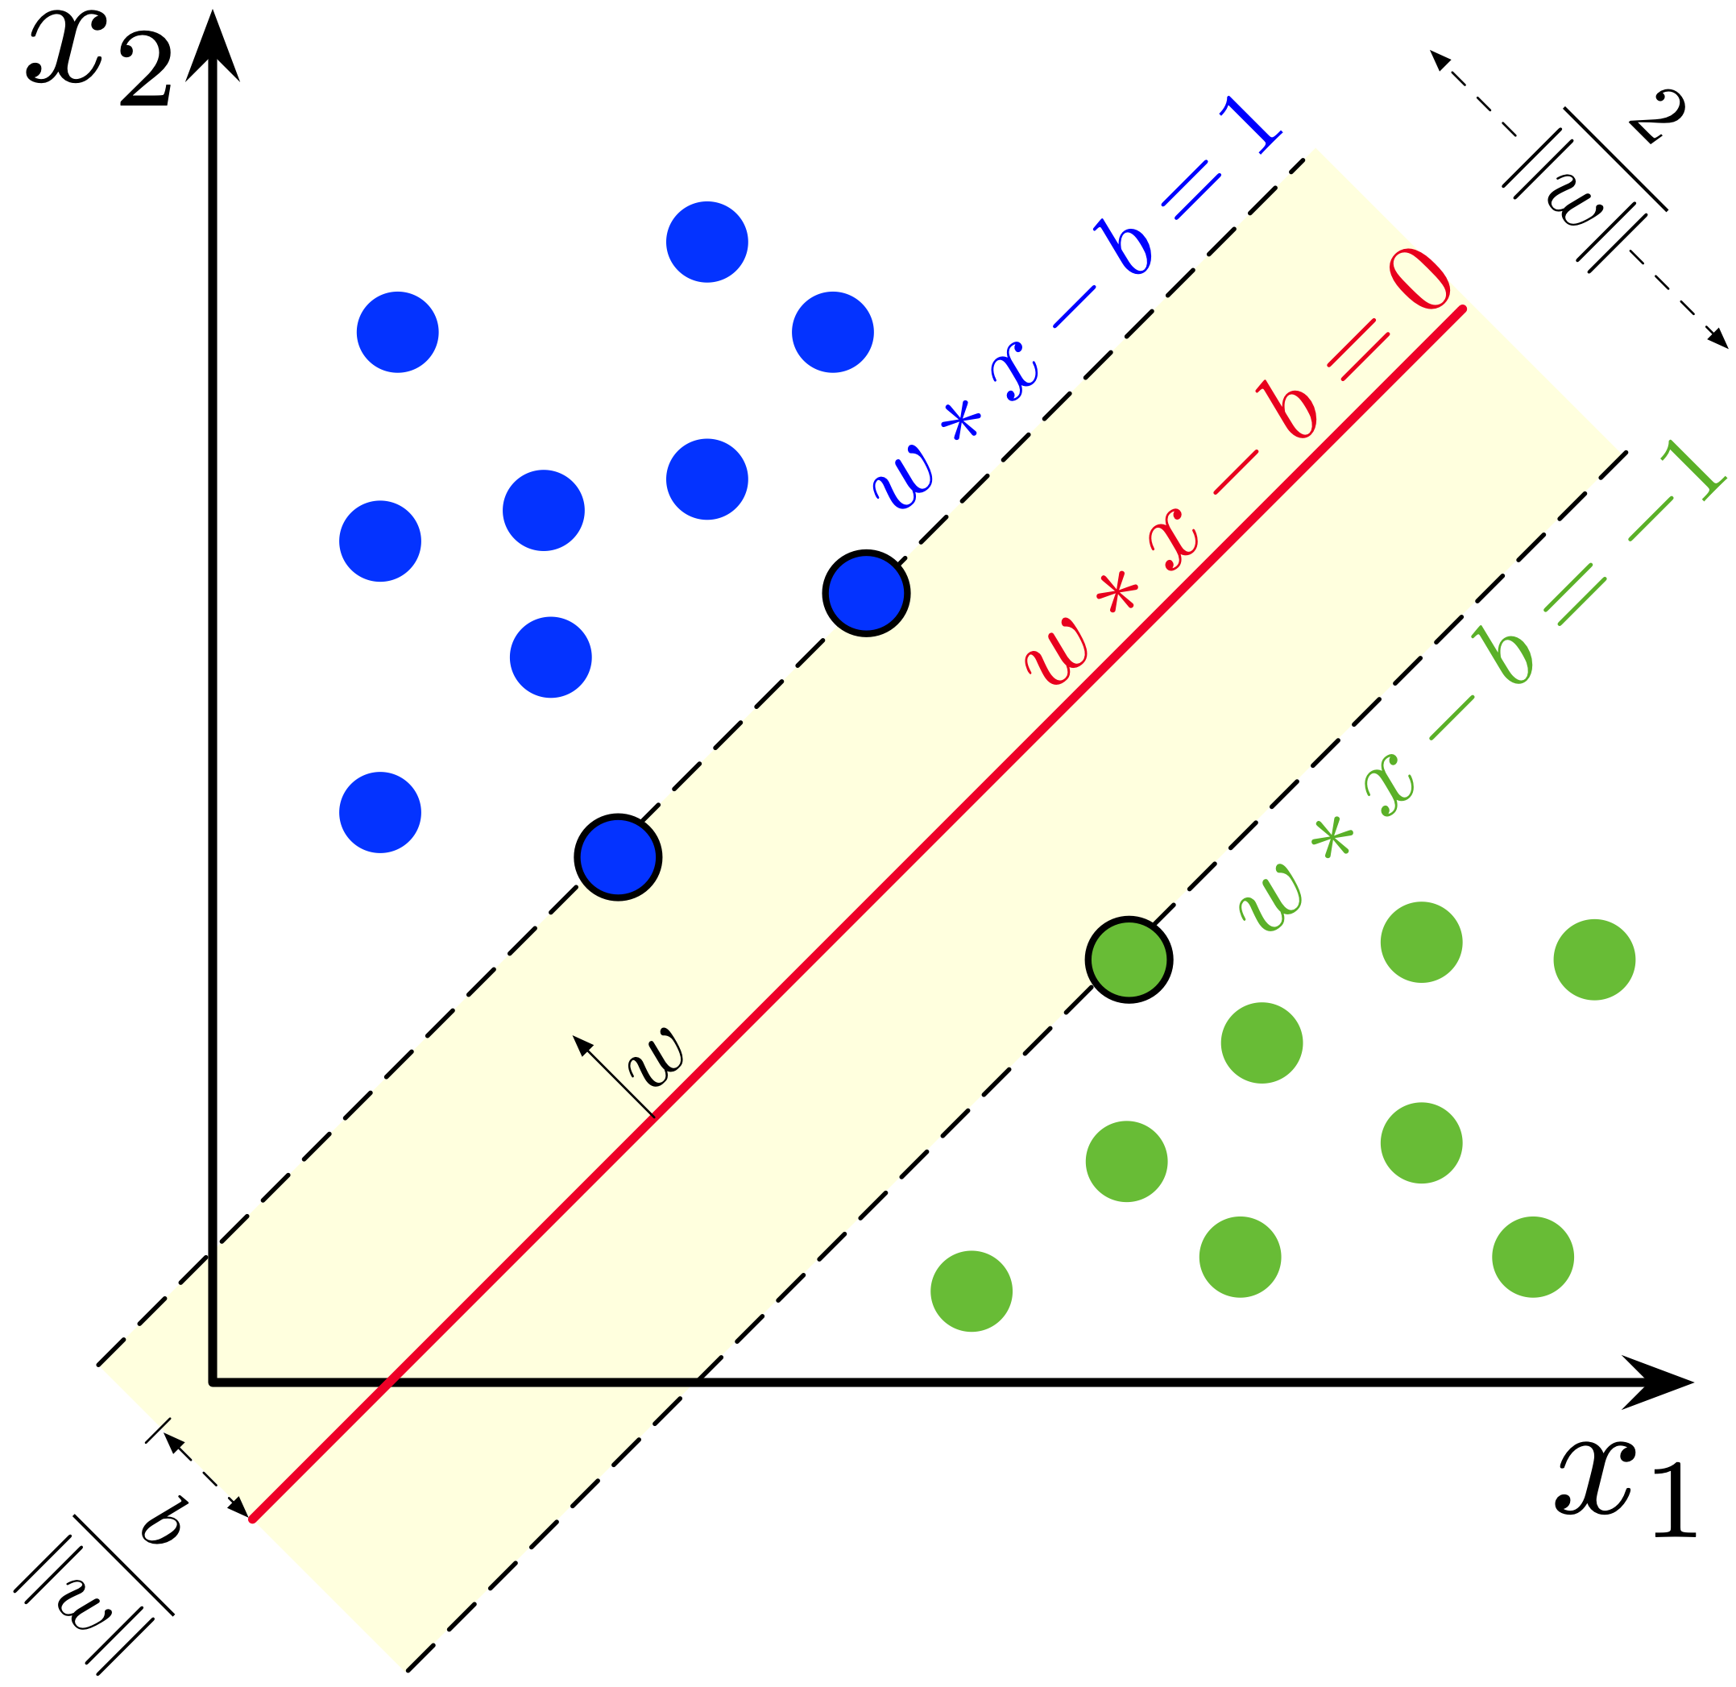
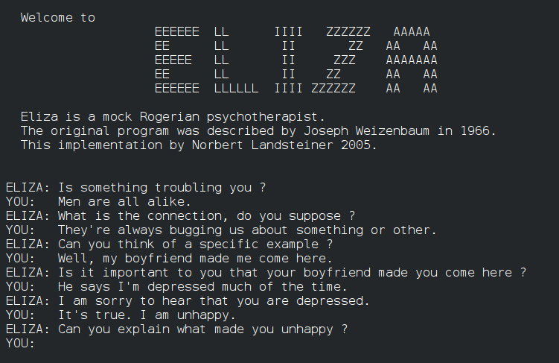
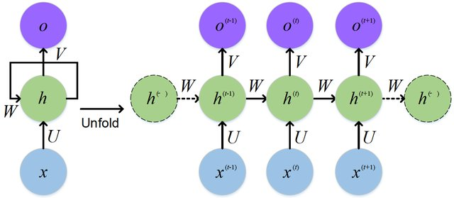
CONCEPTUAL ONTOLOGIES
The 1970s brought new ideas into NLP
Development of conceptual ontologies, i.e. sets of concepts and categories that shows their properties and the relations between them
structured real-world information into computer-understandable data
ELIZA, ALPAC REPORT & AI WINTER
The most famous prototype is perhaps ELIZA, designed to replicate the conversation between a psychologist and a patient
The report by the Automatic Language Processing Advisory Committee (ALPAC), a committee established in 1964 by the United States, led to significant cuts in funding
WEAVER’S MEMORANDUM
most influential publication in the early days of machine translation
formulated goals and methods before most people had any idea of what computers might be capable of
direct stimulus for the beginnings of research into natural language processing
1957
1990
1949
1960s
1970s-80s
STATISTICAL MODELS
statistical models came as a revolution in NLP (SVM, regression-based approaches)
replacing most natural language processing systems based on complex sets of hand-written rules
Recurrent neural networks and long short-term memory networks
GRAMMAR THEORIES
early work in MT was very simple: dictionary-lookup of appropriate words for translation
Noam Chomsky developed a rule based-system of syntactic structures
brought insight into how mainstream linguistics could help machine translation

Slide 3
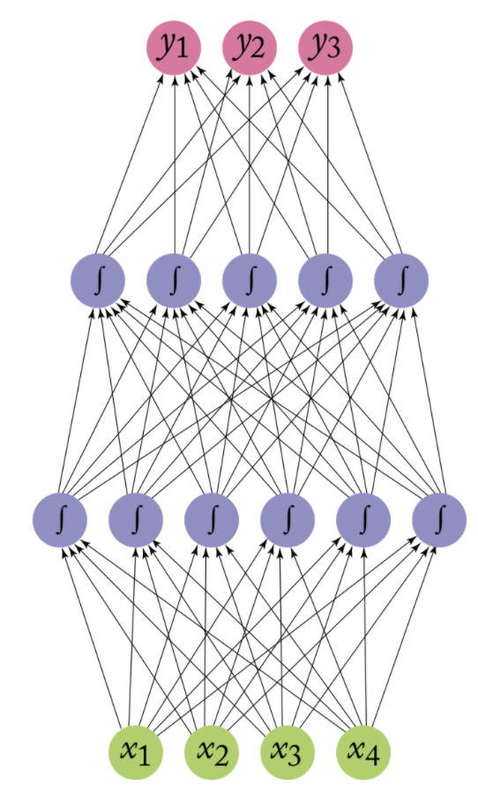
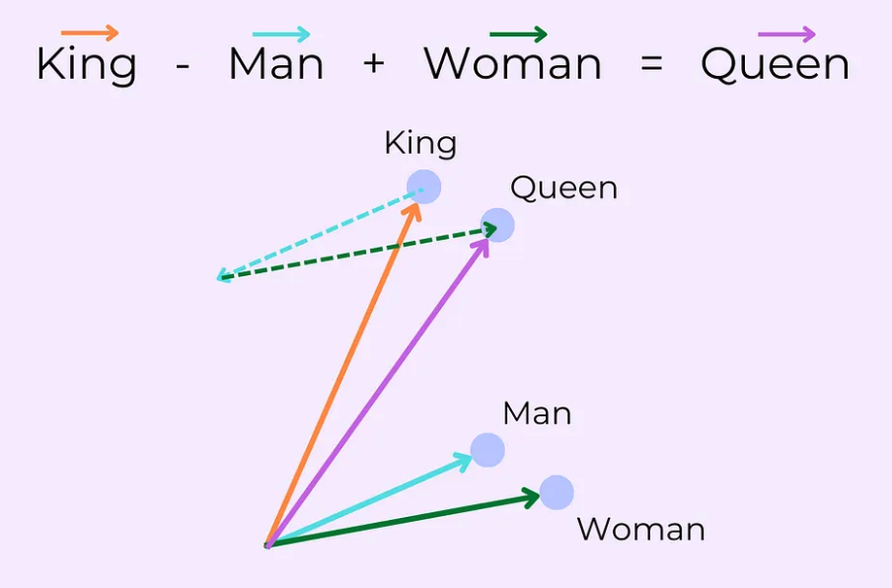

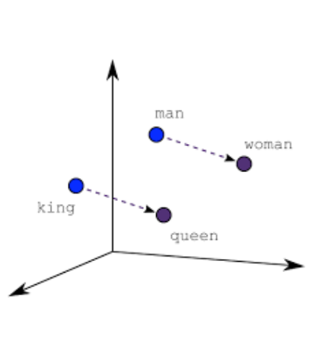
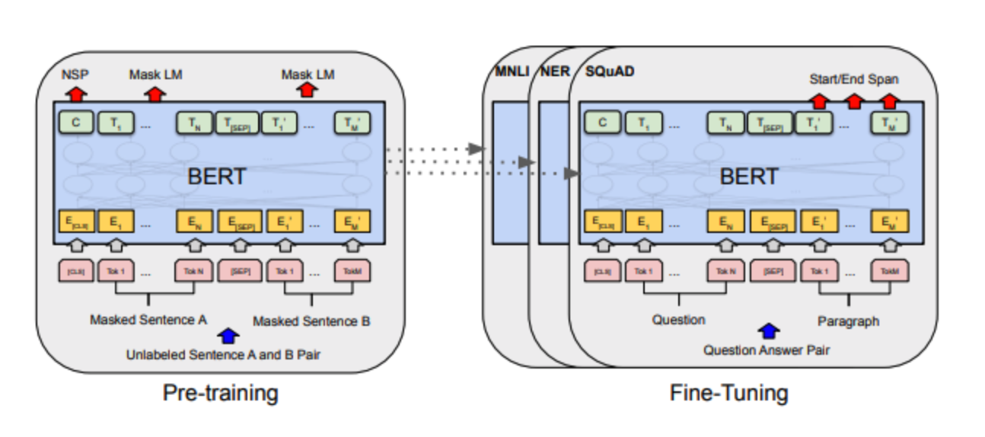
LANGUAGE MODELING, WORD EMBEDDINGS
neural networks are used for learning the distribution of language words and predicting the next words in a text given the previous ones
Start of representing words with dense vectors of numbers
2012: First unsupervised neural network by Google
LSTM RNNs, CNNs, ENCODER-DECODER
Most use models are long short-term memory recurrent neural networks, and convolutional neural networks
sequence-to-sequence learning, a general end-to-end approach for mapping one sequence to another using a neural network
the first encodes the entire input into a vector, the second decodes the output from the vector
PRE-TRAINED MODELS AND LARGE LANGUAGE MODELS
Transformers were trained in a self-supervised way on large data sets to become “language models”
These models can then be reused for different task after only small adaption traning (fine-tuning)
2013
2017
2022
2000s
2014-2016
2020s
WORD2VEC
first algorithm capable of learning word embedding efficiently
possible to do mathematical operations with them that represent semantic operations
using pre-trained embeddings as features for ML models improves performance in downstream tasks
ATTENTION AND TRANSFORMERS
Introduction of the principle of attention
Rise of Transformers, which are still used heavily today
First generative pre-trained transformer by OpenAI in 2018!
GPT, BART and Co
Increasingly larger language models that are trained on the “Internet”
November 2022: Launch of chatGPT and wide-spread use of LLMs
AI revolution?

