Slide 1
95%
5%
Correct Positive
False Positive

Slide 2


10
200

Slide 3
10
200
95% = 9.5

Slide 4
10
200
95% = 9.5
5% = 10

Slide 5
P (Positive given Positive test result) $= \frac{9.5}{9.5+10}=48.7\%$
10
200
95% = 9.5
5% = 10

Slide 6
95%
5%
Correct Positive
False Positive

Slide 7
95%
5%
Correct Positive
False Positive
5%
95%
Positive
Negative
Positive test result, given a sensitivity of 95% and a specificity of 95%
48,7%
51,3%
Correct Positive
False Positive

Slide 8
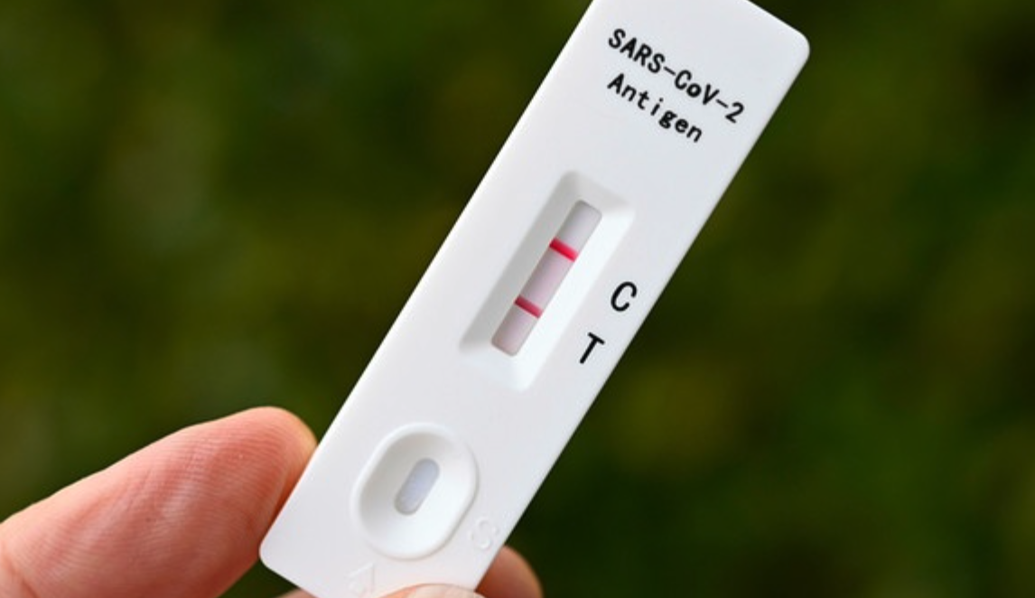
You have observed
evidence:
You want to know:
You have a hypothesis:
P(H | E)
Philipp is positive
Philipp has a positive test result
P(Hypothesis given Evidence)

Slide 9
“Prior” → P(Hypothesis) = 10/210 = 0.048

Slide 10
“Prior” → P(Hypothesis) = 10/210 = 0.048 (Infection rate)
“Likelihood” → P(Evidence|H) = 9.5/10 = 0.95

Slide 11
“Prior” → P(Hypothesis) = 10/210 = 0.048
P(¬ H) = 200/210 = 0.952
“Likelihood” → P(Evidence|H) = 9.5/10 = 0.95
P(E| ¬ H) = 10/200 = 0.05

Slide 12
$P\left(H \right| E)= \frac{ }{ }= \frac{P \left( H \right) P (E|H)}{P \left(H\right) P(E|H)+P \left(\text{¬}H\right) P(E|\text{¬}H)}$ = $\frac{P \left( H \right) P (E|H)}{P(E) }$
+

Slide 13
$P\left(H \right| E)= \frac{ }{ }= \frac{0.048 ∗0.95}{0.048 ∗0.95 +0.05 ∗0.95}$ = $0.499$
+

Slide 14
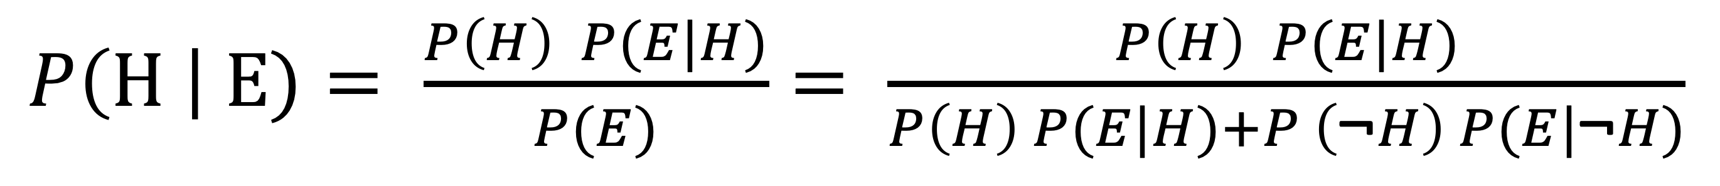
Likelihood: probability of the evidence given the hypothesis
Prior: initial degree of belief in a hypothesis
$P\left(H \right| E)= \frac{P\left(H\right) P(E|H)}{P(E)}= \frac{P\left(H\right) P(E|H)}{P\left(H\right) P(E|H)+P \left(\text{¬}H\right) P(E|\text{¬}H)}$
Posterior: degree of belief in hypothesis, after seeing the evidence

