Slide 1
FROM DATA SCARCITY TO DISCOVERY
Seismology as the bridge to sediment-basin models
Why satellite gravity alone falls short in Indonesia — and how receiver functions make gravity + seismology powerful. A Central Java (MERAMEX) case study.
Workshop & Discussion Forum — Unlocking Under-Explored Basin · FMIPA Universitas Gadjah Mada · 22–23 September 2026
Notes:
Frame: Indonesia's frontier basins are under-explored because data is scarce. Satellite gravity is the obvious cheap tool — but I'll show it is not enough on its own here, and that seismology is the bridge that unlocks it.

Slide 2
THE OPPORTUNITY
Indonesia's under-explored basins — the frontier prize
128 basins
Sediment = the container
Data is scarce
The ESDM 2022 map inventories 128 sedimentary basins; many frontier basins remain undrilled or with only sparse data.
Hydrocarbons need a thick sediment fill and depocentres. Mapping basin geometry is step one of exploration.
Seismic reflection and wells are expensive and thin on the ground in frontier acreage — we need cheaper reconnaissance.
Can we screen basin geometry — depth-to-basement, sediment thickness — from public, low-cost data before committing to seismic?
Two candidates: satellite gravity (dense, cheap, global) and passive seismology (physical, absolute, station-based).

Slide 3
ATTEMPT 1 · GRAVITY ALONE
Can satellite gravity map basins by itself?
The promise
A properly validated pipeline
Sedimentary basins are low-density fill → they should read as Bouguer/isostatic lows. Satellite gravity covers all of Indonesia, cheaply and uniformly.
Literature review → cited physical parameters → conceptual model → 3-D inversion.
Parker forward series verified against the exact forward to 0.0016 mGal.
Synthetic 7-km basin recovered at RMS 79 m, r = 0.9991 — the test even caught a sign error.
The test
A full 3-D gravity inversion for sediment thickness (Parker series, cited densities, compaction), benchmarked against published basin depths.

Slide 4
THE HONEST RESULT
The method works — but gravity alone fails on real basins
r = 0.9991
r = 0.75
r = −0.15
synthetic recovery (framework works)
CRUST1.0 control (same tests)
real inversion vs published thickness
Through identical tests, polygons and metrics, CRUST1.0 scores r = 0.75 — so the validation framework is healthy. The near-zero real-data result is therefore real, not a bug.
Satellite gravity, inverted on its own, does NOT recover Indonesian basin sediment thickness. Why?
Notes:
Key credibility point: the same framework recovers a synthetic basin near-perfectly AND scores CRUST1.0 at 0.75. So the r=-0.15 on real data is a physical result, not a coding error.

Slide 5
WHY · THE PHYSICS
In Indonesia the gravity signal is not the sediment
The Kutai paradox
Sediment fill 10–11 km (− density → gravity LOW)
Kutai holds 10–11 km of sediment — yet its isostatic anomaly is +2.6 mGal (positive).
Rifting raises the Moho; the mantle's positive pull cancels the sediment low.
Compaction closes the density contrast — only −115 kg/m³ left at 8 km depth.
The Indonesian residual field is dominated by plate-boundary & isostatic processes, not sediment.
Crust
Mantle — Moho rises under the rift (+ density → gravity HIGH)
A basin low and a rift-raised Moho high partly cancel — gravity is non-unique.

Slide 6
THE LESSON
Gravity alone is non-unique. It needs an independent depth anchor.
One more caveat: the ESDM 2022 basin outlines already list Badan Geologi gravity as a data source — so gravity outlines are a PRIOR, not an independent check on a gravity inversion.
That anchor is seismology — the P-to-S conversions recorded at a single station read the layering directly beneath it.

Slide 7
SEISMOLOGY 101
A teleseismic P wave converts to S at every interface
station
Sediment (low Vs)
The physics
A distant M5+ earthquake sends a near-vertical P wave up to the station.
At each velocity jump, part of P converts to a slower S wave (a “Ps” phase).
Ps delay after P scales with interface depth.
Vertical ≈ source; radial carries the conversions.
Crust
Ps
Mantle
P
Deeper interface → later Ps → structure straight from arrival time.

Slide 8
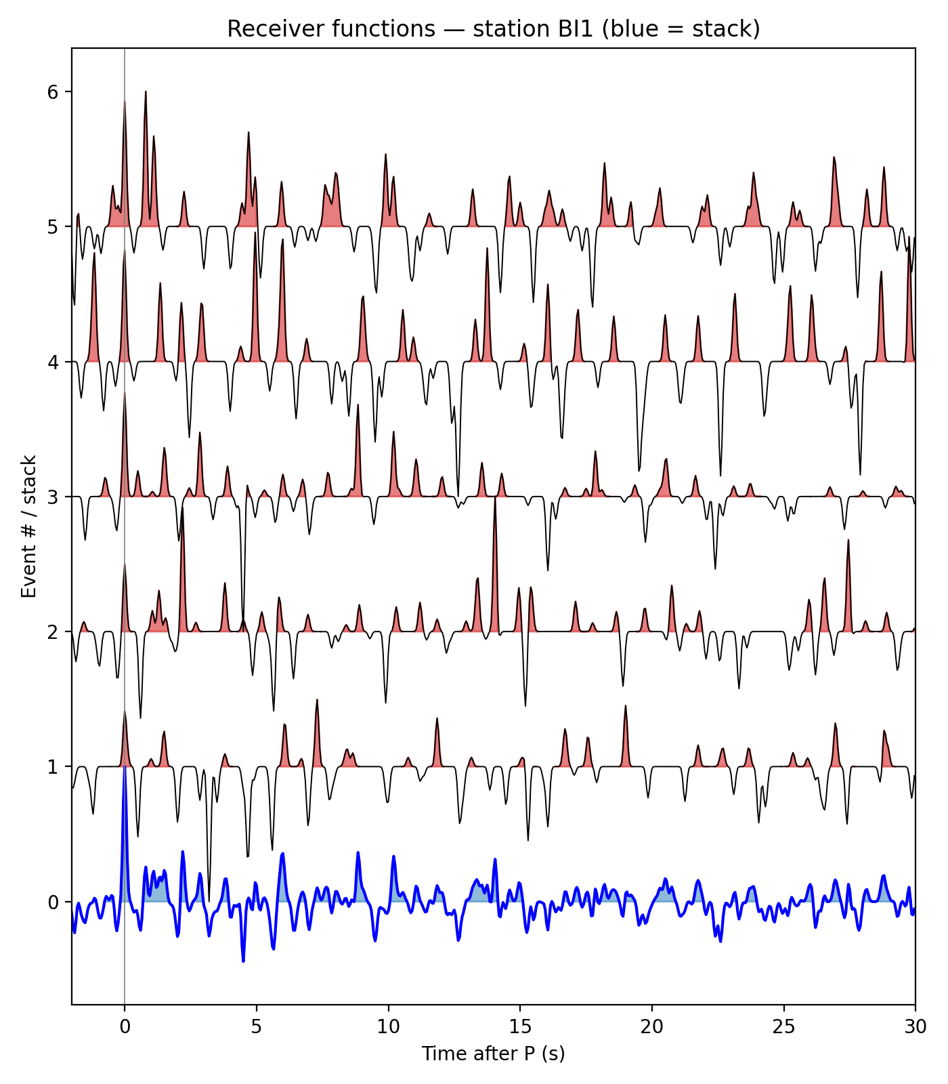
THE METHOD
Receiver function = radial deconvolved by vertical
RF(t) = Radial(t) ÷ Vertical(t)
iterative time-domain deconvolution (Ligorria & Ammon 1999 = CPS saciterd)
Removes the earthquake source & instrument — leaves the site's impulse response.
A spike at t = 0 (direct P), then positive pulses at each Ps conversion.
Stacking many events per station beats down noise.
Gaussian width sets resolution — higher to resolve thin sediment.
Station BI1: individual RFs (red) and their stack (blue).

Slide 9
WORKFLOW
From raw teleseism to a receiver function
01
02
03
04
05
Select events
Rotate
Deconvolve
Quality control
Stack
M≥5, 15–90°, good SNR
N,E → Radial, Transverse
Radial ÷ Vertical (iterative)
keep clean, causal RFs
average → stable RF
MERAMEX 2004: 143 stations · 7 teleseisms (back-azimuth 86–269°) · 106 stations with usable receiver functions.

Slide 10
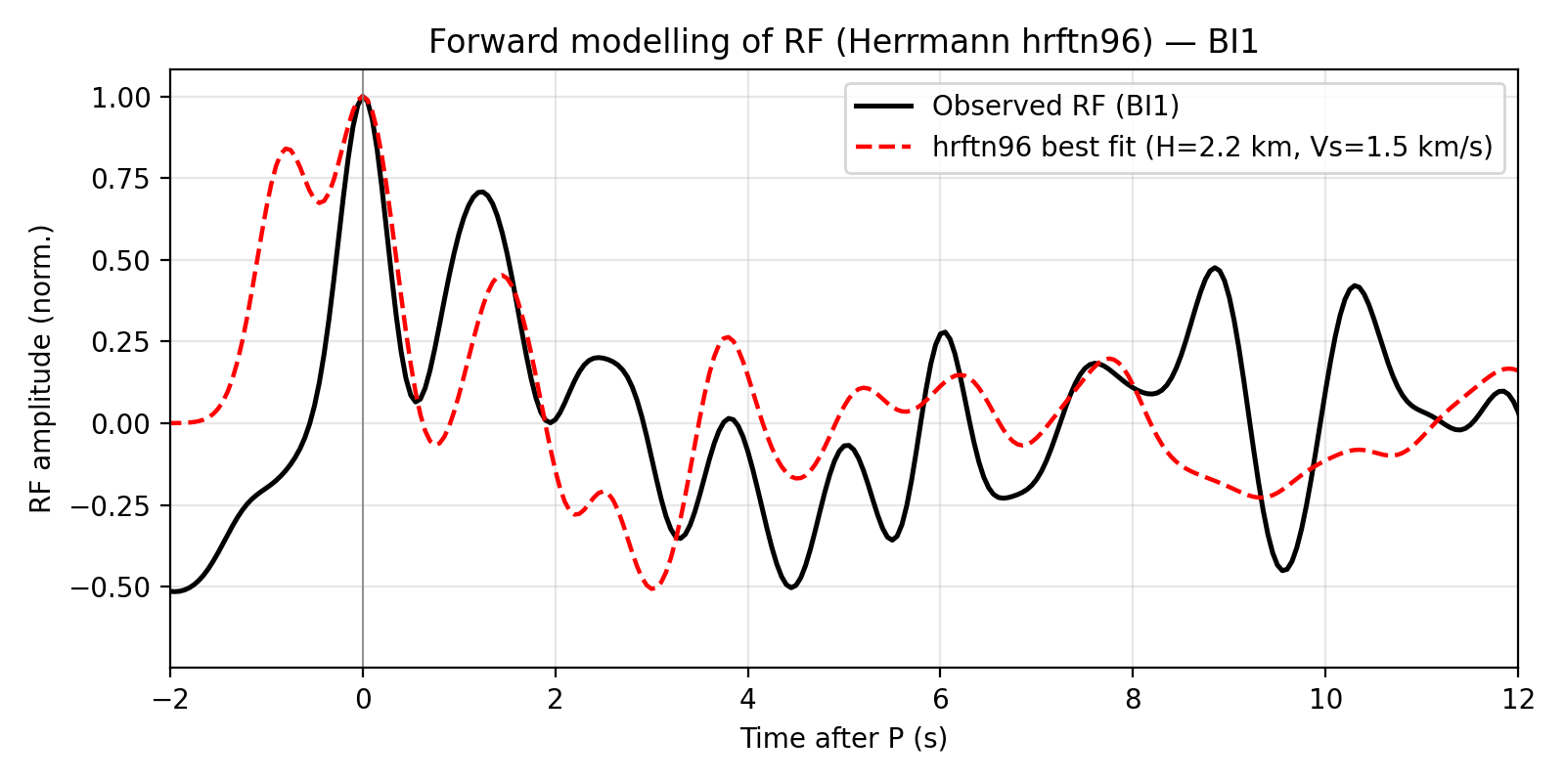
FORWARD MODELLING · PEMODELAN MAJU
Predict the RF a layered earth would produce
hrftn96 (Herrmann CPS)
Input: a velocity model (thickness, Vp, Vs, ρ) + ray parameter + Gaussian.
Output: the exact receiver function that model predicts.
Forward modelling turns interpretation into a test: does my layered model reproduce the data?
It is the engine inside the inversion.
Observed RF (black) vs Herrmann CPS hrftn96 best-fit synthetic (red) — station BI1.

Slide 11
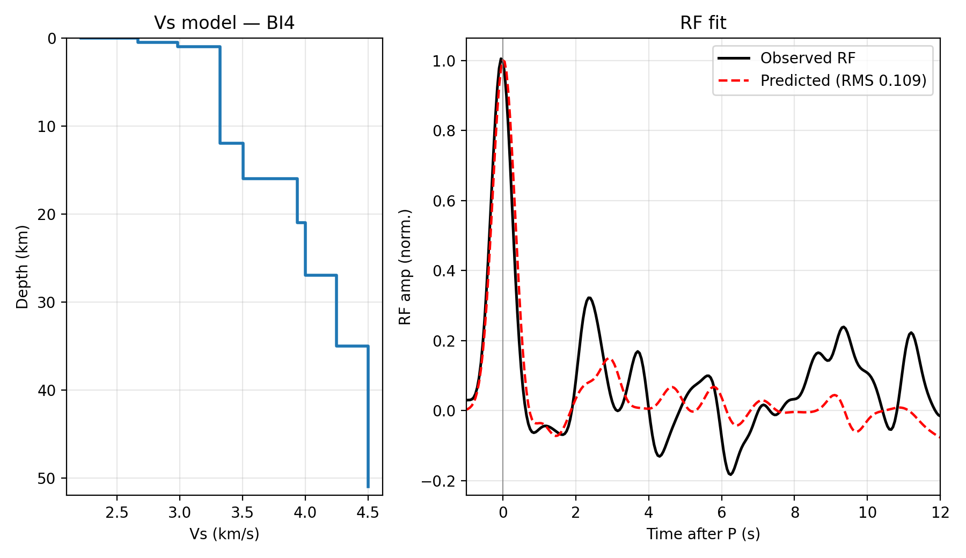
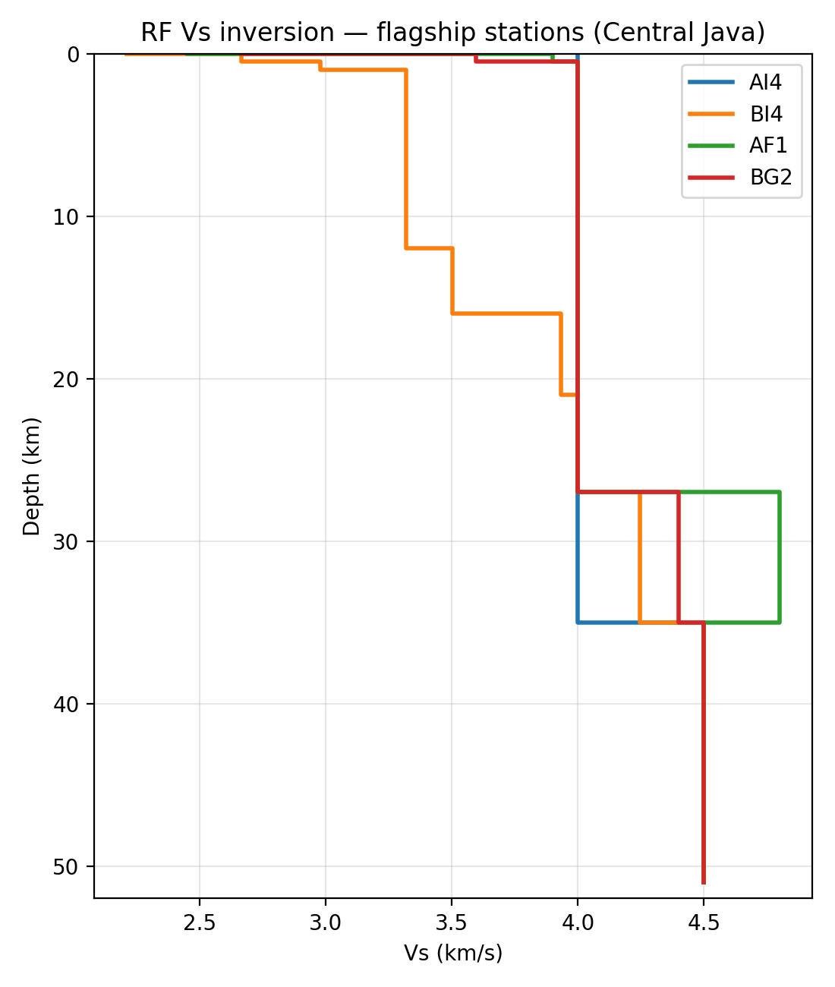
INVERSION · LAYERED Vs
Invert the RF for a shear-velocity profile
BI4 — damped, smoothed, PREM-constrained least-squares (CPS rftn96 scheme; hrftn96 forward). RMS 0.11.
Flagship-station Vs profiles (increase with depth).

Slide 12
SEDIMENT FROM RF
Reading sediment thickness from the conversion delay
Pick the Ps
Absolute, physical
The first strong positive pulse after the direct P is the sediment–basement conversion. Its delay t(Ps) is measured on the stacked RF.
No density assumption — thickness comes from a measured travel time.
92 of 106 stations give a resolvable sediment conversion.
Median ≈ 3.5 km; range 1–7 km — consistent with published Central-Java basins.
Delay → depth
Move-out: H = t(Ps) / [√(1/Vs² − p²) − √(1/Vp² − p²)]. Robust for noisy single-station data; Vs 1.5 km/s assumed.

Slide 13
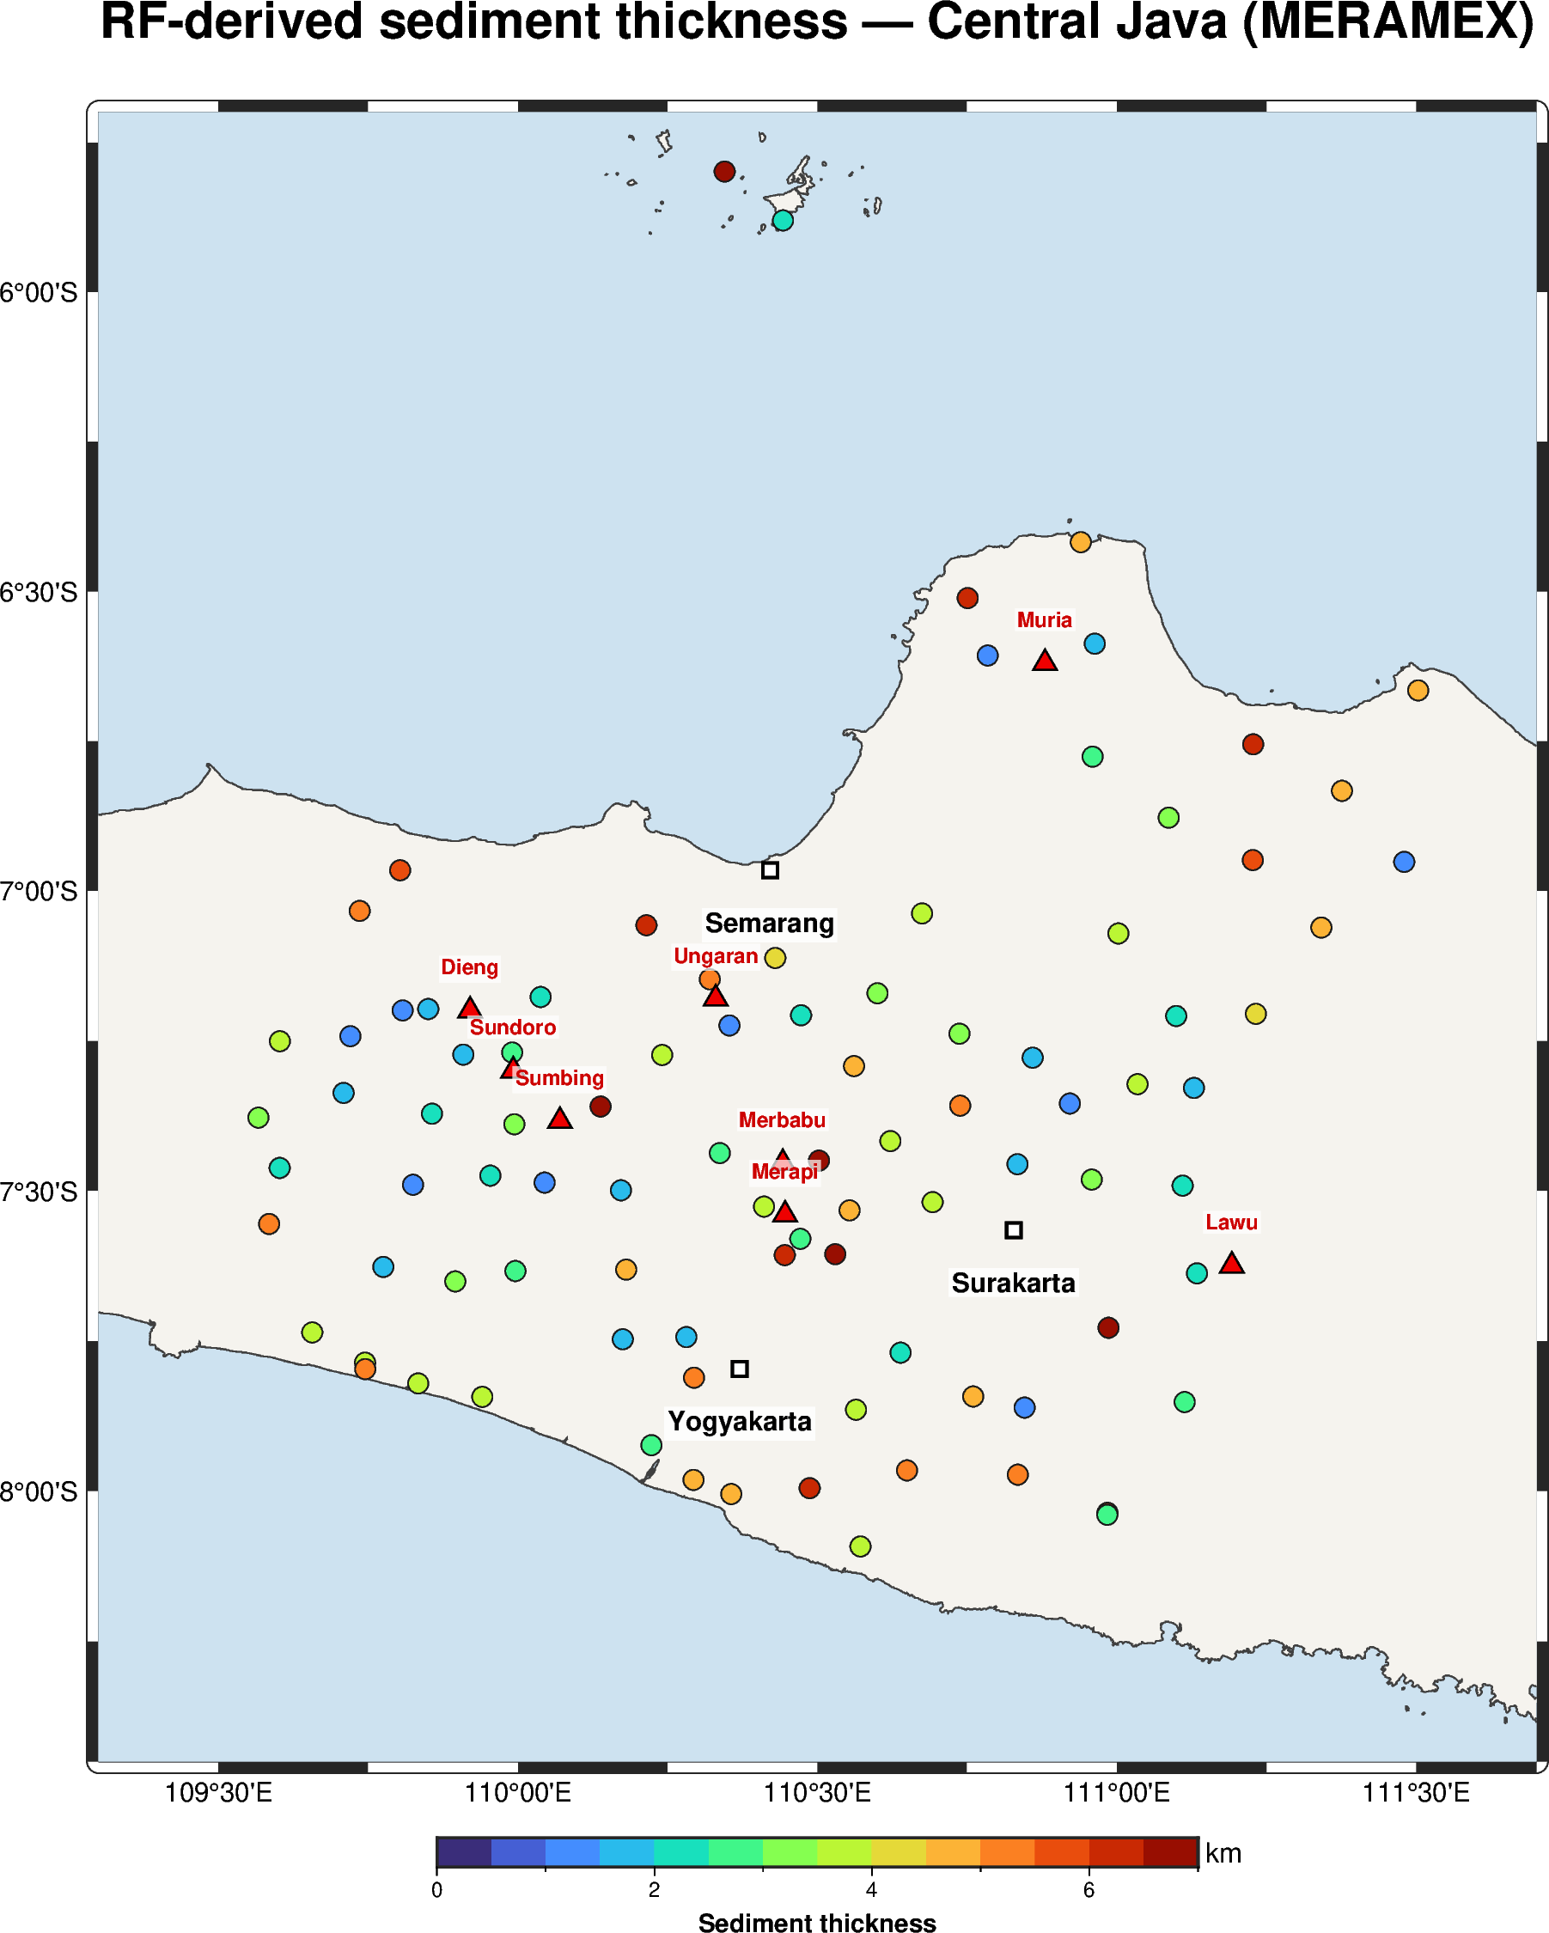
THE EXPERIMENT
MERAMEX 2004 — a dense passive array over Central Java
143
106
7
~3.5 km
seismic stations
stations with RFs
teleseisms
median sediment
Merapi Amphibious Experiment (GFZ), May–Oct 2004.
Broadband + short-period, ~10–20 km spacing.
Public / experiment data — no new acquisition.
Volcanic arc (▲) crosses the array.

Slide 14
RESULT · SEISMOLOGY
Sediment thickness measured directly at 92 stations
What the RFs give
Absolute thickness, no density model.
Thick pockets = depocentres; thin = basement / volcanic highs.
Geographic context: Merapi, Merbabu, Dieng, Lawu, Muria; Yogyakarta, Semarang, Surakarta.
This is the anchor gravity was missing.

Slide 15
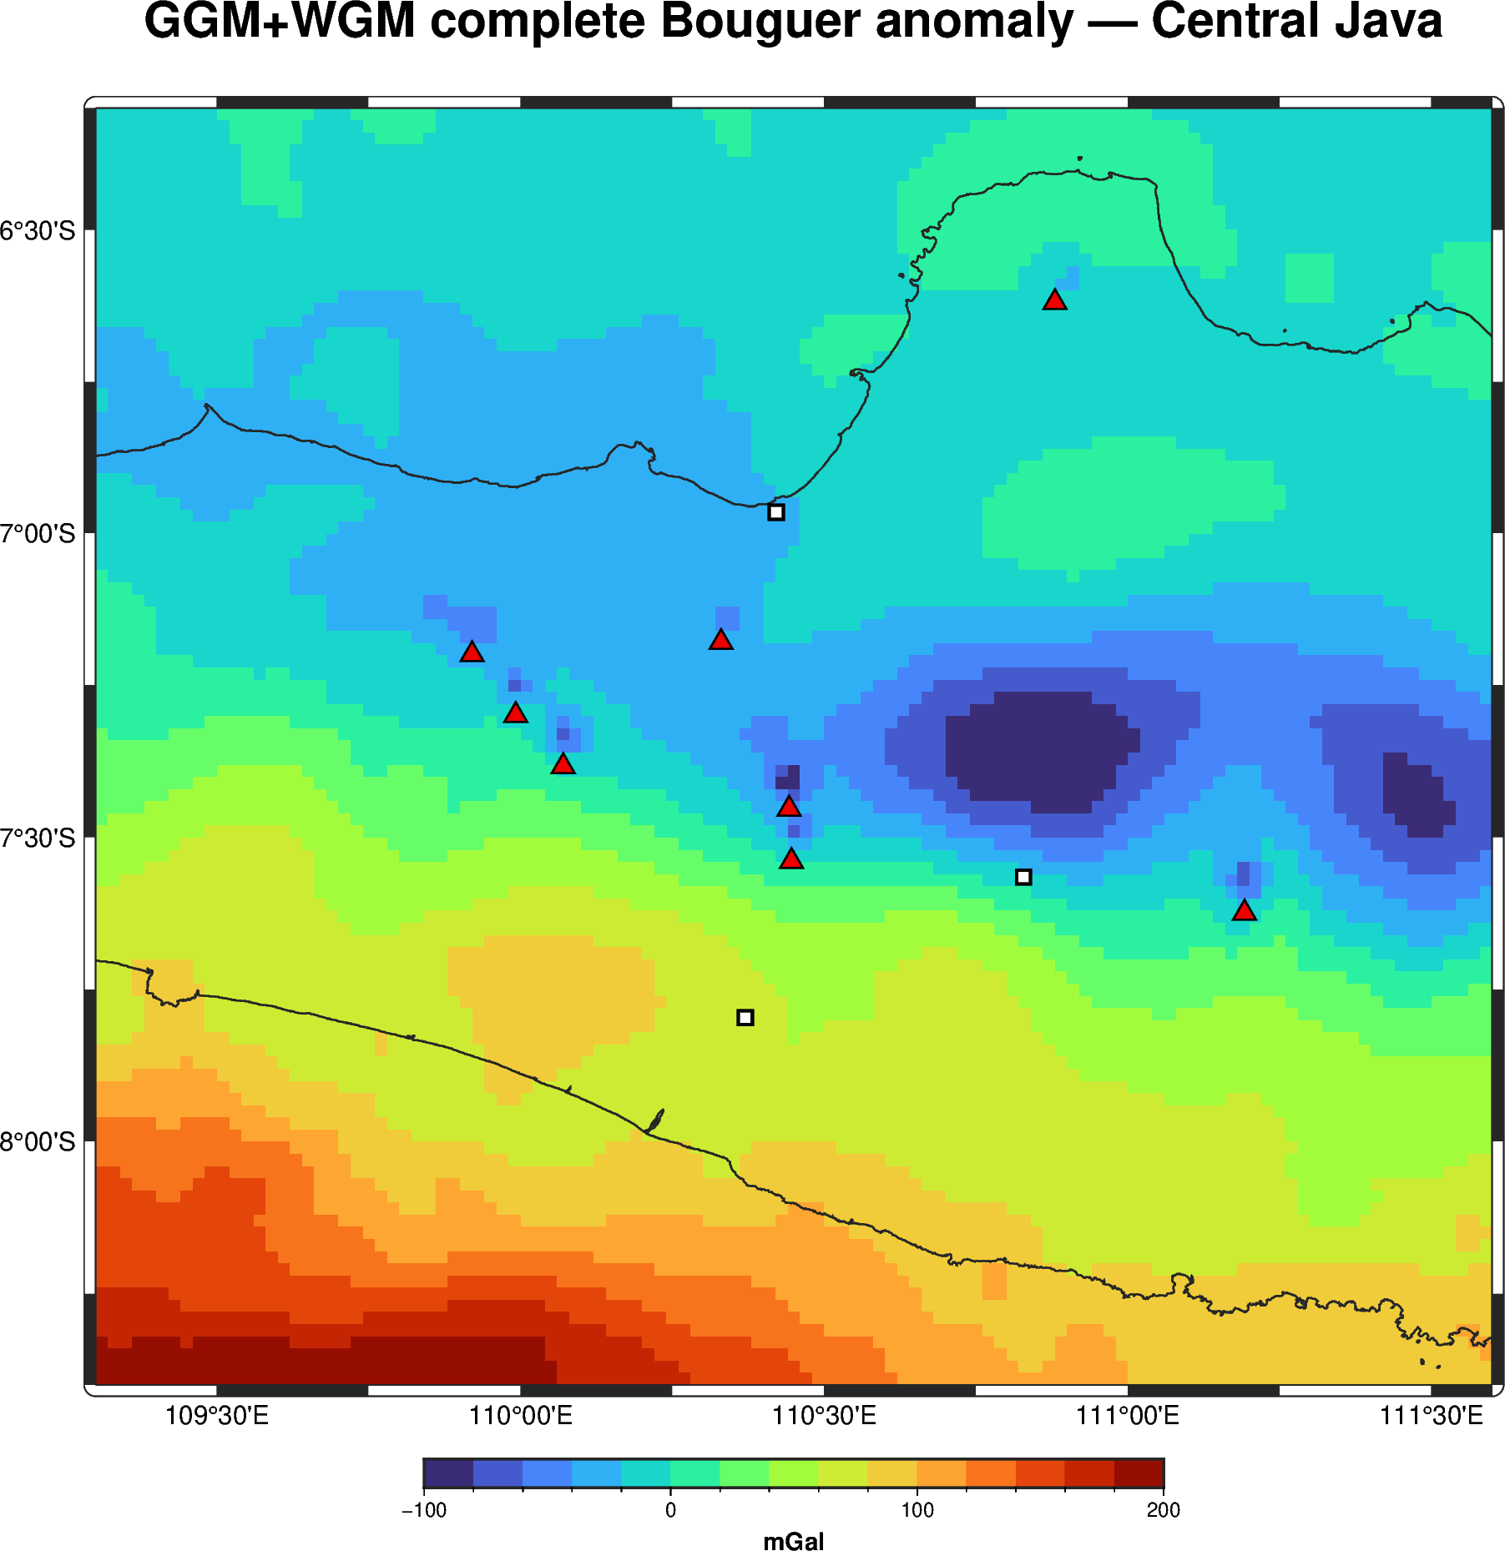
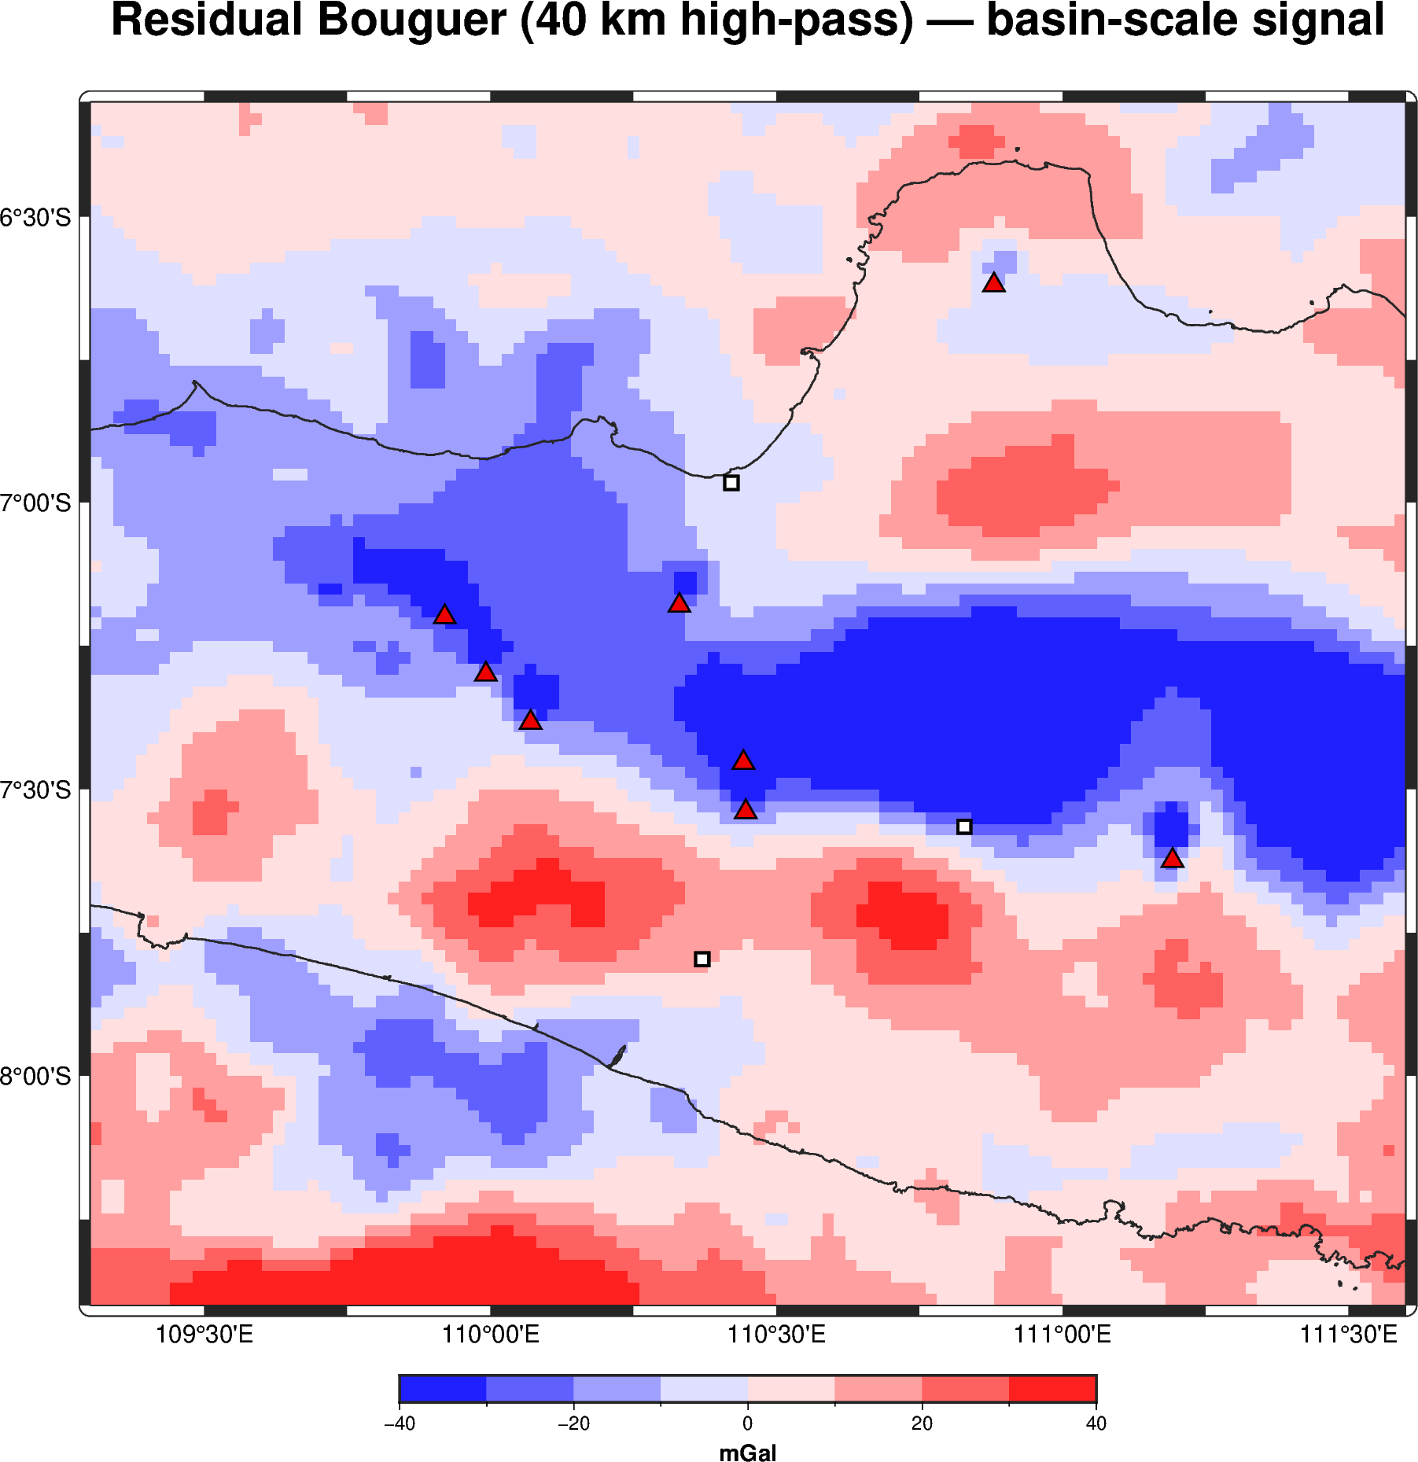
THE OTHER HALF
Satellite gravity over Central Java — dense but ambiguous
GGM+WGM complete Bouguer anomaly (▲ volcanoes).
Residual (40 km high-pass) — basin-scale signal.

Slide 16
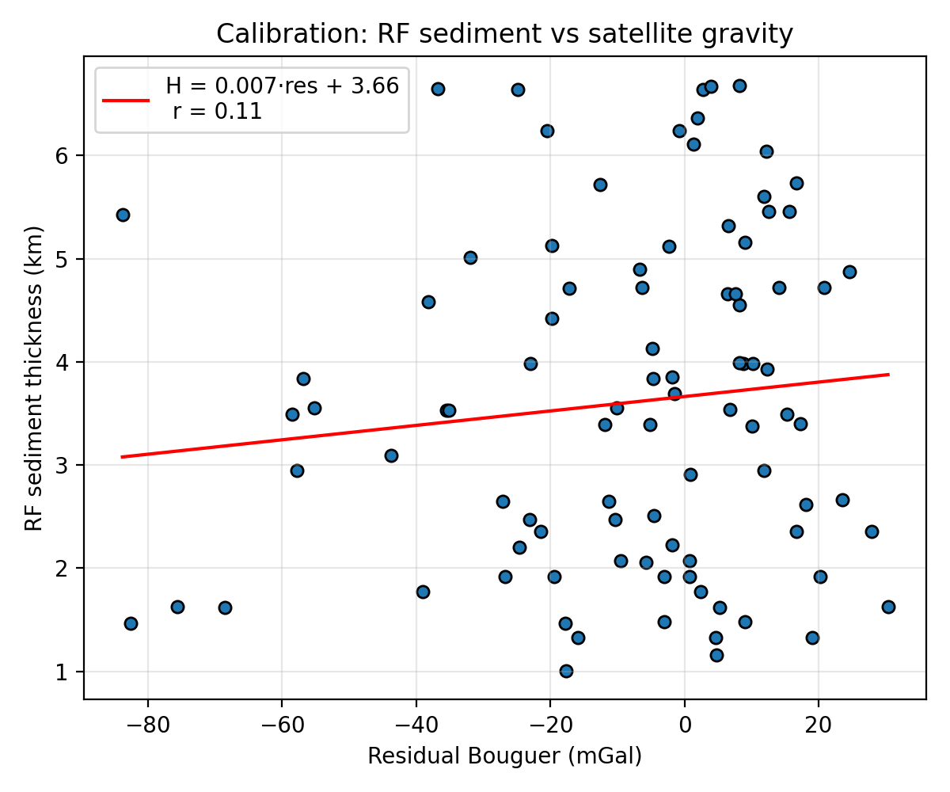
THE KEY INSIGHT
Even in Central Java, gravity alone cannot see the sediment
Correlation r ≈ 0.1
RF sediment thickness does NOT track the Bouguer residual — same story as the Indonesia-wide inversion.
Central Java's gravity is dominated by the volcanic arc and basement density.
So gravity inversion for sediment is under-determined without depth control...
...which the receiver functions now supply.

Slide 17
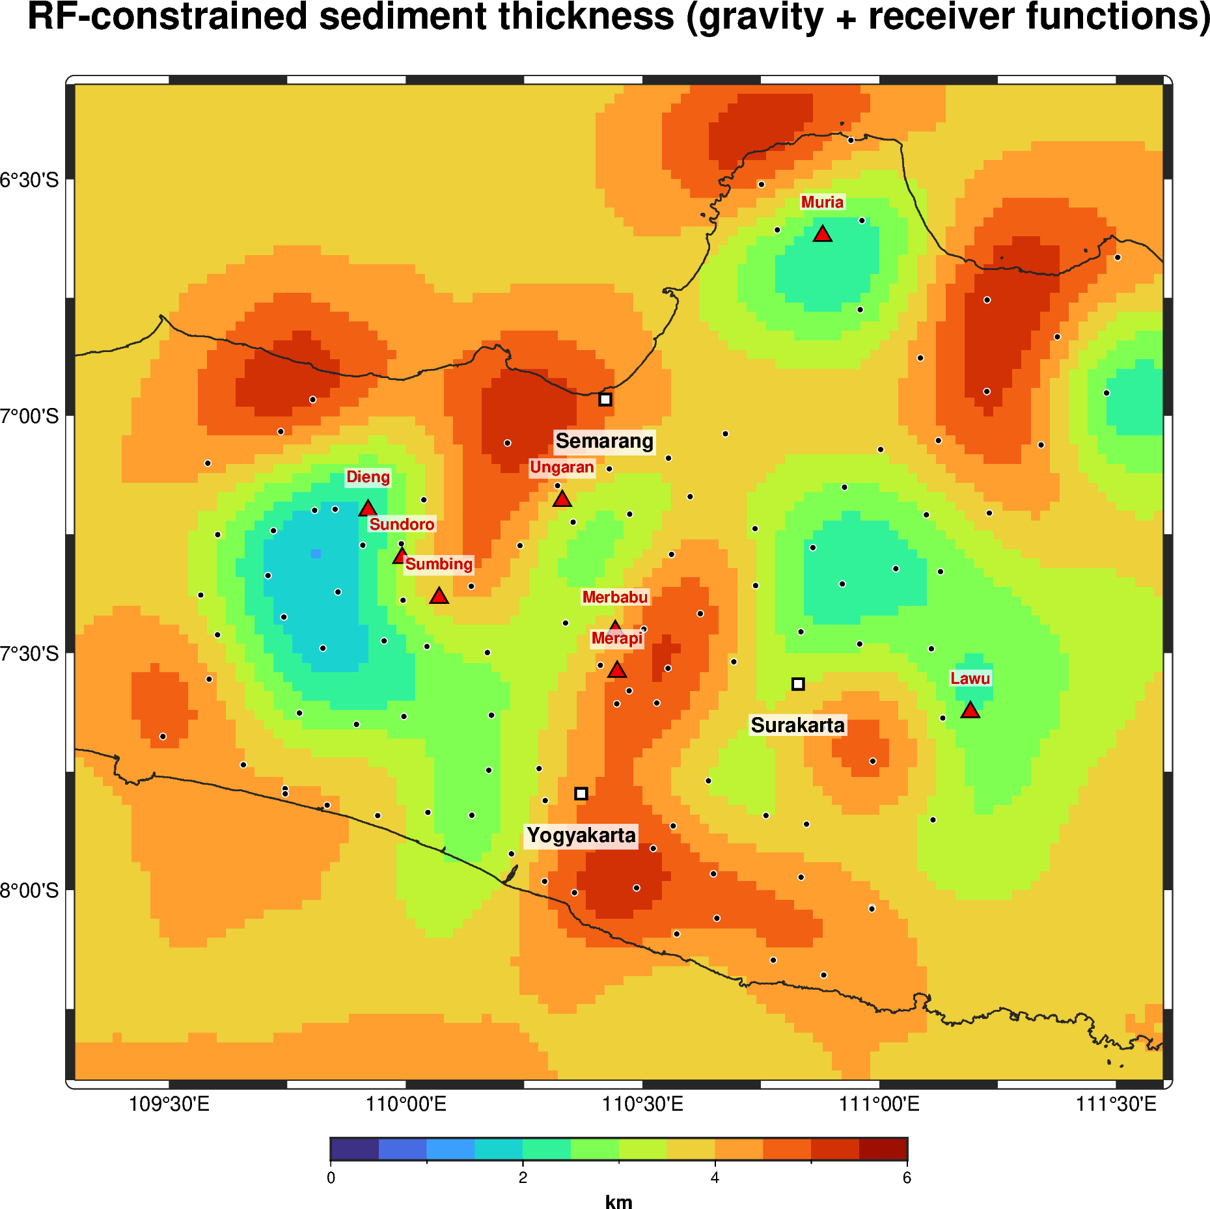
THE BRIDGE
RF-anchored, gravity-contextualised sediment model
Integration
Receiver functions set absolute thickness at ~90 points.
Gravity fills the continuous spatial fabric between stations.
Collocation ties the map to the seismology.
A public-data reconnaissance depth-to-basement model.

Slide 18
THE SYNTHESIS
When we have seismology constraints, gravity + seismology is far more powerful
Gravity alone
Gravity + seismology
Non-unique: basin low cancels rift Moho high.
Indonesia inversion: r = −0.15 vs published thickness.
Dominated by plate-boundary & isostatic effects.
Outlines built from gravity aren't an independent check.
RF gives absolute, physical thickness — no density guess.
Seismology anchors & calibrates the ambiguous gravity field.
Gravity then interpolates between stations, cheaply and densely.
Together: a calibrated basin model where neither works alone.
Central Java is the proof: the RF constraint is exactly what turns gravity from ambiguous into useful.
Notes:
This is the core message for Pertamina Upstream: don't expect gravity alone to deliver basin geometry in Indonesia; pair it with seismological depth control and it becomes powerful.

Slide 19
THE ROADMAP
Scaling the bridge across Indonesia's frontier basins
Mine passive seismology
Add real ground truth
Every temporary/permanent broadband deployment already recorded can yield RF depth control — like MERAMEX here.
MIGAS opens 42,461 wells and 63,691 2-D seismic lines via ArcGIS REST — the true depth-to-basement, still unused.
Terrestrial gravity
Joint inversion
The 2025 Bouguer Anomaly compilation adds resolution satellite gravity cannot.
Invert gravity with RF/well depths as hard constraints — basin by basin, nationally.

Slide 20
The takeaway
Where data is scarce, seismology is the bridge — and gravity + seismology beats either alone.
Receiver functions + satellite gravity + Herrmann CPS → a public-data depth-to-basement model for Central Java, and a template for every frontier basin.
Terima kasih · Thank you

