Slide 1
WORKSHOP · UNLOCKING UNDER-EXPLORED BASINS IN INDONESIA
From Potential Fields to Seismological Constraints
Gravity & magnetics map where basins are — receiver functions tell us how deep. Together they turn reconnaissance into a drillable model.
Gravity + Magnetic reconnaissance of 9 frontier basins
Pak Zuhdi Research Group · Satellite gravity + magnetics + MERAMEX receiver functions · 60-minute keynote

Slide 2
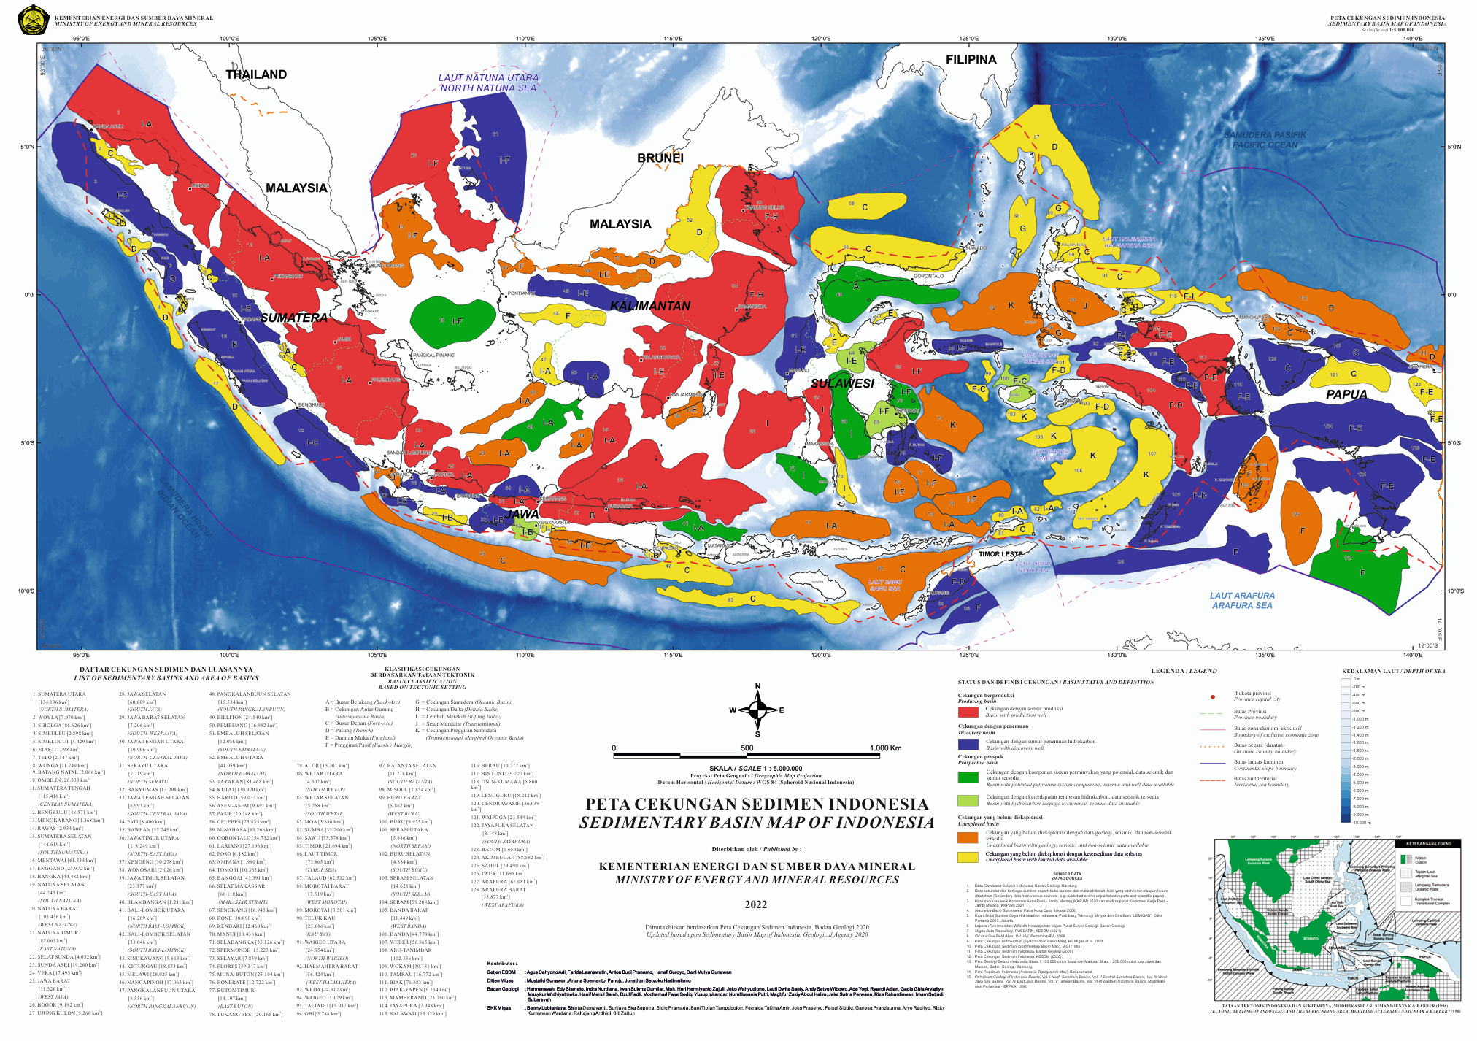
THE PRIZE
Indonesia's under-explored basins are the next frontier
Many basins, little modern data
Indonesia hosts ~128 sedimentary basins; a large share in the east remain frontier — sparse wells, legacy 2-D seismic, no modern depth model.
Satellite fields cover everything
Public satellite gravity & magnetics blanket every basin uniformly — the ideal reconnaissance layer to rank and delineate targets.
The question
Can potential fields alone give a drillable basin model? Or do we need a seismological anchor?
Sedimentary basins of Indonesia (Badan Geologi, 2020).
ID Peta cekungan Indonesia: banyak cekungan timur masih frontier — data sumur & seismik terbatas. Gravity/magnetik satelit menutup semuanya secara merata.
02

Slide 3
ROADMAP
What this hour covers
1 · The toolkit
2 · National portfolio
Why gravity & magnetics respond to basins; processing & edge detection.
Nine frontier basins screened with satellite gravity + magnetic RTP.
3 · Deep dive: Tomini/Gorontalo
4 · The non-uniqueness wall
Reprocessed satellite gravity — better gridding, sharper structure.
Why potential fields alone cannot fix absolute basin depth.
5 · Seismology as the key
6 · The integrated future
Receiver functions anchor depth & velocity — MERAMEX & 91-station Vs.
Gravity + magnetics + seismology, and a roadmap for frontier basins.
ID Alur 60 menit: konsep → portfolio 9 cekungan → reprosesing Tomini → keterbatasan potensi-lapangan → receiver function sebagai kunci → integrasi.
03

Slide 4
THE TOOLKIT · 1
Basins are density & susceptibility contrasts
Gravity — density contrast (Δρ)
Why use both
Low-density sedimentary fill (2.2–2.5 g/cm³) over denser basement (2.67–2.9) makes a NEGATIVE gravity anomaly. Depocentres = residual gravity lows.
Gravity senses total mass deficit; magnetics senses basement/structure. Read together they cut the ambiguity of either field alone (Gibson & Millegan, 1998) — the first step toward a basin model.
But note: both are POTENTIAL fields — smooth, non-unique, and depth-ambiguous. Hold that thought for Part 4.
Magnetics — susceptibility contrast (Δκ)
Sediments are near-non-magnetic; basement & intrusions carry the signal. Magnetics image BASEMENT relief and volcanic/fault trends beneath the fill.
ID Gravity peka ke kontras densitas (isi cekungan lebih ringan → anomali rendah); magnetik peka ke kontras suseptibilitas (relief batuan dasar). Dipakai bersama mengurangi ambiguitas.
04

Slide 5
THE TOOLKIT · 2
Gravity processing chain
01
02
03
04
Free-air
→
Bouguer
→
Isostatic
→
Residual
Satellite/altimetry gravity (Sandwell, GGMPlus)
Remove terrain/bathymetry mass (tesseroid)
Remove deep root compensation
Regional–residual split → basin-scale field
The residual is the interpretation field
Regional–residual separation (upward continuation / Gaussian high-pass) isolates shallow basin structure from deep lithospheric trends. Residual gravity LOWS mark sediment depocentres; HIGHS mark basement highs and horsts.
ID Rantai gravity: free-air → Bouguer (koreksi terrain) → isostatik → residual. Anomali residual RENDAH = depocentre cekungan; TINGGI = tinggian batuan dasar.
05

Slide 6
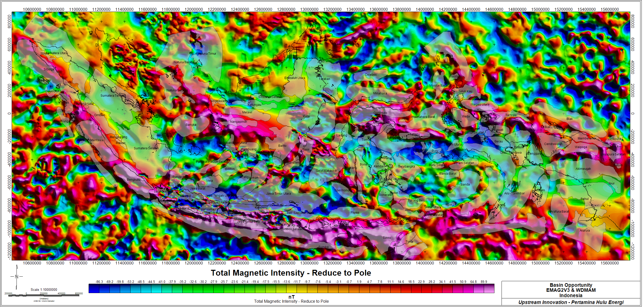
THE TOOLKIT · 3
Magnetics: why Reduce-to-Pole (RTP)
The problem
At low magnetic latitudes the anomaly is shifted and skewed away from its source — a body's peak does not sit over the body.
RTP / RTE fix
Reduce-to-Pole (or Equator) re-centres anomalies over their sources, so magnetic highs/lows line up with basement structure and can be co-interpreted with gravity.
Total magnetic intensity, reduced to pole (EMAG2 V3 + WDMAM).
ID Di lintang magnetik rendah, anomali magnetik bergeser dari sumbernya. Reduce-to-Pole mengembalikan anomali tepat di atas sumber agar bisa dipadu dengan gravity.
06

Slide 7
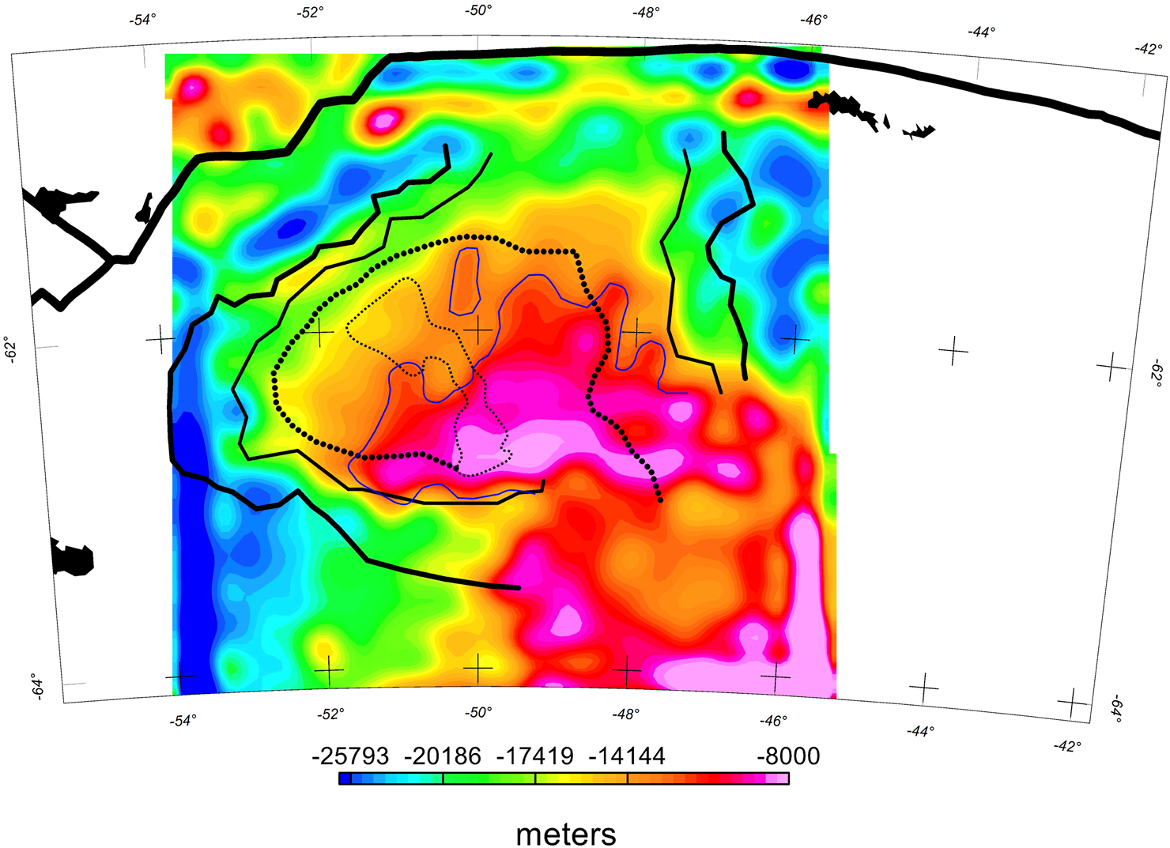
THE TOOLKIT · 4
Edge detection & basin delineation criteria
Derivative filters find edges
THD, tilt (TDR), analytic signal and theta maps sharpen gradients — they trace fault scarps, basin margins and intrusive contacts the raw field blurs.
A basin = converging evidence
Diagnose a basin where a residual gravity LOW, a smooth low-gradient magnetic interior, and edge-detected bounding faults all coincide — not from one map alone.
Basin delineation criteria (source deck).
ID Filter turunan (THD/TDR/analytic signal/theta) menandai tepi & sesar. Cekungan didiagnosis saat gravity rendah + interior magnetik tenang + sesar pembatas saling bertemu.
07

Slide 8
NATIONAL PORTFOLIO
One reconnaissance workflow, nine frontier basins
9
2
3
100%
frontier basins screened
independent fields per basin
depth slices (deep/crust/shallow)
public satellite data
Gravity — GGMPlus 2013 + WGM2012
Magnetics — EMAG2 V3 + WDMAM
Isostatic-corrected satellite gravity, band-pass filtered into deep, crustal and shallow depth slices (wavelength → depth). Deep+shallow composite shown per basin.
Total magnetic intensity, merged and reduced-to-pole. Same footprint as gravity so the two fields are co-registered and jointly interpreted for each basin.
ID Satu alur untuk 9 cekungan: gravity isostatik (GGMPlus+WGM2012) di-slice per kedalaman + magnetik RTP (EMAG2V3+WDMAM). Semua data publik satelit.
08

Slide 9
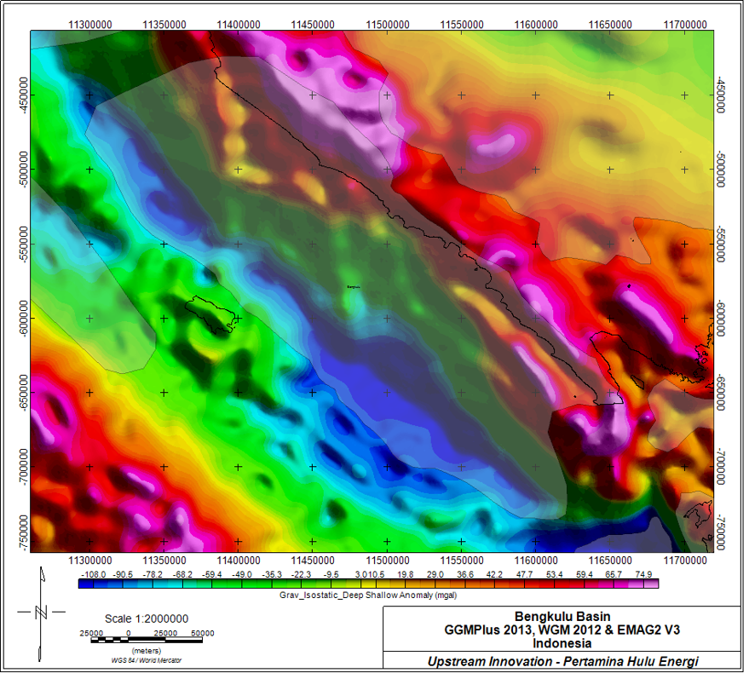
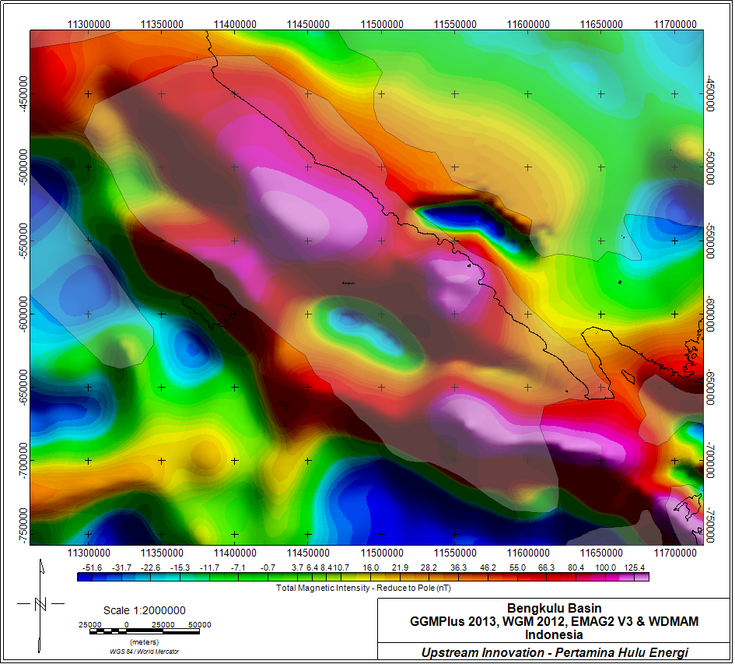
PORTFOLIO · BASIN 1 / 9
Bengkulu — Fore-arc basin, offshore SW Sumatra
Isostatic gravity (deep + shallow)
Total magnetic intensity — RTP
ID Baca cepat: Elongated fore-arc gravity low parallel to the trench; magnetic quiet zone over the fill, magnetic highs on the outer-arc basement ridge.
09

Slide 10
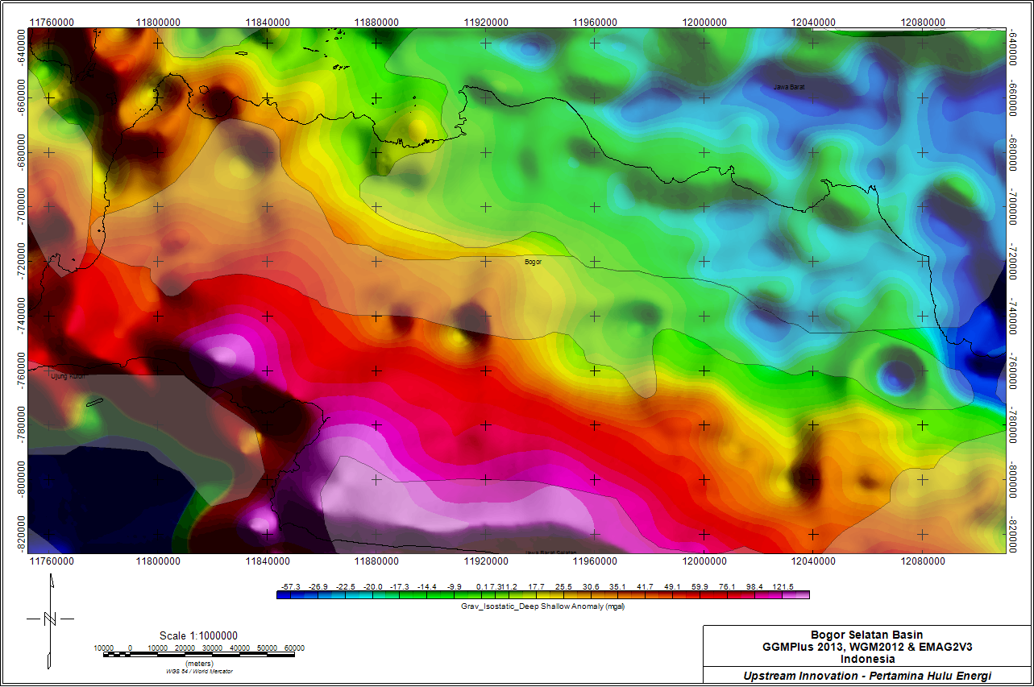
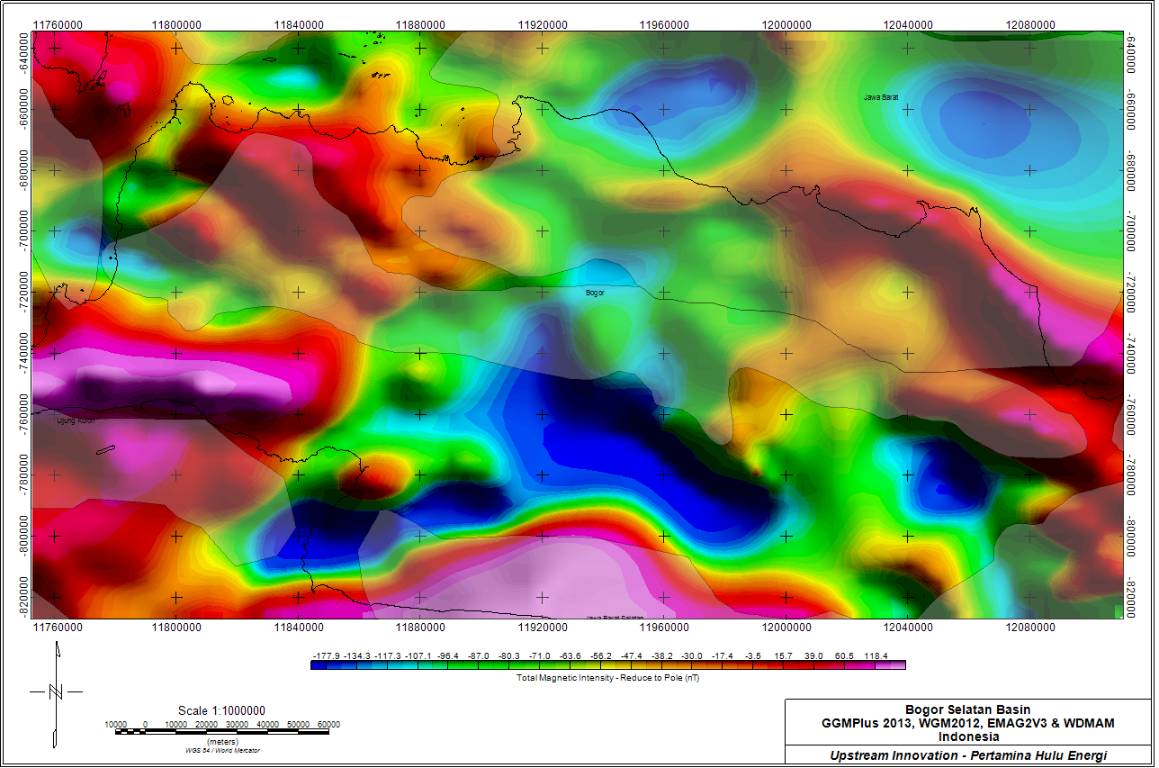
PORTFOLIO · BASIN 2 / 9
Bogor — Back-arc trough, West Java
Isostatic gravity (deep + shallow)
Total magnetic intensity — RTP
ID Baca cepat: Deep E–W gravity low tracks the Bogor Trough; volcanic-arc magnetic highs bound it to the south.
10

Slide 11
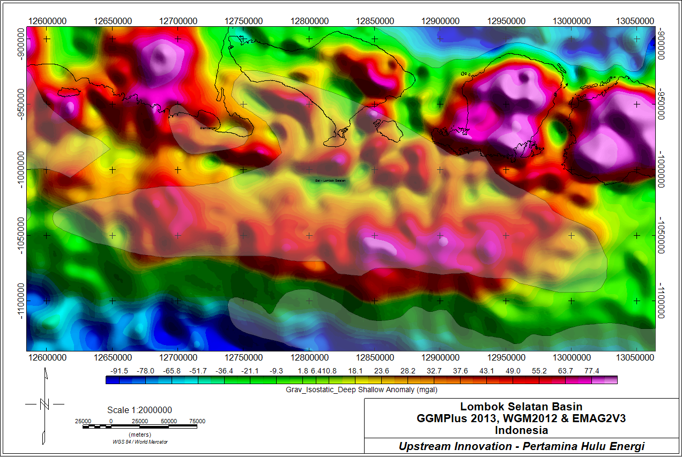
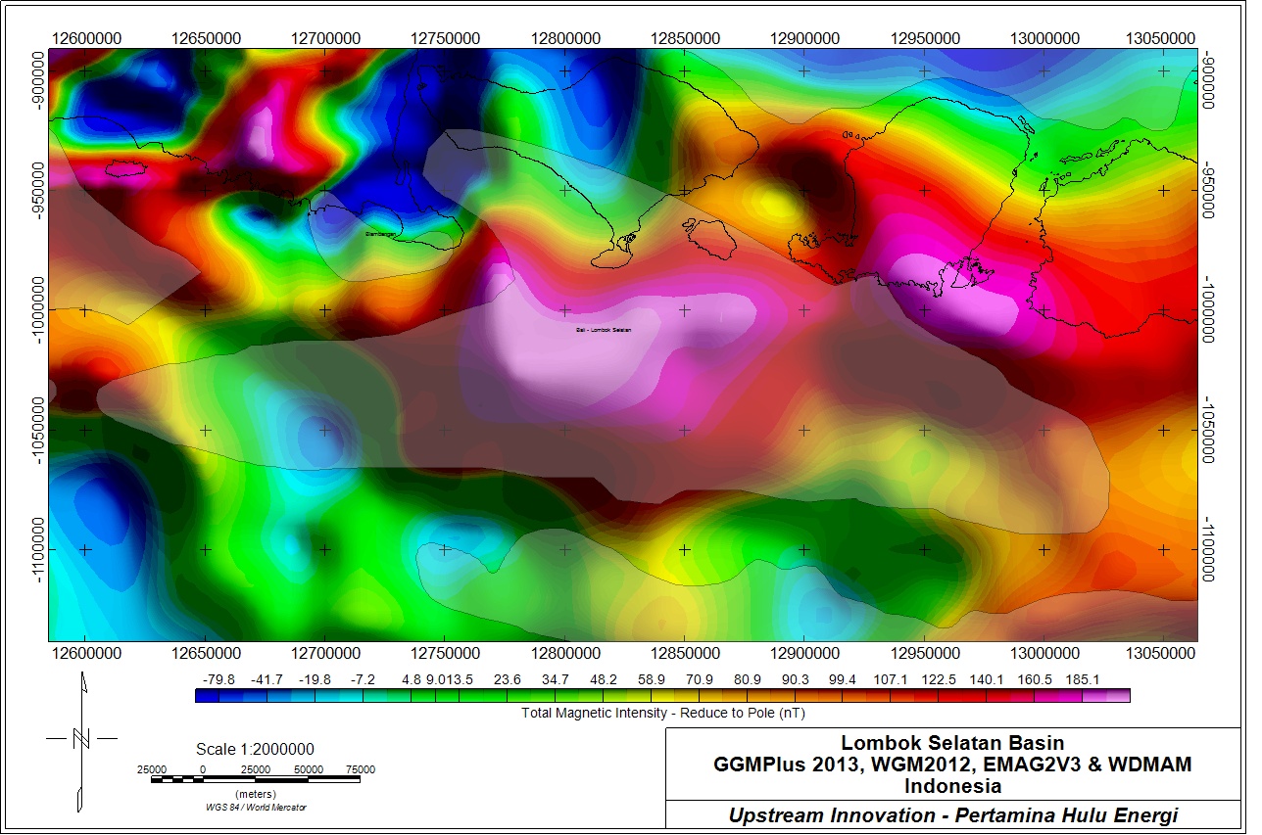
PORTFOLIO · BASIN 3 / 9
Lombok Selatan — Fore-arc, southern Nusa Tenggara
Isostatic gravity (deep + shallow)
Total magnetic intensity — RTP
ID Baca cepat: Fore-arc low south of the volcanic arc; strong arc magnetic signature to the north frames the depocentre.
11

Slide 12
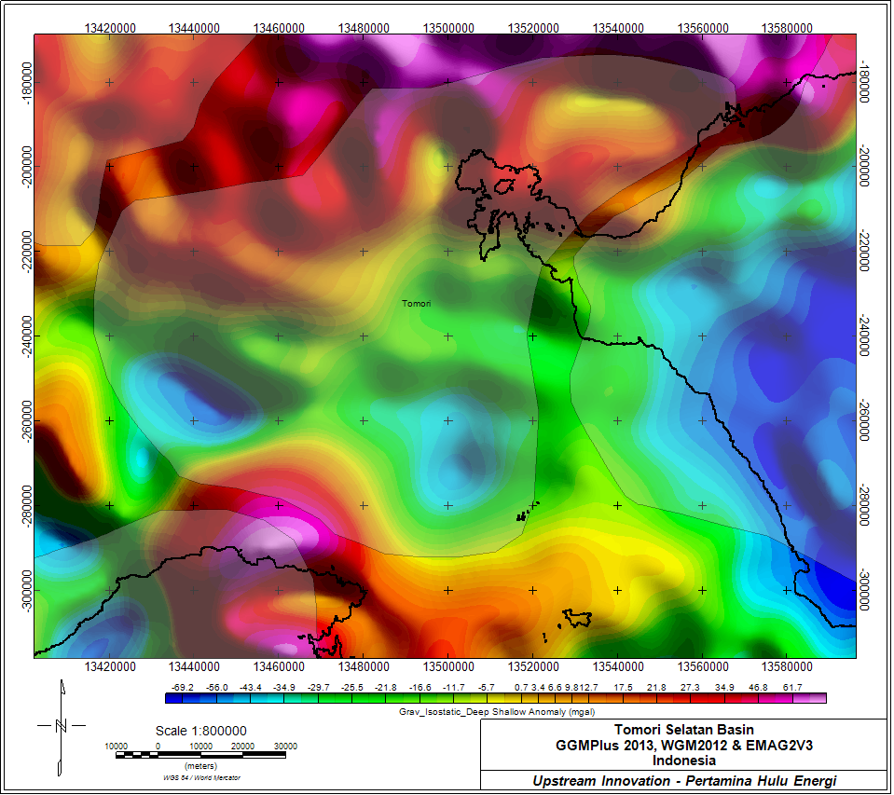
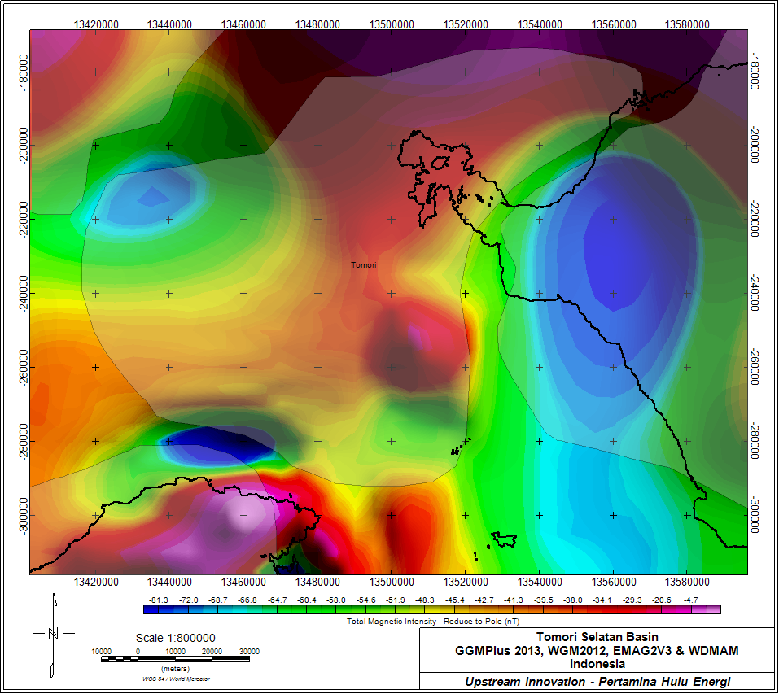
PORTFOLIO · BASIN 4 / 9
Tomori Selatan — East arm, Sulawesi
Isostatic gravity (deep + shallow)
Total magnetic intensity — RTP
ID Baca cepat: Gravity low over the Molucca/East-Sulawesi fill; complex magnetic fabric from ophiolite/basement blocks nearby.
12

Slide 13
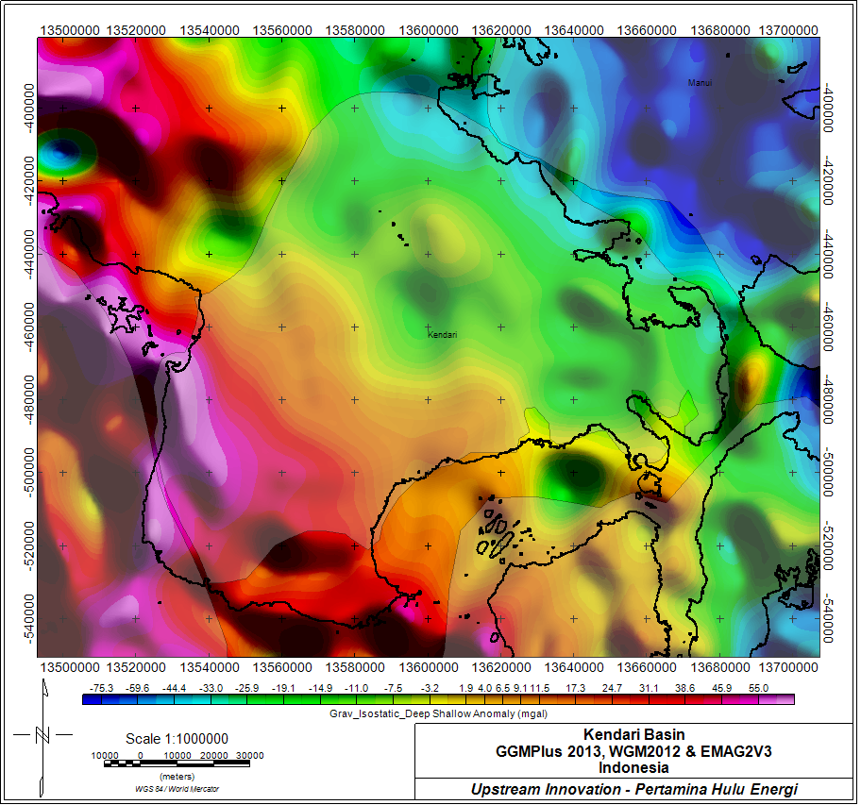
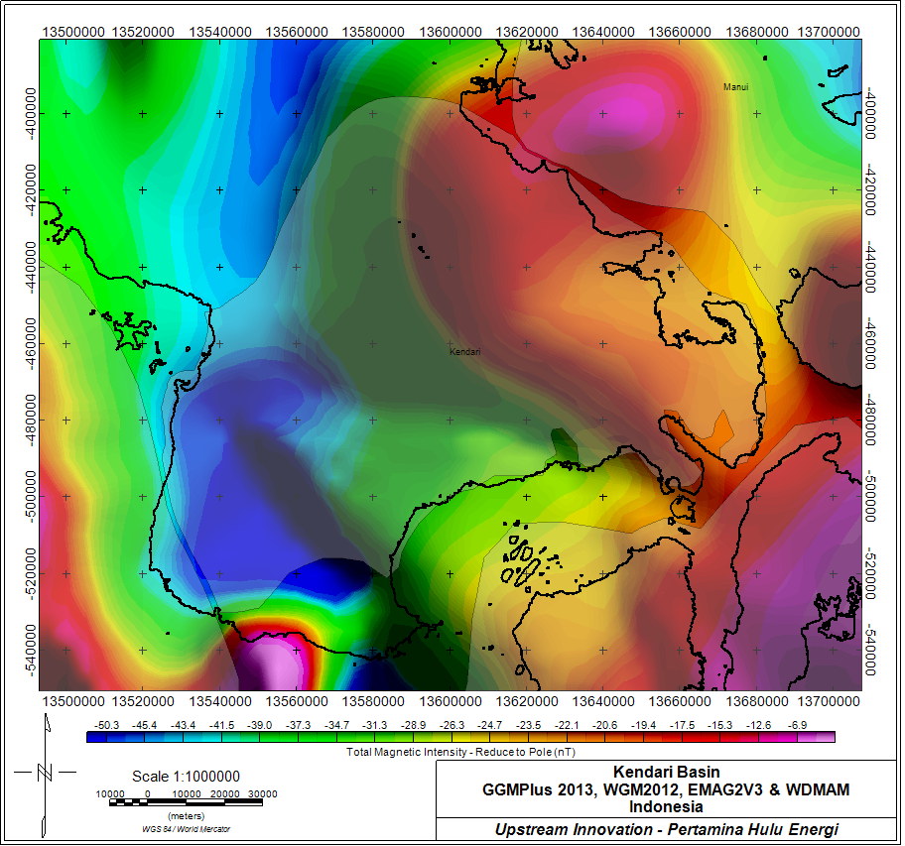
PORTFOLIO · BASIN 5 / 9
Kendari — Southeast Sulawesi
Isostatic gravity (deep + shallow)
Total magnetic intensity — RTP
ID Baca cepat: Intramontane gravity low between metamorphic highs; magnetic contrasts follow the SE-Sulawesi terrane boundaries.
13

Slide 14
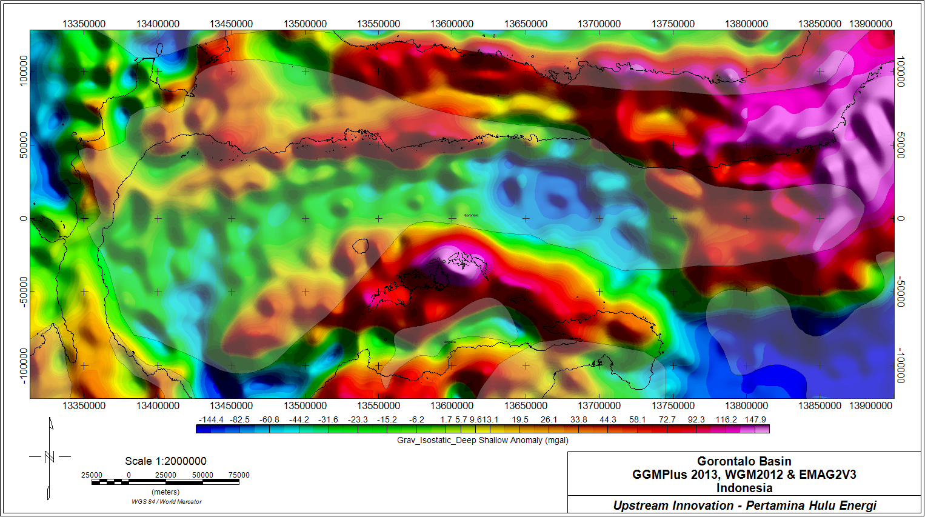
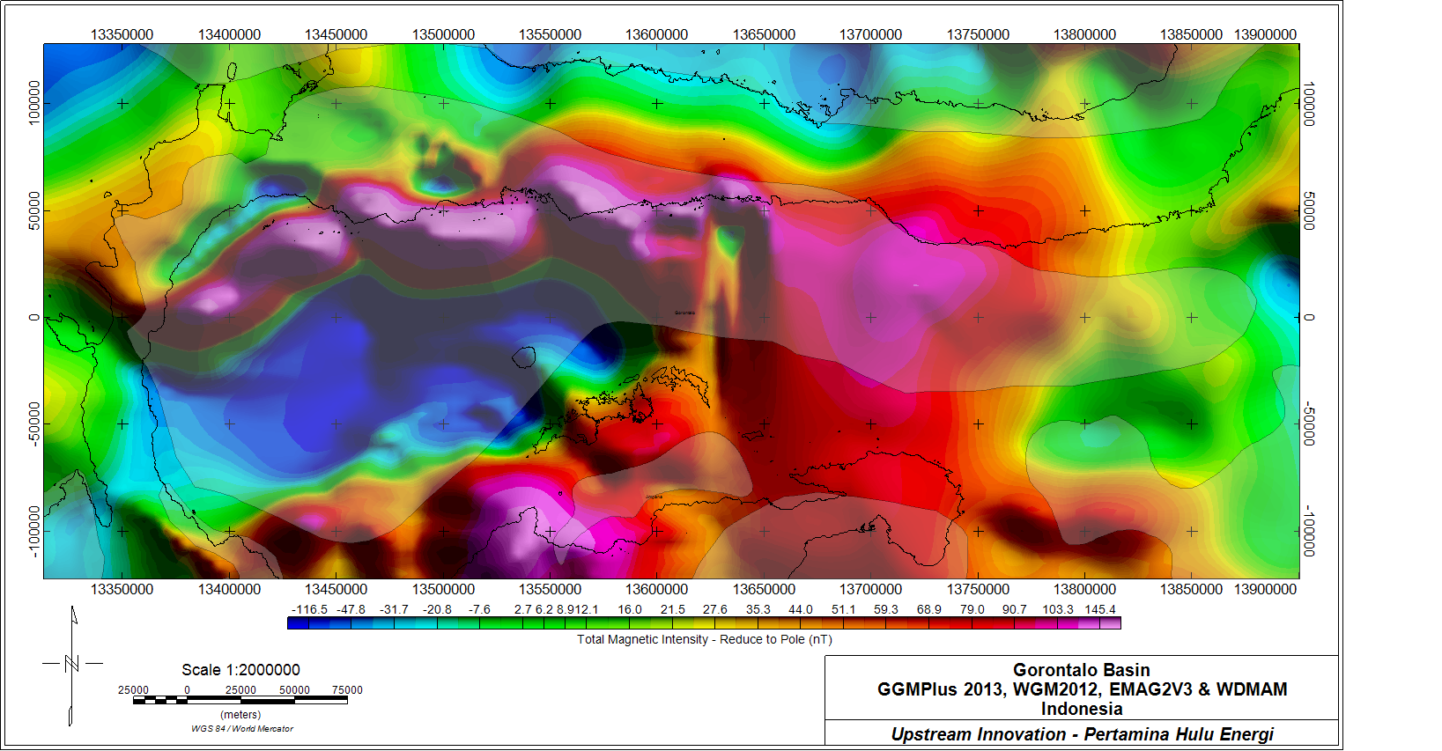
PORTFOLIO · BASIN 6 / 9
Gorontalo — Tomini Bay, North Sulawesi
Isostatic gravity (deep + shallow)
Total magnetic intensity — RTP
ID Baca cepat: Broad deep-marine gravity low in Tomini Bay — a prime depocentre; magnetic highs on the North-arm volcanic basement.
14

Slide 15
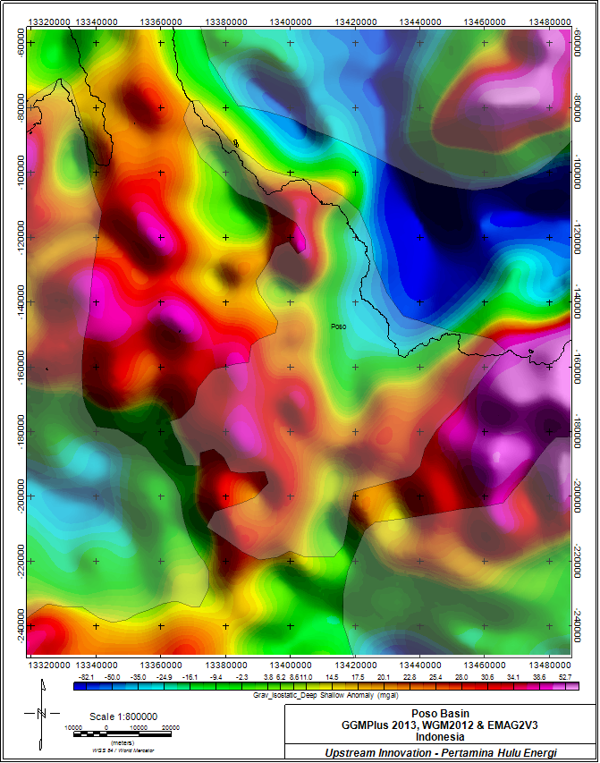
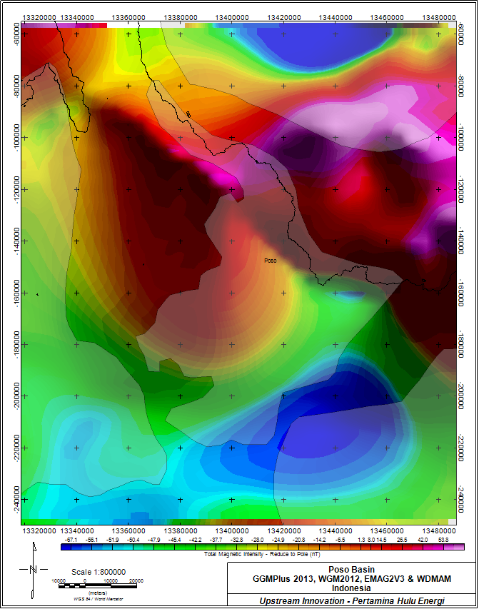
PORTFOLIO · BASIN 7 / 9
Poso — Central Sulawesi
Isostatic gravity (deep + shallow)
Total magnetic intensity — RTP
ID Baca cepat: Gravity low over the Poso/Central-Sulawesi depression; sharp magnetic edges mark bounding fault systems.
15

Slide 16
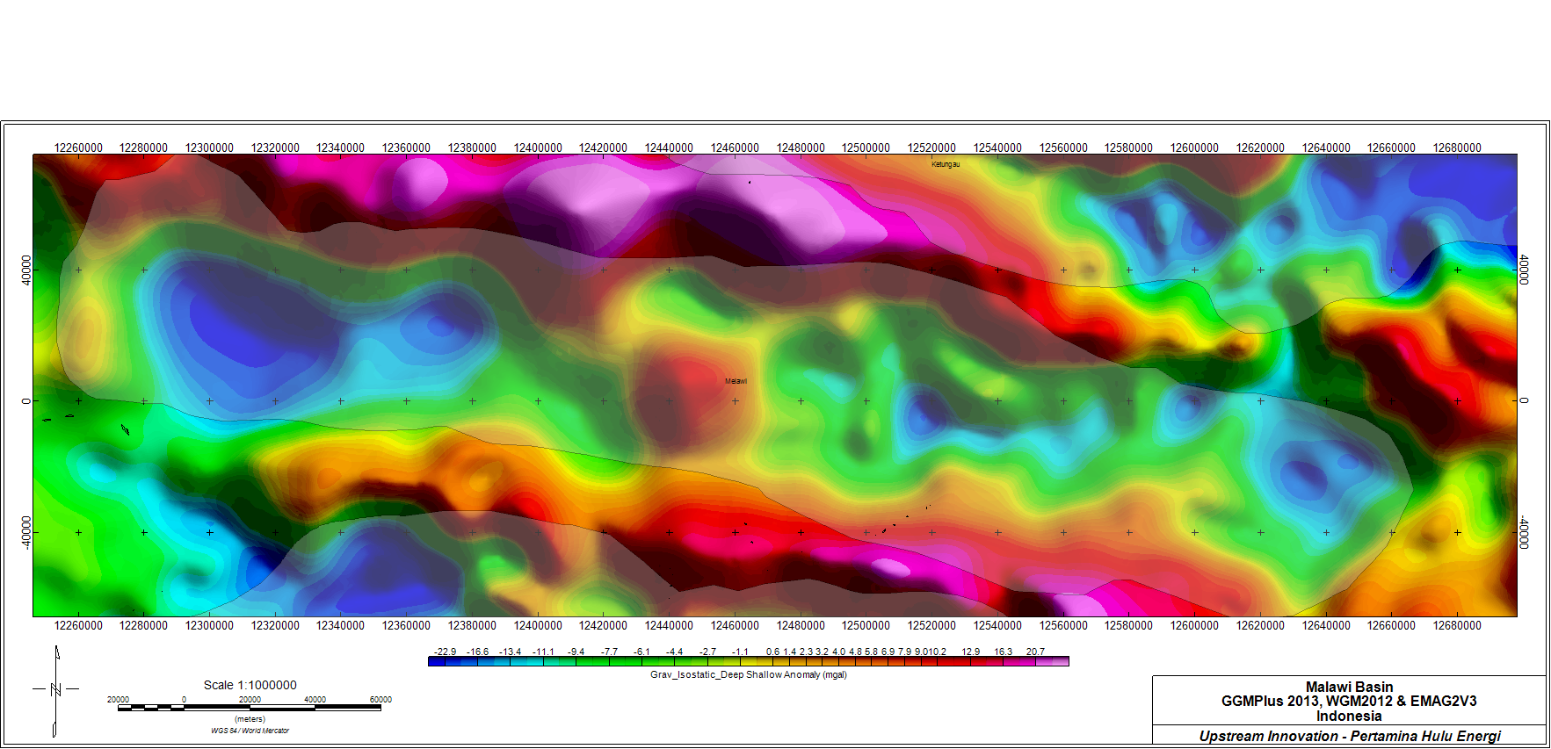
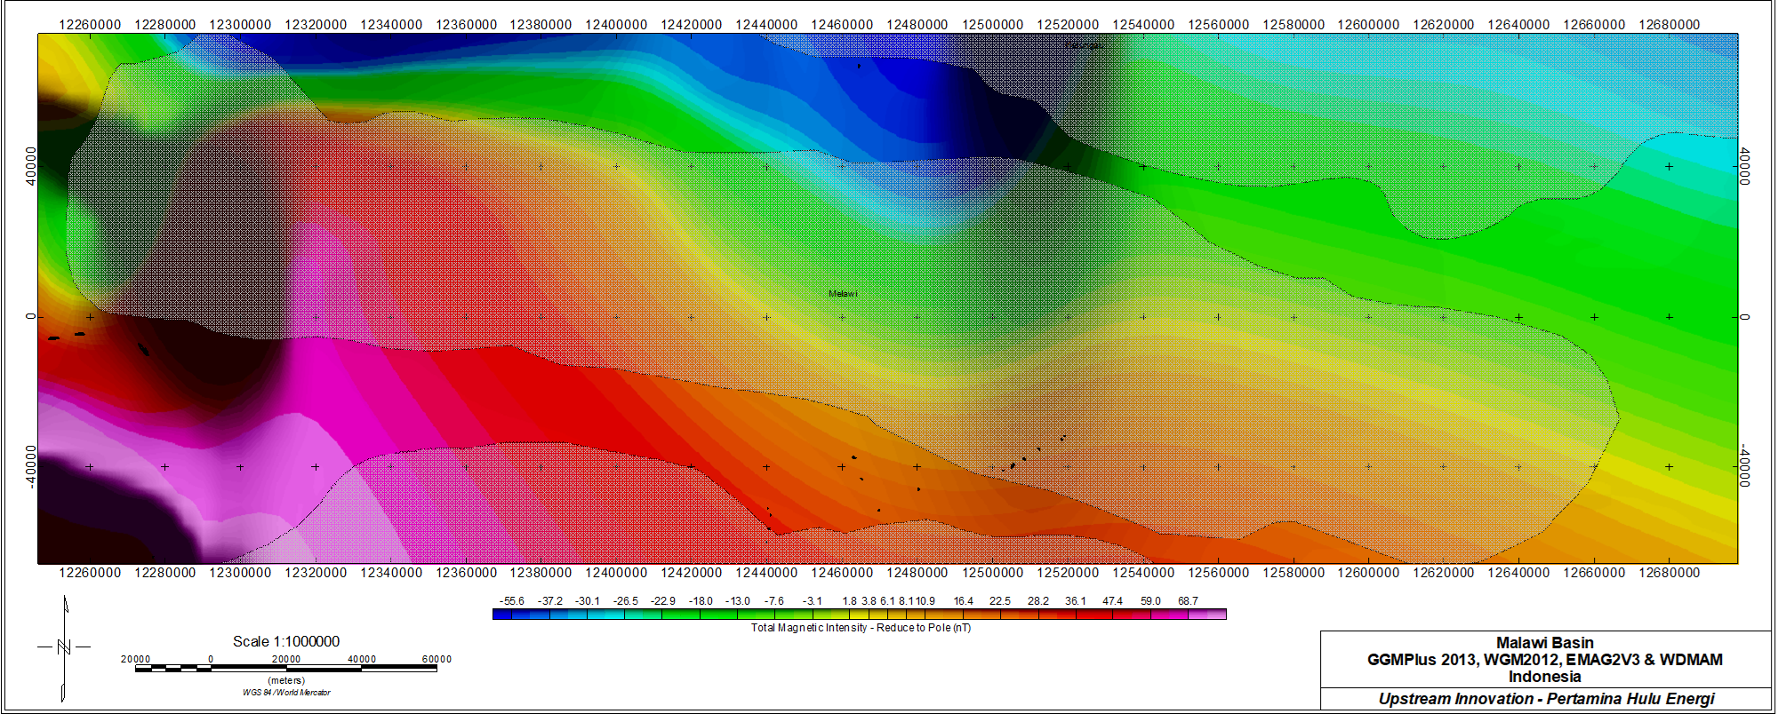
PORTFOLIO · BASIN 8 / 9
Melawi — West Kalimantan
Isostatic gravity (deep + shallow)
Total magnetic intensity — RTP
ID Baca cepat: Large intracratonic gravity low (Melawi–Ketungau); smooth magnetic interior typical of thick continental fill.
16

Slide 17
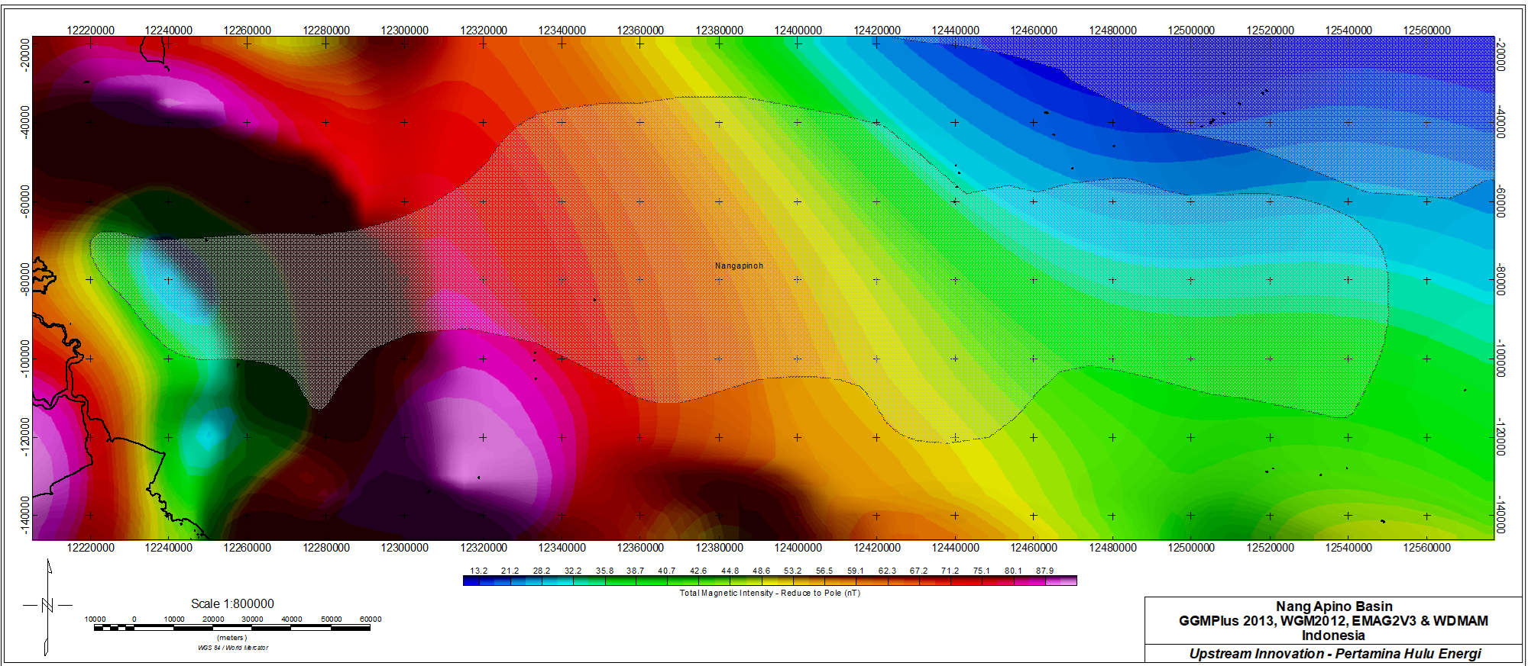
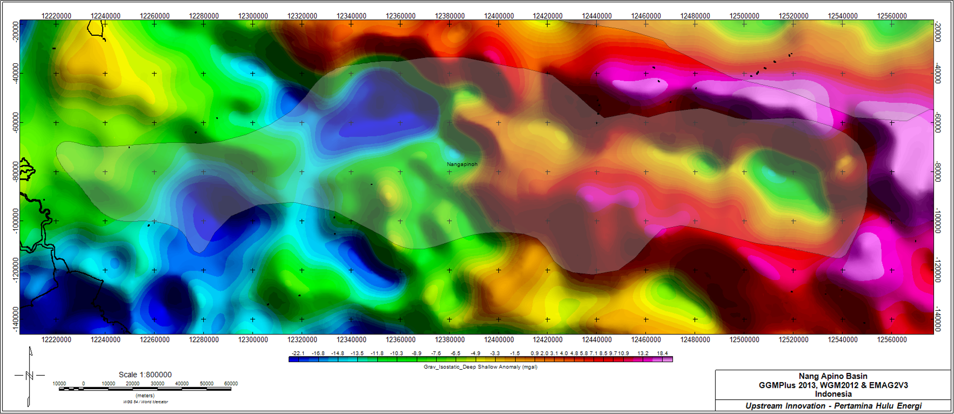
PORTFOLIO · BASIN 9 / 9
Nang Apino — Frontier area
Isostatic gravity (deep + shallow)
Total magnetic intensity — RTP
ID Baca cepat: Reconnaissance gravity low with edge-bounded margins; magnetics used to separate sedimentary fill from magnetic basement.
17

Slide 18
PORTFOLIO · SYNTHESIS
Nine basins ranked — but by relative signal only
Basin
Setting
Gravity low
Magnetic read
Gorontalo
Tomini Bay
Strong / broad
Quiet interior, arc highs N
Bogor
W-Java back-arc
Strong / linear
Arc highs bound S
Melawi
W-Kalimantan
Strong / broad
Smooth interior
Bengkulu
Sumatra fore-arc
Moderate
Outer-arc ridge highs
Poso / Kendari
C/SE Sulawesi
Moderate
Fault-edge fabric
Lombok S / Tomori / Nang Apino
Frontier
Variable
Mixed basement
Ranking uses RELATIVE anomaly strength and pattern — the maps do not yet give absolute depth, thickness, or volume.
ID Peringkat berdasarkan kekuatan & pola anomali relatif. Peta ini belum memberi kedalaman/ketebalan/volume absolut — itu keterbatasan mendasarnya.
18

Slide 19
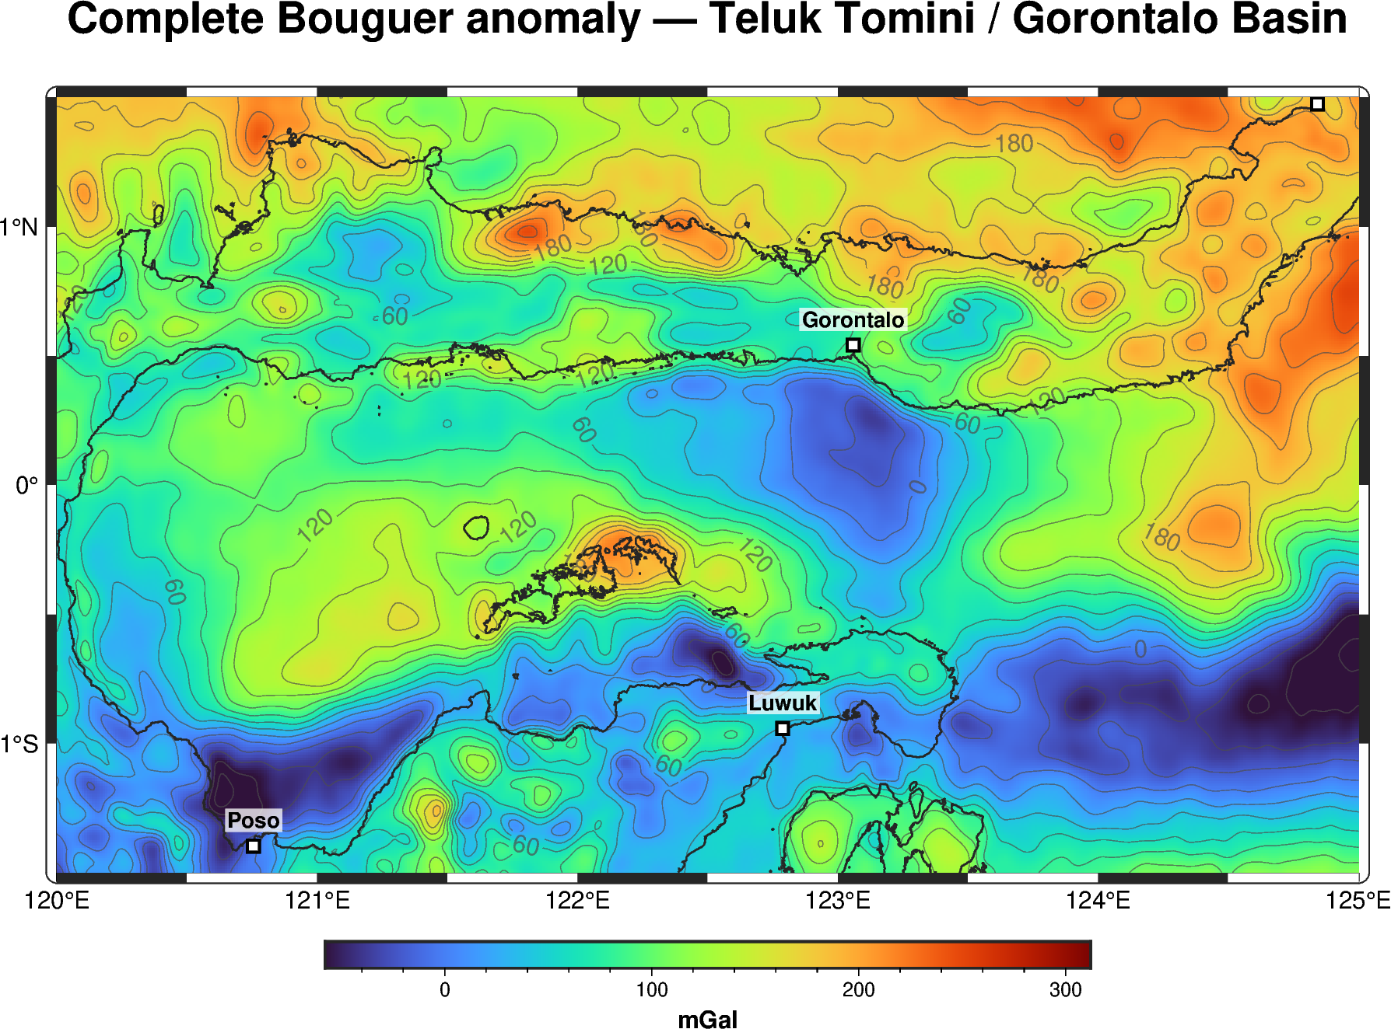
DEEP DIVE
Tomini / Gorontalo — reprocessing the gravity
Why this basin
A deep-marine frontier depocentre in East Indonesia (Tomini Bay). Excellent test bed: strong gravity signal, active tectonics, no modern depth model.
What we redid
Re-fetched free public satellite gravity and re-gridded with minimum-curvature (surface, tension) + light Gaussian — replacing stepped, blocky maps with smooth, continuous fields and clean contours.
Complete Bouguer anomaly, reprocessed (this study).
ID Tomini/Gorontalo = depocentre frontier laut-dalam Indonesia Timur. Gravity satelit gratis diproses ulang: gridding minimum-curvature + smoothing → peta halus & kontur bersih.
19

Slide 20
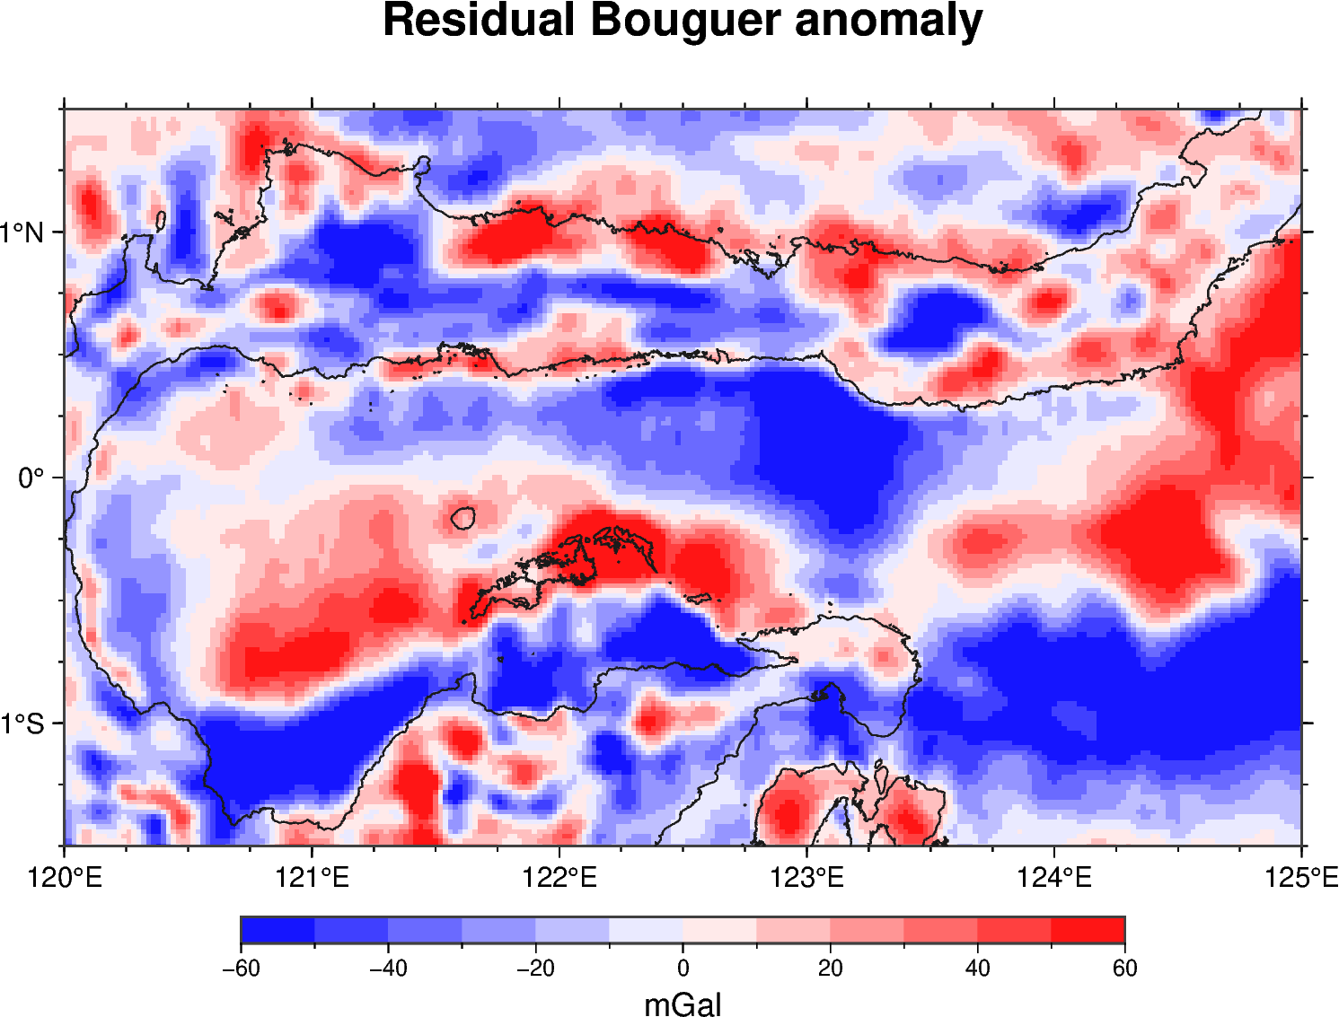
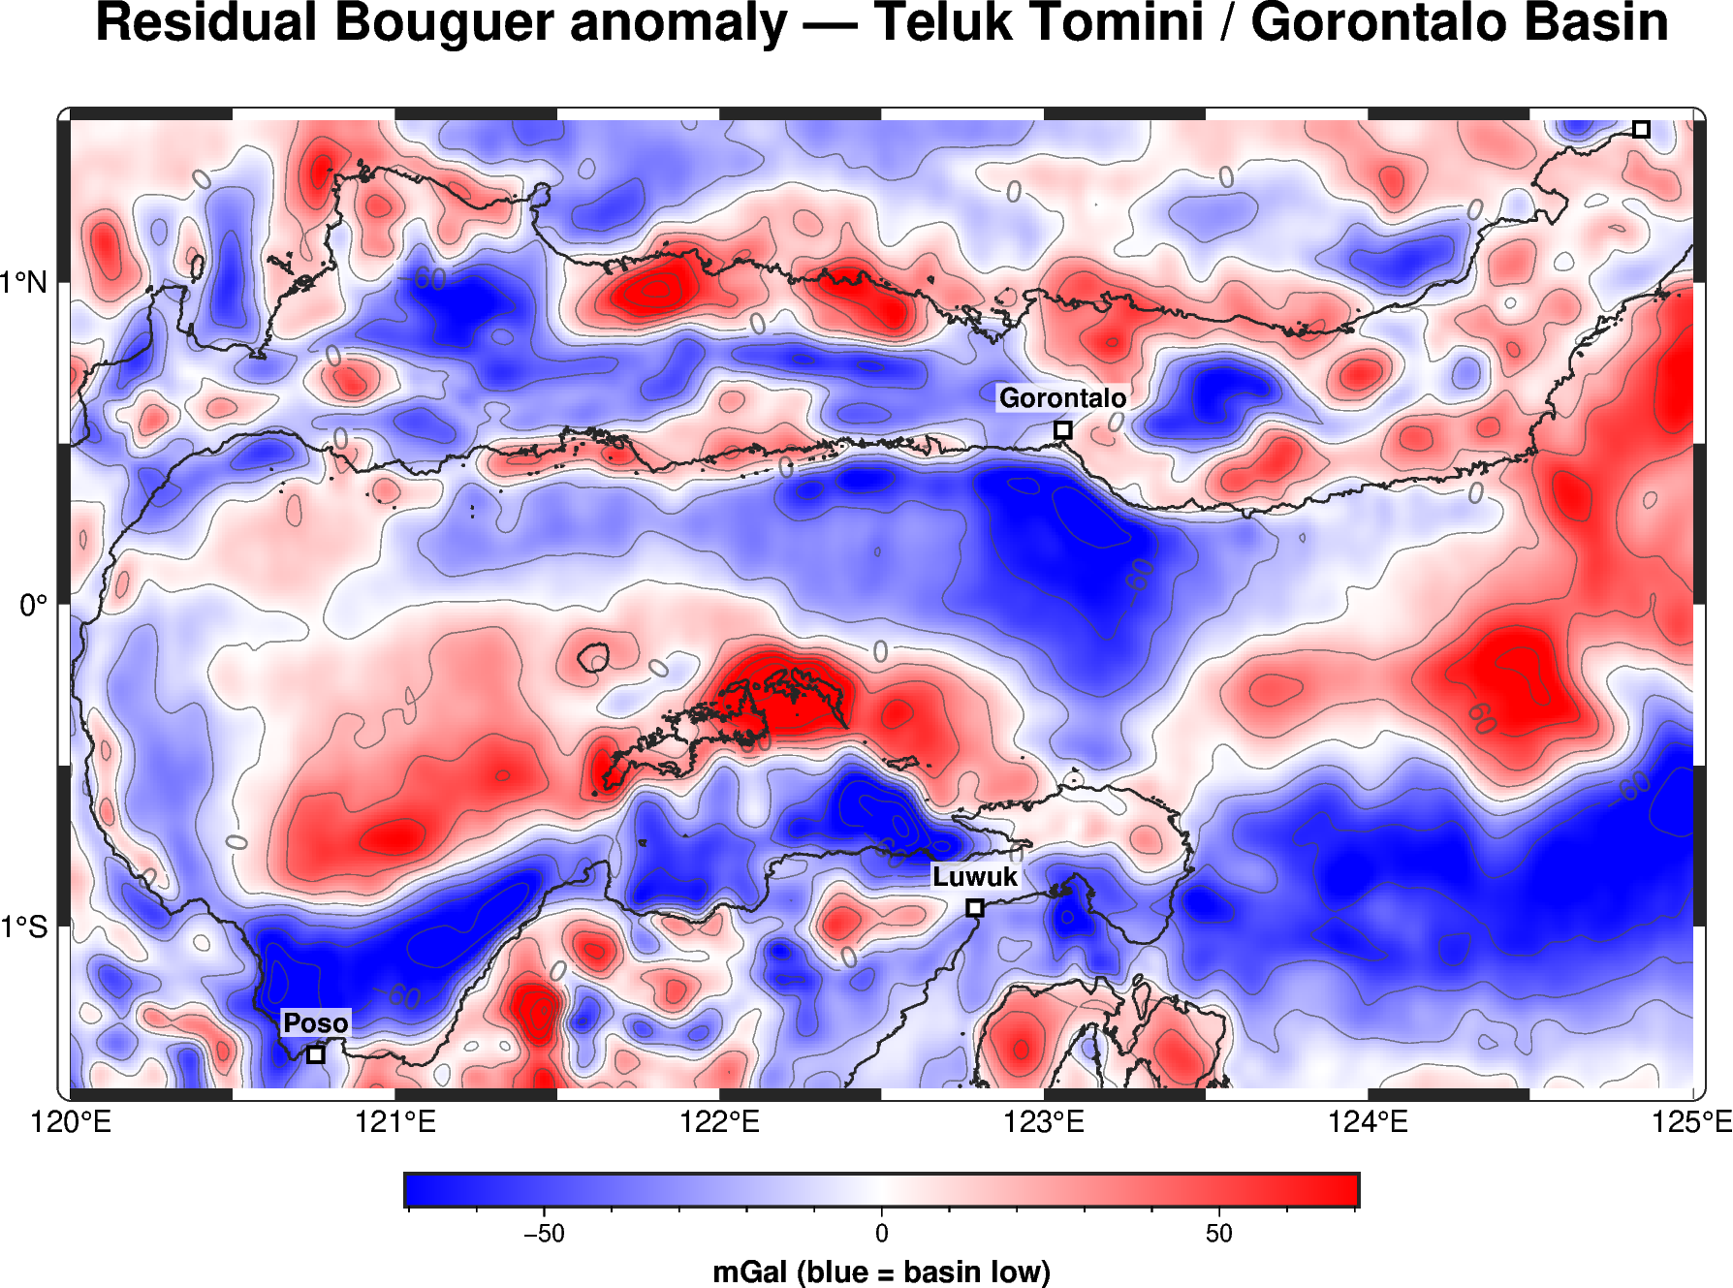
DEEP DIVE · GRIDDING
Better gridding, sharper structure
Before — stepped / blocky
After — minimum-curvature + smooth contours
ID Kiri: gridding lama (bertingkat). Kanan: minimum-curvature (surface, tension) + Gaussian + kontur halus. Depocentre & tepi cekungan jauh lebih terbaca.
20

Slide 21
DEEP DIVE · DEPOCENTRES
Residual Bouguer — where the sediment is
Blue = basin low
Deep residual lows in central Tomini Bay mark the main depocentres — thickest low-density fill.
Red = basement high
Highs flank the North & East arms — structural highs / horsts separating sub-basins.
ID Residual Bouguer: biru = anomali rendah (isi cekungan tebal / depocentre); merah = tinggian batuan dasar. Pola memisahkan sub-cekungan di Teluk Tomini.
21

Slide 22
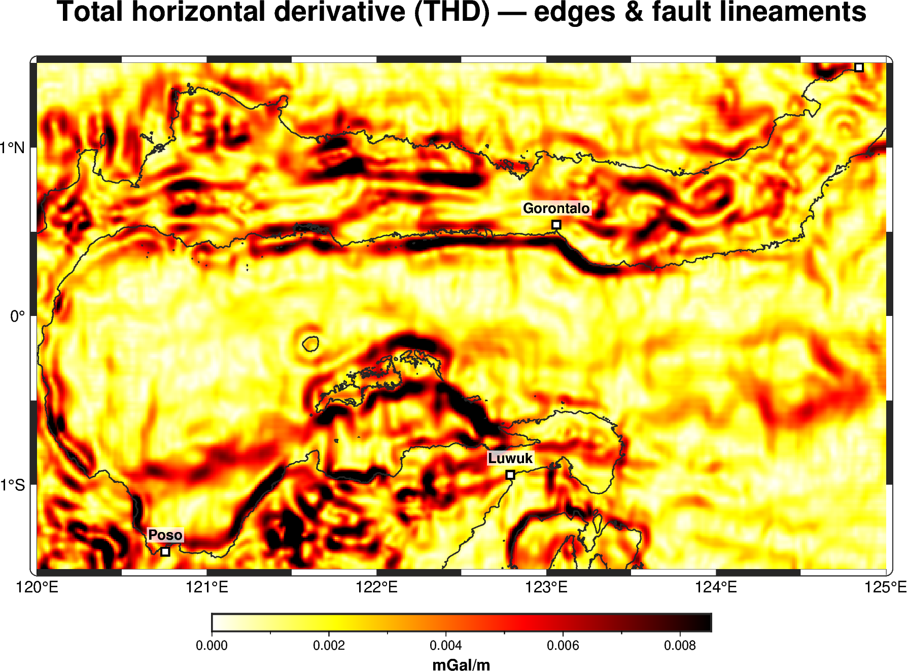
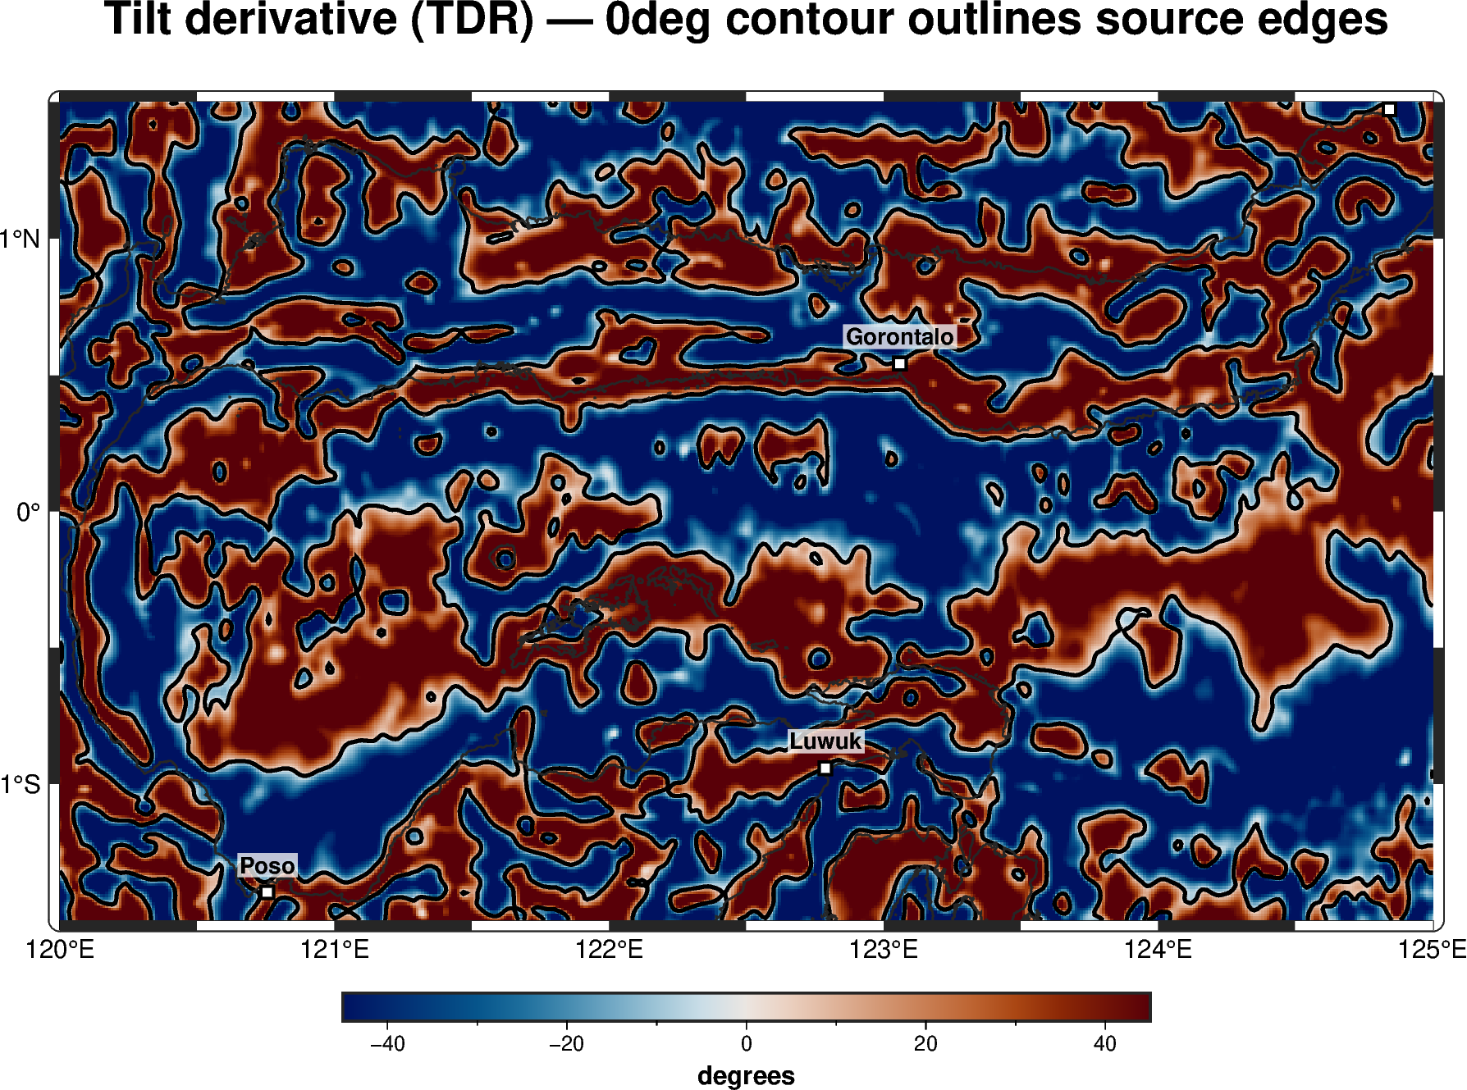
DEEP DIVE · STRUCTURE
Edge detection — the structural framework
Total horizontal derivative (edges)
Tilt derivative — 0° contour = source outline
ID THD menandai tepi/sesar; tilt derivative (kontur 0°) menggambar garis batas sumber. Bersama-sama memberi kerangka struktur & batas depocentre Tomini.
22

Slide 23
PART 4 · THE LIMIT
Potential fields are non-unique
A gravity or magnetic low can be a thin low-density layer — or a thick, slightly-less-low-density one. Infinitely many density×thickness models fit the same map.
Depth ambiguity
Spectral depth = a range
Magnetics = relief, not scale
The field fixes mass deficit, not how it splits into density and depth.
Wavelength→depth gives broad intervals, not a basement pick.
RTP shows basement shape but not absolute burial depth.
ID Gravity/magnetik itu ambigu: satu anomali cocok untuk tak-hingga kombinasi densitas×ketebalan. Butuh jangkar kedalaman independen.
23

Slide 24
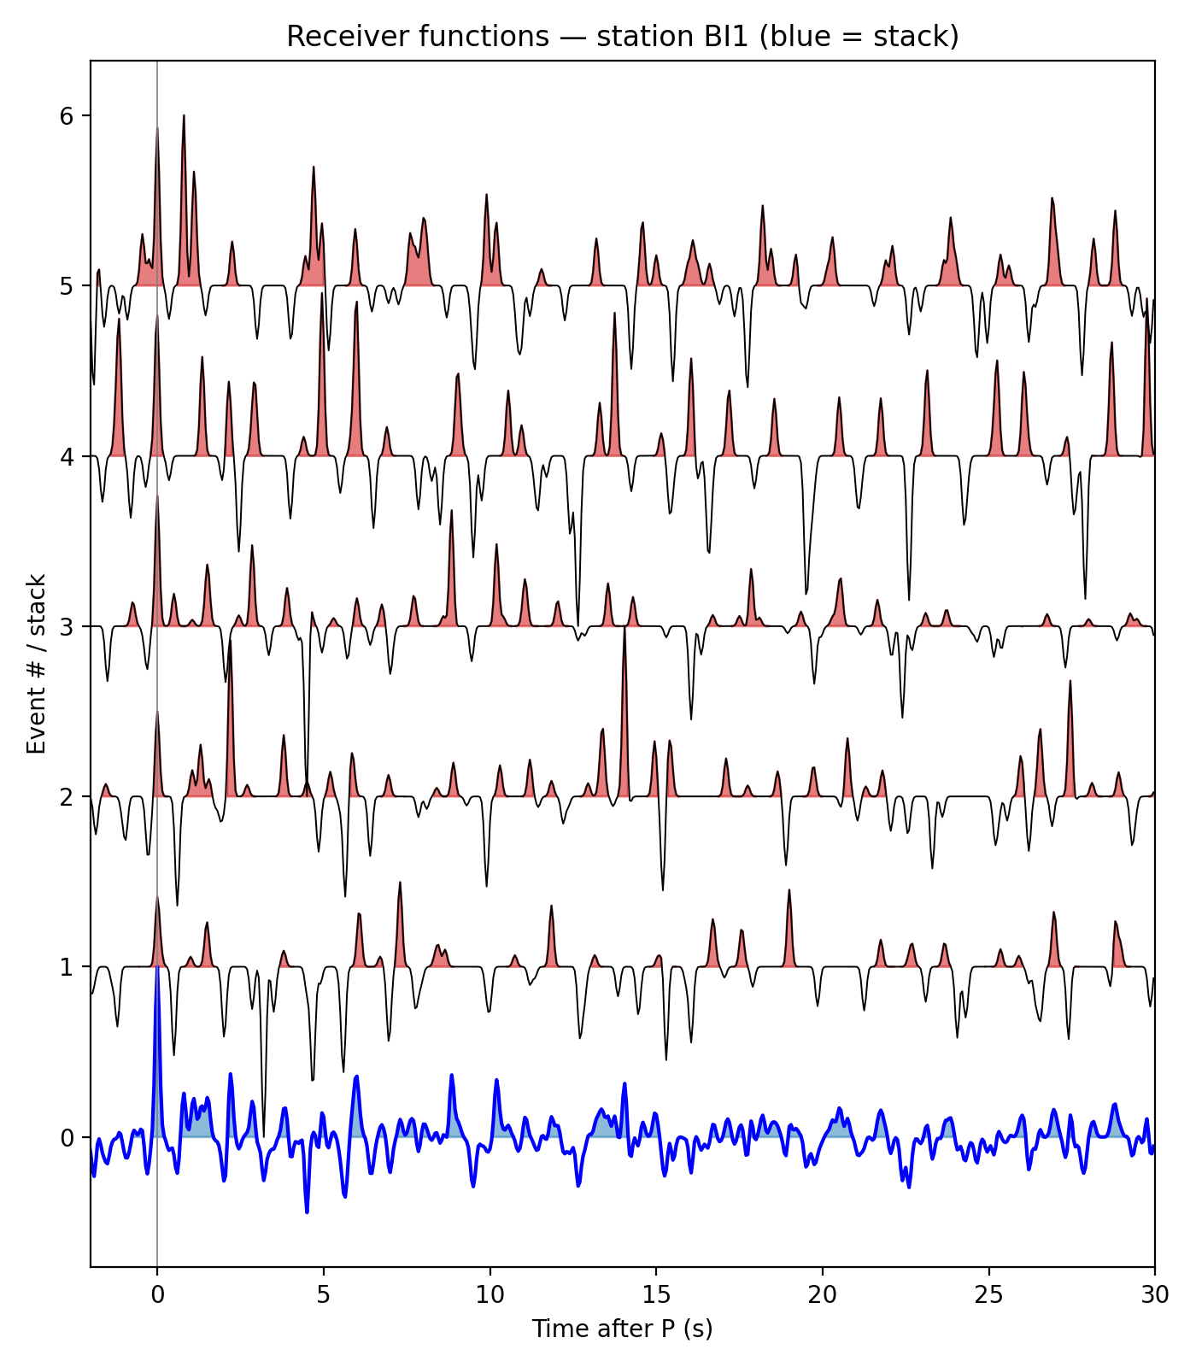
PART 5 · THE KEY
Seismology gives an independent depth anchor
Teleseismic P waves
Distant earthquakes send P energy up through the crust beneath a single station — no source, no survey needed.
Conversions carry depth
At each velocity boundary some P converts to S (Ps). The DELAY of Ps after P is a direct clock on interface depth — the anchor gravity lacks.
Receiver function, station BI1 (MERAMEX, Central Java).
ID Gempa jauh → gelombang P menembus kerak di bawah satu stasiun. Sebagian P berubah jadi S (Ps) di tiap batas; jeda Ps = kedalaman batas. Inilah jangkar yang tak dimiliki gravity.
24

Slide 25
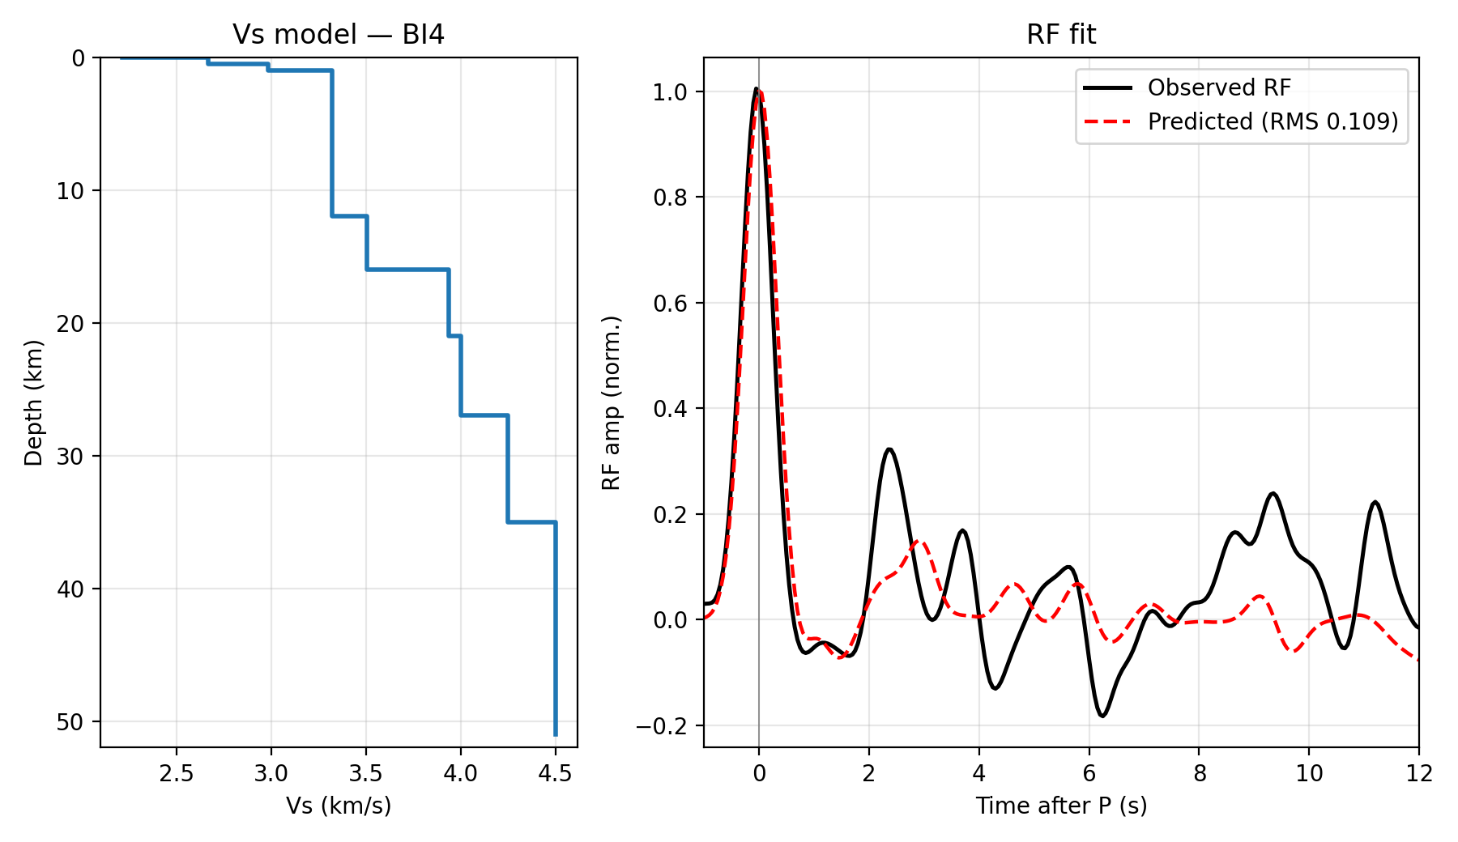
PART 5 · METHOD
Receiver functions → sediment thickness & Vs
Ps move-out → depth
Convert Ps delay + ray parameter into an ABSOLUTE sediment / basement depth per station.
Full Vs inversion
Herrmann CPS rftn96 inverts the waveform for a layered Vs(z) — physically constrained, PREM-like increase with depth.
ID Move-out Ps → kedalaman absolut sedimen/basement; inversi penuh (CPS rftn96) → profil Vs(z) berlapis yang fisis. Kalibrasi densitas untuk gravity.
25

Slide 26
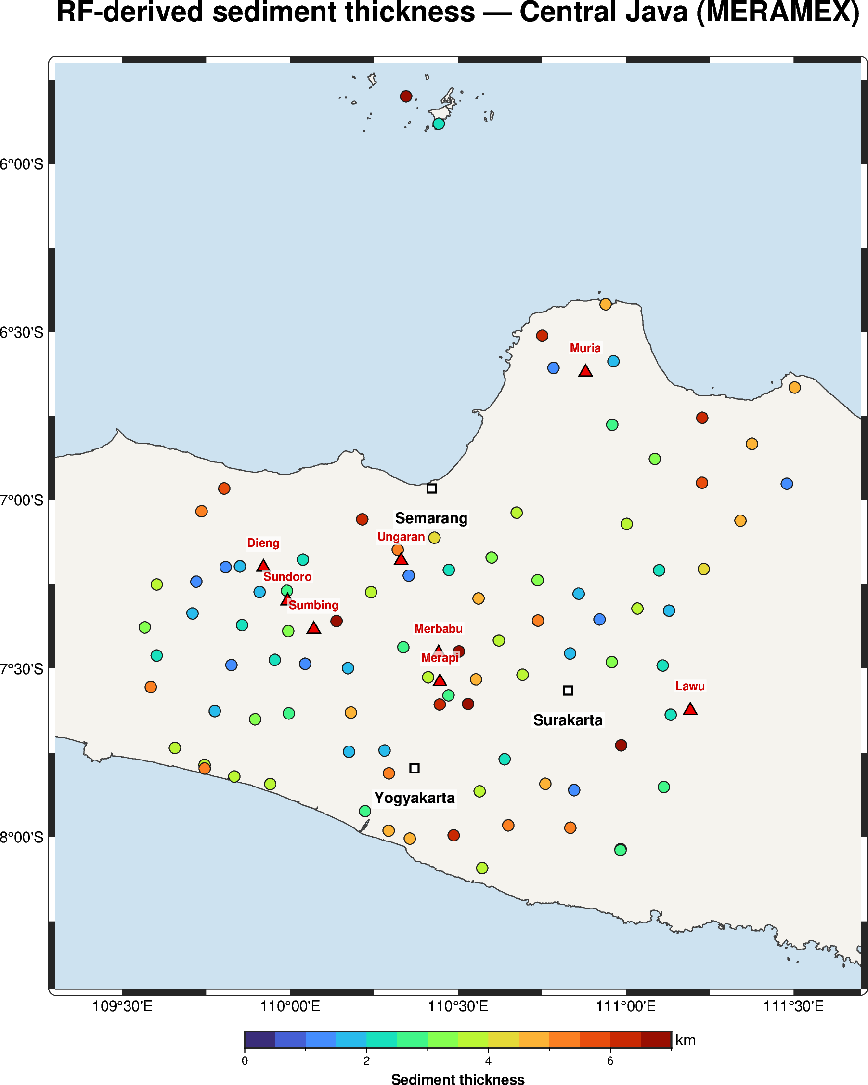
PART 5 · EVIDENCE A
Central Java — RF maps real sediment thickness
MERAMEX 2004
Dozens of temporary broadband stations across Central Java — teleseismic RF at each yields sediment thickness.
A depth grid, not a guess
Each dot is an absolute, station-based sediment estimate — the calibration gravity needs.
ID Central Java (MERAMEX 2004): receiver function tiap stasiun → ketebalan sedimen absolut. Titik-titik ini menjadi kalibrasi untuk inversi gravity.
26

Slide 27
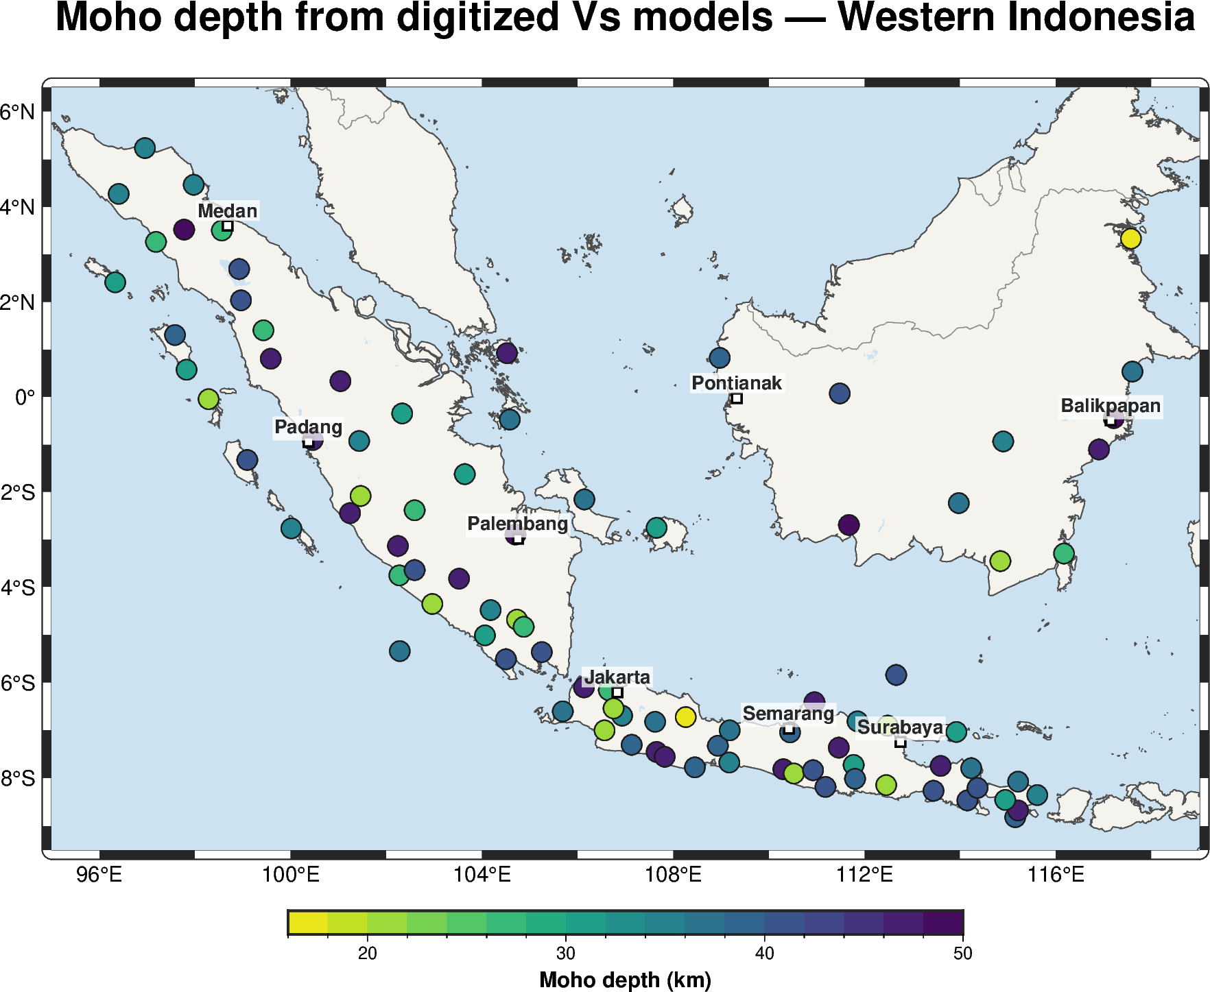
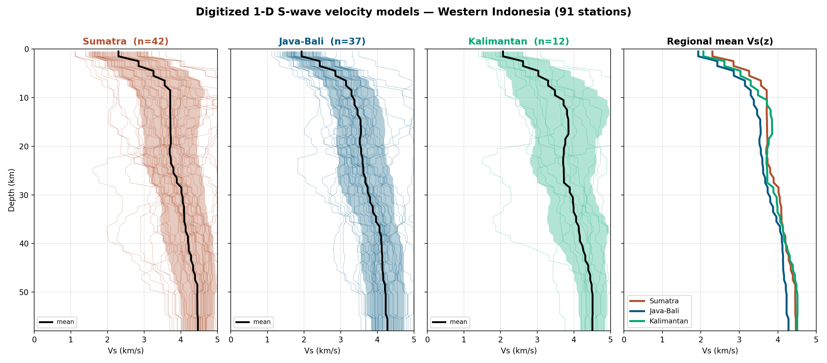
PART 5 · EVIDENCE B
Western Indonesia — 91-station Vs models
Moho depth (left) and regional Vs(z) profiles (right) — Sumatra, Java-Bali, Kalimantan.
ID 91 stasiun broadband Indonesia Barat: model Vs 1-D → kedalaman Moho & profil kecepatan per wilayah. Kerangka kecepatan regional untuk membatasi densitas & kedalaman.
27

Slide 28
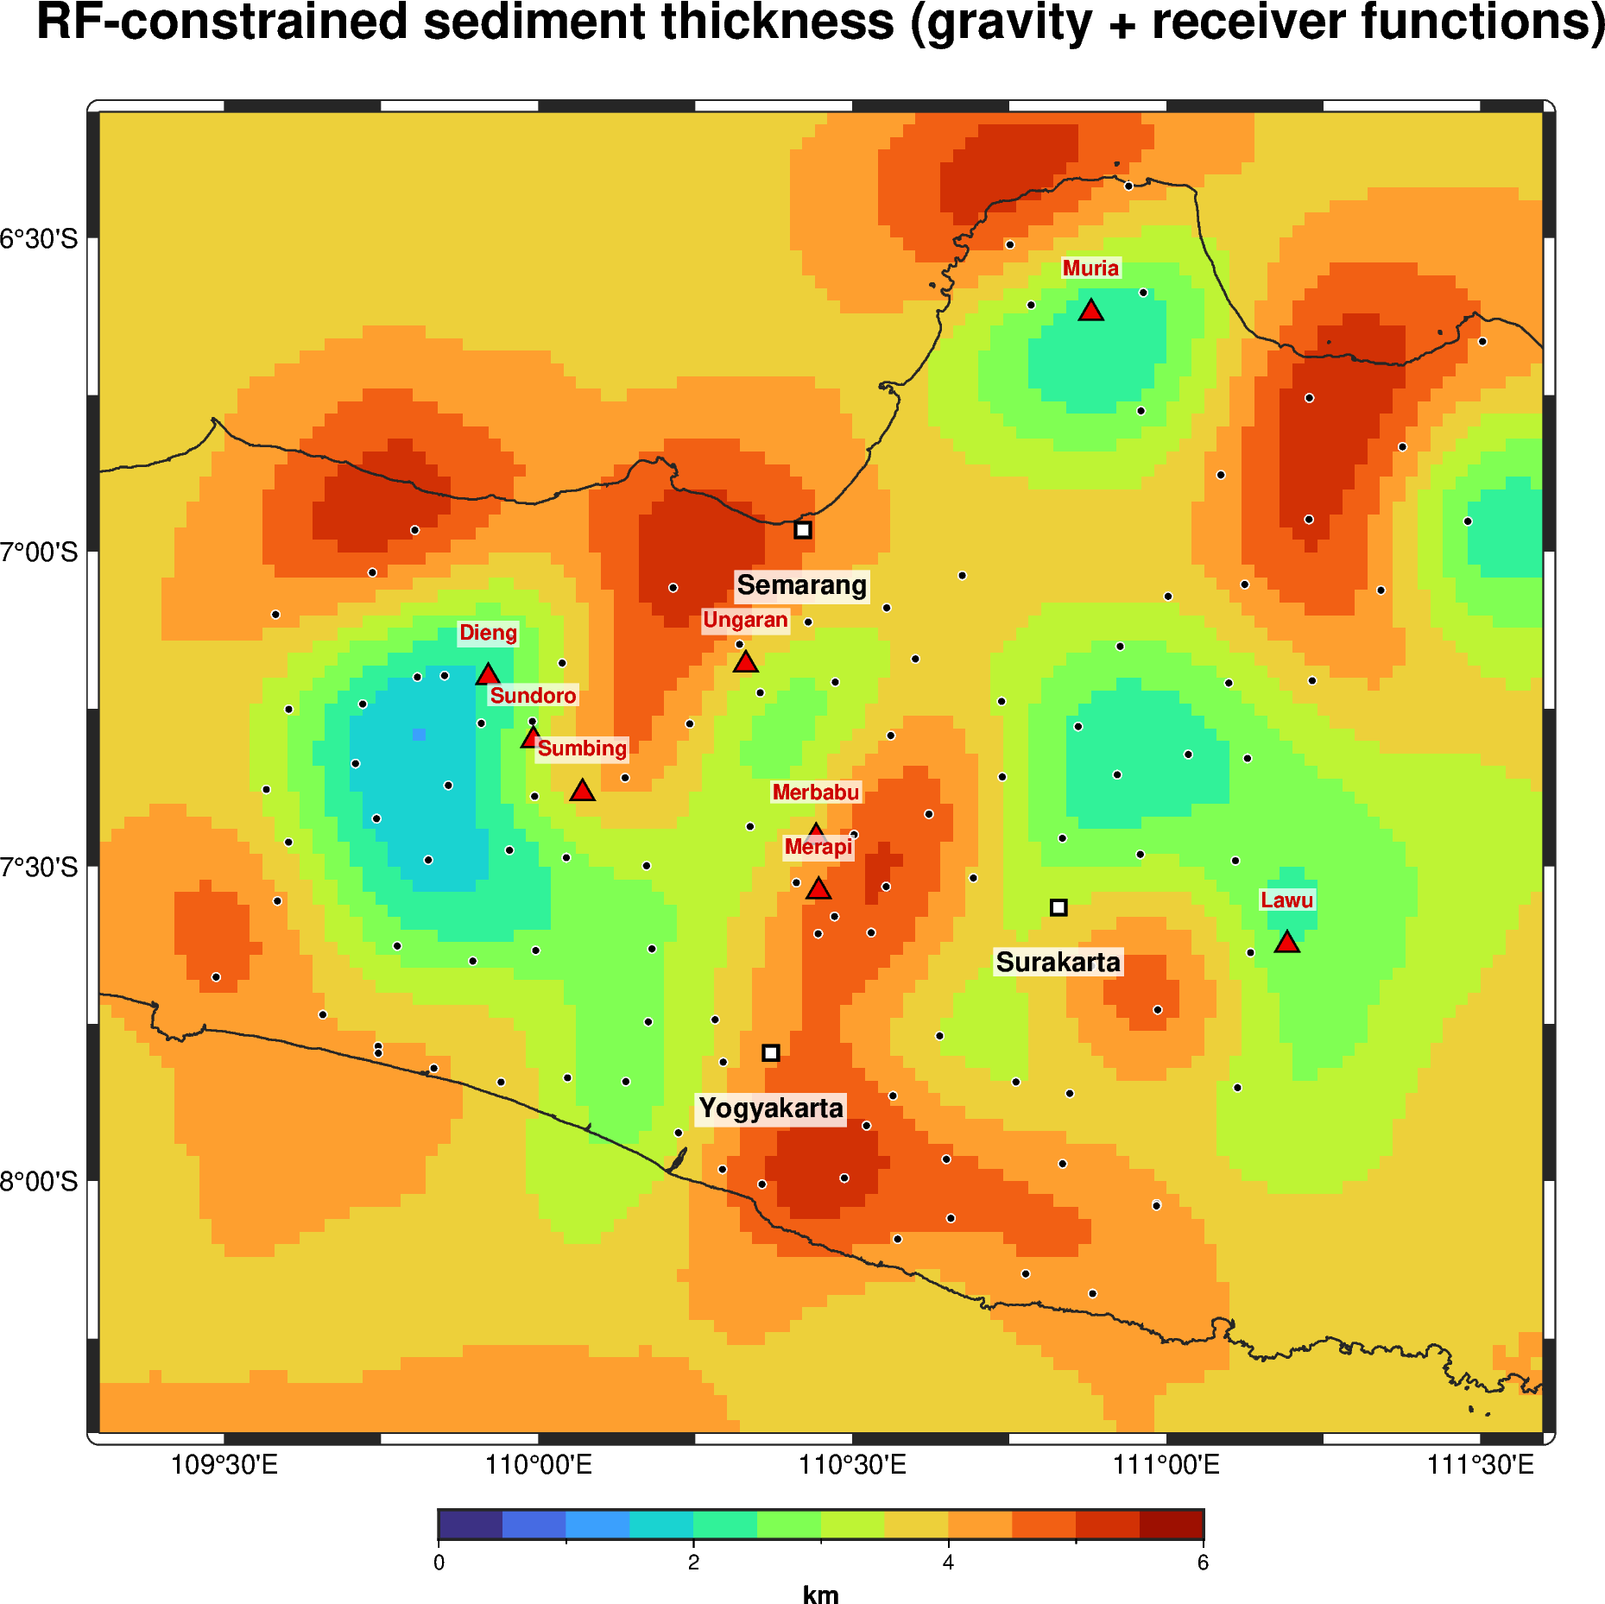
PART 5 · THE BRIDGE
RF-constrained gravity — the anchor pays off
Gravity alone drifts
Unconstrained gravity inversion trades depth against density — weak correlation with true structure.
RF locks the scale
Feeding RF depths as constraints fixes the density×depth trade — gravity now resolves basin geometry.
ID Gravity sendirian ambigu (kedalaman vs densitas). Dengan kedalaman RF sebagai constraint, skala terkunci → gravity menghasilkan geometri cekungan yang benar.
28

Slide 29
THE SYNTHESIS
Gravity + magnetics + seismology
RECONNAISSANCE
CALIBRATION
DECISION
Gravity + magnetics
Receiver functions
Joint model
WHERE the basins are: extent, depocentres, bounding faults, basement relief — over every basin, cheaply.
HOW deep they are: absolute sediment thickness & Vs at each station — the missing scale.
A DRILLABLE basin geometry: potential-field coverage locked to seismological depth. Non-uniqueness resolved.
When we add seismological constraints, gravity + magnetics become far more powerful.
29

Slide 30
PART 6 · ROADMAP
Applying the recipe to frontier basins
1 · Screen
2 · Reprocess
Rank basins by satellite gravity + magnetic RTP (done — 9 basins).
Minimum-curvature gravity + edge detection on the leads (Tomini shown).
3 · Anchor
4 · Joint invert
Occupy existing IA / GE broadband near the basin; compute receiver functions.
Gravity + magnetics constrained by RF depth & Vs → basin geometry.
Data already on the table
5 · Target
MIGAS legacy wells & 2-D seismic + permanent broadband networks — the anchor stations largely exist.
Deliver depocentre maps & prospect leads for the frontier acreage.
ID Resep: screening satelit → reprosesing → jangkar RF di stasiun broadband yang sudah ada → inversi gabungan → peta depocentre & lead. Banyak data sudah tersedia.
30

Slide 31
THANK YOU
From data scarcity to a drillable basin
Satellite gravity & magnetics screen and delineate every Indonesian frontier basin. Receiver functions supply the absolute depth that potential fields cannot. Together they are far more powerful than either alone.
Discussion / Q&A · 30 minutes
Pak Zuhdi Research Group · Gravity + Magnetics + Receiver Functions · Unlocking Under-Explored Basins in Indonesia

