Slide 1

LEAF 2026 · UNIVERSITAS INDONESIA · 8–9 JULY 2026
An Experiment in Research Management
From the Faculty Floor — Notes from FMIPA UGM
WIWIT SURYANTO
Vice Dean for Research and Community Services
Faculty of Mathematics and Natural Sciences, Universitas Gadjah Mada
Notes:
Open with warm greeting to LEAF organizers and audience. Then say the title aloud — emphasize 'experiment' and 'management'. The audience will immediately be intrigued because the combination is unusual.

Slide 2

INTRODUCTION
I do not come with a discovery from the lab.
I come with the report of an experiment —
conducted not in a laboratory,
but in the system that governs laboratories.
— Standing among esteemed colleagues at LEAF 2026
Notes:
Read slowly with genuine humility. The contrast 'not in a laboratory, but in the system that governs laboratories' is the entire conceptual hook. Pause after 'laboratories' for emphasis. This positions you not as a competitor to Nobel laureates in science, but as an experimentalist in a different domain — one they may not have considered.

Slide 3
01 · A METAPHOR
Scientists know experiments.
They happen in the lab.
But what happens
when we run an experiment
on the system itself?
LEAF 2026 · INTRODUCTION · THE PREMISE
3 / 18
Notes:
Use this as the conceptual bridge. Pause briefly before the question. Say: 'Today, I want to walk you through such an experiment — one we ran at FMIPA UGM over four years, not in a laboratory, but in the management system that shapes how science gets done.'

Slide 4
02 · THE VARIABLE
The Key Performance Indicator (KPI)
What we measure determines what we grow.
CONVENTIONAL KPI
EXPERIMENTAL KPI
Number of publications (Q1, Q2)
Number of patents registered
H-index
Citation counts
International rankings
Industry funding value
(industrial collaboration & contract value)
Product adoption
(software, hardware, systems in operational use)
Community impact
(long-term partnerships, services to society)
shift
LEAF 2026 · METHODS · THE VARIABLE
4 / 18
Notes:
This is the conceptual core of the experiment. Walk through both columns. Emphasize: 'We did not remove conventional metrics. We added a new one — and we made it the primary one for the Vice Dean role. Everything else was left to flow naturally.'

Slide 5

03 · THE HYPOTHESIS
What we expected to observe
HYPOTHESIS · H₁
IF the primary research KPI is shifted from publication metrics (count, citation, H-index) to industry funding + product adoption + community impact,
THEN we expect the following observable changes:
· researcher behavior shifts toward industry-relevant questions
· collaboration structures expand across academia–industry boundaries
· resource flows multiply through new funding channels
· scientific quality is preserved — and possibly strengthened
LEAF 2026 · METHODS · THE HYPOTHESIS
5 / 18
Notes:
Pause on the final predicted clause. Say: 'The most important part is the last line. If scientific quality degrades, the experiment fails. We must preserve — or strengthen — the science itself. Let me now show you what happened.'

Slide 6




04 · THE SYSTEM UNDER STUDY
Four stakeholders, four different KPIs
SCIENTIST
UNIVERSITY
The Researcher
The Institution
Measured by publications, citations, H-index. Career advancement tied to scholarly output.
Measured by rankings, accreditation, student numbers. Operations sustained largely by tuition (UKT).
RESEARCH AGENCY
INDUSTRY
The National Body
The Implementer
Measured by grants disbursed, projects funded, publications attributed to national funding.
Measured by revenue, market share, operational efficiency. Engages academia transactionally, project-by-project.
LEAF 2026 · METHODS · THE SYSTEM
6 / 18
Notes:
Walk through each stakeholder briefly. Emphasize: 'In the conventional system, these four actors are measured on different KPIs and rewarded for different things. They rarely speak the same language. The experiment asks: what happens if even ONE of them — in this case, the university — adopts a different KPI?'

Slide 7
05 · THE SETUP
Methodology
UNIT
FMIPA Universitas Gadjah Mada — one faculty
PERIOD
2022 → 2026 (four-year observation)
INTERVENTION
Vice Dean's primary KPI redefined from publication output to industry funding + product adoption + community impact
MEASURED
Industrial collaboration value, project count, product deployments, publication output (control)
CONTROL
Publication output — must not degrade
One faculty as the experimental site. Four years as the observation window.
Notes:
Walk through this like a methods section of a paper. Emphasize: 'The intervention is simple. The Vice Dean's KPI was redefined. Everything else — incentive structures, partnership policies, downstreaming pipelines — followed from that one change.' This makes the experiment crisp and reproducible in concept.

Slide 8
06 · RESULTS · PRIMARY OBSERVATION
Industrial engagement after four years
Observation period: 2022–2026 · Unit: FMIPA UGM
82
184
30+
Rp · Billion
Industrial collaboration
Total contract value
Projects per year
partnership projects
≈ USD 11.2 million
in 2024–2025
Trajectory: 9 (2022) → 12 (2023) → 30 (2024) → 26 (2025) → growing
LEAF 2026 · RESULTS · PRIMARY OBSERVATION
8 / 18
Notes:
Present the numbers as observation, not boast: 'These are the observed outcomes. Not a forecast, not a projection — a count, project by project, over four years.'

Slide 9
07 · RESULTS · SINGLE-FIELD VALIDATION
What one field generated in one year
Rp 75 Billion
from geophysics alone, in 2025
Single-field, single-year observation.
Validates that the scale is achievable, not exceptional.
Notes:
Let the number land. Then say: 'This single-field validation matters because it answers a question we always face: was the overall number just a one-off, or is the scale achievable? Eighty-nine billion from one field, in one year, suggests the latter.'

Slide 10






08 · MATERIAL OUTPUTS
Products generated by the experiment
Each began as a publication. Each became a tool industry actually uses.
SpectraGAMA v4.0
PertaGAMANT v3.0
Tarsius
Cloud-based passive seismic processing — adopted by Pertamina
Ambient noise tomography software — industry-deployed
Earthquake monitoring system — used by BMKG
Geophysical UAV
Ocean Bottom Seismometer
MinerbaOne
Airborne magnetic survey for geothermal exploration
Shallow-water acquisition prototype
Integrated digital system for ESDM Mineral & Coal
LEAF 2026 · RESULTS · MATERIAL OUTPUTS
10 / 18
Notes:
Wave at the grid: 'These are the material outputs of the experiment. Six tangible products — software, hardware, digital systems. Each walked the same path: publication → IP → prototype → pilot → adoption. The path is reproducible.'

Slide 11
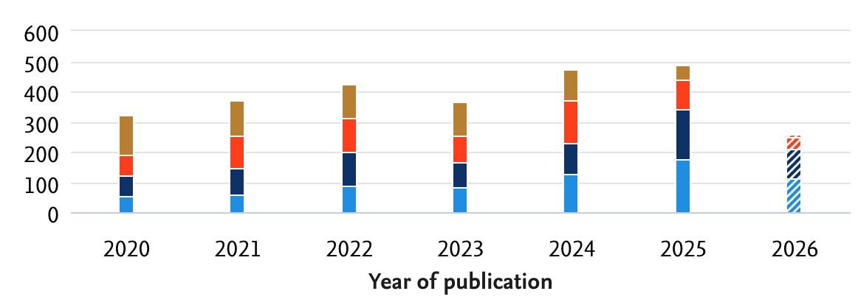

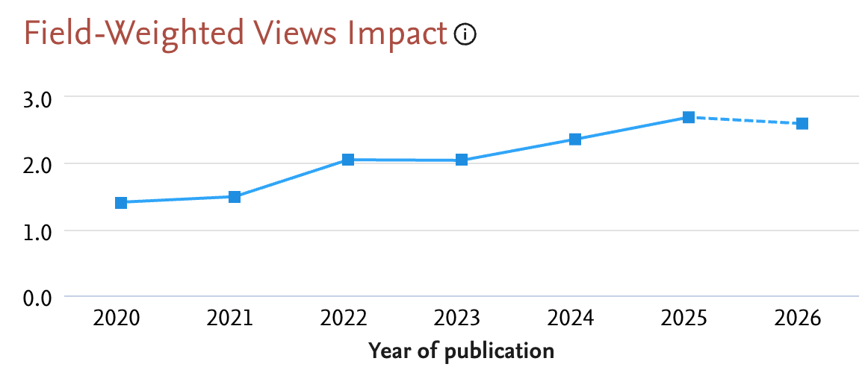
09 · THE CRITICAL CONTROL
Did publication output decline?
HYPOTHESIS · CONFIRMED
Publication output did not decline.
In fact, researchers most active in industry partnerships publish more.
Industry questions opened new research questions. The two loops reinforce each other.
Source: Scival FMIPA
LEAF 2026 · RESULTS · THE CRITICAL CONTROL
11 / 18
Notes:
This is THE most important slide of the talk. Slow down. Say: 'The critical control variable in this experiment was publication output. If it had declined, the experiment would have failed — we would have traded science for commerce. But the data shows the opposite. The hypothesis is confirmed.' Make eye contact with the academic audience as you say this.

Slide 12
10 · A PARALLEL SUB-EXPERIMENT
Do long partnerships compound?
Case: UGM–MFRI–JICA volcanic-disaster mitigation partnership, 2014 → present
2014
2017
2017–20
2022–24
2025
2025+
UGM–MFRI MoU
at Cities on
Volcanoes Conf.
Trilateral PDM
signed at
FMIPA UGM
Phase I — Mt. Merapi
monitoring system
(JPY 56 million)
Phase II — Disaster-
resilient communities
(JPY 45 million)
Phase III —
Schoolchildren in
Dukun, Magelang
Expansion to
Mount Agung,
Bali
LEAF 2026 · RESULTS · SUB-EXPERIMENT
12 / 18
Notes:
Brief sub-experiment context. Say: 'In parallel with the main experiment, we ran a sub-experiment on partnership duration. The data is clear — multi-year trust compounds. A decade of partnership with one Japanese institute produced more depth than ten separate one-year projects ever could.'

Slide 13
11 · DISCUSSION · FOUR IMPLICATIONS
One experiment, four messages
FOR THE SCIENTIST
FOR THE UNIVERSITY
The KPI you pursue shapes the research you do. This experiment shows KPIs are not given — they can be chosen.
A faculty can fund part of itself from research. Implications for the budget you have been treating as fixed.
FOR THE RESEARCH AGENCY
FOR INDUSTRY
One experimental KPI moved one faculty. What would happen if it became national policy?
Academia responds when given the right signal. The signal you send shapes the answers you receive.
LEAF 2026 · DISCUSSION · FOUR IMPLICATIONS
13 / 18
Notes:
This is the heart of the discussion. Read each message slowly, ideally making eye contact with people in those roles if you can identify them. The phrase 'the KPI you pursue shapes the research you do' is worth pausing on — it's the takeaway every scientist should leave with.

Slide 14
12 · DISCUSSION · THE BIGGER EXPERIMENT
If one faculty's experiment scales…
FMIPA UGM is one faculty in one university.
4,000+
300,000+
100+
Higher education
Lecturers
Research centers
institutions in Indonesia
in tertiary education
under BRIN & ministries
If even ten percent adopted the experimental KPI — what would change?
Notes:
Stretch the imagination. Say: 'FMIPA's experiment was small — one faculty, four years. But Indonesia has thousands of higher education institutions and hundreds of thousands of lecturers. The bigger experiment hasn't been run. Yet.'

Slide 15
13 · LIMITATIONS · WHAT THIS TALK IS NOT
Honesty about what one experiment can — and cannot — show
WHAT THIS IS NOT
WHAT THIS IS
Not a critique of conventional metrics — they still matter
Not a prescription for all faculties — context matters greatly
Not a denial of basic science — it remains essential
Not a proof — one faculty cannot prove anything alone
A report of one experiment in research management
One finding: a different KPI yields different research
One observation: it need not cost scientific quality
One suggestion: a direction worth investigating further
LEAF 2026 · DISCUSSION · LIMITATIONS
15 / 18
Notes:
This slide reinforces the experimental framing — every good experiment has limitations. By being explicit about them, you appear more rigorous, not less. Read each item slowly. The phrase 'modesty in claims, confidence in the question' should land at the very end.

Slide 16
14 · AN INVITATION
I came to LEAF not to declare a result.
I came to invite collaboration on the bigger experiment.
If anyone here — scientist, university leader, research agency, industry partner — wishes to think through how this might run in your own domain,
I will be here for the next two days.
LEAF 2026 · INVITATION
16 / 18
Notes:
Sincere invitation. Look around the room. Say: 'I will be in this hall. I will be at the coffee breaks. I will be at the dinner. If any of you carries a question, a challenge, an idea about how this experiment could be extended — please find me.' Make it real, not ceremonial.

Slide 17
15 · A CLOSING REFLECTION
Sometimes the most important experiments
are not the ones we run in the lab.
They are the ones we run on the system that governs the labs.
Thank you — and let us begin.
Notes:
Read slowly. This is the closing meditation. Let it land. Then move to the final thank you slide.

Slide 18
Terima kasih
Thank you
ありがとうございました
Dr.rer.nat. Wiwit Suryanto, M.Si.
Vice Dean for Research and Community Services · FMIPA Universitas Gadjah Mada
ws@ugm.ac.id · github.com/maswiet
Open to collaboration on the bigger experiment.
Notes:
Final slide stays up during Q&A. Stand to the side so people can read the contact details and reach out afterwards.

