Slide 1




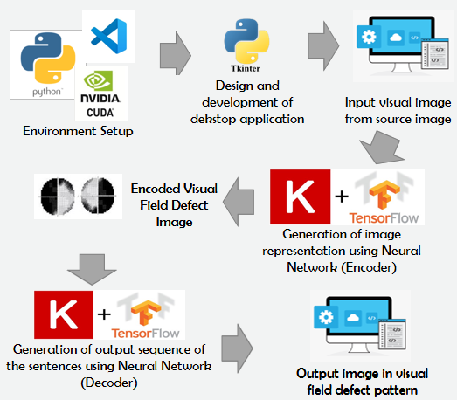
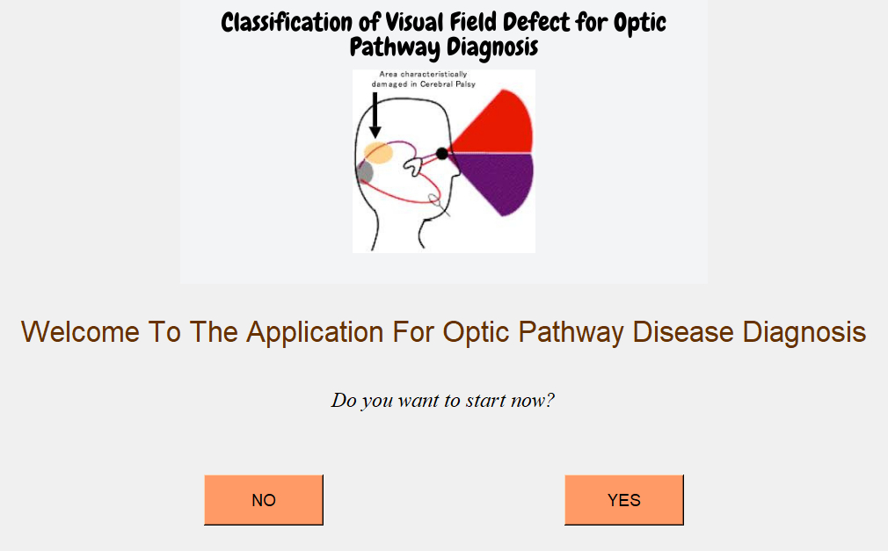
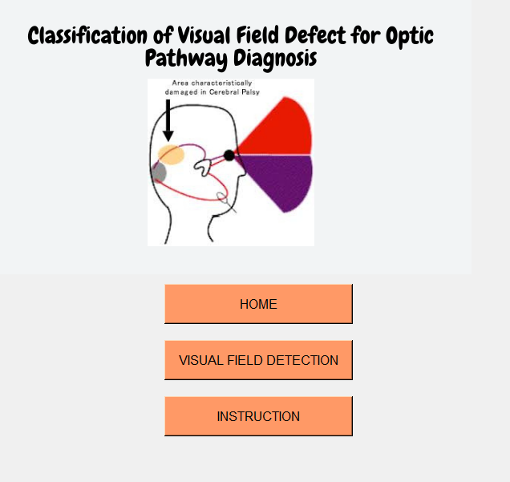
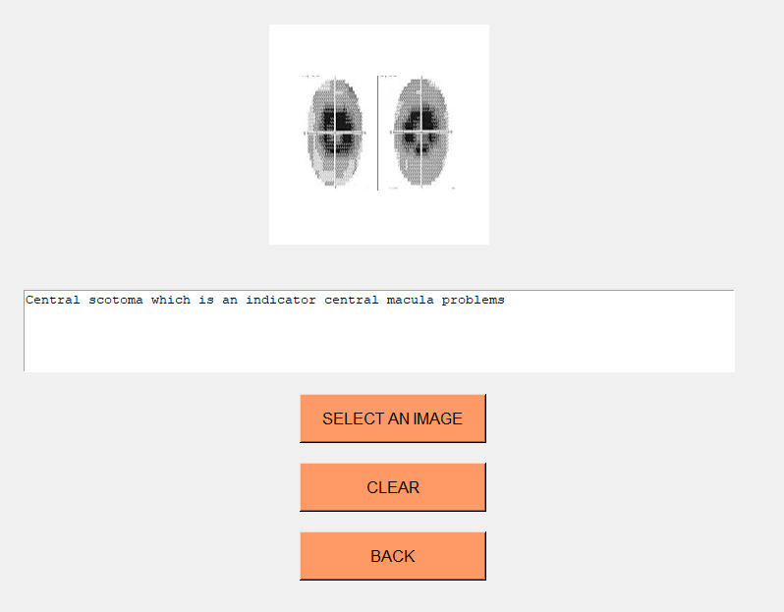


Desktop-Based Ddetection System of Visual Field Defect for Optic Pathway
Diagnosis using Deep Leaning
MASYITAH ABU, NIK ADILAH HANIN ZAHRI, AMIZA AMIR, MUHAMMAD IZHAM ISMAIL
NOVELTY & INVENTIVENESS
PRODUCT OVERVIEW
To design and develop a Web-based application of Visual Field Defect Detection for optic pathway disease diagnostics using deep learning; a sophisticated and evolved neural networks composed by multi-layered models that capable of self-learning the detection task by learning from examples (training data) without explicitly programmed for the task and without any human intervention.
6
1
PROBLEM STATEMENT
The examination of VF requires experience and skills of and expert.
The examination of VF requires huge amount of time to detect type of disease. Compare to using CNN only require couple of time to detect disease
DATA / RESULT & DISCUSSION
Visual Field Defect | Accuracy (%)
central scotoma | 91
right/left/upper/lower quadratopia | 98
right/left hemianopia | 98
vision turnel | 100
superior/inferior field defect | 92
Normal | 97
Average Accuracy | 96
PRODUCT DESCRIPTION
Home page
display the introduction
of the application
Menu page
set menu to enter
other page
ADVANTAGES
The development of deep learning technique for image detection is fast and subjected to the amount of training data and computer power used. It performed as good visual field defect detection systems.
Decrease time and work load in medical field to detect defect from visual field images.
No human expert required.
Works for almost any kind of sequence-to-sequence problem
Detection system page
detect the visual field defect image based on the image choose
COMMERCIALIZATION
Instruction page
Help user how to used this application
A Desktop-based application of Visual FIeld Defect Detection, which will provide accurate, effective and efficient mechanism to aid ophthalmologists to diagnose and prioritize based on the severity of the patient's conditions when dealing with currently rapid growing medical data, while maintain the quality of patient healthcare.

