Slide 1
VOICE-BASED MALAY COMMAND RECOGNITION FOR ELECTRICAL APPLIANCES
Masyitah binti Abu (BK13110203)
Electronic Engineering (Computer)
Faculty of Engineering
Universiti Malaysia Sabah

Slide 2
Introduction

Slide 3
Introduction of Voice-Based Malay Command Recognition for Electrical Appliance
What?
Using voice to control electrical appliance
Malay command is used to activate the electrical appliances

Slide 4
Problem Statement
Limited standard Malay for voice-based command recognition vocabulary
Disturbing of other noises
There will be possible that the command given have similar words regarding their feature

Slide 5
Project Objective
To study the performance of Voice-based command recognition in malay version for electrical appliances in the living room.

Slide 6
How to achieve project objective
How?
To create Malay command databased for electrical appliances in the living room.
To extract data using Mel Frequency Cepstrum Coefficient
To recognize the command using Neural Network Method.

Slide 7
Scope of Work
Device | Environment | Volunteer
Fan | Noisy | Multiple races in FKJ.
Light | Normal | The age range are between 20 to 30 years old
Notes:
Normal environment = sound in normal room
eg: aircond
Noisy environment = background music
Why student?
Can be find in FKJ

Slide 8
Pre-prosessing Command Signal and Feature Extraction

Slide 9
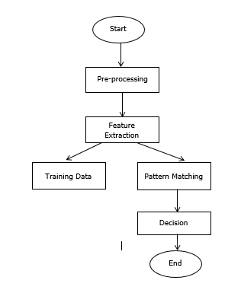
Flowchart of Speech Recognition
Notes:
-preprocessing is a step to record the speaker voices(the speaker voice will be record 3 time)
-feature extraction is a step to extract the speaker voice into signal
-from 3 signal 1 signal will be training data and pattern matching is done to all data.

Slide 10
Malay Command Data Based
Device | Malay Command
Fan | Buka kipas Tutup kipas
Light | Buka lampu Tutup lampu

Slide 11
Distance between Speaker and Device
The distance between speaker and device is 0.5 m
Mobile phone is used to record speaker voice
The sample rate is set 8000 Hz and the device channel is mono.
Notes:
Why 8000Hz?
So all speech have same size and rate
Decrease the size of speech data

Slide 12
Samples recorded
The sample recorded is 720 samples.
120 samples is used as training data.
Each command has 180 samples.
The command are recorded in two environment, each environment has 90 samples.

Slide 13
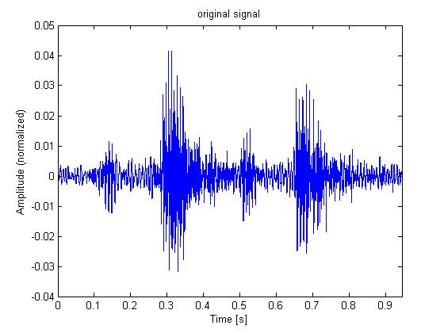
Command signal for ‘Buka Kipas’ normal environment

Slide 14
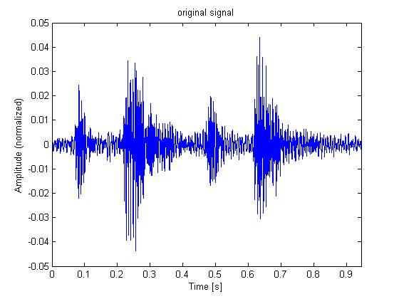
Command signal for ‘Tutup Kipas’ normal environment

Slide 15
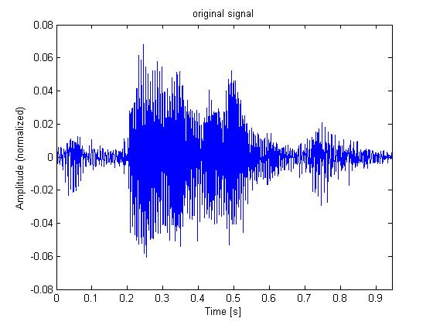
Command signal for ‘Buka Lampu’ normal environment

Slide 16
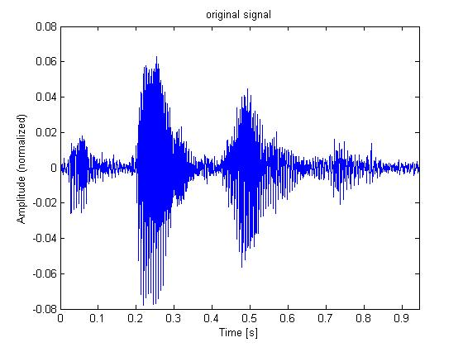
Command signal for ‘Tutup Lampu’ normal environment

Slide 17
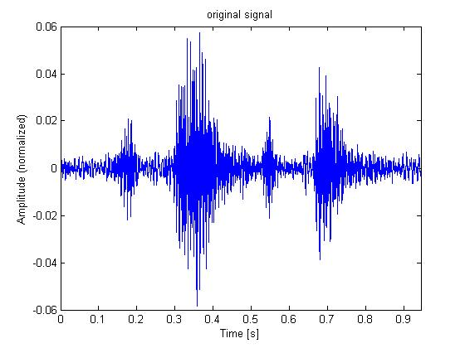
Command signal for ‘Buka Kipas’ noisy environment

Slide 18
The differences of each command can be seen by:
Each phenome has different amplitude and time range
For noisy environment the amplitude of each command will increase.

Slide 19
Pre-processing
Start
Normalization time domain
Pre-emphasis
high/low pass filtering
End

Slide 20
Normalization time domain
First, endpoint and frame shifting is used to normalize the command signal but both method gives different time domain.
Lastly, the command signal is cropped manually using audacity.
Normalization is done because neural network can only read same size data.

Slide 21
Pre-emphasis
To improve high frequency segment in the command pre-emphasis filter is used to balance the decreasing in spectrum analysis.
Notes:
Decreasing in spectrum analysis?
It mean the frequency
Other name of spectrum analysis is signal analysis

Slide 22
High/Low pass filtering
5 filters had been tested to filter noise in command signal.
Low pass filter, high pass filter, low pass IIR, low pass FIR and bandstop IIR.
From this 5 filters, low pass filter is the most suitable filter to filter noise.

Slide 23
Feature Extraction
Start
Frame Blocking
Hamming windowing
Fast Fourier Transform
Band pass filtering
Discrete Cosine Transform
End

Slide 24
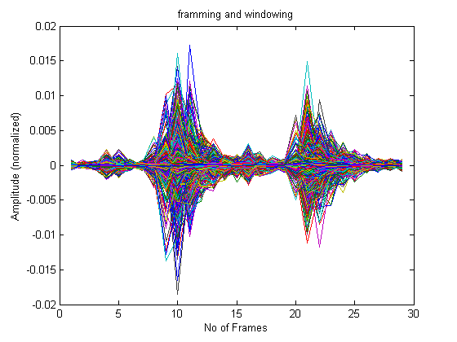
Frame blocking and hamming windowing
Block framing crop the command signal to remove silence or acoustic interference at the beginning or end of the input command signal.
Hamming window is applied to each frame to minimize the discontinuities of the signal by tapering the beginning and end of each frame to zero
Notes:
Discontinuities of signal?
Phase mismatch

Slide 25
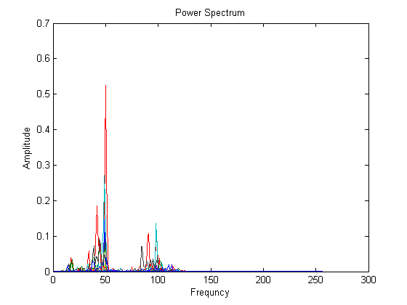
Fast Fourier Transform
Fast Fourier Transform (FFT) change the command signal into power spectrum.
FFT is used for increase efficiency due to rapid transformation ability.

Slide 26
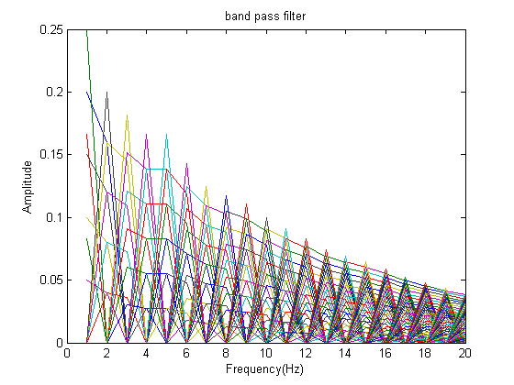
Band pass filtering
20 number of channel is applied instead of 40 because the command signal already filter in pre-processing stage.
band pass filter is also normalize to make sure all the command signal have the same size.

Slide 27
Discrete Cosine Transform
The Mel spectrum coefficient is in real number so the command signal is converted to time domain again using the discrete cosine transform (DCT).

Slide 28
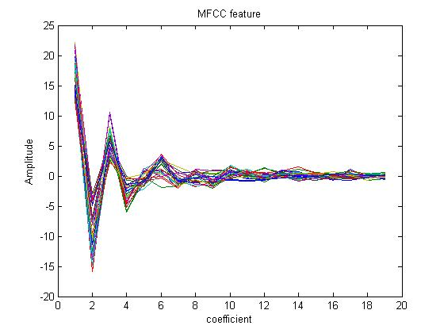
MFCC feature for ‘Buka Kipas’

Slide 29
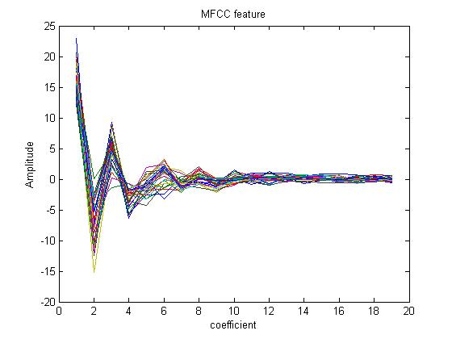
MFCC feature for ‘Tutup Kipas’

Slide 30
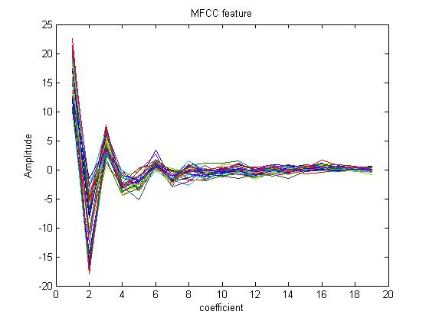
MFCC feature for ‘Buka Lampu’

Slide 31
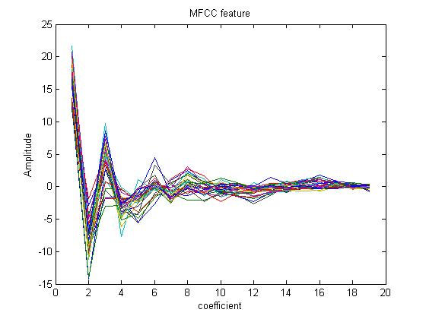
MFCC feature for ‘Tutup Lampu’

Slide 32
The differences between the MFCC can be seen by:
The shape of the MFCC at certain coefficient.
Peak produce by the MFCC feature.

Slide 33
Recognition using Neural Network

Slide 34
Target data
Malay Command | Target Value
Buka Kipas | 1000
Tutup Kipas | 0100
Buka Lampu | 0010
Tutup Lampu | 0001

Slide 35
Training data
The data of each sample is 19 x 29 feature.
The feature will be change into an array and arrange in column using MATLAB.
Each Malay command had 30 samples.
After the sample is arrange a 551 x 120 dataset is produce.
The training data will be divide for training, validation and testing. The division used are 75% samples for training, 10% samples for validation and 15% samples for testing.

Slide 36
Hidden layer
Hidden Layers | Accuracy (%)
10 | 87.5
15 | 93.3
20 | 94.2
25 | 95.8
30 | 92.5
35 | 90.8
40 | 91.7
45 | 94.2
50 | 91.7
55 | 96.7
60 | 90.0
65 | 94.2
70 | 94.2
75 | 90.0
80 | 91.7
85 | 94.2
90 | 98.3
The number of hidden layer should be between the size of input layer and the size of output layer.
18 of hidden layer neural network is test to see the highest accuracy start from 10 to 90 layers in multiples of five.
90 hidden layers is choose because it has the highest accuracy compare to others.

Slide 37
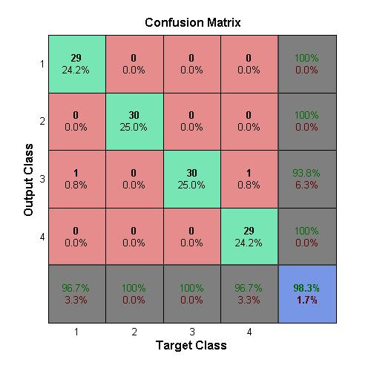
Neural Network accuracy

Slide 38
Performance

Slide 39
normal environment :
It performance is above 80%.
It cannot achieve above 90% because:
The command choose is not suitable for this system.
Health condition of the speakers
speaker slang especially Sabah, Kelantan and Kedah may affect the command signal.
Slang for difference races for example Chinese and Indian also can be the factor of signal change.

Slide 40
noisy environment:
The performance for ‘Buka Kipas’ is 60%, ‘Tutup Kipas’ is 51%, ‘Buka Lampu’ is 43% and ‘Tutup lampu’ is 20%.
It is because:
There are noises that disturbing the command signal.
To used this application any background noise should be close or volume should be slow.

Slide 41
Conclusion
In conclusion, the important step in voice-based Malay command recognition are speech pre-processing, feature extraction and recognize command. These three method affect the accuracy of the command recognition performance.

Slide 42
Future Work
Use other type of recognition method instead of Neural Network to improve the performance of voice-based Malay command recognition method.
The distance between speaker and the system should be test instead of fixed the distance.
Voice-based Malay command recognition in a living room can be develop in real time.

Slide 43
Sustainability
System function for along time.
The system produced executes efficiently.

Slide 44
THANK YOU

Slide 45
Q & A

Slide 46
Literature Review

Slide 47
Voice Signal Acquisition and Extraction
Author | Year | Devices
Norhafizah Aripin &Othman | 2014 | Mobile device. Distances up to 20 meters.
Abhay | 2015 | Directional Carbon Microphone. Can reduce the environmental noise.

Slide 48
Voice Signal Acquisition and Extraction
Author | Year | Classification of speech
Shikha et al. | 2014 | isolated word | connected word | continuous speech | spontaneous speech
 |  | Have sample windows that accepts single utterances at a time. | Similar to isolated word. Allow separate utterance to be run together. | Allows the speaker to speak almost naturally. | Can handle a variety of natural speech feature. eg: word being run together

Slide 49
Voice Signal Acquisition and Extraction
Author | Year | speech Analysis
Shikha et al. | 2014 | segmentation analysis | sub segmental analysis | supra segmental analysis
 |  | Analyzed using frame size and shift in the range of 10-30 ms. Used to extract vocal tract information of speaker recognition | Analyzed using frame size and shift in the range of 3-5 ms. Used to analyze and extract the characteristic of the excitation state | Using frame size. Used to analyzed and characteristic the behavior character of the speaker
Aman et al. | 2016
Om &Navneet | 2013

Slide 50
Voice Signal Acquisition and Extraction
Author | Year | Pre-processing
Wenhao et al | 2010 | includes voice signal sampling anti-aliasing band pass filtration removing individual differences in pronunciation and noise caused by environment in it pre-processing process endpoint detection and element selection of speech recognition will be involved
Jun T. & Xiaoxiao J | 2011 | send the recorded voice toward voice activation detection to detect the strat point of people speech and eliminate the useless noise and signal pre-empt will be done by improving the high frequency segment to balance the decreasing in the spectrum analysing low-pass and high-pass filtering, low-pass and high-pass filtering is to filtering the high and low frequency noise

Slide 51
Recognition Method(HMM)
Author | Year | Advantages Hidden Markov Method
Jianliang M. et al. | 2012 | More complete expression of acoustic model of the voice are suitable to use HMM.
Urmila &Anjali | 2013 | Highly reliable way of recognizing speech for a wide variety of applications as a stochastic modeling tool since HMM integrates well into systems incorporating information about both acoustics and syntax.
Anand et al. | 2014 | HMM model have develop considerably and it also can provide high recognition accuracy.

Slide 52
Recognition Method(ANN)
Author | Year | Artificial Neural Network
 |  | Advantages | Disadvantages
Jianliang M. et al. | 2012 | This method is applied to solve the pattern classification problems.
Urmila &Anjali | 2013 | Artificial Neural Networks (ANN) or Neural networks often used as a powerful discriminating classifier for tasks in automatic speech recognition. Have several advantages over parametric classifiers. | disadvantages in terms of amount of training data required, and length of training time The length of time required to train the networks can present problems, particularly when investigating a variety of feature sets to represent speech data.
Notes:
parametric classifier
- model of data with a categorical responce call classifier.
- classifier is build from training data.

Slide 53
Performance Criteria
Author | Year | Environment Recognition Rate
Parichart et al. | 2010 | quiet room = 98.2% office room = 93.0% noisy room = 44.2%
Rawan et al. | 2012 | quiet background = 75.7% medium noise level = 63.8% noisiest environment = 49.2%,

Slide 54
Performance Criteria
Author | Year | Feature extraction Accuracy
Yoghesh & Mukta | 2015 | MFCC | LPC |  | PLP
 |  | 1st signal = 51.25% 2nd signal = 86.67% 3rd signal = 96.5% | 1st signal = 37.5% 2nd signal = 80.5% 3rd signal = 77.4% |  | 1st signal = 93.6% 2nd signal = 76.6% 3rd signal = 90.4%
Poonam &Anjali | 2016 | MFCC |  | PLP
 |  | 78% |  | 60%

Slide 55
Performance Criteria
Author | Year | Method Accuracy
Poonam &Anjali | 2016 | Neural Network had three technique: feed back = 79% perception neural network = 73% linear neural network = 69%
Pialy et al. | 2014 | ANN is used for speaker recognition, the recognition rate is very close to 83%.
Jun T. &Xiaoxiao J. | 2011 | HMM the recognition rate: 75% for the noisy environment. Female tester has 100% recognition rate in normal environment.

Slide 56
Critical Analysis
Device | mobile phone distances up to 20 meters
Classification of speech | continuose speech Allows the speaker to speak almost naturally.
Feature Extraction | MFCC Has high accuracy compare to other feature extraction
Recognition Method | ANN Can handle bigger data set.
Notes:
from the reseach that I had been done,
mobile device because I can record voice in far distance
classification of speech..cause we will give command natural in our house
HMM
(acoustic model is to represent the relationship between an audio signal and phonemes or other linguistic units)

