Slide 1
RDB2RDF
Push button graph data from RDBMS
Matthew Royal Senior Consultant

Slide 2
RDB2RDF
Converting RDBMS data into MarkLogic sem:triples can be Time-consuming
Metadata analysis of existing databases
Execution speed of XQuery over large XML
Schema-agnostic application converts RDBMS dump from CSV into native XML documents with embedded triples
Preserves relational structure of RDBMS as graph data
No human knowledge of database required
Download source and the binary release at https://github.com/masyukun/convert-csv/

Slide 3
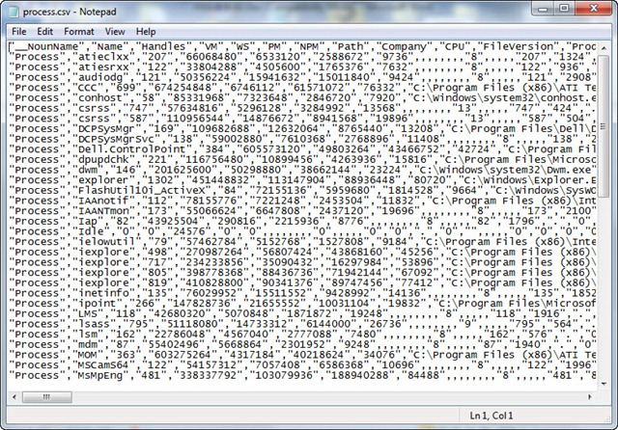
Data conversion
Each CSV table dump is converted into at least 1 corresponding XML file
Splits into multiple files of a specified number of records
Folders of CSV files can be converted as a batch operation
ConvertCSV: Previous MBO project to support batch CSV conversion of Gigabyte-sized files, following the RFC 4180 standard.

Slide 4


Schema ingestion
Uses an ANTLR4 grammar of MySQL CREATE TABLE syntax
Parse tree used to populate in-memory relational model, which is output as triples for later navigation
Additional grammars can be added as modules: Oracle, DB2, etc

Slide 5
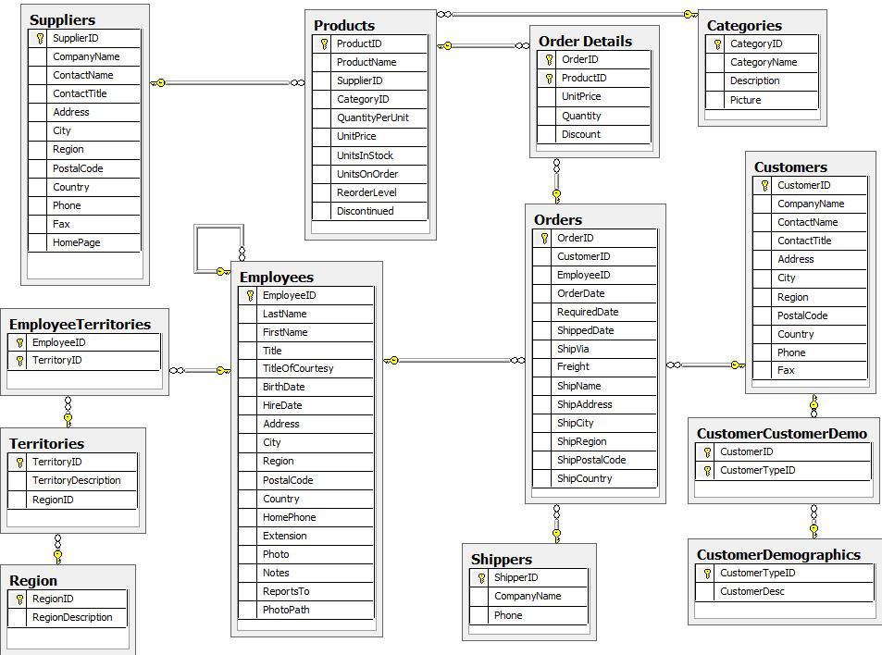
Example: Northwind database
Example database originally from Microsoft, translated into every RDBMS for testing / educational purposes
MySQL version includes table structure as CREATE TABLE statements
Data dumped by SQLDeveloper as 1 CSV file per table
WHY NORTHWIND: Demonstrates main features of a familiar relational database without getting overwhelming.

Slide 6
SQL: Create table
-- -- Table structure for table `Region` -- DROP TABLE IF EXISTS `Region`; CREATE TABLE `Region` ( `RegionID` int(11) NOT NULL, `RegionDescription` varchar(50) NOT NULL, PRIMARY KEY (`RegionID`) ) ENGINE=InnoDB DEFAULT CHARSET=latin1; /*!40101 SET character_set_client = @saved_cs_client */;
-- -- Table structure for table `Territories` -- DROP TABLE IF EXISTS `Territories`; CREATE TABLE `Territories` ( `TerritoryID` varchar(20) NOT NULL, `TerritoryDescrip` varchar(50) NOT NULL, `RegionID` int(11) NOT NULL, PRIMARY KEY (`TerritoryID`), KEY `FK_Territories_Region` (`RegionID`), CONSTRAINT `FK_Territories_Region` FOREIGN KEY (`RegionID`) REFERENCES `Region` (`RegionID`) ) ENGINE=InnoDB DEFAULT CHARSET=latin1;
SQLDeveloper can dump database structure as SQL statements
The MySQL version of the Northwind database has all the core RDBMS features: primary keys, foreign keys, indexes, types, etc
Not implemented:
Create from template
Spatial datatypes
Storage and column_format options

Slide 7
create_statement : ('create'|'CREATE') ('temporary'|'TEMPORARY')? ('table'|'TABLE') ('if not exists'|'IF NOT EXISTS')? tbl_name '('? create_definition (',' create_definition)* ')'? (table_options)? (partition_options)? ;
...
create_definition : (col_name column_definition | ('CONSTRAINT' (symbol)?)? primary (index_type)? '('? (index_col_name (',' index_col_name)*)? ')'? (index_option (',' index_option)*)? | ('INDEX'|'KEY') (index_name)? (index_type)? '('? (index_col_name (',' index_col_name)*)? ')’? (index_option (',' index_option)*)? | ('CONSTRAINT' (symbol)?)? Unique (index_name)? (index_type)? '('? (index_col_name (',' index_col_name)*)? ')’? (index_option (',' index_option)*)? | ('FULLTEXT'|'SPATIAL') ('INDEX'|'KEY')? (index_name)? '('? (index_col_name (',' index_col_name)*)? ')’? (index_option (',' index_option)*)? | ('CONSTRAINT' (symbol)?)? Foreign (index_name)? '('? (index_col_name (',' index_col_name)*)? ')'? reference_definition | 'CHECK' (expr) ) ;
ANTLR: “(ANother Tool for Language Recognition) is a powerful parser generator for reading, processing, executing, or translating structured text or binary files. It’s widely used to build languages, tools, and frameworks. From a grammar, ANTLR generates a parser that can build and walk parse trees.” http://www.antlr.org/

Slide 8
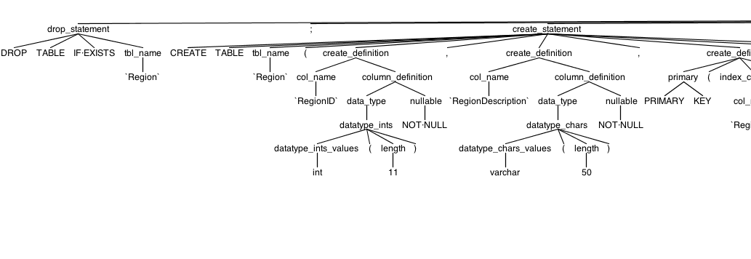
create_definition
: (col_name column_definition
| ('CONSTRAINT' (symbol)?)? primary (index_type)? '('? (index_col_name (',' index_col_name)*)? ')'?
(index_option (',' index_option)*)?
| ('INDEX'|'KEY') (index_name)? (index_type)? '('? (index_col_name (',' index_col_name)*)? ')'?
(index_option (',' index_option)*)?
| ('CONSTRAINT' (symbol)?)? unique
(index_name)? (index_type)? '('? (index_col_name (',' index_col_name)*)? ')'?
(index_option (',' index_option)*)?
| ('FULLTEXT'|'SPATIAL') ('INDEX'|'KEY')? (index_name)? '('? (index_col_name (',' index_col_name)*)? ')'?
(index_option (',' index_option)*)?
| ('CONSTRAINT' (symbol)?)? foreign
(index_name)? '('? (index_col_name (',' index_col_name)*)? ')'? reference_definition
| 'CHECK' (expr)
)
;

Slide 9
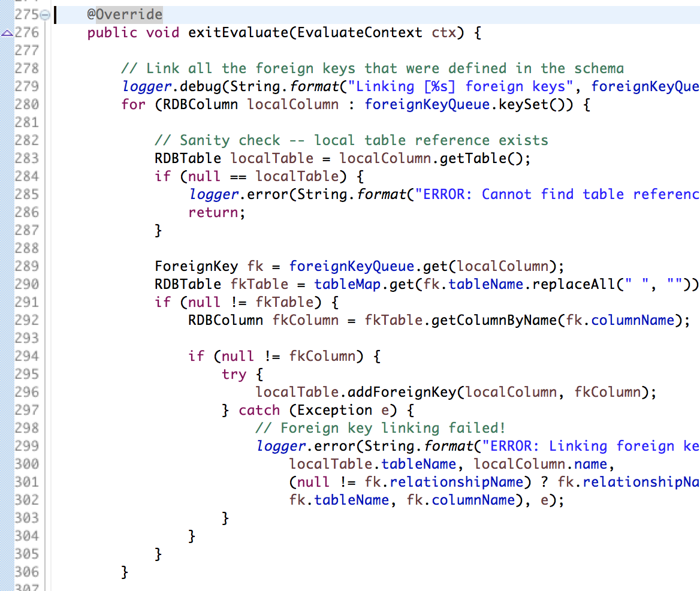
Mapping code
Maps parse tree to in-memory model
DB-specific mapping code is required to map the parse tree content into the memory model
Two classes represent the structure of a RDBMS:
RDBTable
RDBColumn
Grammar implementation matters: It has an impact on the difficulty of writing the mapping code. Notably – checks for presence or absence of terms (NULL, UNIQUE) and differentiating between similar statements are easier with deeper parse trees – i.e., unnecessary-looking rules exist for a reason.

Slide 10
Memory model serialization
TBD
TODO: It

Slide 11
DEMONSTRATION

Slide 12
Next Steps
Implement more grammars and mappings
MySQL INSERT statements
Oracle DDL
Oracle SQL*Loader
Standardize graph vocabulary
Could generate a RDF Schema and/or OWL schema for each database
Annotate dataset with Dublin Core terms

Slide 13
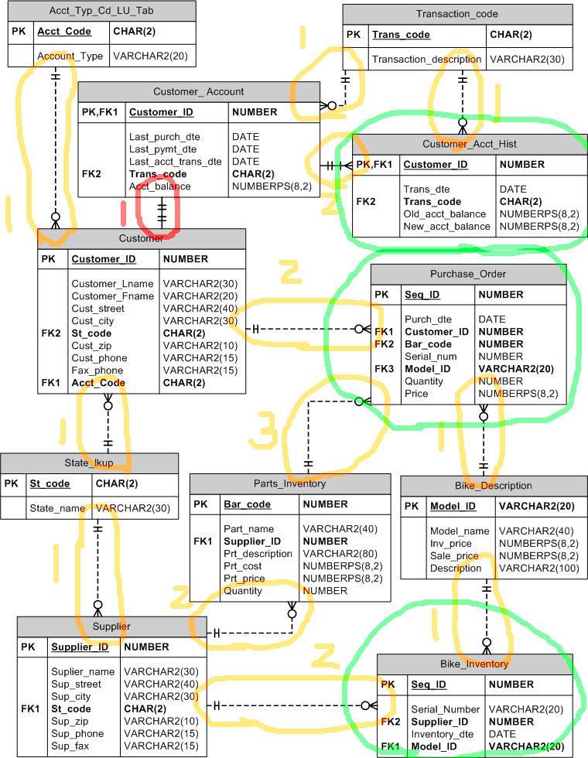
Next Steps
Automatic Denormalization
Join all 1:1 relationships
For all tables having only 1-ary relationships, join INTO each table

