Slide 1
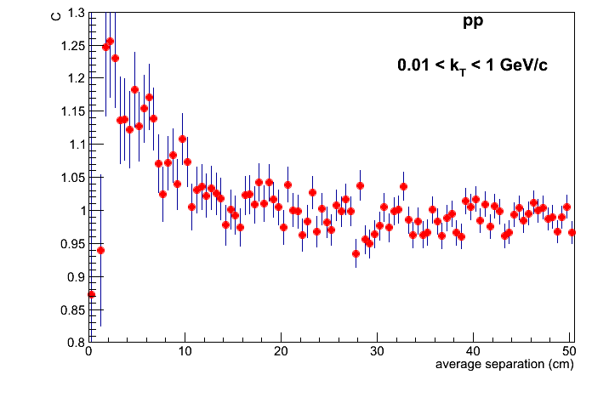
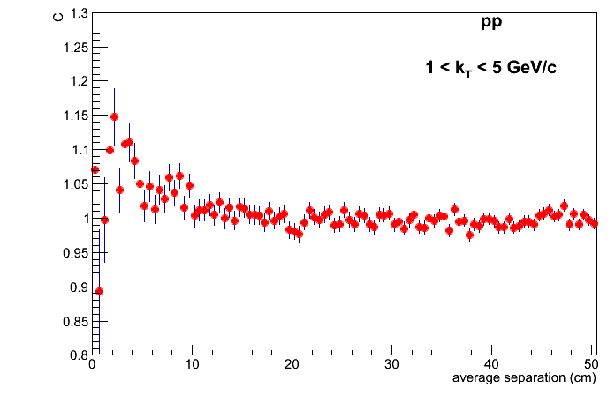
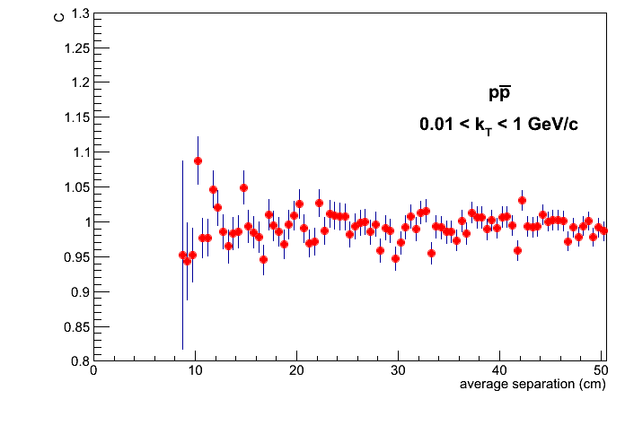
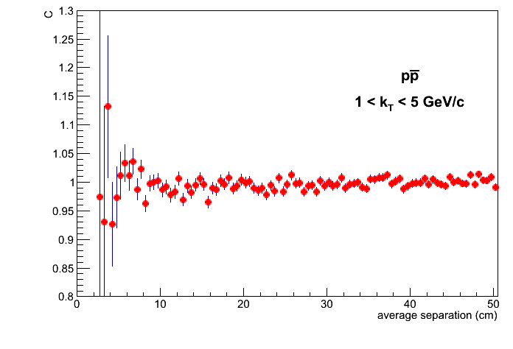
Average separation

Slide 2
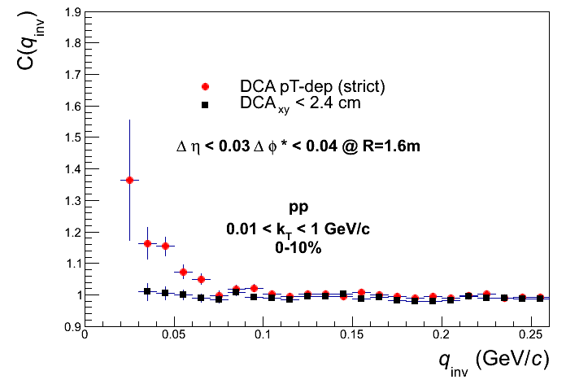
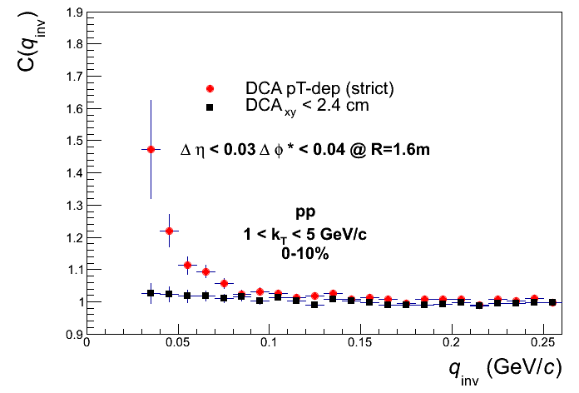
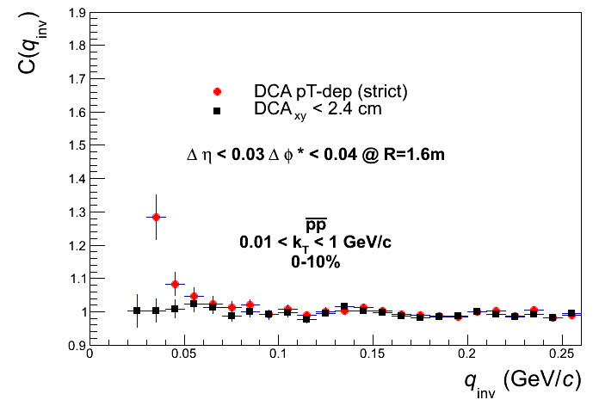
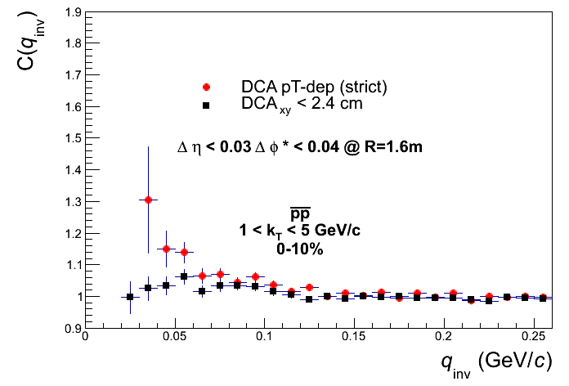
dEta-dPhi* @ R=1.6m DCA p_{T} -dep vs. DCA < 2.4cm

Slide 3
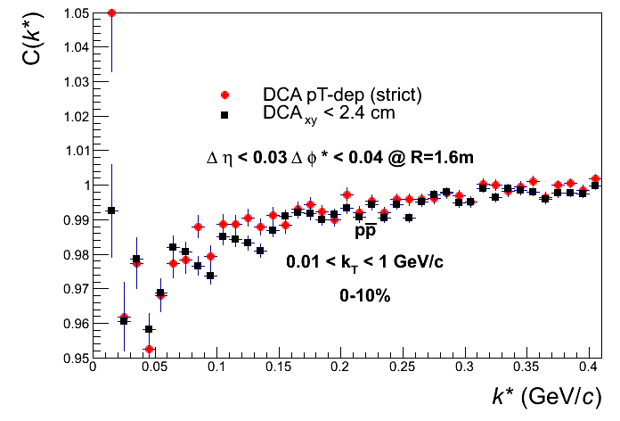
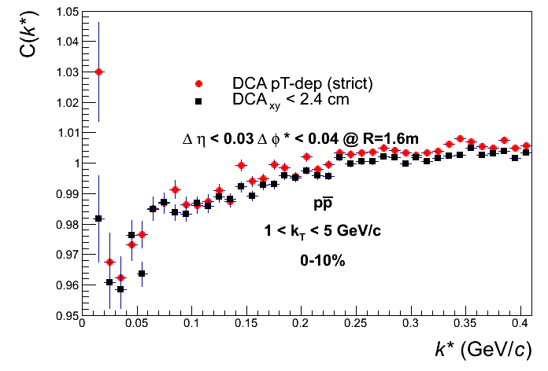
dEta-dPhi* @ R=1.6m DCA p_{T} -dep vs. DCA < 2.4cm

Slide 4
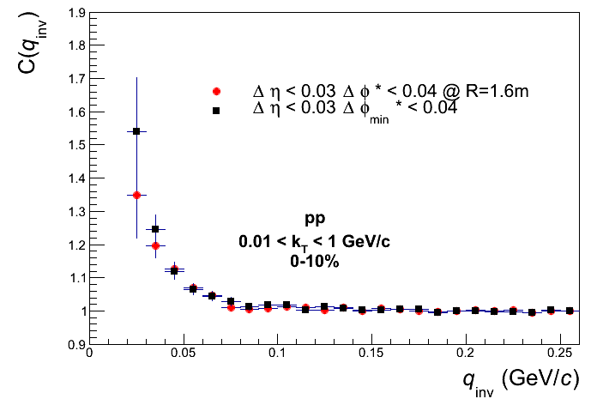
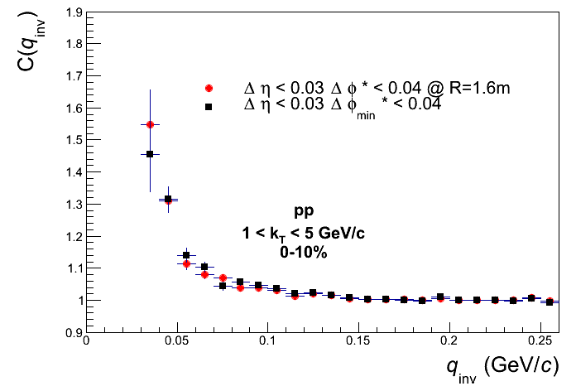
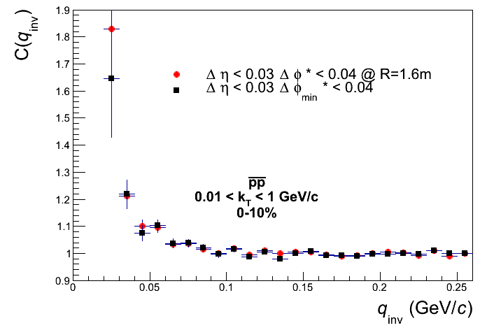
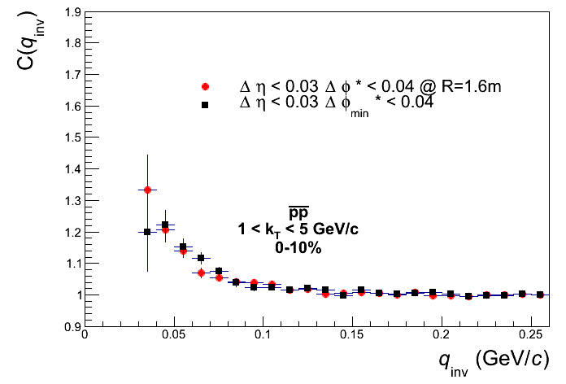
dEta-dPhi* @ R=1.6m vs. dEta-dPhi_{min}*

Slide 5
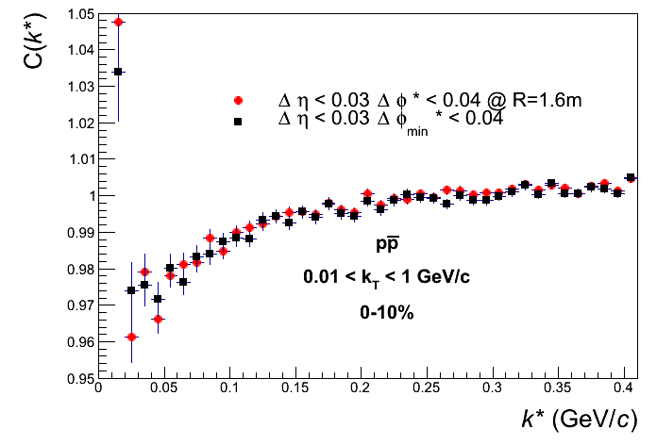
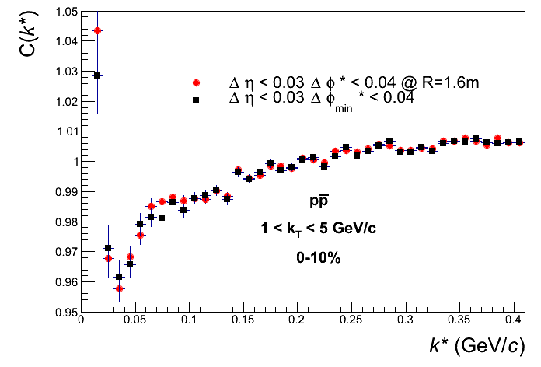
dEta-dPhi* @ R=1.6m vs. dEta-dPhi_{min}*

Slide 6
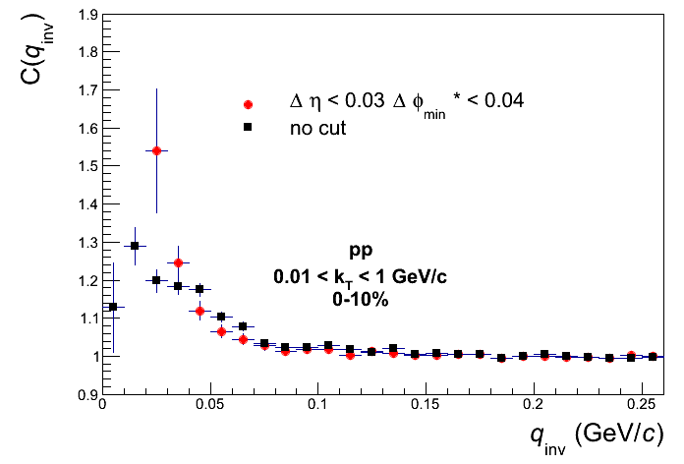
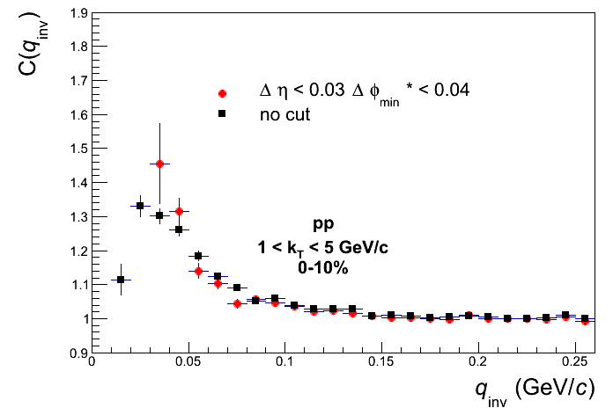
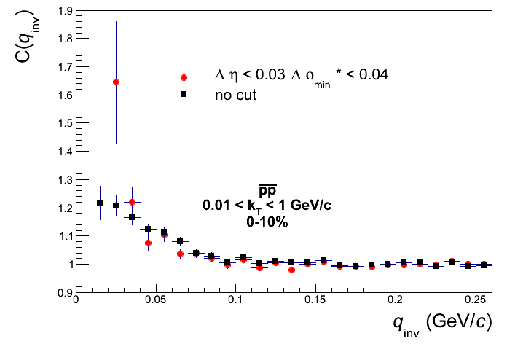
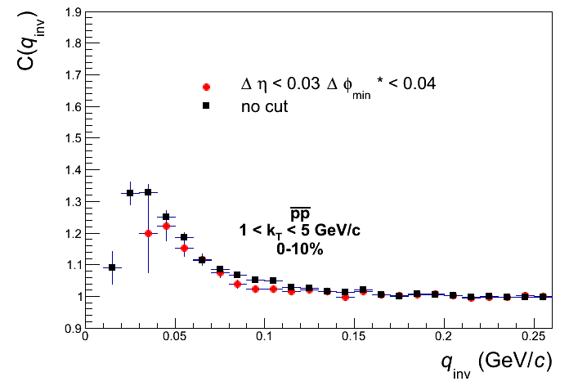
dEta-dPhi_{min}* vs. No cut

Slide 7
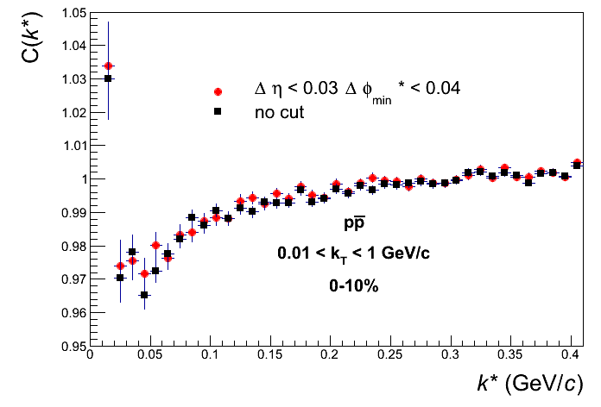
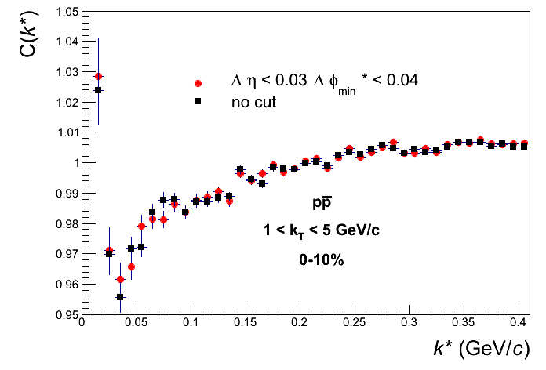
dEta-dPhi_{min}* vs. No cut

Slide 8
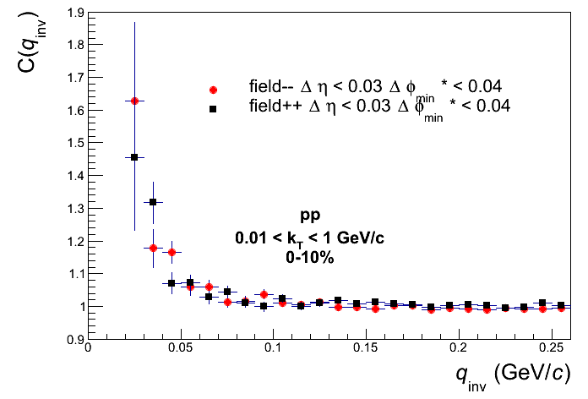
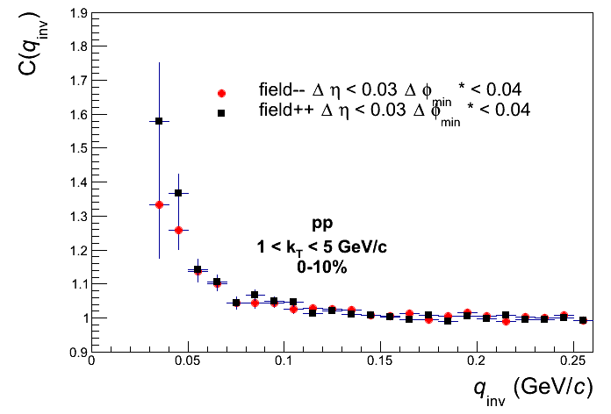
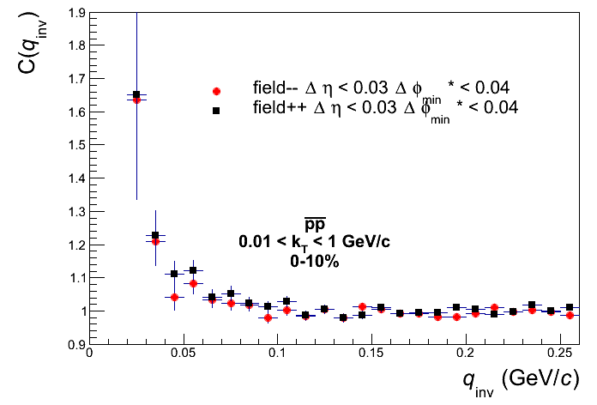
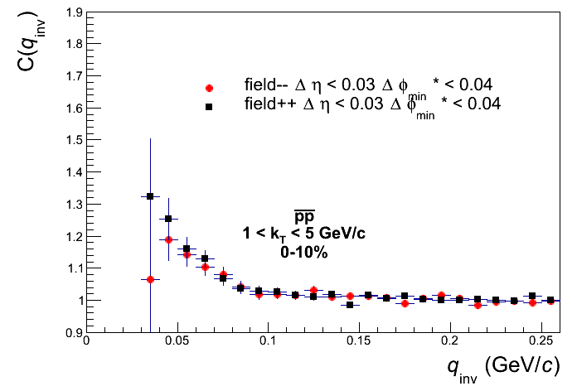
dEta-dPhi_{min}* field1 vs. field3

Slide 9
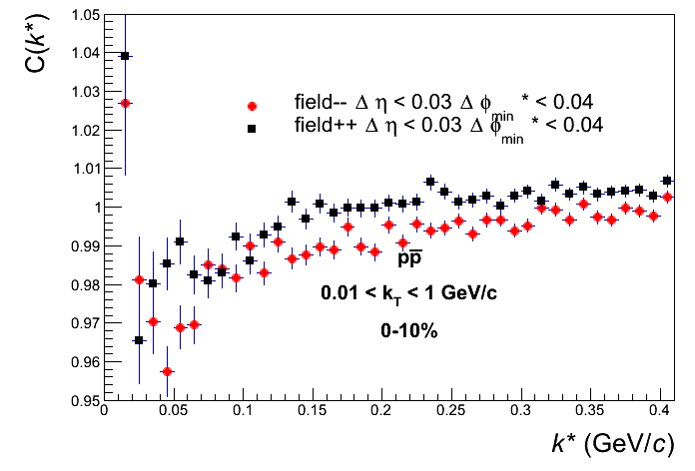
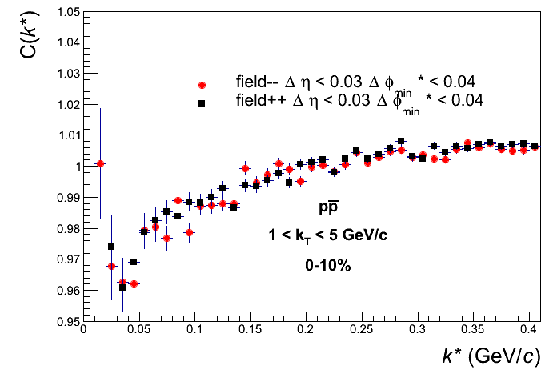
dEta-dPhi_{min}* field1 vs. field3

Slide 10
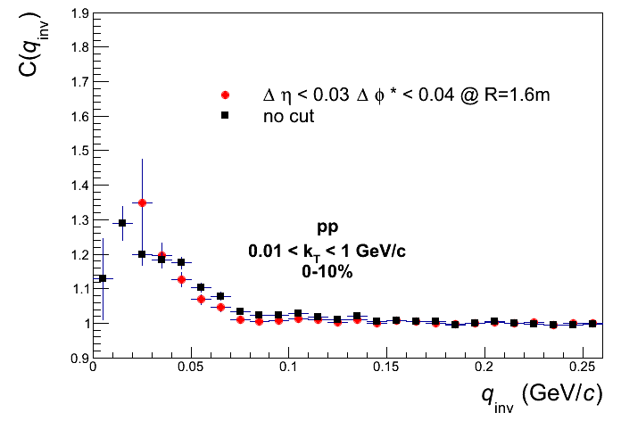
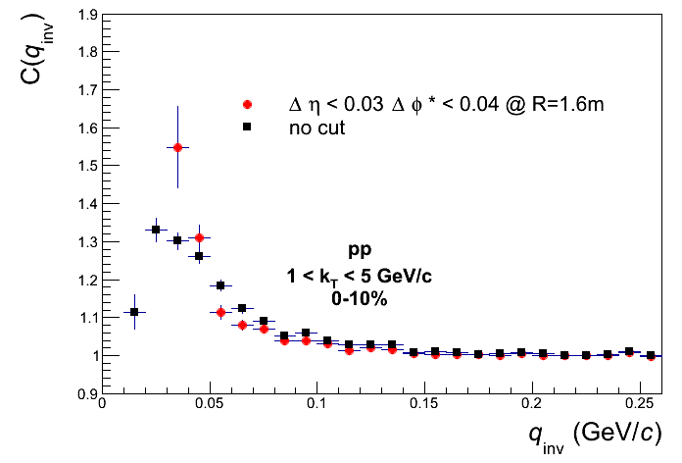
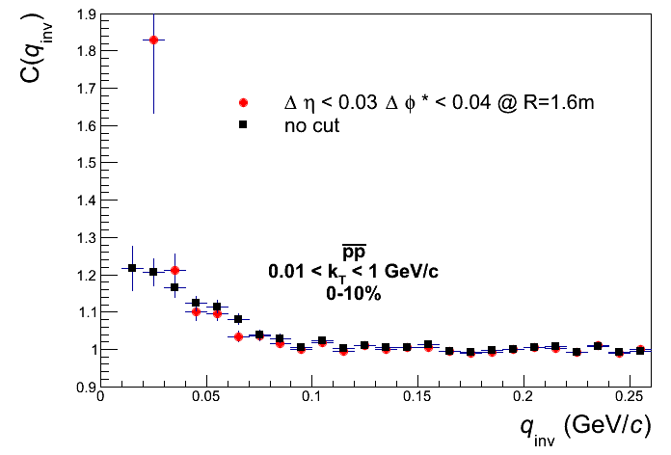
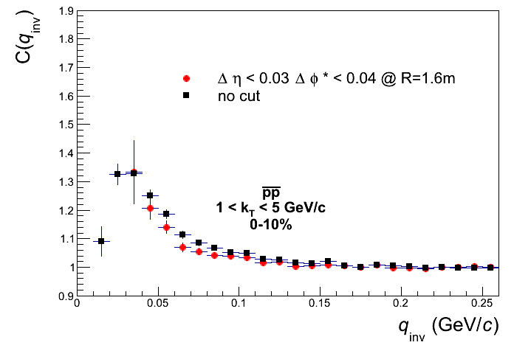
dEta-dPhi* @ R=1.6m vs. no cut

Slide 11
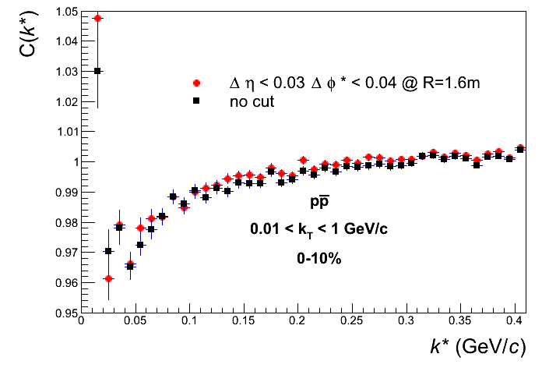
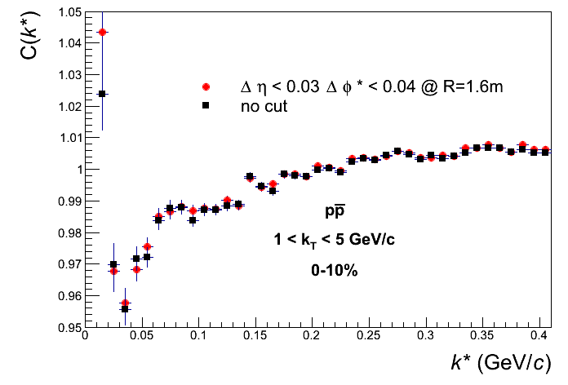
dEta-dPhi* @ R=1.6m vs. no cut

Slide 12
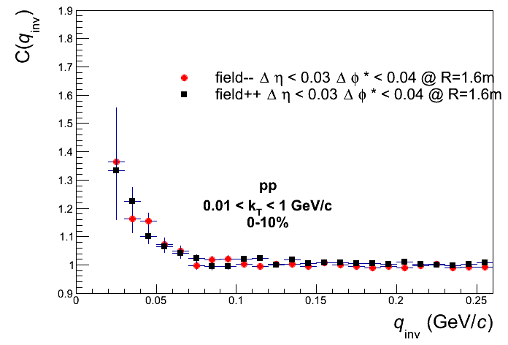
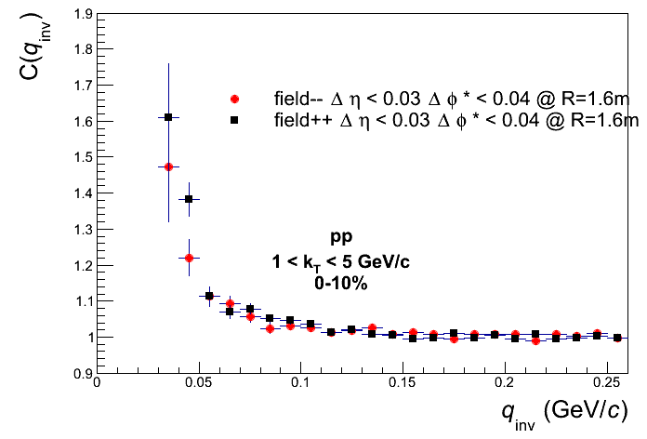
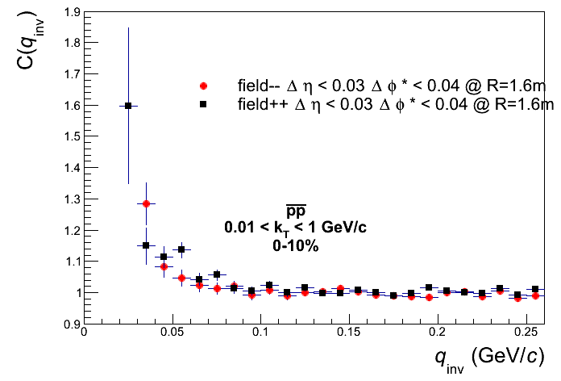
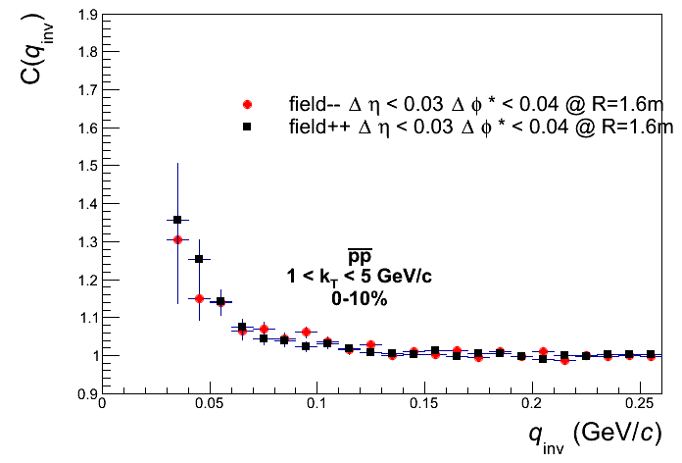
dEta-dPhi*@R=1.6m field1 vs. field3

Slide 13
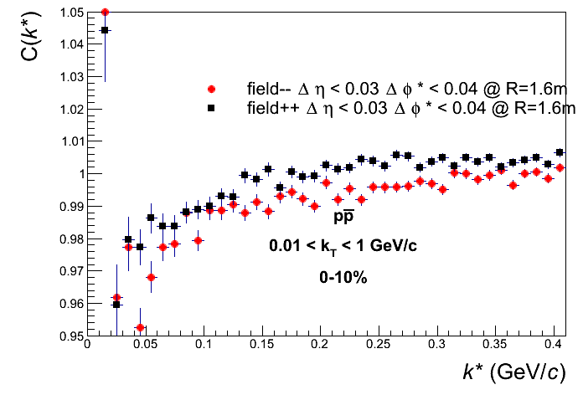
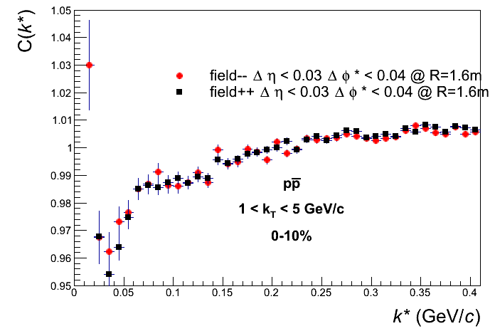
dEta-dPhi*@R=1.6m field1 vs. field3

Slide 14
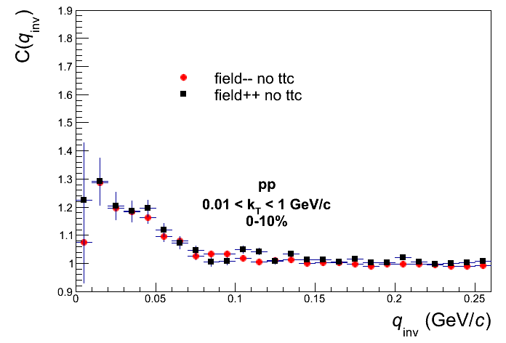
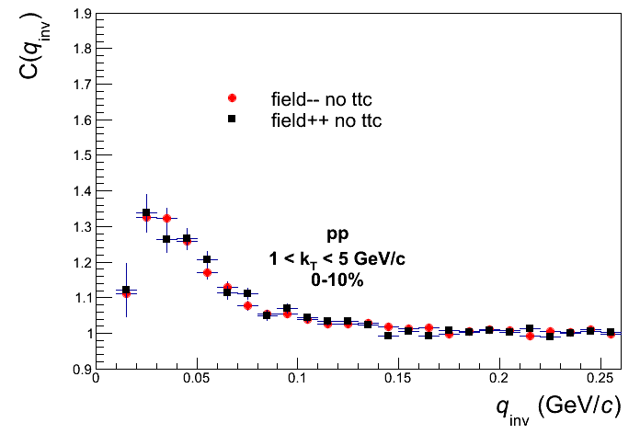
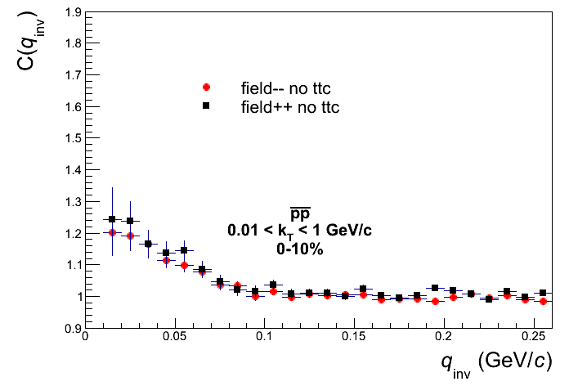
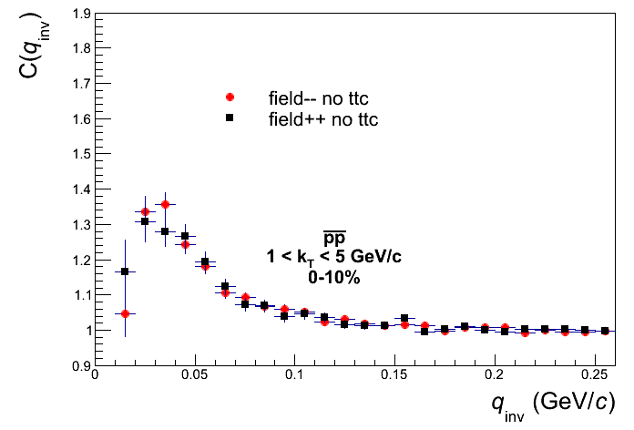
No cut field1 vs. field3

Slide 15
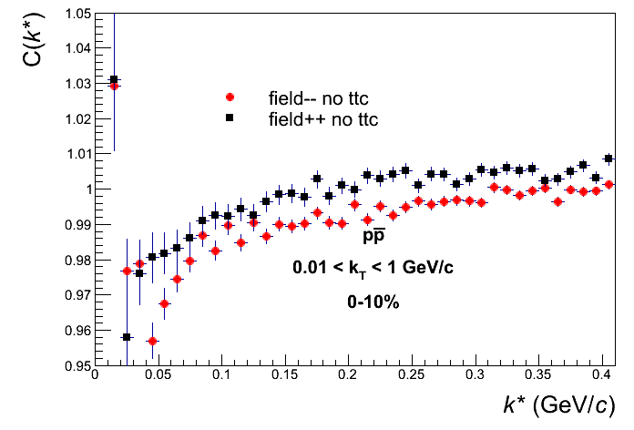
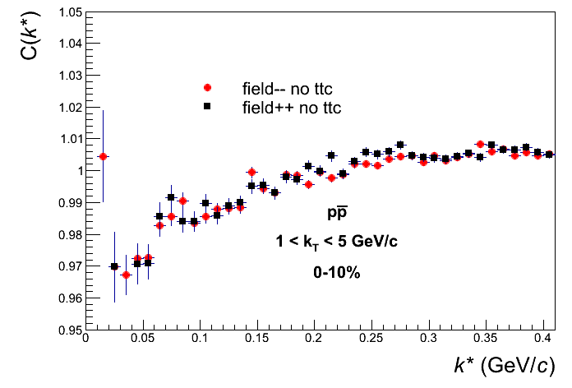
No cut field1 vs. field3

Slide 16
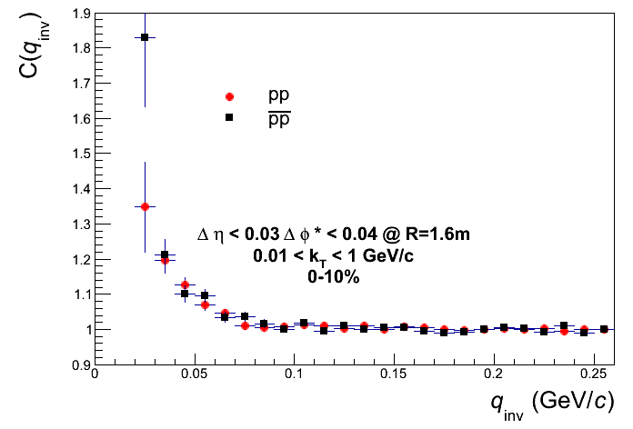
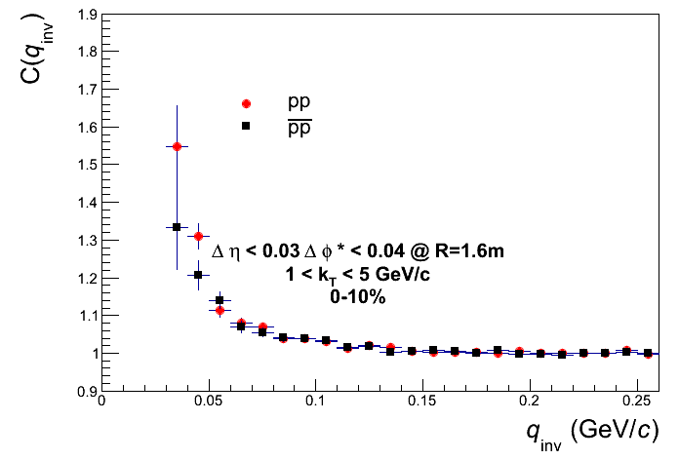
dEta-dPhi*@R=1.6m pp vs. pp

Slide 17
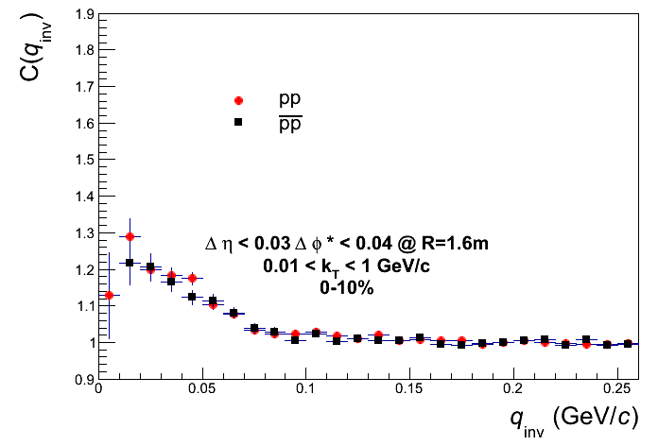
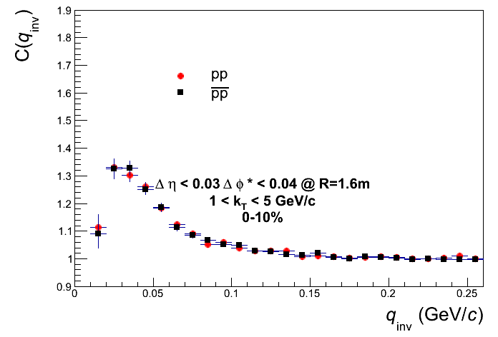
No cut pp vs. pp

Slide 18




MC: dEta-dPhi* @ R=1.6m vs. no cut

Slide 19


MC: dEta-dPhi* @ R=1.6m vs. no cut

Slide 20




MC: dEta-dPhi* @ R=1.6m vs. dEta-dPhi*_{min}

Slide 21


MC: dEta-dPhi* @ R=1.6m vs. dEta-dPhi*_{min}

Slide 22




MC: dEta-dPhi*@R=1.6m field1 vs. field3

Slide 23


MC: dEta-dPhi*@R=1.6m field1 vs. field3

Slide 24


MC: dEta-dPhi*@R=1.6m pp vs. pp

